Slide 1
NLSY Kinship Links: Creating Biometrical Design Structures from Cross-Generational Data
William Howard Beasley, David Bard, Kelly Meredith, Mike Hunter, Joe Rodgers
BGA 2013
Notes:
I’m Will, and I’ll be talking about BG research with the NLSY, which is a public database of 20,000 longitudinal subjects from a nationally representative sample.

Slide 2
Topics
Timeline of NLSY cohorts
Linking subjects within a cohort
Linking subjects across cohorts
Construction of links
NlsyLinks: Online utilities and kinship information for Behavior Genetics and Developmental research using the NLSY
Notes:
First I’ll be talking about the timeline of the cohorts. Then I’ll talk about connecting subjects within cohorts and across cohorts. Then I’ll mention a few points about how the interpersonal relationships were constructed. And finally about how this information can be downloaded used in your own research.

Slide 3
NLSY Cohorts
Nlsy79: 1st generation
Surveyed since 1979; N≈12,000
Nationally representative sample
Nlsy79: 2nd generation
Biological children of the Nlsy79 1st generation females
Surveyed since 1986; N≈12,000
Frequently called “Nlsy79-C” or “CNLSY79”
Nlsy97
Surveyed since 1979; N≈9,000
Nationally representative sample
No genetic relationship to Nlsy79 cohorts
Notes:
There are three active cohorts in the NLSY. The first started 34 years ago. The children born to females of the first cohort … became the 2nd cohort. They have been surveyed for the past 27 years. Finally a third cohort started 16 years ago, and was designed to be a replication of the first cohort –although they are not genetically related to any subjects in 79
Of the three cohorts, the second might be the most used by researchers in this room. It’s the ‘children’. It is frequently called the Nlsy79C or the CNlsy. Within our own team, we’ve mostly stopped using these terms because we conceptualize it as one big sample containing two related generations. It many senses, the responses collected from the second generation can be viewed as outcomes of the first generation. Likewise, the parents in the first generation provide many responses that can be viewed as explanatory variables for the 2nd generation. Depending on your research, there can be big advantages of using one cohort to augment the other.
There are also survey items that provide information about the 3rd generation and the 0th generation.

Slide 4
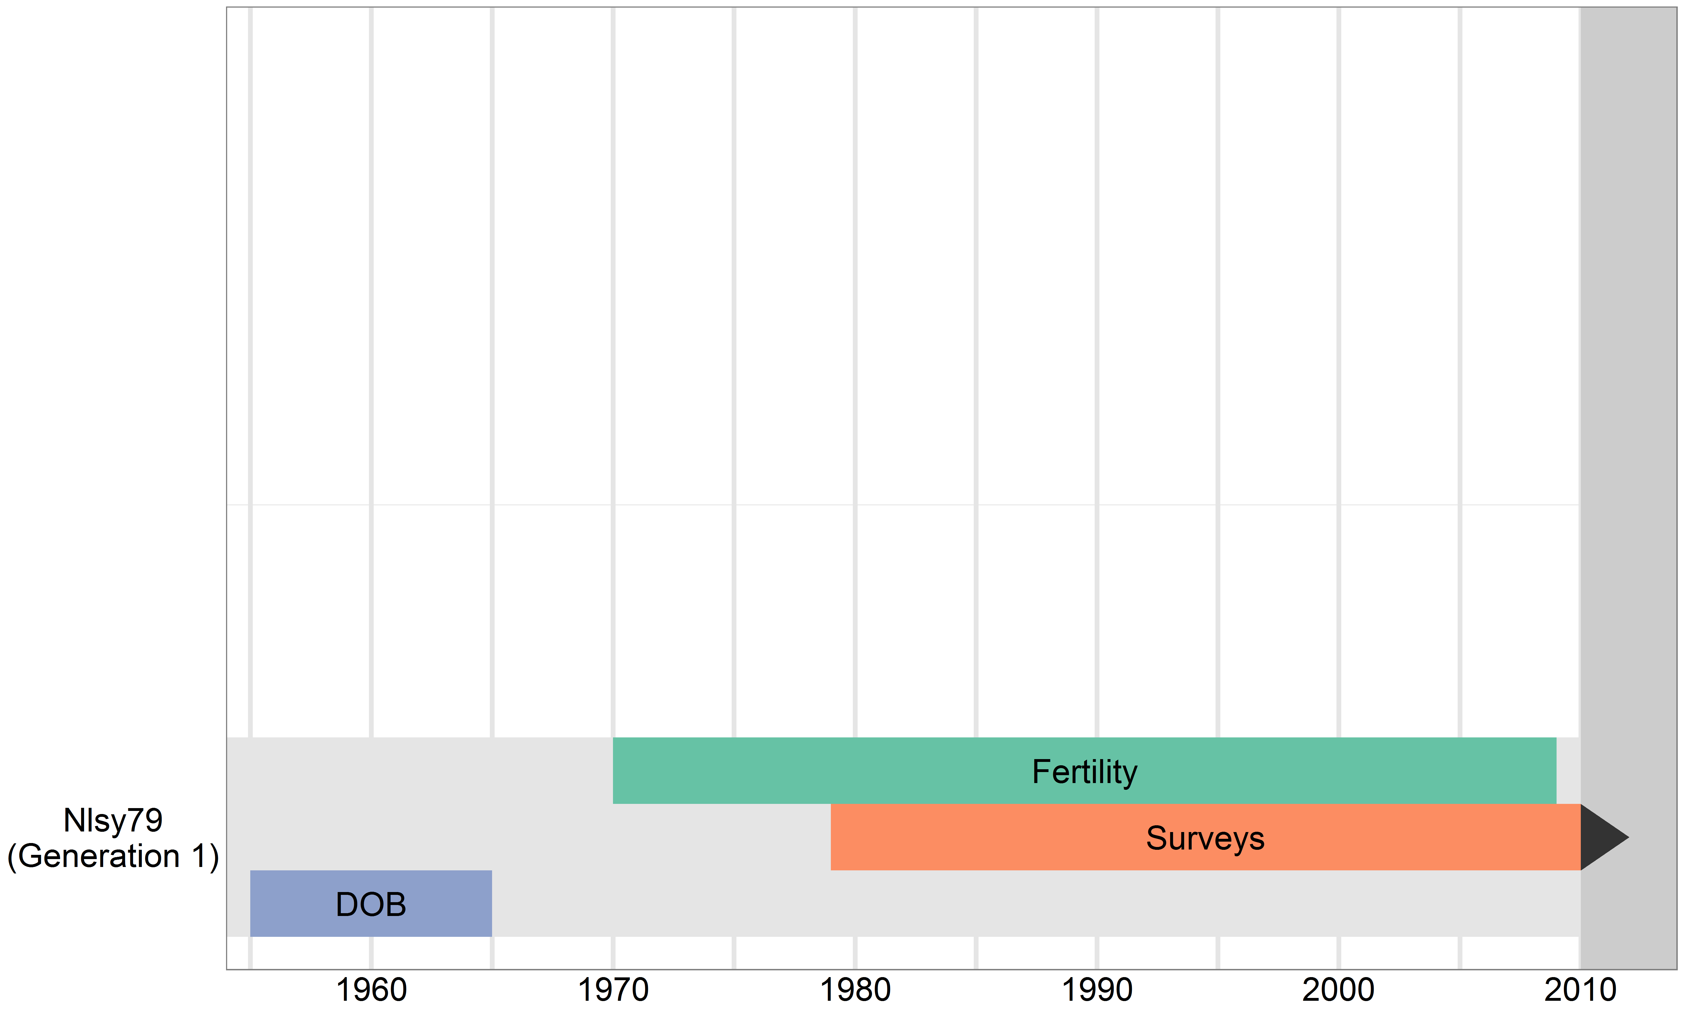
Timeline for Nlsy79
Notes:
Here is the timeline of the original cohort of the Nlsy79. Their birth range is about ten years. The females started having children at age 15, here in 1970. The official survey began in 1979. Yet we have data on this cohort that precedes 1979, because there are many retrospective questions asked of both the subjects, and their parents (the 0th generation).

Slide 5
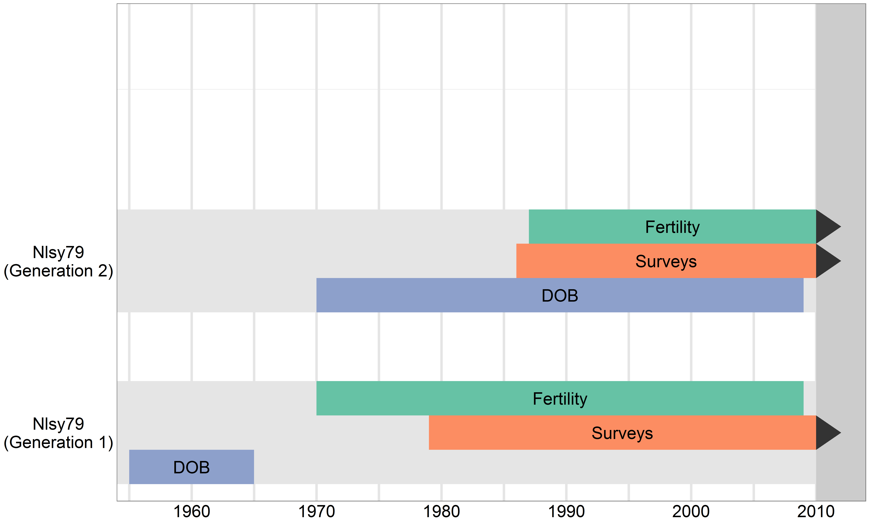
Timeline for Nlsy79 (both generations)
Notes:
This next row up is the second generation of the Nlsy79. Because this cohort is defined as the biological children of the first generation females, their birth dates have a much wider range.

Slide 6
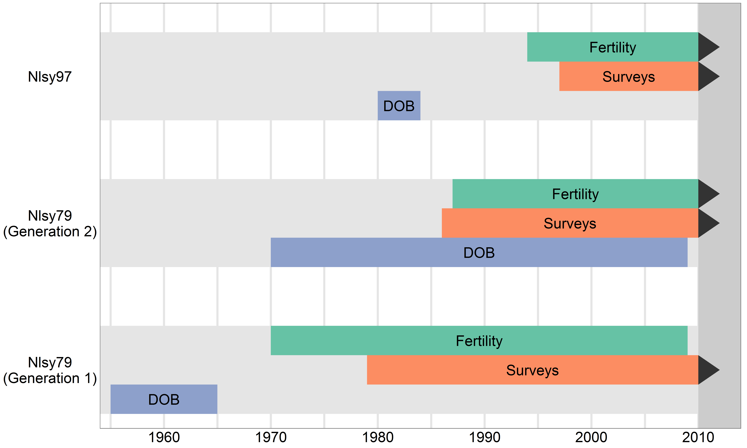
Timeline for Nlsy79 & Nlsy97
Notes:
And the top row is the third active cohort, whose birth dates occur at the peak of the birth dates of the 2nd cohort.
As the arrows indicate, the surveys for all three cohorts are still being collected. Likewise the fertility of the two younger cohorts is still in progress. However, the fertility of the oldest cohort is virtually complete. This closure can be a benefit to life course researchers

Slide 7
Links within & across Nlsy79 Cohorts
 | Gen1 Only | Gen2 Nuclear Families | Gen2 Extended Families | Gen1 + Gen2 Nuclear Families | Gen1 + Gen2 Extended Families
Example Scenario | 3 | 4 (=1+3) | 10 | 7 (=3+1+3) | 28
Nlsy79 Unique Links | 5,300 | 11,100 | 16,100 | 16,400 | 42,800
Notes:
I want to demonstrate some of the statistical benefits of combining both 79 generations. Here’s an example pedigree with three siblings in the first generation. And then the two sisters later have some kids.
Looking at the top row of data. If you consider only the 1st generation, you have only three unique links (because 3-choose-2 is 3). If you consider only the 2nd generation nuclear families, you get 4 links (1 from this pair and 3 from these sibs). If you take these same 5 subjects, but now consider the cousin links as well as sibling, your count is now 250% the size (jumps from 4 to 10). Likewise, when you include all the intra and intergenerational relationships, you jump from 7 to 28 links.
Clearly there can be a statistical advantage with this example pedigree, but there’s also a real advantage in the NLSY sample, as seen in the bottom row. These are the counts of the unique links, depending on what information you include and exclude.

Slide 8
Gen1 + Gen2: Extended Families
 | A1 | A2 | A3 | B1 | B2 | C1 | C2 | C3
A1 |  | 1 | 2 | 3 | 4 | 5 | 6 | 7
A2 |  |  | 8 | 9 | 10 | 11 | 12 | 13
A3 |  |  |  | 14 | 15 | 16 | 17 | 18
B1 |  |  |  |  | 19 | 20 | 21 | 22
B2 |  |  |  |  |  | 23 | 24 | 25
C1 |  |  |  |  |  |  | 26 | 27
C2 |  |  |  |  |  |  |  | 28
C3
Notes:
Here’s another way to look at it –by enumerating all 28 possible links. The row and column headers represent the 8 people in the extended family.

Slide 9
Gen1 + Gen2: Nuclear Families
No cousins
No cross-generational links
 | A1 | A2 | A3 | B1 | B2 | C1 | C2 | C3
A1 |  | 1 | 2
A2 |  |  | 3
A3
B1 |  |  |  |  | 4
B2
C1 |  |  |  |  |  |  | 5 | 6
C2 |  |  |  |  |  |  |  | 7
C3
Notes:
Here are the 7 links remaining after restricting yourself to only nuclear families

Slide 10
Gen2: Extended Families
No Gen1
No cross-generational links
 | A1 | A2 | A3 | B1 | B2 | C1 | C2 | C3
A1
A2
A3
B1 |  |  |  |  | 1 | 2 | 3 | 4
B2 |  |  |  |  |  | 5 | 6 | 7
C1 |  |  |  |  |  |  | 8 | 9
C2 |  |  |  |  |  |  |  | 10
C3
Notes:
Here are the 10 links remaining after restricting yourself to only the 2nd generation (siblings and cousins).

Slide 11
Gen1: Nuclear Families
No Gen2
No cross-generational links
 | A1 | A2 | A3 | B1 | B2 | C1 | C2 | C3
A1 |  | 1 | 2
A2 |  |  | 3
A3
B1
B2
C1
C2
C3
Notes:
If you consider only nuclear families in only one generation, you’re restricting yourself to just 3 …..

Slide 12
Gen2: Nuclear Families
No Gen1
No cross-generational links
 | A1 | A2 | A3 | B1 | B2 | C1 | C2 | C3
A1
A2
A3
B1 |  |  |  |  | 1
B2
C1 |  |  |  |  |  |  | 2 | 3
C2 |  |  |  |  |  |  |  | 4
C3
Notes:
Or 4 links.

Slide 13
Gen1 + Gen2: Extended Families
 | A1 | A2 | A3 | B1 | B2 | C1 | C2 | C3
A1 |  | 1 | 2 | 3 | 4 | 5 | 6 | 7
A2 |  |  | 8 | 9 | 10 | 11 | 12 | 13
A3 |  |  |  | 14 | 15 | 16 | 17 | 18
B1 |  |  |  |  | 19 | 20 | 21 | 22
B2 |  |  |  |  |  | 23 | 24 | 25
C1 |  |  |  |  |  |  | 26 | 27
C2 |  |  |  |  |  |  |  | 28
C3
Notes:
And finally, here are the 28 links that are potentially available if your model accommodates everyone’s possible relationship. Our linking dataset provides this (all 28), and it’s your choice which subjects and/or relationships you choose to exclude.

Slide 14
Links within & across Nlsy79 Cohorts
 | Gen1 Only | Gen2 Nuclear Families | Gen2 Extended Families | Gen1 + Gen2 Nuclear Families | Gen1 + Gen2 Extended Families
Nlsy79 Unique Links | 5,300 | 11,100 | 16,100 | 16,400 | 42,800
Unique Links per Included Subject | 0.8 | 1.1 | ~0.8 | 1.0 | ~2.5
Notes:
Let’s return to the white row showing the number of pairs in the Nlsy79. If there’s a research question where it is appropriate to consider all biological links in an extended family, you can get an enormous jump in sample size.
There are two types of jumps in sample size. The first is the absolute number of pairs, which is easily seen from the white row of the table. The second type is the amount of information per family. In other words, there are about five thousand extended families (5,106). If you use all possible links, you’re getting at least 8 pieces of information per family, which is 2-4 times as much information than if your analysis isolates the nuclear families.
And regardless of sample size, there may be some research questions that are approachable only by incorporating both two generations.

Slide 15
Construction of the Links
We have already assembled for you - I’ll explain their origin, not describe what you need to do
Links incorporate “Explicit” information - eg, “Do you and your sister share a biological dad?” - explicit items started in 2006
Links incorporate “Implicit” information - eg, “When did your biological dad die?” - implicit items started in 1979
Roughly trained implicits to agree with explicits - many families are incomplete with explicits only
Notes:
The NIH has funded us to construct and distribute the links. You don’t need to replicate this. But I’ll mention a few issues anyway.
The links use explicit relationship information (“do you share the same dad”) and implicit information (“when did your dad die?”).

Slide 16
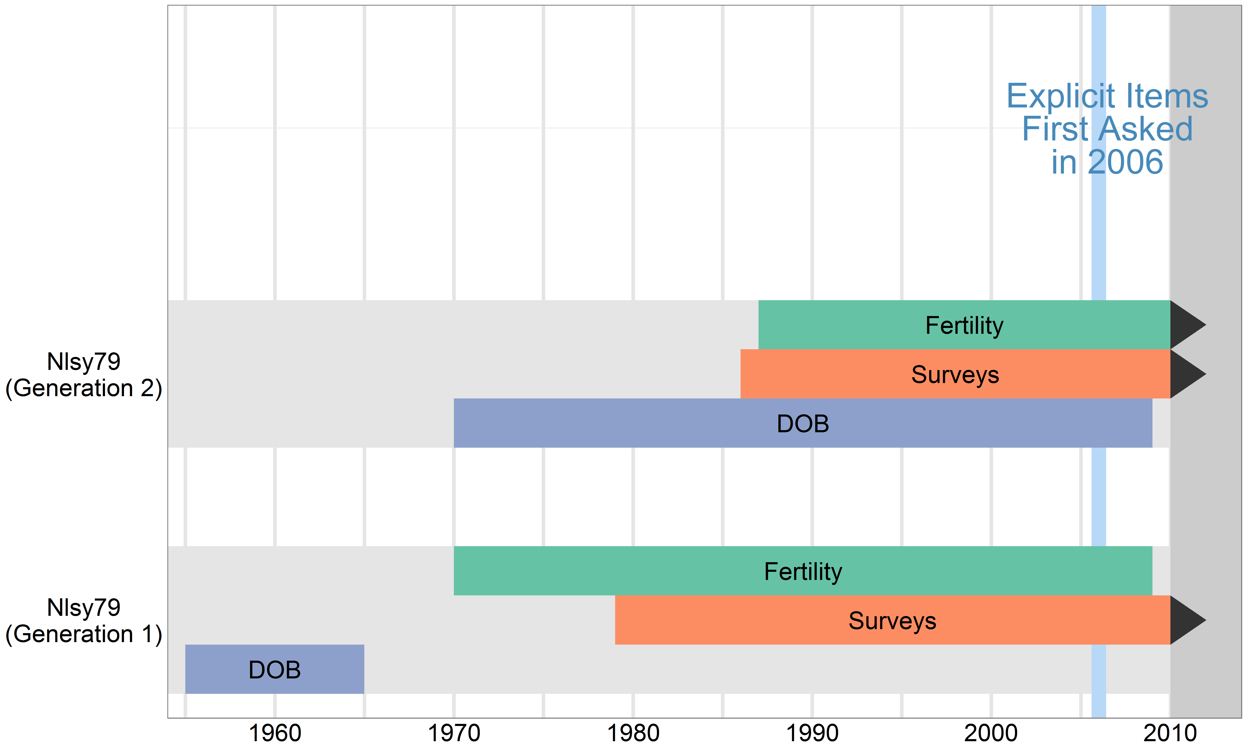
Timeline of Explicit Item
Notes:
This revisited diagram illustrates the importance of the implicit items. People were born here, and started the survey here. The explicits weren’t asked until 2006, [[[CUT: and based on lags in the subject ages, many families cannot be completed without using implicit items until around 2022.]]]
Meanwhile, there has been decades of attrition and death. Implicit items (which have been asked since the beginning) are the best way to get to the families before they’re unreachable. Getting to Gen1 subjects is especially important, because you could be interested in their responses when the were young. And because linking two Gen1 Housemates opens up cousin links and aunt/niece links.

Slide 17
Monitoring the ROC paths
Notes:
In a sense, we trained the weights of the implicit coefficients to correspond with the explicits, and monitored their agreement during the algorithm’s development. Each number in the graph is the algorithm’s version, ranging from 1 to 60 something. If you’re familiar with Receiver Operating Characteristic Curves, you want to be in the top left corner. This is the corner where there’s high true positives, and low false positives.
This graph is zoomed in on the movement.

Slide 18
Monitoring the ROC paths
Notes:
And here it is when the axes are scaled equally. There’s a 21.1 to 1 ratio of agreement to disagreement. I’m pretty happy with this graph.

Slide 19
Agreement of 2004 and 2013 Gen2 Links
Notes:
For those of you who have used previous versions of our links, here’s the agreement between those old ones, and the versions we’ve released in the past year. There’s a 23 to 1 ratio.
When I was coding the current version, I never looked at the code used for the older links. And we used fairly different software development approaches. The developers of the previous versions are even happier with this graph.

Slide 20
Increased sample size of 2004 vs 2013 links
1st Generation (1979)
2nd Generation (1979)
R | 2004 | 2013
.0 | - | 558
.0625 | - | 72
.125 | 76 | 96
.25 | 43 | 275
.375 | 310 | 24
.5 | 1,877 | 3,888
.75 | 32 | 11
1 | - | 11
- | 2,964 | 367
R | 2004 | 2013
.0 | - | -
.0625 | - | -
.125 | - | -
.25 | 2,221 | 3,442
.375 | 2,663 | 610
.5 | 5,778 | 6,997
.75 | - | 12
1 | 36 | 27
- | 390 | -
V58 for Gen2; V73 for Gen1
Notes:
If the agreement is so good, why should you bother using the current version? Because we’ve dramatically decreased the count of unassigned or ambiguously assigned pairs. Gen1 has about 10% of what it used to have. Gen2 is around 20%.
Increased statistical power is nice. But in our opinion, the big advantage is the number of families exclude becomes almost negligible. We’ve always been a little concerned that the families who were difficult to classify could be fundamentally different than the families who were easy to classify.

Slide 21
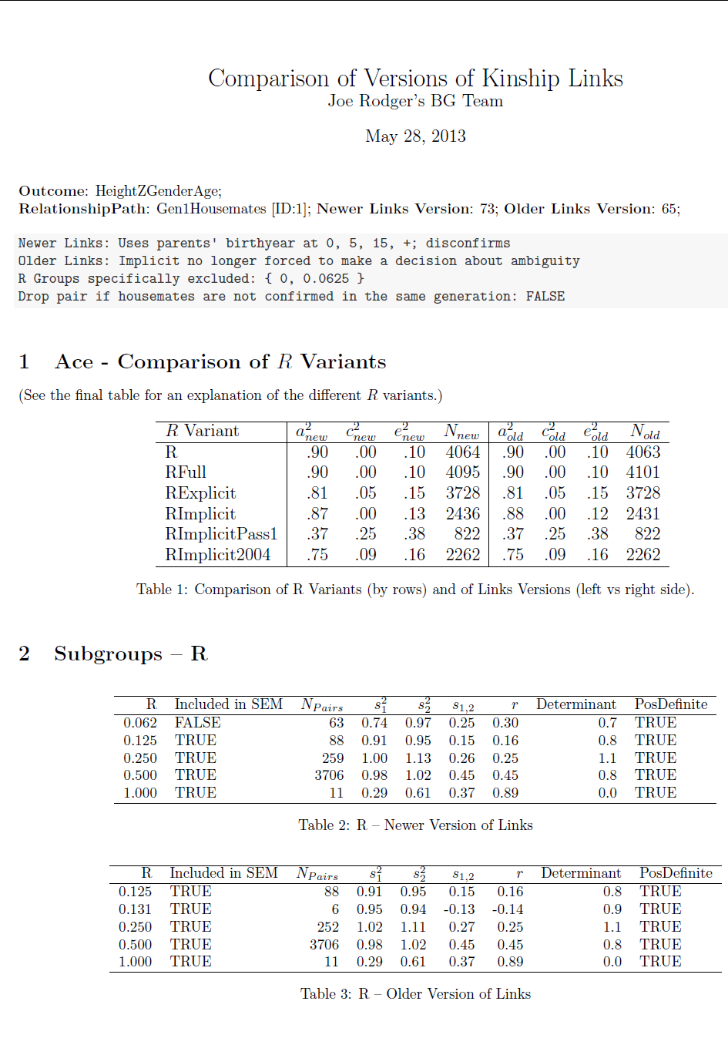
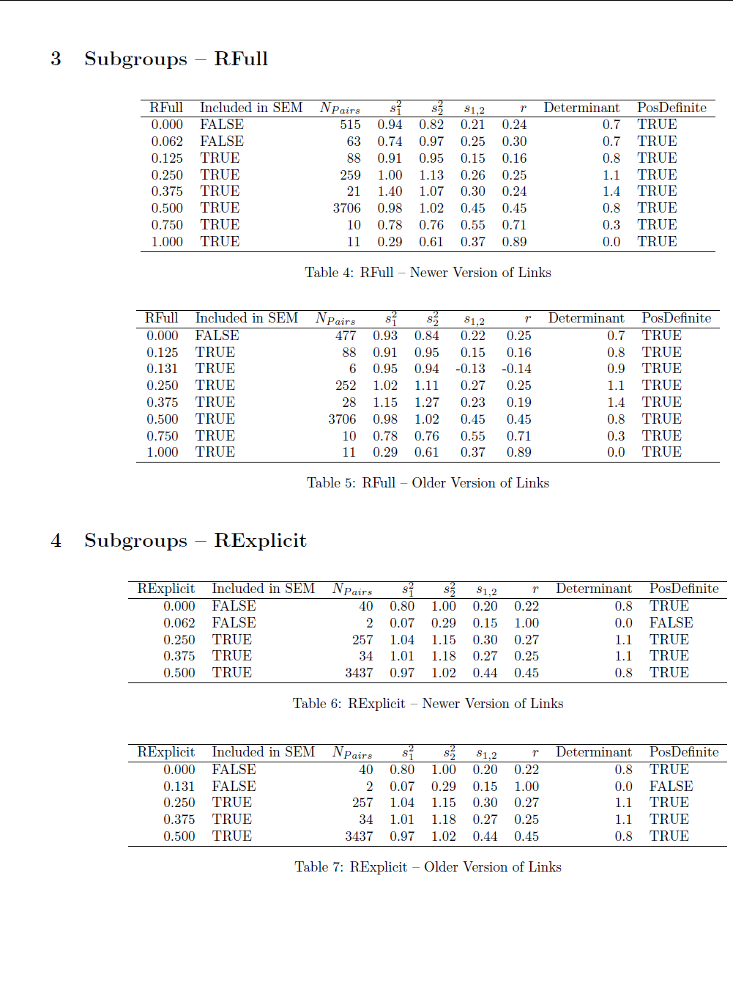
Monitoring ACEs of Basic Variables
Notes:
And of course, agreement and sample size aren’t useful if the biometric properties aren’t good. So we monitored the ACE estimates of several variables after every stage of the algorithm’s development. The example on the screen is adult height of the first cohort.

Slide 22
Future Challenge: Find Other Links
Connecting within the Nlsy79 is only one extension; connecting the Nlsy79 and Nlsy97 is another candidate
The Nlsy97 has 9,000 subjects born during the peak of the Nlsy79 Gen2’s births
Notes:
Joining the two generations of the Nlsy79 is just one connection. Because the Nlsy97 shares many design and demographic characteristics with 79, we’re beginning to identify ways to incorporate all three cohorts.

Slide 23
The ‘NlsyLinks’ package in R Includes:
Datasets that specify the R values
Other auxiliary information to assist your manipulation (eg, date of last completed survey)
Functions that handle a lot of the tedious manipulation preparing ACE models
Thorough documentation and vignettes
Subject1 ID | Subject2 ID | R
1201 | 1202 | .50
1301 | 1302 | .50
1301 | 1303 | .50
1302 | 1303 | .50
1401 | 1402 | .25
…
Notes:
Finally I’ll close the presentation discussing how you can use these links today in your own research. In addition to the linking file (which specifies the R values for pairs), our software package contains many supplemental functions and materials that decrease the time spent on plumbing and data manipulation, so you can concentrate on the issues specific to your research question.

Slide 24
#Step 2: Load packages. require(NlsyLinks); require(lavaan) #Steps 3-4: Load the linking and outcomes datasets. dsLinking <- subset(Links79Pair, RelationshipPath=='Gen2Siblings') dsOutcomes <- ReadCsvNlsy79Gen2('C:/BGResearch/NlsExtracts/Gen2Birth.csv') #Step 5: Verify and rename an existing column. VerifyColumnExists(dsOutcomes, 'C0328600') dsOutcomes <- RenameNlsyColumn(dsOutcomes, 'C0328600', 'BirthWeight') #Step 6: Manipulate, groom, & inspect variables. dsOutcomes$BirthWeight[dsOutcomes$BirthWeight < 0] <- NA dsOutcomes$BirthWeight <- pmin(dsOutcomes$BirthWeight, 300) hist(dsOutcomes$BirthWeight, breaks=500) #Steps 7-8: Merge outcome & linking datasets; Declare outcome variable names. dsSingle <- CreatePairLinksSingleEntered(dsOutcomes, dsLinking, 'BirthWeight') oName_1 <- 'BirthWeight_1'; oName_2 <- 'BirthWeight_2' #Step 9-10: Create GroupSummary & cleaned dataset. dsGroupSummary <- RGroupSummary(dsSingle, oName_1, oName_2) dsClean <- CleanSemAceDataset(dsSingle, dsGroupSummary, oName_1, oName_2) #Steps 11-12: Run the model; inspect the output. ace <- AceLavaanGroup(dsClean) GetDetails(ace)
~14 lines of code
Notes:
If you already have a single value per subject, you can run an entire univariate ACE model with less than 14 lines of code.
Typically Step #6 requires more manipulation, but no more than if you weren’t using the package.

Slide 25
Applicability
The kinship links can be used
anywhere in R; it’s not just with NlsyLinks
with any statistical software that reads CSVs
The NlsyLinks package can be used beyond
Traditional BG research
NLSY
All relevant code is public & open source
Code for the package is on R-Forge
Code for determining the links is on GitHub
Notes:
The kinship links will work in any software, even if your not using our package or even using R
And our package has features that should help beyond BG and the NLSY.

Slide 26
Support Staff
User forums on R-Forge
r-forge.r-project.org/forum/?group_id=1330
Specific NlsyLinks issues
General BG issues
OpenMx, lavaan, SAS, Mplus
CRAN cran.r-project.org/web/packages/NlsyLinks
Help over email Joe Rodgers (jrodgers@ou.edu) Will Beasley (whb4@ou.edu) Mike Hunter (mhunter@ou.edu)
Notes:
Finally, we have online forums intended for kinship users, regardless if you use R. And you can always email us, or Google “NlsyLinks”

