Slide 1
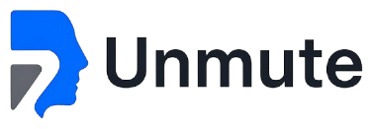
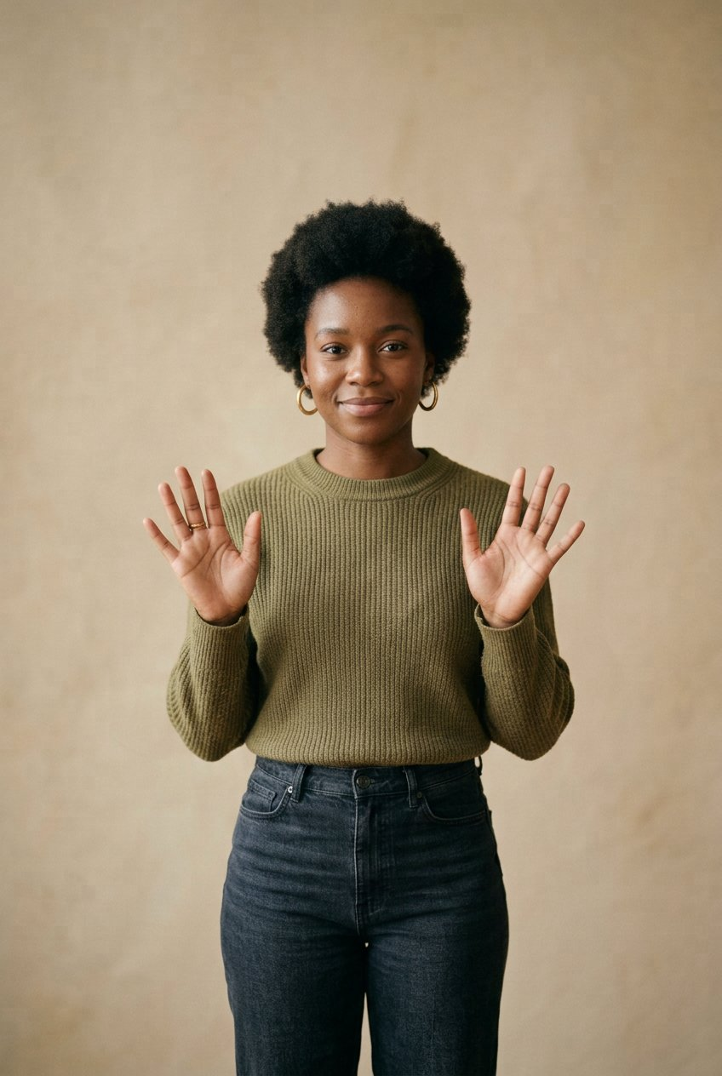
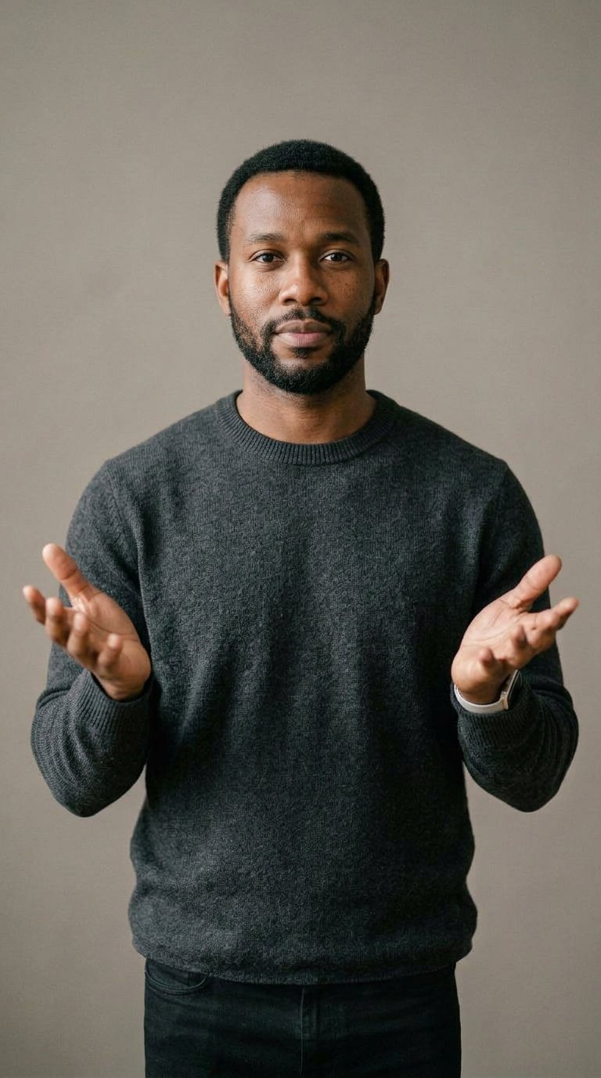
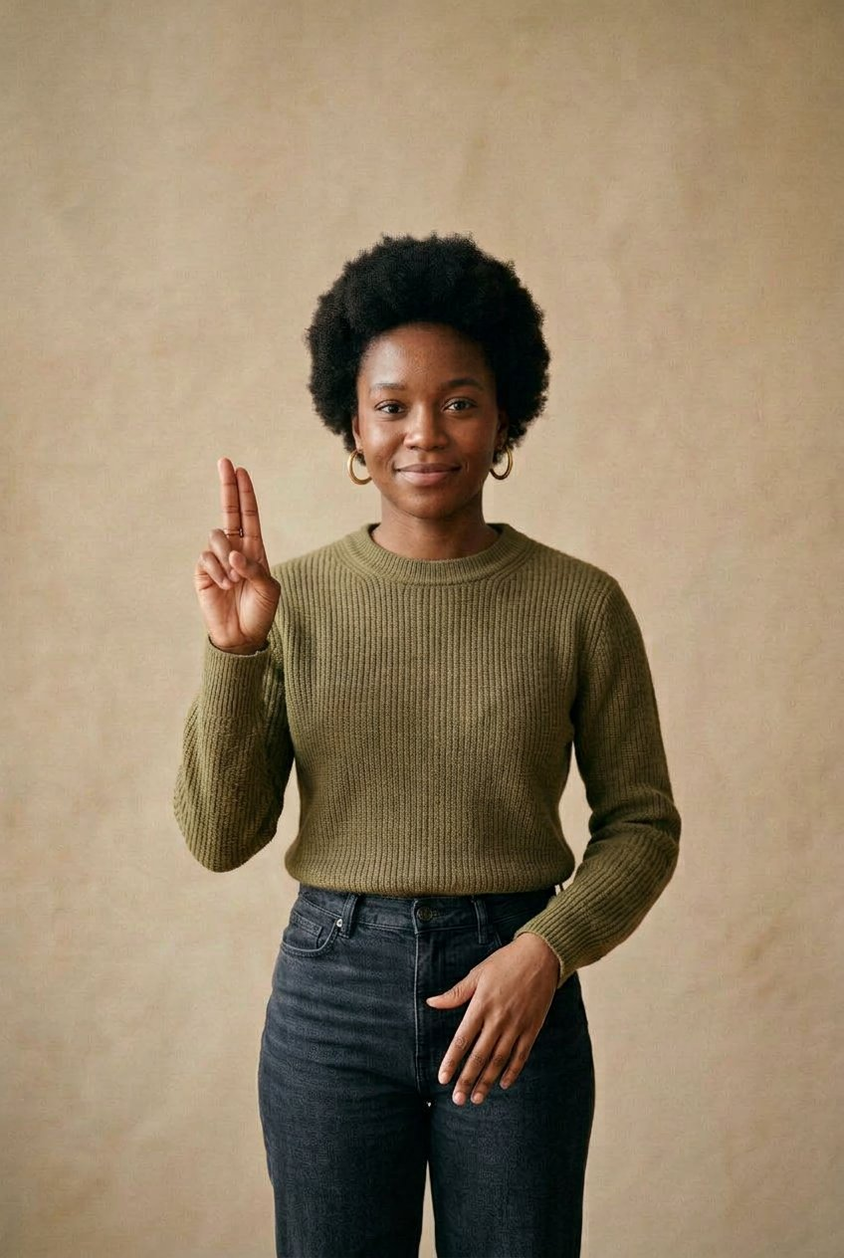
Overview
Problem
Solution
Product
Market
Traction
Team
01 / 13
2026
IDICE · FOUNDERS LAB · DEMO DAY
Every voice deserves
to be understood.
Unmute is two-way sign-language translation for hospitals — so a Deaf patient is understood at the point of care, not when an interpreter becomes free.
THE PRODUCT
RAISING
THE WEDGE
Two-way translation, in one screen
$250K
200 clinical phrases
The patient signs. The clinician speaks. Both are understood.
Pre-seed, 18 months
The vocabulary that carries routine risk.

Slide 2
Overview
Problem
Solution
Product
Market
Traction
Team
02 / 13
2026
01
02
03
04
05
Startup Overview
Problem
Solution
The product
Growth
What Unmute is, in one slide
Who is affected, and the evidence
How it works, and what is new
Three screens, in the room
Market and reach
06
07
08
09
10
Validation
Business model
Traction
Team
The $10,000
What testing changed
Revenue and alternatives
Where we actually are
Who builds it, and the gap
What the grant buys
Contents of this
presentation
Ten sections, following the
Founders Lab Demo Day brief.
+

Slide 3
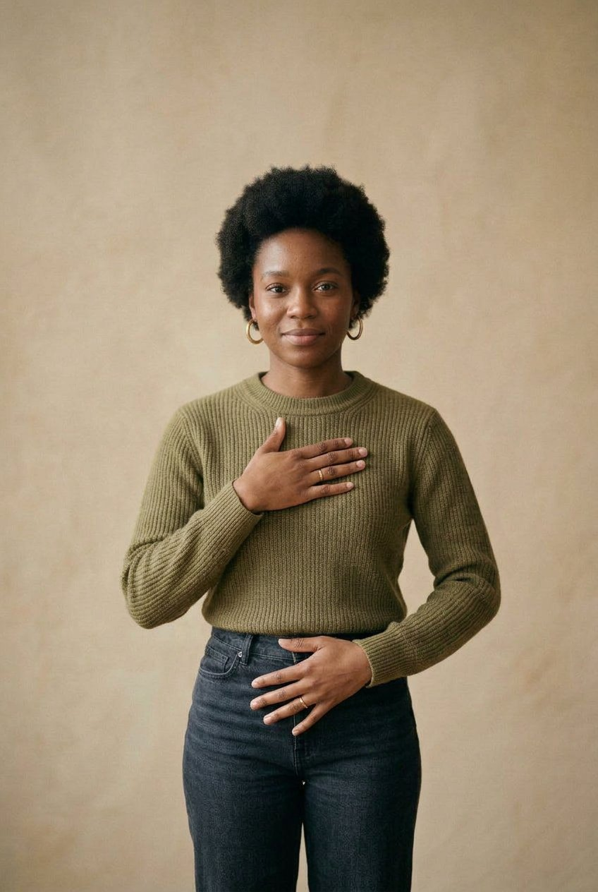
Overview
Problem
Solution
Product
Market
Traction
Team
01 · OVERVIEW
03 / 13
2026
THE GAP
50 : 1
Deaf ASL users to certified interpreters in the United States, before accounting for geography or hours.
THE PRODUCT
One screen.
Both directions.
Sign to English, and English back to sign, without booking anyone.
A hospital conversation,
handled in the room.
Built for the ward, not the app store. Sold to the department that carries the compliance obligation.

Slide 4
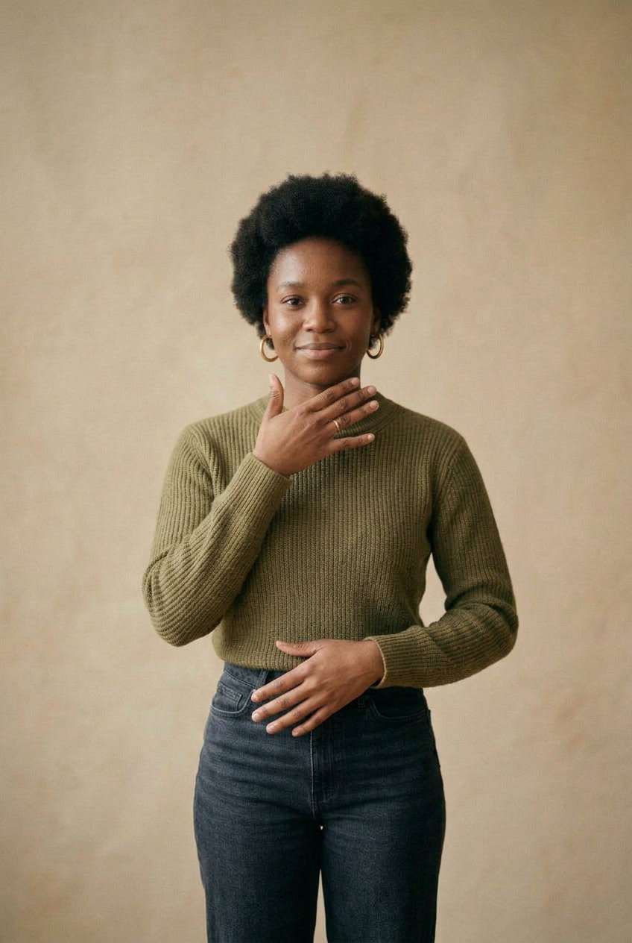
Overview
Problem
Solution
Product
Market
Traction
Team
02 · PROBLEM
04 / 13
2026
01 · THE BASELINE
Fewer than one in ten encounters with a Deaf patient involves a professional interpreter. 63.9% rely on a family member. In the same 166-physician survey, 90.4% of staff knew no sign language at all.
02 · THE CONSEQUENCE
Consent, allergies and dosages get relayed by a relative, or written on paper. Care is improvised exactly where the vocabulary matters most.
The interpreter
is not in the room.
EVIDENCE
Akeely et al., Cureus, 2022 — n = 166 emergency physicians. Corroborated by Pennsylvania Patient Safety Authority (2025).

Slide 5
Overview
Problem
Solution
Product
Market
Traction
Team
03 · SOLUTION
05 / 13
2026
BUILT FOR A WARD
+
01 · SIGN → ENGLISH
Palm 1.0 reads
continuous ASL
Solution &
Technology
Landmarks extracted on device. Text and speech returned to the clinician, with a confidence value shown, never hidden.
Unmute does not train a model. It integrates verified engines behind a clinical interface, and owns the three things a vendor cannot: the vocabulary, the confirmation step, and the record.
02 · ENGLISH → SIGN
Echo 1.0 renders
the reply
The clinician's sentence becomes signing, at 30 FPS. A repeat control lets the patient ask for it again.

Slide 6
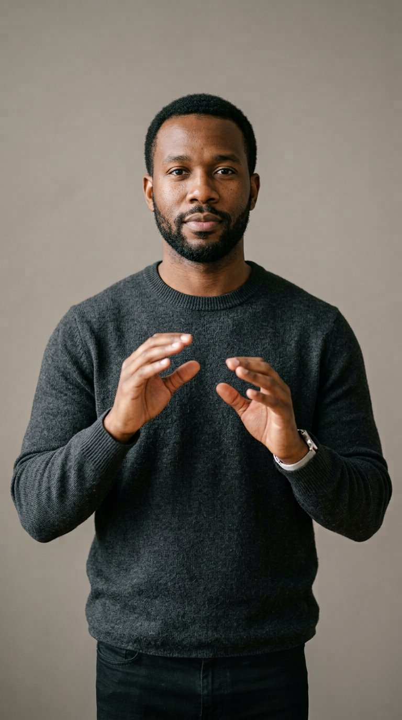
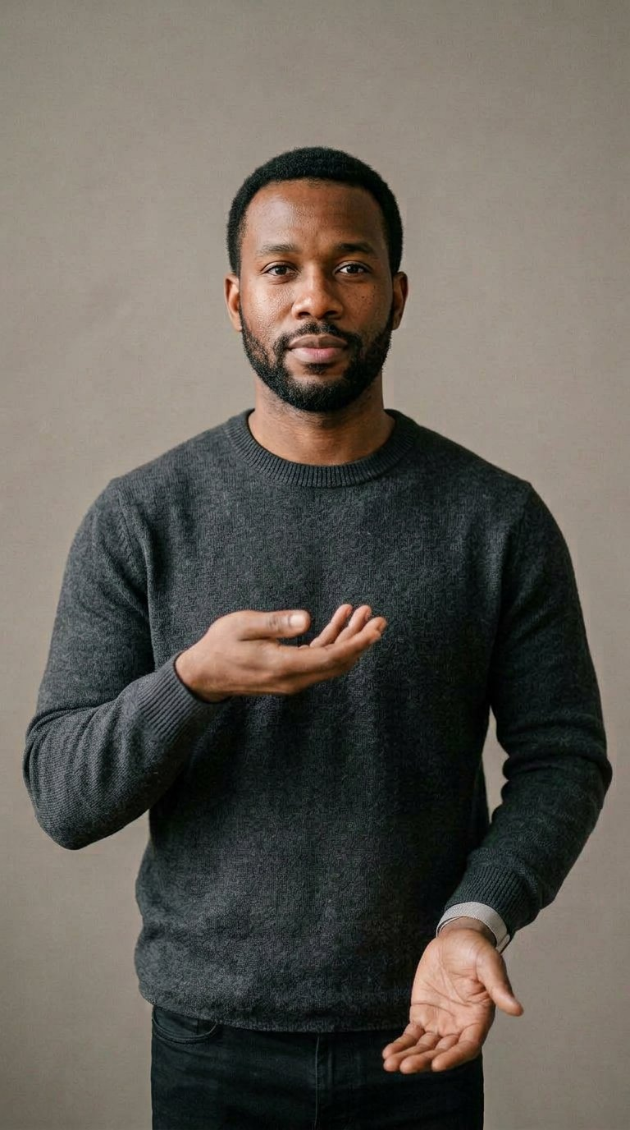
Overview
Problem
Solution
Product
Market
Traction
Team
04 · PRODUCT
06 / 13
2026
What the clinician
actually holds.
Four screens. No onboarding, no training session — a nurse has to use this on the first shift.
HOME
PATIENT SIGNED
CLINICIAN SPEAKING
Speak to patient
My chest hurts.
Where does it hurt?

Slide 7
Overview
Problem
Solution
Product
Market
Traction
Team
05 · GROWTH
07 / 13
2026
THE OPPORTUNITY
Growth &
Scalability
Deaf adults in the US who use ASL
500,000
The smaller, defensible figure — a million sign to some degree
Certified ASL interpreters
10,000
Registry of Interpreters for the Deaf
Departments with no policy for Deaf patients
74.1%
Of 166 emergency departments surveyed
Start with the 200 phrases that carry routine clinical risk. Then every department. Then every sign language — the same architecture, a different corpus.
Staff who knew any sign language
9.6%
The same survey — the reason a tool beats a booking system

Slide 8
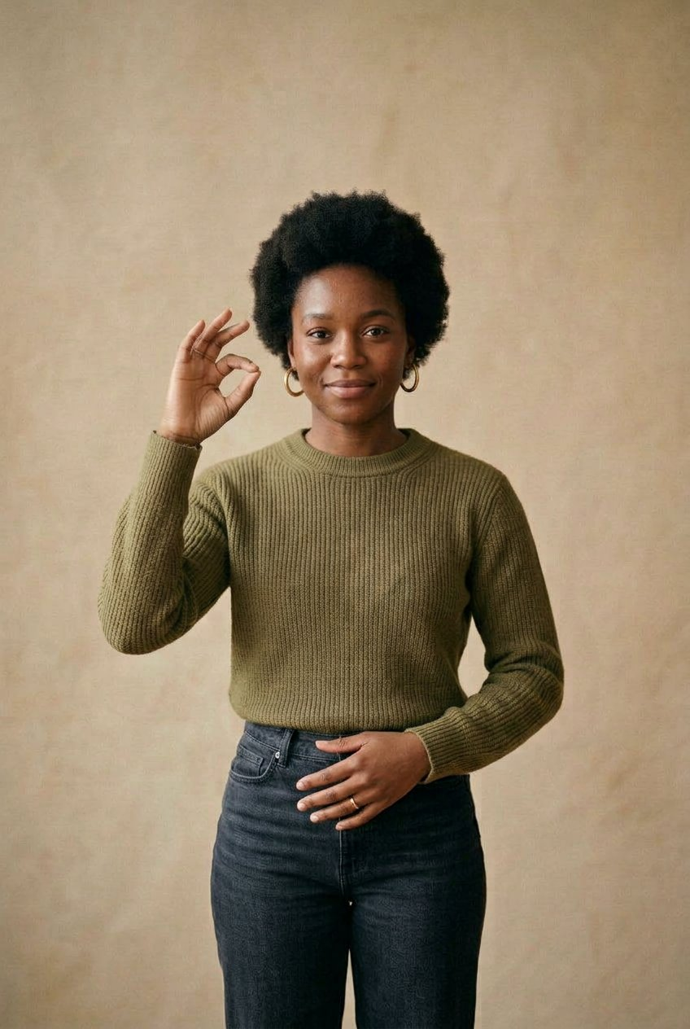
Overview
Problem
Solution
Product
Market
Traction
Team
06 · VALIDATION
08 / 13
2026
WHAT TESTING CHANGED
“I built a general-purpose translator first. The first clinician who used it asked what it does about dosages. It did nothing about dosages.”
16–20 people have used the prototype. 21+ have seen it. Each round narrowed the product: general translation → hospital communication → 200 clinical phrases with a confirmation step the patient approves before anything is spoken.
21+ DEMOS
16–20 TESTERS
10–15 LOIS

Slide 9
Overview
Problem
Solution
Product
Market
Traction
Team
07 · BUSINESS MODEL
09 / 13
2026
Revenue, and the alternatives.
HOW UNMUTE EARNS
WHAT A DEAF PATIENT HAS TODAY
Care team — up to 10 practitioners
$199/mo
Booked interpreter
Scarce
Routine interactions, one department
$60–150 per hour, scheduled days ahead
Department — unlimited practitioners
$599/mo
Video remote interpreter
On request
Every shift covered, one floor
Better, still needs a cart and a connection
Institution
Quoted
Consumer sign apps
Not clinical
Custom: SSO, BAA, audit log
Free; no clinical vocabulary, no confidence, no record
WHY A SUBSCRIPTION
WHERE WE DIFFER
Hospitals already buy interpreter hours by the block. Priced against the encounter it replaces, not against other apps.
Nothing currently on a ward is both immediate and clinical. That intersection is the product.

Slide 10
Overview
Problem
Solution
Product
Market
Traction
Team
08 · TRACTION
10 / 13
2026
Where we actually are.
As of October 2026. Every number below is one we can evidence if asked.
16–20
21+
10–15
198
People have used the working prototype directly
Demonstrated to prospective users and clinicians
Letters of intent from interested organisations
Clinical phrases scoped and specified
What does not exist yet
!
A trained model · a deployed pilot · a signed design partner · revenue. Stated plainly here because it is faster to say it than to be asked, and because the next twelve months are precisely the work of creating them.
Two-way prototype tested by 16–20 people. 198 clinical phrases scoped. Ten to fifteen letters of intent in hand — the strongest asset we have, and the one we can produce on request.

Slide 11
Overview
Problem
Solution
Product
Market
Traction
Team
09 · TEAM
11 / 13
2026
WHO BUILDS THIS
One founder.
A specific gap.
U
Founder — name on application
AI research · NLP · product · integration and evaluation
The gap: two advisors, being recruited
An ASL linguistics advisor for annotation protocol and regional variation, and a clinical advisor for vocabulary and validation. Both are being recruited — neither is claimed as filled.
WHY A SOLO FOUNDER CAN SHIP THIS
The machine translation is licensed, not built. What Unmute actually ships is a clinical interface, a vocabulary and a corpus protocol — all of which one person can own, and all of which compound with every conversation.
Solo at pre-seed, full time. The role that is hired first is clinical, not engineering.

Slide 12
Overview
Problem
Solution
Product
Market
Traction
Team
10 · USE OF GRANT
12 / 13
2026
What $10,000 buys.
Not runway. The specific inputs that turn a prototype into a measured product.
MILESTONE 01
A corpus, not a demo
60 clinical recordings, consented, annotated to a protocol written with an ASL linguist.
Clinical corpus — 60 consented recordings, annotated
45%
$4,500
Clinical validation — 3 design partners, 12 weeks
15%
$1,500
Compliance groundwork — HIPAA counsel, BAA review
15%
$1,500
MILESTONE 02
Engine credits — Palm 1.0 & Echo 1.0, speech
12%
$1,200
Three design partners live
Real departments using it on real shifts, with the failures recorded rather than hidden.
Deaf design panel — 5 paid participants
7.5%
$750
Contingency
5.5%
$550
Total
$10,000
MILESTONE 03
A number we can publish
Clinical accuracy on our own vocabulary, measured by a method a reviewer can reproduce.

Slide 13
Overview
Problem
Solution
Product
Market
Traction
Team
CLOSING
13 / 13
2026
NEXT PRIORITIES
What we do
next.
The jury's recognition would buy the one thing that cannot be faked in a slide: recorded, consented, clinical signing data — and the accuracy figure that comes out of it.
90 DAYS
12 MONTHS
CONTACT
200-term library live. Three design partners using it on shift.
First published clinical accuracy number. First paying care team.
contact@liveunmute.com
app.liveunmute.com

