Slide 1

Seminar 1
Getting Started with PsychoPy Builder

Slide 2



PREPARATION– If you are using your own computer
https://www.psychopy.org/download.html
Run the installation package
Open PsychoPy Builder

Slide 3
Session
Experiment Settings
How to understand trials in experiments
How to create a simple experiment

Slide 4
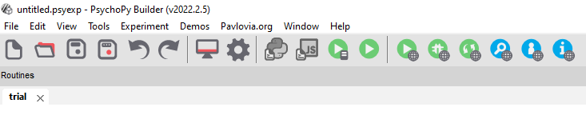
Experiment Settings

Slide 5
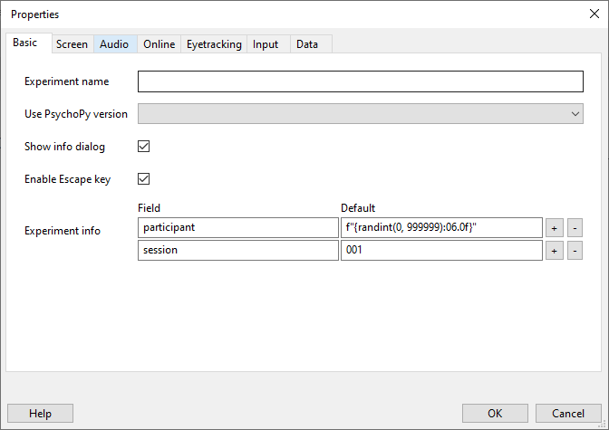
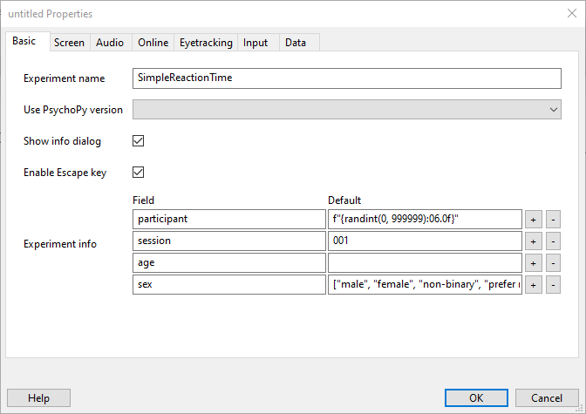
Experiment Settings
Notes:
Things fly in on click.
Click 1 Removes the top banner
Click 2 Brings an image of the Basic tab of the experiment properties
Click 3 highlights the experiment name field (no spaces is best)
Click 4 removes that highlight
Click 5 adds a highlight around the Experiment info field
Explain that the participant field name SHOULD not be changed
That the f”{rand int code is to set a random integer between the values of 0 to 999999
Leave session well alone too
In the example I’ve added age as a variable for people to type in an integer
And added a drop down list for Sex/gender by the square brackets and the words I want in the drop down are in quotation makes and separated by a comma

Slide 6
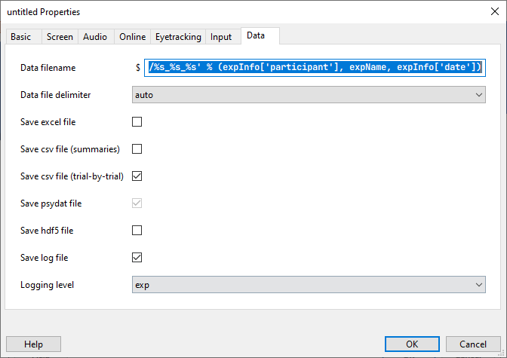
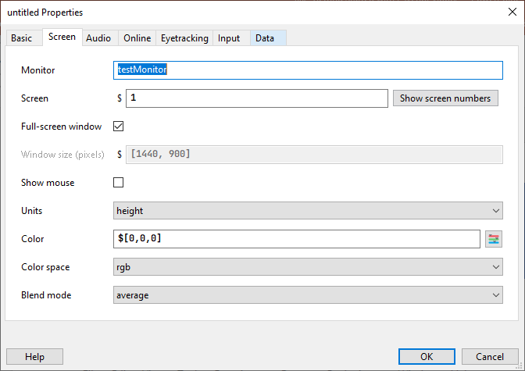
Experiment Settings
Notes:
Main things to highlight here are full screen window is checked for most experiments to avoid distractors in the background during an expt
Window size should be your current screen resolution
We are not dealing with audio so we can leave that alone (you might see warnings relating to the sound settings and recommending changing the parameter to PTB as this is a better way to process sound, but not currently necessary
Final screen is data tab. We need them to know to always ensure save csv trial by trial is checked, and that the data file is created using the info from the Basic tab, and it uses the participant number field to generate the file….hence if they change it, it breaks
Things that can be changed Height units – we will come back to this later in the course
Colour – this is the colour of the background, it is defaulted to grey, but you can change the background here leave the other settings alone

Slide 7
Reference: PsychoPy Builder Interface

Slide 8
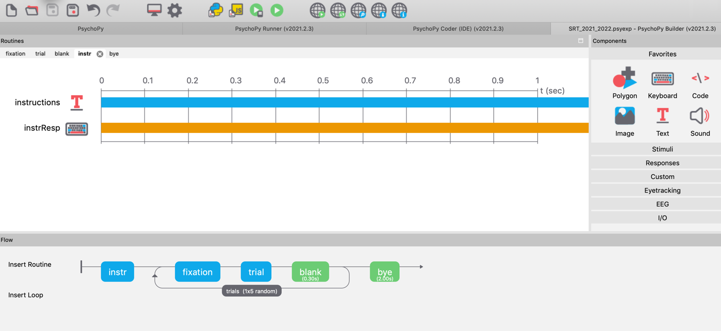
PsychoPy Builder Interface
Toolbar
Components
Routine window
Flow

Slide 9
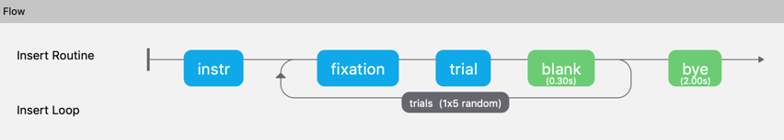
Flow panel
Individual Routines
Experiments can only have ONE flow
Experiments can have MANY routines
Routines can have MANY components
Experiments run sequentially from left to right (unless coding is used)
Each part of flow is executed in turn
Trials and Loops can be randomised
Loops allow us to repeat parts of the experiment (trials and practice blocks)
Loop

Slide 10
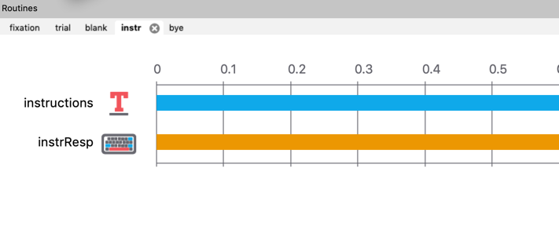
Routine window
Switch between routines using tabs
Routines can have many components, this experiment has 2 components
Text & Keyboard components

Slide 11
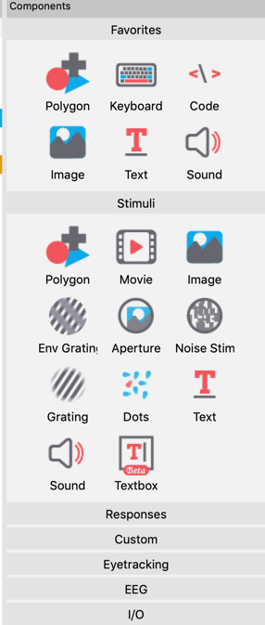
Components panel
Many different types of component – some are for vision science and you will be unlikely to use those, we will focus on the most commonly used tools
Grouped by type
Favourites (you can customise this)
Stimuli
Responses
Custom
Eyetracking
EEG
I/O
Most commonly used are:
Text
Sound
Keyboard/Mouse
Rating scale
Code

Slide 12
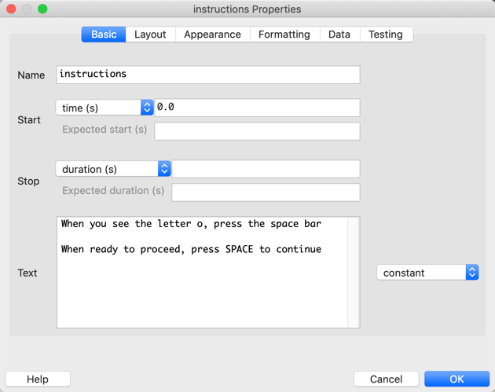
Component properties (Basic)
Component tabs
Component name (must be unique)
Start time in seconds (time after the start of the routine that the stimulus will first appear)
Stop time (duration you want the stimulus to remain on screen)
Text

Slide 13
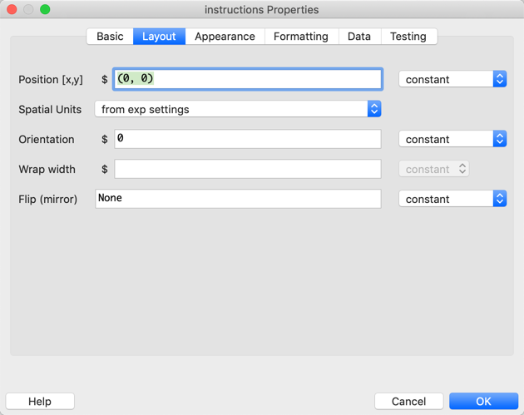
Component properties (Layout)
Position (default is 0,0 which are the x [horizontal] and y [vertical] coordinates in the given units for the centre of the screen)
Spatial Units, for the most part we will be using Pix (pixels) as the units in our experiments, and you can change this from the dropdown menu

Slide 14
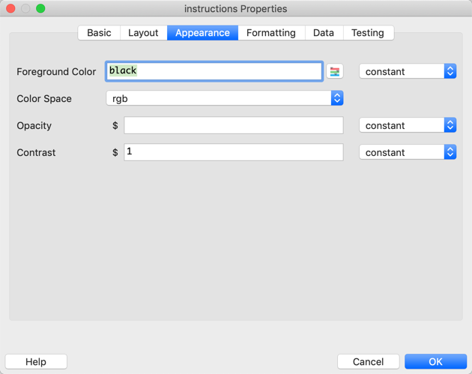
Component properties (Appearance)
Foreground Color is the field we will most typically change. In a text component this is the colour of the text presented

Slide 15
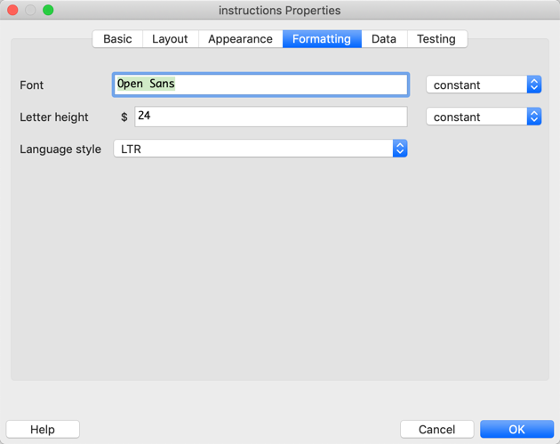
Component properties (Formatting)
Default font is Open Sans, there is no real need to change this setting, unless font type is a variable in your study
Where we specified the Spatial Units on the Layout tab to Pix, the Letter Height is now the font size in pixels and you can change this as you need

Slide 16
Rules of PsychoPy
Everything requires a unique name
Names must only contain letters, numbers and underscores
No spaces, punctuation or math symbols
Save often
Back up often
Naming Conventions
if presenting a text stimulus a sensible programming convention would be name the stimulus stimTxt
a sensible approach to name the response to that stimulus might be stimResp

Slide 17
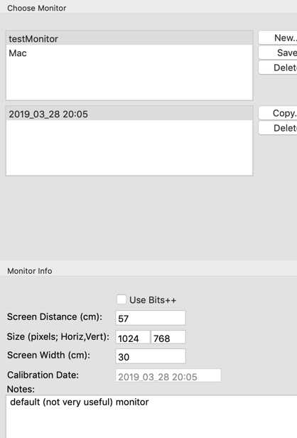
monitor properties
It is important to set your monitor properties
To do this you need to know your screen resolution for the PC/Mac that you are using
https://www.rapidtables.com/web/tools/screen-resolution.html
Click the Monitor icon on the toolbar
Click New, give your monitor a name (call it PC)
Complete the Screen Distance box using 57 cm as the default
Input the screen resolution in the Size boxes
Input the screen width in the Screen Width box
Click Save

Slide 18
Planning & designing experiments

Slide 19
Planning and designing experiments
A well designed experiment is as simple as possible!!
You need to know what you want to test
Define the problem
Hypothesise
You need to know what your variables are, has it been done previously? Anything similar?
Literature search
You need to consider the structure of the experiment – how will it run
Research Design
Create experiment
You need to consider your stimuli carefully
You need to think about designing confounds out of the experiment

Slide 20
Planning & Designing experiments
It is helpful to visualise experiments before you begin programming
We usually begin at the level of the individual trial
+
Stimulus
ISI
Response

Slide 21
DEMO
Building your first experiment

