Slide 1

Week 14 (Seminar 2)
Creating a choice reaction time task

Slide 2
Last week…
You learned:
how to create a very simple experiment
how to use experiment settings
how to add routines, components and loops
how to work with the component properties

Slide 3
Activity Set 2 Consolidating & building upon learning
This session is primarily designed to consolidate your learning from Seminar 1.
In it you will:
create a new simple experiment
include participant instructions & debrief
work with the component properties to make your experiment look good & behave as it should

Slide 4
Activity 2.0 – Example
Imagine a choice reaction time experiment.
We have a study where we want the participant to respond to an emotional expression on a human face.
If the face is angry, we want them to respond with the M key. If the face is happy, they should press the Z key.

Slide 5
Activity 2.0 – Choice Reaction Time
Fixation
(300ms/0.3sec)
Instructions
Goodbye/Debrief
Conditions: Emotion
Angry (m key)
Happy (z key)
Stimulus
(until keypress)
Blank screen
(200ms/ 0.2sec)

Slide 6
Activity 2.0 – Using conds files
Your stimulus must change on each trial iteration
To do this we use a conds file (conditions)
Conditions files are simply repositories for the stimuli that you want to present on screen
They are not limited to just stimulus presentation
You can change things such as
the orientation of a stimulus
the colour of text
the size of text or images
the position of components on the screen
specifying a correct or incorrect response
Stimulus
(until keypress)

Slide 7
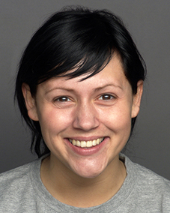
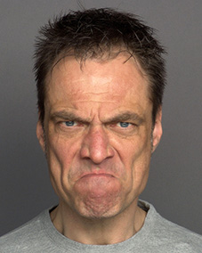
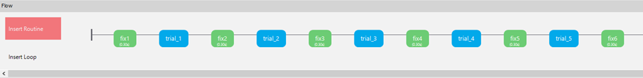
Activity 2.0 – Why do we use them?
Imagine an experiment where you want to present 80 trials to a participant. You could create a routine for each single trial, so your Flow would have at least 1 routine per trial, plus instructions, keyboard responses, fixations, inter-stimulus intervals and a debrief
+
+
+
+
+

Slide 8

Activity 2.0 – Why is this bad?
Inefficient programming method
Unable to randomise stimulus presentation
Resulting dataset would be difficult to interpret

Slide 9
Activity 2.0 – So, what do we do instead?
Trial visualisation shows what ONE trial will look like
“Store” the stimulus information in the excel conds file
faces --------------------------------
emotion --------------------
correct response ----------------------“z”, “m”
Fixation
(300ms/0.3sec)
+
stims/happy.jpg
stims/angry.jpg
Stimulus
(until keypress)
positive
negative
Blank screen
(200ms/ 0.2sec)

Slide 10
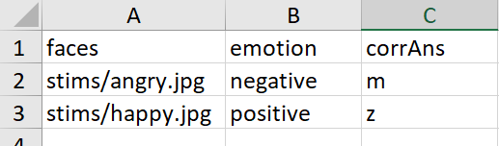
Activity 2.0 – Anatomy of a conds file
variables
folder
image name
file extension
correct
response
levels of the emotion condition

Slide 11
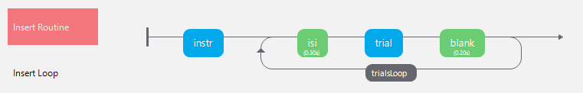
Activity 2.0 – How do we tell PsychoPy to find the conds file?
Insert a Loop around the trial routines

Slide 12
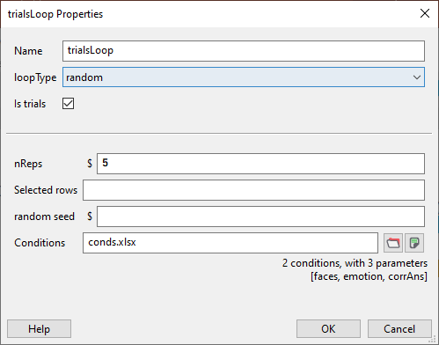
Activity 2.0 – How do we tell PsychoPy to find the conds file??
Click on the Loop to edit
the properties
Use the folder browse icon
to locate the conds file in
your root folder

Slide 13
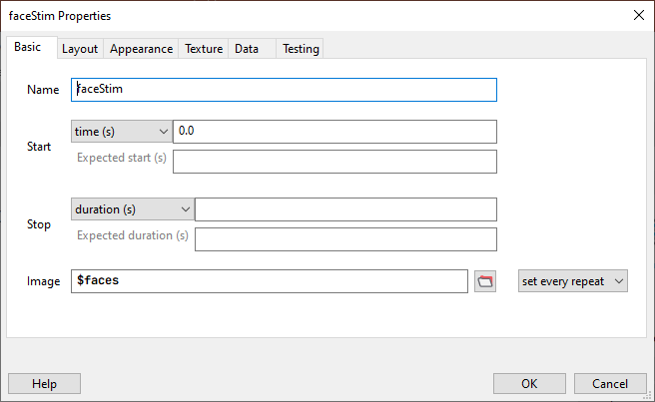
Activity 2.0 – How do we tell components to find the stimuli or other variables in the conds file??
Click the component
you want to allow to
link to a column in
the conds file
Instead of linking directly to
an image stimulus, use the
$ sign to reference the column
you want in the conds file and
ensure this is set every repeat

Slide 14
Activity 2.0 – What happens next?
You also need to tell the response component where to look for the correct response (corrAns) in the conds file using the $ sign again
You may have other columns in the conds file that you want to create variables, such as the colour of text, the size of images, the position on screen etc

Slide 15
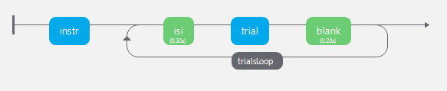
Activity 2.0 – Running the experiment
+
$faces
Notes:
I use a handbag analogy. The conds file is a handbag, the loop is the strap and the dollar sign to reference the conds file is a hand reaching into the bag to grab a ROW from the conds file and present it, then throw it away, reach in and grab the next (random) row

Slide 16
Activity 2.0 – Running the experiment

Slide 17
For next week…
Read all of the Assessment pages on the EDP Website on the Moodle
Read the Introduction and Methodology of the starter reference, there is some guidance to support this here
Run a demo Lexical Decision Task online to help appreciate what the task that you will be developing will look like

