Slide 1

Week 15 (Seminar 3)
More assessment information

Slide 2
EDP 3 Activity Set
Importance of preparation
Setting the scene
Planning
what a trial looks like
what the flow looks like
parameters for stimuli
Beginning literature searching
Considering confounding variables
Looking at word databases

Slide 3
What are we doing?
Replicating a Dual Lexical Decision Task from Experiment 1 from Meyer & Schvaneveldt (1971)
The task measures how participants access lexical information and lexical formation using real words and nonsense words
Results indicated that when presented with pairs of words that were either related, unrelated or nonsense words or pseudowords, responses were faster & more accurate to the pairs of words that were related when compared with the unrelated pairs and the nonsense word pairs

Slide 4
Meyer & Schvaneveldt (1971)
Present Pair
+
Real Words
Key Response YES
Not Real Words
Key Response NO

Slide 5
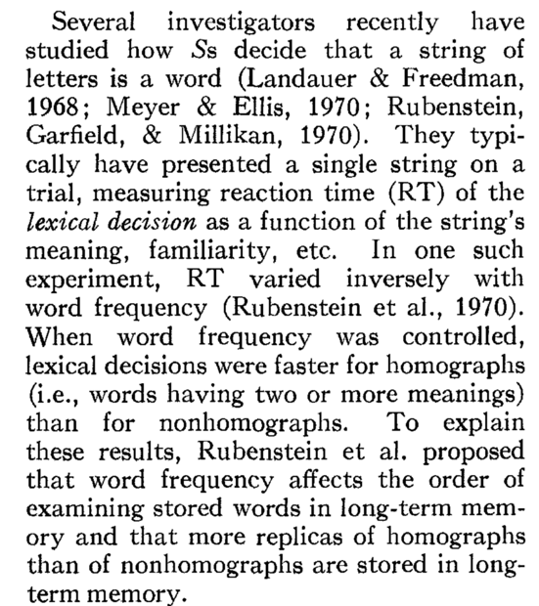
Understanding the starter reference
Responding to a single word stimulus

Slide 6
Single word stimulus hierarchy
Nonwords
e.g. Spelled the same, different meaning PARK (a car)/
PARK (green space, play area)
Slowest
Real words
Homographs/
Homophones
Fastest
e.g. Spelled differently, sound the same,
different meaning BEAR/BARE

Slide 7

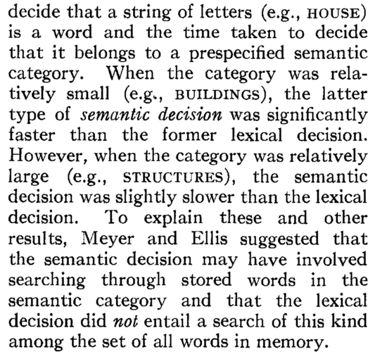
Understanding the starter reference
What else do we we know?

Slide 8
Semantic decisions hierarchy
Nonword Pair
e.g. SHOW - CLANG
Slowest
Semantically unrelated pair
e.g. CAT – DOG
(Animals)
Highly related semantic category pair
Single Word
Fastest

Slide 9
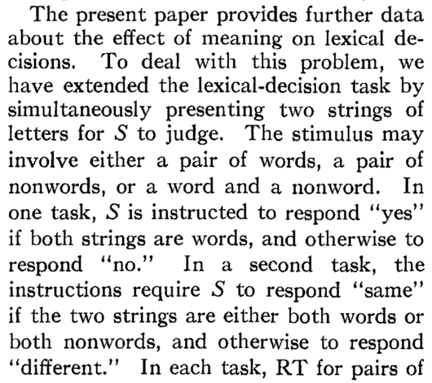
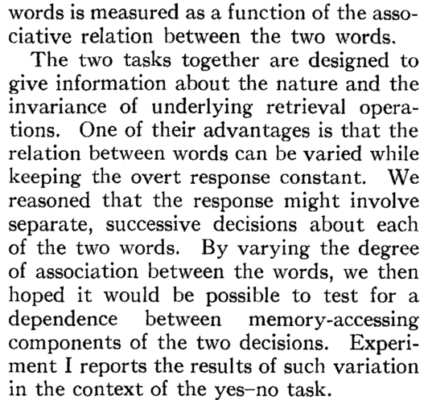
Aims & Hypotheses

