Slide 1

Week 18 (Seminar 6)
Stimulus placement

Slide 2
Learning Objectives
To think more about how to set up conditions files
To learn how to place several stimuli on screen
To work more independently, using previous resources to support you

Slide 3
Why is this useful?
You are going to need to place your word/nonword stimulus pairs on the screen for the assessment
You will need to decide how and where to place them
You will need to use your conds file for this
The information this week will scaffold that process for you

Slide 4
Flanker Task Reference: Eriksen, B. A. & Eriksen, C. W. (1974). Effects of noise letters upon identification of a target letter in a non-search task. Perception and Psychophysics, 16, 143-149.
The basic effect from a Flanker task is that when a participant responds to stimuli "flanked" by irrelevant stimuli.
The irrelevant stimuli can affect your response.
There is a similarity between other paradigms in which this type of interference from an irrelevant stimulus or stimulus feature occurs (like the Stroop task or the Simon task)

Slide 5
Flanker Task
Target
Congruent Left
Congruent Right
left = z
right = m
Incongruent Left
Incongruent Right
Irrelevant distractors

Slide 6
Fill in the blanks
Independent Variable?
Conditions?
Dependent Variables?
Data Type?

Slide 7
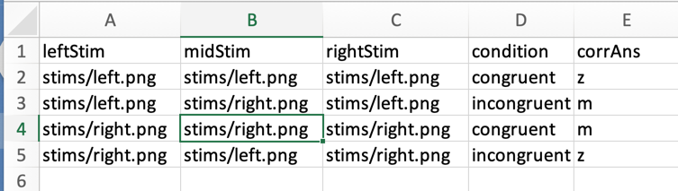
Conds files
There will always be more than one way to set up a conditions file!
Don’t leave PsychoPy default names
Specifying the condition and the corrAns is for data analysis
Use logical names

Slide 8
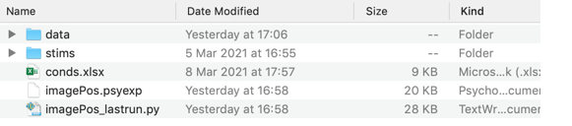
File path
left.png
Component
leftImg
$leftStim
stims/leftStim
right.png

Slide 9
(0, [pixels])
+
(x, y)
([-pixels], 0)
(0, 0)
([pixels], 0)
y-axis
(x, y)
(x, y)
(x, y)
(0, [-pixels])
-
-
+
x-axis

Slide 10


Image dimensions - The dimensions show the pixel height and width of your photo
Find the image file in your Finder, right click the image and select Get Info. A pop-up window will open with the dimensions of your image displaying in the More Info section.
Type File Explorer into the search bar. Open File Explorer.
Find the image you want to check. Place your cursor over the image name until the hover text with the image dimensions appears.

Slide 11


leftImg
midImg
rightImg
Component names
What is the potential confound here?
Position using image dimensions
(-202, 0)
(0, 0)
(202, 0)

Slide 12
leftImg
midImg
rightImg
Component names
Position using image dimensions and padding
(-220, 0)
(0, 0)
(220, 0)

Slide 13
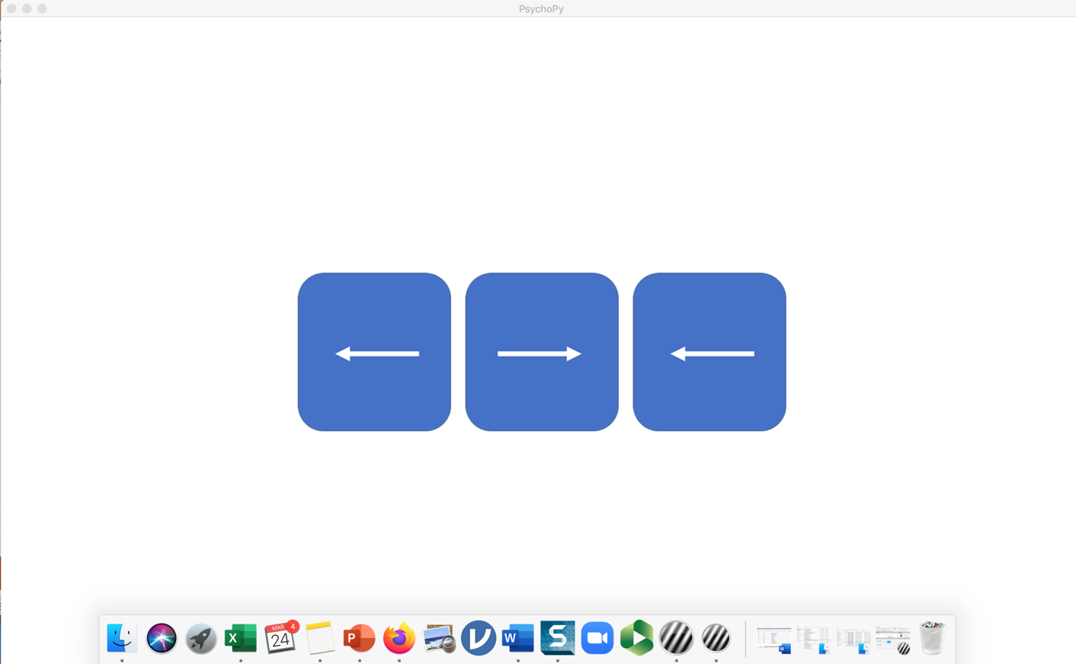
leftImg
$leftStim
stims/leftStim
left.png

Slide 14
Experimental considerations
Too close
difficult to determine the central target stimulus
Too far apart
flankers may not provide a distracting effect

Slide 15
Positioning stimuli for the assessment
You will need to check
font size
position
how to present the stimuli
left/right presentation
top/bottom presentation
stimuli do not overlap
not too close
not too far apart
How might you determine this information?

