Slide 1


+
1000ms
ISI
1000ms
Cue indicator
1500ms
ISI
1000ms
Cue presentation
500ms
ISI
450ms
Target presentation
500ms

Slide 2
+
500ms
Target
3000ms
ISI
250ms

Slide 3


+
250ms
200ms
until keypress

Slide 4
ISI
300ms
Rule
until keypress
ISI
300ms

Slide 5
+
200ms
Go Trials
3 colours
2 sizes
Target
1000ms
No Go Trials
3 colours
2 sizes

Slide 6
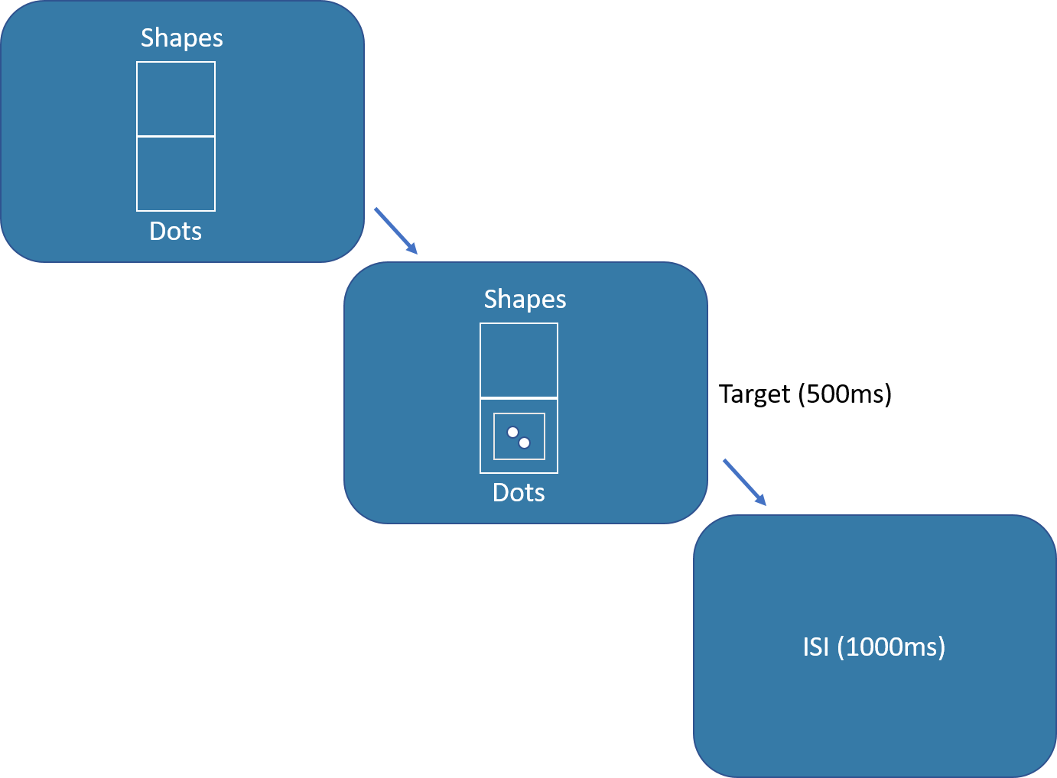

Slide 7
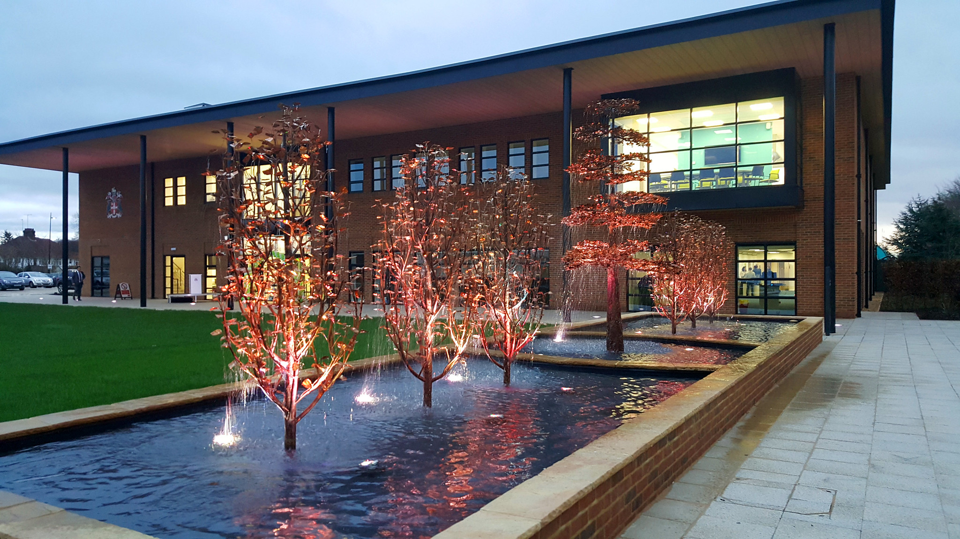

Department of Psychology
Yes
No
Next

