Slide 1
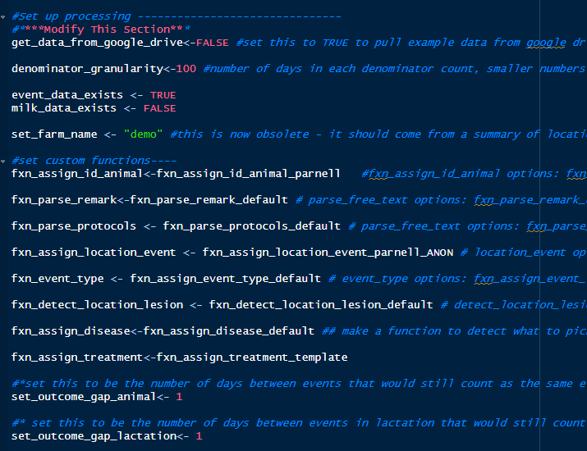
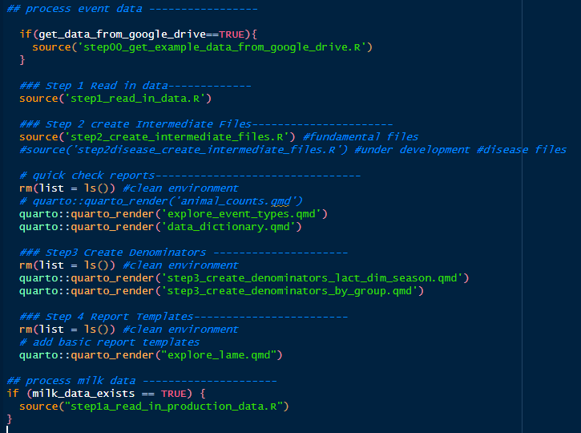
step0_master_processing
controls everything
SET UP
PROCESSING
Notes:
Step0_master processing controls the entire process. It has 2 parts: setup, and processing. The set up can be customized according to your preferences using custom functions if desired.

Slide 2
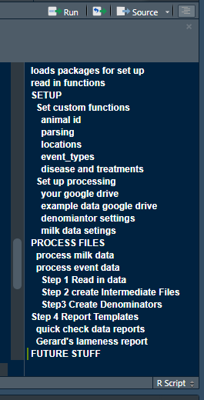
step0_master_processing
controls everything
Outline
You can modify anything but …
Start out only modifying the parts in yellow (carefully)
Leave red sections alone . . . for now

Slide 3
data/event_files/
original event .csv files
Line37 – replace odd characters
Line 38 – add source file path
Line 43 – standardize variable names
Line 58 – assign animal id
Line 63-76 – format dates
Line 79-80 – parse numbers
Line 83 – de-duplication of rows
Line 86-88 – fix missing values (event, remark, protocols)
Line 91 – assign event_type
Line 93 – assign location_event
Line 95-96 – parse remarks and protocols
Line 98 – detect lesion location
Line 100 – qc enrollment date
Line 106-120 – create event template files
Line 129-135 – fix NA values in key variables
Line 139-162 – assign lactation groups
step1_read_in_data
data/template_files/
template_event_details.csv
template_event_details.parquet
data/intermediate_files/
events_all_columns.parquet
All columns new and original
events_formatted.parquet
Selects formatted columns only
data/qc_files/
qc_animal_enrollment.parquet
(under development)
qc_event type.parqet
highlight means it is a customizable function
Notes:
Step1 takes all of the files in event_files folder and puts it into one dataframe with standard formatting. This produces the base file for all the rest of the steps as well as a few qc files.

Slide 4
data/intermediate_files/
events_formatted.parquet
Selects formatted columns only
step2_create_intermediate_files
Line 15-16 – specify event pull dates
Line 23-80 – create animal dataframe
Line 88-157 – create animal_lactations data frame
Line 164-172 – assign disease and treatments
data/intermediate_files/
animals.parquet
Each row is a unique animal
animal_lactations
Each row is a unique animal lactation
events_parsed.parquet
events with disease and treatments assigned
Notes:
Step1 takes all of the files in event_files folder and puts it into one dataframe with standard formatting. This produces the base file for all the rest of the steps as well as a few qc files.

Slide 5
data/intermediate_files/
animals.parquet
Each row is a unique animal
animal_lactations
Each row is a unique animal lactation
events_parsed.parquet
events with disease and treatments assigned
step3_create_denominators
Under development
Step 1 – set interval (as days) between counts
Step 2 – create logic for eligibility
Step 3 – run denominators
Notes:
Step1 takes all of the files in event_files folder and puts it into one dataframe with standard formatting. This produces the base file for all the rest of the steps as well as a few qc files.

Slide 6
Dairy Data Denominators
animal_lactations.parquet
animals.parquet
Calendar
Time (date)
Eligible?
Group_by:
date,
eligible,
…
date | …(grouping variables) | eligible | count
 |  | TRUE

Slide 7
Reporting Data Structure
Report
Report
Report
DC305 File A
DC305 File BC
DC305 File E
DC305 File FG
DC305 File H
Heifer to Left
Fresh to Left
Fresh to Left
Heifers
Close to Preg/Left
Preg to Left/Close
Fresh to Left
Location A
Location B
Location C
Location E
Location F
Location G
Location H
Animal | Date | Location | Description (lact, event, remark, protocol, etc)
Event
Data
(last 5 years)

Slide 8
Reporting Data Structure
Report
Report
Report
source_file_path
DC305 File A
DC305 File BC
DC305 File E
DC305 File FG
DC305 File H
location_event
Heifer to Left
Fresh to Left
Fresh to Left
Heifers
Close to Preg/Left
Preg to Left/Close
Fresh to Left
Location A
Location B
Location C
Location E
Location F
Location G
Location H
Animal | Date | Location | Description (lact, event, remark, protocol, etc)
Event
Data
(last 5 years)

Slide 9
Fundamental Data Structure
Animal | Date | Location | Description (lact, event, remark, protocol, etc)
Event
Data
(last 5 years)
Time
“date_event”, “day_of_phase”“age_at_event”
Unique Animal
“id_animal”
Geographic Location
“location_event”
(source_file_path + ID + BDAT)
Animal Properties:
“date_birth”,
“date_died”, “date_sold”,
“date_enrolled”, “date_archived”
Time Properties:
Calander Time: week, month, year, etc
Phase Time: 0-60 DIM, etc
Age Time: 0-30 Days of Age, etc
Location Properties:
grouping variable at the event level, cows don’t necessarily have static locations

Slide 10
Dairy Data Base Files
Event
Data
(last 5 years)
Animal | Date | Location | Description (lact, event, remark, protocol, etc)
events.parquet
Each row is an event
Animal Properties: “id_animal”, “breed”,
“date_birth”, “date_died”, “date_sold”,
“date_enrolled”, “date_left”,
“age_enrolled”, “age_left”
Unique Animal
animals.parquet
Each row is a unique animal
Unique Animal
Lactation Properties: “id_animal”, “lact”, “lact_group”,
“date_fresh”, “date_dry”, “date_next_fresh”,
“date_archived”, “dim_at_archive”, “age_at_archive”
“date_dim##”
Time
animal_lactations.parquet
Each row is a lactation

Slide 11
Dairy Data Base Files
Event
Data
(last 5 years)
Animal | Date | Location | Description (lact, event, remark, protocol, etc)
events.parquet
Each row is an event
Variables can be added to the fundamental tables, but they must be summarized to the same level as the table
Animal Properties: “id_animal”, “breed”,
“date_birth”, “date_died”, “date_sold”,
“date_enrolled”, “date_left”,
“age_enrolled”, “age_left”
Unique Animal
animals.parquet
Each row is a unique animal
Unique Animal
Lactation Properties: “id_animal”, “lact”, “lact_group”,
“date_fresh”, “date_dry”, “date_next_fresh”,
“date_archived”, “dim_at_archive”, “age_at_archive”
“date_dim##”
Time
location_lactation
summarized from events
animal_lactations.parquet
Each row is a lactation

