Slide 1
Bovine Therapeutic Outcomes
Are they really needed? How do we calculate them?

Slide 2
[2] Picking up where Mike left off
Mike just showed us:
Monitoring, metrics, standardization
That a single number — or a target — can mislead
Granularity matters (his 2×2)
When a measure becomes a target, it ceases to be a good measure.
— Goodhart / Strathern
Same use level splits into good and bad — you can’t tell which without context.
Notes:
This is the hand-off from Mike. His 2×2 proves low use isn’t automatically good and high use isn’t automatically bad. Hold that thought — the rest of the talk is about the measurement that tells these quadrants apart: disease context and therapeutic outcome.

Slide 3
[3] Step 1 — to measure use, we needed disease context
Regimens became our favored AMU metric — a well-defined relationship to disease and to reality (dose × duration × indication).
Total Regimens = Disease Incidence × Regimens per case
The importance of capturing disease data — you can’t read use without it
What changes when disease incidence goes from diagnosed → anticipated?
Building on M. Apley’s regimen decomposition · Schrag et al., dairy AMU quantification, Part 1 (2020)
Notes:
Regimens tie to what actually happens to an animal, unlike defined-constant or weight-based metrics. The decomposition is Mike’s — I’m taking his third term (regimens per disease event) and, next, adding what the regimen achieved.

Slide 4
[4] Step 2 — but the real question is
Did the drug work?
Measuring use was the means. The therapeutic outcome is the end — and the only thing that tells us whether a treatment earned its place.
Notes:
This is the pivot of the talk. Everything before was infrastructure. The question a caretaker actually asks is binary and human: did this animal get better?

Slide 5
[5] How we define an outcome
This is exactly what the ICASA_Disease app computes — you set the 7-day and 30-day windows yourself. · Schrag et al. 2022
Notes:
Four mutually exclusive states over a fixed window. The two window lengths are choices, and the app exposes them so you can test sensitivity. Keep “relapse” and “died” in mind — they’re about to behave very differently.

Slide 6
[6] We’re not alone — this is where the science is going
Human medicine
microbiological cure → composite endpoint → DOOR
One ordinal rank for the whole clinical course — best = alive, no complications; worst = death — combining efficacy and harms. “Moving beyond mortality.”
Cattle
clinical & bacteriological cure · FTS · case-fatality · relapse · chronic
mastitis review “What is success?” — bacteriological cure ranges 27–95% across studies and doesn’t predict clinical outcome.

Slide 7
Both fields converged on the same answer: multi-dimensional, whole-course outcomes — because a single endpoint distorts.
DOOR endpoint — “Moving Beyond Mortality,” Clin Infect Dis 2024; first proposed by Evans et al. 2015. Mastitis review 2021.
Notes:
Credibility slide for the skeptics (Ivanek, Apley). We’re not improvising — human infectious-disease trials reached the same conclusion. DOOR was first proposed by Evans et al. 2015 (CID; a 2023 correction fixed one confidence interval, not the concept). The version I lean on is the 2024 “Moving Beyond Mortality” paper (CID; free on PMC10874265), which builds a 5-tier rank — alive/no-events down to death — and applies it to two real pneumonia trials (ZEPHyR, VITAL). Our within-farm Success/Relapse/ Sold/Died profile is the production analog.

Slide 8
[7] Where DOOR came from
Paper 1 · Evans et al. 2015

Slide 9
The problem they named
Competing risks distort use metrics — days-of-therapy falls if the patient dies
Benefits and harms analyzed separately, so no patient is ever seen whole
Non-inferiority designs reward blurring the difference
The fix: rank the whole course
DOOR — every participant gets one ordinal rank for their entire clinical experience
RADAR — DOOR for use strategies: rank on outcome first, then break ties by shorter antibiotic duration
Their generic 5-level overall clinical outcome — mutually exclusive, ordered by desirability.

Slide 10
For us: “Outcomes are used to analyze patients, rather than using patients to analyze outcomes.” Success / Relapse / Sold / Died is the same move — one ordered verdict per animal.
Evans SR, Rubin D, Follmann D, et al. Clin Infect Dis 2015;61(5):800–6
Notes:
Paper 1 is the origin. The framing gift here is the competing-risks critique: days-of-therapy looks better when the patient dies. That is exactly why a use metric alone can’t be the scoreboard — and it’s an argument from human medicine, not from me.
RADAR’s tie-break rule is the one to say out loud: clinical outcome trumps duration of use. A patient with a worse outcome can never out-rank a patient with a better one, no matter how little antibiotic they got. That is Mike’s line in statistical form — less use is better, but never at the expense of the patient.
The pull-quote is the philosophical heart, and it’s how I’d defend our four-category outcome to a statistician: we’re not tracking four endpoints, we’re issuing one verdict per animal.

Slide 11
[8] The correction — and why I like it
Paper 2 · the erratum, 2023
The 2015 illustration reported a DOOR probability of 64.8% — the chance a random patient does better on the new strategy. Seven years later the authors corrected the confidence interval, not the number: the method was never specified, and the interval was too narrow.
For us: the corrected interval crosses 50% — with 26 patients, the honest answer was “we can’t tell yet.” Small denominators earn wide intervals. One more reason to read the trend, not the point estimate.
Correction to Evans et al. Clin Infect Dis 2023;76(1):182 — interval re-estimated by the method of Halperin et al.
Notes:
This is a one-page erratum and I include it deliberately — it’s the most useful slide in the set for how we should behave.
What changed: the point estimate, 64.8%, stands. The 95% interval went from 57–71% to 43–82%, because the original never specified how it was estimated. The corrected interval crosses 50, which means the illustration never demonstrated a difference at all.
Two takeaways for this room. First, this is science working — the authors published a correction on their own method. Second, and this is the one that matters for us: rank-based outcome measures on small numbers produce wide intervals. Our farm-level denominators are small. When we look at one quarter’s success rate on one farm, we are in exactly this territory. That’s the statistical argument for trending over targeting — and it’s why the next slides are about direction, not thresholds.

Slide 12
[9] DOOR in the wild — two pneumonia trials
Paper 3 · Howard-Anderson et al. 2024
A multidisciplinary task force — clinicians, FDA, NIH, industry, and patient advocates — built a pneumonia DOOR (rank 1 = alive, no events; ranks 2–4 = alive with 1, 2, 3 events; rank 5 = death), then re-analyzed two completed RCTs.
Both headlines say “no difference.” Decompose VITAL and the drugs are not the same: tedizolid did worse on clinical response (46.3%) and better on adverse events (52.3%). The two moved in opposite directions and cancelled — into one flat number.
Howard-Anderson J, et al. Moving Beyond Mortality. Clin Infect Dis 2024;78(2):259–68
Notes:
Paper 3 is the one that earns its place, because it does our argument for us — in human medicine, in a registrational trial, in CID.
Setup first: FDA guidance allows 14- or 28-day all-cause mortality as the primary endpoint for these trials. FNIH and CTTI both said mortality alone is too blunt. So this group built the rank — alive with no events at the top, death at the bottom, graded by how many bad things happened along the way — and applied it retrospectively to ZEPHyR and VITAL.
Now the punchline, and I want to say it slowly. Both trials came back with a DOOR probability of about 50 — no difference. If you stopped there, you’d call the drugs interchangeable. Break VITAL into its components and tedizolid is worse on clinical response and better on safety. Two real, opposite signals, averaging into a number that says nothing happened.
That is precisely my next slide, in people instead of cattle. Their composite hid a real difference; our 66% success hides whether a farm is losing animals or re-treating them. Same failure, same fix: decompose.
And ZEPHyR runs the same trick in reverse — worth having ready if the room engages. The original trial concluded linezolid was superior to vancomycin for MRSA pneumonia. Under DOOR, that advantage disappears: the efficacy gain was offset by non-significant increases in infectious complications, SAEs, and death. The authors say plainly it could change prescribing. So the whole-course view doesn’t just find differences a single number hides — it also dissolves differences a single number manufactures. Both directions, same lesson: the number you choose decides the answer you get.
Weighting comes next slide.

Slide 13
[10] Who decides how bad “bad” is?
Discussion · from Paper 3
DOOR’s partial credit analysis scores the ranks like a test: best = 100, death = 0, and the middle ranks are worth whatever you think they’re worth — as long as the order holds. Two people can score the same trial differently and both be right.
Discussion for this room: on your operation — is one relapse a 90 or a 30? Is a sale at day 20 nearer success or nearer death? The statistics can’t answer that. You do.
Partial credit analysis — Howard-Anderson et al. 2024. Illustrative scores.
Notes:
This is a discussion slide — I’d rather ask it than answer it.
The mechanic: score the ranks like a test. Alive with no events is 100, death is 0, and everything in between is worth whatever the person grading thinks it’s worth, as long as you don’t invert the order. The authors’ point is that this is a values question wearing a statistician’s coat. Whether one complication is a minor detour or a disaster depends on who you ask — so let them say.
Note the scores on this slide are mine, for illustration; the paper used three hypothetical keys and found no difference between arms under any of them. In a real prospective trial you’d have to prespecify the key, or you’re just picking the answer you like.
Why this matters for us: it’s the honest reason we do not collapse Success / Relapse / Sold / Died into one index. The moment you do, you have silently imposed your weighting on every producer who reads it. A cow-calf operation and a commercial yard genuinely should not weigh a sale the same way. Show the profile, let them bring the values.
If the room wants to argue about this — good. That’s the argument worth having, and it’s the one that decides whether a number is trusted or ignored.

Slide 14
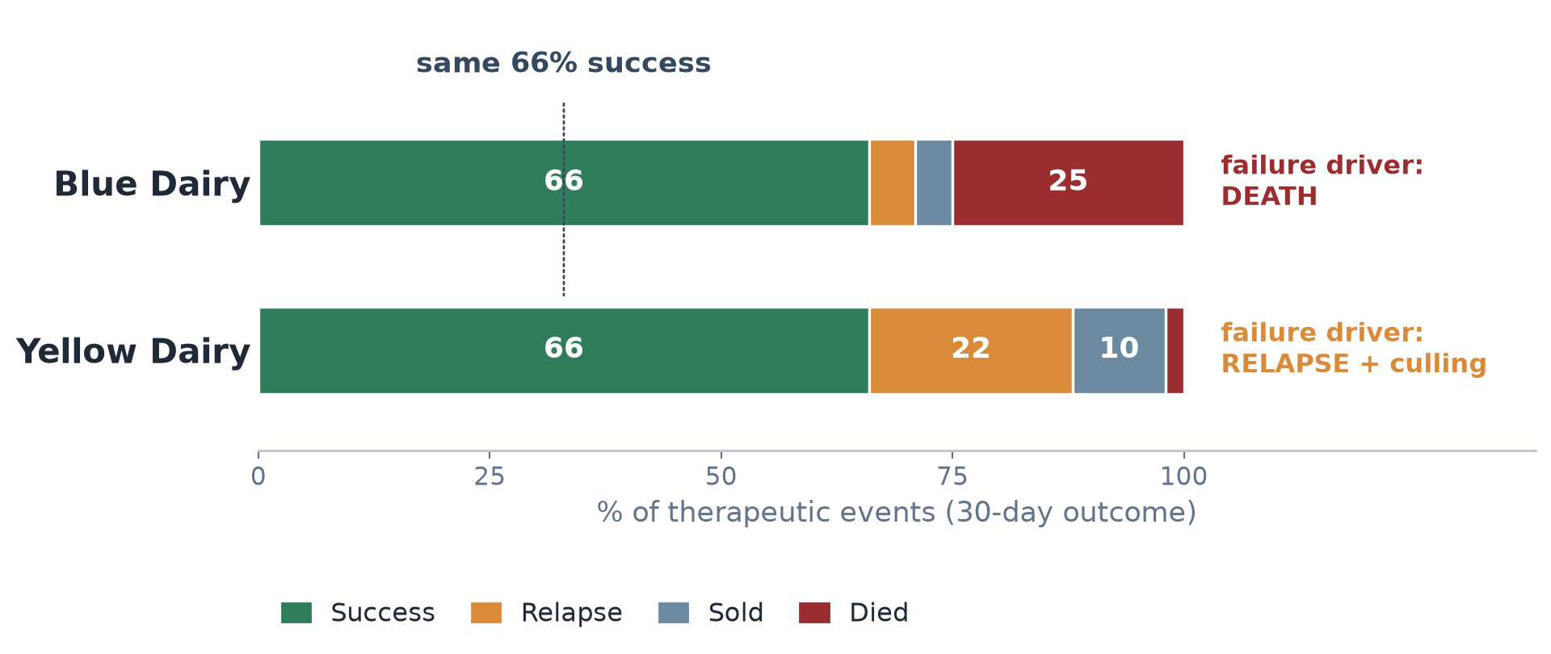
[11] The core insight: a single number lies

Slide 15
Same 66% success — opposite stories. Death is unambiguously bad; relapse/aggressive retreatment is ambiguous and warrants a look.
Notes:
This is the heart of the talk. Two farms, identical headline success. One is losing animals; the other is re-treating and culling. The single number would call them equal. Decompose it and the action is completely different.

Slide 16
[12] The retreatment nuance is real science
Post-Treatment Interval (PTI)
Make animals eligible to re-treat at 3 days → retreatment rates jump
The “failure” is partly an artifact of measuring too soon
Retreatment drug-switching is linked to more resistant isolates

Slide 17
So: investigate the trend — don’t just read the number.
Notes:
Pre-empts the obvious critique of the retreatment example. Retreatment behavior is sensitive to the eligibility window; a rising relapse rate can mean a shortened effective PTI or a protocol change, not drug failure. And switching drugs on relapse is tied to resistance — a first thread toward Bruce.

Slide 18
[13] They named our problem in 2015
Discussion · from Paper 1
Patients may switch therapy because of clinical failure but should not necessarily be considered a clinical failure because they switch therapy.
— Evans et al. 2015, on constructing an overall clinical outcome

Slide 19
Their warning
Some endpoints are partly a clinician decision, not purely a patient outcome
That adds a second source of variation — the person, not the disease
Their fix: prefer outcomes that are “a function of the patient,” or standardize the decision criteria
Our version, word for word
Relapse is a retreatment — and a retreatment is a person deciding
Change the eligibility window and the “failure” rate moves, with no animal changing at all
So: fix the window (that’s the 7 / 30-day setting), then read the trend

Slide 20
Human-medicine statisticians wrote down our PTI problem eleven years ago. Relapse measures the protocol as much as the animal — which is exactly why it’s the category to investigate, not to police.
Notes:
This is the slide I’d put money on for generating discussion, because it tells the room that our messiest category was a known problem in human trials before we ever built the app.
Read the quote slowly — it rewards it. A patient switching therapy is evidence of failure, but it is not the same thing as failure, because a human being made that call. The moment your endpoint contains a clinician decision, you are measuring the clinician as well as the patient.
That is our relapse category exactly. When I said earlier that a 3-day post-treatment interval manufactures failures, this is the formal version: shorten the window and the retreatment rate climbs while not one animal’s biology has changed. We are partly measuring protocol.
Their prescription is the one we followed without knowing it — standardize the decision criteria. That’s what the 7-day and 30-day windows are. Fix them, publish them, hold them constant, and then the trend means something.
The honest concession, if pushed: this doesn’t eliminate the clinician, it just holds them still. Which is why relapse is the flag that starts a conversation, never the number that ends one.

Slide 21
[14] Context changed the answer
Discussion · from Paper 3
Same VITAL trial, same two drugs, sliced by kidney function — and the recommendation flips depending on the patient in front of you.

Slide 22
And they said so themselves: few patients, many subgroups — “should be interpreted with caution, viewed as hypothesis generating.”
That caution is the discipline. Context tells you which question to ask. It never hands you a target.

Slide 23
Subgroup analysis — Howard-Anderson et al. 2024, Figure 4 (intervals there)
Notes:
Setup for the next slide, and a fair-minded one.
The finding: split VITAL by renal function and the drugs trade places. Good kidney function, linezolid looks better. Kidney disease, tedizolid looks better — consistent with what’s already known about linezolid and thrombocytopenia in renal impairment, which is why the authors take it at all seriously.
Now the part I want to model for this room, because it’s the posture I’m asking everyone to adopt. The authors immediately flagged their own finding: small numbers, lots of subgroups, treat it as hypothesis generating. They did not turn it into a rule. I’m quoting directions, not point estimates, on purpose — the intervals are in their Figure 4 and they are wide.
That restraint is the whole argument. Context doesn’t deliver a target; it tells you which question is worth asking. A subgroup finding says “look here,” not “do this.” Which is exactly what I’m about to ask you to do with a farm’s success trend — let it raise “why is…?”, not “above or below the line.”

Slide 24
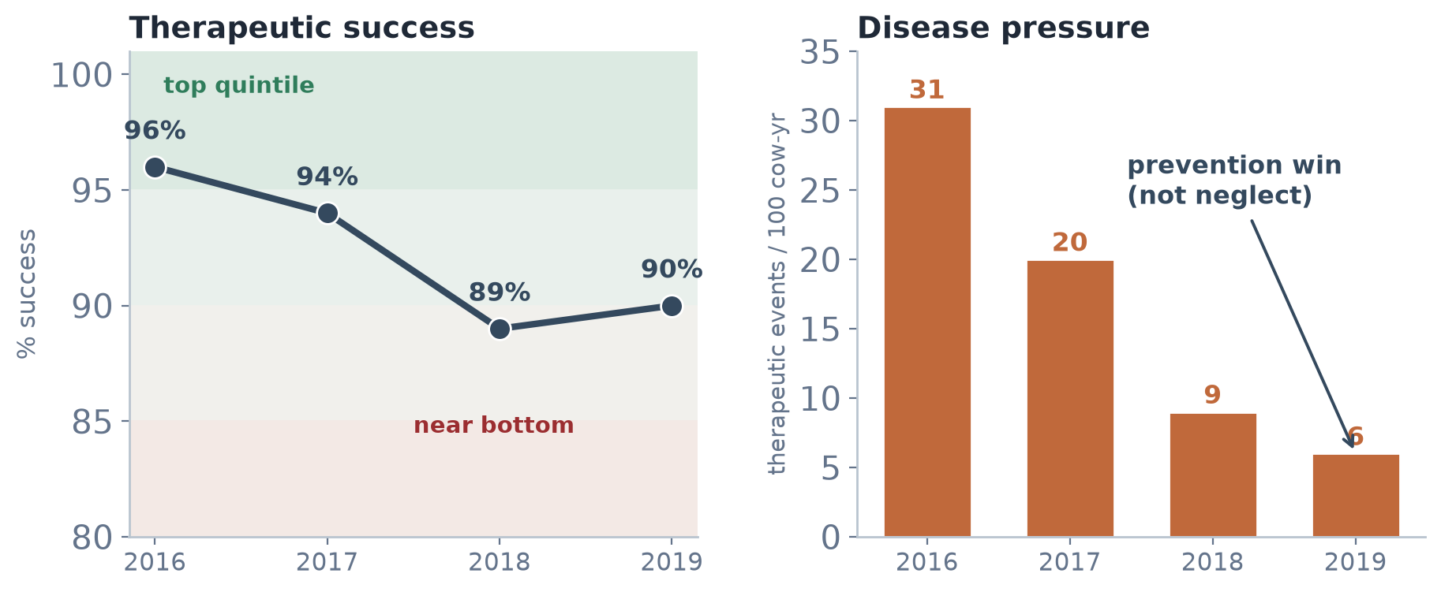
[15] Why trends, within farm context, are the only path to action

Slide 25
Red Dairy metritis: success 96% → 89% looks tiny — but it moved from the top quintile to near the bottom, while disease pressure collapsed 31 → 6. A prevention win, not neglect. Context + trend → ask “why is…?”, not “above or below target.”
Notes:
This is the direct answer to Goodhart from earlier. We don’t set a target and police it. We trend it in context and let it raise questions. The 7-point success drop only means something once you see the quintile bands and the disease-pressure collapse next to it.

Slide 26
[16] The stewardship payoff
Effective → use it. Not effective → don’t.
All anchored in animal welfare — the obligation that makes the decision for us.
Echoing M. Apley — stewardship must never mean withholding an effective treatment
Notes:
Bring it home to welfare. Outcomes let us drive appropriate use directly, because we can see whether use improved the animal’s fate. The three trends are the scoreboard.

Slide 27
[17] The engine: the ICASA pipeline & three apps
Use (FeedlotMetrics) → Outcome (Disease — where we are) → Value (Econ). Each gives the others meaning.
Notes:
Raw feedyard data → the ICASA pipeline → an anonymized handoff (the deliberate break that protects producers) → three apps → the public site. My work lives in the middle app; it’s what makes the use metrics interpretable and the economics meaningful.

Slide 28
[18] Where resistance fits
Bruce is right: progress-over-time has been badly under-measured — ARGs and wastewater are a real frontier
But resistance tells you a state; outcomes tell you what to do
Metaphylaxis study: use ↑, health ↑ (BRD 17% vs 40%), resistance not selected — yet other studies disagree
Outcomes tell us what to do when the resistance science is still uncertain.

Slide 29
Credille et al. 2024 · handing to Bruce Stewart-Brown & Ken Opengart
Notes:
Handle Bruce generously. Validate the ARG question — it’s important and he’s right it’s under-measured. Then place it: resistance is a state measurement, method-dependent and contested; outcomes are the actionable, welfare-anchored layer that give resistance data meaning. Our own metaphylaxis paper shows use, health, and resistance don’t move together simply. Then hand the floor to Bruce and Ken for how poultry measures outcomes.

Slide 30
[19] Take this with you
Papers · tools · apps

Slide 31
The DOOR papers
Evans SR, et al. Desirability of Outcome Ranking (DOOR) and Response Adjusted for Duration of Antibiotic Risk (RADAR). Clin Infect Dis 2015;61(5):800–6 · PMC4542892
Correction. Clin Infect Dis 2023;76(1):182 the CI, re-estimated
Howard-Anderson J, et al. Moving Beyond Mortality: … DOOR Endpoint for HABP/VABP. Clin Infect Dis 2024;78(2):259–68 · PMC10874265 free
Run a DOOR analysis yourself
methods.bsc.gwu.edu free web app · from the ARLG
See it in cattle
ICASA_Disease — outcomes you set the 7- and 30-day windows ICASAProject site → Therapeutic Outcomes

Slide 32
Papers 1 and 3 are the argument; the correction is the humility. All three are in the meeting folder.
Notes:
Leave-behind slide — this is the one to linger on if people are photographing, and the one to skip entirely if I’m running long.
The two worth actually reading are Evans 2015 for the concept and Howard-Anderson 2024 for what it looks like applied; the 2024 one is free on PMC. The correction is one page and I’d still hand it to anyone building a metric, for the reason I gave earlier.
The GWU web app is the genuine “go do something” item — it’s free, it’s from the ARLG, and it will run a full DOOR analysis including partial credit. If anyone in this room is designing a trial, that’s their starting point. They’re also building a sample-size and power tool into it.
Then the bridge back to us: ICASA_Disease is the same idea in cattle, and the windows are yours to set. If someone wants to test whether our outcome definitions survive their assumptions, that’s where they do it — and I’d genuinely like them to try.

Slide 33
[20]
The one thing
Trend outcomes over time, within farm context — the only way to drive data-driven, welfare-anchored action.
Now — Bruce Stewart-Brown & Ken Opengart on how outcomes are measured in poultry.
Notes:
Land the thesis in one sentence, then hand off. Thank Mike for the setup, thank the room, cue Bruce.

Slide 34
[21] Why we do this
Where this started
Respect for the power of effective antimicrobials
A drive to keep them working — for the animals that need them
Stewardship = protecting efficacy, not just cutting use
If antimicrobial stewardship is perceived as not treating a diseased animal when an antimicrobial would be effective, we are probably done.
— M. Apley, Monitoring our way to stewardship?
Notes:
Open on motivation, not data. We didn’t start with a resistance agenda — we started from respect for a tool that works, and a desire to keep it working. That framing keeps the room (industry + regulators) with us. Mike’s line is the anchor: stewardship that means withholding effective treatment is a non-starter.

