Slide 1
第二讲 磁盘
存储技术基础
陆游游
luyouyou@tsinghua.edu.cn

Slide 2
本讲内容
Storage Management
Disk Technologies
Disk components and their functions
Disk performance and how it is measured
Disk drive firmware algorithms

Slide 3
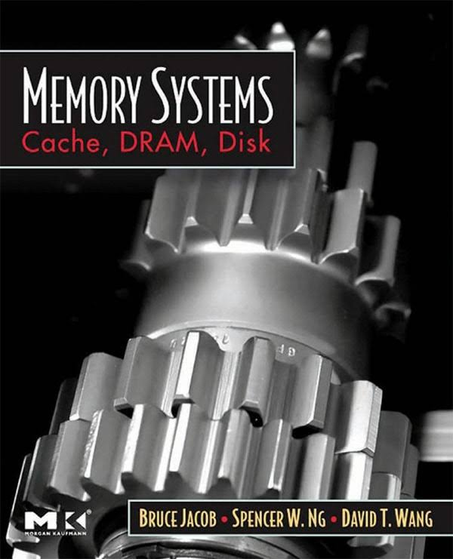
本讲内容参考书
Memory Systems: Cache, DRAM, Disk
作者：Bruce Jacob, Spencer W. Ng, David T. Wang
更细节的内容参考第三大部分

Slide 4
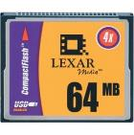




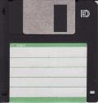



存储介质发展史
Flash Memory
Punched card
ROM
Persistent
Memory
HDD
Floppy Disk
CD-R
Paper tape
1864
1900s
1956
1970s
1971
1984
1988
2010s

Slide 5
Disk Technologies

Slide 6
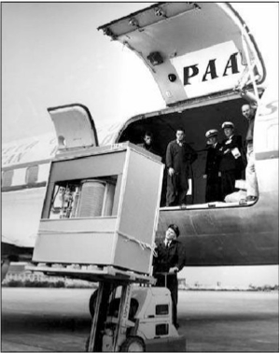
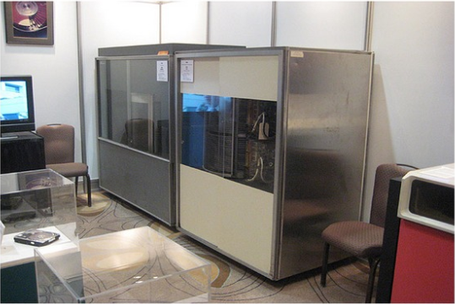
The First Commercial Disk Drive
1956: IBM RAMDAC computer included the IBM Model 350 disk storage system
5M (7 bit) characters
50 x 24” platters
Access time = < 1 second

Slide 7
First Air Bearing Heads (1962): IBM's model 1301 lowers the flying height of the heads to 250 microinches. It has a 28 MB capacity on half as many heads as the original RAMAC, and increases both areal density and throughput by about 1000%.
First Removable Disk Drive (1965): IBM's model 2310 is the first disk drive with a removable disk pack. While many PC users think of removable hard disks as being a modern invention, in fact they were very popular in the 1960s and 1970s.

Slide 8
First Modern Hard Disk Design (1973): IBM‘s model 3340, nicknamed the “Winchester”, is introduced. With a capacity of 60 MB it introduces several key technologies that lead to it being considered by many the ancestor of the modern disk drive. (磁头、盘片和转轴封装在密闭气体空间里)
First Thin Film Heads (1979): IBM's model 3370 is the first with thin film heads, which would for many years be the standard in the PC industry.
First Eight-Inch Form Factor Disk (1979): IBM's model 3310 is the first disk drive with 8" platters, greatly reduced in size from the 14" that had been the standard for over a decade.

Slide 9
First 5.25" Form Factor Disk (1980): Seagate's ST-506 is the first drive in the 5.25" form factor, used in the earliest PCs.
First 3.5" Form Factor Disk Drive (1983): Rodime introduces the RO352, the first disk drive to use the 3.5" form factor, which became one of the most important industry standards.
First Expansion Card Disk Drive (1985): Quantum introduces the Hardcard, a 10.5 MB hard disk mounted on an ISA expansion card for PCs that were originally built without a hard disk. This product put Quantum "on the map" so to speak.
First Voice Coil Actuator 3.5" Drive (1986): Conner Peripherals introduces the CP340, the first disk drive to use a voice coil actuator.
First "Low-Profile" 3.5" Disk Drive (1988): Conner Peripherals introduces the CP3022, which was the first 3.5" drive to use the reduced 1" height now called "low profile" and the standard for modern 3.5" drives.
First 2.5" Form Factor Disk Drive (1988): PrairieTek introduces a drive using 2.5" platters. This size would later become a standard for portable computing.
First Drive to use Magnetoresistive Heads and PRML Data Decoding (1990): IBM's model 681 (Redwing), an 857 MB drive, is the first to use MR heads and PRML.
First Thin Film Disks (1991): IBM's "Pacifica" mainframe drive is the first to replace oxide media with thin film media on the platter surface.
First 1.8" Form Factor Disk Drive (1991): Integral Peripherals' 1820 is the first hard disk with 1.8" platters, later used for PC-Card disk drives.
First 1.3" Form Factor Disk Drive (1992): Hewlett Packard's C3013A is the first 1.3" drive.

Slide 10
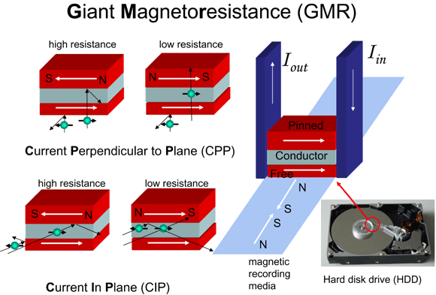
Giant Magneto Resistive(1997):巨磁阻磁头
使用了磁阻效应更好的材料和多层薄膜结构
3~5Gb/in^2 → 10~40Gb/in^2
2007年诺贝尔奖
法国物理学家阿尔贝·费尔与德国物理学家彼得·格林贝格分别发现的巨磁阻效应

Slide 11
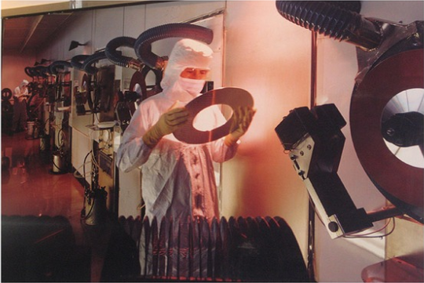
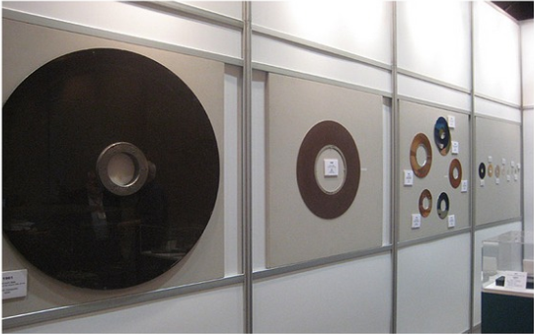

Slide 12
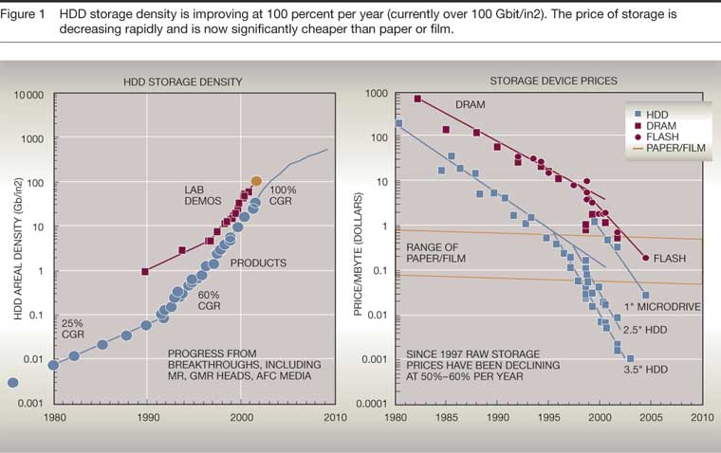
R. J. T. Morris and B. J. Truskowski. The evolution of storage systems. Available at http://www.research.ibm.com/journal/sj/422/morris.html. May, 2003.
Notes:
Hard disks are one of the most important and also one of the most interesting components within the PC. They have a long and interesting history dating back to the early 1950s. Perhaps one reason that I find them so fascinating is how well engineers over the last few decades have done at improving them in every respect: reliability, capacity, speed, power usage, and more.

Slide 13
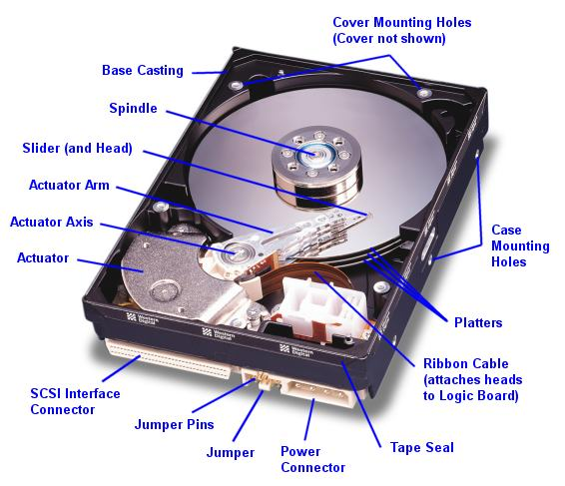
Construction and Operation

Slide 14
Moving-head Disk Mechanism

Slide 15
Disk Device Components
Inner
Track
Arm
Head
Sector
Outer
Track
Platter
Actuator
Several platters, with information recorded magnetically on both surfaces (usually)
Bits recorded in tracks, which in turn divided into sectors (e.g., 512 Bytes)
Actuator moves head (end of arm) over track (“seek”), wait for sector rotate under head, then read or write
“Cylinder”: all tracks under heads

Slide 16




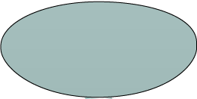



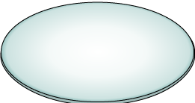

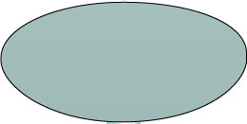








Logical Block Addressing
Sector 8
Block 0
Head 0
(Upper Surface)
Cylinder 1
Block 32
(Lower Surface)
Block 64
Block 128
Physical Address= CHS
Logical Block Address= Block#

Slide 17
Disk Performance

Slide 18
Disk Drive Performance
Electromechanical device
Impacts the overall performance of the storage system
Disk service time
Time taken by a disk to complete an I/O request, depends on:
Seek time
Rotational latency
Data transfer rate
Disk service time = seek time + rotational latency + data transfer time

Slide 19
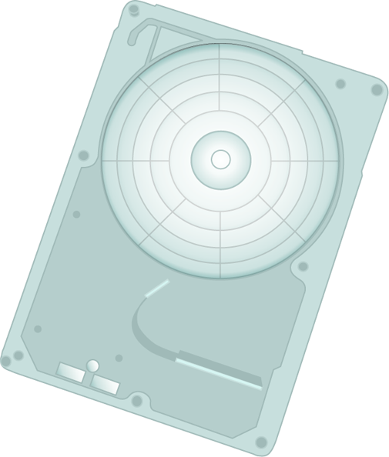
Seek Time
Time taken to position the read/write head
Lower the seek time, the faster the I/O operation
Seek time specifications include:
Full stroke
Average
Track-to-track
The seek time of a disk is specified by the drive manufacturer

Slide 20
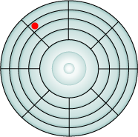
Rotational Speed/Latency
The time taken by platter to rotate and position the data under the R/W head
Depends on the rotation speed of the spindle
Average rotational latency
One-half of the time taken for a full rotation
For ‘X’ rpm, drive latency is calculated as:
Appx. 5.5 ms for 5400-rpm drive
Appx. 2.0 ms for 15000-rpm drive
Rotational delay (in sec) = 0.5/(RPM/60)

Slide 21
Data Transfer Rate
Average amount of data per unit time
Internal Transfer Rate
Speed at which data moves from a track to disk internal buffer
External Transfer Rate
The advertised speed of the interface
External transfer rate measured here
Internal transfer rate measured here
Disk Drive
HBA
Buffer
Head Disk Assembly
Interface
Transfer time = Block size/Transfer rate

Slide 22
Disk Device Performance
Outer
Track
Inner
Track
Sector
Head
Arm
Controller
Spindle
Platter
Actuator
Disk Latency = Seek Time + Rotation Time + Transfer Time + Controller Overhead
Seek Time? depends on no. tracks to move arm, speed of actuator
Rotation Time? depends on speed disk rotates, how far sector is from head
Transfer Time? depends on data rate (bandwidth) of disk (f(bit density,rpm)), size of request

Slide 23
Disk Device Performance (2)
Average distance of sector from head?
1/2 time of a rotation
7200 Revolutions Per Minute ⇒ 120 Rev/sec
1 revolution = 1/120 sec ⇒ 8.33 milliseconds
1/2 rotation (revolution) ⇒ 4.17 ms
Average no. tracks to move arm?
Disk industry standard benchmark:
Sum all time for all possible seek distances from all possible tracks / # possible
Assumes average seek distance is random

Slide 24
Disk Performance Example
Calculate time to read 1 sector (512B) for Deskstar using advertised performance;
Disk latency = average seek time + average rotational delay + transfer time + controller overhead
= 8.5 ms + 0.5 /(7200 RPM/(60000ms/M)) + 0.5 KB / (100 KB/ms) + 0.1 ms
= 8.5 + 4.17 + 0.005 + 0.1 ms = 12.77 ms

Slide 25
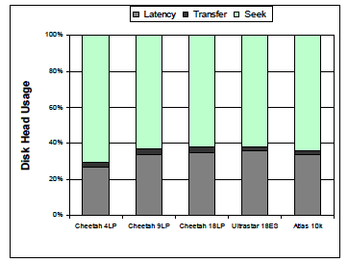
Where does the disk head’s time go?
Random 4KB requests

Slide 26
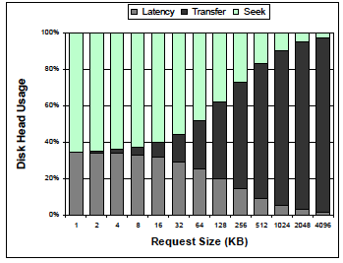
Impact of Request Sizes

Slide 27

I/O Controller Utilization Vs. Response Time
Based on fundamental laws of disk drive performance:
Service time is time taken by the controller to serve an I/O
For performance-sensitive applications disks are commonly utilized below 70% of their I/O serving capability
Knee of curve: disks at
about 70% utilization
Response time (msec)
Low Queue Size
100%
0%
Utilization
70%

Slide 28




Storage Design Based on Application Requirements and Disk Drive Performance
Disks required to meet an application’s capacity need (D_{C}):
Disks required to meet application’s performance need (D_{P}):
IOPS serviced by a disk (S) depends upon disk service time (T_{S}):
T_{S} is time taken for an I/O to complete, therefore IOPS serviced by a disk (S) is equal to (1/T_{S})
For performance sensitive application (S)=
Disk required for an application = max (D_{C},D_{P})

Slide 29

主观题
10分
Scenario
Characteristics of new application:
Require 1TB of storage capacity
Peak I/O workload 4900 IOPS
Typical I/O size is 4KB
Specifications of the available disk drives:
15K rpm drive with storage capacity = 100 GB
Average seek time = 5ms
Data transfer rate = 40 MB/sec
As it is business critical application, response time must be within acceptable range
Task
Calculate the number of disks required for the application
正常使用主观题需2.0以上版本雨课堂
作答

Slide 30
Data Rate: Inner vs. Outer Tracks
To keep things simple, originally same number of sectors per track
Since outer track longer, lower bits per inch
Competition decided to keep bits per inch (BPI) high for outer tracks
More capacity per disk
More sectors per track towards edge
Since disk spins at constant speed, outer tracks have faster data rate

Slide 31
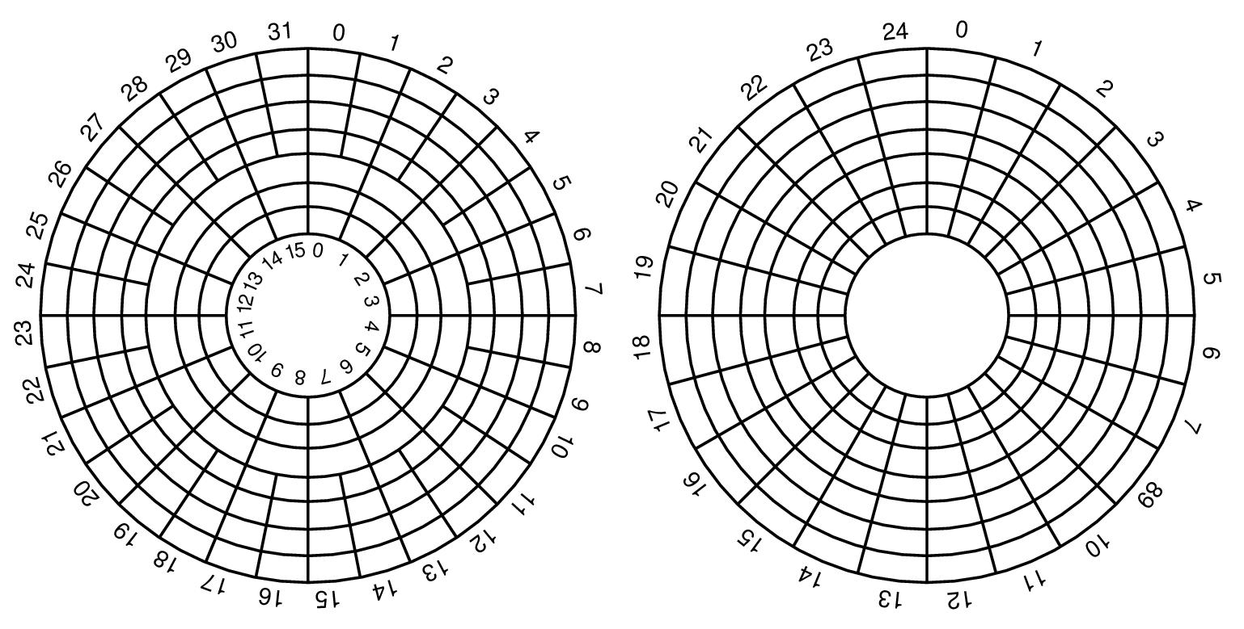
Constant angular velocity (CAV) disks
constant rotation speed
equal amount of data in each track
thus, constant transfer time
Zoned CAV disks
constant rotation speed
zones are ranges of tracks
typical few zones
the different zones have different amount of data, i.e., more better on outer tracks
thus, variable transfer time
OS view
real view
illustration of transfer speed, not rotation speed
Bandwidth outer track 1.7x inner track!

Slide 32
Disk drive firmware algorithms and disk request scheduling

Slide 33
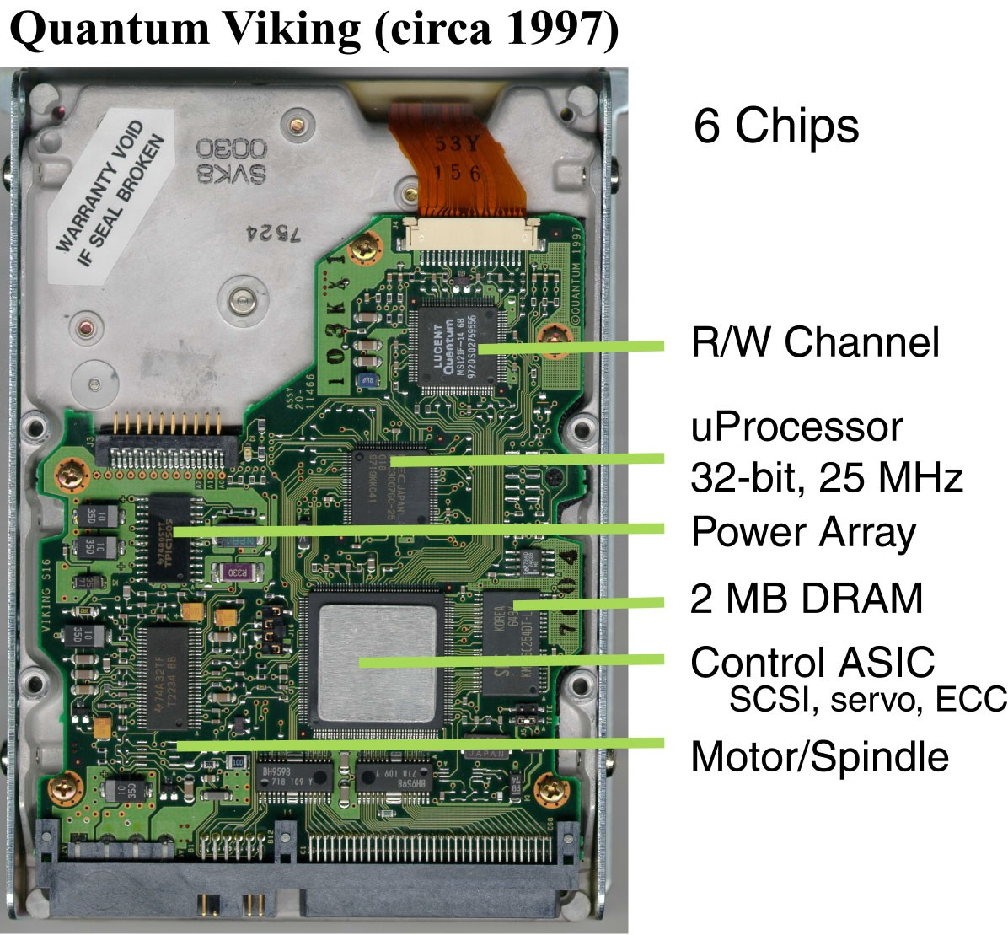
Disk drive – electronics
Connect to disk
Control processor
Cache memory
Control ASIC
Connect to motor

Slide 34
How functionality is implemented
Some of it is in ASIC logic
signal processing
error detection and correction
servo processing
motor/seek control
cache hits (often)
Some of it is in firmware running on control processor
request processing
request queueing and scheduling
LBN-to-PBN mapping
Key considerations: cost and performance
optimize common cases
keep things simple and space-conscious

Slide 35
Mapping LBN to sectors

Slide 36
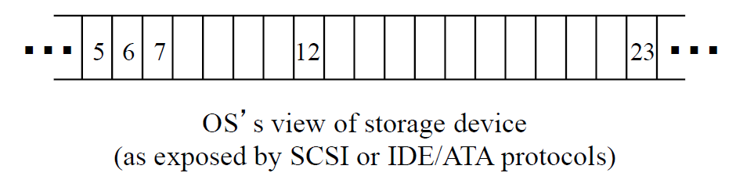
Recall the common storage device interface
Common block size: 512 bytes or 4KB
Number of blocks: device capacity / block size

Slide 37
Recall the physical disk storage reality
Cylinder
Track Sector

Slide 38
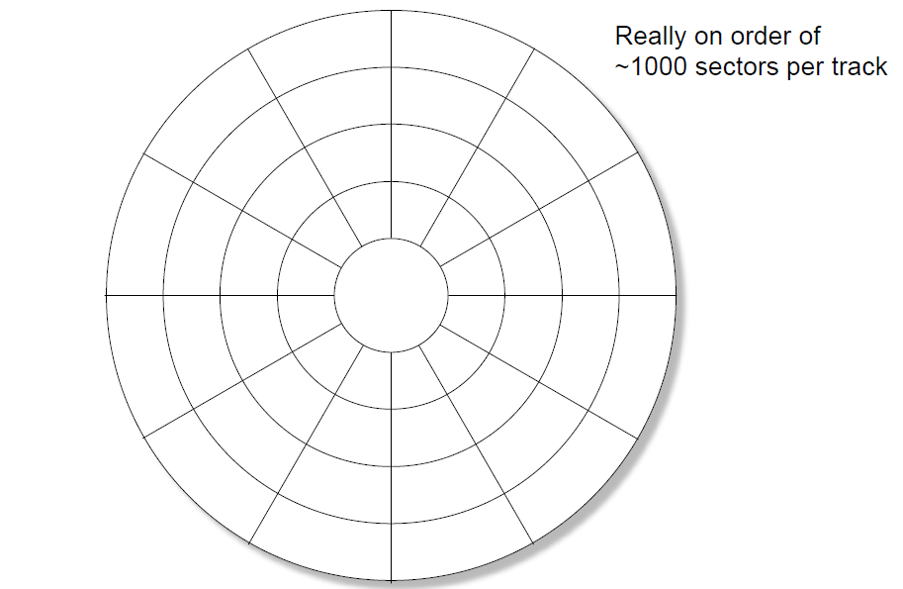
Physical sectors of a single-surface disk

Slide 39
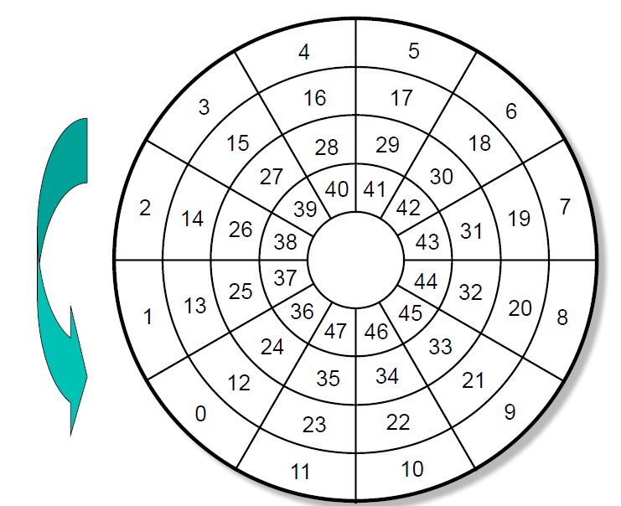
LBN-to-physical for a single-surface disk

Slide 40
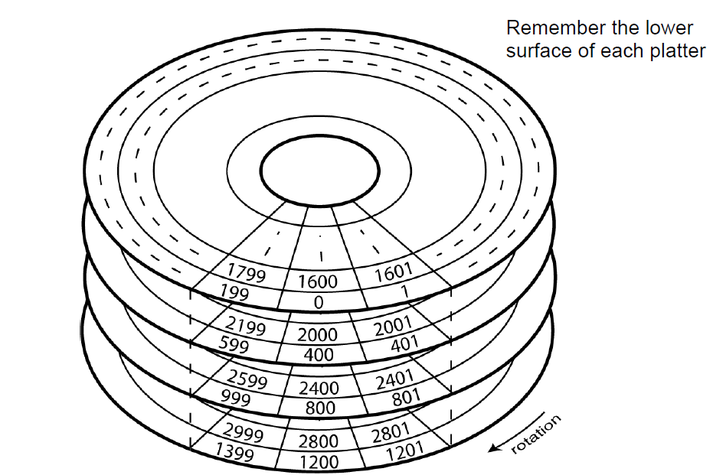
Extending the mapping to a multi-surface disk

Slide 41
Some real numbers for modern disks
# of platters: 1-5
2-10 surfaces for data
# of tracks per surface: 10s to 100s of 1000s
same thing as # of cylinders
# sectors per track: 500-4000
so, 250KB – 2MB
# of bytes per sector: usually 512
can be chosen by OS for some disks (rare)

Slide 42
Computing physical location from LBN
Cyl_no = lbn / sects_per_cyl
Surface_no = (lbn % sects_per_cyl) / sects_per_track
Sect_no = lbn % sects_per_track
Note: straightforward, so far
it gets much more complicated…

Slide 43
First complication: zones
Outer tracks are longer than inner ones
so, they can hold more data
benefits: increased capacity and higher bandwidth
Issues
increased bookkeeping for LBN-to-physical mapping
more complex signal processing logic
because of variable bit rate timing
Compromise: zones
all tracks in each zone hold same number of sectors

Slide 44
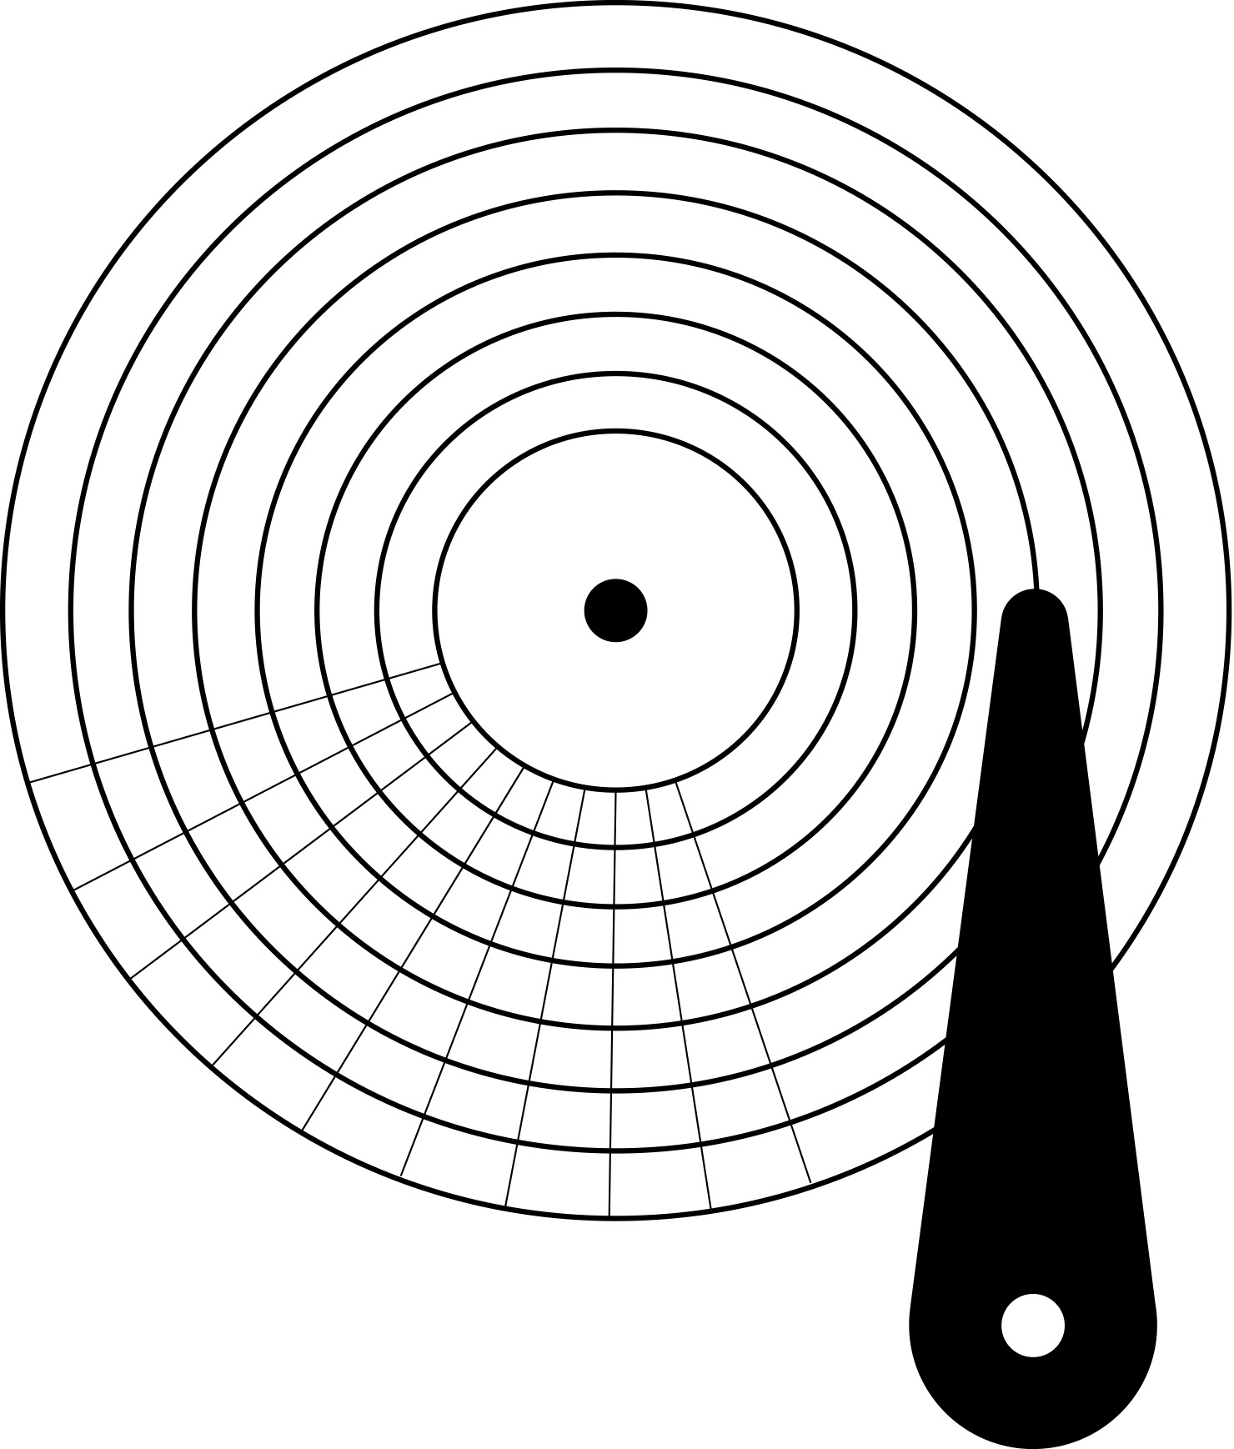
Constant number of sectors per track

Slide 45
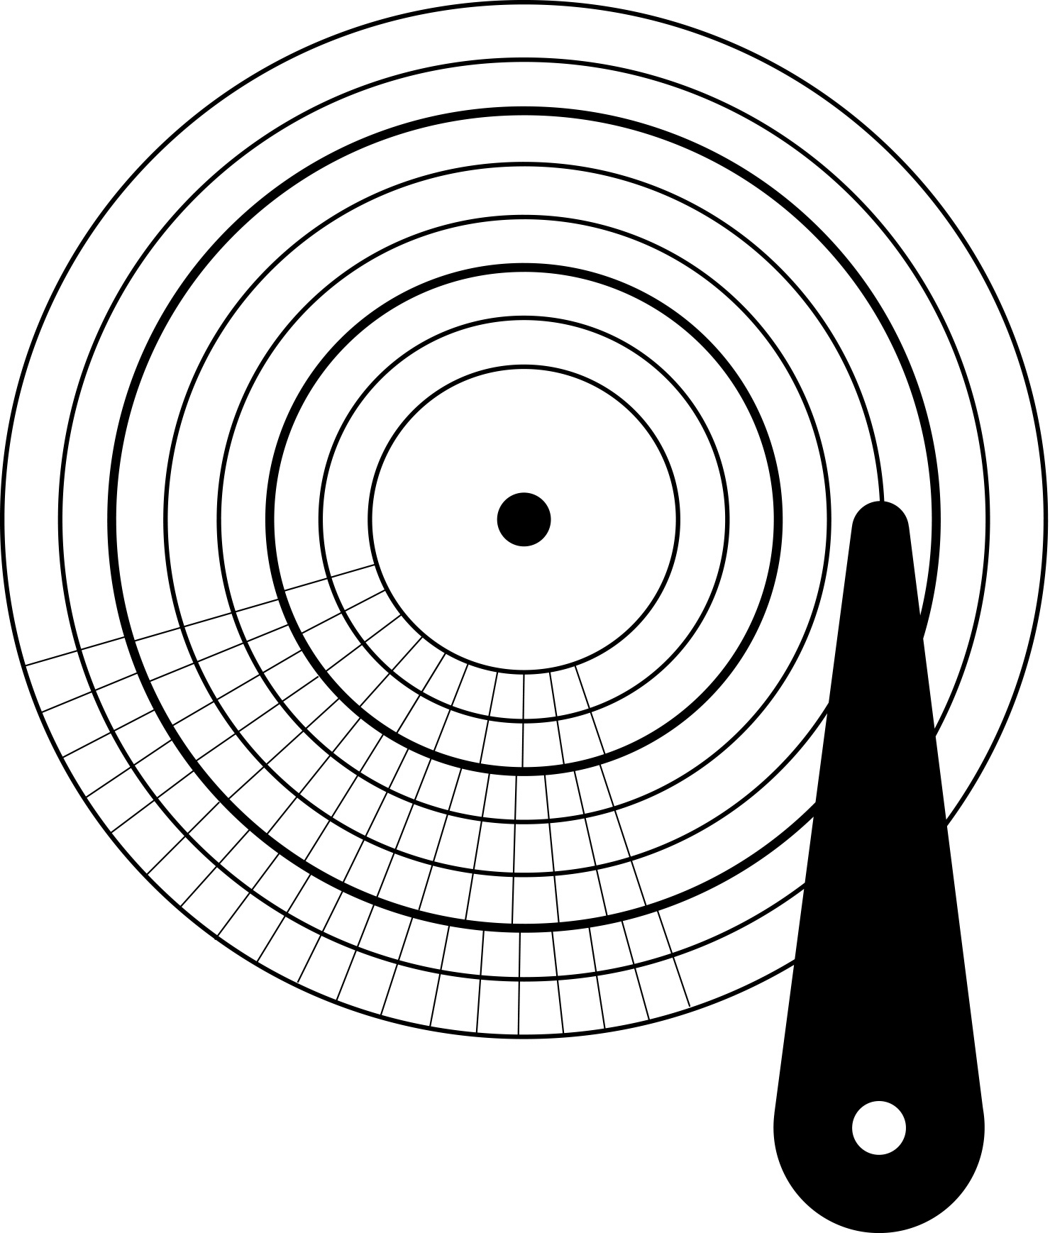
Multiple “zones”

Slide 46
Computing physical location from LBN
First, figure out which zone contains the LBN
can simply iterate through table of per-zone startlbn values
with knowledge of zone comes startlbn, firstcyl, and sectspertrack
Then, adapt previous computations
lbn = lbn - firstlbninzone
cylno = firstcylinzone + (lbn / sectspercyl)
surfaceno = (lbn % sectspercyl) / sectspertrack
sectno = lbn % sectspertrack
Note: still not too bad
it gets still more complicated…

Slide 47
Second complication: remap
Defective sector
Issues
Remapped block
Slipped block
Compromise: remap

Slide 48
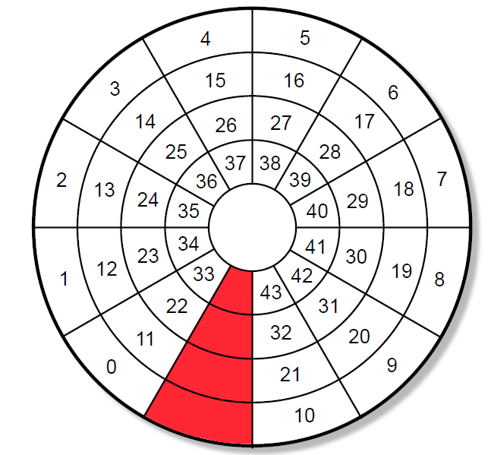
One spare sector per track

Slide 49
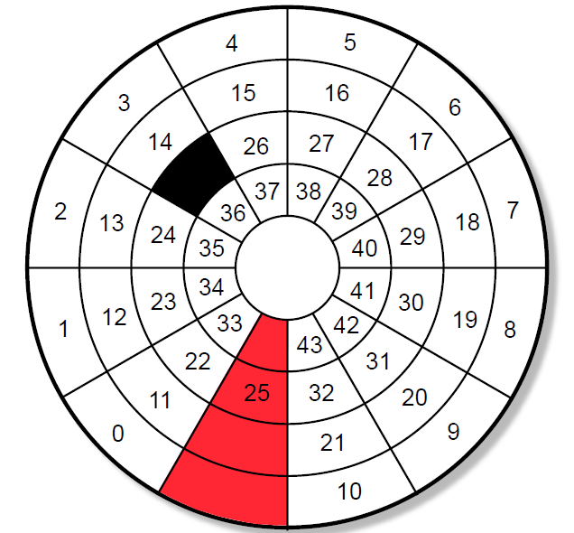
LBN remapped from defective sector to spare

Slide 50
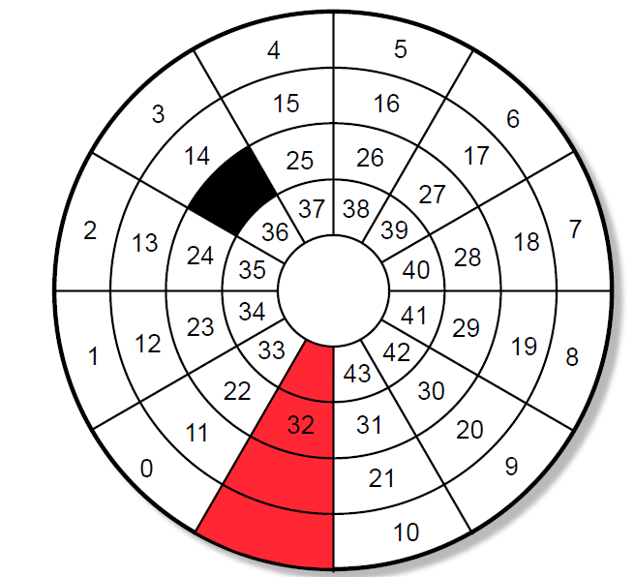
LBN mapping slipped past defective sector
LBN remapped from defective sector to spare

Slide 51
Computing physical location from LBN
First, check list of remapped LBNs
usually identifies exact physical location of replacement
If no match, do the steps from before
but, also account for slipped sectors that affect desired LBN

Slide 52
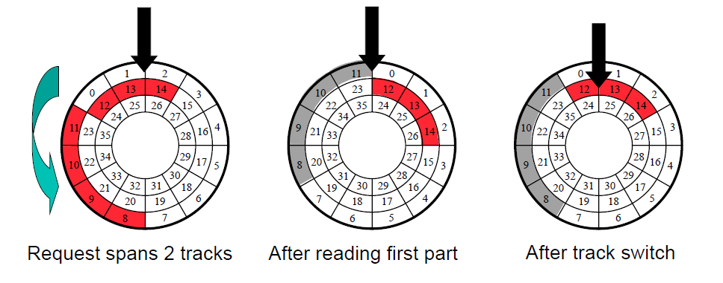
What happens to requests that span tracks?

Slide 53
Third complication: skew
Issue: takes time to switch from one track to another
sequential transfers must therefore suffer full rotation
Solution: skew
offset physical location of first sector to avoid extra rotation
selection of skew value made from switch time statistics
Track skew
for when switching to next surface within a cylinder
Cylinder skew
for when switching from last surface of one cylinder to first surface of next cylinder

Slide 54
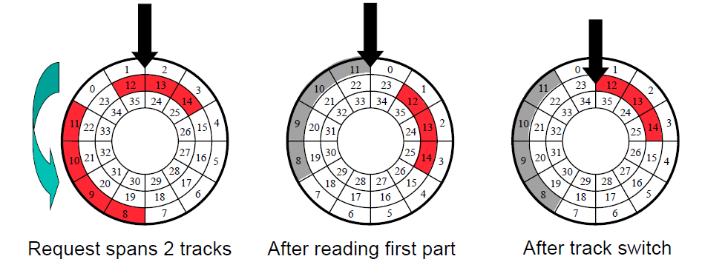
Same request with track skew of one sector

Slide 55
Computing physical location from LBN
First, figure out cylno, surfaceno, and sectno
using algorithms indicated previously
Then, compute total skew effect

Slide 56
Summary LBN → PBN
LBA → PBN
ZONE
Remap
Skew

Slide 57
Disk Cache

Slide 58
DISK CACHE
External transfer rate measured here
Internal transfer rate measured here
Disk Drive
HBA
Buffer
Head Disk Assembly
Interface

Slide 59
Disk Cache
The embedded memory in a hard drive as a buffer between the computer and the physical hard disk platters, used for storage.
2MB to 64MB
The function of cache is to act as a buffer between a relatively fast device and a relatively slow one.
to store the bits going to and coming from the disk platters.
Note: When someone speaks generically about a "disk cache", they are usually not referring to this small memory area inside the hard disk, but rather to a cache of system memory set aside to buffer accesses to the disk system.

Slide 60
Functions -1
Read-ahead
Speed matching
The speed of the disk's I/O interface to the computer vs. the speed at which the bits are transferred to and from the hard disk platter

Slide 61
Functions -2
Write acceleration
the disk logic circuit records the write in its much faster cache, and then immediately sends back an acknowledgement.
This is called write-back caching, which converts application random IOs into sequential disk accesses
Dangerous!
If power is lost before the data are permanently saved in the magnetic media, the data will be lost and no one knows!
a battery-backed memory system for caching data

Slide 62
Function -3
Command Queuing
Newer SATA and most SCSI disks can accept multiple commands while any one command is in operation through "command queuing" .

Slide 63
Disk Scheduling

Slide 64
Disk Scheduling
Seek time is a dominant factor of total disk I/O time
disk scheduling
Disk controller chooses which request to serve next depending on the head’s current position and requested block’s position on disk
Note that disk scheduling ≠ CPU scheduling
a mechanical device – hard to determine (accurate) access times
disk accesses can/should not be preempted – run until it finishes
General goals
short response time
high overall throughput
fairness (equal probability for all blocks to be accessed in the same time)

Slide 65
Disk Scheduling
Several traditional algorithms
First-Come-First-Serve (FCFS)
Shortest Seek Time First (SSTF)
SCAN (and variations)
Look (and variations)

Slide 66
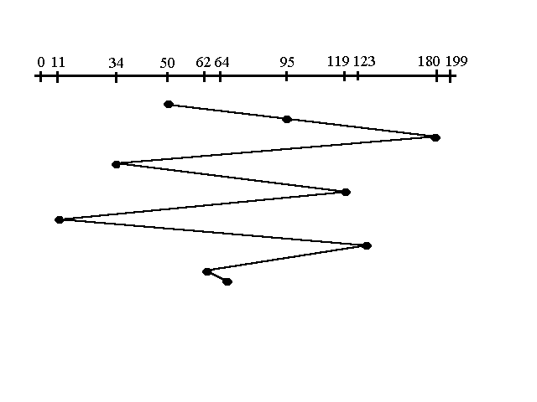
FCFS
First Come -First Serve (FCFS)
Total head movement of 640 tracks
Requests: 95, 180, 34, 119, 11, 123, 62, 64

Slide 67
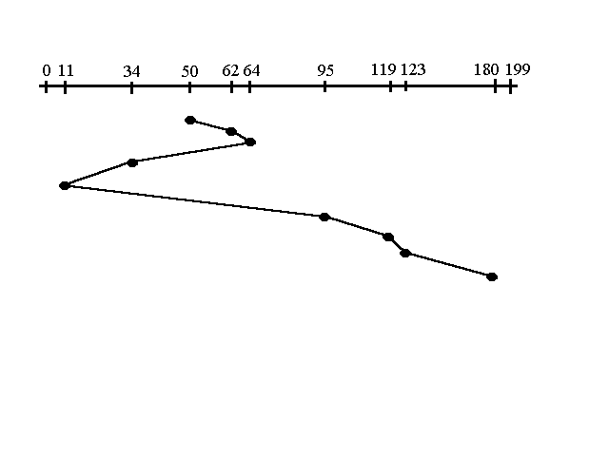
SSTF
Shortest Seek Time First (SSTF)
request is serviced according to next shortest distance
A total of 236 tracks
Problem?
Starvation
Requests: 95, 180, 34, 119, 11, 123, 62, 64

Slide 68
SCAN
SCAN (Elevator Algorithm)
This approach works like an elevator does
The disk arm starts at one end of the disk, and moves toward the other end, servicing requests until it gets to the other end of the disk

Slide 69
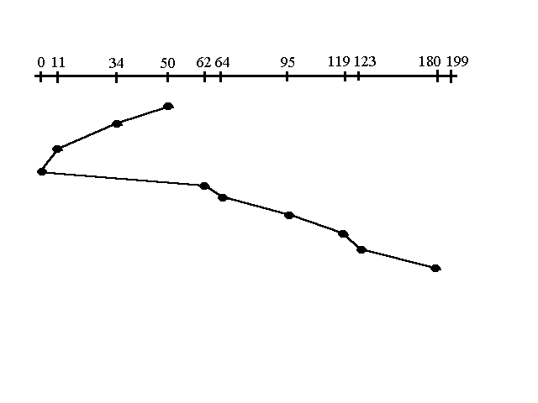
SCAN
Elevator Algorithm (also SCAN)
A total of 230 tracks
Problem?
largest density at other end of disk
Requests: 95, 180, 34, 119, 11, 123, 62, 64

Slide 70
C-SCAN
C-SCAN (Circular Scan)
Provides a more uniform wait time than SCAN
The head moves from one end of the disk to the other, servicing requests as it goes
When it reaches the other end, however, it immediately returns to the beginning of the disk, without servicing any requests on the return trip

Slide 71
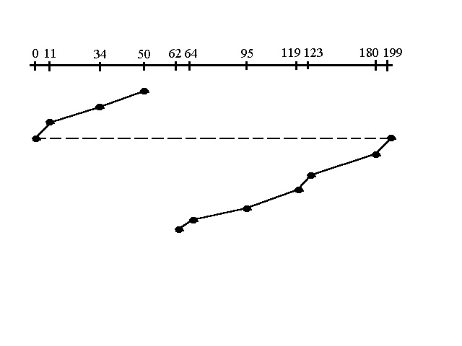
C-SCAN
C-SCAN
A total of 187 tracks
Requests: 95, 180, 34, 119, 11, 123, 62, 64

Slide 72
C-LOOK
LOOK a version of SCAN, C-LOOK a version of C-SCAN
Arm only goes as far as the last request in each direction, then reverses direction immediately, without first going all the way to the end of the disk

Slide 73
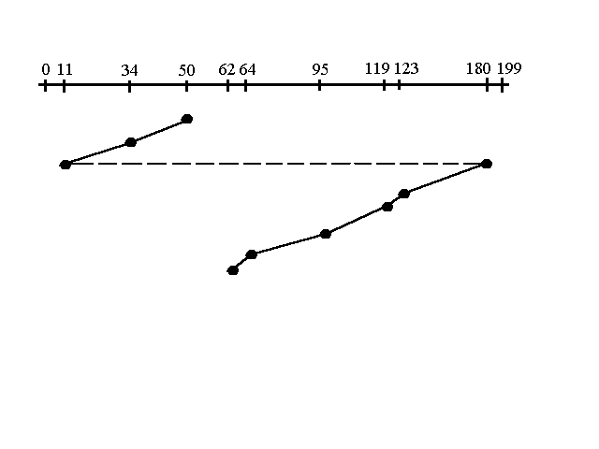
C-LOOK
C-LOOK
A total of 157 tracks
Requests: 95, 180, 34, 119, 11, 123, 62, 64

Slide 74
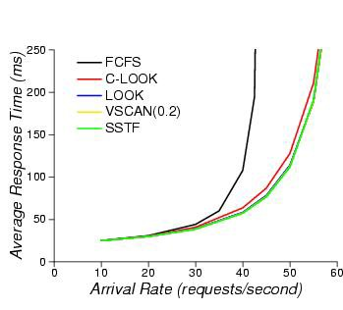
Response times for random disk requests

Slide 75
Selecting a Disk-Scheduling Algorithm
SSTF is common and has a natural appeal
SCAN and C-SCAN perform better for systems that place a heavy load on the disk
Less starvation
Performance depends on the number and types of requests
Either SSTF or C-LOOK is a reasonable choice for the default algorithm

Slide 76
Summary
Disk Technologies
Disk components and their functions
Disk performance
Disk drive firmware algorithms
Advanced Topic (感兴趣的可以自行了解)
Shingled Magnetic Recording (SMR) disk

Slide 77
HDD sound attack
Brandon Gregg

Slide 78
主观题
10分
Scenario
Characteristics of new application:
Require 1TB of storage capacity
Peak I/O workload 4900 IOPS
Typical I/O size is 4KB
Specifications of the available disk drives:
15K rpm drive with storage capacity = 100 GB
Average seek time = 5ms
Data transfer rate = 40 MB/sec
As it is business critical application, response time must be within acceptable range
Task
Calculate the number of disks required for the application
正常使用主观题需2.0以上版本雨课堂
作答

Slide 79
Design Storage Solution for New Application
Scenario
Characteristics of new application:
Require 1TB of storage capacity
Peak I/O workload 4900 IOPS
Typical I/O size is 4KB
Specifications of the available disk drives:
15K rpm drive with storage capacity = 100 GB
Average seek time = 5ms
Data transfer rate = 40 MB/sec
As it is business critical application, response time must be within acceptable range
Task
Calculate the number of disks required for the application

Slide 80
Undergraduate Research Topics
Novel Computer Systems on NVM
File System for Persistent Memory
Graph Computing on SSD
Indexing Data Structure for Non-Volatile Memory
Distributed Systems
RDMA-based Data Replication
Scalable Metadata of Distributed Storage Systems
Key-Value Store for Parameter-Server AI Systems
Novel Computer Architecture
Processing in Memory
Near Data Processing

