Slide 1
第三讲 闪存与固态盘
存储技术基础
陆游游
luyouyou@tsinghua.edu.cn

Slide 2
本节课内容
固态盘（Solid State Drive, SSD）
Flash Memory
Flash Translation Layer (FTL)
Address Mapping
Garbage Collection
Wear Leveling
Some figures or slides are directly borrowed from others, including course slides in previous years at Tsinghua, CMU, Berkeley, Stanford, and FAST tutorial slides etc.

Slide 3

非易失性存储器是什么？
Register
1 ns
CPU Cache
10 ns (L2)
Memory
60 ns (DRAM)
Storage
5,000,000 ns (Disk)
持久性：
可持久保持数据，掉电不丢
性能：
Flash: 20,000 ns
PCM: 100 - 1000 ns
Non-Volatile Memory

Slide 4
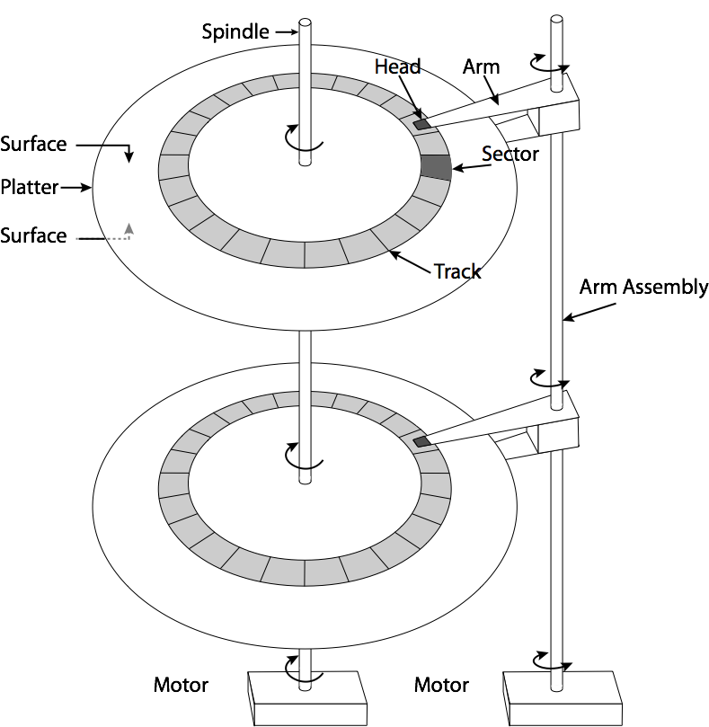
磁盘
硬盘（HDD）
Hard Disk Drive
磁臂、磁头
柱面、盘片、磁道

Slide 5
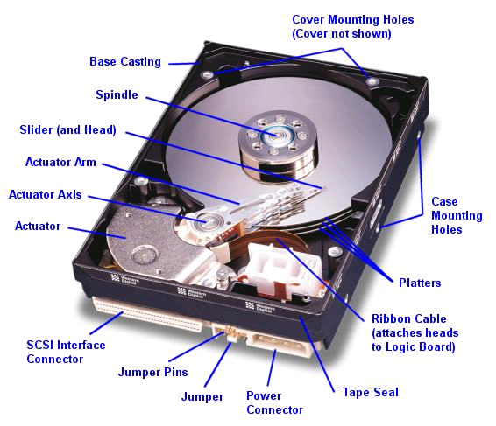
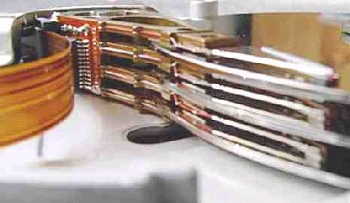
Read/Write Head
Side View
Western Digital Drive
http://www.storagereview.com/guide/

Slide 6
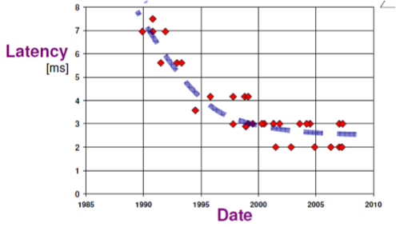
磁盘 － 延迟

Slide 7
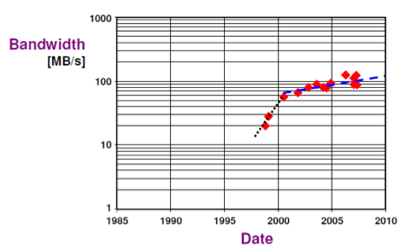
磁盘 － 带宽

Slide 8
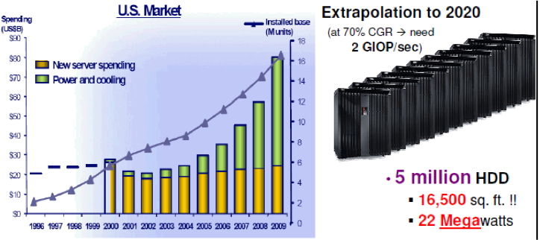
磁盘 － 能耗
Notes:
1532.9平方米，3个篮球场

Slide 9
磁盘 VS. 固态盘
带宽与延迟
类型 | 设备型号 | 读带宽 | 写带宽 | 读延迟 | 写延迟
磁盘 | Seagate Savvio | 202 | 202 | 2.000 | 2.000
SATA 固态盘 | Intel X25-E | 250 | 170 | 0.075 | 0.085
PCIe 固态盘 | FusionIO ioDrive Octal | 6,000 | 4,400 | 0.030 | 0.030
30X
20X
1/100
1/100
体积与能耗
磁盘存储：
5,000,000 块
超过 2,000 平方米
能耗 22 兆瓦
SCM存储：
8,000 个模块
1+平方米
能耗 1千瓦
1/1000
1/10000
例子

Slide 10
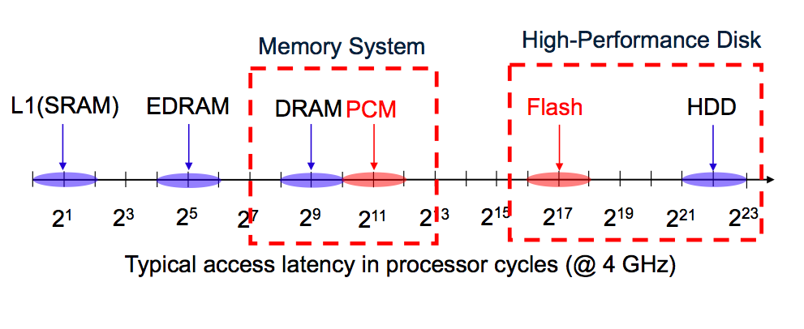

Slide 11
提要
传统存储（磁盘）回顾
块寻址的非易失性存储器
闪存介质（Flash Memory）
固态盘（Solid State Drive）

Slide 12
闪存与SSD
闪存（Flash Memory）
闪存原理
闪存特性：不可覆盖写、读写擦的粒度与操作
固态盘（Solid State Drive）
闪存转换层
垃圾回收
磨损均衡

Slide 13
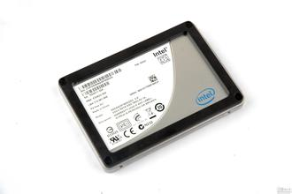
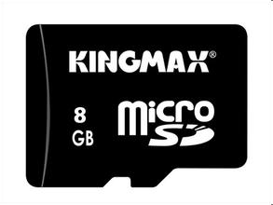

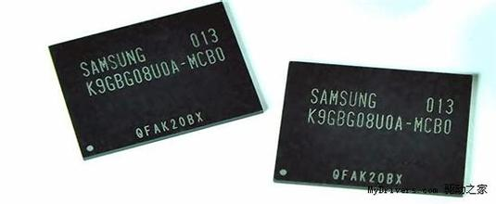
闪存是什么？
An electronic non-volatile computer storage medium that can be electrically erased and reprogrammed

Slide 14
闪存介质类型
NOR闪存
存储密度低
可字节改写
NAND闪存 － 当前主流形式
存储密度高
不可覆盖写
以下所述闪存均为NAND闪存
Source EETimes: http://www.eetimes.com/design/memory-design/4009410/Flash-memory-101-An-Introduction-to-NAND-flash

Slide 15
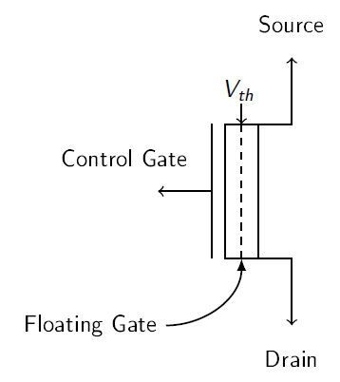
闪存单元
闪存单元：floating gate transistor
读：不同电压代表不同数值
写：电子注入(Charge Injection)
ISPP: Incremental Step Pulse Program
Notes:
以下几页参考NVMW16报告

Slide 16
Conventional MOS Transistor
gate (G)
D
G
n
+
source (S)
p-
substrate
n
+
drain (D)
S
Id
Schematic symbol
Vgs > Vth
Vgs
Vth

Slide 17
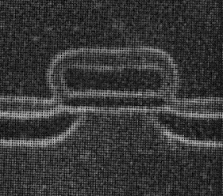
Flash Memory
Control gate
Floating gate
erasure
programming
Thin tunneling oxide
D
n
+
source
n
+
drain
G
p-
substrate
S
Schematic symbol

Slide 18
Flash Memory
Erased Cell
Programmed Cell

Slide 19
Flash Memory: A “Programmable-Threshold” Transistor
Id
“1” state
“0” state
Erased state
Programmed state
Vth-0
Vth-1
Vgs

Slide 20
闪存单元阵列（Flash Cell Array）
Row
Block X
Page Y
Column
Sense Amplifiers
Sense Amplifiers
Notes:
Now, let’s zoom in to a single block of flash memory, which consists of an array of flash pages.
Each flash page is written to flash cells located in the same row.
Each row of cells are controlled by the same horizontal wire.
Each column of cells are connected in series with a sense amplifier at the bottom.

Slide 21
Flash Cell
Drain
Floating Gate
Gate
Source
Floating Gate Transistor
(Flash Cell)
Notes:
Now let’s zoom in again to look at a single flash cell, or, it can also be called, a floating gate transistor.

Slide 22
Flash Read
V_{read} = 2.5 V
V_{th} = 2 V
V_{read} = 2.5 V
V_{th} = 3 V
Gate
1
0
Flash Pass-Through
V_{pass} = 5 V
V_{th} = 2 V
V_{pass} = 5 V
V_{th} = 3 V
Gate
1
1
Notes:
Now, if we have two flash cells programmed to different threshold voltages, 2V and 3V, we can distinguish them with a read voltage of 2.5V.
When we apply 2.5V to the gate, since the read voltage is higher than the threshold voltage, …
Now if we look back at this example, we can see that the threshold voltage of each flash cell actually represents the value being stored.
But, for the same cells, when we apply a high voltage to them, regardless of the threshold voltage, any cell will be passed-through.
So we call this voltage pass-through voltage or Vpass

Slide 23
Read from Flash Cell Array
V_{pass} = 5.0 V
Pass (5V)
3.0V
3.8V
3.9V
4.8V
Page 1
V_{read} = 2.5 V
Read (2.5V)
3.5V
2.9V
2.4V
2.1V
Page 2
V_{pass} = 5.0 V
Pass (5V)
2.2V
4.3V
4.6V
1.8V
Page 3
V_{pass} = 5.0 V
Pass (5V)
3.5V
2.3V
1.9V
4.3V
Page 4
Correct values for page 2:
0
0
1
1
Notes:
Now, let’s look at an example array of flash cells.
In this example, we make up threshold voltage numbers for each cell.
Let’s say we want to read from the second page in this array.
So we apply a read voltage of 2.5 V to the second page
And since all the other pages are connected in series, we apply a high pass-through voltage of 5 V to the other pages.
As we can see, the high pass through voltage switches on all the flash pages being passed-through, allowing the sense amplifier to read the values stored in the second page.
In this case, the correct values …

Slide 24
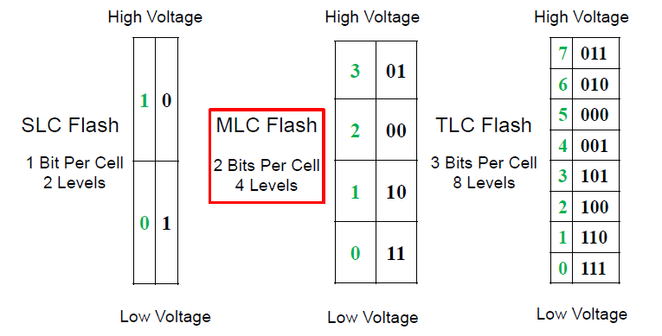
多比特闪存单元
SLC-MLC-TLC：多比特单元
多比特单元采用格雷码编码

Slide 25
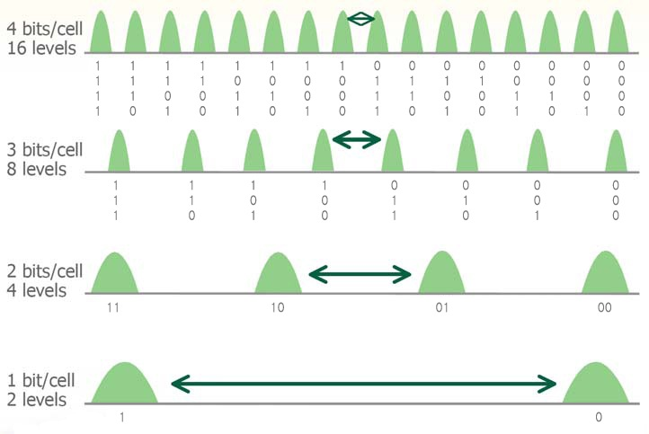
Multiple-Level(Bit) per Cell
Source: Eli Harari (SanDisk), “NAND at Center Stage,” Flash Memory Summit 2007.

Slide 26
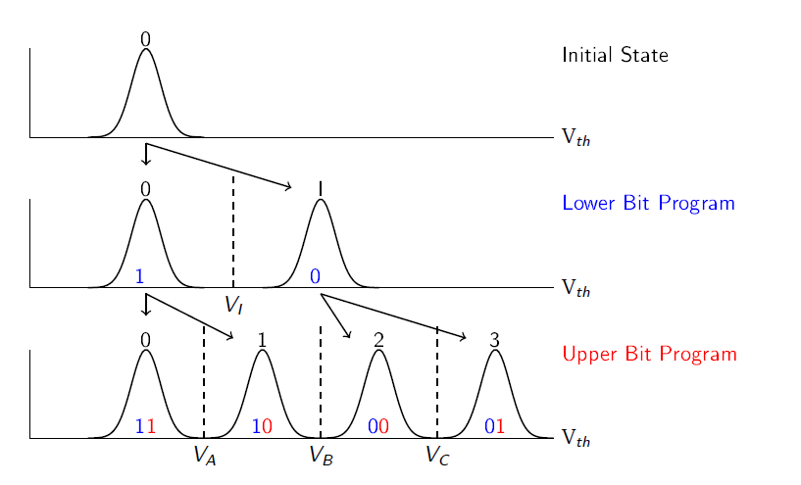
闪存单元-写

Slide 27
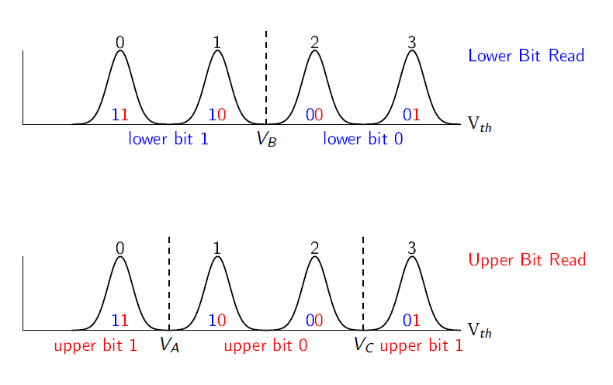
闪存单元-读

Slide 28
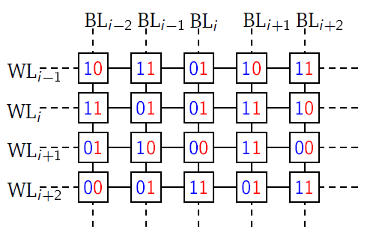
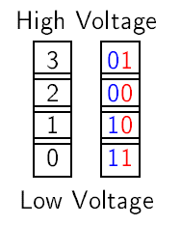
闪存
Rows (wordlines) are ~128K cells; columes (bitlines) are ~64 cells
In each wordline, lower bits of cells constitute the lower page, and upper bits constitute the upper page.

Slide 29
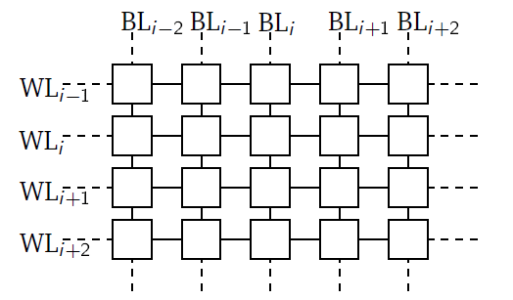

闪存
10
11
00
10
11
1-
1-
0-
1-
1-
11
1-
01
0-
10
01
1-
0-
10
1-
0-
1-
0-
1-
0-
1-
0-
1-
1-
0-
闪存页按固定顺序写入，高低页面相互独立
闪存写入需要先擦除再写入，擦除需要整块擦除

Slide 30
闪存特性之一 – 读/写/擦粒度
闪存页 – 读写粒度
E.g., 4KB
us延迟
闪存块 – 擦除粒度
E.g., 2MB
ms延迟

Slide 31
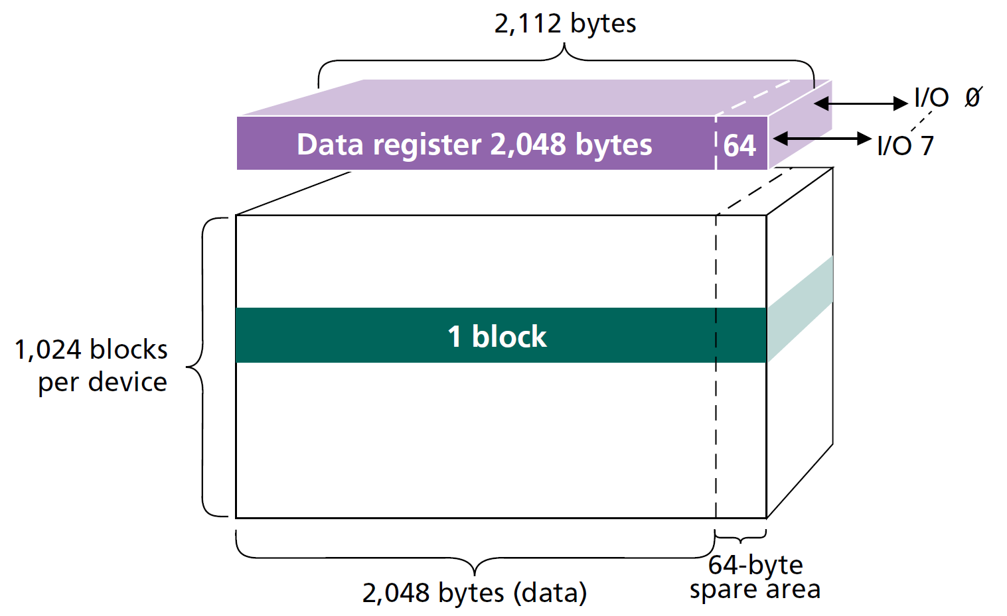
闪存特性之二 － 不可覆盖写
不可覆盖写
需要擦除操作
读写粒度与擦除粒度不同
1 page = (2K + 64) bytes
1 block = (2K + 64) bytes * 64 = (128K + 4K) bytes
1 device = (128K + 4K) bytes * 1024 = 1056 MB

Slide 32
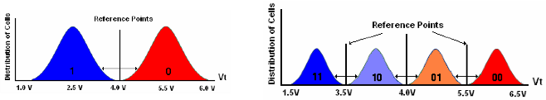
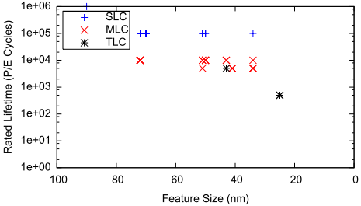
闪存特性之三 － 有限次擦除
有限次擦除
随着擦除次数的增加，存储单元不能可靠地保持状态（存储数据）
耐久性 Endurance
保持力 Retention
SLC：100,000次
MLC：10,000次
TLC：1,000次

Slide 33
闪存特性 → FTL设计
读写擦粒度
写前
擦除
擦除
寿命
数据更新：
- Invalidate
- Out-of-place update
Address Mapping
Garbage Collection
Wear Leveling

Slide 34
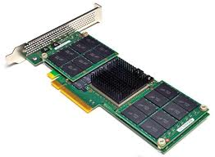
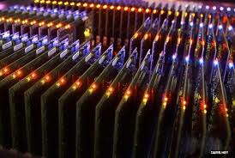
闪存与固态盘的发展
1984年，日本东芝公司研制出闪存
嵌入式存储
SD卡
固态盘 SSD
PCIe 闪存加速卡
全闪存阵列
。。。

Slide 35
页面0
页面1
页面2
页面3
页面4
页数据
OOB
页面63
硬件接口
闪存芯片#0
闪存芯片#1
FTL
(地址映射、垃圾回收、磨损均衡)
闪存块
FTL
(地址映射、垃圾回收、磨损均衡)
闪存控制器
闪存芯片#2
闪存芯片#3
SSD

Slide 36
Plane Level
Channel Level
Block 0
Block 0
Block 1
Block 1
Flash Chip
Flash Chip
FTL
Block ...
Block ...
Host
Interconnect
H/W Interface
Register
Register
Plane 0
Plane 1
Flash Chip
Flash Chip
Die 0
Die 1

Slide 37
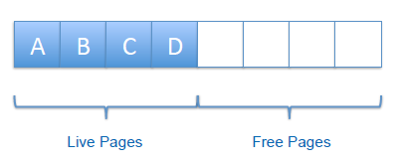
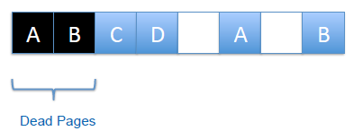
Flash Translation Layer (FTL)
FTL
Address mapping
Garbage Collection
Wear-leveling
Cache and Buffer, Request Handling
Bad block, ECC
etc
Page-Level, Block-Level, Hybrid FTL

Slide 38
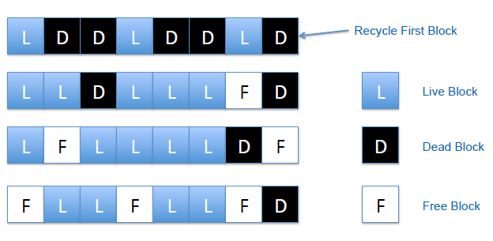
Garbage Collection

Slide 39
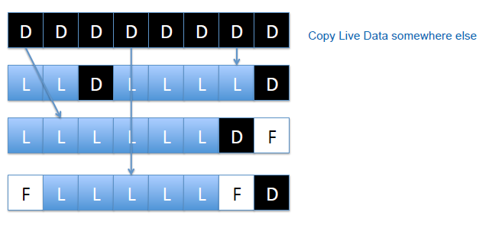

Slide 40
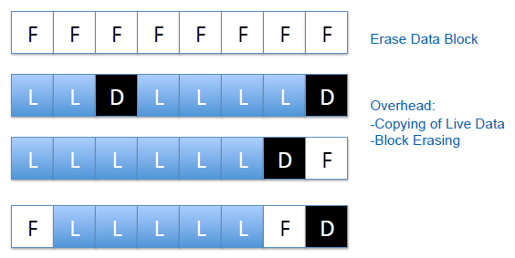

Slide 41
GC Policy
Questions:
When to start garbage collection?
Which block(s) to choose and how many?
How should valid data be written?
Where to write the new data?
GC Overhead
Block erase overhead
Valid page copying overhead: # of pages moved
Greedy policy
Victim blocks = blocks with the most dirty pages
Optimizations
Age: elapsed time since the last modification
Hot/Cold separation

Slide 42
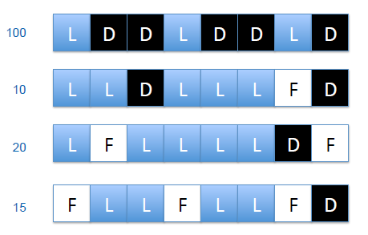
Wear Leveling
Static and Dynamic wear leveling
Hot/Cold data separation

Slide 43
FTL
Maintain mapping:
Virtual address (exposed to upper level) ➔ physical address (on flash)
Use a small, fast SRAM for storing this mapping
Hide erase operation to the above
Avoiding in-place update
Updating a clean page
Performing garbage collection and erasure
Note:
OOB has the physical ➔ virtual mapping
FTL virtual ➔ physical mapping can be rebuilt (at restart)
Page-level, Block-level, Hybrid FTL

Slide 44
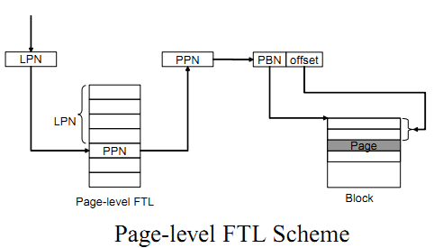
Page-level FTL
Keep page to page mapping table
Pro: can map any logical page to any physical page
Efficient flash page utilization
Con: mapping table is large
E.g., 16GB flash, 2KB flash page, requires 32MB SRAM
As flash size increases, SRAM size must scale
Too expensive!

Slide 45
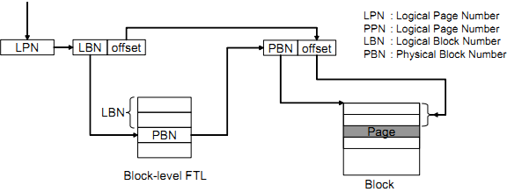
Block-level FTL
Keep block to block mapping
Pro: small
Mapping table size reduced by a factor of (block size / page size) ~ 64 times
Con: page number offset within a block is fixed
Garbage collection overheads grow

Slide 46
Hybrid FTL
Data blocks: block-level mapping
Log/update blocks: page-level mapping

Slide 47
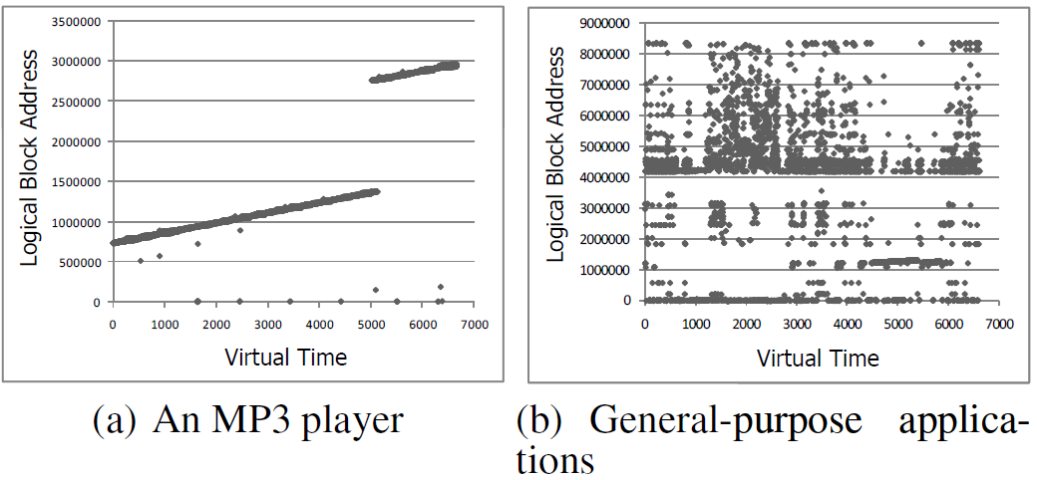
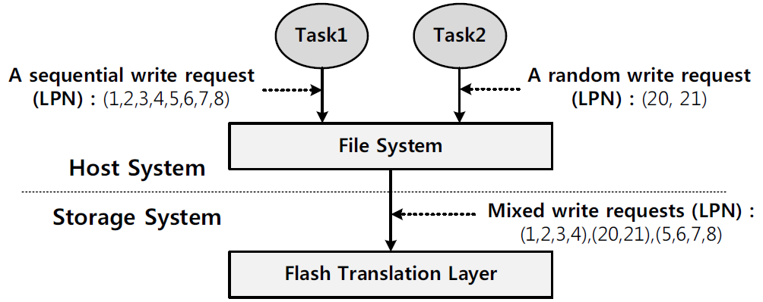
LAST: an example of hybrid FTL
Observations
Typical SSD accesses have both random and sequential traffics
Random traffics can be classified into hot and cold

Slide 48
Block-based FTL
Data Block Area (D-Block)
used to store user data
represent effective storage space
Log Block Area (U-Block)
invisible to users
used to hold rewritten pages
Reserved Blocks
Mapping Blocks
Data Blocks
Log Blocks

Slide 50
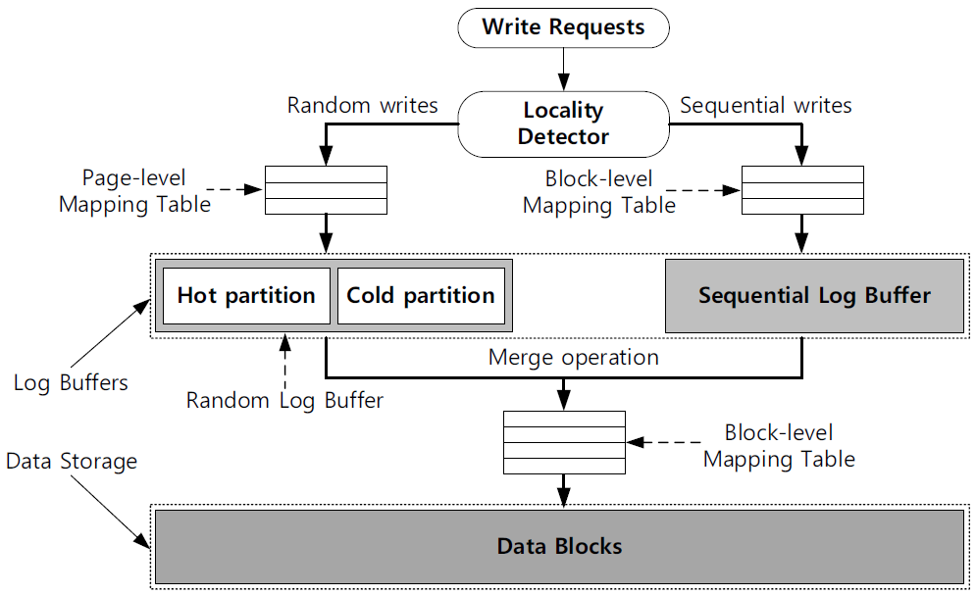
LAST Scheme

Slide 51
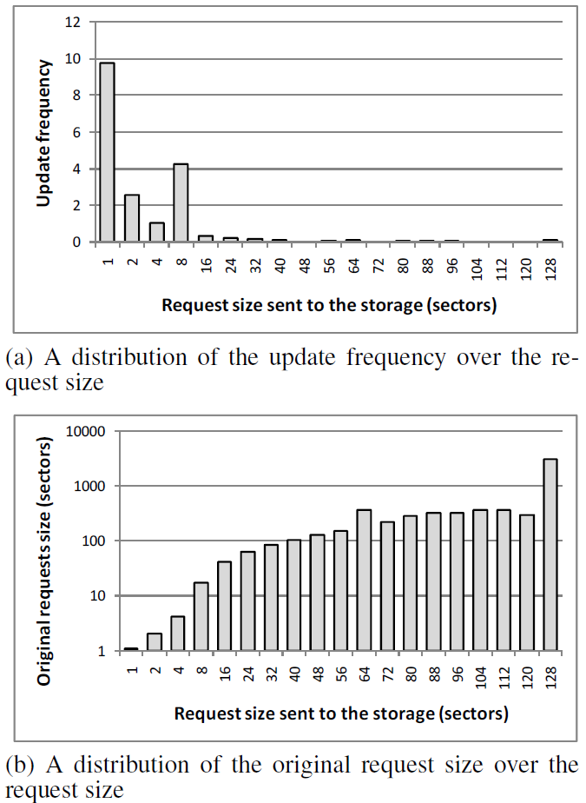
Locality Detection: Random vs. Sequential
Observations
Short requests are very frequent (a)
Short requests tend to access random locations (b)
Long requests tend to access sequential locations (b)
Threshold of randomness
4KB from experiments

Slide 52
LAST Scheme
< 4KB
>= 4KB

Slide 53
Why Hot and Cold?
Observation
A large amount of invalid pages (>50%) occupy random log buffer space
They are mostly caused by hot pages
Problem
Invalid pages are distributed over random log buffer space, which causes full merges (expensive!)

Slide 54
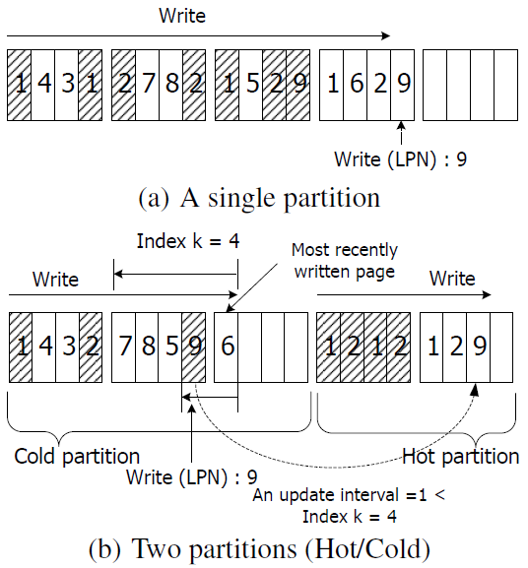
Aggregating Invalid Pages due to Hot Pages
An example trace
1,4,3,1,2,7, 8, 2, 1, …
Single random buffer partition suffer from distributed invalid pages
In LAST method, Hot partition aggregates invalid pages --> full merges can be reduced. In addition, full merges are delayed

Slide 55
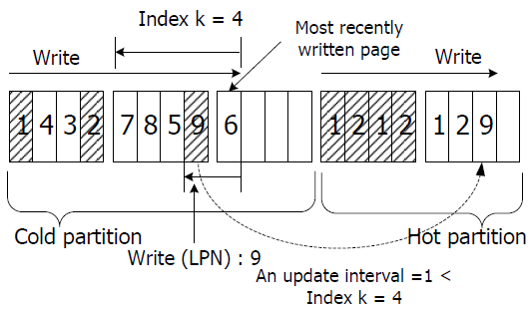
Temporal Locality: Hot or Cold?
Update interval (calculated for each page access)
= Current page access time – last page access time
If update interval < k (threshold)
Hot (means frequent writes)

Slide 56
LAST Scheme
< 4KB
>= 4KB

Slide 57
Garbage Collection in LAST: Step 1 Victim Partition Selection
Basic rule
If there is a dead block in Hot partition, we select Hot partition as the victim partition
Else, we select Cold partition as the victim
Notes:
Demotion from Hot to Cold page
If there is a log block whose updated time is smaller than a certain threshold time, age threshold (i.e., old enough), then we select Hot partition as the victim

Slide 58

Garbage Collection in LAST: Step 2 Victim Block Selection
Case A: Victim partition = Hot partition
If there is a dead block, select it
Else, select a least recently updated block
Case B: Victim partition = Cold partition
Choose the block with the lowest (full) merge cost (in the merge cost table)
N_{a}: associativity degree, N_{p}: # valid page copies
C_{c}: page copy cost, C_{e}: erase cost

Slide 59
DFTL: an example of Page-level FTL
Avoid expensive full merges totally
Do not use log blocks at all
Idea:
Use page-level mapping
Keep the full mapping on flash to reduce SRAM use
Exploit temporal locality in workloads
Dynamically load / unload page-level mappings into SRAM
Notes:
ASPLOS’09

Slide 60
DFTL Architecture
Global mapping table

Slide 61
开放性探索题
由于Flash Memory的异地更新特性，Mapping Table多级指针需要连锁更新，这导致了滚雪球效应。
假设 mapping table采用B+ tree数据结构，如何优化可以减少滚雪球的问题？
可以参考uTree

Slide 62
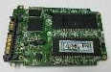
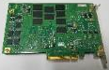
Open-Channel SSD
软件直管闪存（开放通道SSD）
广义的Open-Channel架构
设备内FTL
（~1990s，SanDisk）
主机端FTL
(~2008, FusionIO)
软件直管闪存
(2010, 清华大学)
系统软件
(逻辑功能、存储管理)
系统软件
(逻辑功能、存储管理)
系统软件
（逻辑功能）
命名空间
系统软件
（存储管理）
FTL
SSD
FTL
FusionIO裸闪存
裸闪存设备
芯片
芯片
芯片
芯片
芯片
芯片
芯片
芯片
芯片
去掉闪存转换层（FTL）
协同软硬件设计
闪存物理布局信息暴露给软件
赋予软件更灵活的管理功能
1st Generation: SATA –
Raw Flash Device (2012)
2nd Generation: PCIe –
Raw Flash Device (2013)
Youyou Lu, Jiwu Shu, Weimin Zheng, Extending the Lifetime of Flash-based Storage through Reducing Write Amplification from File Systems. USENIX Conference on File and Storage Technologies (FAST), 2013

Slide 63
总结
Solid State Drive (电子机械式 → 全电子式)
Flash Memory
Flash Translation Layer
Mapping Table
Garbage collection
Wear Leveling
最近研究方向
Open-Channel SSD
Near Data Processing
Kernel Bypass (SPDK)
Distributed Flash (Novel Protocol in Distributed System)

Slide 65
Undergraduate Research Topics
SMR/IMR
Data structure (indexing) for flash memory
Data structure for persistent memory
RDMA+NVM (key-value store, replication)
FUSE file system for NVM
…
Accelerated SSD (Processing in Storage)
Persistent Memory Storage and Computing
Programmable Networked Storage

