Slide 1
第四讲 主存
存储技术基础
陆游游
luyouyou@tsinghua.edu.cn

Slide 2
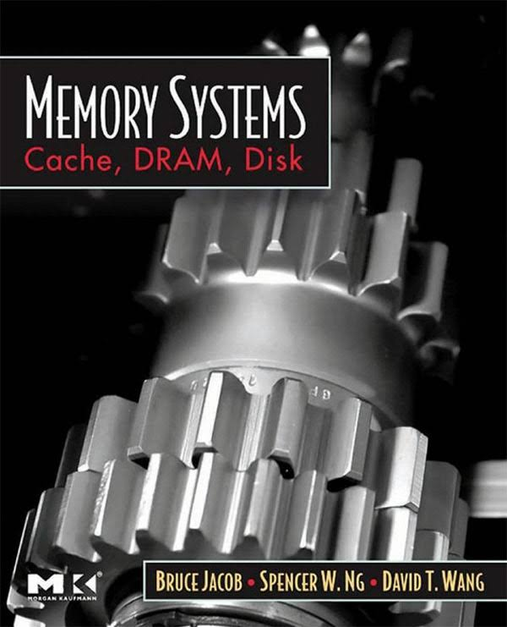
Ack: Most slides in this lecture are directly borrowed from Onur Multu’slides. Some figures or slides are directly borrowed from others, including course slides from CMU.
Memory Systems: Cache, DRAM, Disk
作者：Bruce Jacob, Spencer W. Ng, David T. Wang
更细节的内容参考第二大部分(Chapter 10,11,13)

Slide 3
Main Memory
1. Memory Overview and Challenges
2. DRAM Organization
3. DRAM Refresh
4. Memory Controller
5. Emerging Non-Volatile Memory

Slide 4
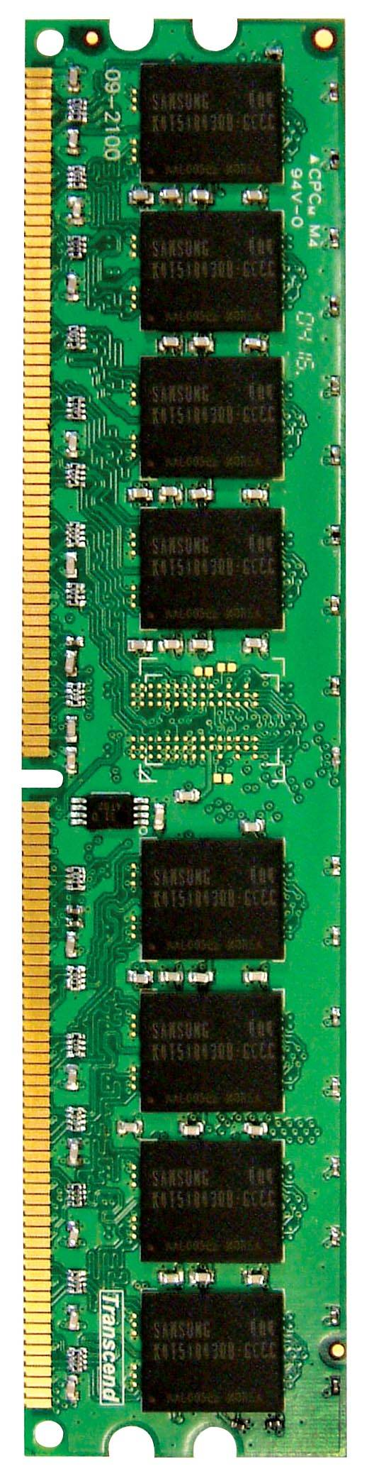
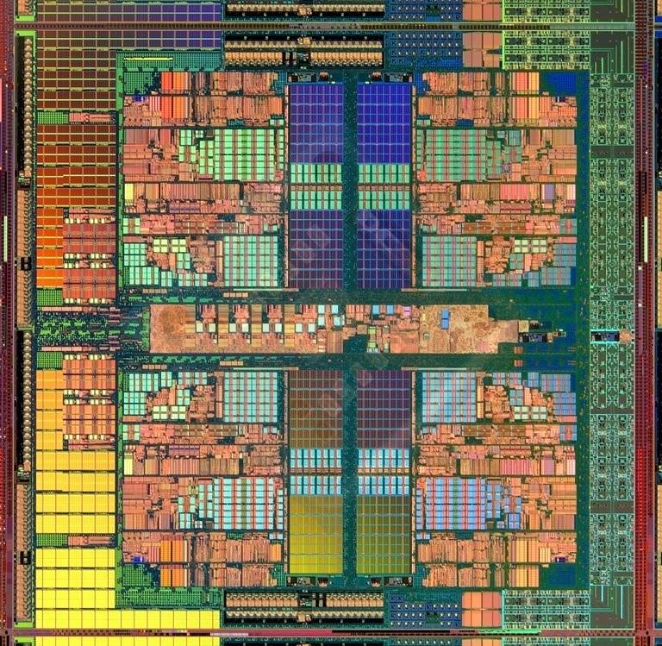
Main Memory in the System
CORE 0
L2 CACHE 1
CORE 1
L2 CACHE 0
SHARED L3 CACHE
DRAM INTERFACE
DRAM MEMORY CONTROLLER
DRAM BANKS
CORE 2
L2 CACHE 2
CORE 3
L2 CACHE 3

Slide 5
Main Memory in the System

Slide 6
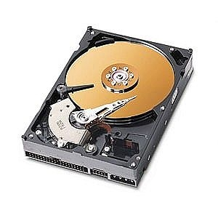
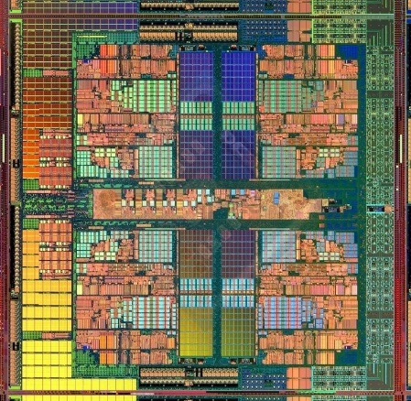
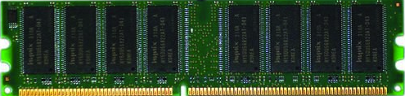
The Main Memory System
Main memory is a critical component of all computing systems: server, mobile, embedded, desktop, sensor
Main memory system must scale (in size, technology, efficiency, cost, and management algorithms) to maintain performance growth and technology scaling benefits
Processors
and caches
Main Memory
Storage (SSD/HDD)

Slide 7
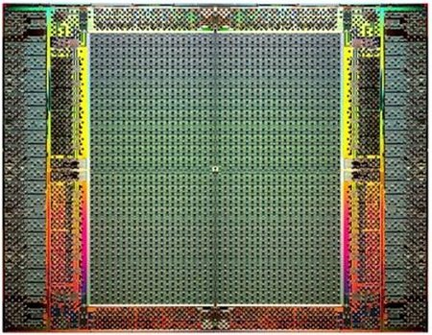
The Main Memory System
Main memory is a critical component of all computing systems: server, mobile, embedded, desktop, sensor
Main memory system must scale (in size, technology, efficiency, cost, and management algorithms) to maintain performance growth and technology scaling benefits
FPGAs
Main Memory
Storage (SSD/HDD)

Slide 8
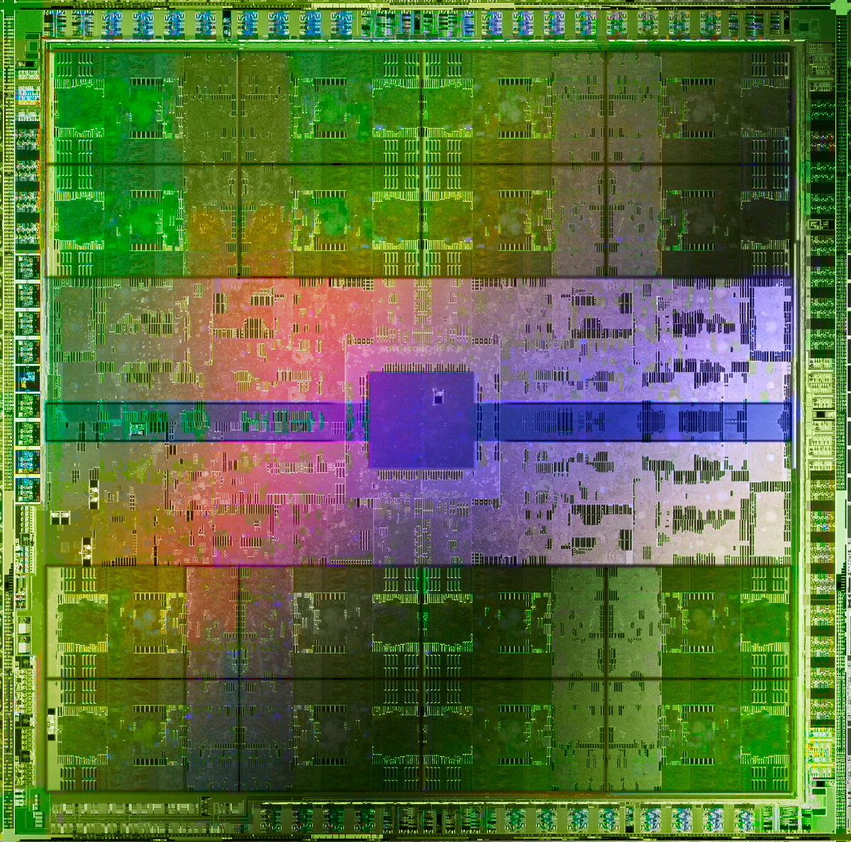
The Main Memory System
Main memory is a critical component of all computing systems: server, mobile, embedded, desktop, sensor
Main memory system must scale (in size, technology, efficiency, cost, and management algorithms) to maintain performance growth and technology scaling benefits
GPUs
Main Memory
Storage (SSD/HDD)

Slide 9
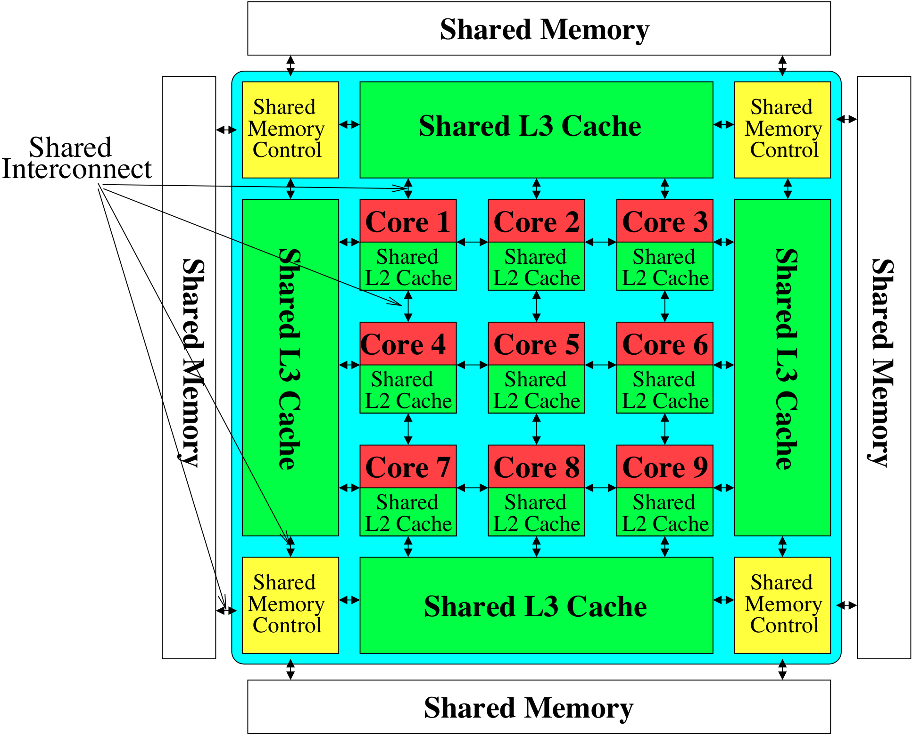
Memory System: A Shared Resource View
Storage
Most of the system is dedicated to storing and moving data

Slide 10
State of the Main Memory System
Recent technology, architecture, and application trends
lead to new requirements
exacerbate old requirements
DRAM and memory controllers, as we know them today, are (will be) unlikely to satisfy all requirements
Some emerging non-volatile memory technologies (e.g., PCM) enable new opportunities: memory+storage merging
We need to rethink the main memory system
to fix DRAM issues and enable emerging technologies
to satisfy all requirements

Slide 11
Major Trends Affecting Main Memory (I)
Need for main memory capacity, bandwidth, QoS increasing
Main memory energy/power is a key system design concern
DRAM technology scaling is ending

Slide 12
Major Trends Affecting Main Memory (II)
Need for main memory capacity, bandwidth, QoS increasing
Multi-core: increasing number of cores/agents
Data-intensive applications: increasing demand/hunger for data
Consolidation: cloud computing, GPUs, mobile, heterogeneity
Main memory energy/power is a key system design concern
DRAM technology scaling is ending

Slide 13
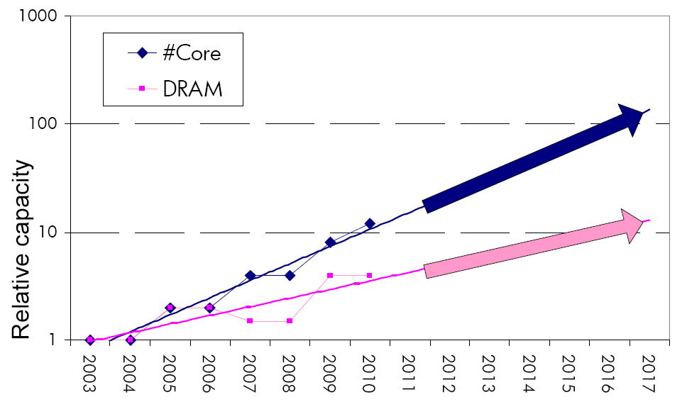
Example: The Memory Capacity Gap
Memory capacity per core expected to drop by 30% every two years
Trends worse for memory bandwidth per core!
Core count doubling ~ every 2 years
DRAM DIMM capacity doubling ~ every 3 years
Lim et al., ISCA 2009

Slide 14
Example: Memory Bandwidth & Latency
128x
20x
1.3x
Memory latency remains almost constant

Slide 15




DRAM Latency Is Critical for Performance
In-memory Databases
[Mao+, EuroSys’12; Clapp+ (Intel), IISWC’15]
Graph/Tree Processing
[Xu+, IISWC’12; Umuroglu+, FPL’15]
Long memory latency → performance bottleneck
In-Memory Data Analytics
[Clapp+ (Intel), IISWC’15;
Awan+, BDCloud’15]
Datacenter Workloads [Kanev+ (Google), ISCA’15]

Slide 16
Major Trends Affecting Main Memory (III)
Need for main memory capacity, bandwidth, QoS increasing
Main memory energy/power is a key system design concern
~40-50% energy spent in off-chip memory hierarchy [Lefurgy, IEEE Computer’03] >40% power in DRAM [Ware, HPCA’10][Paul,ISCA’15]
DRAM consumes power even when not used (periodic refresh)
DRAM technology scaling is ending

Slide 17
Major Trends Affecting Main Memory (IV)
Need for main memory capacity, bandwidth, QoS increasing
Main memory energy/power is a key system design concern
DRAM technology scaling is ending
ITRS projects DRAM will not scale easily below X nm
Scaling has provided many benefits:
higher capacity (density), lower cost, lower energy

Slide 18
Major Trends Affecting Main Memory (V)
DRAM scaling has already become increasingly difficult
Increasing cell leakage current, reduced cell reliability, increasing manufacturing difficulties
Difficult to significantly improve capacity, energy
Emerging memory technologies are promising
3D-Stacked DRAM | higher bandwidth | smaller capacity
Reduced-Latency DRAM (e.g., RLDRAM, TL-DRAM) | lower latency | higher cost
Low-Power DRAM (e.g., LPDDR3, LPDDR4) | lower power | higher latency higher cost
Non-Volatile Memory (NVM) (e.g., PCM, STTRAM, ReRAM, 3D Xpoint) | larger capacity | higher latency higher dynamic power lower endurance

Slide 19
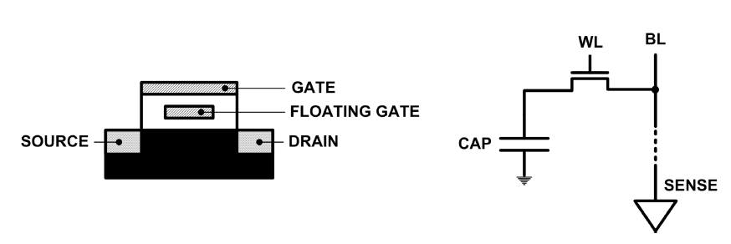
Limits of Charge Memory
Difficult charge placement and control
Flash: floating gate charge
DRAM: capacitor charge, transistor leakage
Reliable sensing becomes difficult as charge storage unit size reduces

Slide 20
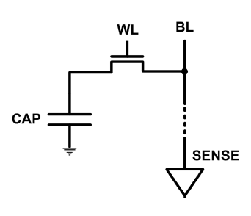
The DRAM Scaling Problem
DRAM stores charge in a capacitor (charge-based memory)
Capacitor must be large enough for reliable sensing
Access transistor should be large enough for low leakage and high retention time
Scaling beyond 40-35nm (2013) is challenging [ITRS, 2009]
DRAM capacity, cost, and energy/power hard to scale

Slide 21
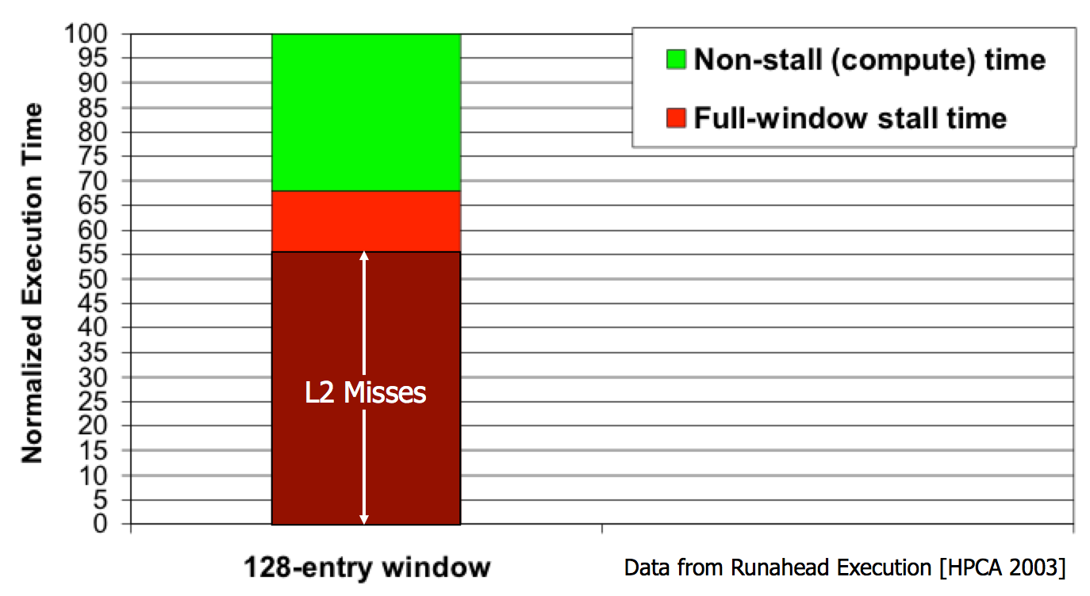
The Performance Perspective
“It’s the Memory, Stupid!” (Richard Sites, MPR, 1996)
Mutlu+, “Runahead Execution: An Alternative to Very Large Instruction Windows for Out-of-Order Processors,” HPCA 2003.

Slide 22
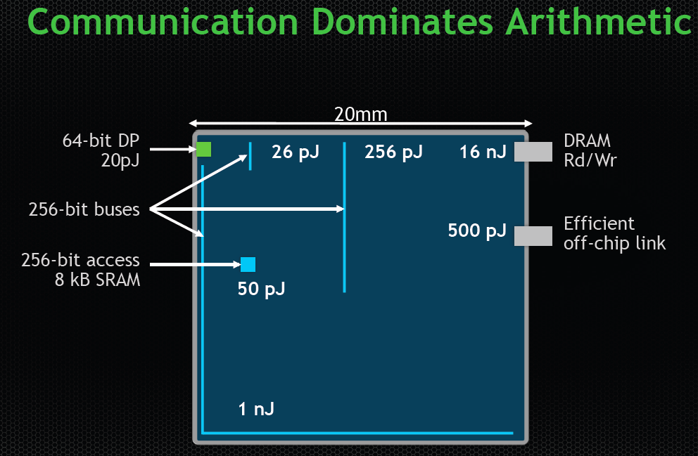
The Energy Perspective
Dally, HiPEAC 2015

Slide 23
The Energy Perspective
Dally, HiPEAC 2015
A memory access consumes ~1000X
the energy of a complex addition

Slide 24
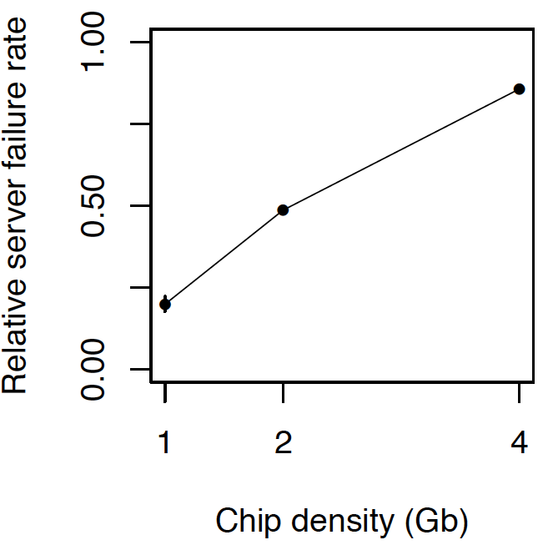
The Reliability Perspective
Data from all of Facebook’s servers worldwide
Meza+, “Revisiting Memory Errors in Large-Scale Production Data Centers,” DSN’15.
Intuition: quadratic increase in capacity

Slide 25
Outline
1. Memory Overview and Challenges
2. DRAM Organization
3. DRAM Refresh
4. Memory Controller
5. Emerging Non-Volatile Memory

Slide 26
DRAM Subsystem Organization
Channel
DIMM
Rank
Chip
Bank
Row/Column

Slide 27
Basic Organization of DRAM

Slide 28
Page Mode DRAM
A DRAM bank is a 2D array of cells: rows x columns
A “DRAM row” is also called a “DRAM page”
“Sense amplifiers” also called “row buffer”
Each address is a <row,column> pair
Access to a “closed row”
Activate command opens row (placed into row buffer)
Read/write command reads/writes column in the row buffer
Precharge command closes the row and prepares the bank for next access
Access to an “open row”
No need for activate command

Slide 29
DRAM Bank Operation
Access Address:
(Row 0, Column 0)
Columns
(Row 0, Column 1)
(Row 0, Column 85)
(Row 1, Column 0)
Row address 0
Row address 1
Row decoder
Rows
Row Buffer
CONFLICT !
HIT
Row 1
HIT
Row 0
Empty
Column address 0
Column mux
Column address 0
Column address 1
Column address 85
Data

Slide 30
The DRAM Chip
Consists of multiple banks (2-16 in Synchronous DRAM)
Banks share command/address/data buses
The chip itself has a narrow interface (4-16 bits per read)

Slide 31
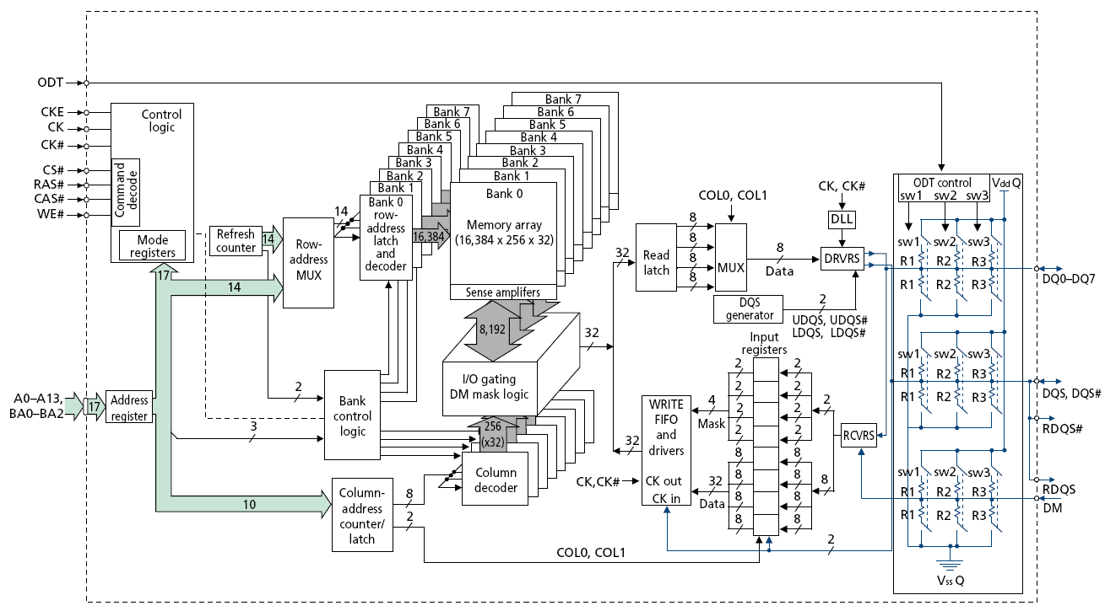
128M x 8-bit DRAM Chip

Slide 32
DRAM Rank and Module
Rank: Multiple chips operated together to form a wide interface
All chips comprising a rank are controlled at the same time
Respond to a single command
Share address and command buses, but provide different data
A DRAM module consists of one or more ranks
E.g., DIMM (dual inline memory module)
This is what you plug into your motherboard
If we have chips with 8-bit interface, to read 8 bytes in a single access, use 8 chips in a DIMM

Slide 33
A 64-bit Wide DIMM (One Rank)

Slide 34
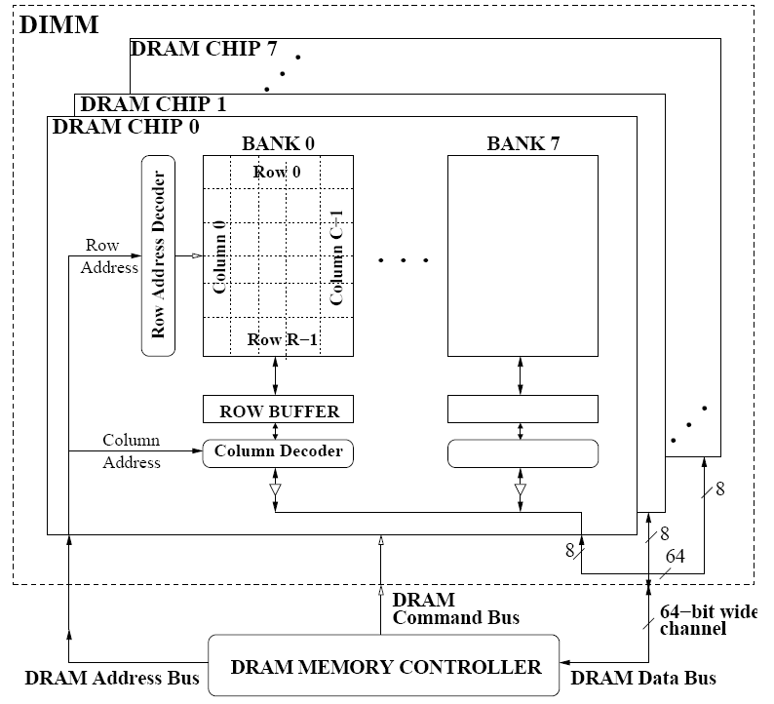
A 64-bit Wide DIMM (One Rank)
Advantages:
Acts like a high-capacity DRAM chip with a wide interface
Flexibility: memory controller does not need to deal with individual chips
Disadvantages:
Granularity: Accesses cannot be smaller than the interface width

Slide 35
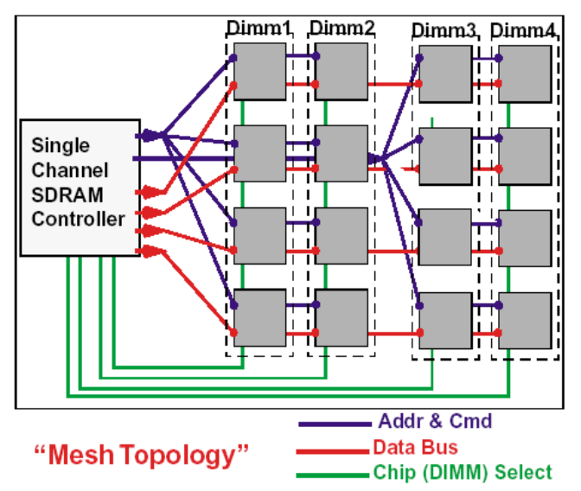
Multiple DIMMs
Advantages:
Enables even higher capacity
Disadvantages:
Interconnect complexity and energy consumption can be high

Slide 36
DRAM Channels
2 Independent Channels: 2 Memory Controllers (Above)
2 Dependent/Lockstep Channels: 1 Memory Controller with wide interface (Not Shown above)

Slide 37
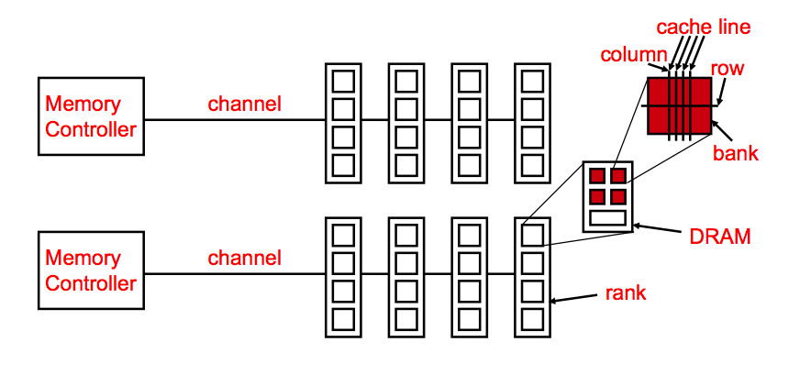
Generalized Memory Structure

Slide 38
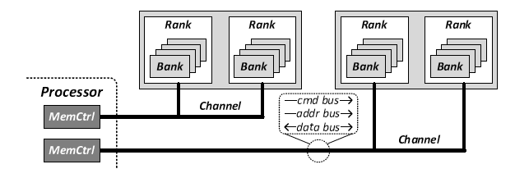
Generalized Memory Structure

Slide 39
DRAM Subsystem Organization
Channel
DIMM
Rank
Chip
Bank
Row/Column
Top-Down View

Slide 40
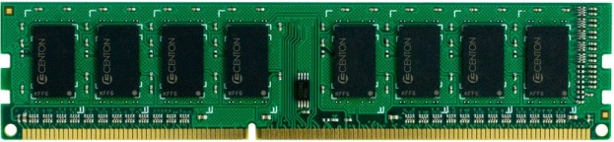
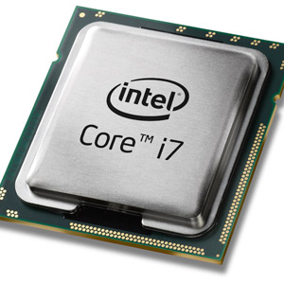
The DRAM subsystem
“Channel”
DIMM (Dual in-line memory module)
Processor
Memory channel
Memory channel

Slide 41
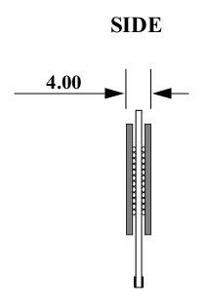
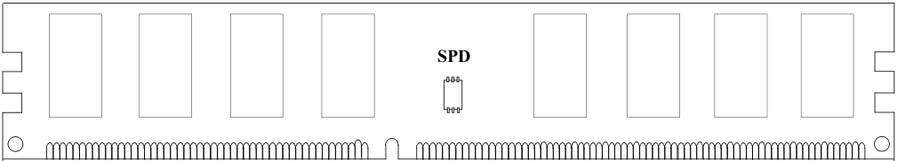
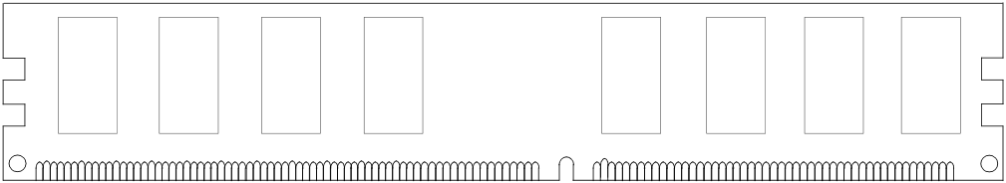
Breaking down a DIMM
DIMM (Dual in-line memory module)
Side view
Front of DIMM
Back of DIMM

Slide 42
Breaking down a DIMM
DIMM (Dual in-line memory module)
Side view
Front of DIMM
Back of DIMM
Rank 0: collection of 8 chips
Rank 1

Slide 43
Rank
Rank 0 (Front)
Rank 1 (Back)
<0:63>
<0:63>
Addr/Cmd
CS <0:1>
Data <0:63>
Memory channel

Slide 44
Breaking down a Rank
. . .
Chip 0
Chip 1
Chip 7
Rank 0
<0:63>
<0:7>
<8:15>
<56:63>
Data <0:63>

Slide 45
Breaking down a Chip
8 banks
Chip 0
Bank 0
<0:7>
<0:7>
<0:7>
...
<0:7>
<0:7>

Slide 46
Breaking down a Bank
2kB
1B (column)
row 16k-1
Bank 0
...
row 0
<0:7>
Row-buffer
1B
1B
1B
...
<0:7>

Slide 47
DRAM Subsystem Organization
Channel
DIMM
Rank
Chip
Bank
Row/Column

Slide 48
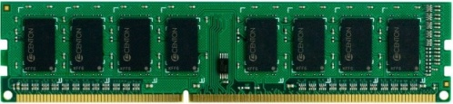


Example: Transferring a cache block
Physical memory space
0xFFFF…F
Channel 0
...
DIMM 0
Mapped to
0x40
Rank 0
64B
cache block
0x00

Slide 49
Example: Transferring a cache block
Physical memory space
Chip 0
Chip 1
Rank 0
Chip 7
0xFFFF…F
. . .
...
<0:7>
<8:15>
<56:63>
0x40
64B
cache block
Data <0:63>
0x00

Slide 50
Example: Transferring a cache block
Physical memory space
Chip 0
Chip 1
Rank 0
Chip 7
0xFFFF…F
. . .
Row 0
Col 0
...
<0:7>
<8:15>
<56:63>
0x40
64B
cache block
Data <0:63>
0x00

Slide 51
Example: Transferring a cache block
Physical memory space
Chip 0
Chip 1
Rank 0
Chip 7
0xFFFF…F
. . .
Row 0
Col 0
...
<0:7>
<8:15>
<56:63>
0x40
64B
cache block
Data <0:63>
8B
0x00
8B

Slide 52
Example: Transferring a cache block
Physical memory space
Chip 0
Chip 1
Rank 0
Chip 7
0xFFFF…F
. . .
Row 0
Col 1
...
<0:7>
<8:15>
<56:63>
0x40
64B
cache block
Data <0:63>
8B
0x00

Slide 53
Example: Transferring a cache block
Physical memory space
Chip 0
Chip 1
Rank 0
Chip 7
0xFFFF…F
. . .
Row 0
Col 1
...
<0:7>
<8:15>
<56:63>
0x40
8B
64B
cache block
Data <0:63>
8B
0x00
8B

Slide 54
Example: Transferring a cache block
Physical memory space
Chip 0
Chip 1
Rank 0
Chip 7
0xFFFF…F
. . .
Row 0
Col 1
...
<0:7>
<8:15>
<56:63>
0x40
8B
64B
cache block
Data <0:63>
8B
0x00
A 64B cache block takes 8 I/O cycles to transfer.
During the process, 8 columns are read sequentially.

Slide 55
Latency Components: Basic DRAM Operation
CPU → controller transfer time
Controller latency
Queuing & scheduling delay at the controller
Access converted to basic commands
Controller → DRAM transfer time
DRAM bank latency
Simple CAS if row is “open” OR
RAS + CAS if array precharged OR
PRE + RAS + CAS (worst case)
DRAM → CPU transfer time (through controller)

Slide 56
Multiple Banks (Interleaving) and Channels
Multiple banks
Enable concurrent DRAM accesses
Bits in address determine which bank an address resides in
Multiple independent channels serve the same purpose
But they are even better because they have separate data buses
Increased bus bandwidth
Enabling more concurrency requires reducing
Bank conflicts
Channel conflicts
How to select/randomize bank/channel indices in address?
Lower order bits have more entropy
Randomizing hash functions (XOR of different address bits)

Slide 57
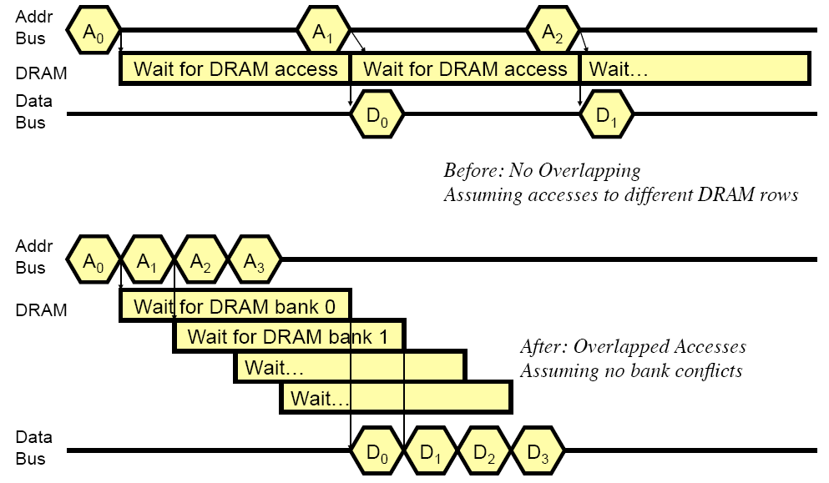
How Multiple Banks/Channels Help

Slide 58
Multiple Channels
Advantages
Increased bandwidth
Multiple concurrent accesses (if independent channels)
Disadvantages
Higher cost than a single channel
More board wires
More pins (if on-chip memory controller)

Slide 59
Address Mapping (Single Channel)
Single-channel system with 8-byte memory bus
2GB memory, 8 banks, 16K rows & 2K columns per bank
Row interleaving
Consecutive rows of memory in consecutive banks
Cache block interleaving
Consecutive cache block addresses in consecutive banks
64 byte cache blocks
Accesses to consecutive cache blocks can be serviced in parallel
How about random accesses? Strided accesses?
Row (14 bits)
Bank (3 bits)
Column (11 bits)
Byte in bus (3 bits)
Row (14 bits)
High Column
Bank (3 bits)
Low Col.
Byte in bus (3 bits)
8 bits
3 bits

Slide 60
Bank Mapping Randomization
DRAM controller can randomize the address mapping to banks so that bank conflicts are less likely
3 bits
Column (11 bits)
Byte in bus (3 bits)
XOR
Bank index (3 bits)

Slide 61
Address Mapping (Multiple Channels)
Where are consecutive cache blocks?
C
Row (14 bits)
Bank (3 bits)
Column (11 bits)
Byte in bus (3 bits)
Row (14 bits)
C
Bank (3 bits)
Column (11 bits)
Byte in bus (3 bits)
Row (14 bits)
Bank (3 bits)
C
Column (11 bits)
Byte in bus (3 bits)
Row (14 bits)
Bank (3 bits)
Column (11 bits)
C
Byte in bus (3 bits)
C
Row (14 bits)
High Column
Bank (3 bits)
Low Col.
Byte in bus (3 bits)
8 bits
3 bits
Row (14 bits)
C
High Column
Bank (3 bits)
Low Col.
Byte in bus (3 bits)
8 bits
3 bits
Row (14 bits)
High Column
C
Bank (3 bits)
Low Col.
Byte in bus (3 bits)
8 bits
3 bits
Row (14 bits)
High Column
Bank (3 bits)
C
Low Col.
Byte in bus (3 bits)
8 bits
3 bits
Row (14 bits)
High Column
Bank (3 bits)
Low Col.
C
Byte in bus (3 bits)
8 bits
3 bits

Slide 62
Interaction with Virtual → Physical Mapping
Operating System influences where an address maps to in DRAM
Operating system can control which bank/channel/rank a virtual page is mapped to.
It can perform page coloring to minimize bank conflicts
Or to minimize inter-application interference
Virtual Page number (52 bits)
Page offset (12 bits)
VA
Physical Frame number (19 bits)
Page offset (12 bits)
PA
Row (14 bits)
Bank (3 bits)
Column (11 bits)
Byte in bus (3 bits)
PA

Slide 63

主观题
10分
Bank和Rank有什么区别？分别的作用是什么？
正常使用主观题需2.0以上版本雨课堂
作答

Slide 64
Outline
1. Memory Overview and Challenges
2. DRAM Organization
3. DRAM Refresh
4. Memory Controller
5. Emerging Non-Volatile Memory

Slide 65
DRAM Refresh
DRAM capacitor charge leaks over time
The memory controller needs to refresh each row periodically to restore charge
Read and close each row every N ms
Typical N = 64 ms
Downsides of refresh
-- Energy consumption: Each refresh consumes energy
-- Performance degradation: DRAM rank/bank unavailable while refreshed
-- QoS/predictability impact: (Long) pause times during refresh
-- Refresh rate limits DRAM capacity scaling

Slide 66
DRAM Refresh: Performance
Implications of refresh on performance
-- DRAM bank unavailable while refreshed
-- Long pause times: If we refresh all rows in burst, every 64ms the DRAM will be unavailable until refresh ends
Burst refresh: All rows refreshed immediately after one another
Distributed refresh: Each row refreshed at a different time, at regular intervals

Slide 67
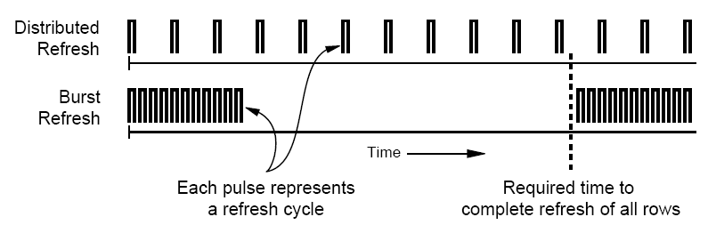
Distributed Refresh
Distributed refresh eliminates long pause times
How else can we reduce the effect of refresh on performance/QoS?
Does distributed refresh reduce refresh impact on energy?
Can we reduce the number of refreshes?

Slide 68
Refresh Today: Auto Refresh
Columns
BANK 0
BANK 1
BANK 2
BANK 3
Rows
Row Buffer
DRAM Bus
A batch of rows are
periodically refreshed
via the auto-refresh command
DRAM CONTROLLER
Notes:
The DRAM system consists of the DRAM banks, the DRAM bus, and the DRAM memory controller. DRAM banks store the data in physical memory. There are multiple DRAM banks to allow multiple memory requests to proceed in parallel.
Each DRAM bank has a 2-dimensional structure, consisting of rows by columns. Data can only be read from a “row buffer”, which acts as a cache that “caches” the last accessed row. As a result, a request that hits in the row buffer can be serviced much faster than a request that misses in the row buffer.
Existing DRAM controllers take advantage of this fact. To maximize DRAM throughput, these controllers prioritize row-hit requests over other requests in their scheduling. All else being equal, they prioritize older accesses over younger accesses. This policy is called the FR-FCFS policy. Note that this scheduling policy is designed for maximizing DRAM throughput and does not distinguish between different threads’ requests at all.
-----------------------------
Explain bank operation at a high level
- An access that is to the row in the row buffer takes a shorter time than to an access that is to another row.
Multiple banks put together to allow for multiple requests to be serviced in parallel
The DRAM controller treats each bank as an independent entity
In each bank, the DRAM controller optimizes for improving row buffer locality to improve DRAM throughput
- It prioritizes row-hit requests over other requests and all else being equal, older requests over younger requests. It is not aware of the different threads accessing it.
The DRAM controller does not coordinate accesses to different banks.
As a result requests of different threads can be serviced in different banks even though a single thread’s requests might be outstanding to multiple banks

Slide 69
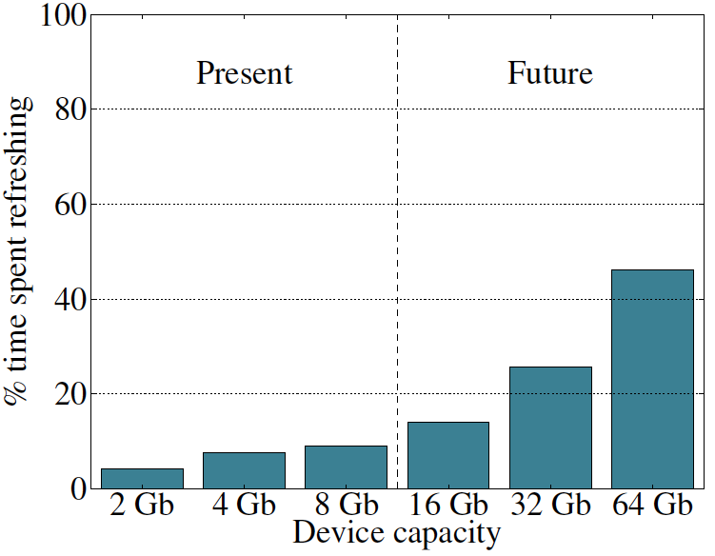
Refresh Overhead: Performance
46%
8%
Liu et al., “RAIDR: Retention-Aware Intelligent DRAM Refresh,” ISCA 2012.

Slide 70
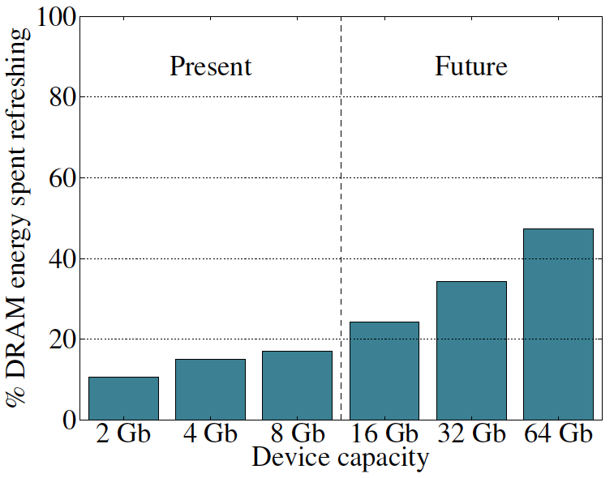
Refresh Overhead: Energy
47%
15%
Liu et al., “RAIDR: Retention-Aware Intelligent DRAM Refresh,” ISCA 2012.

Slide 71
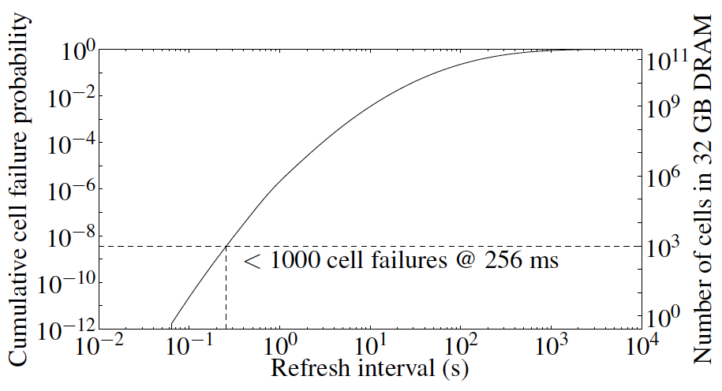
Problem with Conventional Refresh
Today: Every row is refreshed at the same rate
Observation: Most rows can be refreshed much less often without losing data [Kim+, EDL’09]
Problem: No support in DRAM for different refresh rates per row

Slide 72
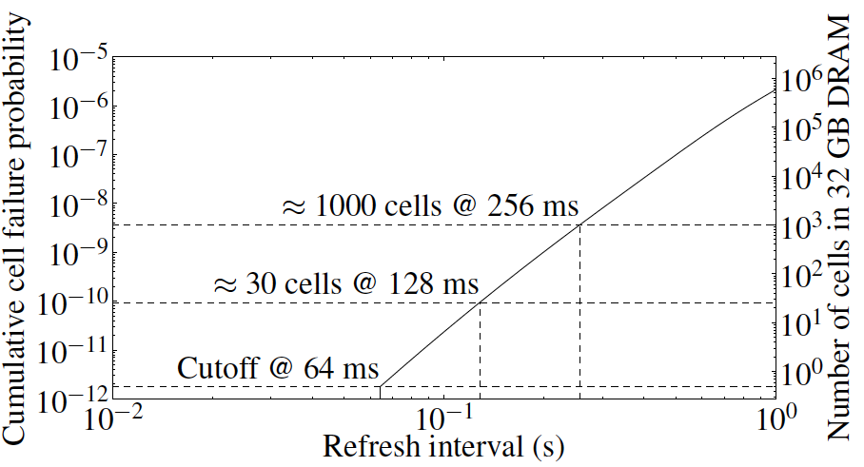
Retention Time of DRAM Rows
Observation: Only very few rows need to be refreshed at the worst-case rate
Can we exploit this to reduce refresh operations at low cost?

Slide 73
Reducing DRAM Refresh Operations
Idea: Identify the retention time of different rows and refresh each row at the frequency it needs to be refreshed
(Cost-conscious) Idea: Bin the rows according to their minimum retention times and refresh rows in each bin at the refresh rate specified for the bin
e.g., a bin for 64-128ms, another for 128-256ms, …
Observation: Only very few rows need to be refreshed very frequently [64-128ms] → Have only a few bins → Low HW overhead to achieve large reductions in refresh operations
Liu et al., “RAIDR: Retention-Aware Intelligent DRAM Refresh,” ISCA 2012.

Slide 74
DRAM Refresh: More Questions
What else can you do to reduce the impact of refresh?
What else can you do if you know the retention times of rows?
How can you accurately measure the retention time of DRAM rows?
Recommended reading:
Liu et al., “An Experimental Study of Data Retention Behavior in Modern DRAM Devices: Implications for Retention Time Profiling Mechanisms,” ISCA 2013.

Slide 75
Outline
1. Memory Overview and Challenges
2. DRAM Organization
3. DRAM Refresh
4. Memory Controller
5. Emerging Non-Volatile Memory

Slide 76
DRAM versus Other Types of Memories
Long latency memories have similar characteristics that need to be controlled.
The following discussion will use DRAM as an example, but many issues are similar in the design of controllers for other types of memories
Flash memory
Other emerging memory technologies
Phase Change Memory
Spin-Transfer Torque Magnetic Memory

Slide 77
DRAM Controller: Functions
Ensure correct operation of DRAM (refresh and timing)
Service DRAM requests while obeying timing constraints of DRAM chips
Constraints: resource conflicts (bank, bus, channel), minimum write-to-read delays
Translate requests to DRAM command sequences
Buffer and schedule requests to improve performance
Reordering, row-buffer, bank, rank, bus management
Manage power consumption and thermals in DRAM
Turn on/off DRAM chips, manage power modes

Slide 78
DRAM Controller: Where to Place
In chipset
+ More flexibility to plug different DRAM types into the system
+ Less power density in the CPU chip
On CPU chip
+ Reduced latency for main memory access
+ Higher bandwidth between cores and controller
More information can be communicated (e.g. request’s importance in the processing core)

Slide 79
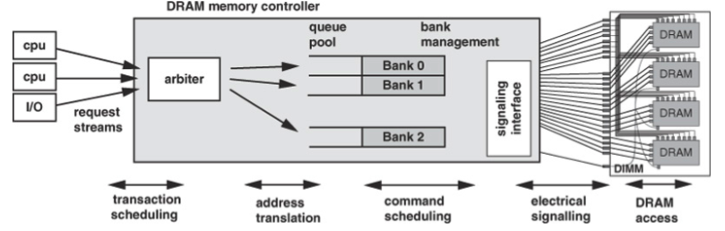
DRAM Controller (II)

Slide 80
A Modern DRAM Controller

Slide 81
DRAM Scheduling Policies (I)
FCFS (first come first served)
Oldest request first
FR-FCFS (first ready, first come first served)
1. Row-hit first
2. Oldest first
Goal: Maximize row buffer hit rate → maximize DRAM throughput
Actually, scheduling is done at the command level
Column commands (read/write) prioritized over row commands (activate/precharge)
Within each group, older commands prioritized over younger ones

Slide 82
DRAM Scheduling Policies (II)
A scheduling policy is essentially a prioritization order
Prioritization can be based on
Request age
Row buffer hit/miss status
Request type (prefetch, read, write)
Requestor type (load miss or store miss)
Request criticality
Oldest miss in the core?
How many instructions in core are dependent on it?

Slide 83
Row Buffer Management Policies
Open row
Keep the row open after an access
+ Next access might need the same row → row hit
-- Next access might need a different row → row conflict, wasted energy
Closed row
Close the row after an access (if no other requests already in the request buffer need the same row)
+ Next access might need a different row → avoid a row conflict
-- Next access might need the same row → extra activate latency
Adaptive policies
Predict whether or not the next access to the bank will be to the same row

Slide 84
Open vs. Closed Row Policies
Policy | First access | Next access | Commands needed for next access
Open row | Row 0 | Row 0 (row hit) | Read
Open row | Row 0 | Row 1 (row conflict) | Precharge + Activate Row 1 + Read
Closed row | Row 0 | Row 0 – access in request buffer (row hit) | Read
Closed row | Row 0 | Row 0 – access not in request buffer (row closed) | Activate Row 0 + Read + Precharge
Closed row | Row 0 | Row 1 (row closed) | Activate Row 1 + Read + Precharge

Slide 85
Why are DRAM Controllers Difficult to Design?
Need to obey DRAM timing constraints for correctness
There are many (50+) timing constraints in DRAM
tWTR: Minimum number of cycles to wait before issuing a read command after a write command is issued
tRC: Minimum number of cycles between the issuing of two consecutive activate commands to the same bank
…
Need to keep track of many resources to prevent conflicts
Channels, banks, ranks, data bus, address bus, row buffers
Need to handle DRAM refresh
Need to optimize for performance (in the presence of constraints)
Reordering is not simple
Predicting the future?

Slide 86
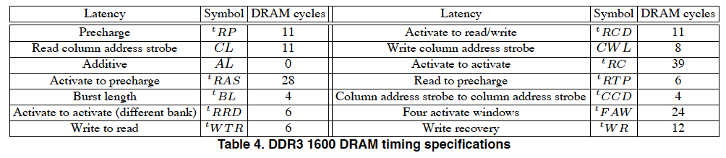
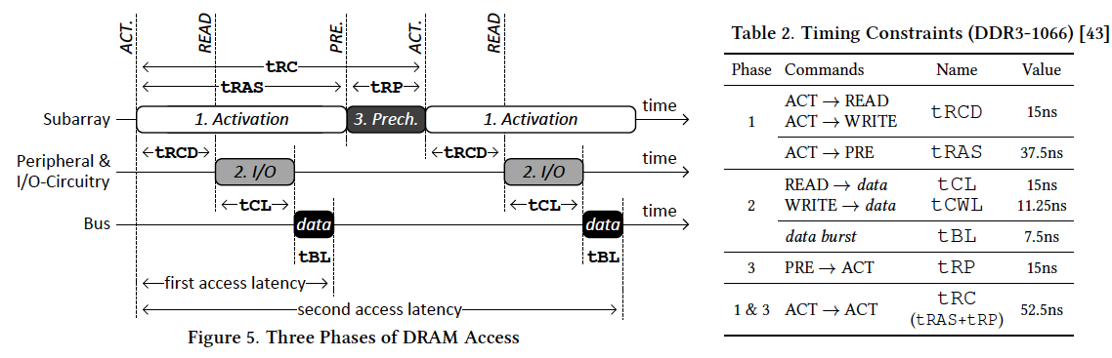
Many DRAM Timing Constraints
Notes:
From Lee et al., “DRAM-Aware Last-Level Cache Writeback: Reducing Write-Caused Interference in Memory Systems,” HPS Technical Report, April 2010.
Kim et al., “A Case for Exploiting Subarray-Level Parallelism (SALP) in DRAM,” ISCA 2012.
Lee et al., “Tiered-Latency DRAM: A Low Latency and Low Cost DRAM Architecture,” HPCA 2013.

Slide 87
DRAM Power Management
DRAM chips have power modes
Idea: When not accessing a chip power it down
Power states
Active (highest power)
All banks idle
Power-down
Self-refresh (lowest power)
State transitions incur latency during which the chip cannot be accessed

Slide 88
Outline
1. Memory Overview and Challenges
2. DRAM Organization
3. DRAM Refresh
4. Memory Controller
5. Emerging Non-Volatile Memory

Slide 89
Limits of Charge Memory
Difficult charge placement and control
Flash: floating gate charge
DRAM: capacitor charge, transistor leakage
Reliable sensing becomes difficult as charge storage unit size reduces

Slide 90
Charge vs. Resistive Memories
Charge Memory (e.g., DRAM, Flash)
Write data by capturing charge Q
Read data by detecting voltage V
Resistive Memory (e.g., PCM, STT-MRAM, memristors)
Write data by pulsing current dQ/dt
Read data by detecting resistance R

Slide 91
Promising Resistive Memory Technologies
PCM
Inject current to change material phase
Resistance determined by phase
STT-MRAM
Inject current to change magnet polarity
Resistance determined by polarity
Memristors/RRAM/ReRAM
Inject current to change atomic structure
Resistance determined by atom distance

Slide 92
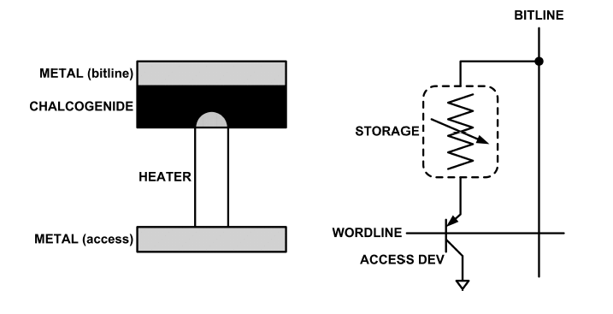
What is Phase Change Memory?
Phase change material (chalcogenide glass) exists in two states:
Amorphous: Low optical reflexivity and high electrical resistivity
Crystalline: High optical reflexivity and low electrical resistivity
PCM is resistive memory: High resistance (0), Low resistance (1)
PCM cell can be switched between states reliably and quickly

Slide 93
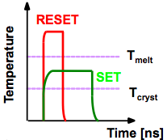
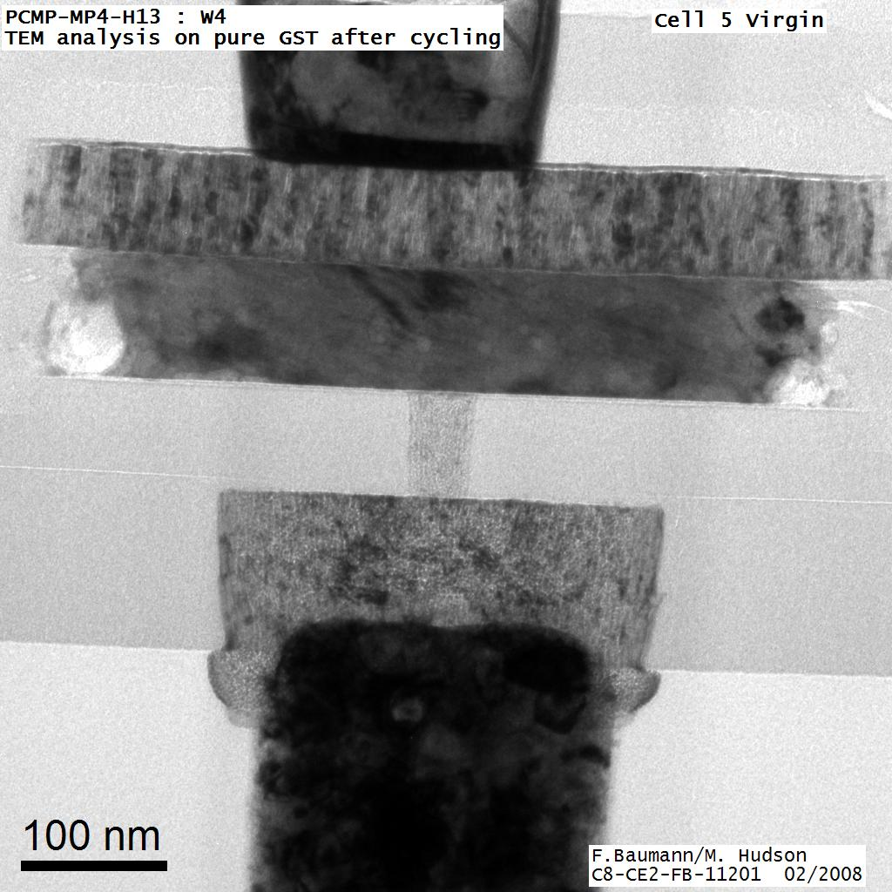
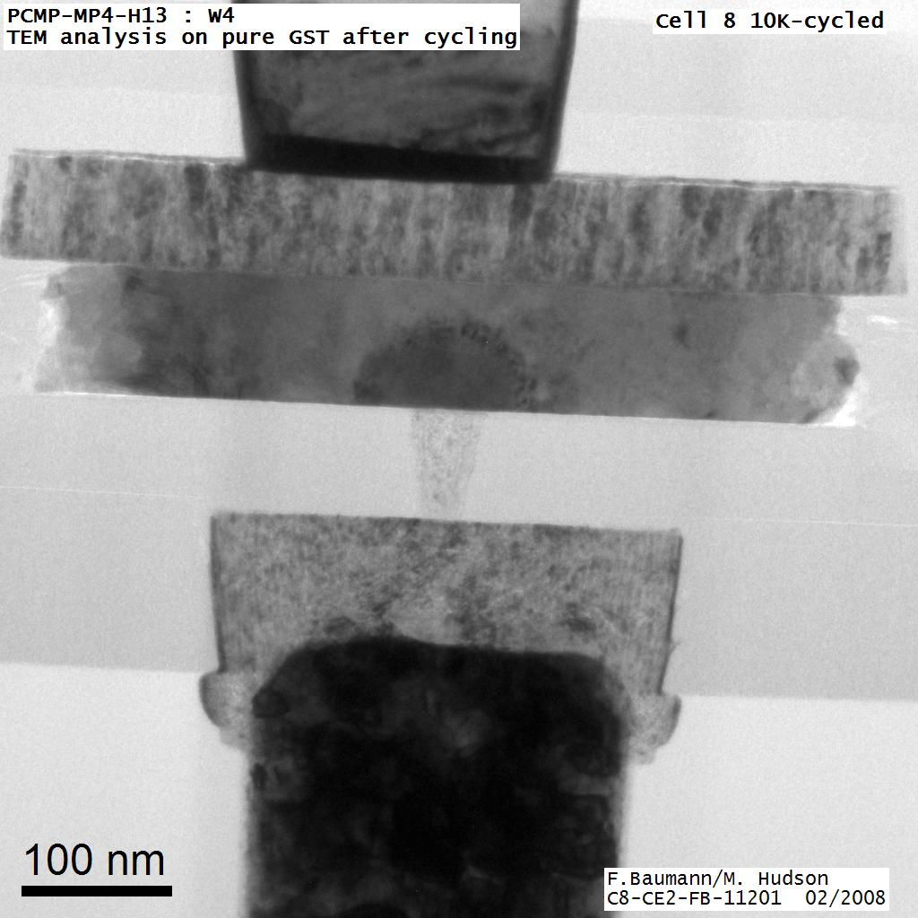
How Does PCM Work?
Write: change phase via current injection
SET: sustained current to heat cell above Tcryst
RESET: cell heated above Tmelt and quenched
Read: detect phase via material resistance
amorphous/crystalline
Large
Current
Small
Current
Memory
Element
SET (cryst)
Low resistance
Access
Device
RESET (amorph)
High resistance
10³-10⁴ Ω
10⁶-10⁷ Ω
Photo Courtesy: Bipin Rajendran, IBM
Slide Courtesy: Moinuddin Qureshi, IBM

Slide 94
Opportunity: PCM Advantages
Scales better than DRAM, Flash
Requires current pulses, which scale linearly with feature size
Expected to scale to 9nm (2022 [ITRS])
Prototyped at 20nm (Raoux+, IBM JRD 2008)
Can be denser than DRAM
Can store multiple bits per cell due to large resistance range
Prototypes with 2 bits/cell in ISSCC’08, 4 bits/cell by 2012
Non-volatile
Retain data for >10 years at 85C
No refresh needed, low idle power

Slide 95
PCM Resistance → Value
1
0
Cell value:
Cell resistance

Slide 96
MLC-PCM Resistance → Value
Bit 1
Bit 0
1
1
1
0
0
1
0
0
Cell value:
Cell resistance

Slide 97
MLC-PCM Resistance → Value
Less margin between values
→ need more precise sensing/modification of cell contents
→ higher latency/energy (~2x for reads and 4x for writes)
1
1
1
0
0
1
0
0
Cell value:
Cell resistance

Slide 98
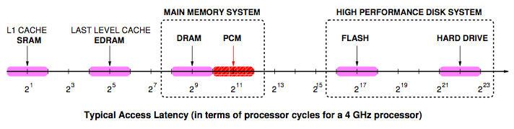
Phase Change Memory Properties: Latency
Latency comparable to, but slower than DRAM
Read Latency
50ns: 4x DRAM, 10-3x NAND Flash
Write Latency
150ns: 12x DRAM
Write Bandwidth
5-10 MB/s: 0.1x DRAM, 1x NAND Flash
Qureshi+, “Scalable high performance main memory system using phase-change memory technology,” ISCA 2009.

Slide 99
Phase Change Memory Properties
Dynamic Energy
40 uA Rd, 150 uA Wr
2-43x DRAM, 1x NAND Flash
Endurance
Writes induce phase change at 650C
Contacts degrade from thermal expansion/contraction
10+8 writes per cell
10-8x DRAM, 10+3x NAND Flash
Cell Size
9-12F2 using BJT, single-level cells
1.5x DRAM, 2-3x NAND (will scale with feature size, MLC)

Slide 100
Phase Change Memory: Pros and Cons
Pros over DRAM
Better technology scaling (capacity and cost)
Non volatile → Persistent
Low idle power (no refresh)
Cons
Higher latencies: ~4-15x DRAM (especially write)
Higher active energy: ~2-50x DRAM (especially write)
Lower endurance (a cell dies after ~108 writes)
Reliability issues (resistance drift)
Challenges in enabling PCM as DRAM replacement/helper:
Mitigate PCM shortcomings
Find the right way to place PCM in the system

Slide 101
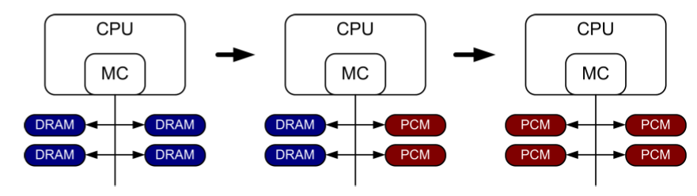
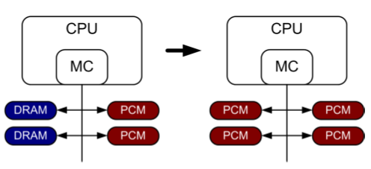
PCM-based Main Memory (I)
How should PCM-based (main) memory be organized?
Hybrid PCM+DRAM [Qureshi+ ISCA’09, Dhiman+ DAC’09]:
How to partition/migrate data between PCM and DRAM

Slide 102
PCM-based Main Memory (II)
How should PCM-based (main) memory be organized?
Pure PCM main memory [Lee et al., ISCA’09, Top Picks’10]:
How to redesign entire hierarchy (and cores) to overcome PCM shortcomings

Slide 103
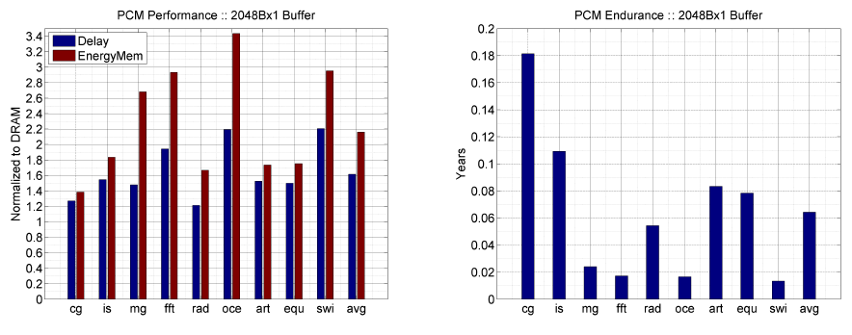
Results: Naïve Replacement of DRAM with PCM
Replace DRAM with PCM in a 4-core, 4MB L2 system
PCM organized the same as DRAM: row buffers, banks, peripherals
1.6x delay, 2.2x energy, 500-hour average lifetime
Lee, Ipek, Mutlu, Burger, “Architecting Phase Change Memory as a Scalable DRAM Alternative,” ISCA 2009.

Slide 104
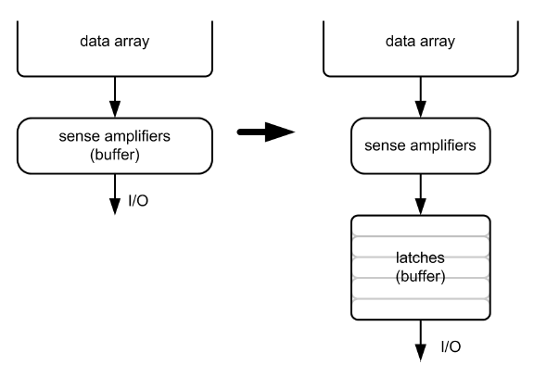
Architecting PCM to Mitigate Shortcomings
Idea 1: Use multiple narrow row buffers in each PCM chip
→ Reduces array reads/writes → better endurance, latency, energy
Idea 2: Write into array at cache block or word granularity
→ Reduces unnecessary wear
DRAM
PCM

Slide 105
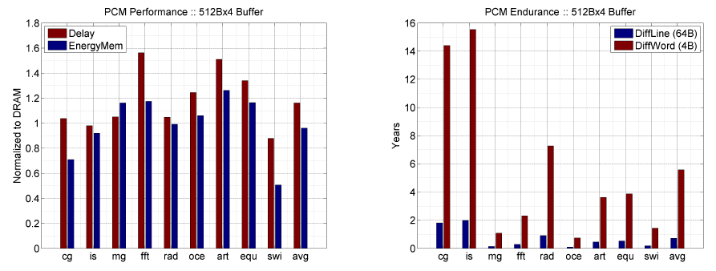
Results: Architected PCM as Main Memory
1.2x delay, 1.0x energy, 5.6-year average lifetime
Scaling improves energy, endurance, density
Caveat 1: Worst-case lifetime is much shorter (no guarantees)
Caveat 2: Intensive applications see large performance and energy hits
Caveat 3: Optimistic PCM parameters?

Slide 106
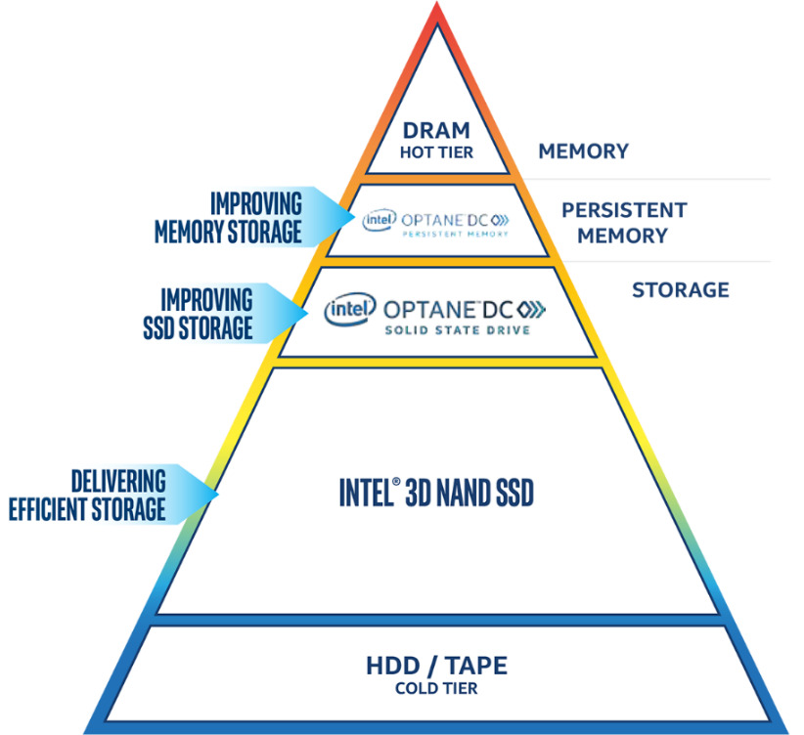
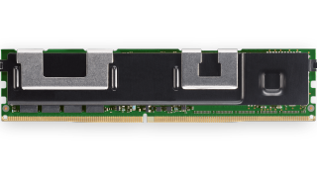
Intel Optane DC Memory
Intel 3D-XPoint
Optane DC Persistent Memory: just released in April, 2019
DDR-T Interface
Capacity: 128GB/256GB/512GB per module
Memory Mode
Large memory capacity
Easy to adopt
Doesn’t require application changes
App Direct Mode
App talks directly to Optane
OS sees Optane and DRAM as separate pools

Slide 107
STT-MRAM as Main Memory
Magnetic Tunnel Junction (MTJ) device
Reference layer: Fixed magnetic orientation
Free layer: Parallel or anti-parallel
Magnetic orientation of the free layer determines logical state of device
High vs. low resistance
Write: Push large current through MTJ to change orientation of free layer
Read: Sense current flow
Logical 0
Reference Layer
Barrier
Free Layer
Logical 1
Reference Layer
Barrier
Free Layer
Word Line
MTJ
Access
Transistor
Bit Line
Sense Line
Notes:
Moving from DRAM to STT-RAM, instead of a capacitor that stores charge, now we have a magnetic tunnel junction that has one reference layer with a fixed magnetic orientation, and a free layer that can be parallel or anti parallel to the reference layer; which determines the resistance, and in turn, the data stored in the MTJ. In addition to the MTJ, the cell, again, has an access transistor.
Reading requires a small voltage to be applied across the bitline and sense line; and the current is sensed. This current varies depending on the resistance of MTJ. To write data, we push a large current into the MTJ, which re-aligns the free layer. The direction of the current determines whether it becomes parallel or anti-parallel; i.e. logical 0 or 1.

Slide 108
STT-MRAM: Pros and Cons
Pros over DRAM
Better technology scaling (capacity and cost)
Non volatile → Persistent
Low idle power (no refresh)
Cons
Higher write latency
Higher write energy
Poor density (currently)
Reliability?
Another level of freedom
Can trade off non-volatility for lower write latency/energy (by reducing the size of the MTJ)

Slide 109
Architected STT-MRAM as Main Memory
4-core, 4GB main memory, multiprogrammed workloads
~6% performance loss, ~60% energy savings vs. DRAM
Kultursay+, “Evaluating STT-RAM as an Energy-Efficient Main Memory Alternative,” ISPASS 2013.

Slide 110
A More Viable Approach: Hybrid Memory Systems
CPU
DRAMCtrl
PCM Ctrl
DRAM
Phase Change Memory (or Tech. X)
Fast, durable
Small,
leaky, volatile,
high-cost
Large, non-volatile, low-cost
Slow, wears out, high active energy
Hardware/software manage data allocation and movement
to achieve the best of multiple technologies

Slide 111
Memory Management in OS
很重要
Virtual Memory
Page Table
MMU
TLB

Slide 112
Persistent Memory Systems
当前的研究热点
New Problems
Crash Consistency
Redundant copies
Novel Paradigms
Persistent program (persistent heap)
Neural/Brain Computing

Slide 113
Conclusion
1. Memory Overview and Challenges
2. DRAM Organization
3. DRAM Refresh
4. Memory Controller
5. Emerging Non-Volatile Memory

