Slide 1
第六讲: 文件系统
存储技术基础
陆游游
luyouyou@tsinghua.edu.cn

Slide 2
文件系统
1. 文件系统基本概念
2. 文件系统操作：从用户角度
File and directories
Operations: open/create, read, write, delete/unlink
3. 文件系统设计：从实现角度
A simple file system
Namespace management
Storage management
Caching and consistency
Most slides in this lecture are directly borrowed from slides at Tsinghua (in previous years) and CMU.

Slide 3
What is a File?
A (potentially) large amount of information or data that lives a (potentially) very long time
Often much larger than the memory of the computer
Often much longer than any computation
Sometimes longer than life of machine itself
(Usually) organized as a linear array of bytes or blocks
Internal structure is imposed by application
(Occasionally) blocks may be variable length
(Often) requiring concurrent access by multiple processes
Even by processes on different machines!
Notes:
Slide from WPI

Slide 4





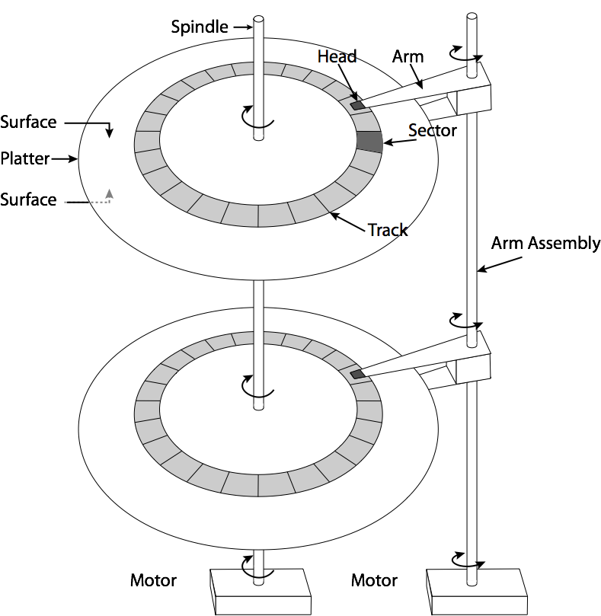

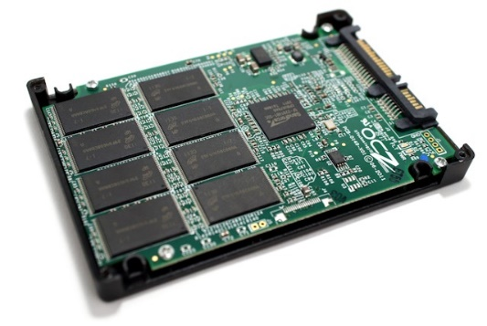
Why a File System?
File System

Slide 5
What is a File System?
文件系统的产生
用户直接操作和管理外存储器上的信息，繁琐复杂、易于出错、可靠性差
多道程序、分时系统的出现要求以方便 、可靠的方式共享大容量外存储器
文件系统的定义
In computing, a file system or filesystem is used to control how data is stored and retrieved.
-- wikipedia
文件系统是操作系统中负责存取和管理信息的模块，它用统一的方式管理用户和系统信息的存储、检索、更新、共享和保护，并为用户提供一整套方便有效的文件使用和操作方法。
-- 操作系统教程（第3版），高等教育出版社

Slide 6
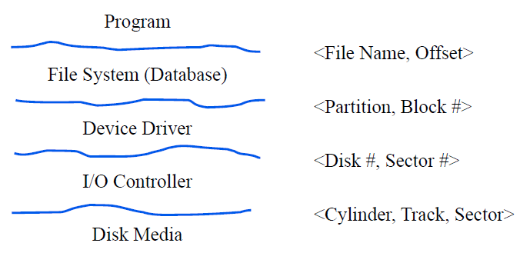
Where is File System?

Slide 7
File System Functions
命名空间
按名存取（naming）: 文件目录的建立、维护和检索
存储管理
空间管理（free space）：存储空间的分配与管理
文件块管理（file allocation）：逻辑地址与存储物理地址的映射
高级特性
数据保护
可靠性/一致性

Slide 8
Outline
1. File system concepts
2. File system operations: a user view
Operations
File and directory
3. File system internals: an implementation view

Slide 9
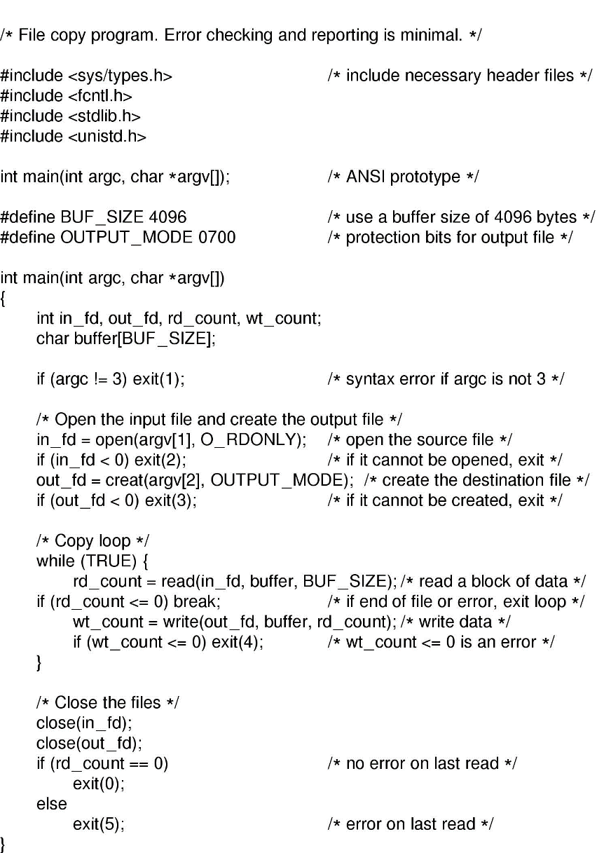
Use Case: file copy

Slide 11
File System Operations
File operations
Create: make a new file
Delete: remove an existing file
Open: prepare a file to be accessed
Close: indicate that a file is no longer being accessed
Read: get data from a file
Write: put data to a file
Append: like write, but only at the end of the file
Seek: move the “current” pointer elsewhere in the file
Getattr: retrieve attribute information
Setattr: modify attribute information
Rename: change a file’s name

Slide 12
File System Operations
Directory operations
createdir: make a new directory
rmdir: remove a directory (usually must be empty)
Link: create a new entry in a directory to link to an existing file
Unlink: remove an entry in a directory
Remove the file if this is the last link to this file
Readdir: read a directory entry
Rename: change the name of a directory
Similar to renaming a file

Slide 13
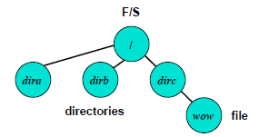
File and directory
File
Content of a file: sequence of bytes.
File metadata: file control block (inode in UNIX).
Directory
A special file: <file/dir-name, inode-number> pairs

Slide 14
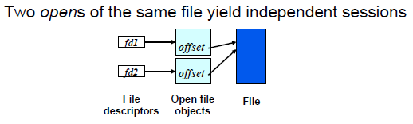
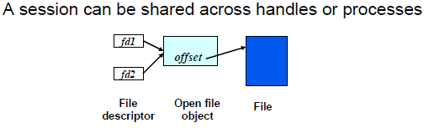
File Handle

Slide 15
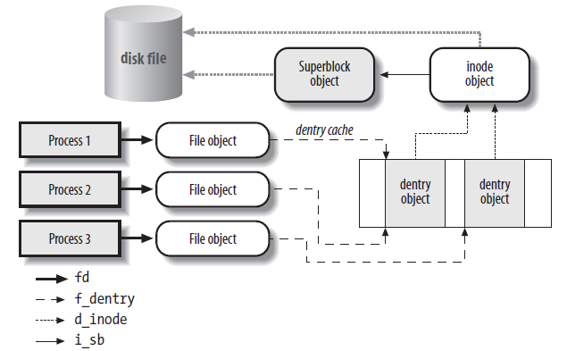
Example: linux vfs

Slide 16
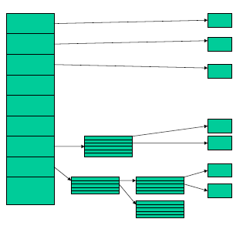
File Metadata – File Control Block (Inode)
Index node: a unique id for a file
List of blocks
Data size
Ctime, utime, atime
Ownership, ACL
Link count

Slide 17
The Ext2 inode

Slide 18
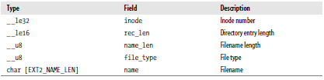
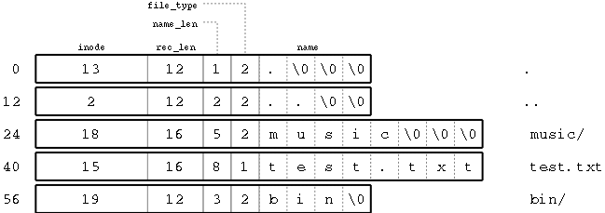
Directory Metadata - dirent
Directory entries
A list of children files and directory names
Inode, name…
Notes:
http://cs.smith.edu/~nhowe/262/oldlabs/ext2.html

Slide 19


What is in a directory
Directories to translate file names to inode IDs
Just a special file with entries formatted in some way
Often ,sets of entries organized in sector-sized chunks

Slide 20
Directory Tree
/
d-inode
d-entry
foo
bar
bar
foo
f-inode
bar.txt
bar.txt

Slide 21
Pathname Lookup
File System performs a pathname lookup to derive an inode from the corresponding file pathname.
The standard procedure requires breaking the path name into a sequence of filenames and analyzing each name repeatedly.
Identify the initial directory: the process-current directory ( ./ ), the root directory ( / ).
Examine the entry that matching the first filename to derive the corresponding inode.
Read the directory file that has that inode from disk.
Examine the entry that matching the second filename to derive the corresponding inode.
Repeated for each name.
Speed up the procedure: using dentry cache to keep the most recently used dentry objects in memory.

Slide 22
Lookup also need to consider:
Check permissions
The access rights of each directory must be checked to verify whether the process is allowed to read the directory’s content.
Symbolic link
Analysis must be extended to that linked pathname.
Circular references must be took care of by the kernel.
Mount point
A filename can be the mount point of a mounted filesystem. This situation must be detected, and the lookup operation must continue into the new filesystem.

Slide 23
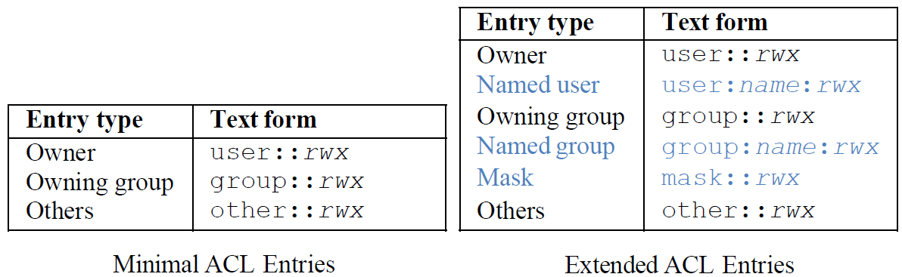
Access Control Lists in Linux
ACLs is fully supported by Linux 2.6. The inode extended attributes have been introduced to support ACLs.
The permissions of each file system object have an ACL representation.
An ACL consists of a set of entries.

Slide 24
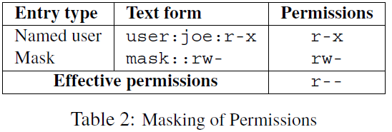
Masking of permissions in extended ACL
The permissions defined in the entries owner and other are always effective.
With extended ACLs, permissions granted by named user, owning group, and named group are masked by the mask entry.

Slide 25
Example: walking thru an open operation
Int fd = open(“/foo/bar.txt”, RO)
Steps:
Translate file name to inode identifier
Look up “foo” in root directory
Read directory “foo” content
Lookup “bar” in directory “foo”
Use directory lookup cache first for each lookup step
Create a vnode structure for inode
Lookup inode in inode cache; fetch from disk if necessary
Initialize vnode structure appropriately
Create open file structure
Initialize, pointing to new vnode
Fill in fd table entry
Pick unused entry in table; have it point to new open file structure
Return corresponding index into fd table

Slide 26
Example: walking thru a read operation
Int ret = read(fd, buffer, size)
Steps:
Index into fd table to get open file object
Call vnode_op_read(vnode, offset, buffer, size)
Calls into specific file system with associated inode (part of vnode)
Index into block list at offset/blocksize to find data’s LBN
May involve reading indirect blocks
Grab ownership of buffer containing corresponding data
Check buffer cache first
Read from disk if not there
Copy data from cache buffer to caller’s buffer
Repeat last three steps until size reached
Return to application
Update open file object’s offset on the way

Slide 27
Outline
1. File system concepts
2. File system operations: a user view
3. File system internals: an implementation view
A simple file system
Namespace management
Storage management
Caching and consistency

Slide 29
A simple file system

Slide 35
Revisit the read operation
open(bar.txt)
read
read
read

Slide 37
Revisit the write operation
open(/foot/bar.txt)
Write
Write
write

Slide 39
File System Implementation Issues
How to find a file and then the data block?
How does the file system allocate blocks to files?
How does the file system manage free space?
How can the file system improve…
Performance?
Reliability?

Slide 40
Outline
File system operations: a user view
File system internals: an implementation view
A simple file system
Namespace management
Storage management
Caching and consistency

Slide 41
Namespace Management
Naming: one of the biggest problems
With TBs of data, how does one organize things
Specially, how ensure can find what you want later?
Not nearly as easy as it seems
Key-value?
How to remember the key?
Search engine?
How search engine organize data?
Chicken-egg problem?

Slide 42
Common approach: directory tree
Hierarchies are a good way to deal with complexity
… and data organization is a complex problem
It works pretty well for moderate-sized data sets
Easy to identify coarse breakdowns
Whenever gets too big, split it and refine namespace
Traversing the directory hierarchy
The ‘.’ and ‘..’ entries

Slide 43
What is in a directory
Directories to translate file names to inode IDs
Just a special file with entries formatted in some way
Often ,sets of entries organized in sector-sized chunks

Slide 44
Managing namespace: mount/unmount
One can have many FSs on many devices
… but only one namespace
So, one must combine the FSs into one namespace
Start with “root file system”
The one that has to be there when the file system boots
“mount” operation attaches one FS into the namespace
At a specific point in the overall namespace
“unmount” detaches a preciously-attached file system

Slide 45
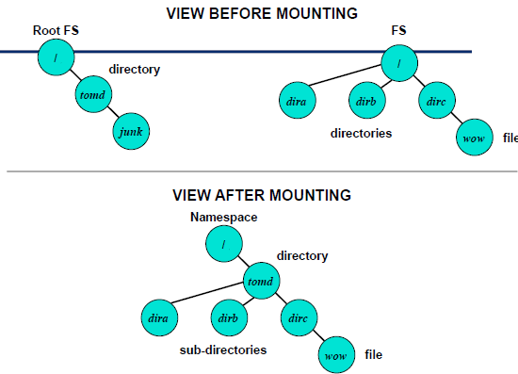

Slide 46
There is no magic: how find the root directory
Need enough information to find key structures
Allocation structures
Inode for root directory
Any other defining information
Common approach
Use predetermined locations within file system
Alternative approach
Some external record

Slide 47
How can we have multiple FSs on one disk
How is this possible?
Divide capacity into multiple “partitions”
How are the partitions remembered?
Commonly, via a “partition map” at the first or second LBN
Each partition map entry specifies
Start LBN for partition
Length of partition (in logical blocks)
Commonly, device drivers handle the partition map
File system requests are relative to their partition
Device driver shifts these requests relative to partition start

Slide 48
Difficulty with directory hierarchies
Can be very difficult to scale to large sizes
Eventually, the refinements become too fine
And they tend to be less distinct
Problem: what happens when number of entries in directory grows too large?
Think about having to read through all of those entries
Possible solution: partition into subdirectories again
Problem: what happens when data objects could fit into any of several subdirectories?
Think about having to find something specific
Possible solution: multiple names for such files

Slide 49
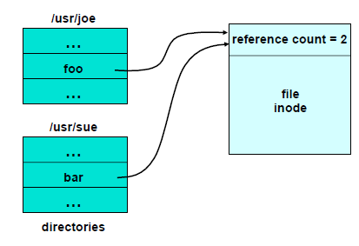
One approach: hard link

Slide 50
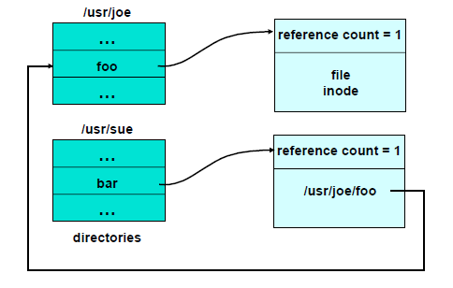
Alternative approach: symbolic approach

Slide 51
Outline
File system operations: a user view
File system internals: an implementation view
A simple file system
Namespace management
Storage management
Caching and consistency

Slide 52
Carving up the disk
Entire disk
Partition table
Master boot record
Partition 1
Partition 2
Partition 3
Partition 4
Boot block
Super block
Free space management
Index nodes
Files & directories

Slide 53
3.1 File Allocation Schemes
Contiguous
Blocks of file stored in consecutive disk sectors
Directory points to first entry
Linked
Blocks of file scattered across disk, as linked list
Directory points to first entry
Indexed
Separate index block contains pointers to file blocks
Directory points to index block

Slide 54
Allocation #1 – contiguous allocation
A
B
C
D
E
F
A
Free
C
Free
E
F
Contiguous allocation requires all blocks of a file to be consecutive on disk
Problem: deleting files leaves “holes”
Similar to memory allocation issues
Compacting the disk can be a very slow procedure…

Slide 55
Contiguous allocation
Data in each file is stored in consecutive blocks on disk
Simple & efficient indexing
Starting location (block #) on disk (start)
Length of the file in blocks (length)
Random access well-supported
Difficult to grow files
Must pre-allocate all needed space
Wasteful of storage if file isn’t using all of the space
Logical to physical mapping is easy blocknum = (pos / 1024) + start; offset_in_block = pos % 1024;
0
1
2
3
4
5
6
7
8
9
10
11
Start=5
Length=2902

Slide 56
Variant – Extents
Extent: a contiguously allocated subset of a file
Directory entry points to
(For file with one extent) the extent itself
(For file with multiple extents) pointer to an extent block describing multiple extents
Disadvantages
Too many extents ⇒ degenerates to indexed allocation
As in Unix-like systems, but not so well
Popular in 1960s & 70s
OS/360, other systems for commercial data processing
Currently used for large files in NTFS

Slide 57
Allocation #2 - Linked allocation
File is a linked list of disk blocks
Blocks may be scattered around the disk drive
Block contains both pointer to next block and data
Files may be as long as needed
New blocks are allocated as needed
Linked into list of blocks in file
Removed from list (bitmap) of free blocks
0
1
2
3
4
6
4
5
6
7
x
x
8
9
10
11
0
Start=9
End=4
Length=2902
Start=3
End=6
Length=1500

Slide 58
Linked allocation
Directory structure is simple
Starting address looked up from directory
Directory only keeps track of first block (not others)
No wasted space - all blocks can be used
Random access is difficult: must always start at first block!
Logical to physical mapping is done by block = start; offset_in_block = pos % 1020; for (j = 0; j < pos / 1020; j++) { block = block->next; }
Assumes that next pointer is stored at end of block
May require a long time for seek to random location in file
Used in Xerox Alto file system

Slide 59
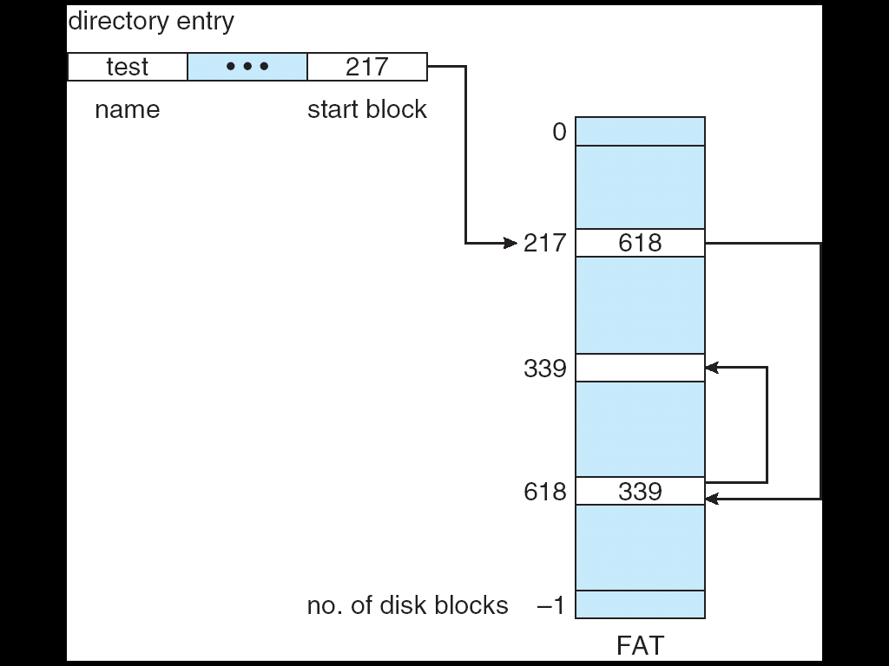
Variant – File Allocation Table (FAT)
Slow list operation in disk
Instead of link on each block, put all links in one table — the FAT
Each entry corresponds to physical block in disk
i^{th} entry contains link for block i
Each entry points to next block (or EOF)
Directory points to first & last blocks of file

Slide 60
FAT File Systems
Advantages
Advantages of Linked File System
FAT can be cached in memory
Searchable at CPU speeds, pseudo-random access
Disadvantages
Limited size, not suitable for very large disks
FAT cache describes entire disk, not just open files!
Not fast enough for large databases
Used in MS-DOS, early Windows systems
Also USB Flash drives, floppy disks, etc.

Slide 61
Allocation #3 – indexed allocation
Store file block addresses in an array
Array itself is stored in a disk block
Directory has a pointer to this disk block
Non-existent blocks indicated by -1
Random access easy
Limit on file size?
Name index size
grades 4 4802
0
1
2
3
6
9
7
0
8
4
5
6
7
8
9
10
11

Slide 62
Indexed allocation
Need location of index table: look up in directory
Random & sequential access both well-supported: look up block number in index table
Space utilization is good
No wasted disk blocks (allocate individually)
Files can grow and shrink easily
Overhead of a single disk block per file
Logical to physical mapping is done by block = index[block % 1024]; offset_in_block = pos % 1024;
Limited file size: 256 pointers per index block, 1 KB per file block -> 256 KB per file limit

Slide 63
Indexed allocation + linked index blocks
How can indexed allocation allow files larger than a single index block?
Linked index blocks: similar to linked file blocks, but using index blocks instead
Logical to physical mapping is done by index = start; blocknum = pos / 1024; for (j = 0; j < blocknum /255); j++) { index = index->next; } block = index[blocknum % 255]; offset_in_block = pos % 1024;
File size is now unlimited
Random access slow, but only for very large files

Slide 64
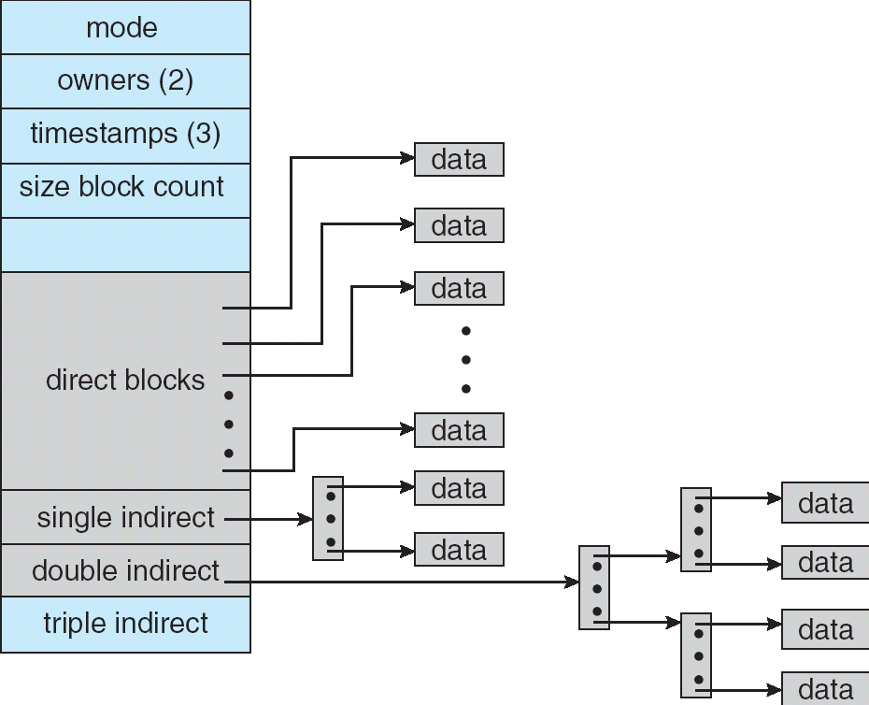
Index allocation + indirect indexing
Direct blocks:
Pointers to first n sectors
Single indirect table:
Extra block containing pointers to blocks n+1 .. n+m
Double indirect table:
Extra block containing single indirect blocks
…
Widely used in Unix, Linux, Windows NTFS

Slide 65
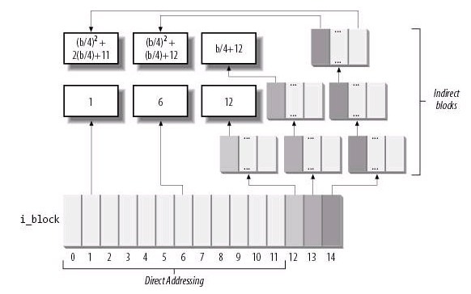
Example: ext2
"There are pointers to the first 12 blocks which contain the file's data in the inode. There is a pointer to an indirect block (which contains pointers to the next set of blocks), a pointer to a doubly indirect block and a pointer to a trebly indirect block."
Qizz:
Supposing a 4KB block size,
what is the file size limit in ext2?

Slide 66
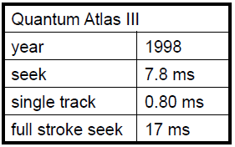
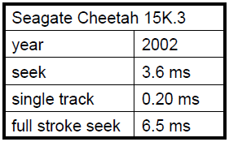
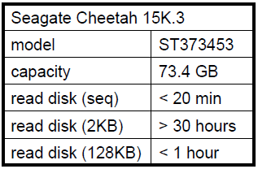
Fact: seek time

Slide 67
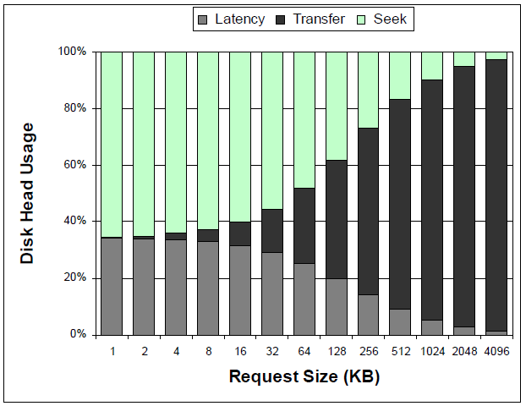
Time breakdown by request size

Slide 68
File system allocation - summary
FS performance (largely) dictated by disk performance
… and optimization all starts with allocation algorithms
As always, there are exceptions to this rule
Two technology drivers yield two goals
Closeness (locality)
Reduce seeks by putting related things “close” to each other
Close means get both in one fetch == prefetching
Generally, benefits can be in the 2x range
Amortization (large transfers)
Amortize each positioning delay by accessing lots of data
Also means getting more per fetch == prefetching
Generally, benefits can reach into the 10x range

Slide 69
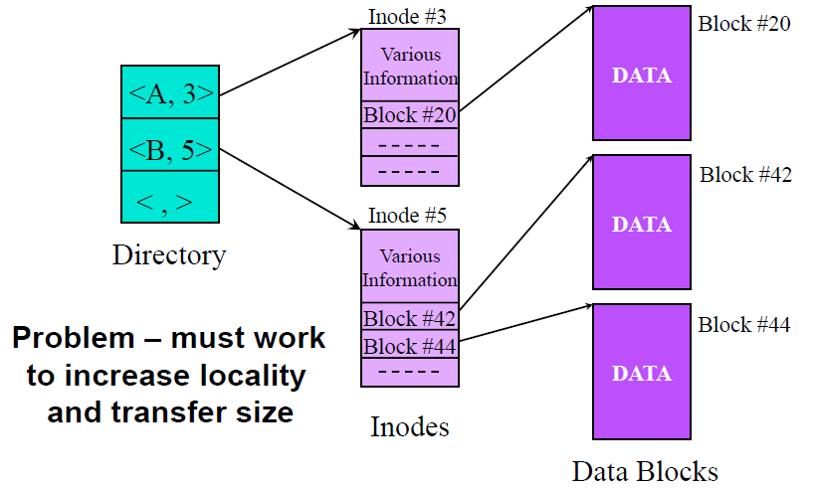

Slide 70
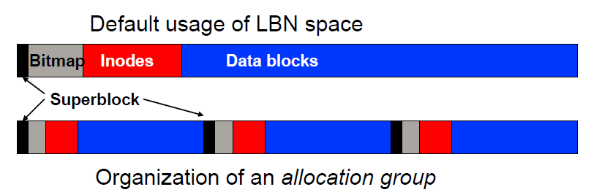
Fast File System (1984)
Source of many still-popular optimizations
For locality – cylinder groups
Called allocation groups in many modern file systems
Allocate inode in cylinder group with directory
Allocate first data blocks in cylinder group with inode

Slide 71
Other ways of enhancing locality
Delay in cache longer so there is more to write
So look for longer run of blocks for each dirty file
Disk request scheduling applied to allocation
For example, by considering all dirty blocks in file cache
Write anywhere
Specifically, writing near the disk head
Assumes space is free and we can detect the head’s location
Cool idea that very few implementations currently use
Same thing for read
If you have multiple replicas in different places on the disk

Slide 72
FFS scheme (cont.)
To get large transfers
Large block size
More data per disk read or write
Subdivide into “fragments” for small files (less internal fragmentation)
Allocate next block after previous one, when possible
Do this by starting search at block # just after previous
Fetch meta-unit when sequential access detected
So, multiple blocks per seek + rotational latency
This is classical simple prefetching, called readahead
The disk may have done the hard work for you, up to a track or a few; if too large disk may be busy a long time

Slide 73
Other ways of getting large transfers
Re-allocation (moving data around)
To re-establish sequential allocation when it was not feasible at the time of original allocation
Beware of not gaining back as much benefit as effort spent
Pre-allocation (allocating more than you need now)
To avoid a failure to allocate sequentially later
Beware of users or guesses vastly over allocating
Extents (and extend-like)
As a replacement for blocks lists and bitmaps
Beware lots of space hiding in incompletely used extents, leading to very long small-extent lists (and expensive coalescing)

Slide 74
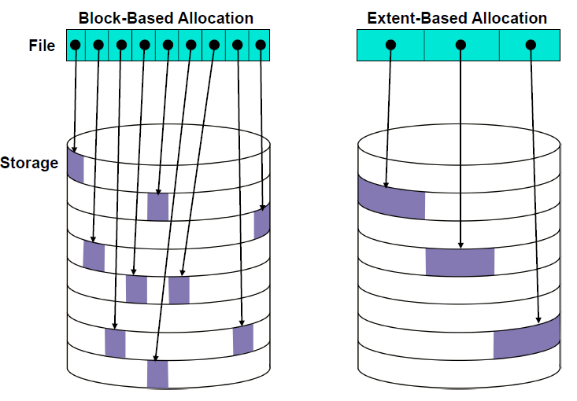

Slide 75
Log-structured file system (LFS)
All about amortization, try to achieve large writes
Buffer and remap new versions of data into large segments
Segment sized writes make efficient use disk head
But, two problems
Random read
Data distributed across multiple segments
“cleaning” cost
Reclaims space from fragmented segments
Maybe expensive, that is ,may cost more than benefits
Must happen immediately on file system full (cost and complexity)

Slide 76
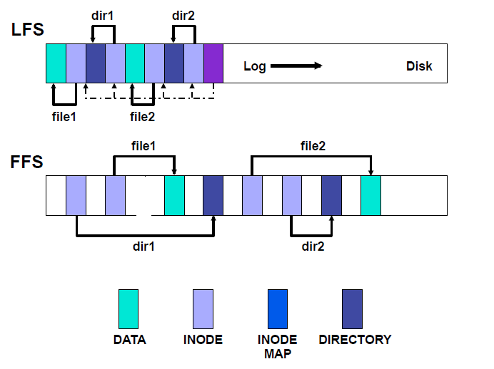
LFS layout versus FFS

Slide 77
3.2 Free space mgmt: bit vector
Keep a bit vector, with one entry per file block
Number bits from 0 through n-1, where n is the number of file blocks on the disk
If bit[j] == 0, block j is free
If bit[j] == 1, block j is in use by a file (for data or index)
If words are 32 bits long, calculate appropriate bit by: wordnum = block / 32; bitnum = block % 32;
Search for free blocks by looking for words with bits unset (words != 0xffffffff)
Easy to find consecutive blocks for a single file
Bit map must be stored on disk, and consumes space
Assume 4 KB blocks, 8 GB disk => 2M blocks
2M bits = 2²¹ bits = 2¹⁸ bytes = 256KB overhead

Slide 78
Free space mgmt: linked list
Use a linked list to manage free blocks
Similar to linked list for file allocation
No wasted space for bitmap
No need for random access unless we want to find consecutive blocks for a single file
Difficult to know how many blocks are free unless it’s tracked elsewhere in the file system
Difficult to group nearby blocks together if they’re freed at different times
Less efficient allocation of blocks to files
Files read & written more because consecutive blocks not nearby

Slide 79
Issues with free space management
OS must protect data structures used for free space management
OS must keep in-memory and on-disk structures consistent
Update free list when block is removed: change a pointer in the previous block in the free list
Update bit map when block is allocated
Caution: on-disk map must never indicate that a block is free when it’s part of a file
Solution: set bit[j] in free map to 1 on disk before using block[j] in a file and setting bit[j] to 1 in memory
New problem: OS crash may leave bit[j] == 1 when block isn’t actually used in a file
New solution: OS checks the file system when it boots up…
Managing free space is a big source of slowdown in file systems

Slide 80
Outline
File system operations: a user view
File system internals: an implementation view
A simple file system
Namespace management
Storage management
Caching and consistency

Slide 81
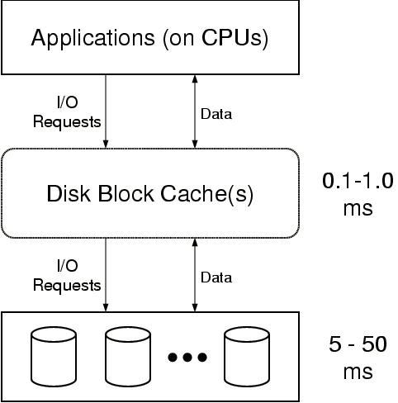

Slide 82
Goal of caching: hide storage latencies
Avg. latency = hit time + (avg. miss time * miss probability)
Example
500us = 100us + (10ms * 0.04)
300us = 100us + (10ms * 0.02)
A few very expensive accesses dominate average
Miss ratio is a more useful concept the hit ratio
Halving miss ratio can nearly halve average

Slide 83
So, then, what counts as a miss?
Among read requests
Reads for which not all data is in cache
Have to go to disk and the reader has to wait
Note: prefetches also go to disk
But, they are supposed to be in the background
Among write requests
None for most storage caches
Just put new (block-aligned) data into cache and move on
Writer only waits if no cache space is available for new data
Note: write-back caching usually comes with a vulnerability
… and everyone does it, so let’s dig in

Slide 84
Software interface layers
Each layer uses metadata to translate higher-level names to lower-level names

Slide 85
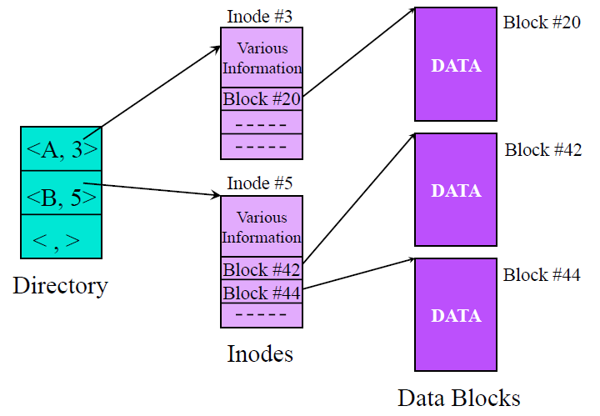
Metadata contains lots of pointers

Slide 86
… and other convoluted inter-relationships
Counts
E.g., inode usually contain a “link count” (# name for file)
Refinements
E.g., file length refines the block list
Auxiliary information
E.g., last modification time for a file
Aggregates
E.g., maximum or average values in a file
Redundant listings
E.g., an extra hash index for fast directory lookup
Note: all have consistency issues
… though not of equal importance

Slide 87
Challenges to internal consistency
Concurrent modifications
Two processes or systems could induce race conditions
Solution: proper use of concurrency control mechanisms
Media defect growth
Contents of newly-defective sectors are lost
Solution: redundancy of some sort
Transient storage subsystem oopsies
Flipped bits on bus, writes to wrong sector, etc.
Solution: integrity checks plus redundancy
System crashes
Volatile main memory contents lost upon system failure
Only the stuff on stable storage is there upon restart
Such failures are unpredictable and can happen at any time
Solution: on-disk image must always be sufficiently consistent

Slide 88
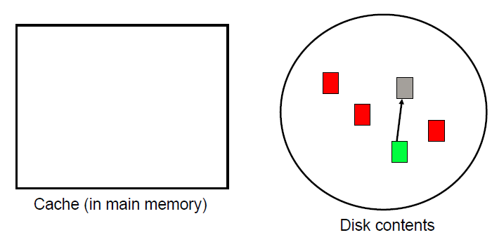
Volatile main memory and caching
Sanity check questions
Why not just write everything to disk immediately?
Why not just make memory non-volatile?

Slide 89
Tools for protecting internal consistency
Static mappings
If they do not change, they do not cause problems
Most people do not think of this one most of the time …
“atomicity” of writes
Ala the tri-state post-write guarantee of per-sector ECC
Update ordering
Simply ensuring that one update propagates before another
Real atomicity
Ensuring that a set of updates all occur or none do

Slide 90


“atomicity” of writes as a tool
Unwritten guarantee provided by per-sertor ECC
Because the ECC check will fail if only partially written
Same trick (checksum) can be used by FS or app
Good for grouping inter-related updates
But increases likelihood of data loss due to the third state
Data is lost when write is only partially completed
While uncommon, such loss is more likely than a grown defect
Especially if not physically co-located
Often used only for limited cases (but growing adoption)
E.g., internal consistency of directory chunks and inodes

Slide 91
Update ordering as a tool
Just what is sounds like…
Good for single-direction dependencies
Just do one before the other
Problem: no good for bidirectional dependencies
Which, unfortunately, is most of then
Solution: some can be converted to single-direction
Because some directions are more important than others
Clean-up must be done after system failures

Slide 92
Real multi-write atomicity as a tool
Ensure that multiple updates are all reflected or not
By a combination of extra writes and post-failure clean-up
Good at all of the internal consistency issues
May be over-kill (in space+code) for simple requirements
As characterizes many FS issues
But, this is the standard mechanism in databases
And also common in many modern file systems
Two main approaches
Write-ahead logging
Shadow paging

Slide 93
Write-ahead logging (or “journaling”)
Pre-post intended changes to log (a.k.a. journal)
Make sure that it is written before corresponding blocks
Log space reclaimed via periodic “checkpointing”
During crash recovery, can roll forward intended changes
Recovery time proportional to uncheckpointed log size
Key concept: recording changes to alternate location first so that a safe version is always present
Can even deal with third state of ECC thing
Write-ahead logging can be nearly zero overhead
Requires delayed log/grouped writes and enforced ordering

Slide 94
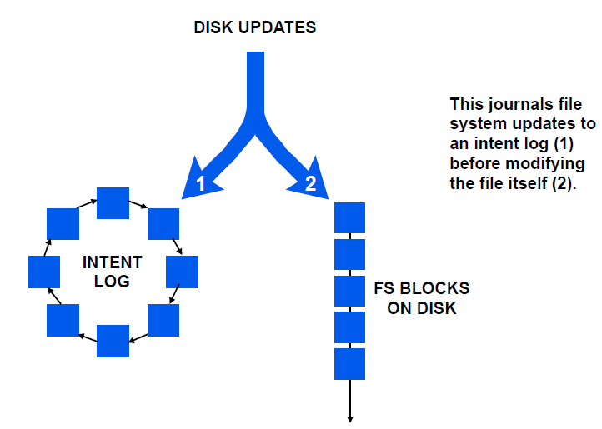
Updates go to log first, then to real destination

Slide 95
Transactions
Support for complex integrity rules
Multiple updates can be grouped as a “transaction”
Transaction “committed” via explicit commit record
During crash recovery, changes that are part of uncommitted transactions are rolled back and discarded
ACID rules
Atomicity
Consistency
Isolation
Durability

Slide 96
Shadow paging
New versions of data blocks written to new locations
Never overwrite live data in place; instead remap identity
During crash recovery, non-remapped writes discarded
Recovery time can be immediate or like write-ahead logging
Deprecated versions of data blocks must be garbage collected
Key concept: write changes to alternative location and replace previous so that safe version is always present
Note: shadow paging can support transactions too…

Slide 97
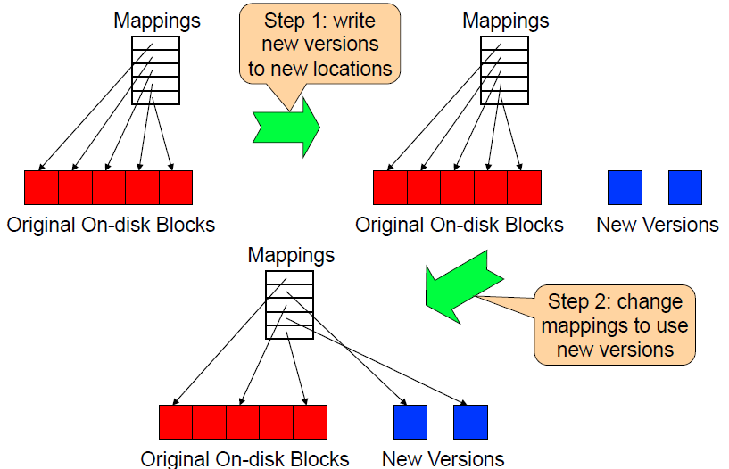
Shadow Paging illustrated

Slide 98
Conclusion
File system operations: a user view
File and directories
Operations: open/create, read, write, delete/unlink
File system internals: an implementation view
A simple file system
Namespace management
Storage management
Caching and consistency

