Slide 1
网络存储
存储技术基础
陆游游
luyouyou@tsinghua.edu.cn

Slide 2
网络存储
设备接口
直连式存储（Direct Attached Storage, DAS）
网络附加存储（Network Attached Storage, NAS）
存储区域网络（Storage Area Network, SAN）
内容寻址存储（Content-Addressable Storage, CAS）

Slide 3
网络存储
设备接口
ATA
SATA
SCSI
SAS
FC
NVMe
直连式存储（DAS）
网络附加存储（NAS）
存储区域网络（SAN）
内容寻址存储（Content-Addressable Storage, CAS）

Slide 4





设备接口
connectivity
Host
Device
ATA
SCSI
– Parallel
Serial ATA (SATA)
SAS
– Serial
and more!

Slide 5
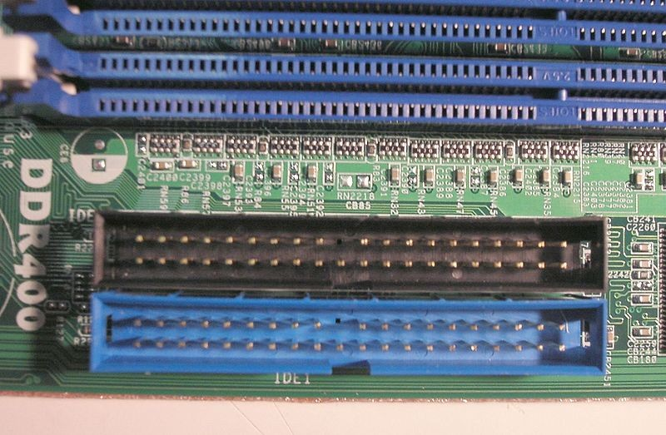
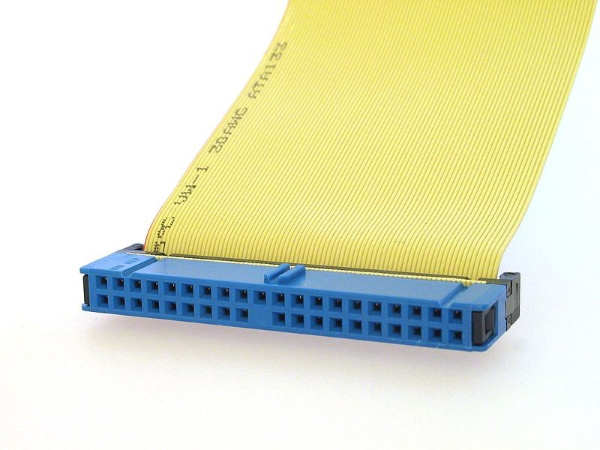
ATA
ATA：Advanced Technology Attachment
since 1986, designed by Western Digital and Compaq.

Slide 6
ATA Specification
Hot pluggable | No
External | No
Protocol | parallel
Data width | 16 bit
Bandwidth | 16 MB/s originally, later 33, 66, 100 and 133 MB/s
Pins | 40 (16 data)
Others | Max. devices = 2 (master/slave)

Slide 7
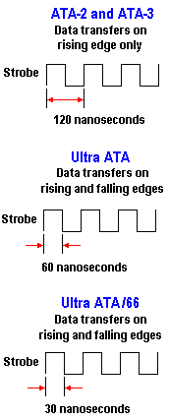
ATA to Ultra ATA
Ultra ATA: Data transfer at both the rising and falling edges of the strobe
1996-1997
16 MB/s
Since 1998
33 MB/s
Since 2000
66 MB/s
Nowadays 167 MB/s at 24ns
Notes:
ATA 是旧接口了，最后更新在2010，达到167MB/s

Slide 8
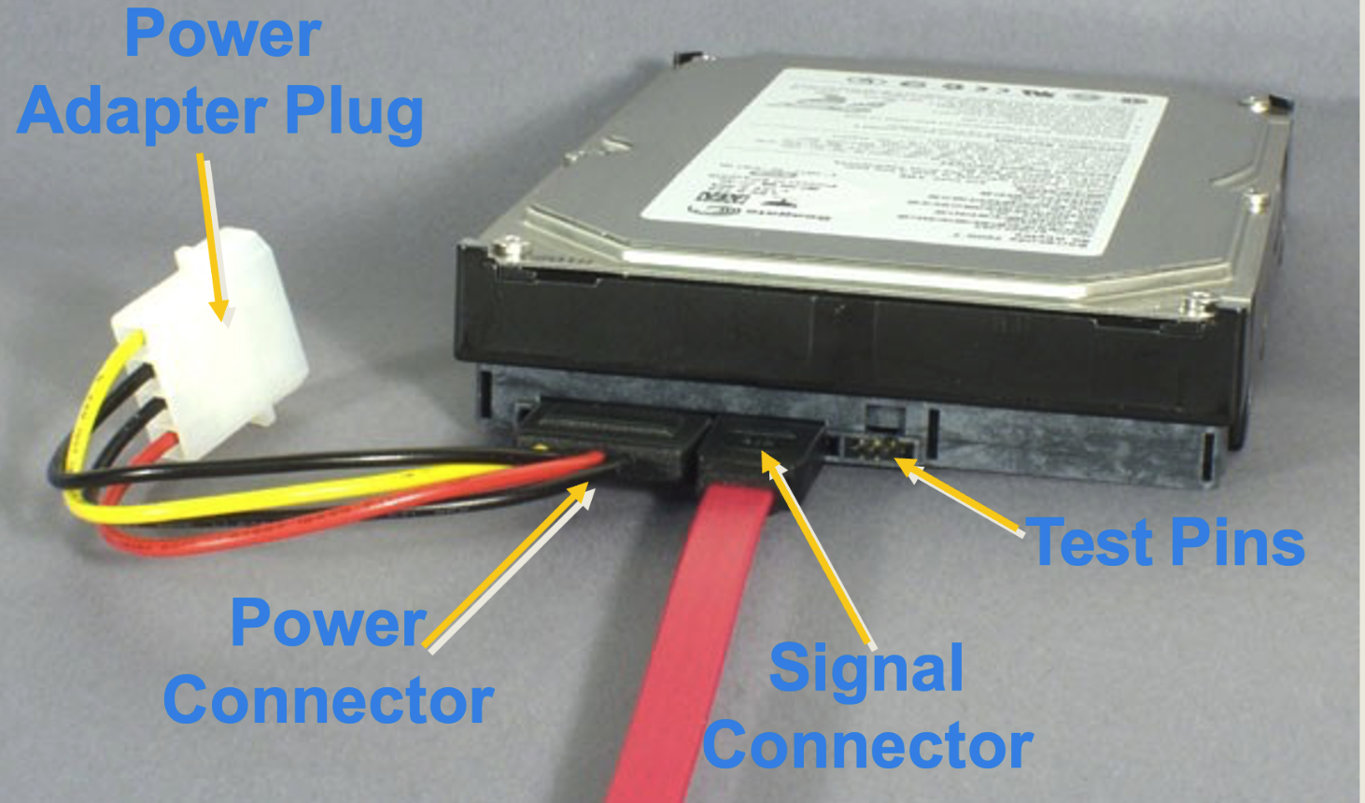
SATA
SATA: Serial ATA
since 2000, replacement of ATA
Lower voltages, higher performance, support hot-plug

Slide 9
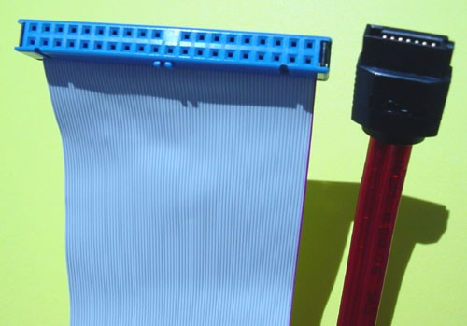
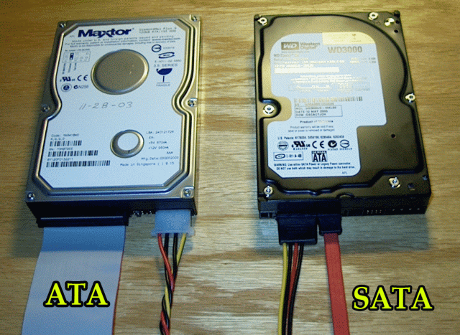

Parallel ATA vs Serial ATA

Slide 10
SATA Specifications
Hot pluggable | Yes (with support of other system components)
External | Yes (eSATA)
Bandwidth | 1.5Gbit/s，3.0Gbit/s， 6.0Gbit/s
Pins | 7 (4 data, 3 ground)
Others | One device, one meter

Slide 11
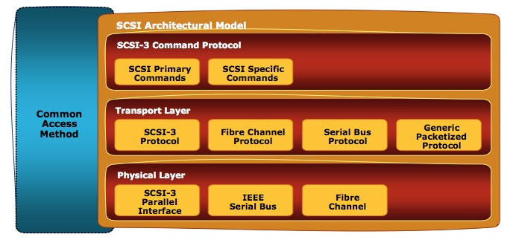
SCSI
Small Computer System Interface (SCSI, /ˈskʌzi/)
Is a set of standards

Slide 12
SCSI Language
Primary commands common to all devices
Every architecture uses the SCSI command sets and upper layer protocol

Slide 13
SCSI Language
Command | Description
READ | Reads data from a device
WRITE | Writes data to a device
TEST UNIT READY | Queries the device to check whether it is ready for data transfer
INQUIRY | Returns basic information, which is also used to ping the device
REPORT LUNS | List the logical unit numbers
SEND AND RECEIVE DIAGNOSTIC RESULTS | Runs a simple self-test or a specialized test defined in a diagnostic page
FORMAT UNIT | Sets all sectors to all zeroes and allocates logical blocks, avoiding defective sectors
LOG SENSE | Returns current information from log pages
LOG SELECT | Used to modify data in the log pages of a SCSI target device
MODE SENSE | Returns current device parameters from mode pages
MODE SELECT | Sets device parameters on a mode page

Slide 14
SCSI Transport
Standard rules for device communication and information sharing
Defines protocol mapping and control of SCSI language

Slide 15
SCSI Physical Architectures
Interface details
such as electrical signaling methods and data transfer modes

Slide 16

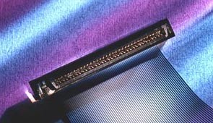
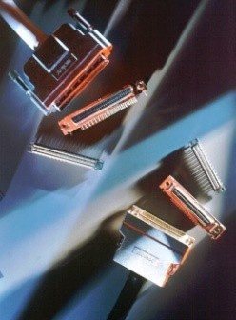
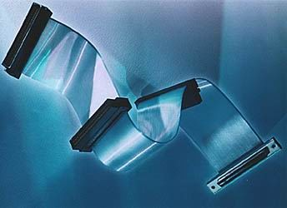
SCSI 接口连接线

Slide 17
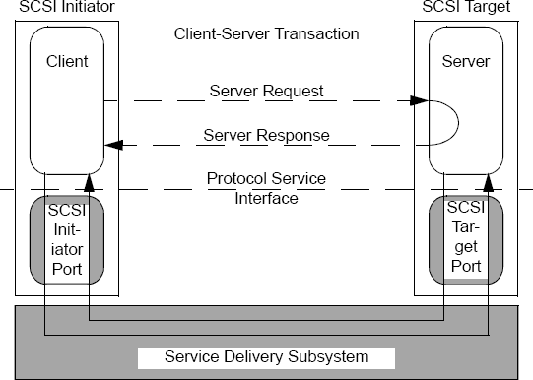
SCSI – Client-Server Model
SCSI is a client-server protocol
Client (Initiator): issues requests to the server
Server (Target): receives, executes and responds initiator requests

Slide 18
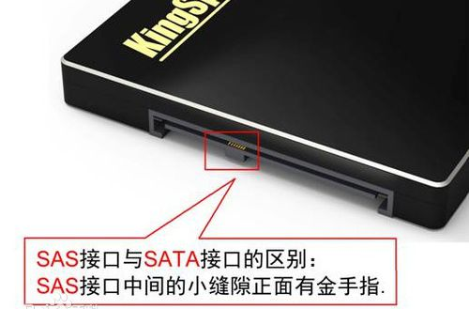
SAS（Serial Attached SCSI）
SAS: Serial Attached SCSI
采用串行技术以获得更高的传输速度
SAS 向下兼容SATA
物理层：完全兼容
接口标准：SATA 是SAS 的子标准，SAS 控制器可操控SATA 硬盘

Slide 19
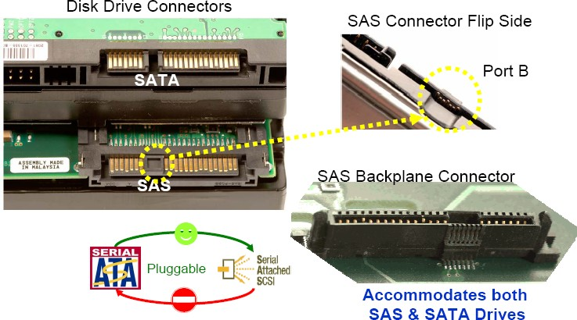
SAS/SATA Compatibility

Slide 20
SAS Specifications
Hot pluggable | Yes
External | Yes
Bandwidth | 3.0 Gbit/s, 6.0 Gbit/s (8b/10b encoding )
Pins | 7 (4 data, 3 ground)
Others | 128 device port expanders; eight-meter cables "downwards"-compatibility with the second-generation SATA

Slide 21
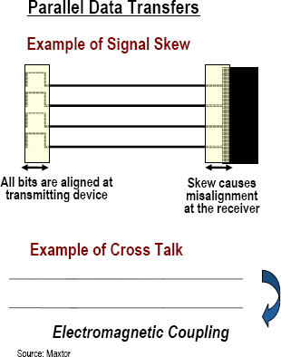
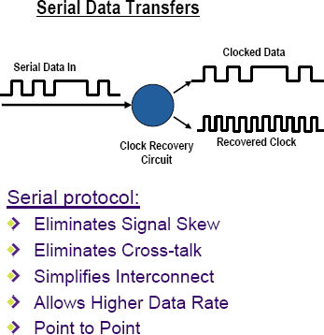
串行/并行接口
ATA => SATA SCSI => SAS

Slide 22
SATA vs SAS (1)
SATA is way cheaper than SAS
SATA uses ATA commands while SAS uses SCSI commands
SAS has better error reporting and recovery than SATA
SAS can use longer cables (8m) than SATA (1m)
SATA drives can be used in SAS backplanes (but not the opposite way)
SAS is designed for mission-critical enterprise applications whereas SATA is a general-purpose interface common in the consumer market.

Slide 23
SATA vs SAS (2)
SAS supports multiple initiators, while SATA has no such provision
SAS is dual ported where as SATA is single ported. SAS is therefore capable of multi-path I/O without additional hardware
SATA transfers data at half duplex while SAS can transfer data at full duplex. For SAS, each port can read and write data at the same time (not for SATA)

Slide 24
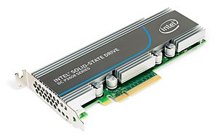
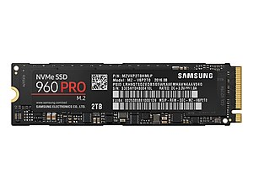
NVMe
NVM Express (NVMe)：专为高速SSD设计的逻辑设备接口规范
允许SSD使用PCIe总线的软硬标准
支持大容量操作队列
SAS: 256
SATA 32
NVMe: 65536
M.2 型
PCIe 型

Slide 25
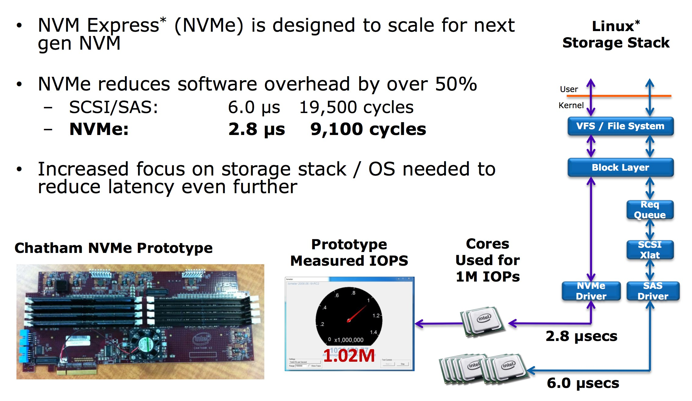
NVMe 延迟

Slide 26
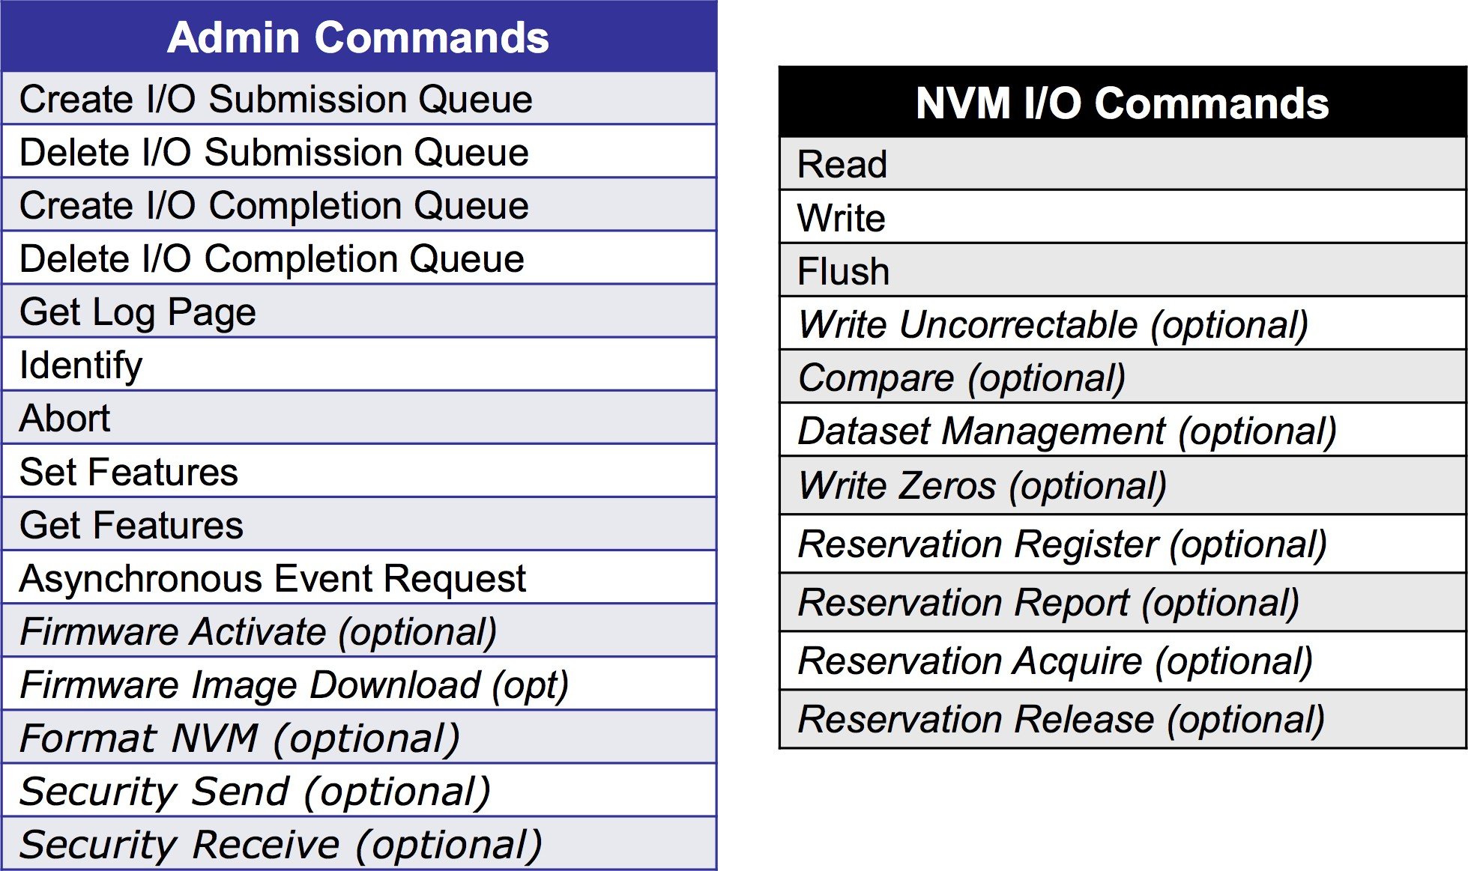
NVMe 命令集

Slide 27
网络存储
设备接口
直连式存储（DAS）
网络附加存储（NAS）
存储区域网络（SAN）
内容寻址存储（CAS）

Slide 28
DAS
Direct-Attached Storage (DAS)
Storage connects directly to servers
Application access data using block-level protocol

Slide 29
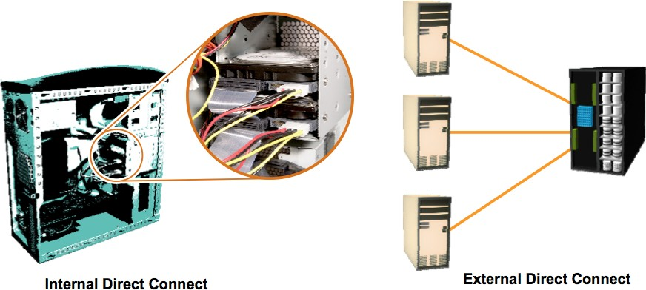
直连式存储（DAS）
DAS is classified as internal or external
Based on the location of the storage device with respect to the host

Slide 30
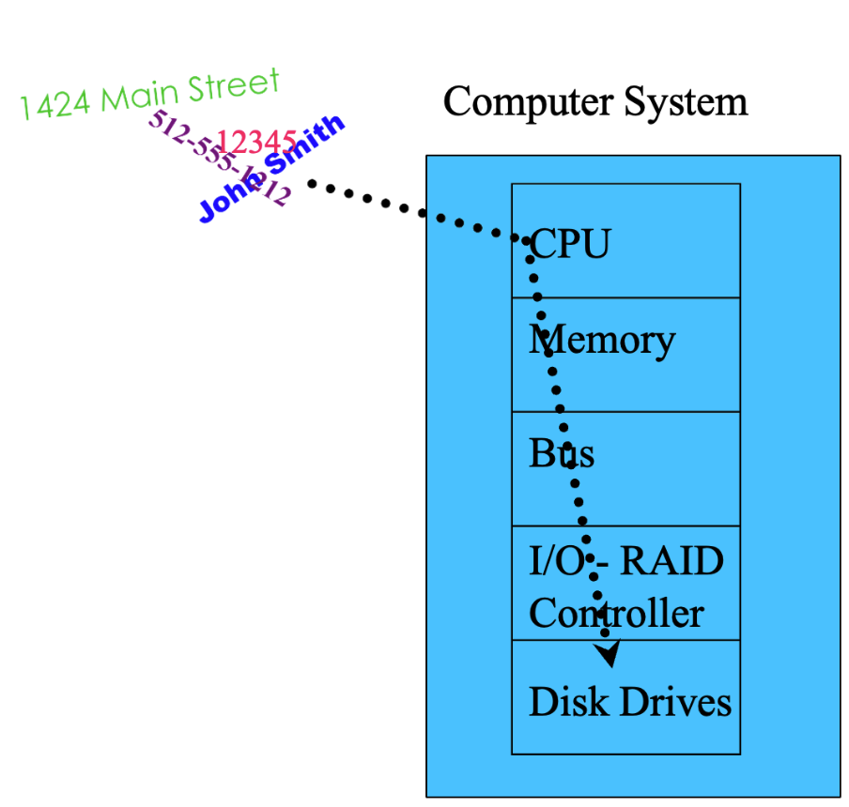
直连式存储 - Internal
Internal DAS: storage device internally connected to the host by a serial or parallel bus
distance limitations for high-speed connectivity
limited number of devices
occupy a large amount of space inside the host

Slide 31
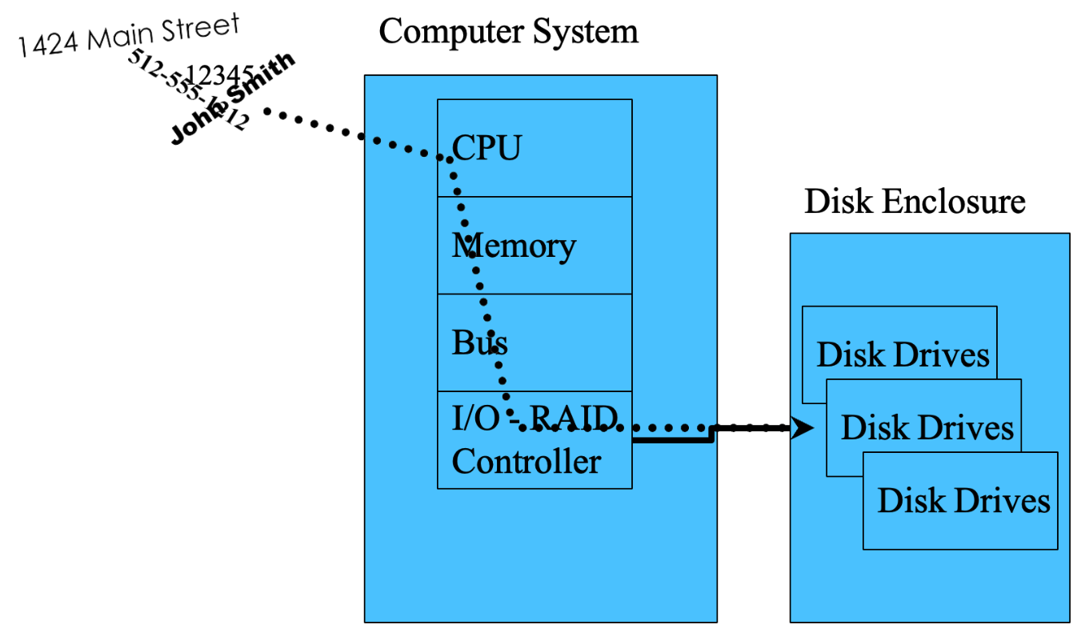
直连式存储 - External
External DAS: server connects directly to the external storage device
Communication via SCSI/SAS or FC protocol
Overcomes the distance and device count limitations of internal DAS
provides centralized management of storage devices

Slide 32
直连式存储 – Internal vs External
RAID controllers and disk drives are internal to the server
SCSI, ATA, or SATA
protocol between controller and disks
Server
Storage
Dis
k D
rive
s
Server
RAID Controller
RAID Controller
RAID controller is internal
SCSI or SATA protocol between controller and disks
Disk drives are external
Internal Storage
Storage
 |  |  | Dis | k Dr | ives
SCSI Bus w/ external storage

Slide 33
DAS Benefits
Ideal for local data provisioning
Quick deployment for small environments
Simple to deploy
Low capital expense

Slide 34
DAS Challenges
limited scalability
Number of connectivity ports to hosts
Number of addressable disks
Distance limitations
Limited ability to share resources

Slide 35
网络存储
设备接口
直连式存储（DAS）
网络附加存储（NAS）
存储区域网络（SAN）
内容寻址存储（CAS）

Slide 36
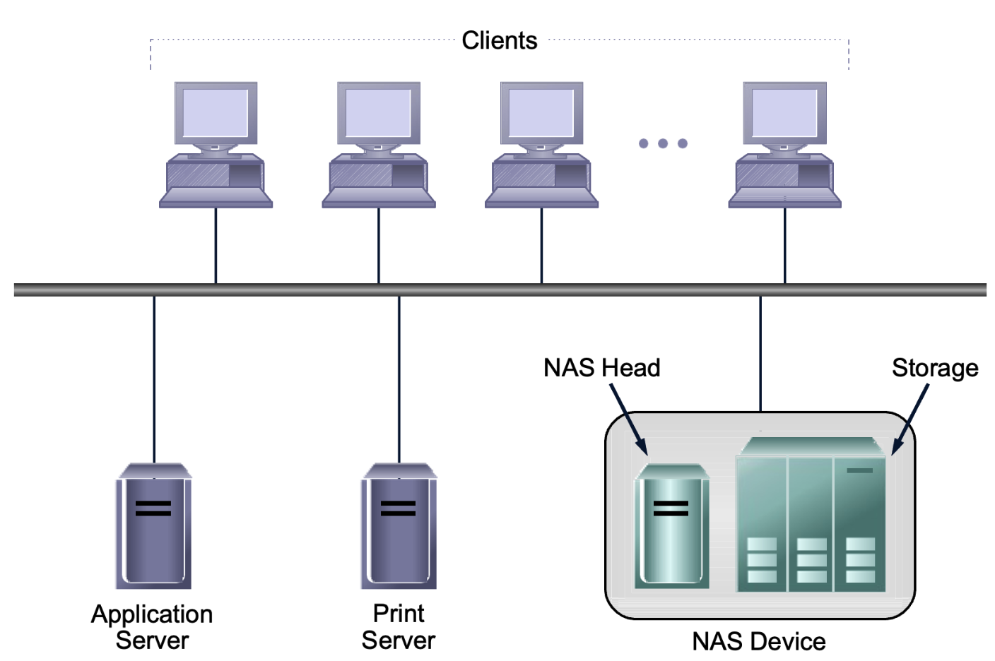
What is NAS
Network Attached Storage（NAS）
Utilizes a TCP/IP network to “share” data
Uses file sharing protocols
like Unix NFS and Windows CIFS

Slide 37
NAS
Public or Private Ethernet network
NIC
NIC
All data converted to file protocol for transmission (may slow down database transactions)
Server
NAS Server
Storage
 | Dis | k D | rive | s
Server has a Network Interface Card
No RAID Controller or HBA in the server
RAID Controller

Slide 38













NAS - Evolution
Portable Media for File Sharing
Networked PCs
Networked File Sharing
Stand Alone PC
Network Attached Storage (NAS)

Slide 39


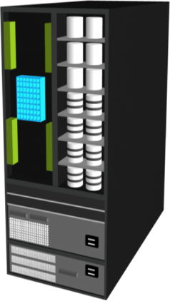
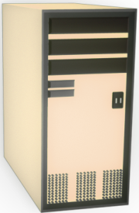


NAS supports multiple protocols
Without NAS
With NAS
NAS
UNIX
NT W2K
IP
IP
UNIX Windows
General purpose OS serving files via FTP, CIFS, NFS, HTTP. . .
UNIX Windows
General purpose OS serving files via FTP, CIFS, NFS, HTTP. . .
79

Slide 40









NAS supports multiple protocols
Unix
NAS Device
NFS
Network Interface NFS CIFS
NAS Device OS
IP Network
CIFS
Storage Interface
Windows
SCSI, FC, or ATA

Slide 41


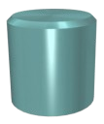



NAS – Integrated vs Gateway
Integrated NAS
IP Network
NAS Head
NAS Gateway
FC Fabric
IP Network
NAS Head

Slide 42
Why NAS
Supports global information access
Improves efficiency
Provides flexibility
Centralizes storage
Simplifies management
Scalability
High availability – through native clustering
Provides security integration to environment (user authentication and authorization)

Slide 43
网络存储
直连式存储（DAS）
网络附加存储（NAS）
存储区域网络（SAN）

Slide 44
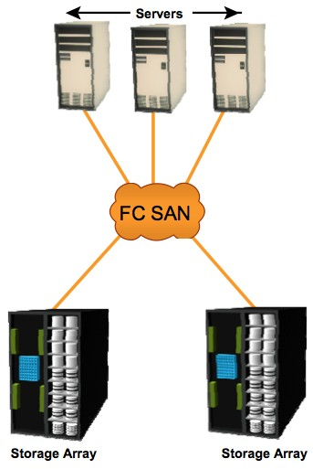
SAN
SAN: It is a high-speed, dedicated network of servers and shared storage devices.
block-level data access

Slide 45
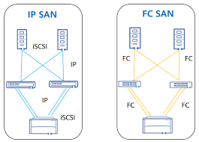
FC SAN and IP SAN
Common SAN deployments are
Fibre Channel (FC) SAN: uses FC protocol for communication
IP SAN: uses IP-based protocols for communication

Slide 46
FC SAN
Common SAN deployments are
Fibre Channel (FC) SAN: uses FC protocol for communication
IP SAN: uses IP-based protocols for communication

Slide 47











Evolution of FC SAN
HUB
SAN Islands
FC Arbitrated Loop
Interconnected SANs
FC Switched Fabric
Enterprise SANs
FC Switched Fabric

Slide 48



SAN - 组成部分
Host Bus Adapter (HBA)
Fiber Cabling
Fiber Channel Switch /Hub
Disk Array
Management System
HBA
SAN-attached Server
SAN

Slide 49
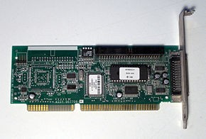
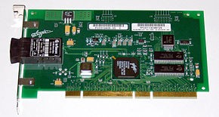
SAN 组成部分 - HBA Cards
HBA → Host Bus Adapter
connects a host system (the computer) to storage devices
Just like NIC
SCSI Host Bus Adapter
Fibre Channel Host Bus Adapter

Slide 50
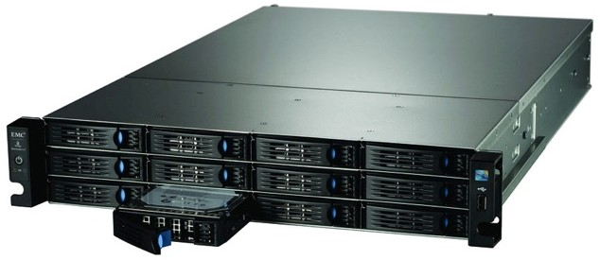
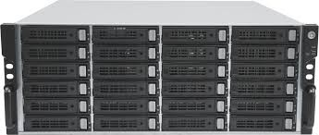
SAN 组成部分 - Disk Array
Disk Array
– A hardware element that contains a large group of hard disk drives

Slide 51
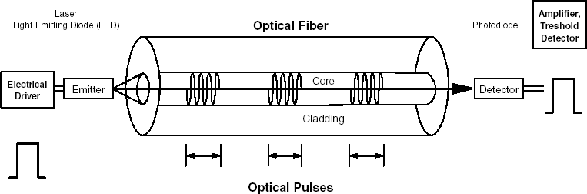
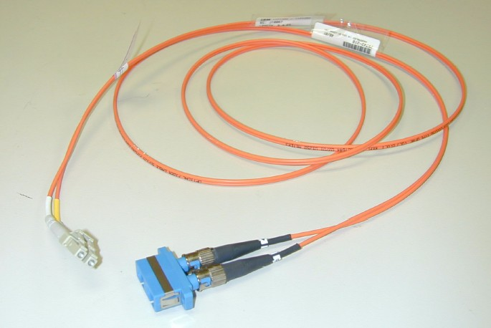
SAN 组成部分 - 光纤通道
Fiber Channel is an open standard communications and transport protocol operates over copper and fiber optic cabling at distances of up to 10 kilometers
Single-mode (SM) fiber
Multi-mode (MM)
Fiber Channel Speed: up to 1Gb/s, 2Gb/s, 4Gb/s
Maximum Transmission Unit: 64 kB … but in theory unlimited
The structure of a fiber optic cable
Fiber Channel adapter cable

Slide 52

光纤通道基本原理
OSI模型 |  | 以太网和 TCP/IP |  | 光纤通道
应用层 |  |  |  | 高层协议 (ULP)
表示层 |  | 应用层 (i.e. POP3, SMTP, DNS, DHCP,FTP, WWW 协议)
会话层
 |  |  |  | FC-4: ULP Mapping
传输层
 |  | TCP / UDP
网络层
 |  | 动态 IP 地址 10.77.77.77
 |  |  |  | FC-3: 通用服务
数据链路层
 |  |  |  | 动态 Native 地址 (8/24-bits) 固定 World-Wide Name (64-bits)
 |  | 固定 MAC 地址 x‘00-00-0E-21-17-6B’
 |  |  |  | FC-1: 8b/10b 编码
物理层 |  | 物理接口 |  | FC-0:物理接口

Slide 53
IP SAN
Common SAN deployments are
Fibre Channel (FC) SAN: uses FC protocol for communication
IP SAN: uses IP-based protocols for communication

Slide 54







What is IP-SAN
Traditional SAN technology is built around Fiber Channel.
IP technology is emerging as an alternative or supplemental transport for storage traffic.
= IP
= FC

Slide 55
Why IP SAN?
Existing network infrastructure can be leveraged
Reduced cost compared to new SAN hardware and software
Many long-distance disaster recovery solutions already leverage IP-based networks
Many robust and mature security options are available for IP networks

Slide 56
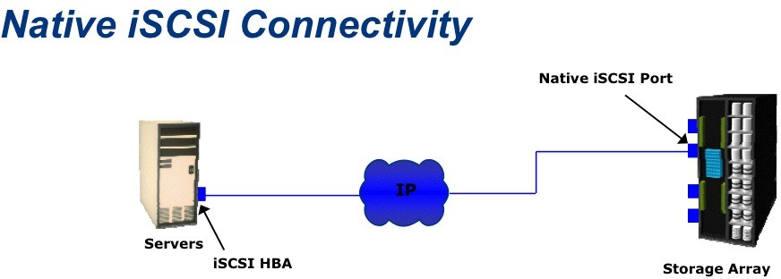
No FC components
Each iSCSI port on the array is configured with an IP address and port number

Slide 57
iSCSI Storage
Public or Private Ethernet network
 | NIC or iSCSI HBA
Server
NIC or iSCSI HBA
SCSI commands are encapsulated in TCP/IP packets
iSCSI Storage
 | Dis | k D | rive | s
Server has a Network Interface Card or iSCSI HBA
iSCSI HBAs use TCP/IP Offload Engine (TOE)
RAID Controller

Slide 58


















Block Storage over IP - protocols
iSCSI
SCSI over IP
IP encapsulation done on host / HBA(host bus adapter)
Hardware-based gateway to Fibre Channel storage
IP FC
IP IP
FCIP
– Fibre Channel-to-IP bridge / tunnel (point
to point)
FC IP
IP
IP FC
➢ Fibre Channel end points
FC/ IP/
iFCP
IP as the inter-switch fabric
Fibre Channel end points
IP
FC
IP
FC/
IP/ FC
IP

Slide 59
SAN Advantage
Resource Consolidation
centralized storage and management
Enables sharing of storage resources across multiple servers at block level
Scalability
~16 million devices
High bandwidth with Fiber Channel
meets increasing storage demands efficiently with better economies of scale
Secure Access
Isolation and filtering

Slide 60
网络存储
直连式存储（DAS）
网络附加存储（NAS）
存储区域网络（SAN）
总结与对比
内容寻址存储（CAS）

Slide 61
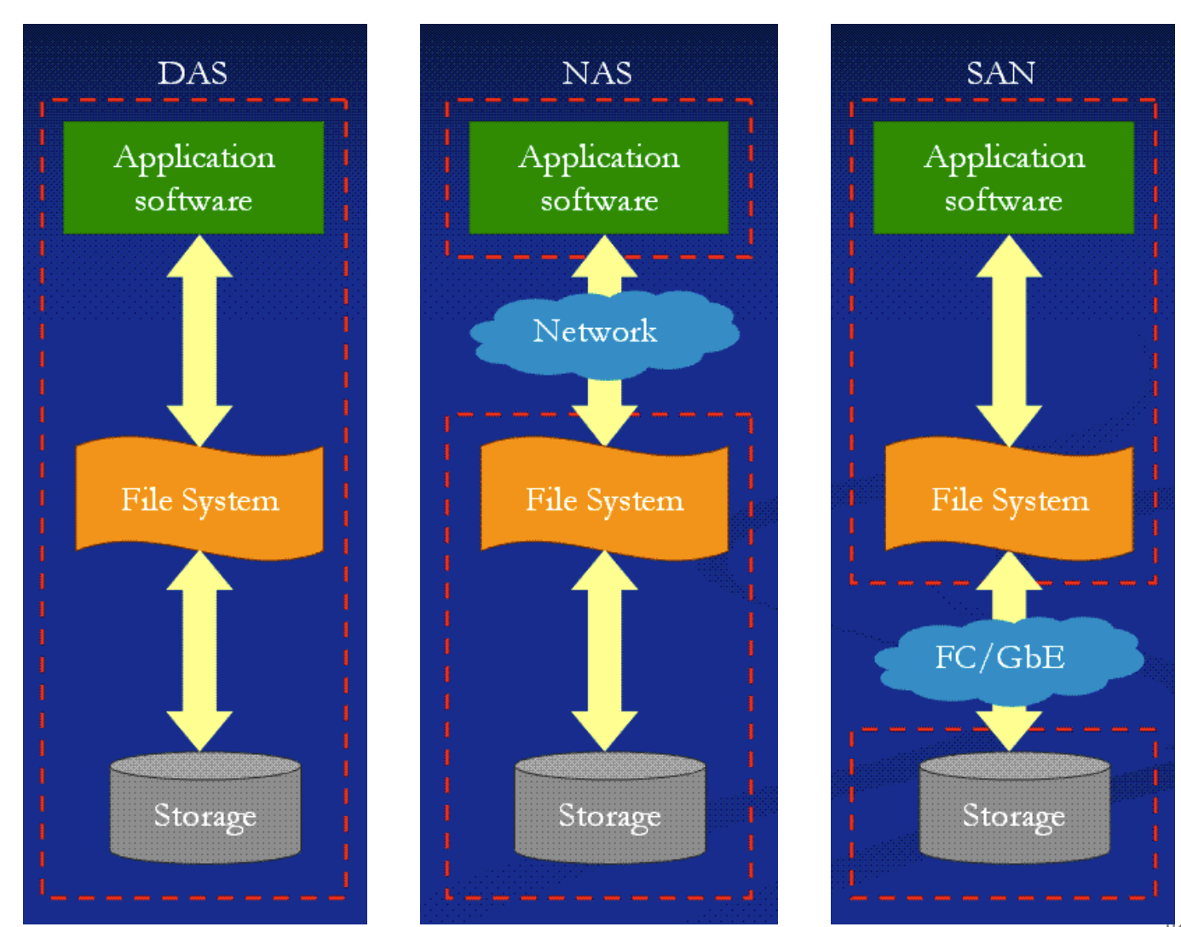
Analysis – DAS vs NAS vs SAN

Slide 62
Analysis - DAS vs SAN
Common
Block Level
DAS
Direct connection
Limited devices
SAN
Network connection
More devices

Slide 63
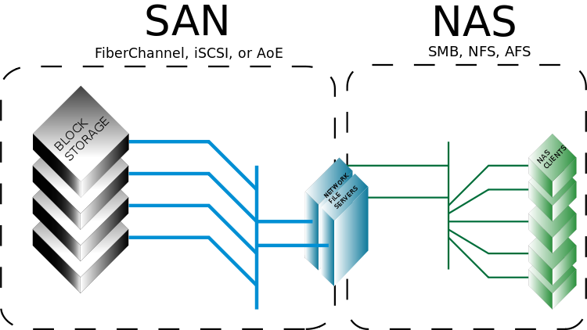
Analysis – SAN vs NAS
Common
Can be supported by one device
Hybrid SAN and NAS
SAN
Block level
NAS
File level
For heterogeneous clients

Slide 64




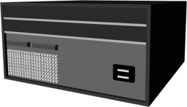


SAN with NAS
Internal Users
Business Clients
Surfers, Shoppers
LAN/WAN
NAS
Head
Database Transaction Mission Critical Servers
FC SAN

Slide 65
网络存储
直连式存储（DAS）
网络附加存储（NAS）
存储区域网络（SAN）
总结与对比
内容寻址存储（CAS）

Slide 66
CAS
SAN: Block Level
NAS: File Level
CAS: Object Level

Slide 67
CAS
Object-oriented, location-independent approach to data storage.
Repository for the “Objects”.
Access mechanism to interface with repository.
Globally unique identifiers provide access to objects.
Extensible metadata that enables automated data management practices and applications.

Slide 68









What is Fixed Content?
Generate New Revenues
Improve Service Levels
Leverage Historical Value
Digital Assets Retained For Active Reference And Value
Electronic Documents
Contracts, claims, etc.
E-mail and attachments
Financial spread sheets
CAD/CAM designs
Presentations
Digital Records
Documents
Checks, securities trades
Historical preservation
Photographs
Personal / professional
Geophysical
Seismic, astronomic, geographic
Rich Media
Medical
X-rays, MRIs, CTI
Video
News / media, movies
Security serveillance
Audio
Voicemail
Radio
68

Slide 69
Challenges of Storing Fixed Content
Most new digital content is fixed content.
Fixed content is growing at more than 90% annually.
Long-term preservation is required (years- decades).
Simultaneous multi-user access.
Need for faster access to records for business and legal reasons.
Need for location independent data, enabling technology refresh and migration.
Emerging regulations require retention.
Traditional storage methods are inadequate.

Slide 70



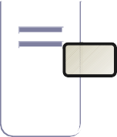





How CAS Stores a Data Object
4
CAS authenticates the Content Address and stores the object
2
Unique Content Address is calculated
1
Client presents data to API to be archived
CAS
3
Object is sent to CAS via CAS API over IP
Application Server
Client
API
Object ID
5
Acknowledgement
6
Object-ID is retained and stored for future use
returned to application

Slide 71





How CAS Retrieves a Data Object
4
CAS authenticates the request and delivers the object
1
Object is needed by an application
CAS
Application Server
Client
API
3
2
Application finds Content Address of object to be retrieved
Retrieval request is sent to the CAS via CAS API over IP
Object ID

