Slide 1


Cross-Modal Video Representation Alignment for Robust Action Recognition
Presented by: Bastian Rothenburger
Supervised by: M.Sc. David Lerch
Perceptual User Interface
Fraunhofer IOSB, Karlsruhe, DE
Supervised by: Prof. Dr. Gemma Roig, Professor for Brain-inspired Artificial Intelligence

Slide 2
1. Motivation
2. Representation Learning
3. Approach
4. Selected Results

Slide 3
Introduction
Motivation: Action recognition crucial for autonomous driving, healthcare, security
Challenges: Heavy reliance on labels, poor cross-dataset generalization
Our Approach: Cross-Modal Video Representation Alignment (CMVRA)
  Use CLIP-ViP (a video extension of CLIP) as core of our framework
  Align multiple modalities (RGB, depth, infrared, skeleton) into unified embedding
Key Explorations:
  Alignment setups
  CLIP-ViP fine-tuning with artificial annotations
  Robustness across datasets, views and missing modalities

Slide 4
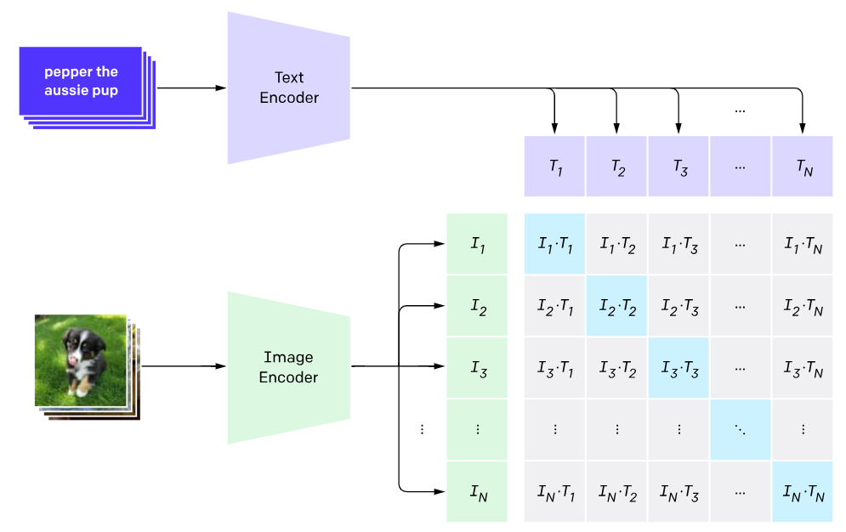
Representation Learning
Generalizability
Extendable to video
Extendable to other modalities
Depends on large scale datasets and large batch sizes when trained from scratch (400 million pairs)
Source: https://openai.com/research/clip

Slide 5
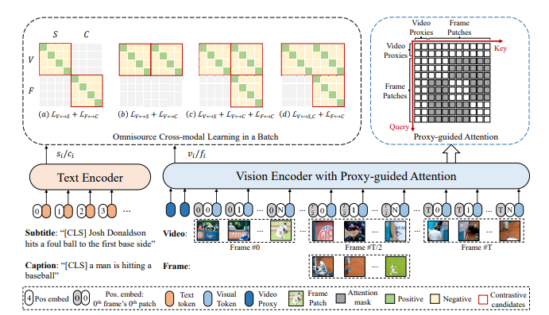
Representation Learning- Choosing a Suitable Model
Add temporal modeling
CLIP Video Extensions learning can retain or omit the binding text
Base model choice CLIP-VIP
Source: https://arxiv.org/pdf/2209.06430.pdf

Slide 6
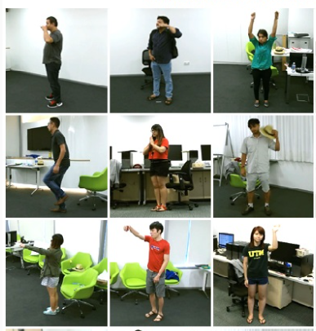
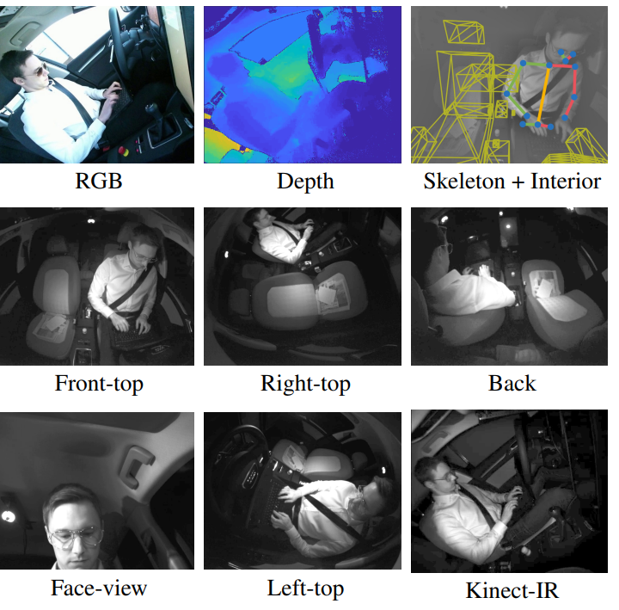
Datasets
NTU
  Short human action clips from indoor settings
  60 and 120 class versions (roughly 60k and 120k samples)
  RGB, IR, DEPTH and Skeleton from different views
  2 Splits Cross-View and Cross-Subject
Drive and Act
  Short human action clips from inside the car (lab situation)
  34 classes, unbalanced (roughly 10k samples)
  RGB, IR, DEPTH and Skeleton one view + 5 additional IR views
  3 Splits (no theme) all are Cross-Subject

Slide 7
Approach
CMVRA
Fine-tuning CLIP-ViP
Alignment to RGB for different modality pairs
Evaluation
LEP
Retrieval
Fusion

Slide 8
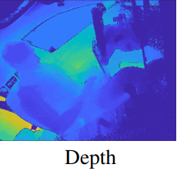
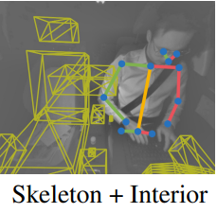
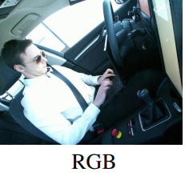
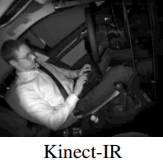
Approach
CMVRA
Finetuning CLIP-VIP
Alignment to RGB for different modality pairs
Linear Classifier
Evaluation
Encoder
Encoder
Encoder
Skeleton
Encoder Models:
CLIP-VIP (pre-trained on RGB video)
MAE (pre-trained for each modality)
OMNIVORE (pre-trained on Depth Images RGB video and images)
DINO v2 (pre-trained on RGB and Depth Images)
TAHAR
Encoder

Slide 9
CMVRA
Hypotheses
Finetuning CLIP-VIP
Alignment to RGB for different modality pairs
Linear Classifier
Evaluation
One-way vs. mutual adaptability: One-way adaptability (freezing the RGB encoder) will outperform mutual adaptability for most modalities and tasks while being more computationally efficient.
Fully integrated vs. pairwise alignment: Fully integrated alignment will outperform pairwise alignment in terms of capturing complementary information from different modalities.
Modality-specific pre-trained encoders: Using modality-specific pre-trained encoders will lead to faster convergence and higher performance compared to using weights initially trained on RGB data for all encoders.
Self-alignment: Self-alignment of RGB representations will lead to improved performance of the target encoder (OMNIVORE) compared to the anchor encoder (CLIP-ViP) in both retrieval tasks and linear evaluation protocol.

Slide 10
CMVRA
Hypotheses
Finetuning CLIP-VIP
Alignment to RGB for different modality pairs
Linear Classifier
Evaluation
Cross-Dataset robustness: Encoders aligned on the larger, balanced NTU dataset will outperform those aligned on the smaller, imbalanced DAA dataset in the Linear Evaluation Protocol (LEP).
Retrieval vs. LEP: Retrieval using the language encoder will be competitive with the LEP for many tasks while being more efficient and flexible.
Fusion: The fusion performance, when evaluated through an attention-based mechanism, should surpass the performance of any individual encoder assessed with LEP.
Language variety: Greater language variety during fine-tuning will not only improve RGB encoder performance but also facilitate better alignment and performance of the IR encoder.
Vision language model captioning: Fine-tuning using captions generated by the LLaVA model will: Outperform the base version (no fine-tuning) by leveraging the semantic information captured in the generated captions in retrieval evaluations.

Slide 11
Results
Effective alignment strategies
Pre-trained modality-specific models enhance alignment efficacy significantly
OMNIVORE and CLIP-VIP showed great synergies for IR and depth
Using a strong RGB encoder as base is superior to mutual adaptability
Fully integrated alignment outperforms pairwise alignment with CLIP-ViP base

Slide 12
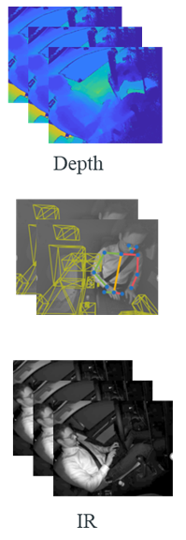
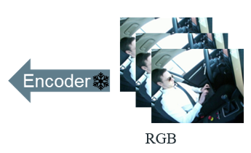



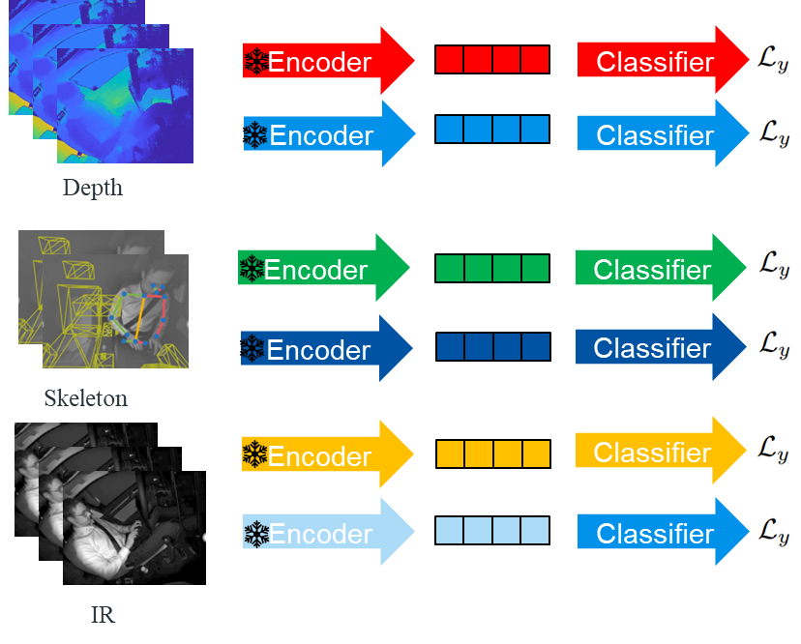









Pairwise vs. Fully Integrated Alignment (to RGB)
Pairwise
Classifier Phase
Fully Integrated
Trainable weights
Frozen
Representation
InfoNCE-Loss
Balanced CrossEntropy-Loss

Slide 13
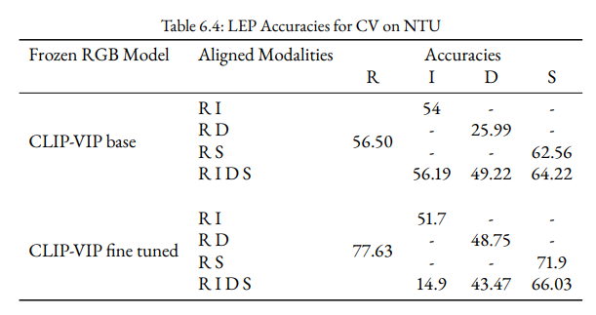
Results
Pairwise vs. Fully Integrated Alignment
Finetuning CLIP-VIP
Alignment to RGB for different modality pairs
Linear Classifier
Evaluation
Fully Integrated Alignment yields benefits primarily when oriented towards rich, foundational representations rather than those refined through fine-tuning.

Slide 14
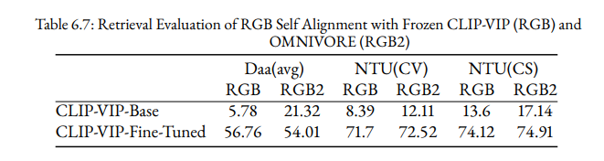
Results
Successful self alignment improves alignment towards text

Slide 15
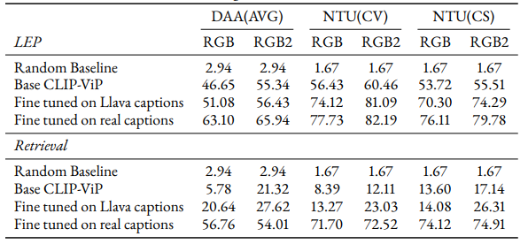
Results
Self Alignment and LLaVa generated captions
Fine-tuning on LLaVa generated captions paired with self alignment significantly improve upon base version

Slide 16
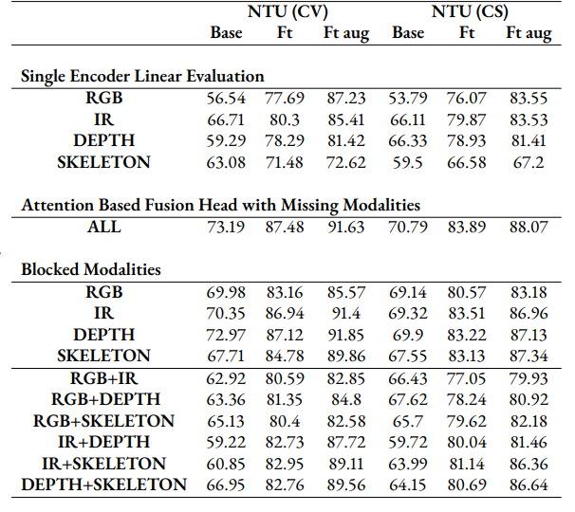
Results
Fusion
Adding a simple attention based fusion head shows robustness against missing modalities to some extent
Aligned encoders learn complimentary features on NTU but fail on DAA

Slide 17
Results
Conclusions
Created CMVRA: A novel framework unifying RGB, depth, infrared, skeleton, and text data into a shared embedding for enhanced action recognition.
Advanced Alignment Techniques: Achieved faster encoder alignment with modality-specific pre-training and improved embedding quality through self-alignment.
Integrated Vision-Language Models: Demonstrated the potential of vision-language models for label-free classification across modalities

Slide 18
Thanks!
Any questions?

Slide 19
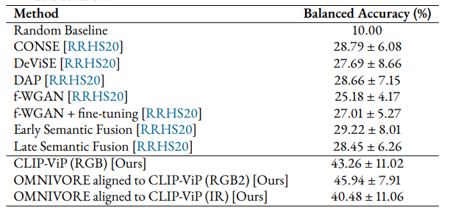
Results
Beating sota on DAA ZS benchmark
We beat previous sota on DAA ZS benchmark with RGB self alignment
We also surpass sota in IR

Slide 20
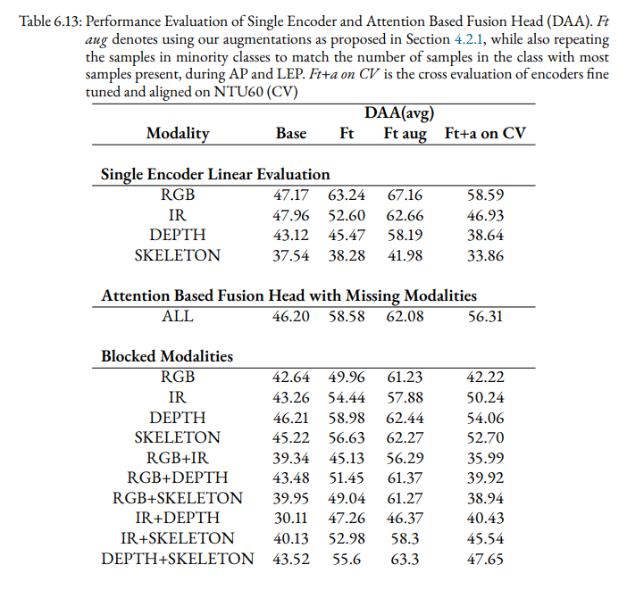
Results
Fusion
Adding a simple attention based fusion head shows robustness against missing modalities to some extent
Aligned encoders learn complimentary features on NTU but fail on DAA

Slide 21
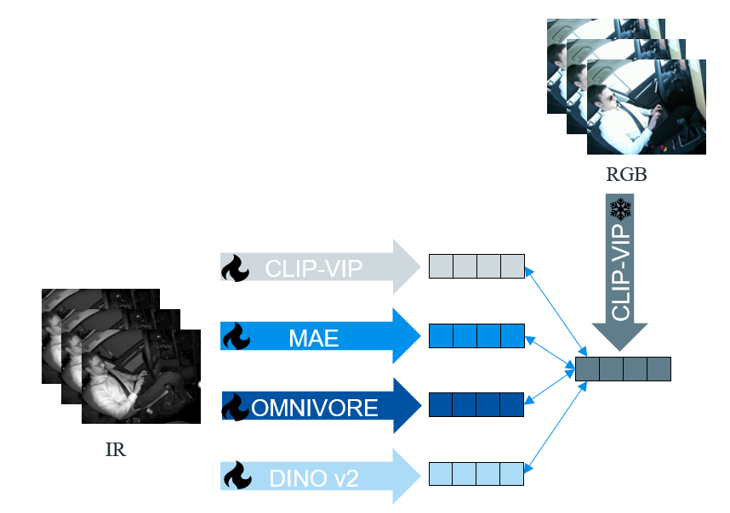
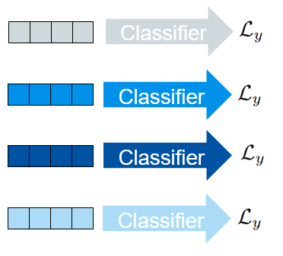
1. Convergence Improvements
Alignment Phase
Classifier Phase
Trainable weights
Frozen
Representation
InfoNCE-Loss
Balanced CrossEntropy-Loss

Slide 22
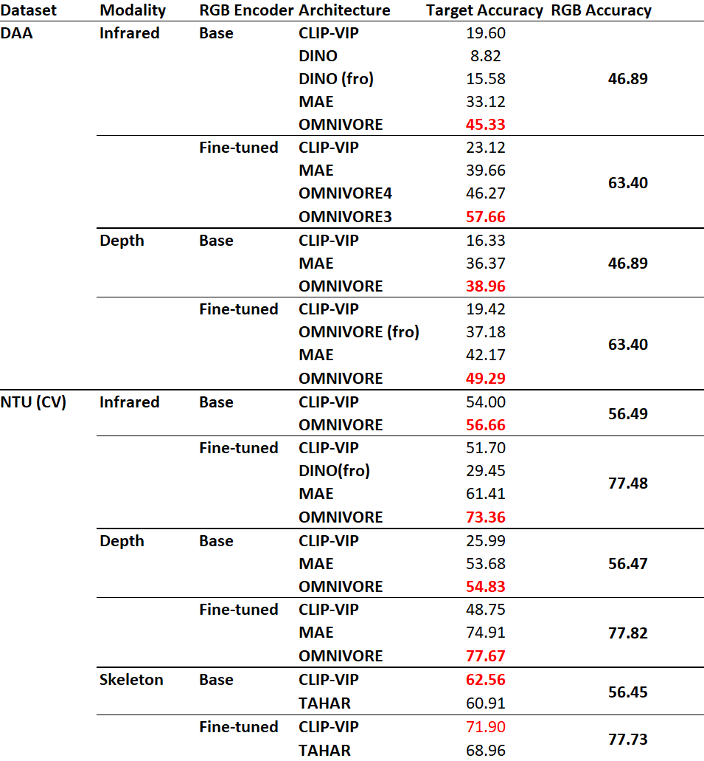
Results
Improving Alignment Convergence
Finetuning CLIP-VIP
Alignment to RGB for different modality pairs
Linear Classifier
Evaluation
Pretrained modality-specific models enhance alignment efficacy significantly
Modality specific MAEs outperform CLIP-VIP and OMNIVORE improves results further
On NTU the performance gap to RGB is smaller than on DAA

Slide 23
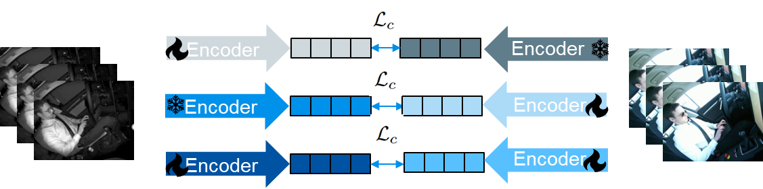
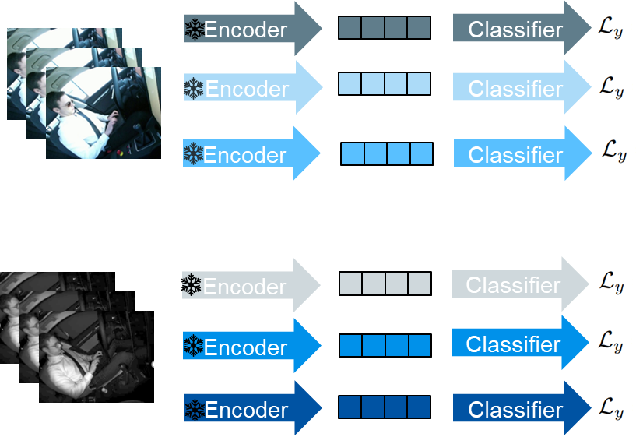
2. One-Way vs Mutual Adaptability
Alignment Phase
Classifier Phase
Trainable weights
Frozen
Representation
InfoNCE-Loss
Balanced CrossEntropy-Loss

Slide 24
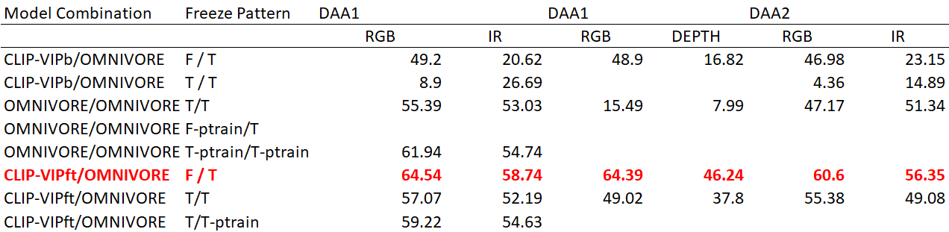
Results
One-Way outperforms Mutual Adaptability
Finetuning CLIP-VIP
Alignment to RGB for different modality pairs
Linear Classifier
Evaluation
Mutual Adaptability improves loss convergence significantly
Loss convergence improvements do not necessarily result in higher classifier performance
For the best combination “binding to RGB” leads to superior results for both modalities

Slide 25
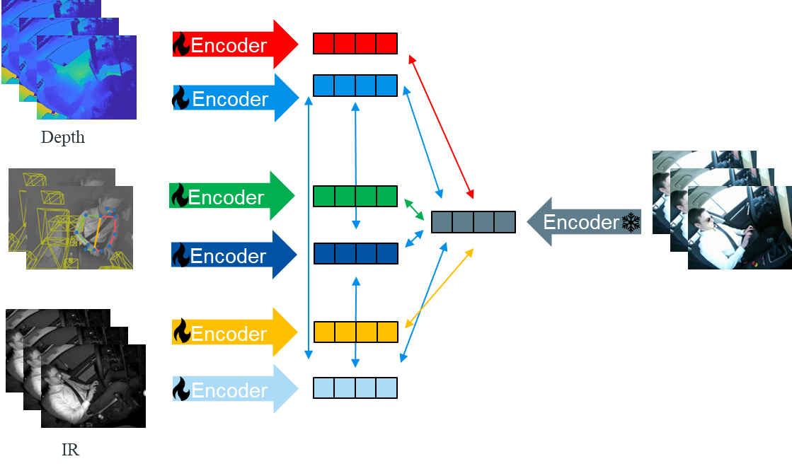
3. Pairwise vs. Fully Integrated Alignment (to RGB)
Alignment Phase
Classifier Phase
RGB
Trainable weights
Frozen
Representation
InfoNCE-Loss
Balanced CrossEntropy-Loss

Slide 26
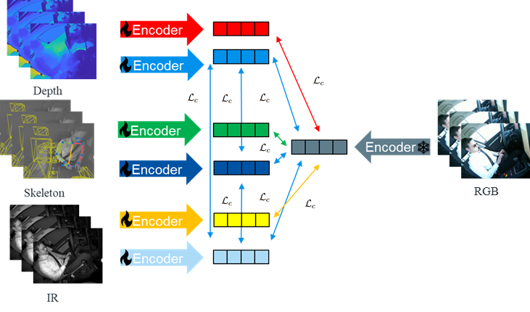
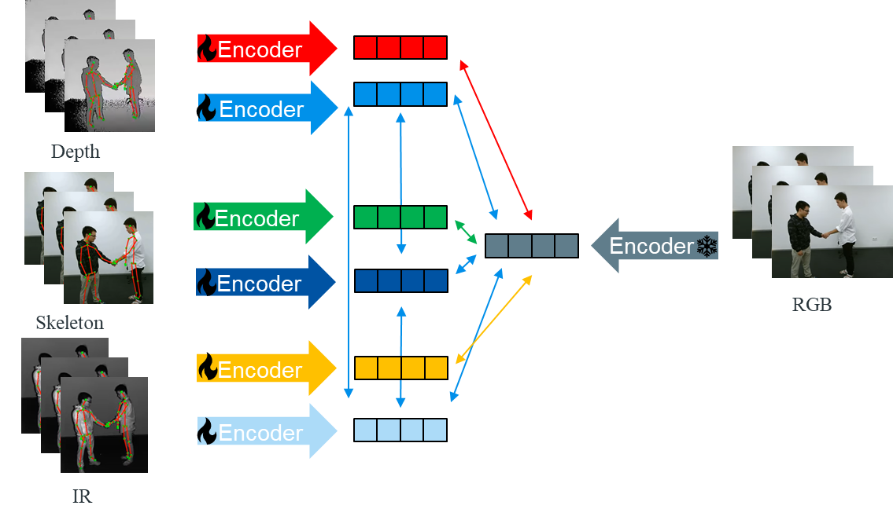
4. Generalizability (Cross-Dataset)
Alignment Phase A:
DAA
Classifier Phase on DAA for aligned
models from A and B
Alignment Phase B:
NTU
Trainable weights
Frozen
Representation
InfoNCE-Loss
Balanced CrossEntropy-Loss

Slide 27
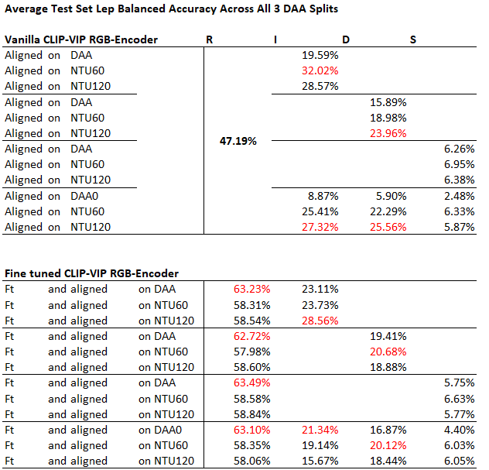
Results
Generalizability (Cross-Dataset)
Finetuning CLIP-VIP
Alignment to RGB for different modality pairs
Linear Classifier
Evaluation
CLIP-VIP encoders aligned on NTU60 outperform those aligned on DAA
Marginal improvements achieved on NTU120 compared to NTU60
Fine-tuning on NTU enhances RGB performance on DAA, however, this improvement does not generalize to the aligned target modality

Slide 28
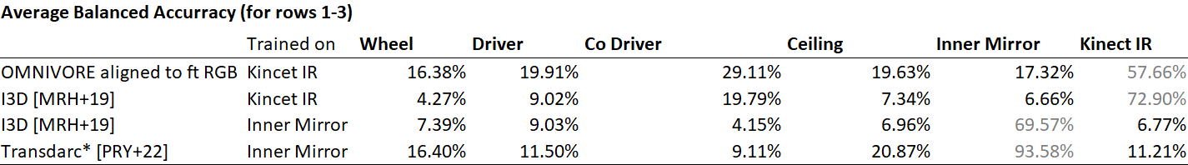
Results
Generalizability (Cross-View)
Finetuning CLIP-VIP
Alignment to RGB for different modality pairs
Linear Classifier
Evaluation
Cross View evaluations on DAA are competitive with SOTA
*unbalanced accuracy

Slide 29
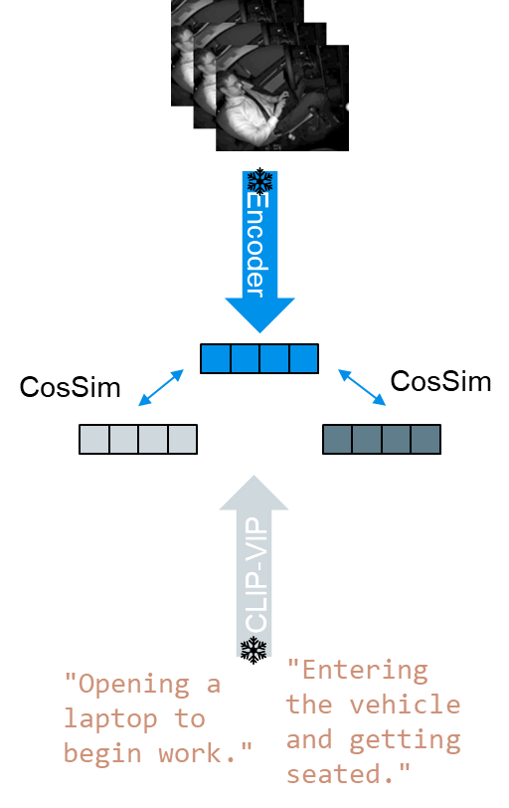
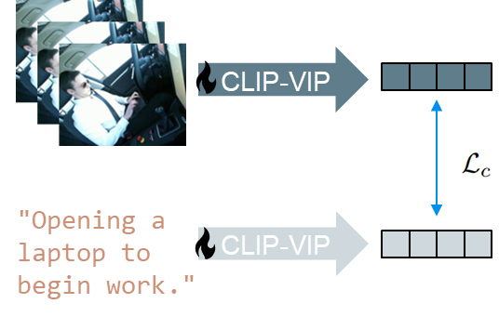
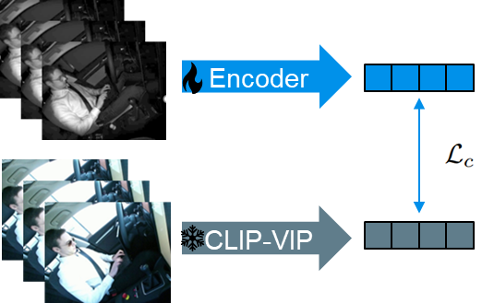
5. Emergent Textual Alignment
Fine-tuning Phase
Alignment Phase
Retrieval
…
…
…
…
Trainable weights
Frozen
Representation
InfoNCE-Loss
CosSim
Cosine Similarity

Slide 30
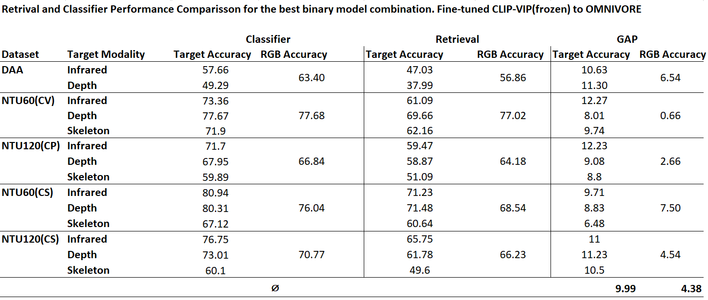
Results
Emergent Textual Alignment
Finetuning CLIP-VIP
Alignment to RGB for different modality pairs
Linear Classifier
Evaluation
Retrieval does not match classifier performance
Performance gap is smaller for RGB than for the target modality
Nonetheless allows for the omission of the classifier training phase

Slide 31
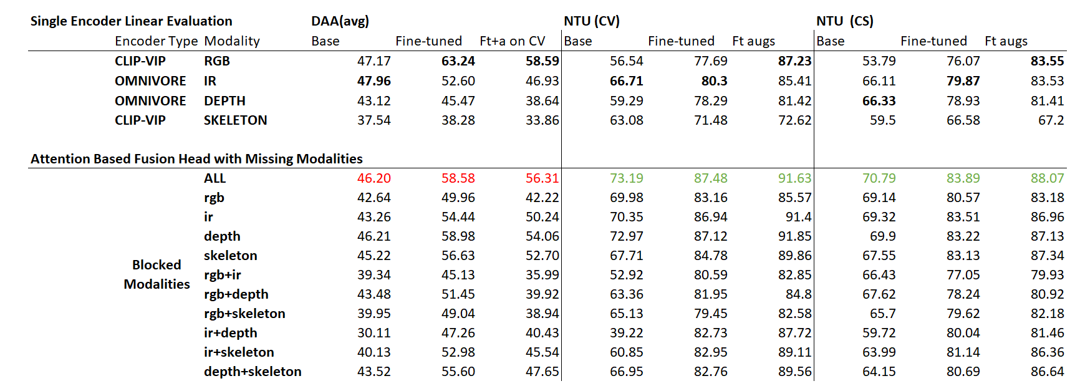
Fusion

Slide 32
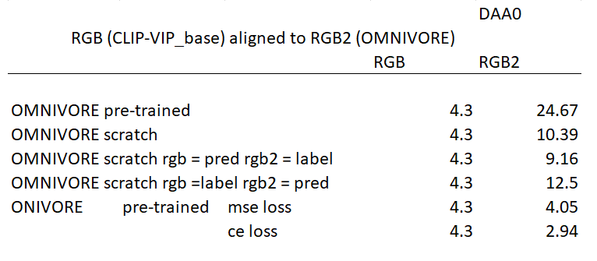
Analysis
OMNIVORE weights are a big contribution to the gap
Off diagonal values in cosine similarity matrix seem to be the other main contributing factor

Slide 33
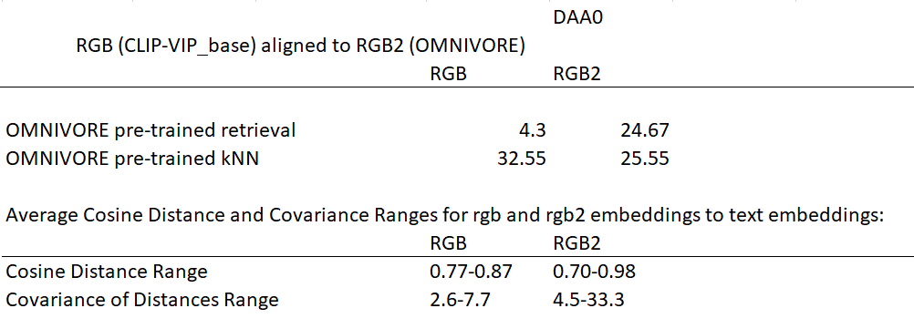
Analysis

Slide 34
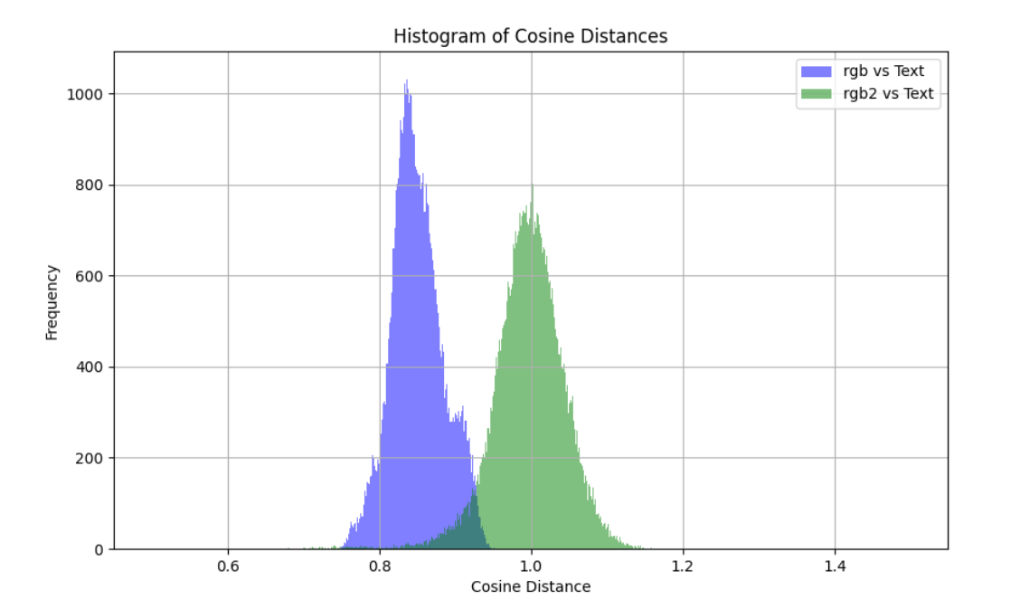
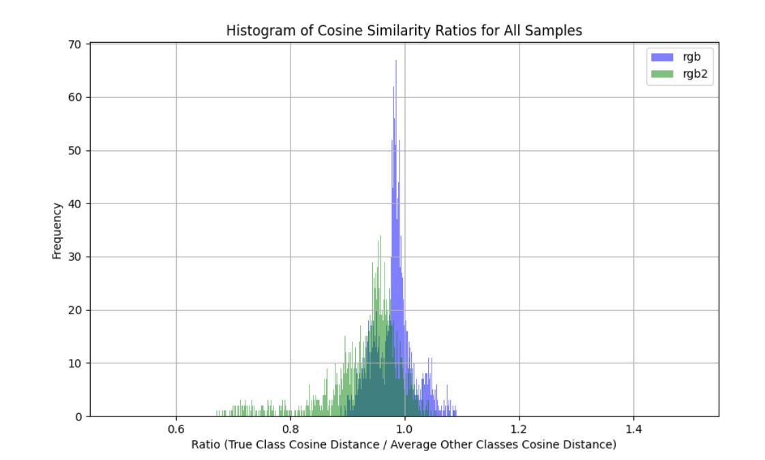
Analysis
True class cosine distance compared to
average false class cosine distance
Cosine Distances

Slide 35
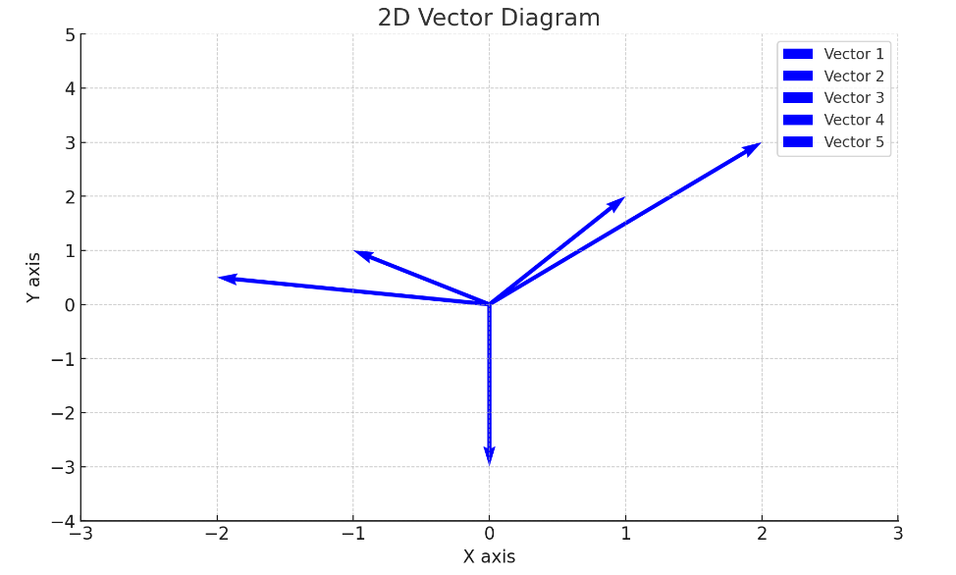
Opening laptop
Closing laptop
Opening bottle
Closing bottle
Sitting still

Slide 36
Main Hypothesis
Generalizability (Cross-Dataset): Encoders aligned on NTU outperform those aligned on DAA in a LEP
Convergence Improvements: Initializing alignment with modality specific pretrained encoders improves loss convergence (and subsequently LEP performance)
Pairwise vs. Fully Integrated Alignment (to RGB) : Fully integrated alignment outperforms pairwise alignment in a LEP
Emergent Textual Alignment: Aligning multimodal and textual data may reach the effectiveness of linear classifiers
One-Way vs Mutual Adaptability: Aligning a basic modality encoder to a more sophisticated, pretrained one may improve downstream task results compared to allowing two pretrained encoders to adapt to each other

Slide 37
Generalizability (Cross-Dataset)
Results:
The encoders aligned to the "base" version of the CLIP-VIP model shows better generalizability across datasets compared to fine-tuned versions. Because they outperform the encoders aligned on DAA while the ones aligned to the fine tuned version do not
Fine-tuning on NTU only improved RGB encoder performance by approximately 11 percentage points over the base model, while fine-tuning on DAA led to a 16 percentage point improvement.
Encoders for modalities other than RGB, when aligned against fine-tuned versions, exhibited poor generalizability.
Interpretation:
The experiment demonstrates that the generalizability inherent in the CLIP-VIP base model, thanks to its diverse pretraining, can be partially transferred to other modalities aligned with it. This suggests that aligning new modality encoders to the base CLIP-VIP representations not only utilizes its robust feature representations but also imparts some of its capacity to generalize across datasets to these new modalities. However, this transfer of generalizability is less effective with fine-tuned versions
The diminished generalizability of fine-tuned models indicates that fine-tuning either lacks diversity in screen descriptions or does not have a sufficient size, thereby reducing its applicability to other datasets. This effect is particularly pronounced in modalities other than RGB.

Slide 38
Convergence Improvements
Results:
Using modality-specific pretrained encoders for alignment improves the efficiency of the alignment process, particularly for infrared and depth modalities.
The pretrained skeleton model shows limitations due to dataset-specific variations in joint configurations, impacting the effectiveness of using these weights for alignment.
Modality-specific Masked-Auto-Encoders(MAEs) are better than using a generic CLIP-VIP model but fall short of more advanced models like Omnivore.
Performance parity between IR, depth, and RGB is achieved on NTU, but a performance gap remains on DAA.
Interpretation:
The weights of the Omnivore model are quite adaptable and work well in the alignment context
CLIP-VIP weights are efficient for learning skeleton data (on NTU)

Slide 39
Pairwise vs. Fully Integrated Alignment (to RGB)
Results:
Fully integrated alignment outperforms pairwise alignment in terms of LEP performance, but this advantage is primarily observed with the base model representations rather than fine-tuned versions on NTU.
The advantages of fully integrated alignment were not observed on DAA
Interpretation:
The differences on DAA are possibly due to lower data quality or the complexity of skeleton data.
The benefit of fully integrated alignment suggests that a holistic approach to learning from multiple modalities simultaneously can lead to richer, more generalizable representations. But this depends on having a model that is able to extract such representations that you can align to.
The success in dealing with missing sensor data scenarios largely relies on the quality of the basic representations used for alignment.

Slide 40
Emergent Textual Alignment
Results:
j
Interpretation:
The weights of the Omnivore model are quite adaptable and work well in the alignment context

Slide 41
One-Way vs Mutual Adaptability
Results:
Aligning a basic modality encoder (RGB) to a more sophisticated, pretrained one (Omnivore) improved target modality performance but worsened RGB performance.
Interpretation:
This experiment highlights the challenges and considerations in balancing the adaptability and specialization of models in multimodal learning scenarios.
The improvement in target modality performance at the expense of RGB performance suggests a need for careful calibration of learning objectives and alignment strategies to optimize overall system performance.

Slide 42
Results
Pairwise vs. Fully Integrated Alignment (to RGB) :
Fully Integrated alignment yields benefits primarily when oriented towards rich, foundational representations rather than those refined through fine-tuning on NTU.
The same cannot be oberserved for DAA most likely because the skeleton data is to hard or has to low data quality.
This is an requirement for improved missing sensor performance. Since it only works to extract information from modalities during training when you have at least one very strong and general encoder to bind to it is rather difficult to extact something that has a chance to beat sota approaches or end to end trained modality specific models

Slide 43
Results
Emergent Textual Alignment:
Relies on having a fine tuned text encoder.
Is roughly 10-20% behind modality specific trained classifiers.

Slide 44
Results
One-Way vs Mutual Adaptability:
  Done 1 weird sample run
  Open everything

