Slide 1
Java
GUI building with the AWT

Slide 2
AWT (Abstract Window Toolkit)
Present in all Java implementations
Adequate for many applications
Uses the controls defined by your OS
  therefore it's “least common denominator”
Difficult to build an attractive GUI
import java.awt.*;
import java.awt.event.*;

Slide 3
Swing
Same concepts as AWT
Doesn’t work in ancient Java implementations (Java 1.1 and earlier)
Many more controls, and they are more flexible
  Some controls, but not all, are a lot more complicated
Gives a choice of “look and feel” packages
Much easier to build an attractive GUI
import javax.swing.*;

Slide 4
Swing vs. AWT
Swing is bigger, slower, and more complicated
  But not as slow as it used to be
Swing is more flexible and better looking
Swing and AWT are incompatible--you can use either, but you can’t mix them
  Actually, you can, but it’s tricky and not worth doing
Learning the AWT is a good start on learning Swing
Many of the most common controls are just renamed
  AWT: Button b = new Button ("OK");
  Swing: JButton b = new JButton("OK");

Slide 5
To build a GUI...
Make somewhere to display things—usually a Frame or Dialog (for an application), or an Applet
Create some Components, such as buttons, text areas, panels, etc.
Add your Components to your display area
Arrange, or lay out, your Components
Attach Listeners to your Components
  Interacting with a Component causes an Event to occur
  A Listener gets a message when an interesting event occurs, and executes some code to deal with it

Slide 6
Containers and Components
The job of a Container is to hold and display Components
Some common subclasses of Component are Button, Checkbox, Label, Scrollbar, TextField, and TextArea
A Container is also a Component
  This allows Containers to be nested
Some Container subclasses are Panel (and Applet), Window, and Frame

Slide 7
An Applet is a Panel
A Panel is a Container
java.lang.Object
|
+----java.awt.Component
|
+----java.awt.Container
|
+----java.awt.Panel
|
+----java.applet.Applet
…so you can display things in an Applet

Slide 8
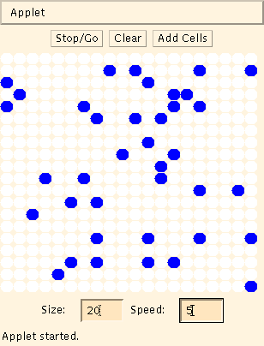
Example: A "Life" applet
Container (Applet)
Containers (Panels)
Component (Canvas)
Components (Buttons)
Components (TextFields)
Components (Labels)

Slide 9
Applets
An application has a
public static void main(String args[ ]) method, but an Applet usually does not
An Applet's main method is in the Browser
To write an Applet, you extend Applet and override some of its methods
The most important methods are init( ), start( ), and paint(Graphics g)

Slide 10
To create an applet
public class MyApplet extends Applet { … }
  this is the only way to make an Applet
You can add components to the applet
The best place to add components is in init( )
You can paint directly on the applet, but…
…it’s better to paint on a contained component
Do all painting from paint(Graphics g)

Slide 11
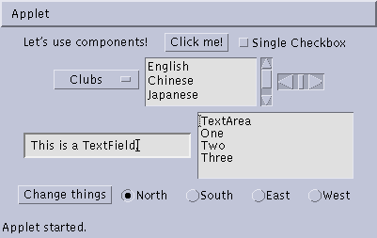
Some types of components
Button
Checkbox
Label
Choice
Scrollbar
TextField
List
TextArea
Button
Checkbox
CheckboxGroup

Slide 12
Creating components
Label lab = new Label ("Hi, Dave!");
Button button = new Button ("Click me!");
Checkbox toggle = new Checkbox ("toggle");
TextField txt =
new TextField ("Initial text.", 20);
Scrollbar scrolly = new Scrollbar
(Scrollbar.HORIZONTAL, initialValue,
bubbleSize, minValue, maxValue);

Slide 13
Creating a Frame
When you create an Applet, you get a Panel “for free”
When you write a GUI for an application, you need to create and use a Frame:
  Frame frame = new Frame();
  frame.setTitle("My Frame");
  frame.setSize(300, 200); // width, height
  ... add components ...
  frame.setVisible(true);
Or:
  class MyClass extends Frame {
  ...
  setTitle("My Frame"); // in some instance method

Slide 14
Arranging components
Every Container has a layout manager
The default layout for a Panel is FlowLayout
An Applet is a Panel
Therefore, the default layout for a Applet is FlowLayout
You could set it explicitly with
setLayout (new FlowLayout( ));
You could change it to some other layout manager

Slide 15
FlowLayout
Use add(component); to add to a component when using a FlowLayout
Components are added left-to-right
If no room, a new row is started
Exact layout depends on size of Applet
Components are made as small as possible
FlowLayout is convenient but often ugly

Slide 16
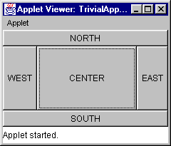
BorderLayout
At most five components can be added
If you want more components, add a Panel, then add components to it.
setLayout (new BorderLayout());
add (new Button("NORTH"), BorderLayout.NORTH);

Slide 17
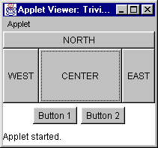
Using a Panel
Panel p = new Panel();
add (p, BorderLayout.SOUTH);
p.add (new Button ("Button 1"));
p.add (new Button ("Button 2"));

Slide 18
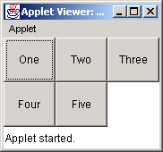
GridLayout
The GridLayout manager divides the container up into a given number of rows and columns:
new GridLayout(rows, columns)
All sections of the grid are equally sized and as large as possible

Slide 19
Making components active
Most components already appear to do something--buttons click, text appears
To associate an action with a component, attach a listener to it
Components send events, listeners listen for events
Different components may send different events, and require different listeners

Slide 20
Listeners
Listeners are interfaces, not classes
  class MyButtonListener implements
  ActionListener {
An interface is a group of methods that must be supplied
When you say implements, you are promising to supply those methods

Slide 21
Writing a Listener
For a Button, you need an ActionListener
  b1.addActionListener
  (new MyButtonListener ( ));
An ActionListener must have an actionPerformed(ActionEvent) method
  public void actionPerformed(ActionEvent e) {
  …
  }

Slide 22
Listeners for TextFields
An ActionListener listens for someone hitting the Enter key
An ActionListener requires this method:
  public void actionPerformed (ActionEvent e)
You can use getText( ) to get the text
A TextListener listens for any and all keys
A TextListener requires this method:
  public void textValueChanged(TextEvent e)

Slide 23
AWT and Swing
AWT Buttons vs. Swing JButtons:
  A Button is a Component
  A JButton is an AbstractButton, which is a JComponent, which is a Container, which is a Component
Containers:
  Swing uses AWT Containers
AWT Frames vs. Swing JFrames:
  A Frame is a Window is a Container is a Component
  A JFrame is a Frame, etc.
Layout managers:
  Swing uses the AWT layout managers, plus a couple of its own
Listeners:
  Swing uses many of the AWT listeners, plus a couple of its own
Bottom line: Not only is there a lot of similarity between AWT and Swing, but Swing actually uses much of the AWT

Slide 24
Summary I: Building a GUI
Create a container, such as Frame or Applet
Choose a layout manager
Create more complex layouts by adding Panels; each Panel can have its own layout manager
Create other components and add them to whichever Panels you like

Slide 25
Summary II: Building a GUI
For each active component, look up what kind of Listeners it can have
Create (implement) the Listeners
  often there is one Listener for each active component
  Active components can share the same Listener
For each Listener you implement, supply the methods that it requires
For Applets, write the necessary HTML

Slide 26
The End

