Slide 1
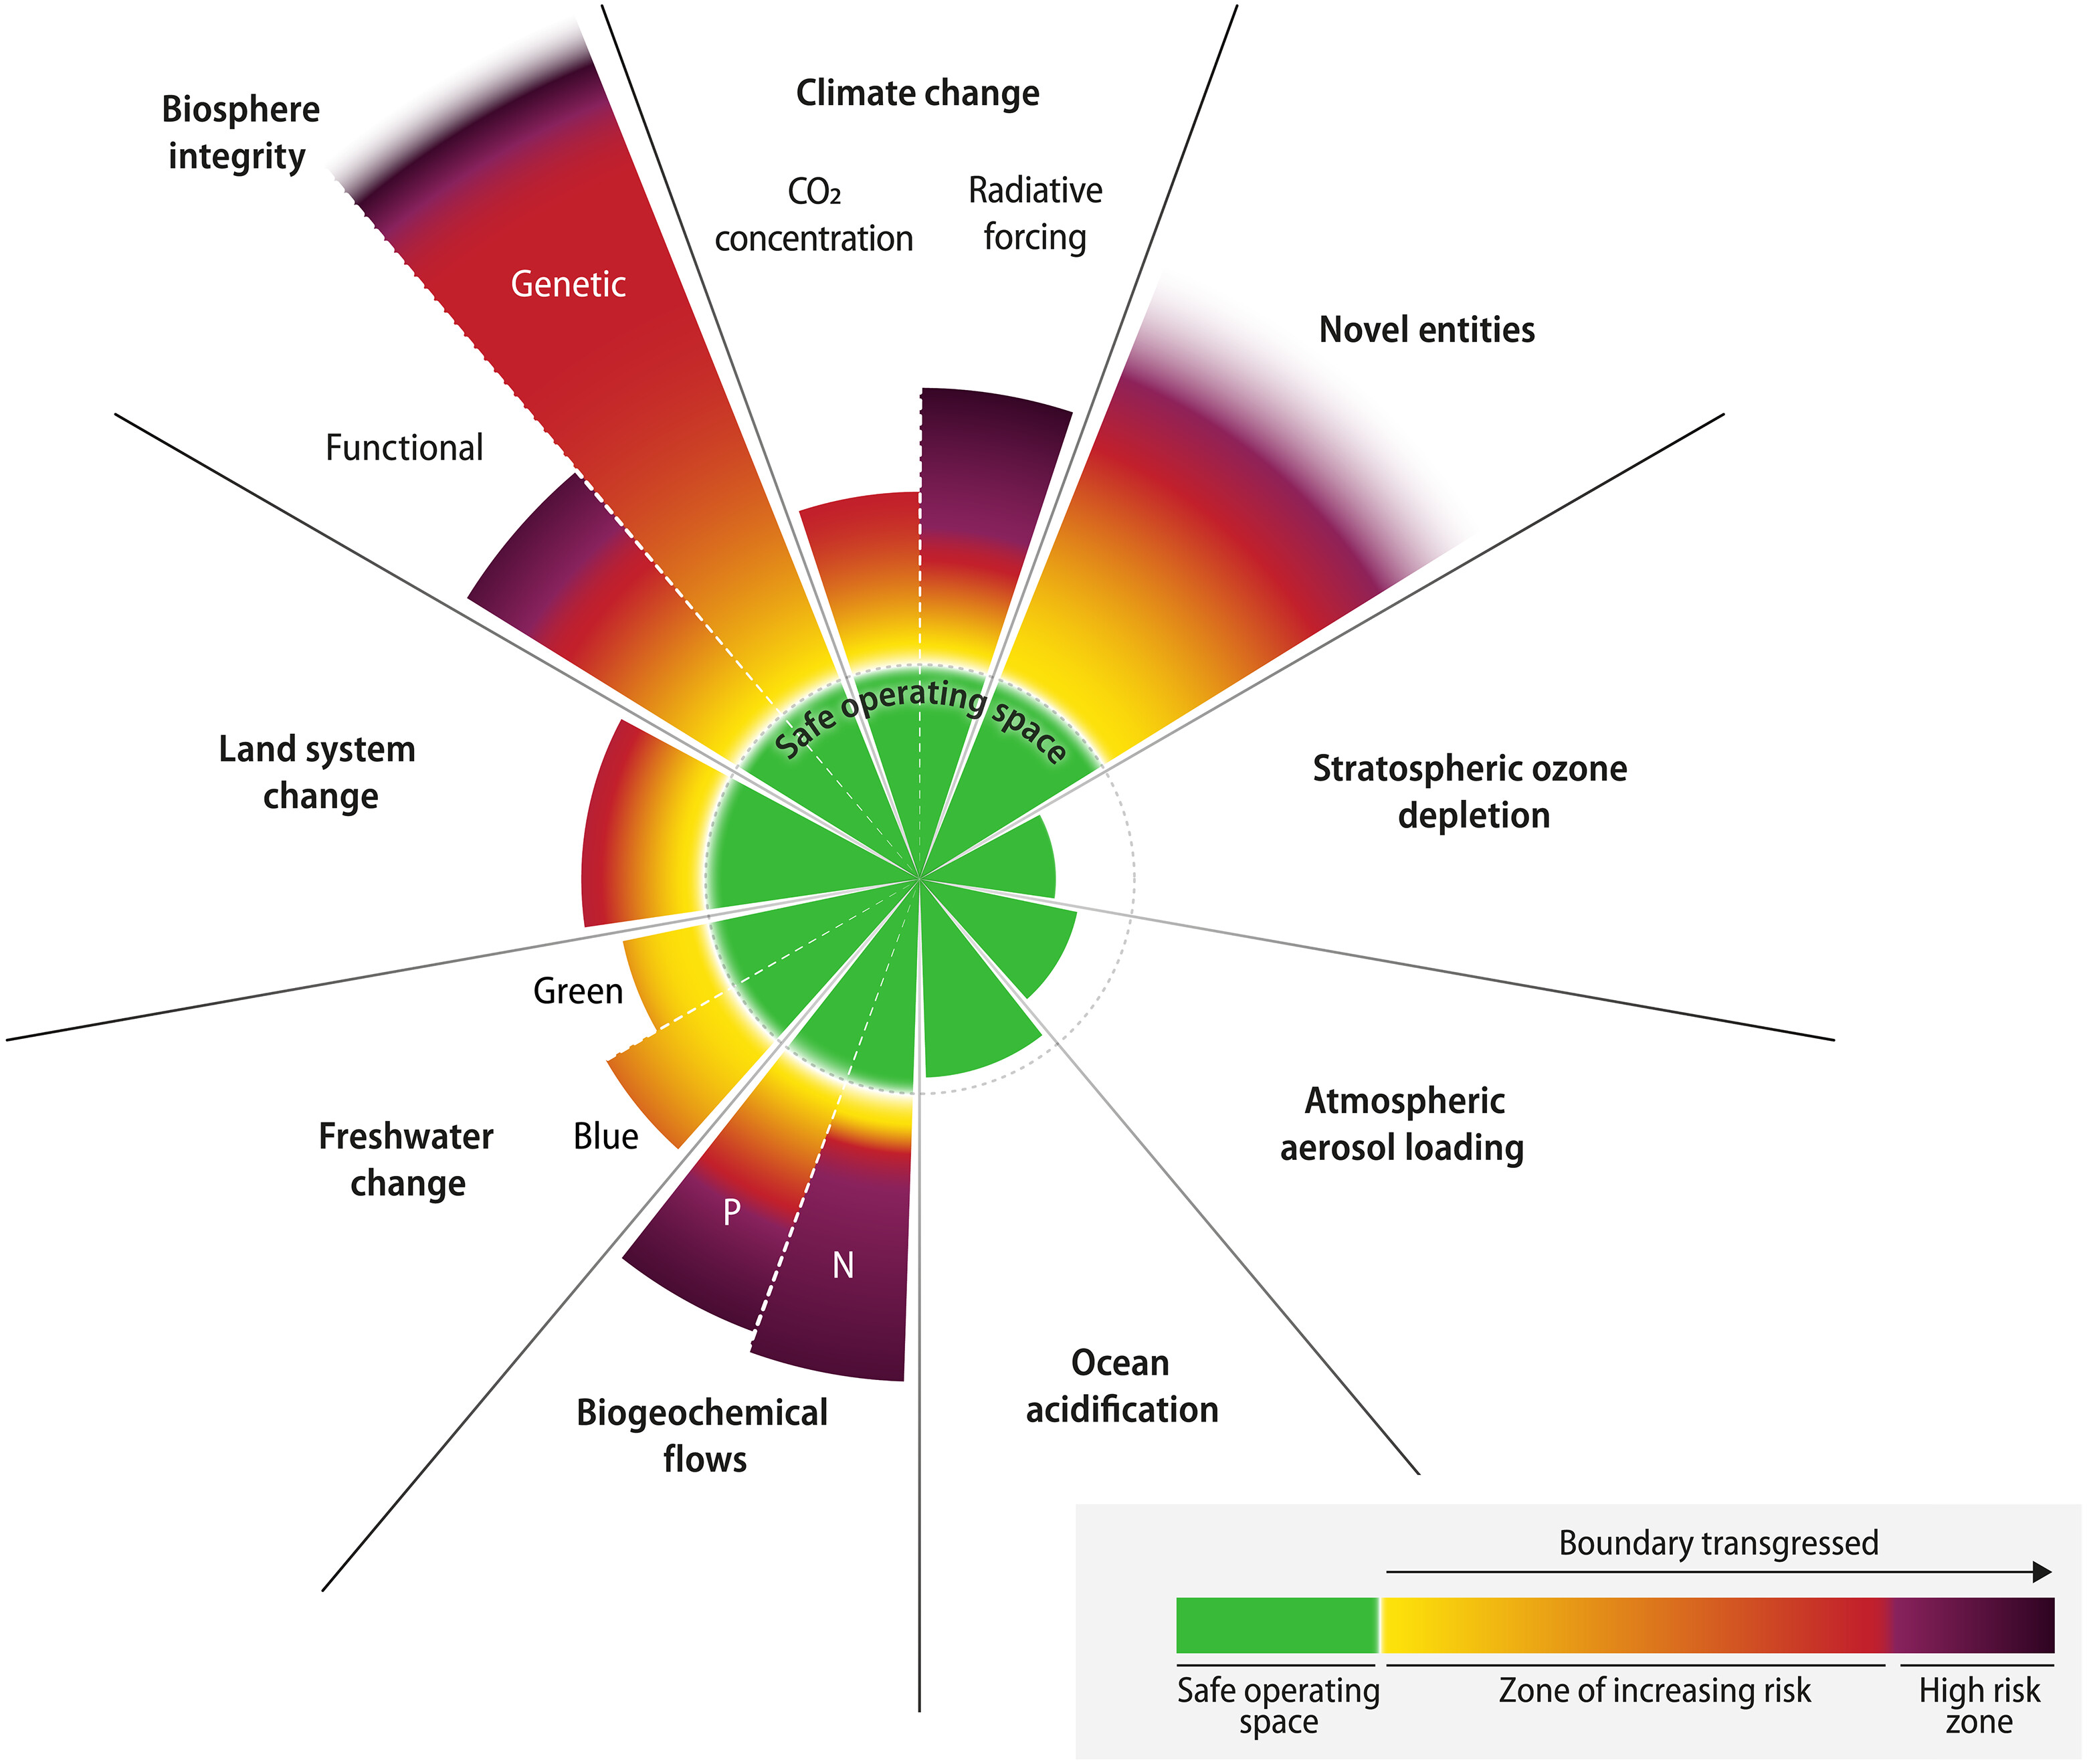
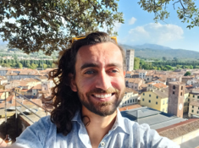
Living in the Anthropocene
The Biodiversity Crisis
Earth system science, planetary boundaries, and the variety of life
John Shorter
Associate Professor of Biomedical Data Science, INM
johnsh@ruc.dk · 21 September 2026
Notes:
Session 3 of 10. Sambach students plus open drop-ins; assume no natural science background. 14:15-16:00 with a break around 15:00.

Slide 2
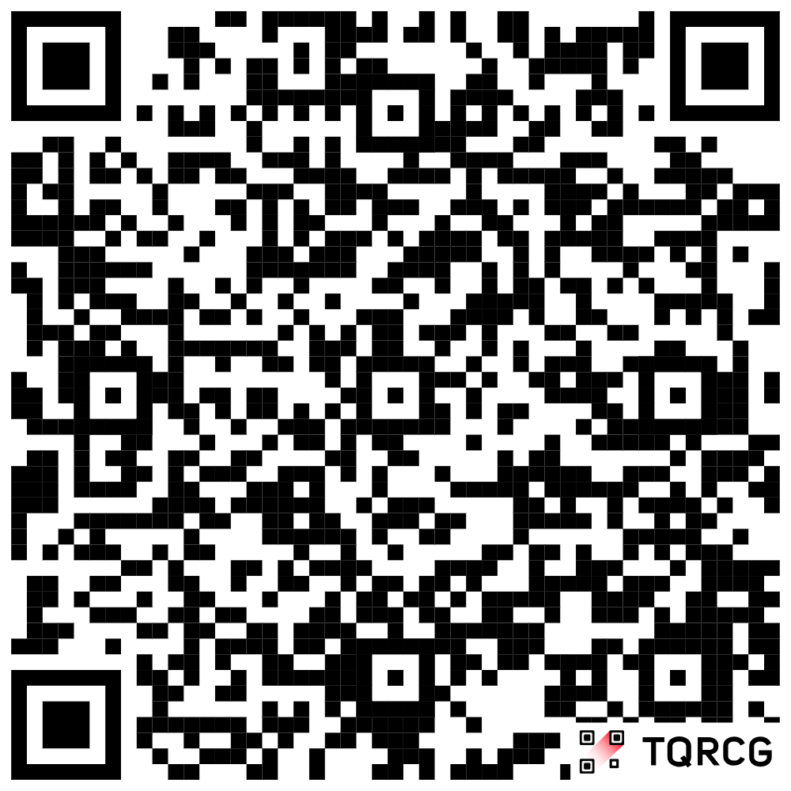
Want to see the teaching material, but can’t access Moodle? Visit the website via the QR code!
Notes:
Session 3 of 10. Sambach students plus open drop-ins; assume no natural science background. 14:15-16:00 with a break around 15:00.

Slide 3
My background and why I teach this session
Ecology & evolution
BSc Michigan, MSc Purdue, PhD Genetics (NC State, 2015)
Statistical and population genetics
Postdocs at UNC and the Institute for Biological Psychiatry
Biomedical data science at RUC
Register-based epidemiology, pharmacogenomics, Genome Wide Association Studies (since 2022)
Part 1 · The crisis · slide 2/24
Notes:
30 seconds. The point is credibility plus the bridge: genetic variation is a form of biodiversity, and it comes back in the banana case.

Slide 4
One central idea for today
Humans are removing the variety of life faster than at any point in our species' history, and the evidence is overwhelming!
1
2
3
4
5
What biodiversity is
The evidence
The drivers
The safe limits
Your turn
genes, species, ecosystems
populations, extinctions, biomass
five ways we cause it
planetary boundaries
case analysis in groups, after the break
Part 1 · The crisis · slide 3/24
Notes:
State the one idea in minute one and again at the close. Signpost the five arcs; the fifth is theirs.

Slide 5
Biodiversity means variety at three levels
1
2
3
Genes
Species
Ecosystems
Variation within a species
Variety of organisms
Variety of living systems
Wild banana relatives carry disease-resistance genes that plantation bananas lack.
Roughly 2 million species described; around 8 million estimated to exist.
A Danish bog, a coral reef, and farmland soil each run on different species interactions.
Losing any level is a loss: a species can survive while its genetic diversity, and its options, disappear.
Part 1 · The crisis · slide 4/24
Notes:
Definition slide. Stress the genetic level; social science students usually only know the species level. Sets up the banana case.

Slide 6
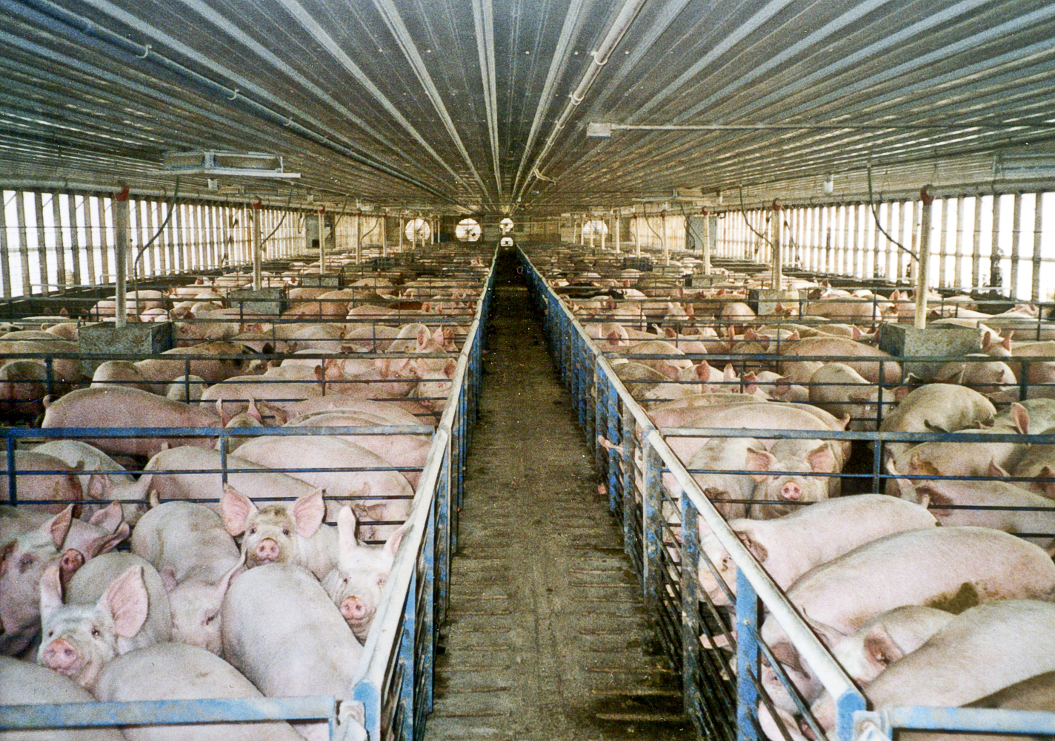
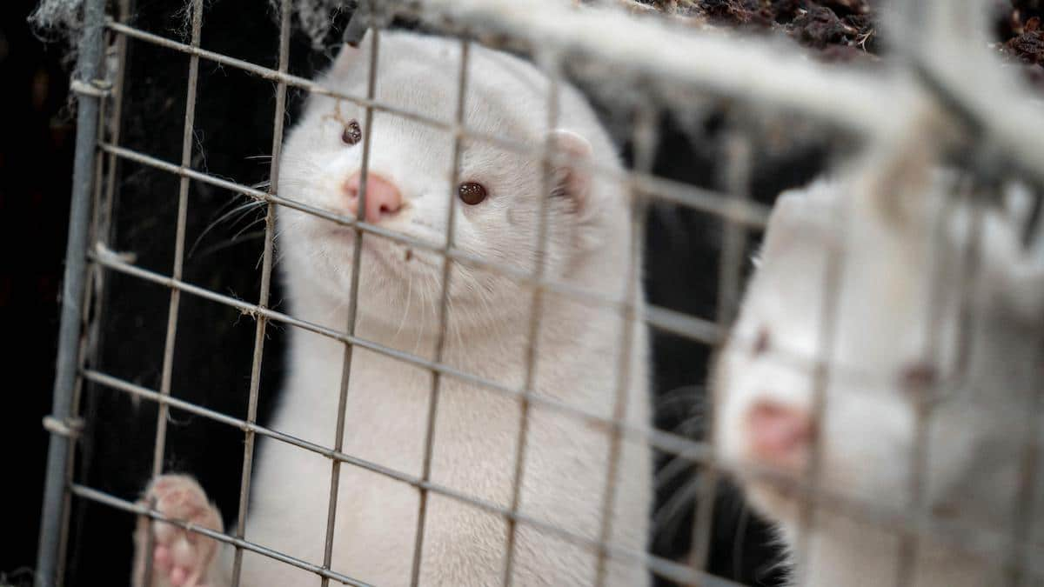
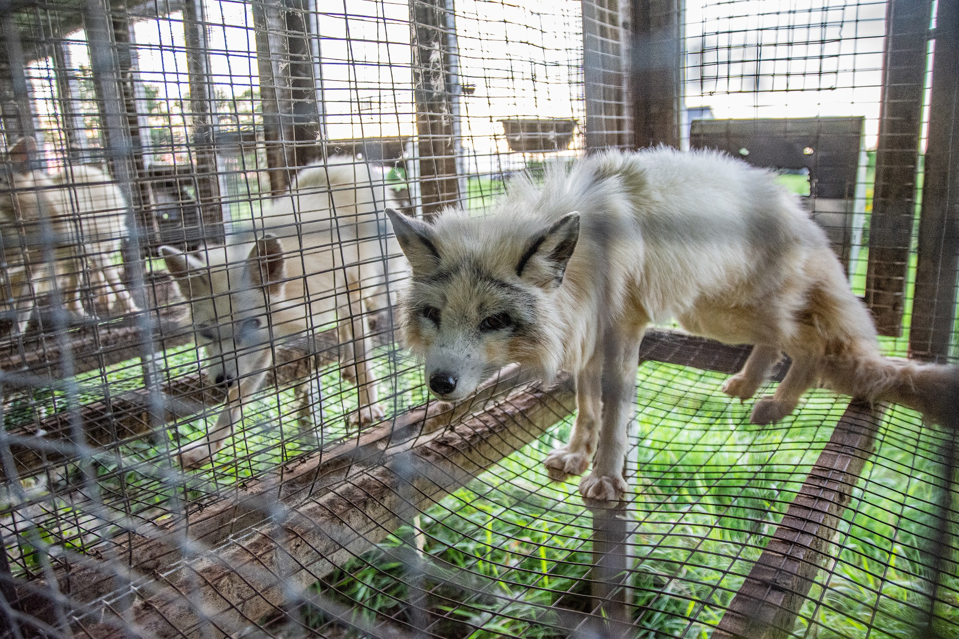
The living world is now mostly us and what we farm
Share of global mammal biomass
Livestock 60%
Humans 36%
Wild 4%
96%
~70%
75%
of mammal biomass is humans and livestock
of bird biomass is farmed poultry
of the land surface significantly altered by human activity
Sources: Bar-On, Phillips & Milo 2018 (PNAS); IPBES Global Assessment 2019
Part 1 · The crisis · slide 5/24
Notes:
The 'wow' slide. Ask the room to guess the wild share before revealing. Biomass estimates are in carbon; uncertainty is real but the pattern is robust.

Slide 7
Monitored wildlife populations declined 73% on average, 1970–2020
What this is:
the average trend across ~35,000 vertebrate populations of 5,495 species.
What this is not:
“73% of animals are gone.” It is an average of population trajectories, and averages hide winners and losers.
Source: WWF/ZSL Living Planet Report 2024
Part 1 · The crisis · slide 6/24
Notes:
Teach the number AND how to read it critically. This doubles as data literacy: an index is a model choice, and the headline stat is routinely misreported. Freshwater populations declined most (-85%).

Slide 8
Is extinction easy to measure?
What are some ways to measure the extinction rate of species?
How do we know if it is accelerating?
Notes:
Teach the number AND how to read it critically. This doubles as data literacy: an index is a model choice, and the headline stat is routinely misreported. Freshwater populations declined most (-85%).

Slide 9
Extinctions now run 10–100+ times faster than the background rate
~1 million
of ~8 million species are threatened with extinction (IPBES 2019)
The range is wide because we know only a fraction of species, extinction is hard to observe, and the background rate is itself estimated from fossils.
Even the conservative end is far outside anything in human history.
Part 1 · The crisis · slide 7/24
Notes:
Uncertainty as a feature of honest science, not a reason for doubt. E/MSY = extinctions per million species-years. Ceballos et al. 2015 is the conservative-assumptions paper.

Slide 10
Counting extinctions: 338 vertebrates verified lost since 1500
EX = extinct · EW = extinct in the wild · PE = possibly extinct
Vertebrate taxon | Highly conservative (EX) |  | Conservative (EX + EW + PE) |  | Assessed by IUCN
 | Since 1500 | Since 1900 | Since 1500 | Since 1900
Vertebrates | 338 | 198 | 617 | 477 | 59% (39,223)
Mammals | 77 | 35 | 111 | 69 | 100% (5,513)
Birds | 140 | 57 | 163 | 80 | 100% (10,425)
Reptiles | 21 | 8 | 37 | 24 | 44% (4,414)
Amphibians | 34 | 32 | 148 | 146 | 88% (6,414)
Fishes | 66 | 66 | 158 | 158 | 38% (12,457)
These are counts of documented losses. Every mammal and bird species has been assessed; only 38% of fishes have, so the total is a minimum estimate!
Source: Ceballos et al. 2015, Science Advances 1:e1400253, Table 1
Part 1 · The crisis · slide 8/24

Slide 11
Every group is losing species far faster than the fossil record predicts
Losses since 1900 would have taken 800 to 10,000 years at the background rate.
The dotted line is the same 500 years at 2 extinctions per million species-years, the rate the fossil record gives. The distance between it and the rest is the finding.
Redrawn from Ceballos et al. 2015, Science Advances 1:e1400253, Fig. 1A (highly conservative estimate)
Part 1 · The crisis · slide 9/24

Slide 12
Five mass extinctions in 540 million years. Is this the sixth?
444 Mya
372 Mya
252 Mya
201 Mya
66 Mya
Now
Ordovician
Devonian
Permian
Triassic
Cretaceous
Anthropocene?
~85% of species
~75%
~95% of marine species
~80%
~76%, end of dinosaurs
caused by one species
The five earlier events took thousands to millions of years and were driven by volcanism, asteroids, and climate shifts. The current pulse is unfolding over centuries. Whether it qualifies as a “mass extinction” yet is debated; the rate is not.
Part 1 · The crisis · slide 10/24
Notes:
Geological deep time gives the Anthropocene framing teeth: this is where the 'geological claim' from session 1 meets biology. Percentages are species-loss estimates and vary by study.

Slide 13
Five direct drivers, ranked by global impact (IPBES 2019)
1
Land- and sea-use change
Agriculture, logging, urbanization. The single largest driver on land.
2
Direct exploitation
Fishing, hunting, harvesting. The largest driver in the ocean.
3
Climate change
Shifting ranges, bleaching reefs. Rising fast; interacts with all the others.
4
Pollution
Nitrogen, pesticides, plastics. Nutrient runoff hits freshwater hardest.
5
Invasive species
Moved by trade and travel; islands are most vulnerable.
Part 1 · The crisis · slide 11/24
Notes:
Note that climate change is only #3 today but climbing; the biodiversity crisis is not reducible to the climate crisis. These five categories structure the exercise questions.

Slide 14
The reduction in biodiversity directly impacts you, and the food you eat!
Large scale agriculture reduces food biodiversity
How easy is it to find different varieties of bananas in your local store?
Notes:
Note that climate change is only #3 today but climbing; the biodiversity crisis is not reducible to the climate crisis. These five categories structure the exercise questions.

Slide 15
Your banana is a genetic monoculture
1950s
1960s
Today
One clone feeds the world
One fungus ends it
We are doing it again!
Gros Michel, grown clonally on vast plantations, dominates the export trade.
Panama disease (Fusarium wilt) sweeps through; with no genetic variation, no plants resist. Commercial collapse.
The replacement, Cavendish, is 99% of export bananas and just as clonal. Fusarium TR4 reached Latin America in 2019.
Genetic diversity is an insurance policy. Industrial agriculture systematically cancels it, then pays with fungicides, and eventually with collapse.
Part 1 · The crisis · slide 12/24
Notes:
Reused from my earlier lecture. Wild banana relatives carry resistance genes; should we breed or gene-edit them in? That question returns in the exercise: it is scientific AND political (who owns the solution, who bears the fungicide exposure).

Slide 16
The flavor outlived the variety: Tasting extinction?
Pass the snacks around
What is in your mouth
1
Take one banana and some banana candy.
· Flavoring was sold in the US in the 1850s, before most Americans had tasted a banana.
2
Taste both. Do they taste similar?
· One ester, isoamyl acetate, picked for a fruity note.
3
If there is more than one banana variety near you, compare those too.
· The candy tastes more like Gros Michel than Cavendish, because of the ester.
Footnote. Gros Michel still exists in a few place, however it can no longer be grown at industrial scale and consumed like before. That is what extinction usually means for a commodity crop.
Sources: Berenstein, in Mayer, Science Friday / Massive Science 2020; Swain, Massive Science 2020
Part 1 · The crisis · slide 13/24

Slide 17
Four things ecosystems do for us
Food security
Clean water
75% of food crops depend at least partly on animal pollination.
Wetlands and forests filter and regulate water; over 85% of wetlands are already lost.
Medicine
Stability
~70% of cancer drugs are natural products or synthetic compounds inspired by them.
Diverse systems absorb shocks: pests, drought, disease. Monocultures amplify them.
Part 1 · The crisis · slide 14/24
Notes:
The caveat line is the red thread to the critical sessions. Sources: IPBES 2019 (pollination, wetlands); Newman & Cragg 2020 (natural product drugs).

Slide 18
The boundaries interact: biodiversity loss and climate feed each other
warming shifts ranges, bleaches reefs, dries forests
Climate change
Biodiversity loss
degraded forests and soils release carbon instead of storing it
Example, the Amazon: deforestation plus warming weakens the forest's own rainfall recycling. Flores et al. estimate that by 2050, 10% to 47% of Amazonian forest will face compounding disturbances that could tip parts of it toward savanna, releasing stored carbon. A biodiversity problem becomes a climate problem becomes a biodiversity problem.
Source: Flores et al. 2024, Nature 626:555
Part 1 · Safe limits · slide 17/24
Notes:
Key concept: tipping point = self-reinforcing change that does not reverse when the pressure stops. This is why treating climate and biodiversity as separate crises fails.

Slide 19
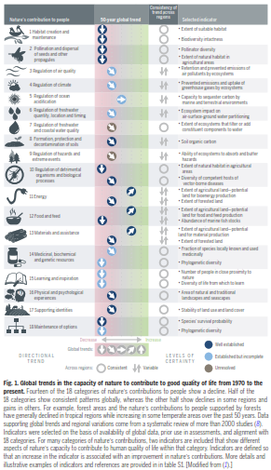
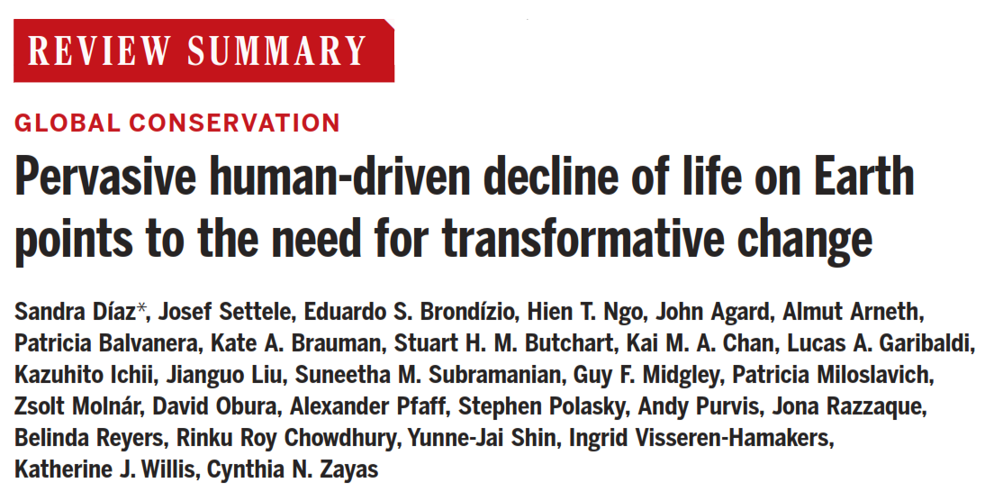
5-minute discussion in groups. Talk to your neighbor!
What is Figure 1 from this paper showing?

Slide 20
14 of the 18 contributions nature makes to people have declined since 1970
▲ The four that rose are the four we extract: Energy · Food and feed · Materials and assistance · Medicinal, biochemical and genetic resources
▼ The fourteen that declined
· Habitat creation and maintenance
· Formation, protection and decontamination of soils
· Pollination and dispersal of seeds and other propagules
· Regulation of hazards and extreme events
· Regulation of air quality
· Regulation of detrimental organisms and biological processes
· Regulation of climate
· Regulation of ocean acidification
· Learning and inspiration
· Regulation of freshwater quantity, location and timing
· Physical and psychological experiences
· Supporting identities
· Regulation of freshwater and coastal water quality
· Maintenance of options
Redrawn from IPBES Global Assessment 2019 (Díaz et al. 2019), Fig. 1 · slide 15/24

Slide 21
We take far more living matter from the world, and not from where we consume it
90% of land-related biodiversity loss and water stress comes from extracting and processing biomass.
Who consumes is not who extracts. Per person, high-income countries use about 13 times the materials of low-income countries. Rising consumption in richer countries is met by extraction elsewhere.
Panel C of Díaz et al. 2019, Science 366:eaax3100, Fig. 5, redrawn with values from the UNEP International Resource Panel (Global Resources Outlook 2019, 2024)
Part 1 · Safe limits · slide 18/24

Slide 22
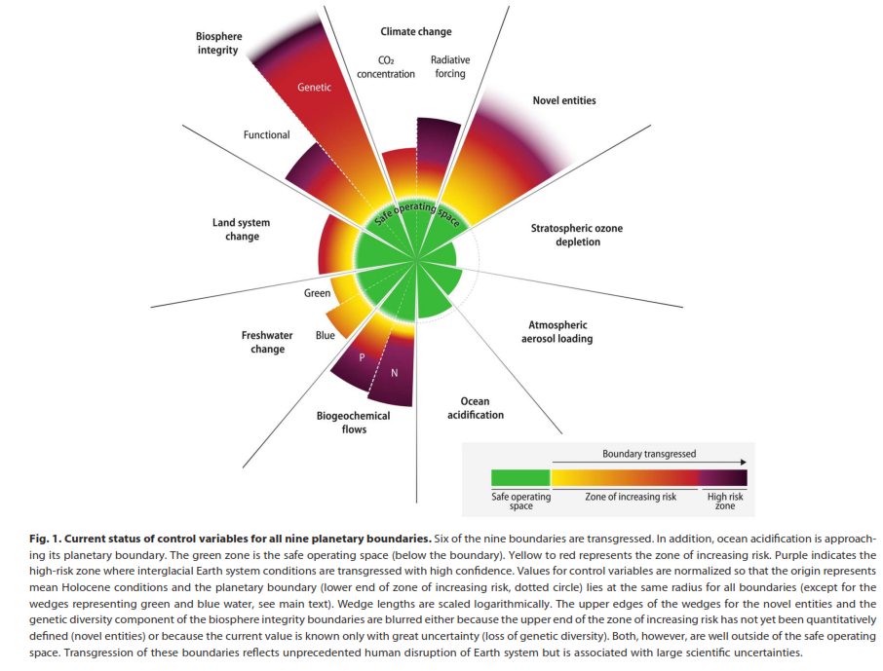
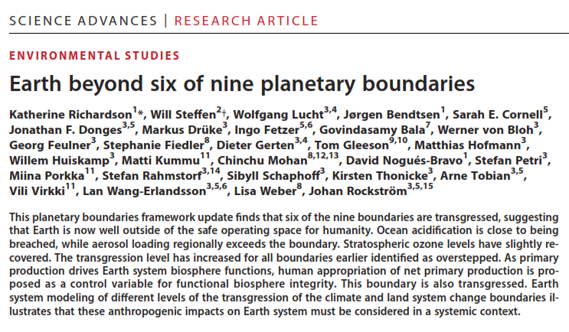
What is Figure 1 from this paper showing? (Review from last time)

Slide 23
What each boundary actually measures
Climate change
CO₂ concentration; radiative forcing
Biosphere integrity
Extinction rate (E/MSY); energy captured by plants
Land-system change
Forest cover remaining, by biome
Freshwater change
Soil moisture (green); river flow (blue)
Biogeochemical flows
Nitrogen and phosphorus applied to land
Novel entities
Synthetic chemicals released without safety testing
Ocean acidification
Aragonite saturation of surface seawater
Stratospheric ozone
Ozone concentration, Dobson units
Atmospheric aerosols
Aerosol optical depth, interhemispheric difference
Within the safe zone
Crossed
Far beyond
Crossed in 2025
Redrawn from Richardson et al. 2023, Fig. 1; status from Planetary Health Check 2025 · slide 16/24

Slide 24
What biodiversity loss says about the Anthropocene
As geological claim
Extinctions, invasions, and domesticated biomass will be legible in the fossil record. Future strata will show broiler chicken bones on every continent.
As political concept
“Humanity” did not clear the land equally. Land-use change and exploitation track specific economic systems, a thread session 4 picks up as the Capitalocene critique.
As cultural condition
How do you act on a curve you will never personally see the end of? Sessions 6 and 8 take over from here.
Part 1 · Safe limits · slide 19/24
Notes:
The red-thread slide, echoing session 1's three framings of the Anthropocene and handing off to later sessions. The closing line sets up the exercise's third question.

Slide 25
Break · 10 minutes
Back at ???? for the case exercise.
Notes:
Denmark answer for after the break: land use. Roughly 60% of Danish land is farmed, among the highest shares in the world.

Slide 26
Exercise: three biodiversity cases, three questions each
Form groups of 4–5. Each group takes one case. For your case, answer:
Q1 · Diagnose
Which of the five direct drivers are at work? Is the loss at the gene, species, or ecosystem level?
Timing
15 min group work
15 min report back
(5 min per case)
10 min open discussion
Q2 · Evidence
What data would demonstrate the problem, and what are its limits?
Q3 · Politics
Who decides what to do? Who wins and who loses? Where does the science stop and the value judgment begin?
Nominate one person to present. One key point per question is enough, and report any disagreement inside the group.
Part 2 · Exercise · slide 21/24
Notes:
Same format as my bird/fossil exercise but with an explicit interdisciplinary Q3, matching learning objective 3. With ~20+ students, run duplicate groups per case and have the second group add rather than repeat.

Slide 27
The cases
Case A
Case B
Case C
The last banana
The Danish farmland
The wolves return
Cavendish bananas are clonal and Fusarium TR4 is spreading. Options on the table: gene-editing resistance in, breeding from wild relatives, diversifying varieties, or accepting higher prices and fungicide use.
About 60% of Denmark is farmed; farmland birds and insects have declined for decades. The 2024 green tripartite agreement converts 400,000 hectares, about 15% of farmland, to forest and nature, and taxes farm emissions.
Wolves returned to Denmark in 2012, about 200 years after the last one was shot. They prey on sheep and divide rural and urban opinion. In 2025 the EU downgraded them from strictly protected to protected, which makes culling easier to authorize.
Part 2 · Exercise · slide 22/24
Notes:
A = genetic level, global commodity chain. B = ecosystem level, local and politically live. C = species level, conservation success that creates conflict. Each case has a real contested response, so Q3 has substance.

Slide 28
Report back, then two questions for everyone
Across the three cases
Did the science ever settle the disagreement, or did it sharpen where the disagreement is?
For this assignment
Write down the names of the people in your group, and upload the case notes your group made to Moodle before you leave!
Part 2 · Exercise · slide 23/24
Notes:
Keep report-backs to 5 min per case. If duplicate groups, second group adds one new point only. Close the discussion by 15:55.

Slide 29
The sentence to leave with
Humans are removing the variety of life faster than at any point in our species' history, and the evidence is overwhelming!
Next session · 28 September · Laura Horn
What can political economy tell us about the Anthropocene? Whether emissions can be decoupled from economic growth, what degrowth and post-growth offer, and who has paid and continues to pay for the transition.
Notes:
Leave this on screen for questions. Do not end on a 'Thank you' slide.

