Slide 1
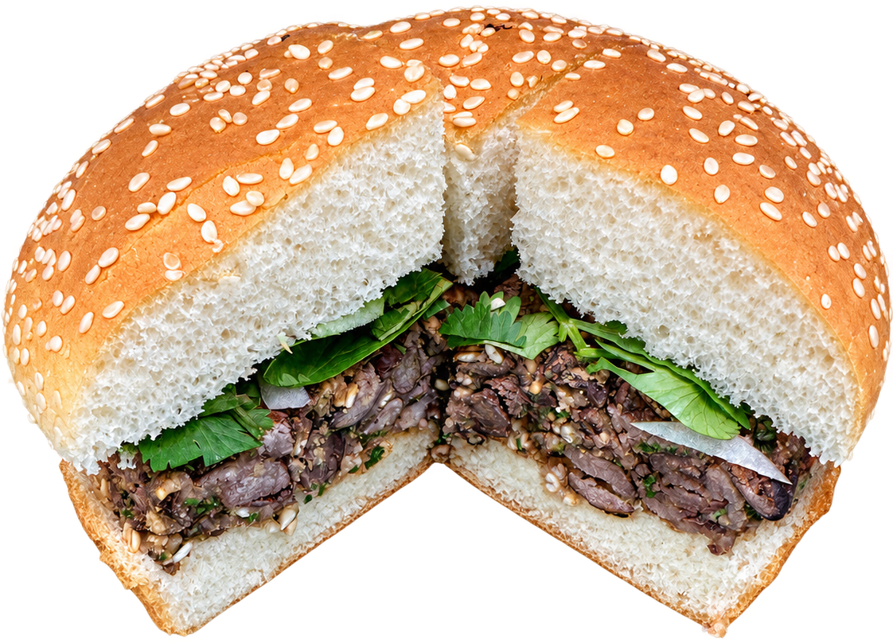
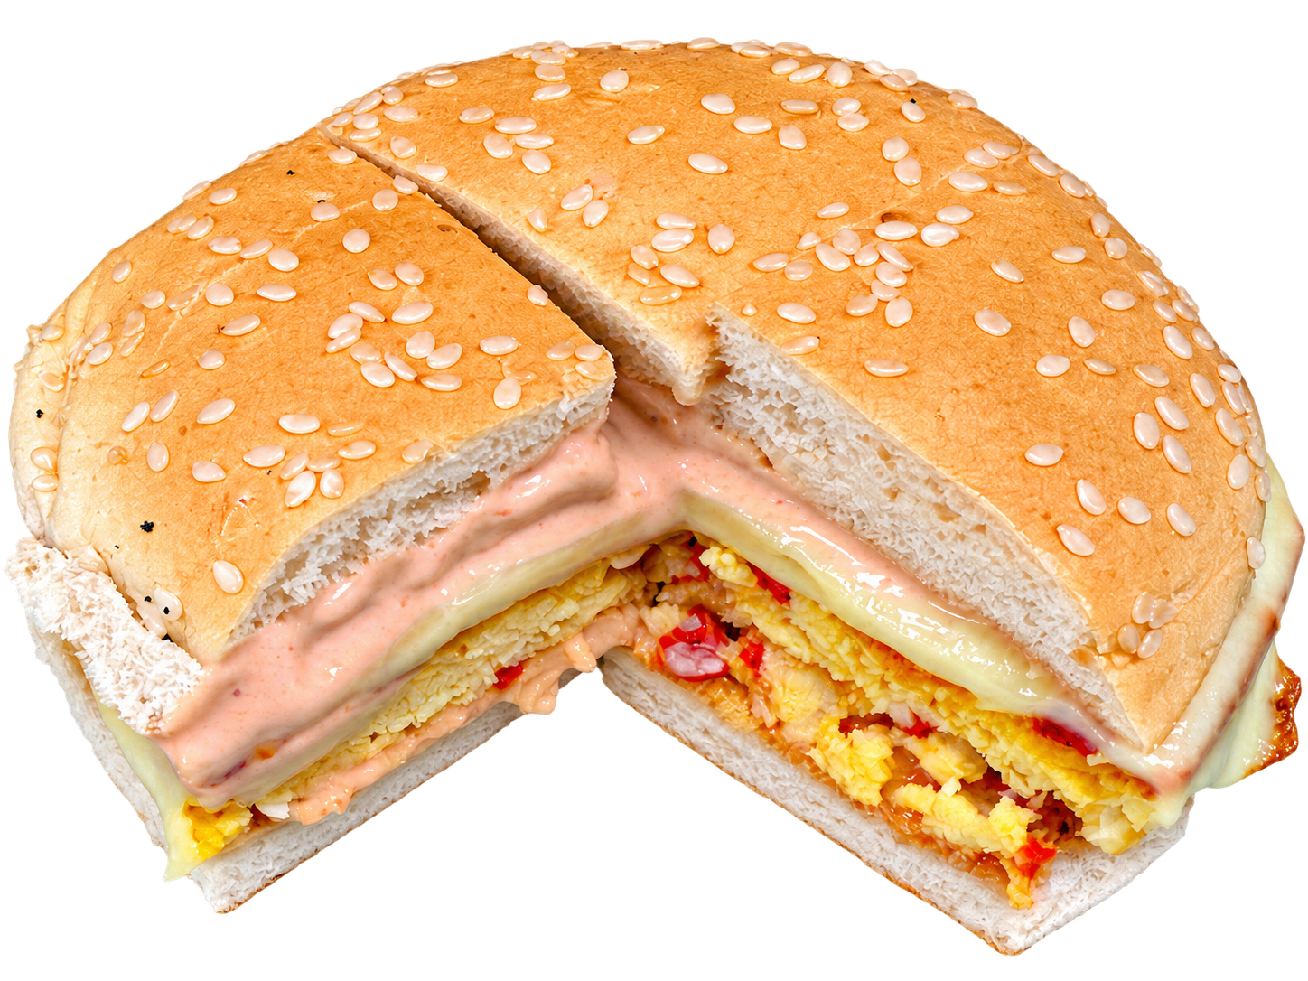
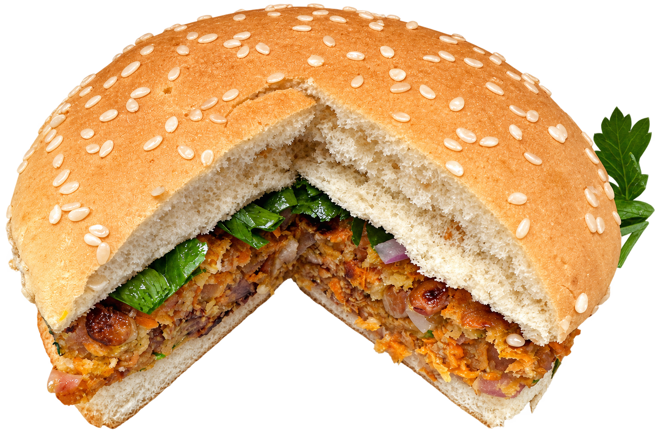
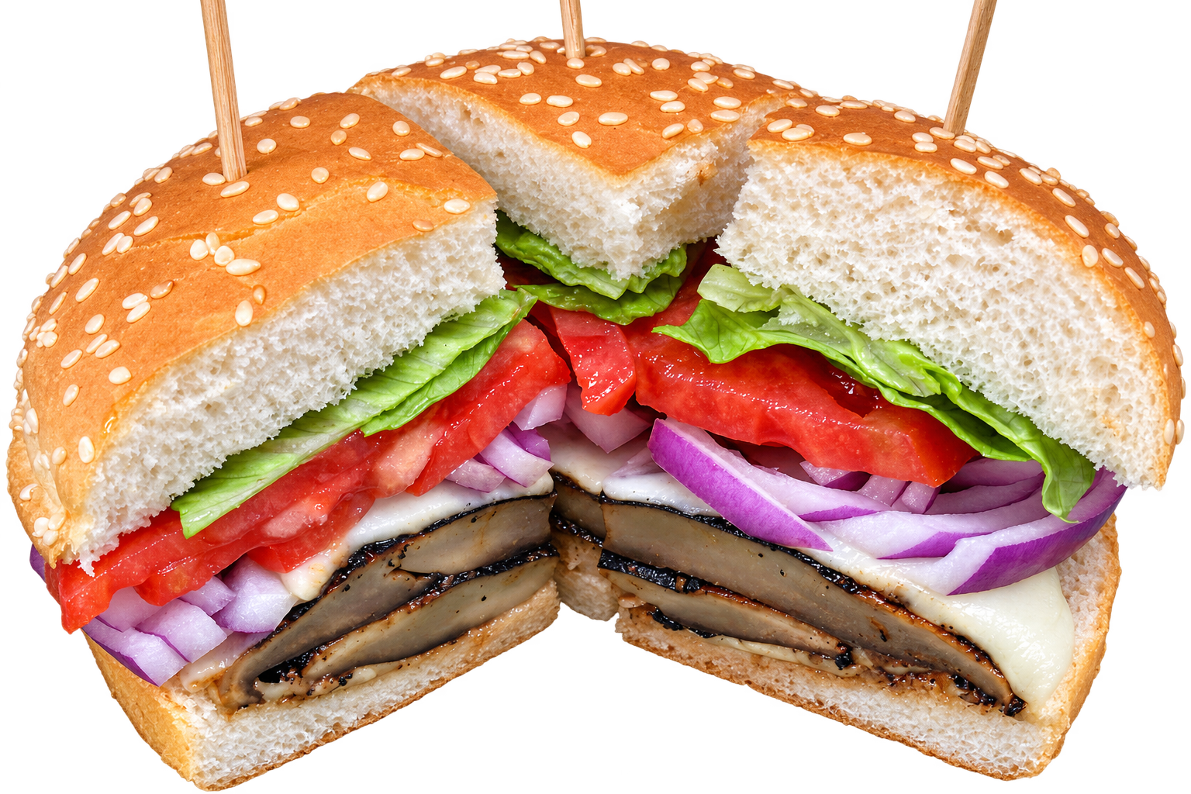
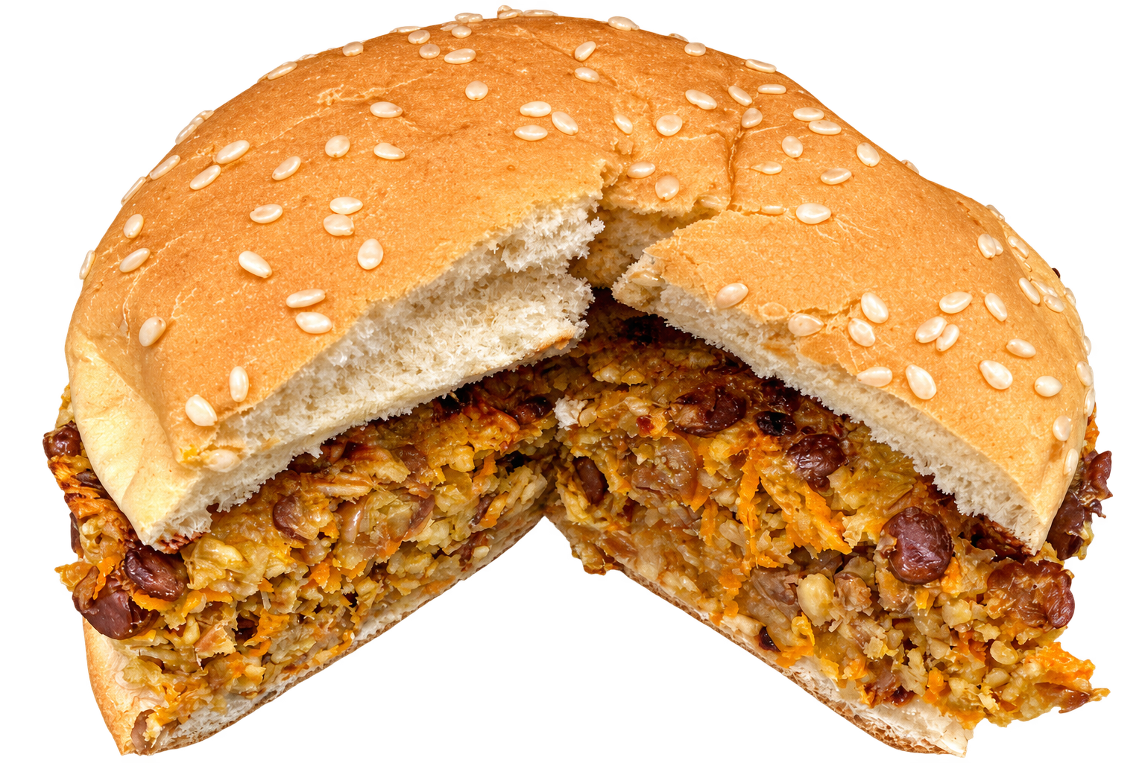
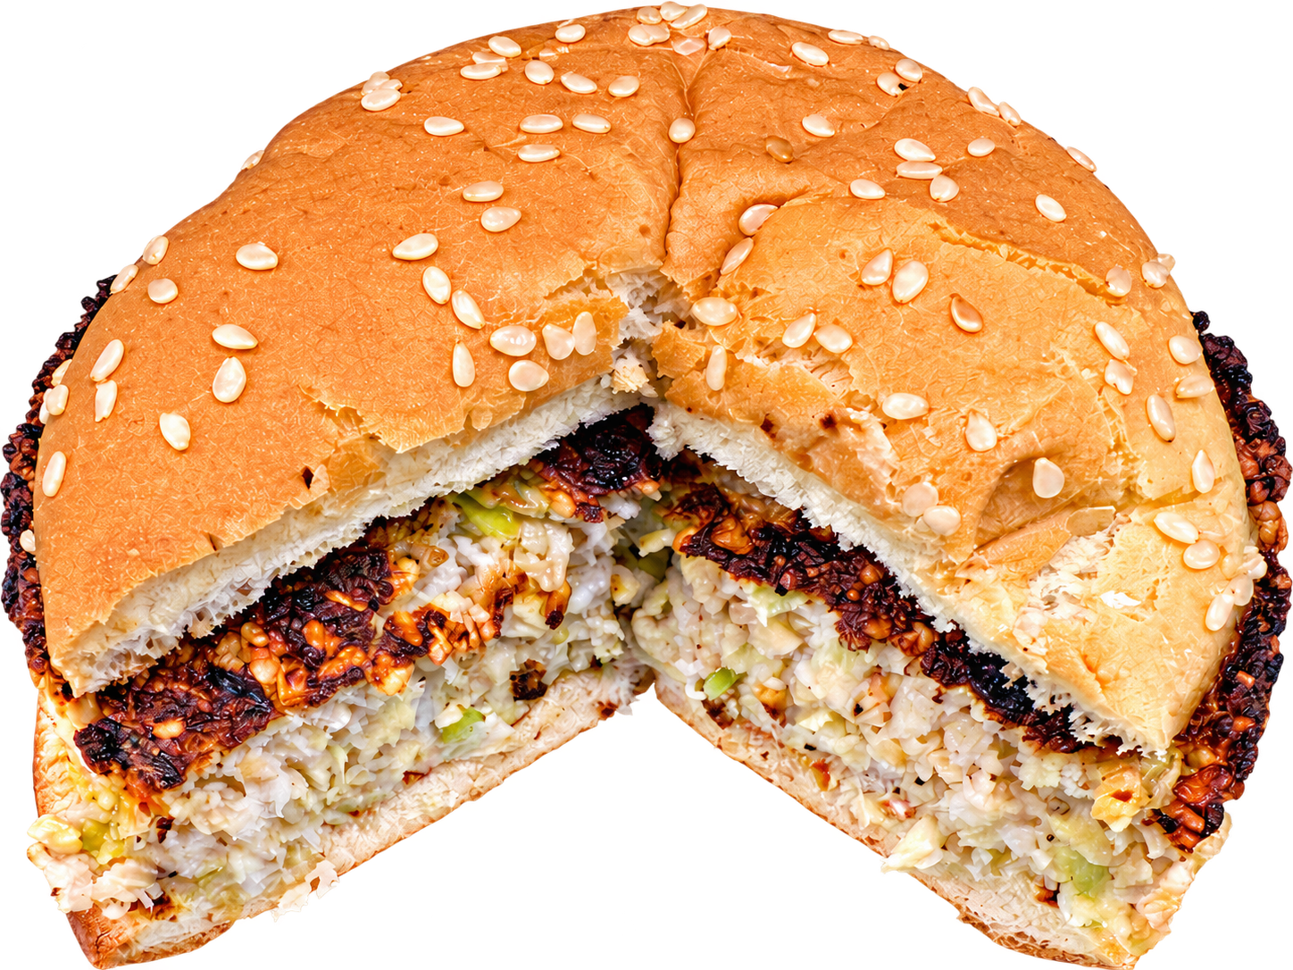
Fig. 2: AI generated burger recipes, and adjustments by the human chef.
Key observations:
The AI chef and human chef are in very good agreement for all recipes except oat burgers. The AI model needs to be enhanced with better/more data on oat burgers.

Slide 2
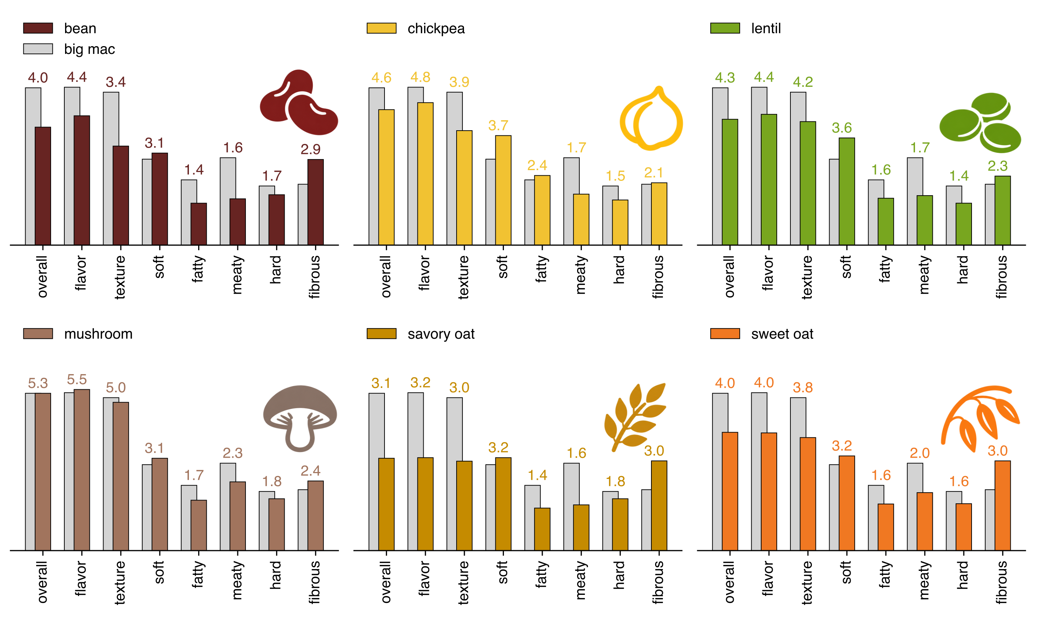
Fig. 1: Overall, flavor, and texture scores, and six textural attributes for the surveyed burgers.
Key observations:
The mushroom burger is on par with the big mac even though our cohort is omnivores.
The big mac is softer, meatier, and harder than all six. It is also less fibrous than all six. It is second in fattiness.
The sweet oat burger is significantly more liked than the savory oat burger, suggesting sweetness is very important.

Slide 3
Fig. 3: Environmental impacts of the surveyed burgers compared to the big mac on a per-calorie basis.
Key observations:
All the burgers have extremely low environmental footprints compared to a typical meat burger like the big mac. Most have less than 1/10 the impact of the big mac.

Slide 4
bean
mushroom
chickpea
lentil
savory oat
sweet oat
Fig. 4: Proposed sustainability facts labels alongside standard nutrition facts labels for the six burgers.
Key observations:
The sustainability facts label uses the big mac as the baseline due to its familiarity.
It also gives an intuitive environmental impact score alongside a colorbar for quick lookups.

Slide 5
Fig. 5: Correspondence analysis biplot for the 6 veggie burgers from the current study, as well as 4 meat-based burgers from our previous survey.
Key observations:
Most of the meat burgers are clustered together.
Most of the veggie burgers are significantly different from the meat burgers, and they are divergent (different in their own protein-specific ways).
The mushroom burger is associated closely with meat-based burgers.
The big mac (meat burger 1) is different from the other meat-based burgers. This could be because it is a fast food restaurant item.

Slide 6
Fig. 6: Mixed effects coefficients for texture and flavor score as determinants of overall liking, and flavor- and texture-related CATA attributes as determinants of flavor and texture scores, respectively.
Key observations:
Texture and flavor both have significant positive impact on overall liking.
The coefficients for texture and flavor are consistent with our previous findings. (The texture paper).
We only include the cata attributes that have statistically significant impact on the scores.
Good aftertaste and savory have the most positive impact, and weird aftertaste and off-flavor have the most negative impact on flavor score.
Holds together has the most positive and toughness has the most negative impact on texture liking.

Slide 7
Fig. 7: Predicted and observed scores using the constructed mixed effects model for the 6 burgers in the current survey (left). Validation of the model with unseen data from the previous survey (right).
Key observations:
The model predicts all three scores with high accuracy, even for the validation cases, and even without observing data for any meat burgers.

