Slide 1
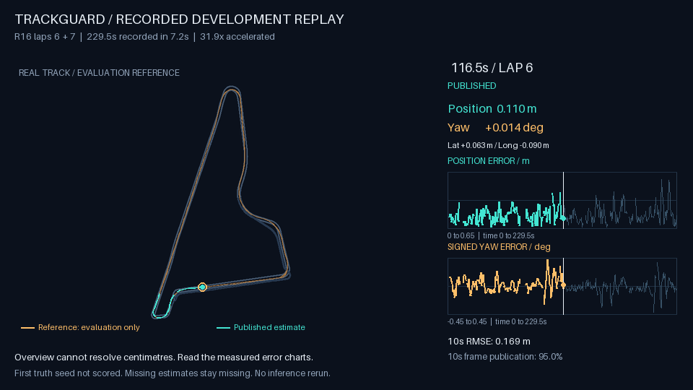
TRACKGUARD
REAL TRACK / SEALED DEVELOPMENT REPLAY
Vehicle localization
from the cameras
you already run
Seven calibrated cameras, a reference map and motion signals produce one shared vehicle pose.
Laps 6 + 7. One seed. 49 unavailable outputs.
POSE AVAILABLE
UNAVAILABLE
When geometric evidence is insufficient, the output is unavailable.
x y heading
No pose published
TRACKGUARD / CUSTOMER PILOT BRIEF / 22 OCT 2026
01
Notes:
Source: data/metrics.json and data/replay.json (approved derived evaluation display, 2026-10-22). The cover shows the real sealed R16 development replay. Architecture diagrams are illustrative. Raw recordings, world-coordinate poses and labels remain local. Recorded real-track replay of the selected R16 run; its reference is evaluator-only after sealed inference. Animation is accelerated and does not measure live throughput. The interactive dashboard retains all 460 rows.

Slide 2
CUSTOMER DECISION
An additional position signal for a mapped course
Vehicle autonomy leads
and track operators
THE PILOT DECISION
When the existing position signal weakens, can camera evidence provide a useful second input?
Is the signal accurate and available often enough for our course and operating conditions?
Existing inputs
Proposed integration
Value to test
Compatible calibrated cameras and a reference map
A timestamped pose and explicit availability status
Useful supplementary coverage within the existing stack
TRACKGUARD / CUSTOMER PILOT BRIEF / 22 OCT 2026
02
Notes:
Source: data/metrics.json and data/replay.json (approved derived evaluation display, 2026-10-22). The cover shows the real sealed R16 development replay. Architecture diagrams are illustrative. Raw recordings, world-coordinate poses and labels remain local. Customer value and integration fit are hypotheses for a pilot. No customer deployment, ROI or hardware saving has been measured. This is a supplementary signal, with no actuator authority in the proposed pilot.

Slide 3
SOLUTION
One vehicle pose from map geometry and motion
SYNTHETIC ILLUSTRATIVE GEOMETRY
CAUSAL ESTIMATION
Reference map
01 Geometry
Match the map and solve a consistent body pose.
BODY
02 Motion
Fuse motion signals with current and past evidence.
7 calibrated cameras
1 shared body pose
Map correspondences constrain camera poses.
03 Quality gate
Publish an accepted pose or mark it unavailable.
Calibration ties cameras to one vehicle frame.
The quality threshold remains uncalibrated.
TRACKGUARD / CUSTOMER PILOT BRIEF / 22 OCT 2026
03
Notes:
Source: data/metrics.json and data/replay.json (approved derived evaluation display, 2026-10-22). The cover shows the real sealed R16 development replay. Architecture diagrams are illustrative. Raw recordings, world-coordinate poses and labels remain local. Architecture is a conceptual explanation from the task and design contract. It does not specify unsupported sensor rates or production interfaces. Publication uncertainty threshold is uncalibrated, not an actual-error bound.

Slide 4
VERIFIED AGGREGATE EVIDENCE
Same-session development meets aggregate targets
Laps 6 + 7 / One continuous run / One initial truth seed / No lap 7 reset
17.48cm
11.42cm
94.8%
Position RMSE
Lateral RMSE
One-second coverage
Target ≤20cm
Target ≤20cm
Target ≥90%
Metric | Observed | How to read it
Position error, p95 | 31.95cm | RMSE is not a per-output guarantee
Yaw / longitudinal RMSE | 0.107° / 13.23cm | Wrapped heading / along-track position
Within 20cm, all planned | 71.24% | 327/459 non-seed frames, unavailable = miss
Published / unavailable | 411 / 49 | 460 planned, 89.35% publication fraction
Coverage counts occupied one-second bins. Development data is consumed, not untouched validation.
TRACKGUARD / CUSTOMER PILOT BRIEF / 22 OCT 2026
04
Notes:
Source: data/metrics.json and data/replay.json (approved derived evaluation display, 2026-10-22). The cover shows the real sealed R16 development replay. Architecture diagrams are illustrative. Raw recordings, world-coordinate poses and labels remain local. Position RMSE sqrt(mean(dx^2+dy^2)) on finite published estimates, excluding initial truth seed. Lateral error projects across ground-truth heading. One-second coverage differs from publication fraction. {"id":"later_laps","label":"Development laps 6 + 7","kind":"same-session development","coverage_percent":94.8,"planned":460,"published":411,"unavailable":49,"seed_count":1,"qualified":true,"note":"One continuous run. One initial truth seed. No reset between laps. Consumed development data, not untouched validation.","position_rmse_m":0.1747753326636938,"lateral_rmse_m":0.11421952782837566,"position_median_m":0.13351518078480298,"position_p95_m":0.31945388599089014,"position_max_m":0.5874495693389843,"within20cm_all_planned_percent":71.24183006535948,"within20cm_count":327,"scored_planned_excluding_seed":459,"paired_scored_frames":410,"longitudinal_rmse_m":0.13228876131541847,"yaw_rmse_deg":0.10694967979624358,"absolute_lateral_p95_m":0.25184152755336653,"absolute_lateral_max_m":0.5706257251895852,"absolute_longitudinal_p95_m":0.2595835414358725,"absolute_longitudinal_max_m":0.39985447463360063,"absolute_yaw_p95_deg":0.21044725023463787,"absolute_yaw_max_deg":0.41764192530648103}

Slide 5
OPERATIONAL BOUNDARIES
Coverage and cold start remain
the deployment blockers
Original 131-second stress window
Blind day replay
18.48 / 9.95cm
0 / 148
Position / lateral RMSE on published poses
Published / planned groups, all unavailable
72% coverage: FAIL
Never initialized
179/263 published, 84 unavailable.
Separate seeded window. Below 90% target.
No truth labels or initial seed. No RMSE.
No approved three-camera fix.
Next proof: independent day/night runs, reliable cold starts and calibrated confidence.
End-to-end latency is unproven. No production deployment or safety certification.
TRACKGUARD / CUSTOMER PILOT BRIEF / 22 OCT 2026
05
Notes:
Source: data/metrics.json and data/replay.json (approved derived evaluation display, 2026-10-22). The cover shows the real sealed R16 development replay. Architecture diagrams are illustrative. Raw recordings, world-coordinate poses and labels remain local. Stress is not ranked. Day: 73.9s, 148 complete groups at 2 Hz, 145 geometry rejects, 3 single-camera results. Day coverage uses 74 camera-time bins without ground-truth interval. No independent-session 20cm result, live 10Hz measurement, GPU speed result, deployment or safety certification. Nominal 0.20m publication uncertainty threshold is uncalibrated and cannot guarantee actual error. Earlier R14 raw geometry timing is not R16 end-to-end latency.

Slide 6
PROPOSED CUSTOMER PILOT
One vehicle. One mapped course. A decision in four weeks.
Offline replay, then
shadow operation
Acceptance item | Proposed target
Independent day + night | Freeze map and parameters before capture
Position / lateral RMSE | ≤20cm each on published non-seed poses
One-second coverage | ≥90% in each agreed test condition
Cold start, no truth seed | ≥95% of agreed starts within 30s
Tail error + missing poses | Report p95 and all-planned within 20cm
Signal integrity + latency | 100% explicit unavailable states, measure p95
Use compatible existing cameras and recorded motion signals. Keep the output outside vehicle control.
Customer contribution
Course access, calibration, an independent evaluation capture and an agreed latency budget.
Decision: extend the pilot only if the agreed gates pass.
TRACKGUARD / CUSTOMER PILOT BRIEF / 22 OCT 2026
06
Notes:
Source: data/metrics.json and data/replay.json (approved derived evaluation display, 2026-10-22). The cover shows the real sealed R16 development replay. Architecture diagrams are illustrative. Raw recordings, world-coordinate poses and labels remain local. Proposed pilot, scope and acceptance targets, not measured achievements or committed delivery dates. Week 1 calibrate/freeze/evaluation design, week 2 independent capture, week 3 replay and cold-start evaluation, week 4 shadow integration only if earlier gates pass. Agree denominator and trial count for cold-start target before capture. No truth seed enters the proposed deployment signal. Independent ground truth is evaluation only and must remain separate from map construction. Timing target requires customer stack budget agreed before evaluation. Report failures and unavailable outputs. No safety certification or ROI claim.

