Slide 1

Traditional and Modern Aboriginal Games

Slide 2
First Nations Games
Games are intertwined with traditional and cultural values that centre on: sportsmanship, competition, setting goals, having fun and desire to perform.

Slide 3
First Nations Games
Many First Nations games have similarities from one group to another. Games have filled an important role in education, refining life skills and the development of the physical and social self.
Often new games were received as gifts from another tribe.
Games varied slightly from tribe to tribe.

Slide 4
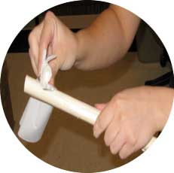
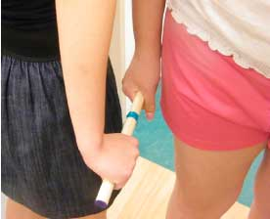
Similar to the Inuit games many First Nations games do not require much equipment.
STICK PULL
Greasing the stick in order to prepare the stick for the game
Trying to pull the stick out of each other’s hand

Slide 5
First Nations
Hand Games
Hand games involve hiding and guessing objects through using elaborate hand signals, songs, rhythms and gestures to both hide and find the object.
Years ago hand games were played as a form of gambling among friends and different groups. People would gamble for bullets, furs, dogs toboggans, or stick matches.

Slide 6
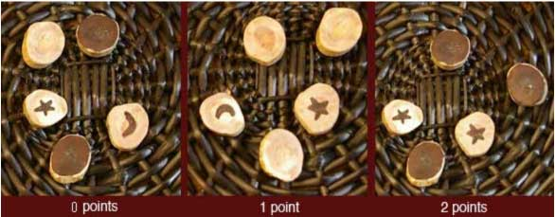
First Nations
Games of Chance
The games of chance that are shown in this project mostly deal with dice and gambling.
Plum Stones Game

Slide 7
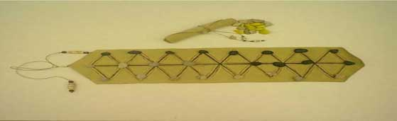
First Nations
Games of Strategy
Games of strategy describe games where decision making skills directs the results of the game.

Slide 8
Métis Traditional Games
Métis games were designed to teach children critical thinking and manual dexterity skills.
The games helped bring some excitement to the winter months or to engage children.

Slide 9
Métis Traditional Games
Several of these games were adopted from Plains and Boreal Forest First Nations, such as the Dene and Plains, and Woodland and Swampy Cree, respectively.
While some of the games were modified within Métis communities, many are still played in their original forms.

Slide 10
Metis Traditional Games
The Métis have long enjoyed playing cards, an activity very popular among their voyageur ancestors.
Card games of European origin have long been a form of social gambling for the Métis.

Slide 11
Inuit games
Many traditional Inuit games need little, if any, equipment. Games require no special equipment or are played with small pieces that allowed for easy transportation when the Inuit moved around the Arctic. This allowed people to play anytime they came together.
These games often require concentration, physical strength, agility, and endurance.

Slide 12
Inuit Games
The skills required in the games often represent those skills that are necessary for survival.
For example, strong arms and hands were required to harpoon walruses, whales and polar bears and then hold on to the struggling animal.

Slide 13
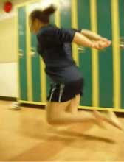
“One Elder mentioned that this Game was used to prepare hunters for conditions they may face on the land or frozen water. This game help enable hunters to move quickly when ice started to break.”
The player must jump up from a kneeling position and spring themselves forward to jump as far as they can. The winner travels the farthest distance forward.
http://www.youtube.com/watch?v=YLHQ6SctK1c

Slide 14
Modern Day Games
Some of today’s favorite pastimes come from First Nations culture. These include: tobogganing, snowshoeing, shinny, lacrosse, hide and seek, tag and canoeing.
Many popular team sports such as: basketball, hockey, football and baseball were all invented within the last two hundred years and seem to be based on Indigenous games.

Slide 15
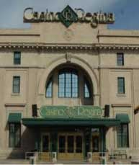
Casinos
First Nations run casinos tend to hire a large number of people helping in the employment rate for both skilled and unskilled jobs.
In Saskatchewan there are six First Nations casinos these casinos include machines, live table games, a full line of food and live entertainment

Slide 16
Aboriginal Athletes
Jordin Tootoo
Jordin Tootoo became the first Inuk to play in an NHL game and is a role model for many youth. He is known for giving a full effort on the ice even though he only stands at 5'-9" tall, making him one of the NHL's shortest players. Jordon is proud to be Inuit and often highlights the rights of Inuit people.

Slide 17
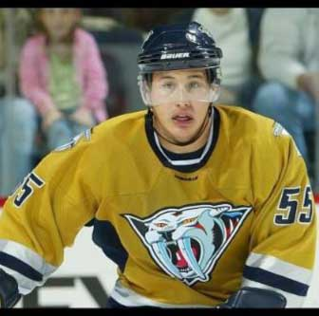
Jordin Tootoo
Jordin Tootoo became the first Inuk to play in an NHL game

Slide 18
Tom Longboat
Tom Longboat has been called the greatest marathon runner of all time, and one of the greatest Canadian athletes that ever lived. He has been inducted into the Canadian Indian Hall of Fame and the Canadian Sports Hall of Fame.
During a time of long distance running, Longboat was the greatest of them all, he had won more races than any runner in his generation and triumphed at every distance from three miles to marathons.

Slide 19
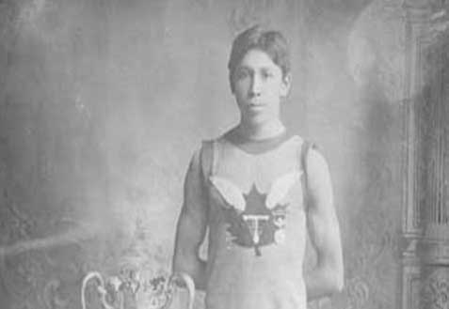
Tom Longboat

Slide 20
Neil Hughes
Neil Hughes is a Metis man who plays football for the Saskatchewan Roughriders in the CFL.
Neil played his collage football with the Regina Rams at the U of R and was named a Canada West All-Star.
Neal is a member of the 2007 Grey Cup Championship team.

Slide 21
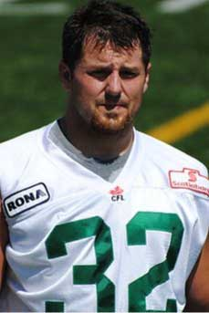
Neil Hughes

Slide 22
Andrew Merasty
Eighteen year-old Andrew Merasty from Northern Saskatchewan, completed a bike marathon across Canada, and achieved a personal goal.
When his dad was asked the purpose of his sons marathon he replied, “I wanted a change in lifestyle. I wanted to get in shape and just accomplish something for myself.”

Slide 23
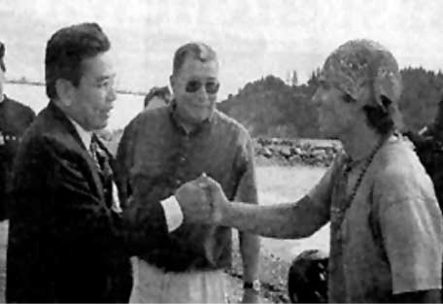
Andrew Merasty

Slide 24
References
http://www.gamesmuseum.uwaterloo.ca/VirtualExhibits/Inuit/english/index.html
http://www.denegames.ca/dene-games/hand-games.html
http://www.manataka.org/page103.html#Introduction%20to
http://www.royalsaskmuseum.ca/education/pdf/Time_Well_Spent.pdf

Slide 25
References Continued
http://www.metismuseum.ca/media/db/00724
http://www.yasc.ca/TraditionalSportsDescription/tabid/67/Default.aspx
http://www.pocketwatchgames.com
http://mathcentral.uregina.ca/RR/database/RR.09.00/treptau1/
http://nealhughesfootball.com/bio.htm

