Slide 1
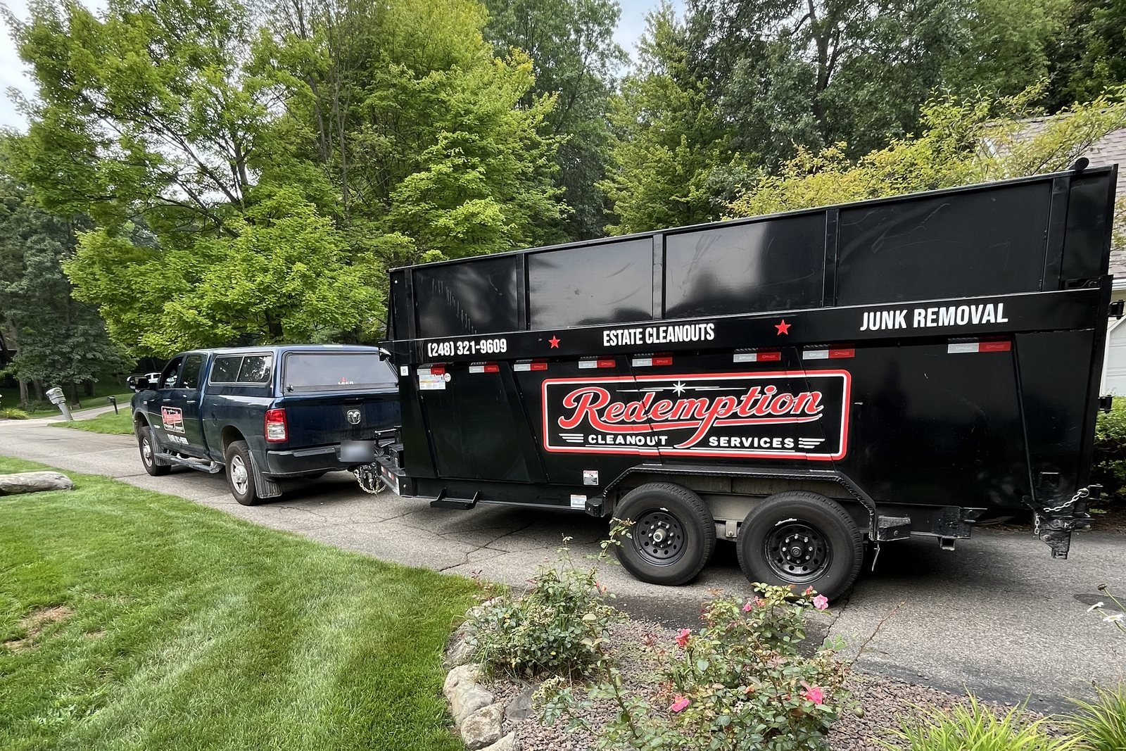
PROJECT REVIEW · LIVING WATER NETWORK
REDEMPTION
CLEANOUT SERVICES
Everything built and shipped — from first line of code to a live site and a Google listing.
September 1, 2026
Notes:
Cover. Photo is Redemption's own branded truck and trailer, pulled from the company Drive — no stock imagery anywhere in this deck, matching the site's content policy.

Slide 2
WHERE IT STANDS TODAY
The site is live, and everything you asked
for in your review is on it.
redemptioncleanoutservices.com is serving to the public over HTTPS, on both the apex and www. Google is allowed to crawl every page. The restructure you asked for is not staged or waiting — it shipped and it is what visitors see right now.
53
27
32
117
PAGES LIVE AND
INDEXABLE
METRO DETROIT
CITY PAGES
REAL JOB PHOTOS,
ZERO STOCK
WRITTEN FAQ
ANSWERS
Notes:
53 = the exact URL count in the live sitemap.xml, verified today. 27 city pages, 7 county pages, 2 service pages, plus the guides, legal and static pages. 32 photos = files in public/images/photos, all from Redemption's own Drive. 117 = FAQ question entries counted across src/content (12 site FAQ, 12 service, 14 county, 79 city).

Slide 3
YOUR REVIEW, ANSWERED
You asked for six changes. All six are live.
1
Make it simpler
2
Stop making it about Rochester
Eight service pages became two. Home page cut from 13 sections to 8.
Two Rochester pages became seven counties and 27 named cities.
3
Demolition is a real service, not "light"
4
Just show the photos
Promoted to a full service line, licensed and insured, up to full teardowns.
/projects is now one clean gallery of all 32 photos — no per-project pages.
5
Quote the way we actually quote
6
Lead with the slogan
Ballpark from photos over the phone; the real number given on site, in person.
"Redeem Your Property. Redeem Your Space." is the home page headline.
Notes:
These six map directly to the changes recorded in HANDOFF.md §0b as coming out of the client's own site review. Each one is verifiable on the live site right now.

Slide 4
THE PART NOBODY SEES
Removing pages is where most sites quietly
lose their Google ranking. This one didn't.
When a page disappears, every link pointing at it — and everything Google learned about it — normally dies with it. Every retired page here permanently forwards to the page that replaced it, so the old address still works and the credit carries over.
EXAMPLES
/services/estate-cleanouts
→ full-property-cleanouts #estate
/services/light-demolition
→ /services/demolition
/who-we-serve/realtors
→ /services/full-property-cleanouts
/service-areas/rochester-mi
→ oakland-county-mi/rochester-mi
17
0
OLD ADDRESSES
PERMANENTLY FORWARDED
DEAD LINKS OR
404 PAGES
Notes:
17 = the entries in legacyRedirects in next.config.mjs, each returning a permanent 301. Verified live today: /who-we-serve and /services/estate-cleanouts both return a redirect, not an error.

Slide 5
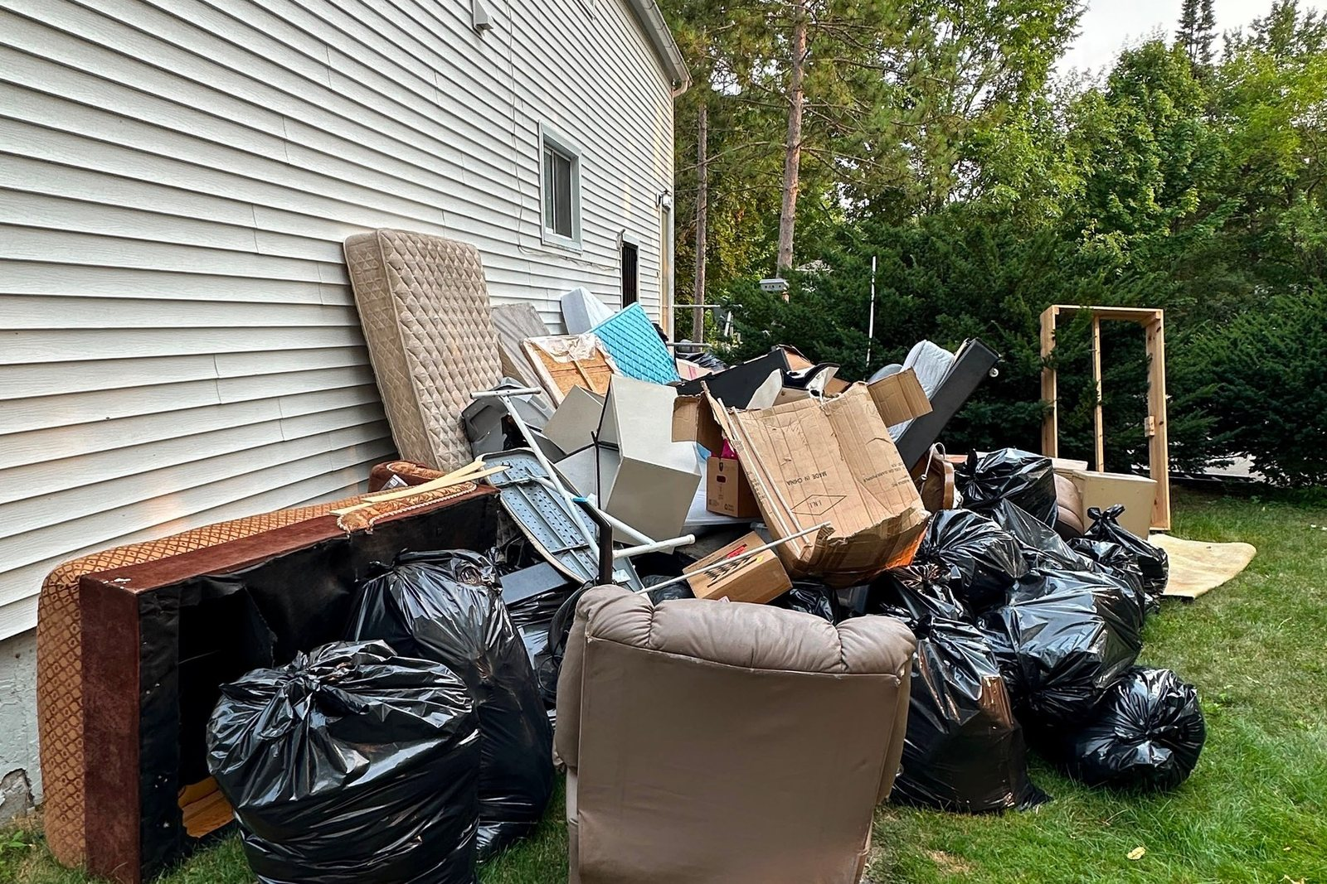
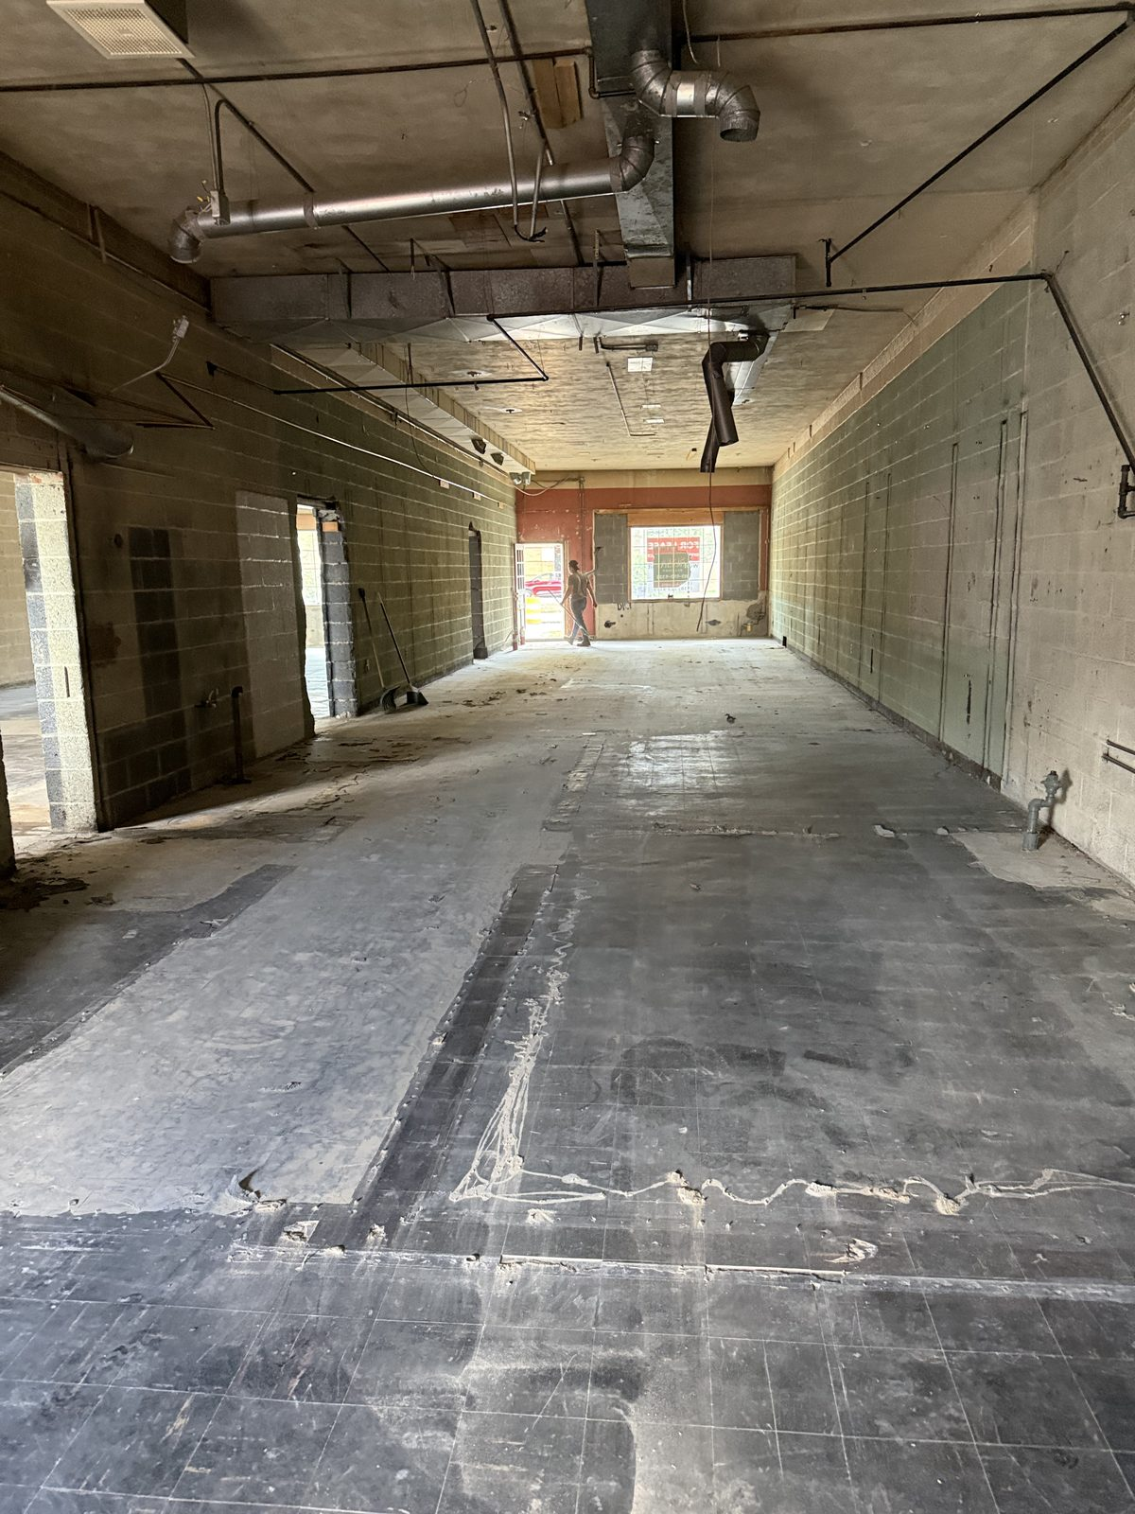
WHAT YOU SELL, IN TWO PAGES
Two services, not eight.
FULL PROPERTY CLEANOUTS
DEMOLITION
Estate · Foreclosure · Commercial · Severe clutter · Move-out · Junk removal
Each is its own section on one page, so a searcher lands on the exact kind of job they have — without you maintaining six pages.
Interior gut-outs · Garages · Decks · Sheds · Pole barns · Concrete · Full structure teardowns
No longer "light demolition" anywhere on the site, and the old URL forwards to the new page.
Notes:
Service names taken verbatim from src/content/services.ts. Photos are Redemption's own: a full property cleanout load-out, and the finished commercial gut-out from the August demolition job.

Slide 6
COVERAGE
All seven Metro Detroit counties.
Each one has its own page. Before your review the site claimed two cities. It now claims the area you actually serve — and says it in the places Google reads.
OAKLAND
WAYNE
MACOMB
WASHTENAW
7 city pages
6 city pages
5 city pages
3 city pages
27 city pages in total.
Adding the 28th costs
copy, not code.
LIVINGSTON
ST. CLAIR
MONROE
2 city pages
2 city pages
2 city pages
Notes:
Counts are the live city pages per county in the sitemap. The architecture point is real: a new city is one content file, and the page, its county page, the navigation and the sitemap all update themselves.

Slide 7
THE 27 CITY PAGES
Anyone can spray a city name across a template.
Google punishes that.
A set of pages that differ only by the city name is a pattern Google specifically demotes — and it drags down the pages that were already working. So every one of these 27 was written about that city's actual housing, streets and access problems, then reviewed independently before launch.
WHAT THE REVIEW CAUGHT
Invented local facts — figures, landmarks and neighborhoods that could not be verified
Passages that read identically on two different cities
Claims about jobs the company has not confirmed doing
Three lines that described the people in a neighborhood rather than the buildings
79
79
PROBLEMS FOUND IN
INDEPENDENT REVIEW
FIXED BEFORE A SINGLE
PAGE WENT LIVE
Notes:
The review was run page-by-page against the 27 city files and logged in CITY_PAGE_FIXES.md; the fixes are in the git history as one commit per county. An automated gate (tools/check-city-pages.mjs) now blocks unverifiable claims, prices, statistics and phrase overlap above 18% between any two pages.

Slide 8
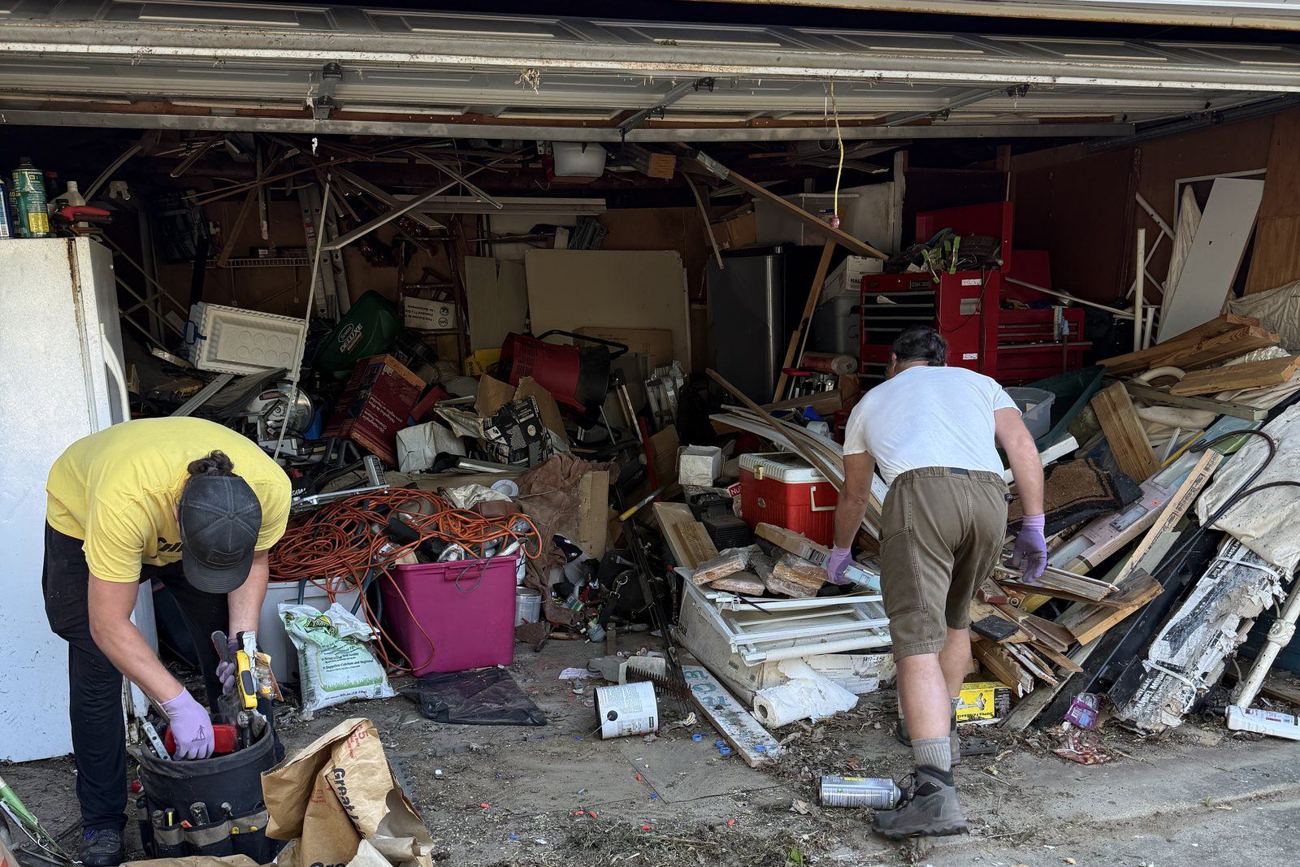
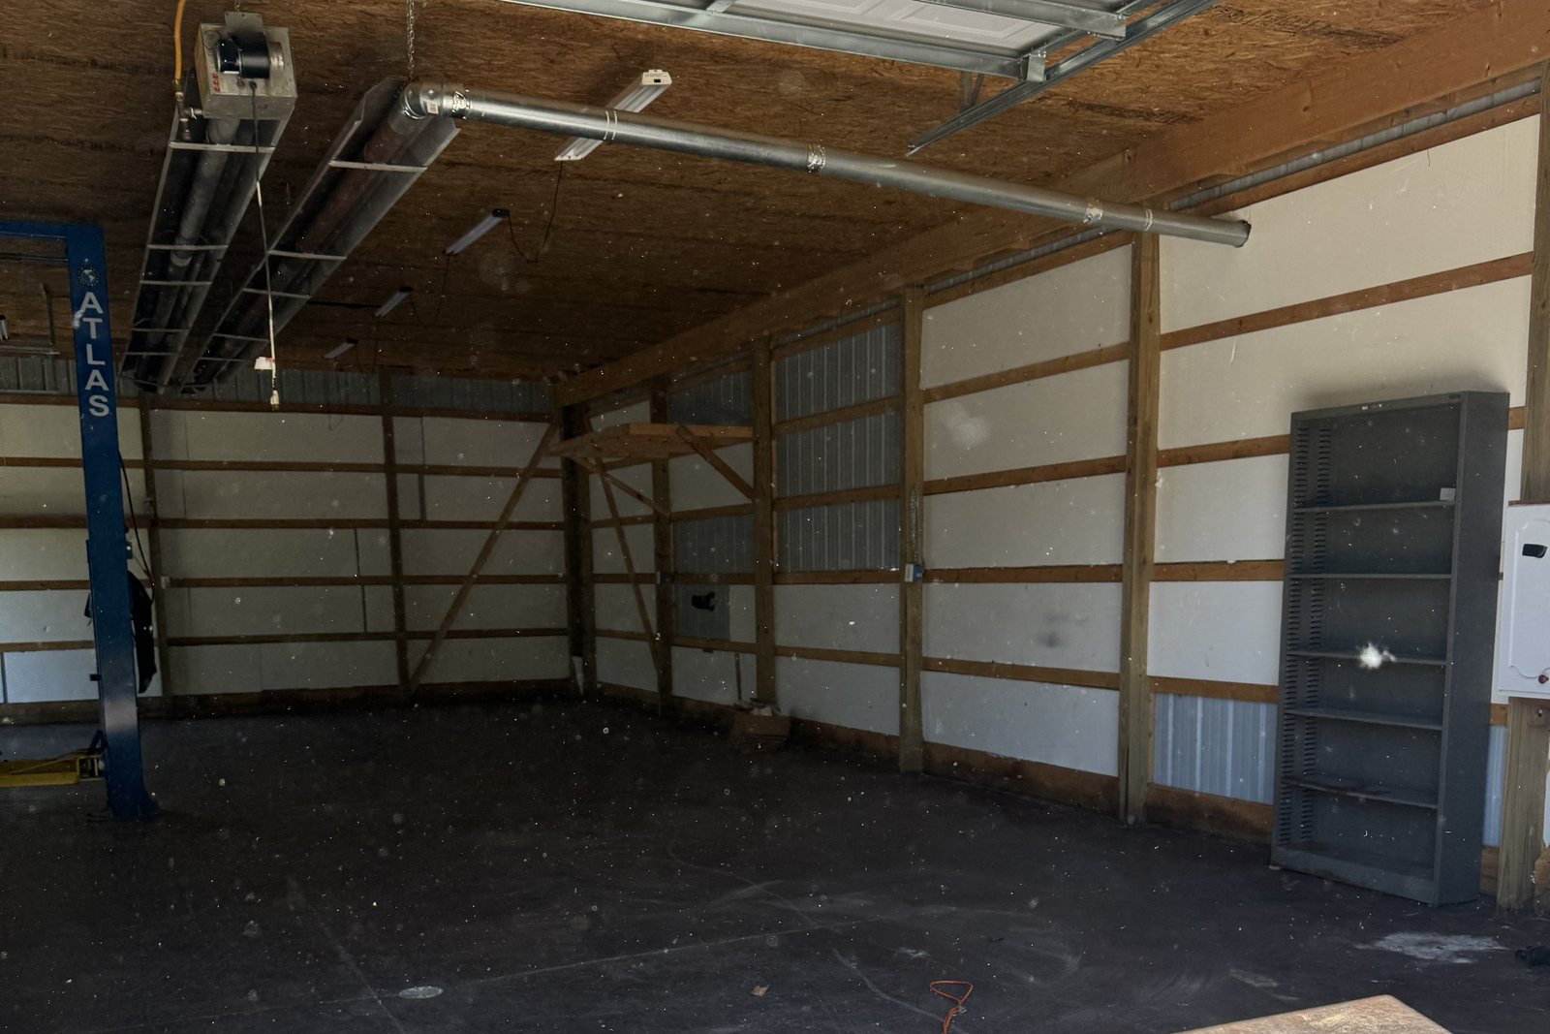
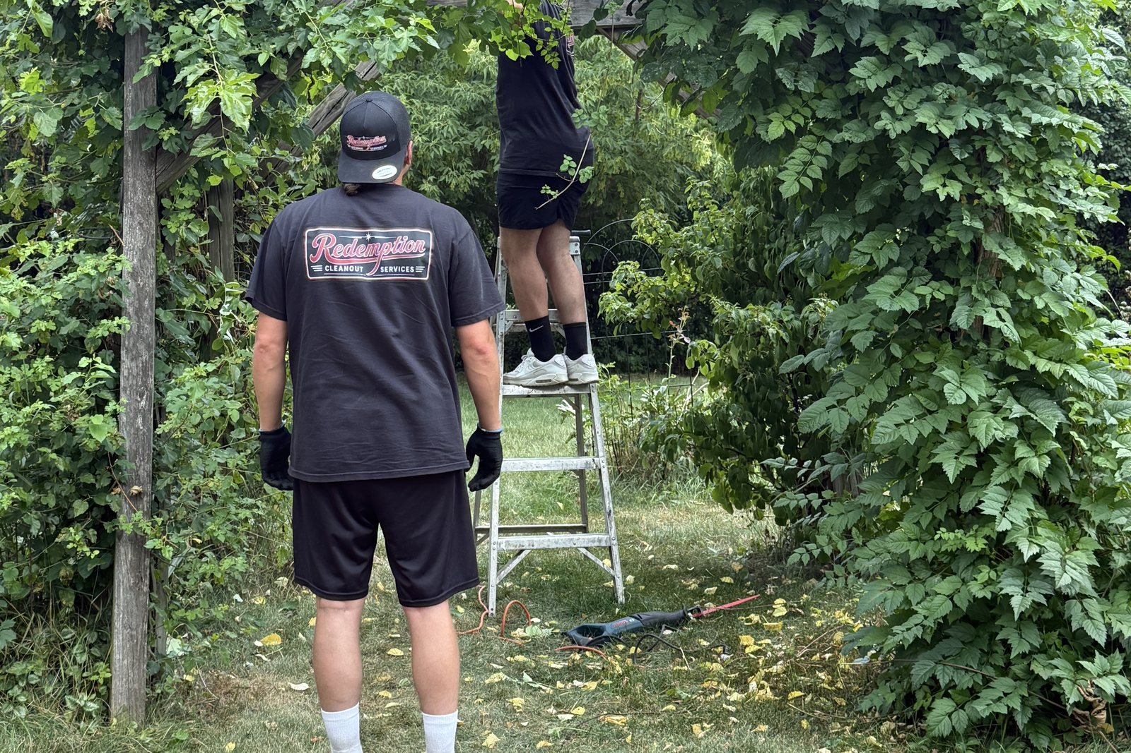
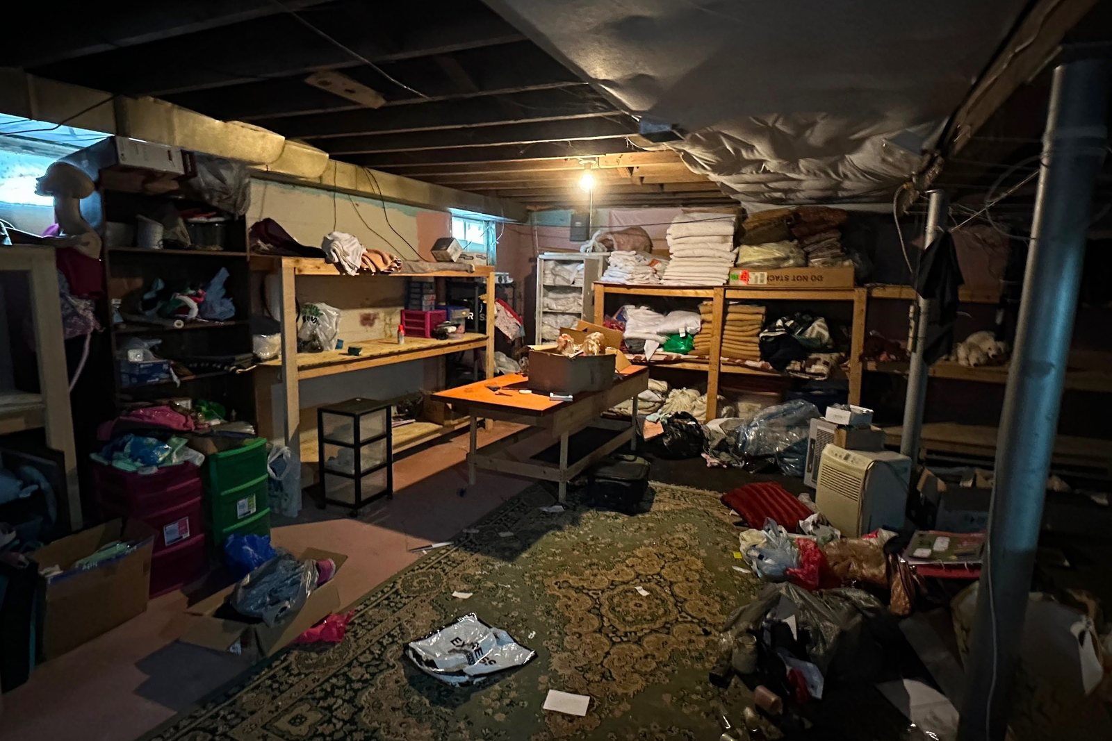
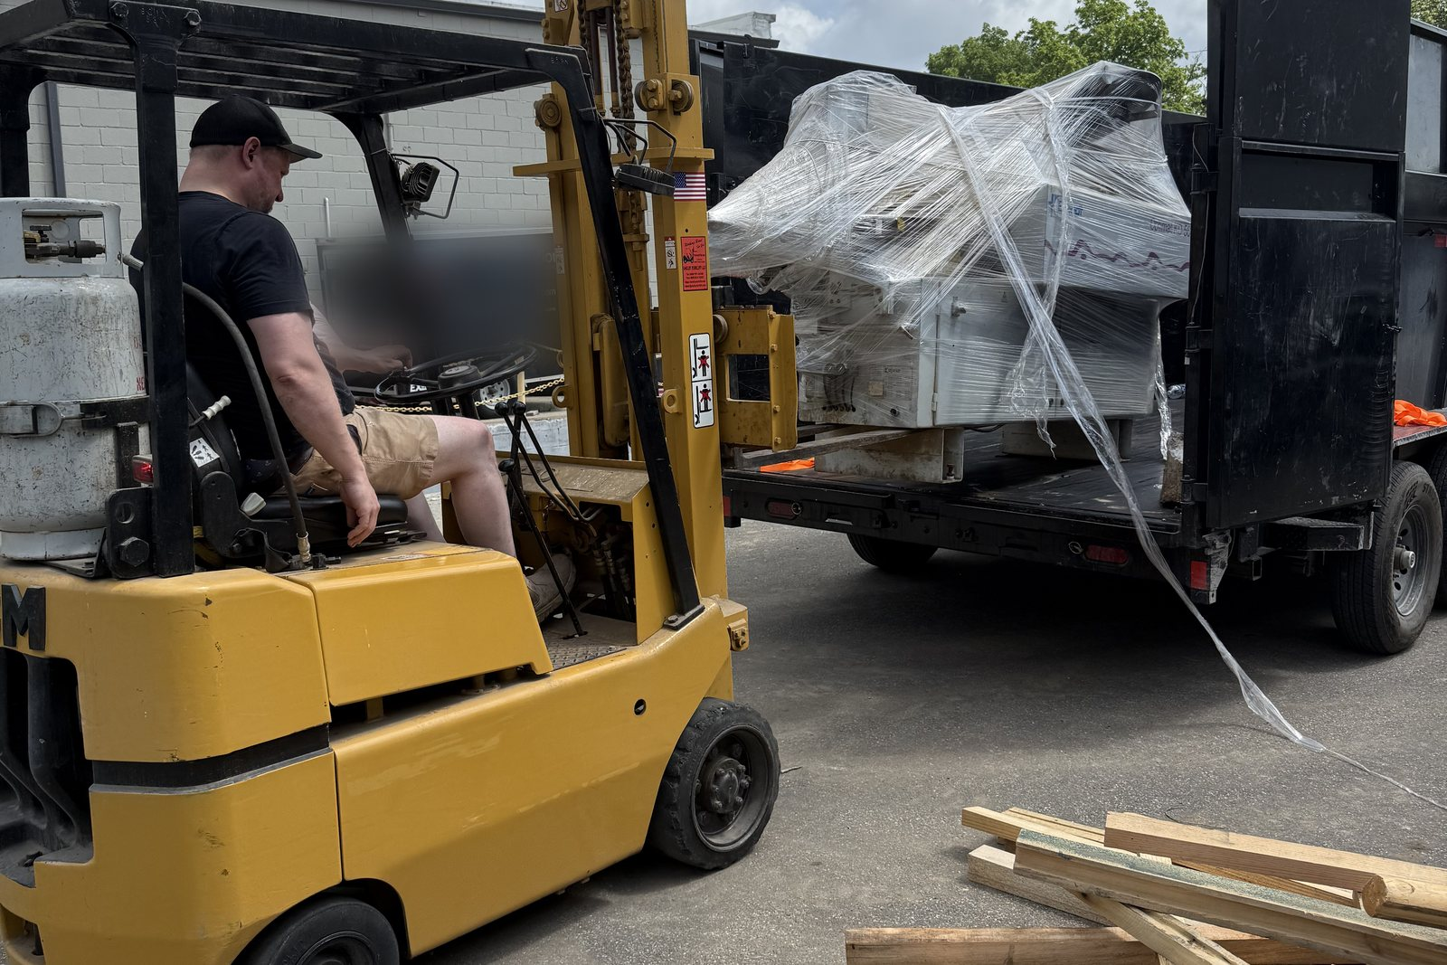
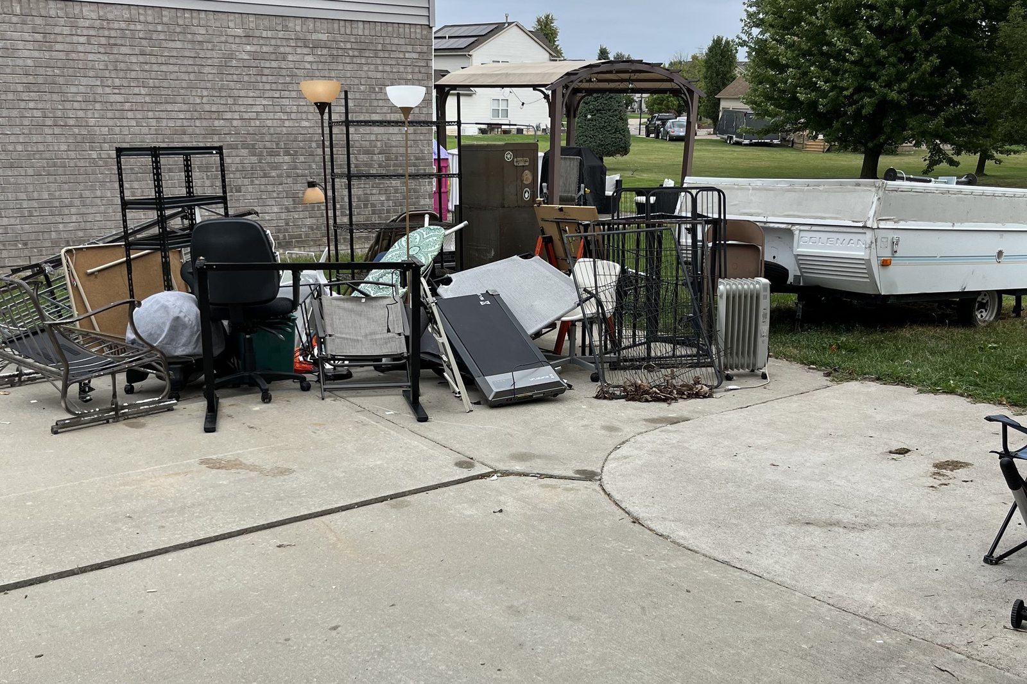
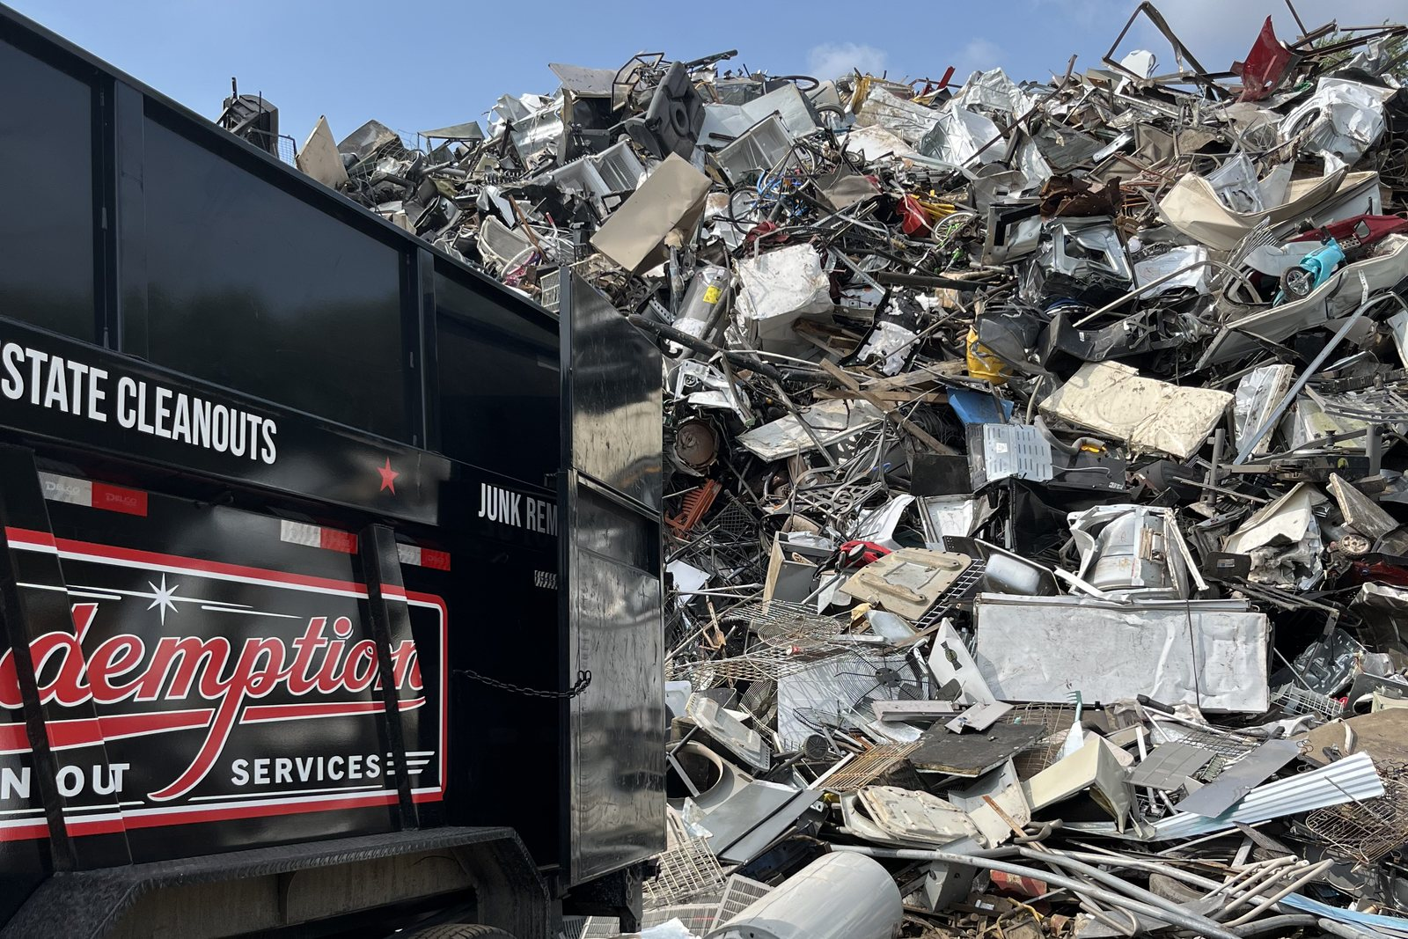
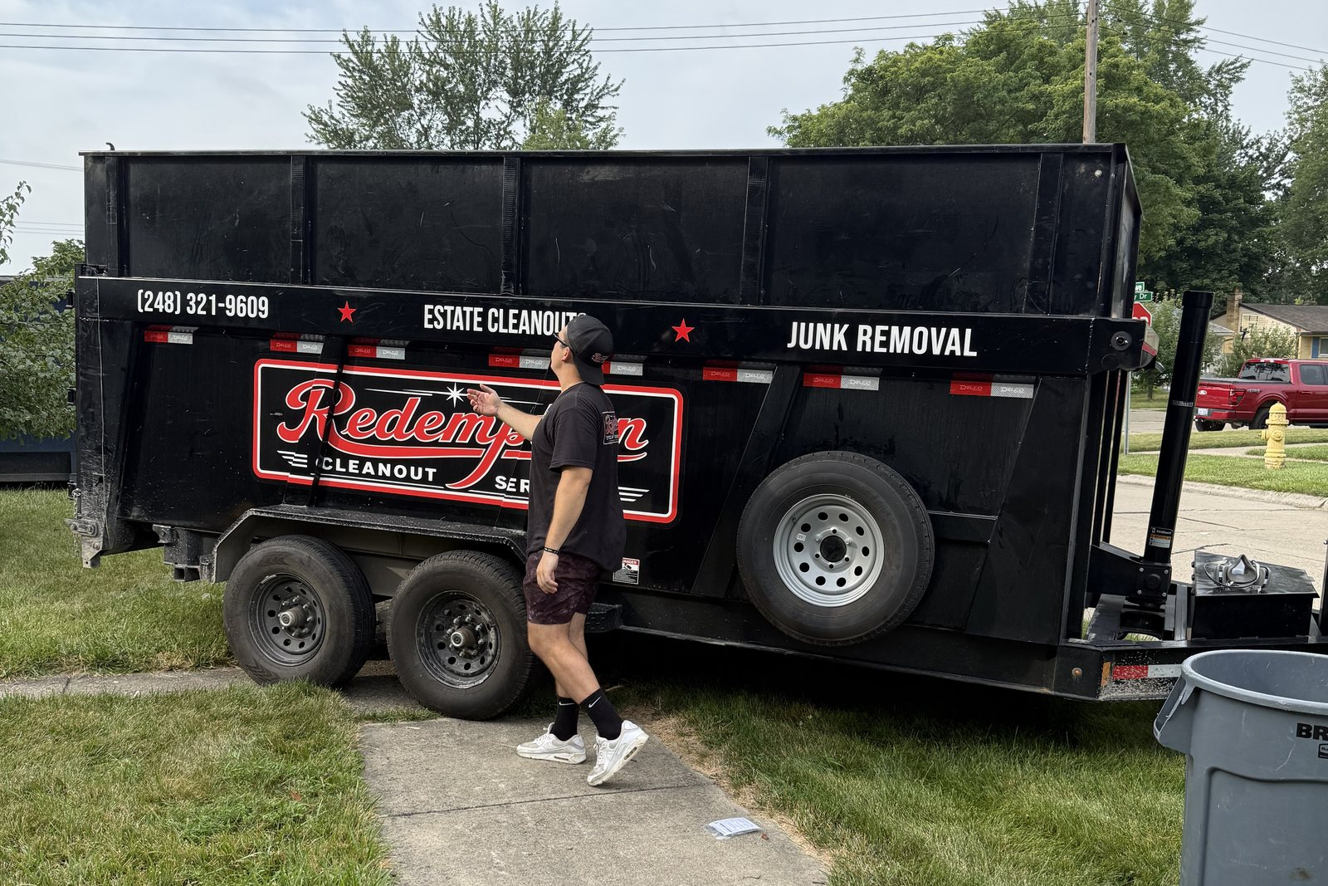
PHOTOGRAPHY
32 photographs. All yours. Not one stock image.
Pulled from your own Drive, cropped to one consistent frame, and stripped of location data before publishing. The whole gallery lives on one page with a lightbox — including all 13 frames from the August commercial gut-out.
Notes:
32 files in public/images/photos, every one traced to the client's shared Drive folder. EXIF including GPS is stripped by tools/import-photos.py on the way in. PRESENTER: The GPS point is worth making out loud — job photos routinely carry the property's coordinates, and most contractors publish them without knowing.

Slide 9
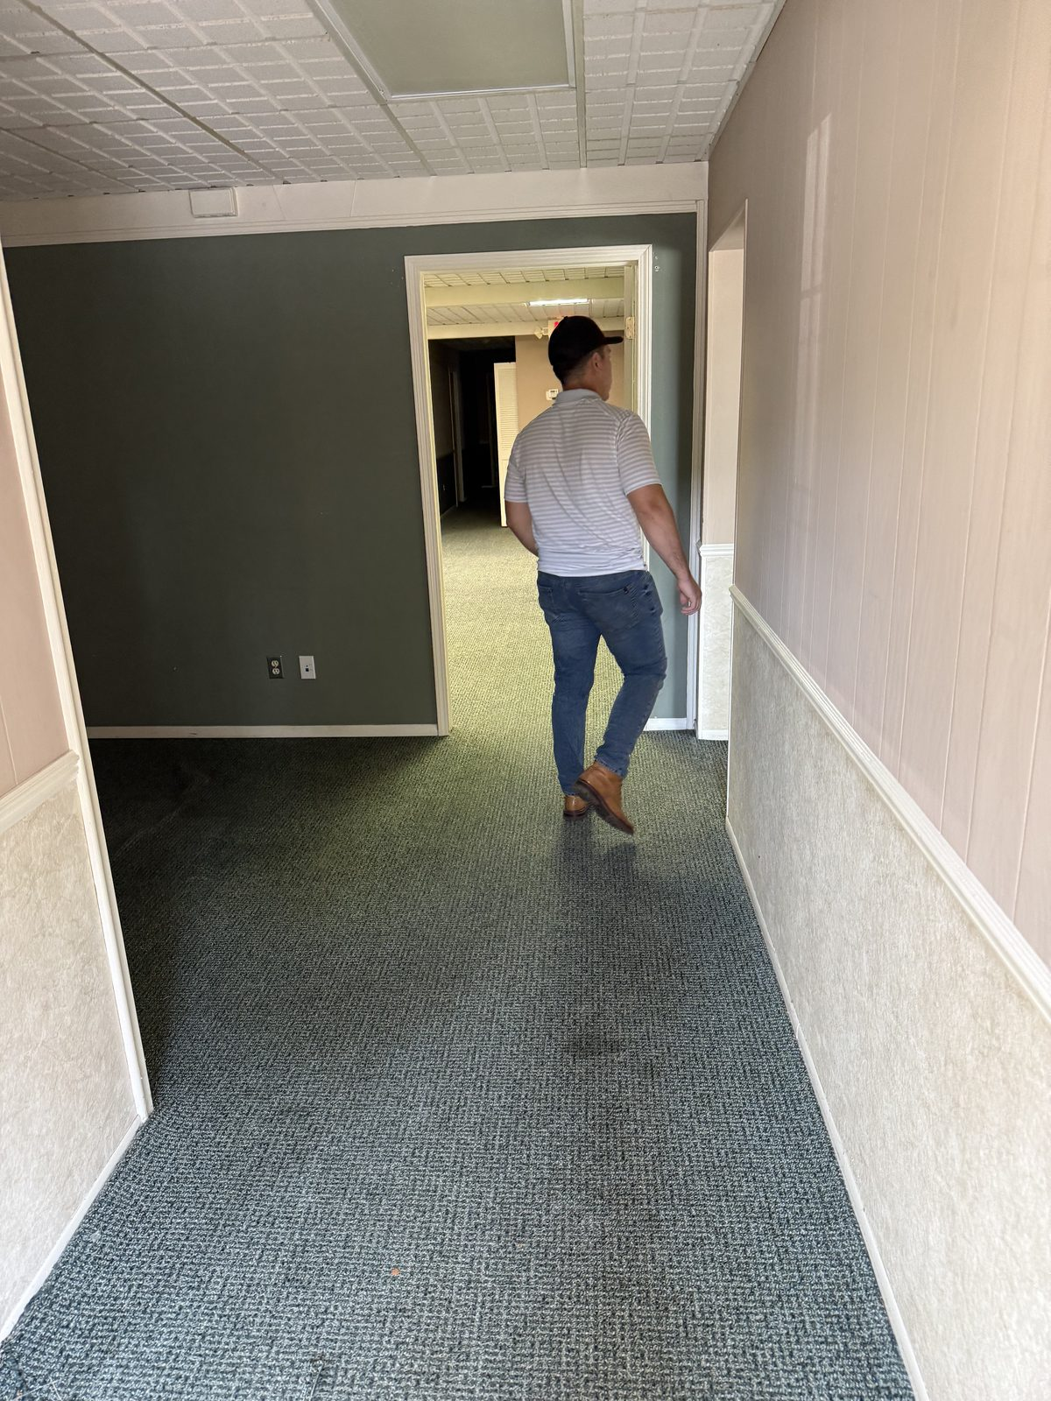
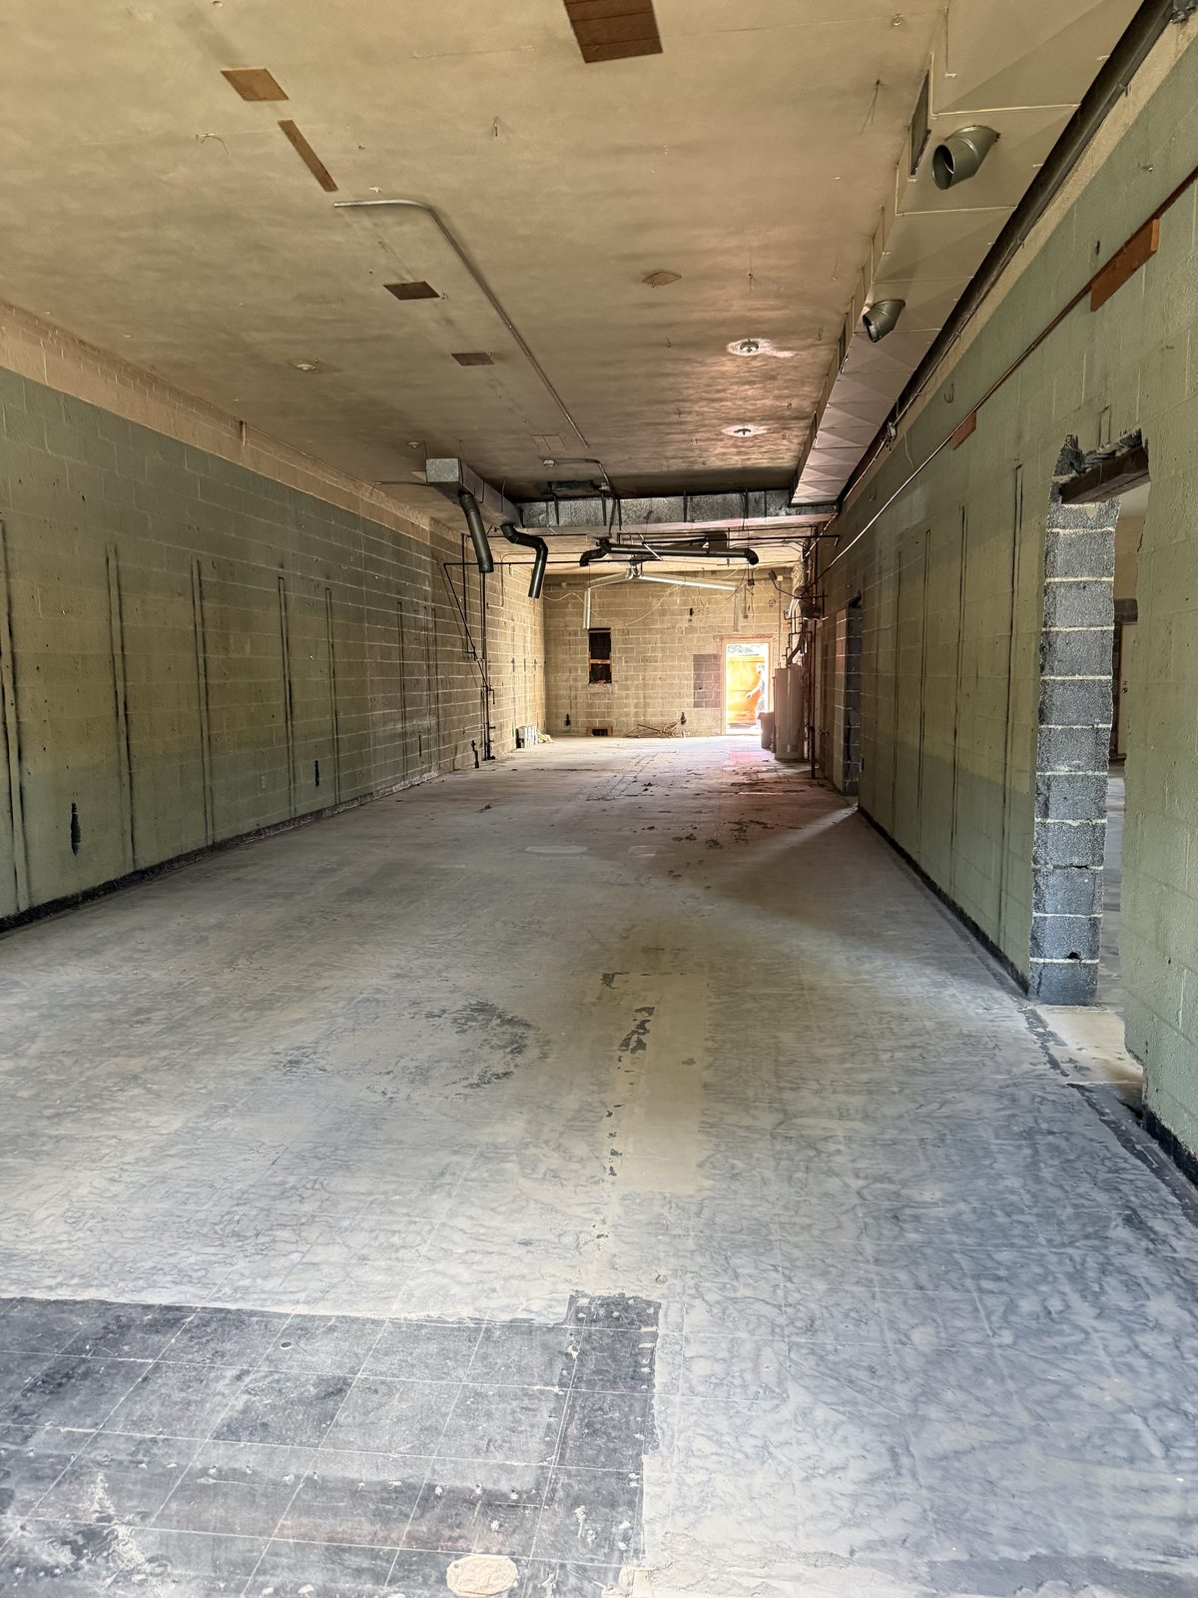
THE AUGUST COMMERCIAL GUT-OUT
The demolition job, published in full.
BEFORE
AFTER
A fully partitioned commercial office suite — corridor, private offices, washroom, suspended ceilings, carpet — taken back to bare block and slab. Eight before frames and five after frames are on the site, and the after shot leads the demolition page.
Notes:
Deliberately described as a large interior gut-out, not a structure teardown, because that is what the photographs actually show. The site's copy is written so nothing implies otherwise — this is the kind of accuracy that keeps a claim defensible.

Slide 10
HOW THE SITE DESCRIBES YOUR PROCESS
It now quotes the way you actually quote.
The old copy said you never price from photos. You told us that isn't how it works — so the site now walks a customer through the real sequence, and every other page that mentions pricing was rewritten to match it.
1
2
3
4
5
Send photos
Ballpark by phone
On-site visit
The work
Final walkthrough
Rooms, garage, basement — whatever needs to go.
A range, usually same day. No obligation, no charge.
Access, volume and condition are what move a price. The real quote is given here, in person.
Cleared or taken down, sorted for donation and recycling where practical.
Walked with you at completion, against what was quoted.
Notes:
Wording is verbatim from src/content/process.ts, which is the single source the rest of the site is kept consistent with.

Slide 11
GOOGLE BUSINESS PROFILE
The biggest lever on your phone ringing.
Your existing Business Manager account turned out to be an empty shell — both of you listed as admins on a listing that did not exist anywhere on Search or Maps. We built a new one properly instead of troubleshooting a dead end.
DONE
WAITING ON THE POSTCARD
Service-area business, address hidden — no fake storefront for Google to flag
Junk removal service (primary) + Demolition contractor (secondary)
All 7 counties set as the service area
Open 24 hours, phone (248) 321-9609, website linked
Description written; 2 real job photos uploaded; email Dante@redemptioncleanoutservices.com on file
Postcard with the verification code is in transit — until the code is entered, the listing is invisible on Search and Maps
Logo and 3 more photos are in hand on our side and go up as soon as the listing is verified
Review link goes live the moment the profile is verified
Notes:
Postcards typically arrive 5-14 days from the request. The code is the whole gate: the profile exists but customers cannot see it in Search or Maps until it is entered. Two upsells were deliberately left unclicked — the $500 Google Ads credit, because ad spend is the owner's decision, and the Google Workspace trial, already handled through the email setup. PRESENTER: Before sending or presenting: the profile description still reads 13 years and must be edited by hand in the dashboard to 12.

Slide 12
A POLICY, NOT A GAP
Some things on this site are deliberately empty.
If you look at the reviews page or the online request form and see nothing there, that is the policy working — not work left undone. Nothing on this site is invented, and automated tests fail the build if anyone tries.
No fabricated reviews or star ratings
No stock photography
The reviews page stays empty until real ones exist. Fake ratings are a Google penalty waiting to happen.
Every image is a Redemption job.
The request form refuses to fake it
Your street address is withheld
Until Jobber is connected it shows working call and text buttons instead of a form that looks live but goes nowhere.
429 S Main appears nowhere public — on the site or on Google — until you decide it should.
Notes:
This is the most defensible thing in the build and the easiest to misread as unfinished. Explain it before he encounters it. It is enforced by unit tests, not just by intention — the address rule in particular has a test that fails the build if the address is ever rendered.

Slide 13
MEASURED, NOT ASSERTED
Google's own scorecard on the live site.
100
100
100
98
ACCESSIBILITY
BEST PRACTICES
SEO
PERFORMANCE
Usable with a screen reader, a keyboard, or older eyes — which is much of estate and downsizing work.
Security headers, HTTPS, no risky third-party code.
Everything Google checks for automatically, in place on every page.
Desktop. 96 on mobile — both measured, not estimated.
Measured with Google Lighthouse against the production build of the current site, desktop and mobile. Every page was also swept for accessibility faults at phone and desktop width — clean. 35 automated tests run on every change, including one that fails the build if your street address is ever rendered publicly.
Notes:
Run on 2026-09-01 against a production build of the current site (post-restructure), desktop preset and mobile preset. Desktop performance 98, mobile 96, and 100/100/100 for accessibility, best practices and SEO on both. Accessibility sweep is axe-core across 16 routes at 390px and 1440px, run today. One contrast flag appeared intermittently on the home page's main button; isolated re-tests came back clean twice, and the button's actual colours measure 5.66:1 against white — comfortably above the 4.5:1 standard. It is an artefact of catching the fade-in animation mid-transition, not a real fault. Test count is the Vitest suite, verified passing today.

Slide 14
OVER TO YOU
Seven things. Six take minutes; one needs a shoot.
Each one switches on something that is already built and waiting. The video is the one real project on the list.
01
Enter the Google code
05
Send the About page rewrite
The day the postcard lands. Nothing else moves your phone as much.
Plus the mission statement and crew photos. /about still runs the old copy.
02
The team video
06
A photo of you
The professionally shot piece we discussed — the one item here that needs a crew and a date.
Or confirm the hard-hat photo in the Drive is you, and we will use it.
03
Send the Jobber form link
07
Accepted and excluded materials
Turns the online request form on. It is built and waiting for the URL.
The FAQ currently says this is still being finalized.
04
Point past clients at the review link
They have already agreed. The link exists the moment Google verifies you.
Notes:
Every item here has a feature already built behind it. The Google code is the highest-value one and takes about a minute. The team video is the only line that is a project rather than an errand — it needs a crew, a site and a date. PRESENTER: Three earlier asks came off this slide: the logo and profile photos are in hand on our side, the business email is settled (Dante@redemptioncleanoutservices.com) and now published on the site, and the old Business Manager account is ours to clean up, not his. Raise the video early — it has the longest lead time on the list.

Slide 15
SETTING THE CLOCK HONESTLY
Being findable is the starting line, not the finish.
This matters more than anything else in this deck. A brand-new site does not rank next week — no site does, and anyone who tells you otherwise is selling something.
DAYS TO WEEKS
Google discovers and indexes the pages
WEEKS
Your own name — "Redemption Cleanout Services" — returns you first
1–3 MONTHS
City and county searches start showing you, helped most by a verified Google profile and real reviews
MONTHS+
Competitive terms like "estate cleanout Oakland County"
Don't test it by searching "junk removal michigan." That is the wrong term, and the site is deliberately not built to win it. Search your own business name, or "estate cleanout" plus a city you work in.
Notes:
This timeline is standard for any new domain. It is not a comment on the quality of the build, and no amount of work on the site shortens it. PRESENTER: Say this one out loud rather than letting him read past it. Overselling here buys three good weeks and then a hard conversation when he checks Google and finds nothing.

Slide 16
WHERE WE ARE
The build, and what comes after it.
PROJECT TOTAL
REVISION WINDOW
$2,500
14 days
$1,250 received — thank you
$1,250 remaining, ideally by Friday, September 4
From final payment, to send through any last edits, corrections and content updates — included. If Friday holds, that runs to September 18.
AFTER THAT — WORTH A CONVERSATION
A monthly retainer for the back-office side: keeping the site and the Google profile current, publishing new job photos as they come in, posting to the profile, chasing and answering reviews, and integrating the CRM so leads, quotes and jobs run through one system instead of a phone and a notebook. Happy to put shape and a number to it whenever you want to talk.
Notes:
The retainer is an offer, not an assumption. CRM integration is the piece with the clearest operational payoff: Jobber is already the system of record, it is just not connected to anything yet. PRESENTER: Keep this factual and unpushy. Let the work argue for itself rather than pitching.

Slide 17
REDEEM YOUR PROPERTY.
REDEEM YOUR SPACE.
redemptioncleanoutservices.com — live now.
Questions, edits, or anything you want changed: send them over and we'll get to them.
Notes:
Close on his own words — the slogan is his, and it earns the last slide.

