Slide 1

LIVING WATER NETWORK
You know someone who's gifted.
We help make them ready.
A referral partnership for pastors and business owners
Groundwork — the 9-month leadership formation journey | lwnetwork.org
Rooted in truth. Sent to lead.
Notes:
Title slide. Open by framing this as a referral ask, not a donation ask — you are inviting the pastor/business owner into a partnership of trust, sending their most promising people to be formed.

Slide 2




Talented. Willing. Not yet formed.
The pattern every pastor and business owner has watched play out
Burnout before breakthrough
Leading from wounds, not wholeness
Calling without clarity
Shallow discipleship
Gifted people pushed into leadership before their character has caught up to their capacity.
Unresolved hurt quietly drives decisions, relationships, and ministry or management style.
Real potential, but no framework to discern what they're actually built and called to do.
Sunday teaching and on-the-job training aren't built for deep, sustained personal formation.
Living Water Network | Referral Partnership
2
Notes:
This is the pain point pastors and business owners recognize immediately — they see it in their congregations and teams every week. Keep this relatable, not clinical.

Slide 3
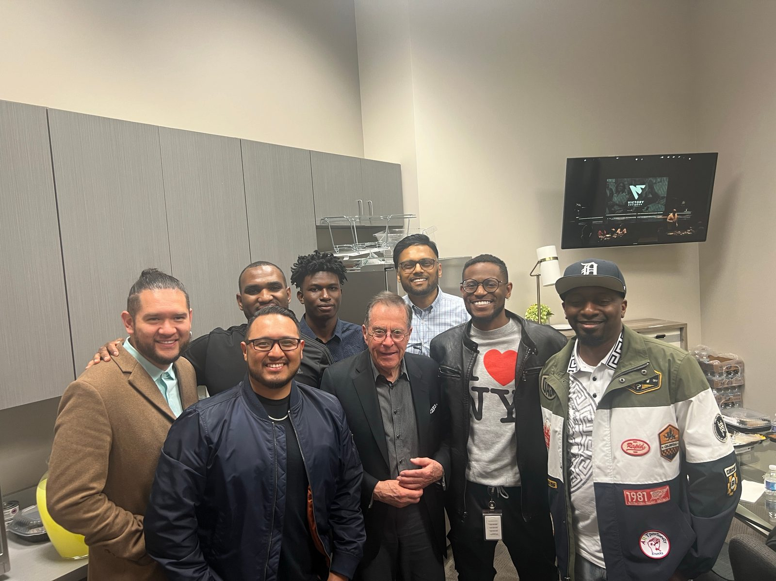
Introducing Groundwork
LWN's 9-month whole-person leadership formation journey
Groundwork forms the whole person before it hands anyone a title. Over nine months, small cohorts of 8–12 leaders walk through formation, discovery, and activation — led by seasoned, formed leaders with pastoral and licensed therapeutic support woven throughout.
9
months, three phases
8–12
leaders per cohort
3
tracks: Shepherd, Builder, Canvas
Living Water Network | Referral Partnership
3
Notes:
High-level intro to Groundwork before we drill into pillars, phases, and tracks. Photo is a real LWN leadership gathering image, not a stock/staged testimonial claim.

Slide 4


Phase 1: At the Table
Twelve weeks of whole-person formation, built on six pillars
Presence
Mind
Heart
Rooted daily communion with God
Renewed thinking and biblical worldview
Emotional health and inner healing
Body
Community
Stewardship
Stewarding physical health and rest
Relational depth and accountability
Time, resources, and calling well-managed
Living Water Network | Referral Partnership
4
Notes:
These six pillars form the shared curriculum in Phase 1, drawn from Omar's 'At the Table' formation guide. All three tracks (Shepherd, Builder, Canvas) walk this together before diverging.

Slide 5

The full journey: three phases, nine months
Delivered virtually with in-person intensives and one international missions trip
1
MONTHS 1–3
2
MONTHS 4–6
3
MONTHS 7–9
At the Table
Discover & Refine
Activate
Whole-person formation across the six pillars — Presence, Mind, Heart, Body, Community, Stewardship.
Calling discovery, gift identification, inner healing, and licensed therapeutic support.
Local serving, missions fundraising, and an international missions trip.
Living Water Network | Referral Partnership
5
Notes:
Walk through the three phases at a glance. Emphasize this is a real time commitment (9 months) which is why the referral, not just interest, matters — these are serious, vetted candidates.

Slide 6



Three tracks. One shared foundation.
Everyone walks Phase 1 together, then diverges into a track built for their calling
Shepherd
Builder
Canvas
MINISTRY & MISSION
MARKETPLACE & ENTREPRENEURSHIP
CREATIVES & INFLUENCERS
For those called to pastoral or ministry work.
For business owners and entrepreneurs.
For creative professionals and influencers.
Pastors: this is who you send — the emerging leader in your church who's called but not yet formed.
Business owners: this is who you send — the high-potential leader on your team who needs more than a management course.
For the gifted creative voice who needs rootedness to match their reach.
Living Water Network | Referral Partnership
6
Notes:
This is the slide to slow down on. Speak directly to the pastor about Shepherd, and directly to the business owner about Builder. Canvas exists but isn't the focus of this particular pitch audience.

Slide 7
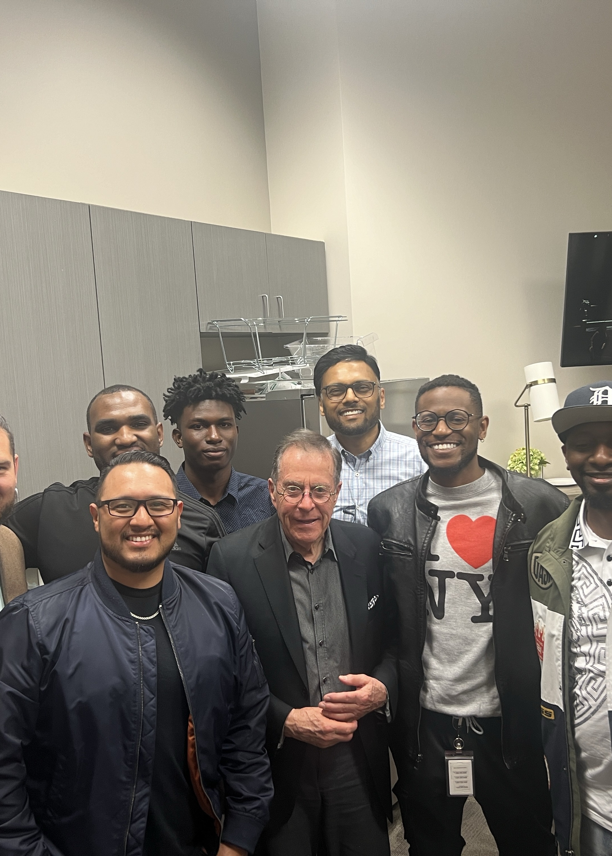

Who should come to mind right now?
The kind of person who thrives in Groundwork
Gifted, but leading (or about to lead) beyond their current formation
Shows real promise, yet you sense something under the surface isn't settled
Hungry to grow, teachable, and willing to be honest about their blind spots
Carries real responsibility — staff, volunteers, a team, a ministry, a growing business
You've quietly wondered, “Who is helping them become who they're capable of being?”
Living Water Network | Referral Partnership
7
Notes:
Ask the pastor/business owner to mentally picture one or two specific names in their church or company while reading this list. This is the emotional pivot point of the deck.

Slide 8
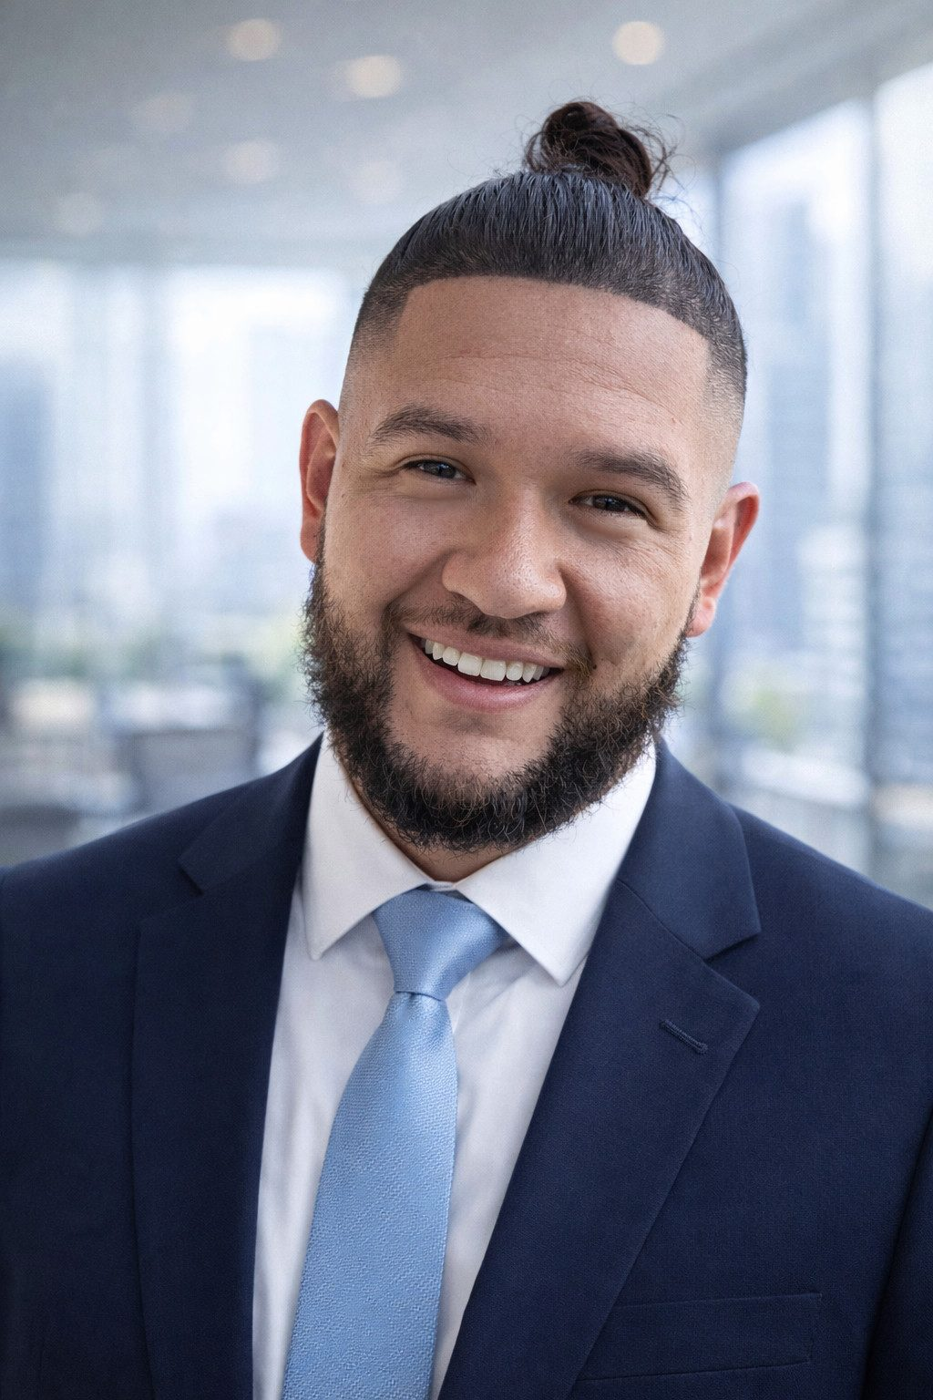

Why LWN exists
Omar J. Fandino
Founder & CEO, Living Water Network — Atlanta, GA
Author of “At the Table,” the formation guide used as LWN's Phase 1 curriculum
“I kept meeting gifted leaders — in churches and in business — who were talented enough to lead but had never been formed enough to lead well. LWN exists to close that gap: to give leaders a real, guided path to wholeness before we hand them more influence.”
Living Water Network | Referral Partnership
8
Notes:
PLACEHOLDER: keep this honest and brief per instructions -- do not fabricate bio details, track record, or past outcomes. This quote paraphrases the founding motivation; confirm exact wording with Omar before external use.

Slide 9
“I can't afford to send them.” Yes, you can.
Groundwork runs on a scholarship model — the referred person is not asked to fund it
$3,000–$5,000
How the scholarship model works
The real per-leader cost of Groundwork, covered by ministry and business partners — not billed to the person you refer.
Ministry and business partners fund the full cost of formation for each leader.
Referred candidates pay only the application fee — removing cost as a barrier for the person you're sending.
This keeps Groundwork focused on character and calling, not who can pay.
A modest application fee to reserve their spot — that's it.
No leader is turned away from Groundwork for financial need.
Living Water Network | Referral Partnership
9
Notes:
Directly removes the #1 objection a pastor or business owner will raise. This deck intentionally has no donation tier structure -- that lives in a separate fundraising deck for funding partners.

Slide 10

Who comes to mind?
That's the ask. Take a moment — who in your church or company is gifted, but not yet formed?
We're asking you to refer 1–3 people from your church or company into the next Groundwork cohort. You know them. You've watched their potential. We'll take it from there.
Pastors
Business Owners
Think of the emerging leader in your congregation ready for real formation, not just another program.
Think of the high-potential team member or fellow entrepreneur worth investing in beyond the job description.
Living Water Network | Referral Partnership
10
Notes:
This is the emotional and practical center of the deck. Pause here. Let them literally think of names before moving on.

Slide 11




What happens after you refer someone
Simple, and no burden on you beyond the introduction
1
2
3
4
You make the introduction
They complete an application
LWN's team follows up
They begin Groundwork
Share a name, or connect them to us directly — a quick email or text is enough.
The candidate fills out a short application and pays the modest application fee.
We handle scheduling, screening, and onboarding into the next cohort — not you.
Your referral steps into a 9-month formation journey alongside 7–11 peers.
Living Water Network | Referral Partnership
11
Notes:
Reassure them: their only job is the introduction. LWN's team owns everything from application forward.

Slide 12
Why this matters for you
Formed leaders make everything around them healthier
Stronger succession pipelines
Better staff and volunteers
You develop the next generation of pastors, elders, managers, or partners — before you need them.
Formed character shows up in how people lead teams, handle conflict, and steward responsibility.
Healthier culture
A trusted formation partner
One formed leader changes the emotional and spiritual temperature of a church or company.
You get infrastructure for deep leadership development without having to build it yourself.
Living Water Network | Referral Partnership
12
Notes:
Reframe the referral as a self-interested win, not just generosity -- investing in someone's formation pays back into their own church or company.

Slide 13

How to refer someone
Three easy ways to start
Email us a name
Point them to the application
Ask us to talk it through
Send Omar an email with the person's name and best contact — we'll take it from there.
Application opens at lwnetwork.org for the Spring 2027 cohort.
Not sure if it's a fit? We're glad to talk through a specific person with you first.
Omar J. Fandino, Founder & CEO
Application link: lwnetwork.org/cohort
ofandino@lwnetwork.org
lwnetwork.org
Living Water Network | Referral Partnership
13
Notes:
PLACEHOLDER: confirm the exact live application URL before distributing this deck externally -- using lwnetwork.org/apply as a placeholder pending Omar's confirmation of the real path.

Slide 14
Rooted in truth. Sent to lead.
Equipping Kingdom leaders to disrupt darkness and disciple nations.
Living Water Network Inc. | Georgia 501(c)(3) | EIN 93-1859873
lwnetwork.org · ofandino@lwnetwork.org
Notes:
Closing slide. Thank the pastor/business owner for their time and reiterate: this is a partnership, not a program purchase.

