Slide 1

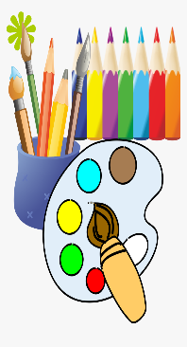


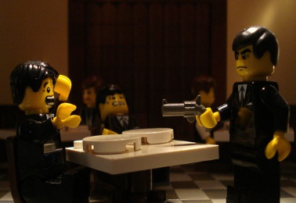
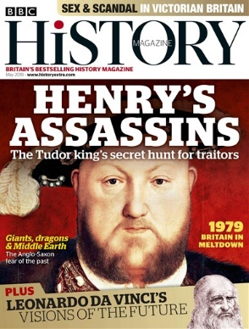


History Project Competition!
Historical film
Recreate a historical scene
Get arty
Make a game
Create a mini-film or documentary of your choice from a past event and get creative with your portrayal!
Create a comic-book strip to tell a story from history. Alternatively, paint or draw a picture of a historical figure.
Take a classic board game such as ‘Guess Who?’ or ‘Monopoly’ and recreate it with a historical theme. Alternatively, you can create your own game with your set of rules.
Recreate a historical scene using whatever you have.
Create a magazine
Instagram a historical figure
This should include key historical moments for the month of May and any other historical stories that interest you.
Produce an Instagram account for a historical figure of your choice. Remember to select relevant images with appropriate captions.
We’re looking for effort, creativity and historical accuracy in your submissions. Have fun with it!
Greater challenge?
Select a topic you haven’t studied before such as Joan of Arc, William Wilberforce, Dunkirk or the creation of the NHS.

