Slide 1



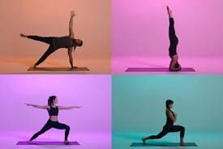



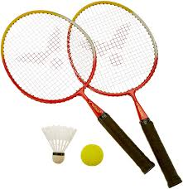
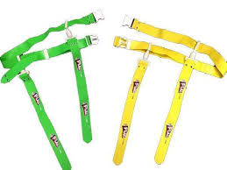



PE Competition
The PE department would like to set you the challenge of …
Creating the most interesting and engaging display/poster about 1 sport you have studied at Park.
Level 1 –
You create a poster covering the key criteria and include what you enjoyed about this sport/why you chose it.
Level 2 –
You create a poster covering the key criteria but also include top level sports performers quotes and information about British athletes in this sport.
You should ensure it shows …
An introduction about the game
A brief history of the sport
5 key skills and their coaching points (how to perform them)
How competition take place/is structured
10 rules of the sport
Supportive pictures
Level 3 –
Once you have completed level 1 and 2 you then present you poster/display of research to a family member. Ask them to write a short evaluation of your presentation.
Entries to k.sexton@pcs.hants.sch.uk

