Slide 1
齊來崇拜

Slide 2
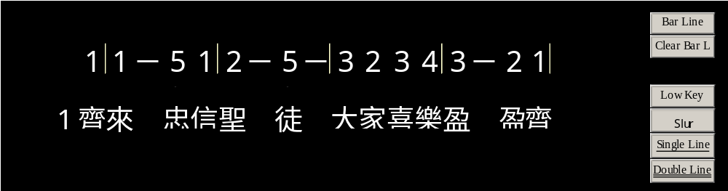
1
2
3

Slide 3
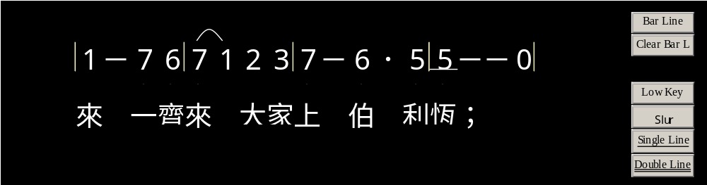
1
2
3

Slide 4
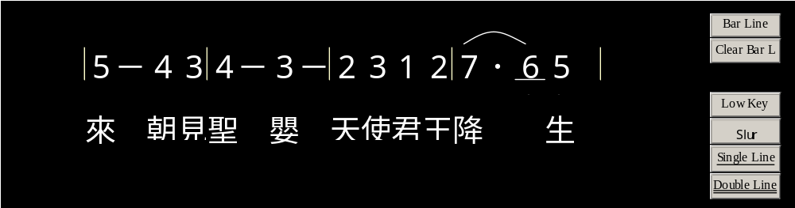
1
2
3

Slide 5
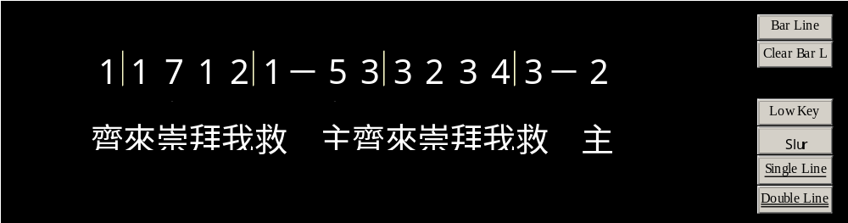
1
2
3

Slide 6
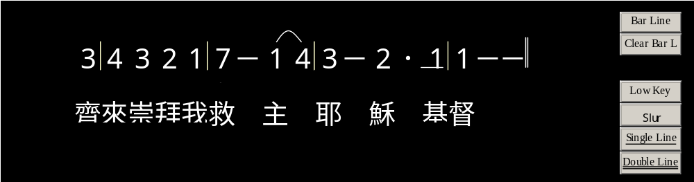
1
2
3

Slide 7
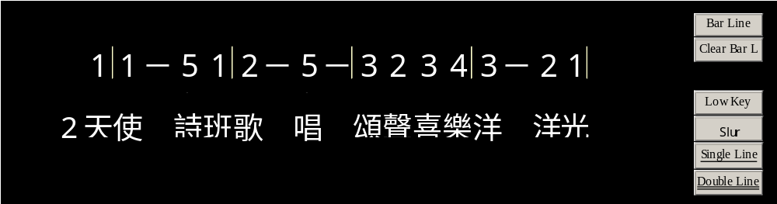
1
2
3

Slide 8
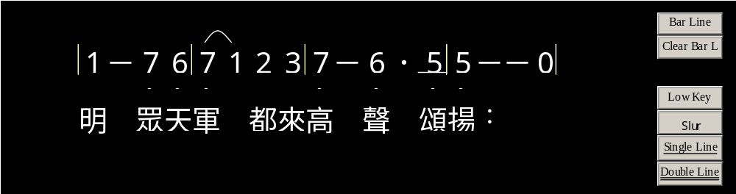
1
2
3

Slide 9
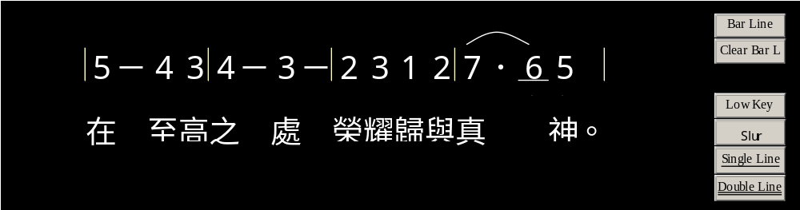
1
2
3

Slide 10
1
2
3

Slide 11
1
2
3

Slide 12
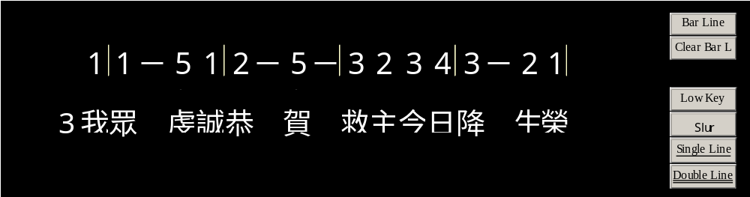
1
2
3

Slide 13
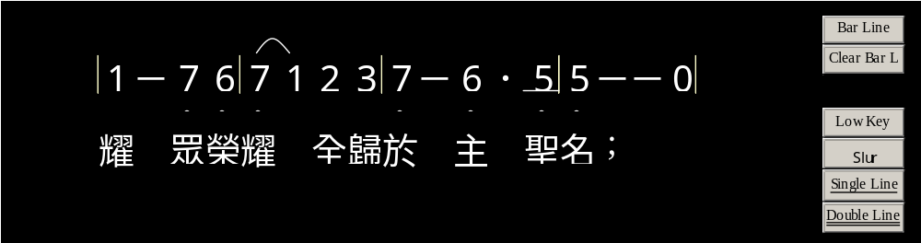
1
2
3

Slide 14
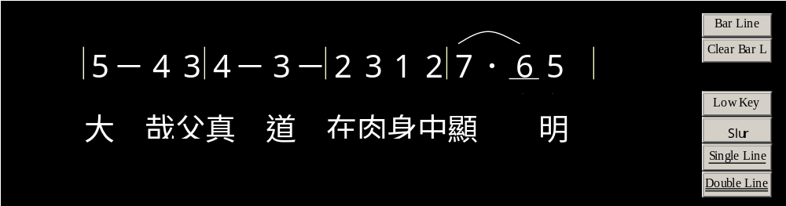
1
2
3

Slide 15
1
2
3

Slide 16
1
2
3

Slide 17
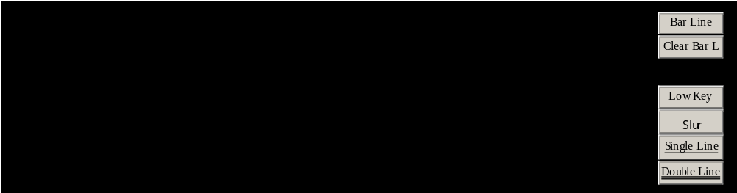
1
2
3

