Slide 1
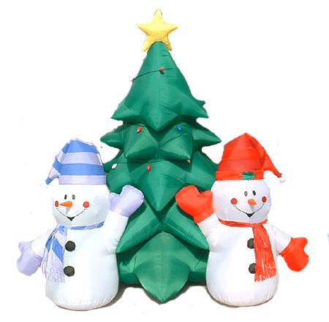
O Christmas Tree

Slide 2
O Christmas tree , o Christmas tree

Slide 3
However green your brances

Slide 4
They’re green when summer days are bright

Slide 5
They’re green when winter snow is white

Slide 6
O Christmas tree,
O Christmas tree

Slide 7
However green your brances

