Slide 1
Sing a new song

Slide 2
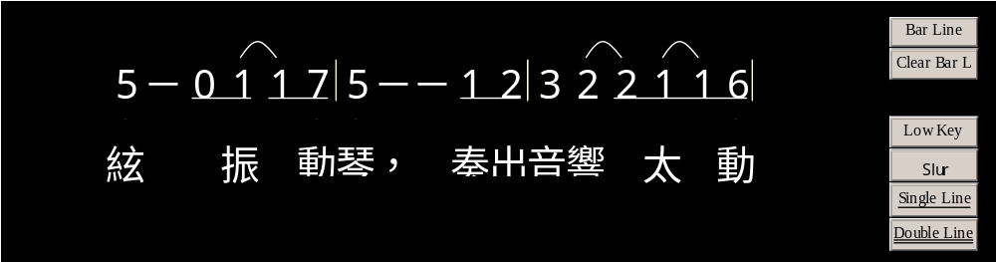
1
2

Slide 3
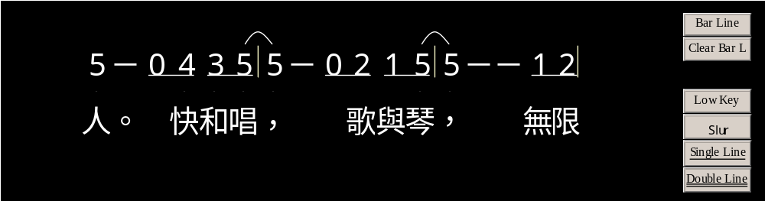
1
2

Slide 4
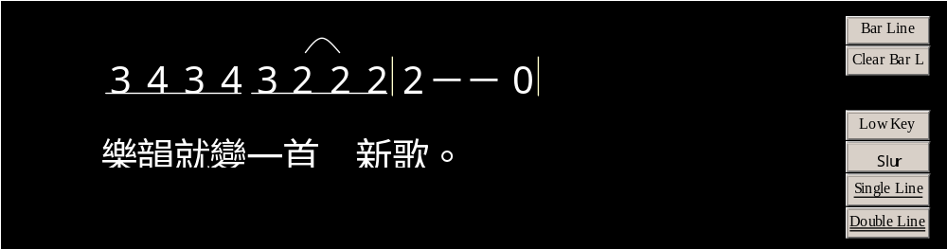
1
2

Slide 5
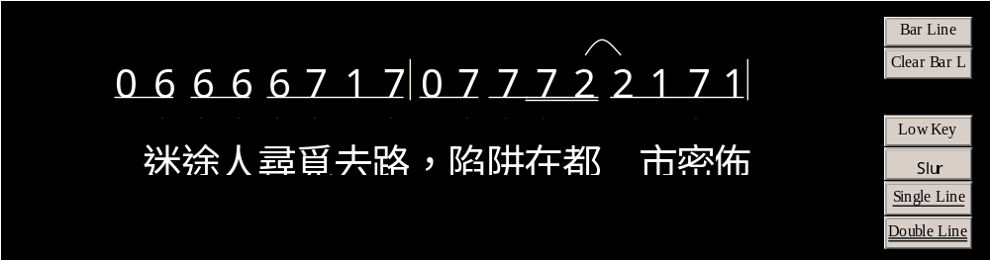
1
2

Slide 6
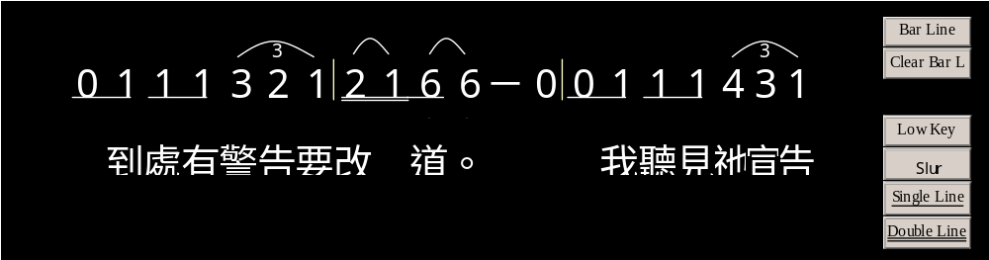
1
2

Slide 7
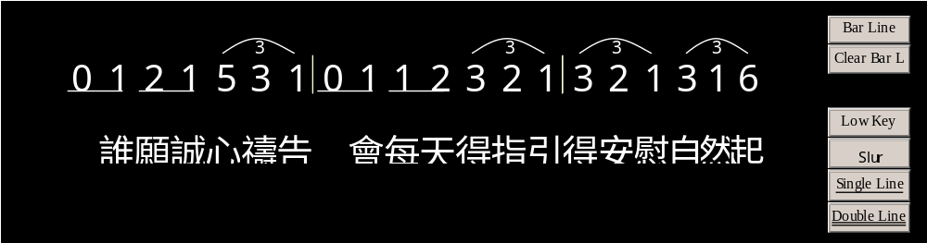
1
2

Slide 8
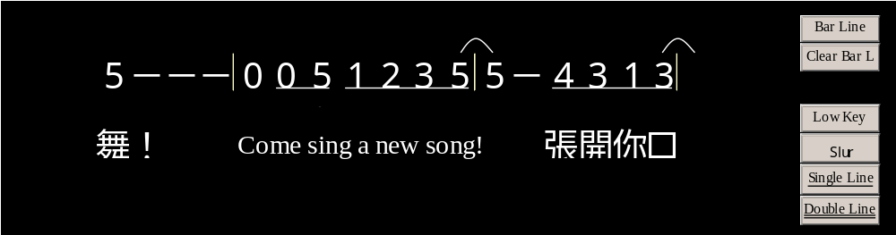
1
2

Slide 9
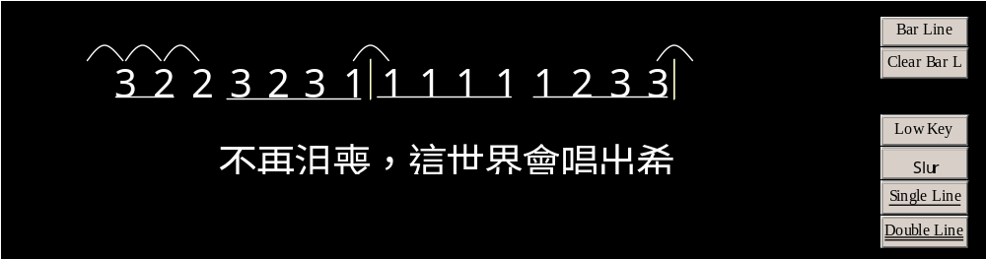
1
2

Slide 10
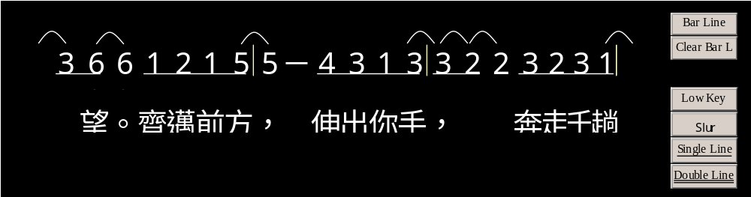
1
2

Slide 11
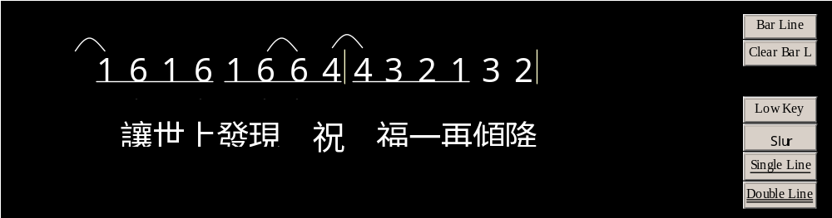
1
2

Slide 12
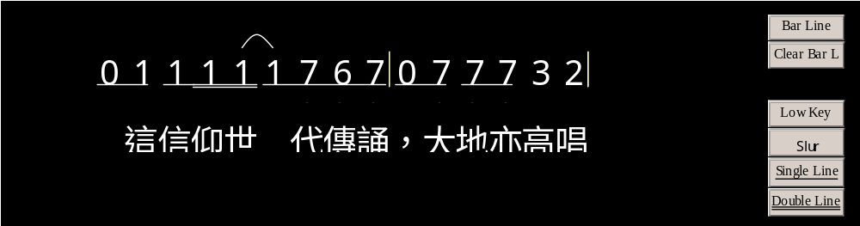
1
2

Slide 13
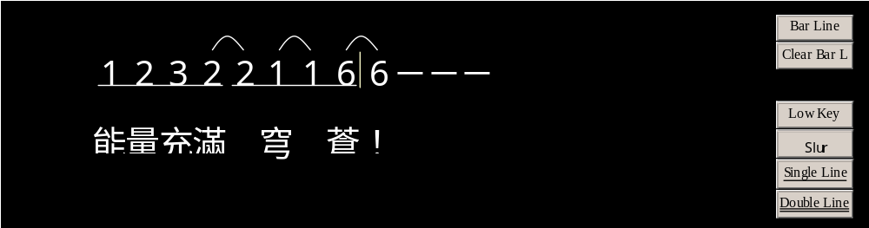
1
2

Slide 14
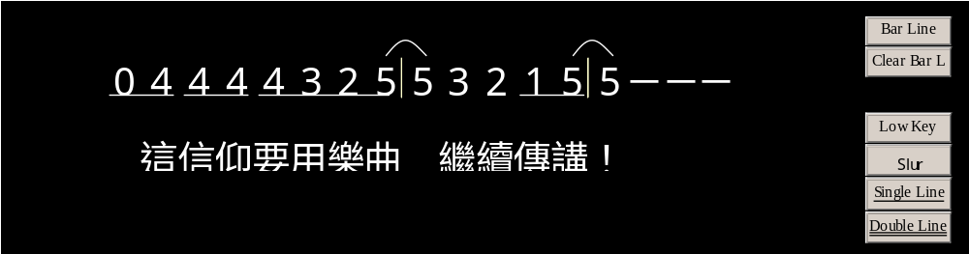
1
2

Slide 15
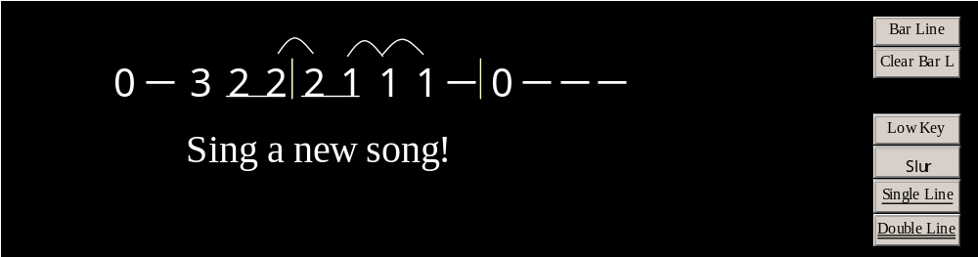
1
2

Slide 16
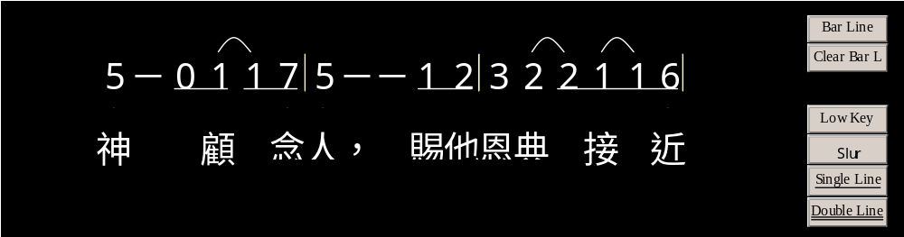
1
2

Slide 17
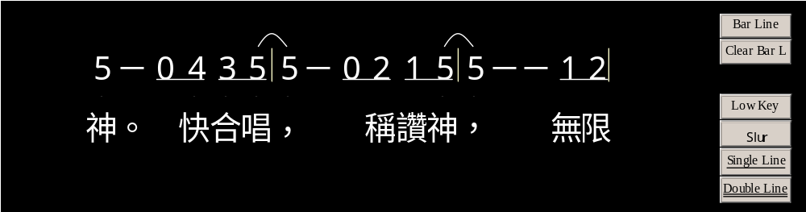
1
2

Slide 18

1
2

Slide 19

1
2

Slide 20
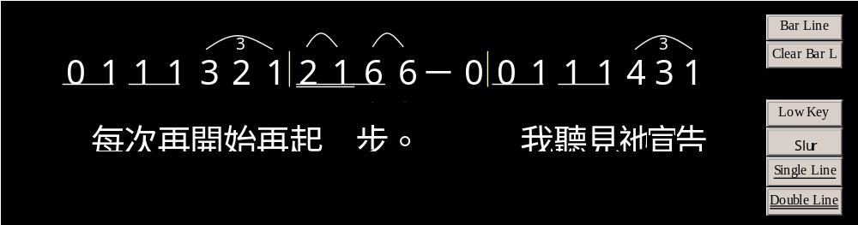
1
2

Slide 21
1
2

Slide 22
1
2

Slide 23
1
2

Slide 24
1
2

Slide 25
1
2

Slide 26
1
2

Slide 27
1
2

Slide 28
1
2

Slide 29
1
2

Slide 30
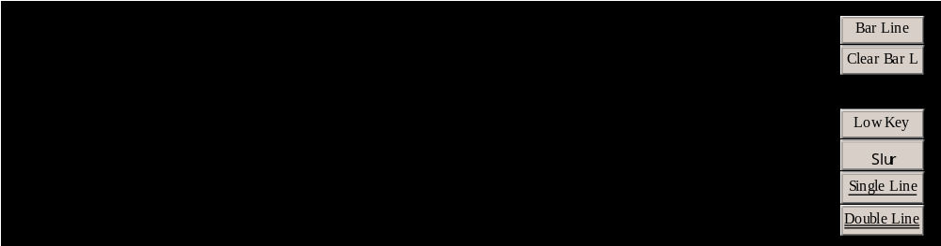
1
2

