Slide 1

Student： Yujie Ying

Slide 2
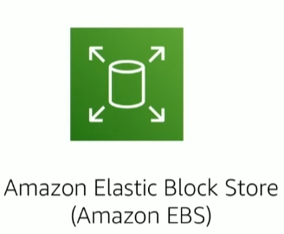
Amazon Elastic Block Store（Amazon EBS）
A block storage
Low-latency performance
Highly available
Easy data backup and restoration
EBS encryption
Must be paired with an EC2 instance
High performance with a single instance

Slide 3
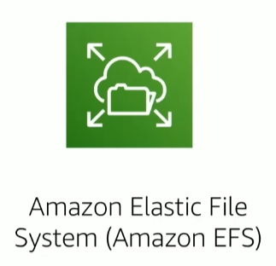
Amazon Elastic File System（Amazon EFS）
A file storage system
Adaptive throughput
Totally elastic
Additional accessibility
Scalable file storage for multiple EC2 instances

Slide 4
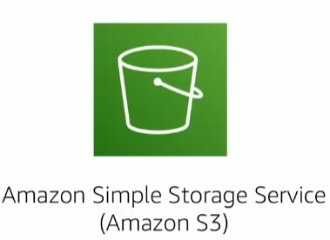
Amazon S3
An object storage service
Accessing other cloud services
Running analytics
Data archiving
Highly available
Flexible

Slide 5

Amazon S3 Glacier
Long-term cold storage
Low Cost
Secure & Durable
Simple
Flexible
Integration

Slide 6
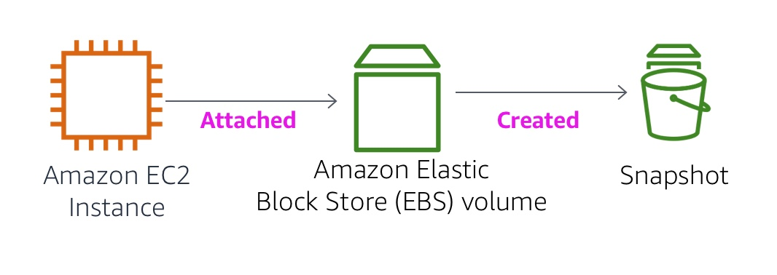
Demonstration -EBS

Slide 7
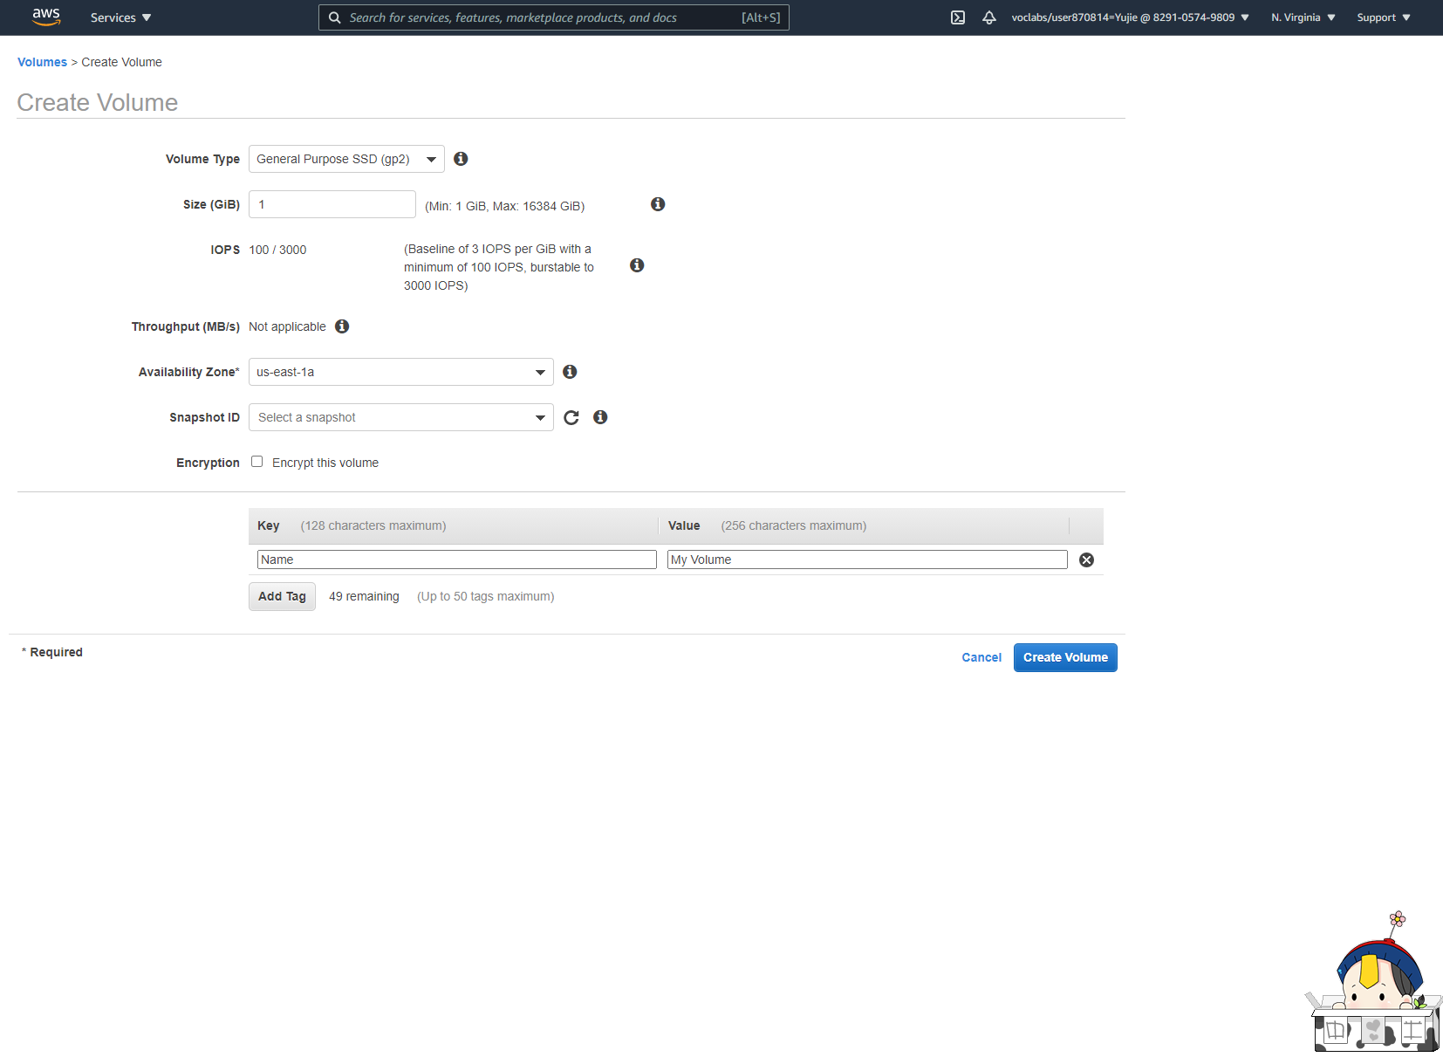
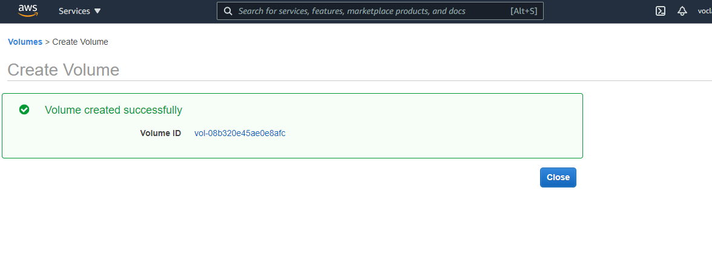

Slide 8
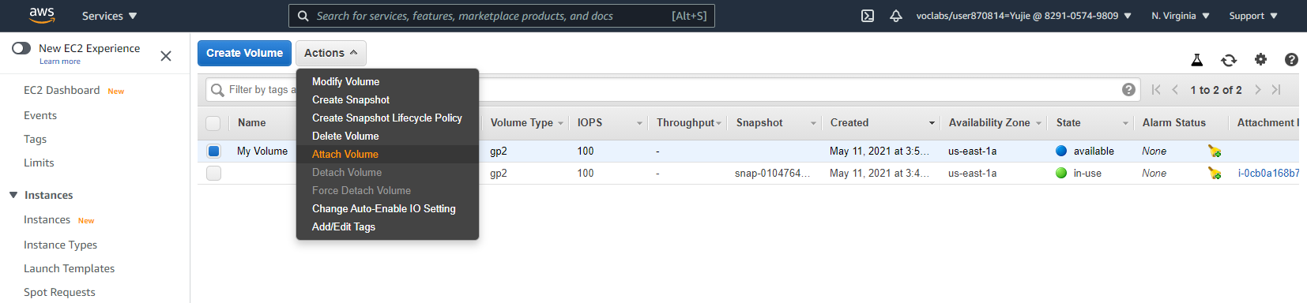
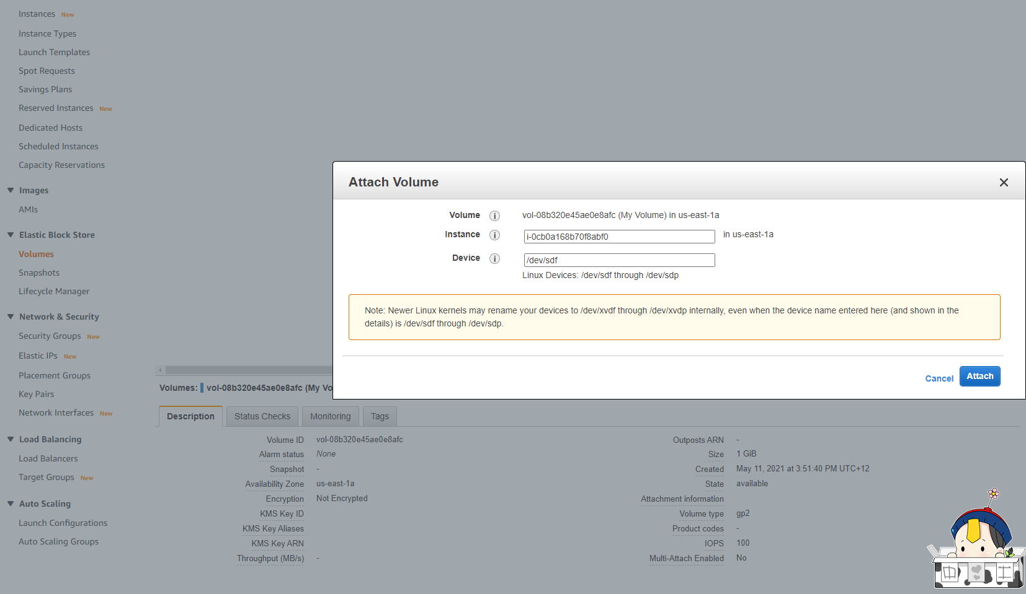

Slide 9
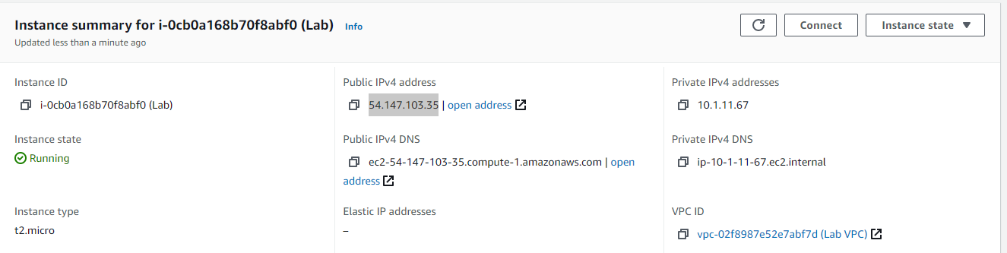

Slide 10
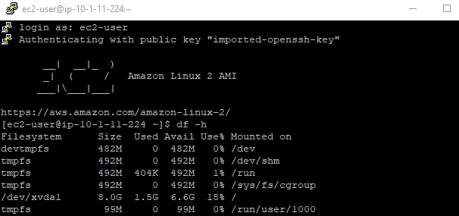
ec2-user : User
df -h :View the storage available on your instance

Slide 11
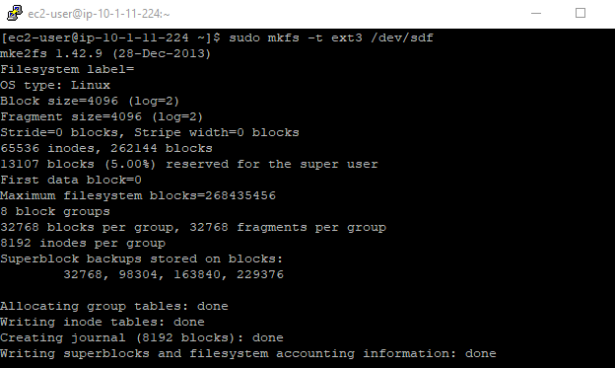
sudo mkfs -t ext3 /dev/sdf :Create an ext3 file system on the new volume

Slide 12
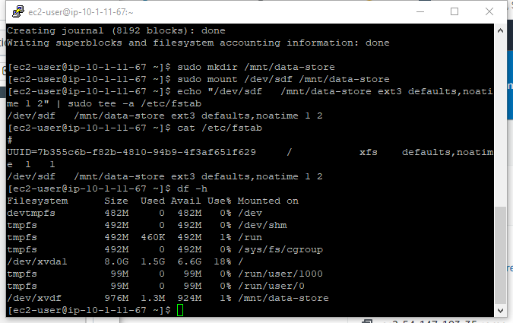
sudo mkdir /mnt/data-store:Create a directory for mounting the new storage volume
sudo mount /dev/sdf /mnt/data-store:Mount the new volume
echo "/dev/sdf /mnt/data-store ext3 defaults,noatime 1 2" | sudo tee -a /etc/fstab:To configure the Linux instance to mount this volume whenever the instance is started, you will need to add a line to /etc/fstab.

Slide 13
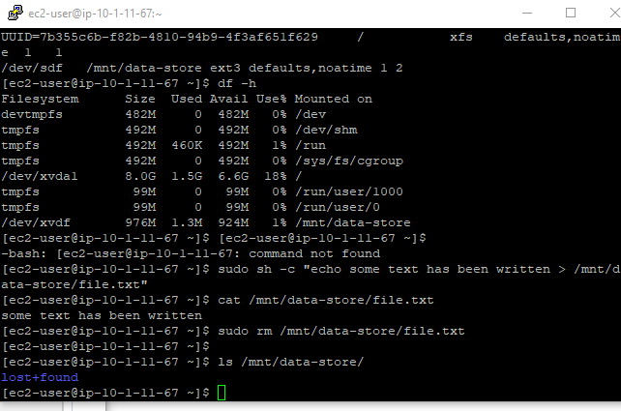
sudo sh -c "echo some text has been written > /mnt/data-store/file.txt":Create a file and add some text to it.
cat /mnt/data-store/file.txt:Verify that the text has been written to volume
sudo rm /mnt/data-store/file.txt: Delete the file
ls /mnt/data-store/:Verify that the file has been deleted

Slide 14
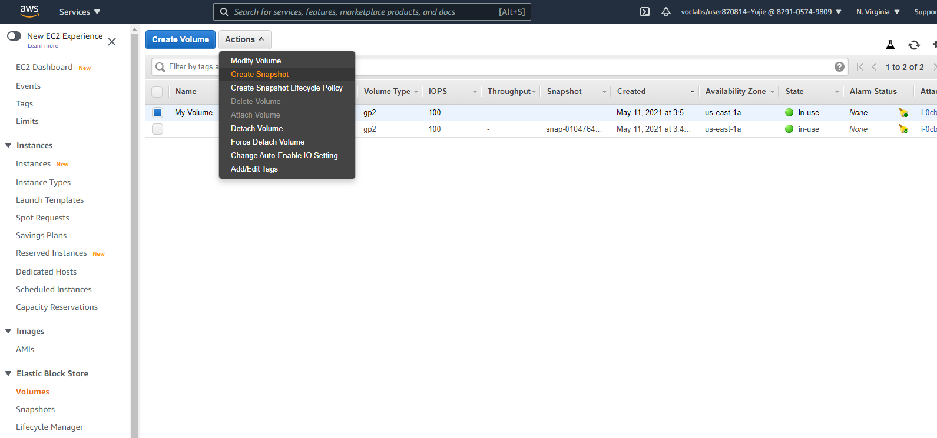
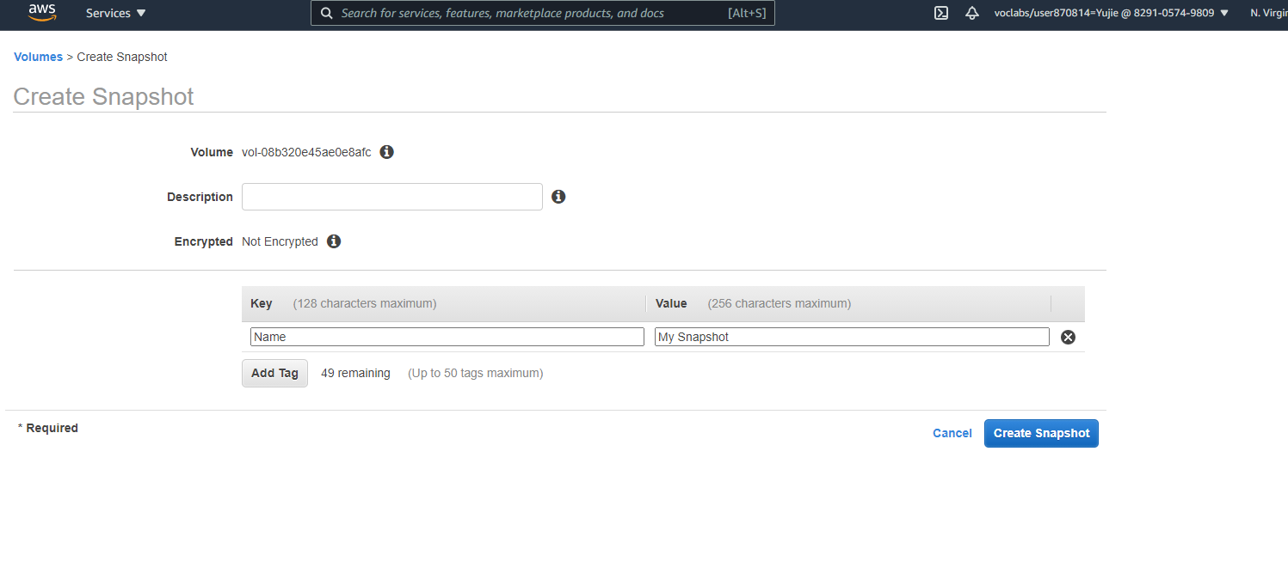

Slide 15
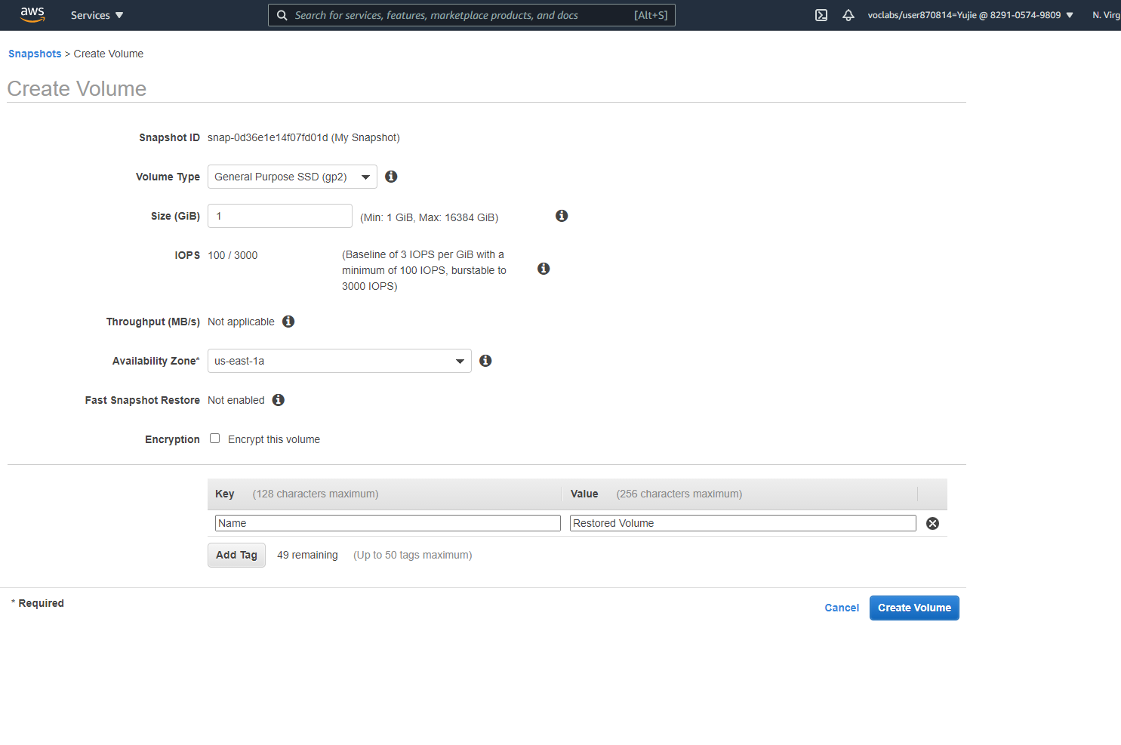

Slide 16
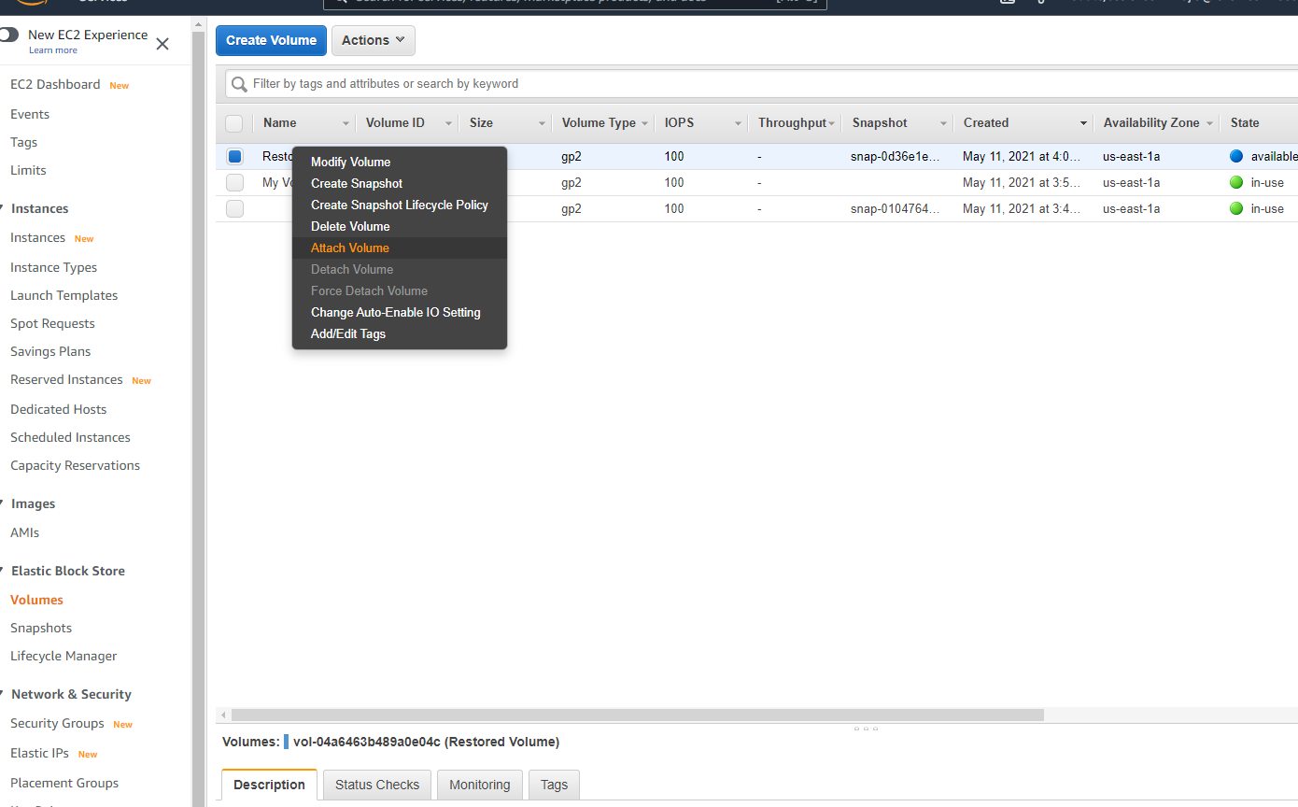

Slide 17
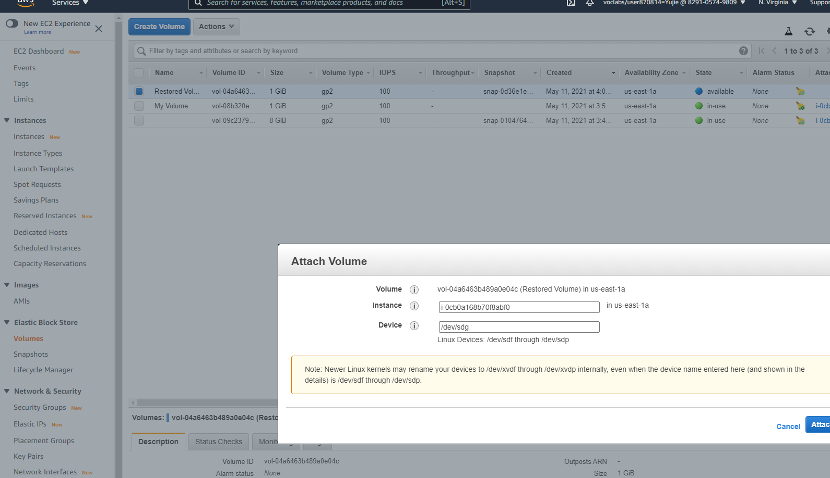

Slide 18
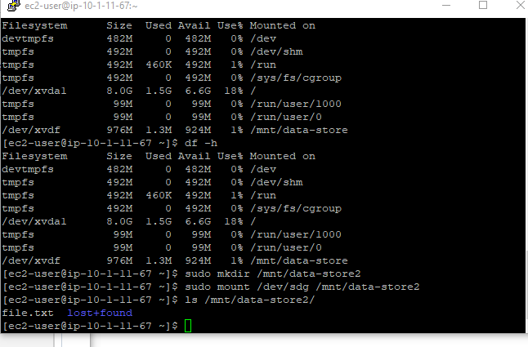
sudo mkdir /mnt/data-store2:Create a directory for mounting the new storage volume
sudo mount /dev/sdg /mnt/data-store2:Mount the new volume:
ls /mnt/data-store2/:Verify that volume you mounted has the file that you created earlier.

Slide 19
Thank you

