Slide 1
Flutter Widgets 2
Abdifatah Yassen Yousof

Slide 2
Ways to Run Flutter App
1. Emulator/Simulator
2. ADB(android debug bridge) with USB
3. ADB and WiFi
4. Chrome DevTools Mobile Emulation

Slide 3
What is Grade in flutter?
Gradle is the tool used to build and package Flutter apps, especially for the Android platform. It handles important tasks like:

Slide 4
Gradle
Gradle: The build automation tool used for Android development in Flutter projects. It handles tasks like building, packaging, and managing dependencies for the Android platform.

Slide 5
1. Configuring the app's build settings (for Android)
2. Managing the project dependencies
3. Creating different versions/builds of the app
4. Signing the final app package

Slide 6
Gradle automates these build-related processes, making it an essential part of developing Flutter apps.

Slide 7
Scaffold:
- The Scaffold widget is the foundation for the overall structure of a Flutter app.
- It provides a standard set of app bars, drawers, snack bars, and other common UI elements.
- It serves as a container for the app's body, which is where the main content of the app is placed.
- Scaffold ensures proper layout and behavior for these UI elements, making it easier to build consistent and visually appealing apps.

Slide 8
Appbar
AppBar: The primary top-level toolbar in a Flutter app, providing a consistent layout and appearance.

Slide 9
Fab
FloatingActionButton: A circular button that floats above the content, typically used for the primary action in a Flutter app.

Slide 10
Column and row
- Column and Row are the primary layout widgets in Flutter, used for organizing child widgets vertically and horizontally, respectively.
- They provide a flexible and powerful way to control the positioning and size of UI elements within the app's layout.
- Columns and Rows can be nested to create complex, multi-dimensional layouts.
- Understanding how to use these widgets effectively is crucial for building responsive and adaptive user interfaces.

Slide 11
Text
- The Text widget is used to display text on the screen, ranging from simple labels to more complex, styled text blocks.
- It supports a wide range of text styling options, such as font size, color, weight, and alignment.
- Text is a fundamental building block for many UI elements, from headings and body content to form fields and buttons.
- Mastering the Text widget and its various properties is essential for creating visually appealing and readable app interfaces.

Slide 12
Container:
- The Container widget is a versatile and powerful widget that serves multiple purposes.
- It can be used for styling, positioning, and decorating other widgets, making it a crucial tool for building custom UI components.
- Containers can be used to apply padding, margins, borders, backgrounds, and other visual effects to the widgets they contain.
- Understanding how to use Containers effectively is key for creating visually polished and responsive layouts in your Flutter apps.

Slide 13
ListView and GridView
- ListView and GridView are the primary widgets for displaying scrollable lists and grids of items in a Flutter app.
- They provide a flexible and efficient way to display large amounts of content, with support for various scrolling behaviors and interactions.
- Mastering the use of these widgets, including their various configuration options and optimization techniques, is essential for building high-performance, data-driven apps.
- Implementing efficient list and grid views is crucial for creating engaging and visually appealing user experiences in your Flutter applications.

Slide 14
Resources for images/icons
https://www.appicon.co/#image-sets
https://icons8.com/
https://www.vecteezy.com/
https://www.canva.com/

Slide 15
Image widget
A widget that displays an image.
Image.asset, for obtaining an image from an AssetBundle using a key.
Image.network, for obtaining an image from a URL.

Slide 16
hot reload
You have to have two states stateless(static) and state full (dynamic).

Slide 17
Icons widget
1. Create a Row of Icons with different colors and sizes using `Icon(Icons.xxx, color:, size:)`.
2. The `uses-material-design: true` setting in `pubspec.yaml` includes the Material Icons font.

Slide 18
Container widget
The Container is a widget in Flutter that allows you to create a rectangular area on the screen. It's like a box that you can customize and put other widgets inside.
You can set the size of the `Container` by giving it a width and height. You can also change the color of the `Container` or add a border around it.

Slide 19
The most important thing about the `Container` is that you can put other widgets inside it. This means you can use the `Container` to hold and position other UI elements, like text, images, or buttons.

Slide 20
For example, you can create a blue square `Container` that has a message "Hello, Flutter!" written in the center. The `Container` acts as a box that holds and displays the text.
Overall, the `Container` is a very useful widget in Flutter because it allows you to create custom layouts and arrange your UI elements in a flexible way.

Slide 21
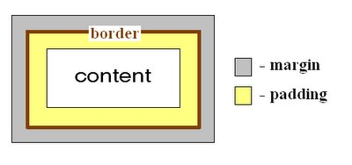
Padding and margin
- Padding adds space between the `Container`'s content and its edges.
- Margin adds space between the `Container` and its parent widget.

Slide 22
Padding and margin properties
1. padding: Sets the padding on all sides of the widget.
Example: padding: EdgeInsets.all(16.0)
2. paddingOnly: Sets the padding on specific sides of the widget.
Example: paddingOnly(left: 8.0, right: 8.0)

Slide 23
3. paddingSymmetric: Sets the symmetric padding (horizontal and vertical).
Example: paddingSymmetric(horizontal: 16.0, vertical: 8.0)
4. paddingAll: Same as padding: EdgeInsets.all(16.0).
5. paddingLeft, paddingTop, paddingRight, paddingBottom: Sets the padding on a specific side of the widget.

Slide 24
1. margin: Sets the margin on all sides of the widget.
Example: margin: EdgeInsets.all(16.0)
2. marginOnly: Sets the margin on specific sides of the widget.
Example: marginOnly(left: 8.0, right: 8.0)
3. marginSymmetric: Sets the symmetric margin (horizontal and vertical).
Example: marginSymmetric(horizontal: 16.0, vertical: 8.0)

Slide 25
4. marginAll: Same as margin: EdgeInsets.all(16.0).
5. marginLeft, marginTop, marginRight, marginBottom: Sets the margin on a specific side of the widget.

Slide 26
Row Widget:
The Row widget arranges its child widgets horizontally in a row.
Key properties of the Row widget:
1. children: The list of widgets to be arranged horizontally.
2. mainAxisAlignment: Controls how the children are aligned along the main axis (horizontal).
3. crossAxisAlignment: Controls how the children are aligned along the cross axis (vertical).

Slide 27
4. mainAxisSize: Controls the size of the Row along the main axis.
5. textDirection: Controls the text direction for the Row.
6. verticalDirection: Controls the vertical direction of the Row.
7. textBaseline: Specifies the text baseline to use for positioning the children.

Slide 28
Colum widget
The Column widget arranges its child widgets vertically in a column.
Key properties of the Column widget:
1. children: The list of widgets to be arranged vertically.
2. mainAxisAlignment: Controls how the children are aligned along the main axis (vertical).
3. crossAxisAlignment: Controls how the children are aligned along the cross axis (horizontal).

Slide 29
4. mainAxisSize: Controls the size of the Column along the main axis.
5. textDirection: Controls the text direction for the Column.
6. verticalDirection: Controls the vertical direction of the Column.
7. textBaseline: Specifies the text baseline to use for positioning the children.

Slide 30
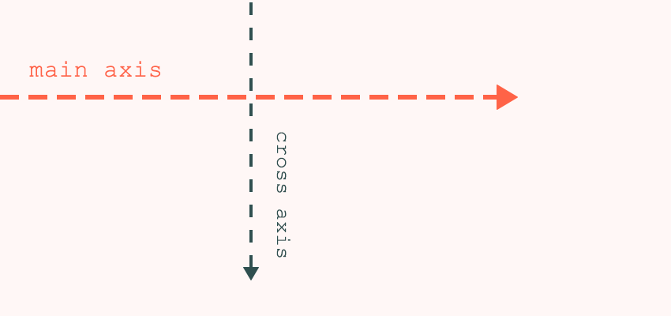
Main and cross axisaligmnet

Slide 31
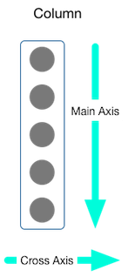
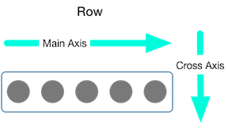

Slide 32
Selectable text
The `Selectable` widget allows users to select and copy text within your app. It provides a simple way to enable text selection and copying functionality without requiring additional custom implementation.

Slide 33
Buttons
The various button types in Flutter include TextButton, IconButton, and ElevatedButton, each with their own use cases.

Slide 34
BottomNavigationBar
The `BottomNavigationBar` in Flutter is a commonly used widget that provides a navigation bar at the bottom of the screen. It allows users to switch between different views or sections of the app.

Slide 35
1. Purpose: Allows users to navigate between different views or sections of the app.
2. Functionality: Displays a set of buttons or icons at the bottom of the screen, each representing a different view or section.
3. Usage: Ideal for apps with a small number of top-level views (typically 3-5) that the user needs to access frequently.

Slide 36
Leading/actions
The `leading` parameter in Flutter allows you to add a widget at the start of the layout, while the `actions` parameter lets you add one or more widgets at the end or right side of the layout, commonly used in widgets like `AppBar`.

Slide 37
Colum and list view
Column: A widget that arranges its child widgets vertically. Useful for laying out a set of widgets in a vertical manner.
ListView: A scrollable, linear list of widgets. Useful for displaying a large number of widgets that may not fit on the screen at once.

Slide 38
drawer
Drawer: A panel that slides in horizontally from the edge of the screen, often used for navigation. Provides access to primary destinations and app-level functionality.

Slide 39
navigation
Navigation: The process of moving between different screens or views in a Flutter app. Facilitated by widgets like `Navigator`, `MaterialPageRoute`, and `BottomNavigationBar`.

Slide 40
Default sizes of the appbar,…
AppBar: The default height of the AppBar is 56 logical pixels on iOS, and 64 logical pixels on Android.

