Slide 1
Flutter widgets

Slide 2
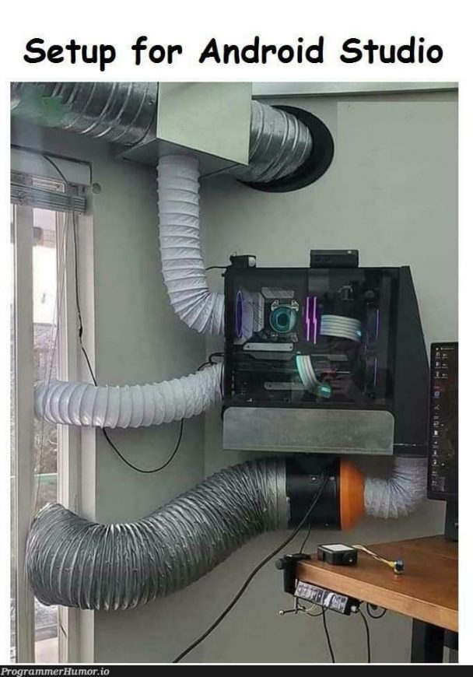
Set up android studio

Slide 3
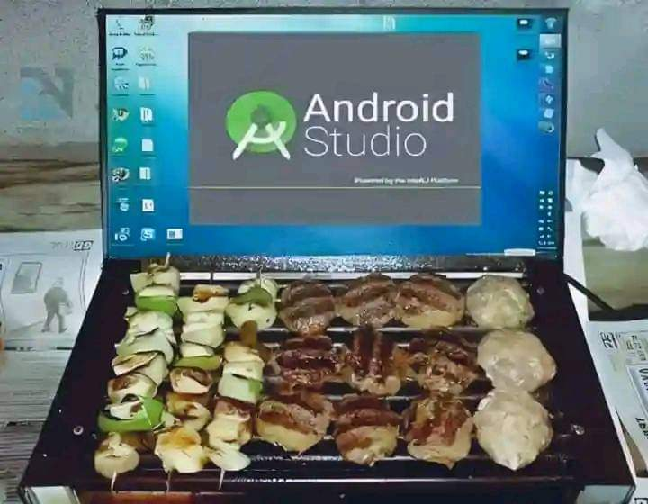

Slide 4
What is flutter?
Flutter is Google’s UI toolkit for designing beautiful, natively compiled iOS and Android apps from a single code base. To build any application we start with widgets – The building block of Flutter applications. Widgets describe what their view should look like given their current configuration and state. It includes a text widget, row widget, column widget, container widget, and many more.

Slide 5
What are Widgets?
Each element on the screen of the Flutter app is a widget. The view of the screen completely depends upon the choice and sequence of the widgets used to build the apps. And the structure of the code of apps is a tree of widgets

Slide 6
Widgets are the building blocks of your Flutter app.
You can put different widgets together to make cool things.
You can change how the widgets look and work.

Slide 7
Categories of widgets
There are many different categories of Flutter widgets, but here are some of the main ones:
1. Basic Widgets:
- Text: Displays text
- Image: Displays an image
- Icon: Displays an icon

Slide 8
2. Layout Widgets:
- `Row`: Arranges child widgets horizontally
- `Column`: Arranges child widgets vertically
- `Stack`: Overlays child widgets on top of each other

Slide 9
2. Layout Widgets:
- Row: Arranges child widgets horizontally
- Column: Arranges child widgets vertically
- Stack: Overlays child widgets on top of each other

Slide 10
3. Interactive Widgets:
- Button: Allows users to tap and trigger an action
- TextField: Allows users to enter and edit text
- Slider: Allows users to select a value from a range

Slide 11
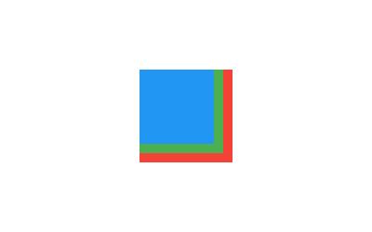
Stack

Slide 12
4. Scrolling Widgets:
- ListView: Displays a scrollable list of child widgets
- GridView: Displays a scrollable grid of child widgets
- SingleChildScrollView: Allows a single child widget to be scrollable

Slide 13
5. Styling Widgets:
Container: Allows you to apply padding, margins, and decorations to child widgets
Padding: Adds padding around a child widget
Theme: Allows you to apply a consistent style across your app

Slide 14
Types of Widgets
There are broadly two types of widgets in the flutter:
Stateless Widget
Stateful Widget

Slide 15
Stateless Widget
Stateless Widget is a type of widget which once built , then it’s properties and state can’t be changed. These widgets are immutable, once created can’t be modified.

Slide 16
Note: These are used for static content or UI content that don’t need a change after time.
Key Characterstics of Stateless Widgets are: Immutable , No State and Lightweight.
Examples: Display Text , Icons, Images, etc.

Slide 17
2. Stateful Widget
Stateful Widgets is a type of widget that can change state. It can maintain and update the appearance in the response to change in state.

Slide 18
Note: These are used for dynamic change in the properties and appearance over the time.
Key Characterstics of Stateful Widgets are: Mutable State , State Lifecycle and Dynamic Updates.
Examples: Buttons, Sliders, Text Fields, etc.

Slide 19
Flutter tree
App
├── Scaffold
│ ├── AppBar
│ └── Body
│ └── Center
│ └── Text
└── FloatingActionButton

Slide 20
The widget tree in Flutter is a hierarchical structure that represents the app’s UI. It is used by the Flutter framework to render the app’s UI on the screen. The widget tree is a recursive structure, meaning that a widget can have children, which can also have children, and so on.

Slide 21
1. App: This is the root widget of the app.
2. Scaffold: This is a commonly used widget that provides a basic structure for the app's UI, including an app bar and a body.
3. AppBar: This is a widget that represents the top bar of the app, often containing a title and other UI elements.

Slide 22
4. Body: This is the main content area of the Scaffold widget, where the app's main UI elements are placed.
5. Text: This is a widget that displays a piece of text on the screen, which is placed inside the Body widget.

Slide 23
Flutter folders
1. lib: This is the core of your Flutter application, containing all the Dart code that defines your app's functionality, user interface, and business logic.
2. Test: This folder contains your app's unit tests and integration tests, which help ensure the quality and reliability of your code.

Slide 24
3. android: This folder contains the Android-specific files needed to build and run your app on Android devices.
4. ios: This folder contains the iOS-specific files needed to build and run your app on iOS devices.

Slide 25
5. assets: This folder contains any static assets used in your app, such as images, fonts, and JSON data files.
6. web: This folder contains the files needed to build and run your Flutter app on the web.
7. windows: This folder contains the files needed to build and run your Flutter app on Windows devices.

Slide 26
8. macos: This folder contains the files needed to build and run your Flutter app on macOS devices.
9. linux: This folder contains the files needed to build and run your Flutter app on Linux devices.

Slide 27
Material design
Material Design is a design language and set of design principles developed by Google, which is heavily integrated into the Flutter framework. Flutter's widgets and overall visual style are heavily influenced by Material Design guidelines.

Slide 28
Some key aspects of Material Design in Flutter include:
1. Widgets: Flutter provides a wide range of Material Design-inspired widgets, such as AppBar, Drawer, FloatingActionButton, Card, Chip(Chips are commonly used to represent small pieces of information, provide user input, or display status.) and many others. These widgets follow Material Design guidelines for layout, typography, and interaction.

Slide 29
2. Colors and Themes: Flutter's ThemeData class allows you to define a global theme for your app, including primary and accent colors, font styles, and other visual properties that follow Material Design principles.

Slide 30
3. Animations and Transitions: Flutter's animation system is designed to seamlessly implement Material Design-style animations and transitions, such as ripple effects, fade animations, and motion-based UI changes.

Slide 31
4. Responsive Design: Material Design emphasizes a consistent user experience across different screen sizes and devices. Flutter's layout system and widgets are designed to adapt to various screen sizes and resolutions.

Slide 32
5. Accessibility: Material Design guidelines prioritize accessibility, and Flutter's widgets are built with accessibility features like support for screen readers and keyboard navigation.

Slide 33
6. Icons : Flutter provides a set of pre-defined Material Design icons that can be easily used in your app, ensuring a consistent visual style.

Slide 34
By using Flutter's Material Design-inspired widgets, you can create apps with a polished, modern, and consistent look and feel that follows the Material Design guidelines.
However, it's important to note that Flutter also supports other design languages and UI styles, such as Cupertino (iOS-style) widgets, allowing you to create cross-platform apps that maintain a native look and feel on each platform.

Slide 35
I am rich App
Release Date: The app was first released on the Apple App Store on August 5, 2008.
Developer: Armin Heinrich, a German independent software developer, created the "I Am Rich" app.
Platform: It was an iOS app, designed to run on iPhones and iPod Touch devices at the time.

Slide 36
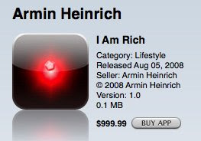

Slide 37
-Cost: The app was priced at $999.99, making it one of the most expensive apps on the App Store.
Functionality: The app did nothing more than display a glowing red gem on the user's screen, serving as a status symbol.
Controversy: The app drew immediate criticism for its lack of functionality and its exorbitant price tag, which many saw as an exploitative cash grab.
Removal: Apple ended up removing the "I Am Rich" app from the App Store just one day after its initial release, as the company deemed it to be of no real value to users.

Slide 38
Initial reports indicated that only around 8 people had purchased the app before it was taken down.
2. The app developer, Armin Heinrich, has stated that he made around $5,600 in revenue from the app's brief time on the App Store.

Slide 39
Creating flutter using cmd
flutter create my_app
To run use flutter run

