Slide 1
Real-time Audio Descrambler
（Analogue Design)

Slide 2
Introduction
We need to build a digital real time audio descrambler that can work out the secret message hidden inside the scrambled file.

Slide 3
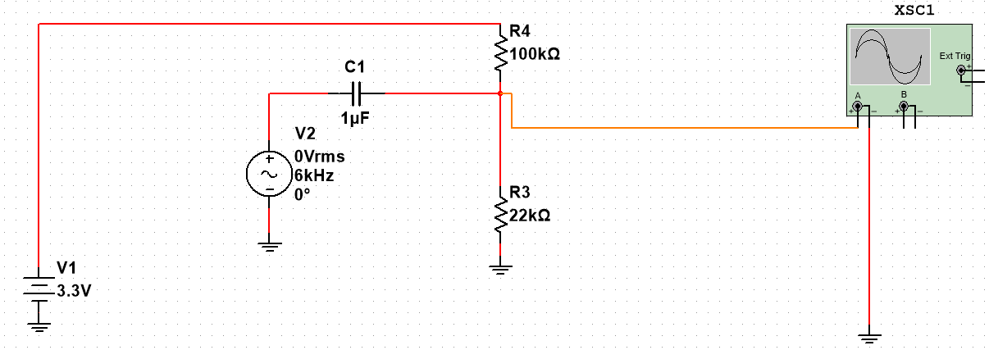
DC Bias design
0.6 V DC biasing

Slide 4
Code Part
ADC converting
Input measuring
Sin wave generating
Bandstop filter
Sine wave mixing
Output

Slide 5
Analog to Digital converter
Set Vref,Output ,GPIO
Configure the pin for HFXT crystal
Set the clock frequency
Configure GPIO to be ADC input
Configure ADC resolution and memory
Get the result

Slide 6
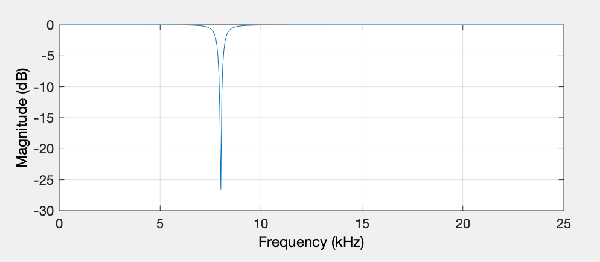
Bandstop Filter
We used MATLAB to calculate the nominators and denominators with cutoff frequency1 of 7800 Hz, cutoff frequency2 of 8200 Hz to remove the 8K noise and sampling frequency of 50kHz.

Slide 7
Sine Wave
The sine wave is in the form of sin(2π*f*m).
The systick_isr is in the rate of 50kHz, the number of points, PTS is set to 50 to make a base frequency of 1kHz
7.0 times the base frequency 1kHz is the frequency of the sine wave
sin(2.0*π*7.0*m/(float)PTS)* the digital signal where 0=<m<PTS

Slide 8
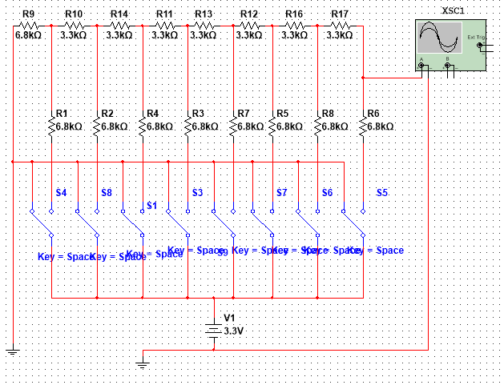
DAC
The R-2R ladder digital-to-analog converter

Slide 9
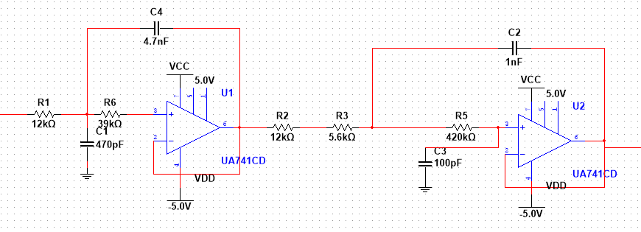
Low Pass Filter
The first cut-off frequency is 4949 Hz. The second cut-off frequency is 5853 Hz.

Slide 10
Power Amplifier
Signal from low-pass filter is small. Power amplifier is used to amplify the signal, including both voltage and current.
Overall Gain is approximately 300

