Slide 1
Quality Keeper at PR side based on sonar scan ITOM Shanghai FedEx Day – SMA 2019.10
Contributors: Zou Zongming, Dong ChengCheng, Li Xue
Notes:
Hello everyone,
I am lixue , my team members are zongming and chengcheng.
Our topic is

Slide 2
Problems
PRs
New bugs
Coverages
Bad code smell
Vulnerabilities
Technical debts
Cost
Notes:
In our daily work, One PR may contain new_bugs, bad code smell,,low coverage … and many other problems
But it’s hard for the reviewer to figure out all the thing. It’s a high requirement for our colleagues. and it does cost time.
And Time is life ~
So The reality is ：
Code is merged into master , without UT
And can also be merged with critical, blocked issues.
All those defects can be scanned by sonar, we can get the results in our daily report.
but it’s already late.
For the other side,
And even we have the PR’s scan result
, we can’t determine whether the PR is ok to merge.
Because it’s a high level information.
We can’t determine whether the PR is ok according the whole repo’s coverages and bugs.

Slide 3
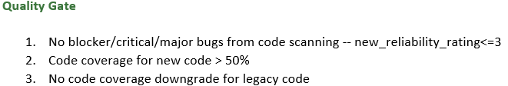
Solution
Trigger Sonar scan at PR side
Focus on single file metrics
Notes:
-sonar scan at the very begging
Customize the Quality Gate based on your repo’s current status.
We designed the Quality Gate for single file. Each repo should have it’s own based on it’s status.
We focus on following metrics.
Coverage, bugs, rating ,
The information will be marked as red when it violates the quality gate.

Slide 4
Implement steps
Step1
Config webhook and trigger condition - When PR(opened,changed)/comments “sonar”
Step2
trigger sonar to scan repo code.(pr/{$prNum/merge} and analyze the code quality.
Step3
get PR’s “Files Changed” List by calling GitHub API
Step4
Collect sonar metrics value for single file (xx.java and skipped xxTest.java)
Step5
Organize sonar scan result and send Email, and mark job status as fail if you break the rules.
Notes:
Step1: configure webhook at repo side and job side, configure triggering condition - When PR(opened,changed)/comments “sonar”
Step2: trigger sonar to scan repo code.(pr/{$prNum/merge} and analyze the code quality.
Step3: get PR’s “Files Changed” List by calling GitHub API
Step4: Collect sonar metrics value for single file (xx.java and skipped xxTest.java) with
Step5: Organize sonar scan result and send Email, and mark job status as fail if you break the rules.

Slide 5
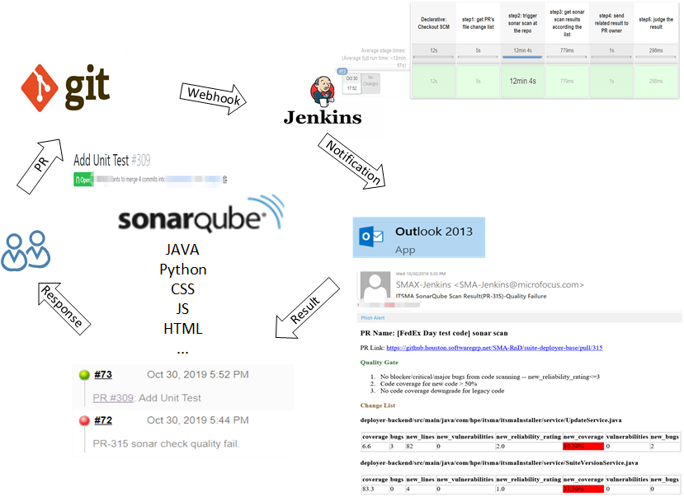
Implement steps
Notes:
Step1: configure webhook. Which can help us to trigger job when When PR(opened) and comments “sonar”. Then jobs are triggered .
Step2: trigger sonar to scan repo code.(pr/{$prNum/merge} and analyze the code quality.
Step3: get PR’s “Files Changed” List by calling GitHub API
Step4: Collect sonar metrics value for single file by calling sonar APIs
Step5: Organize sonar scan result and send Email, and mark job status. If the File Changes in the PR is following the Quality Gate, it will be green,

Slide 6
Live Demo
https://github.houston.softwaregrp.net/SMA-RnD/suite-deployer-base/pull/322
Notes:
https://github.houston.softwaregrp.net/SMA-RnD/suite-deployer-base/pull/322

Slide 7
Thank You!
Q&A

