Slide 1

SENTIMENT ANALYSIS FOR USER REVIEWS
Presented By,
Liya Mathew
Roll No:37
S10,DDMCA

Slide 2
CONTENTS
Introduction
  What is a Review?
  What is Sentiment Analysis?
    Sentiment Analysis Algorithms
    Types of Sentiment Analysis
    Levels of Sentiment Analysis
    Proposed System
      K-Nearest Neighbour Algorithm
    Result
    Conclusion

Slide 3
Reviews
Review evaluation procedure of a service, a product, a publication or any other company.
User review a review written by a user for a product or a service based on his/her experience as a user of the reviewed product.
Consumer reviews several lines of texts along with a numerical rating.
Customer review user generated content.

Slide 4
Sentiment Analysis
Sentiment analysis:
  method of extraction of the text based on the polarity.
Based on a scoring mechanism, sentiment analysis monitors:
  conversations and evaluates language and voice inflections to quantify attitudes, opinions, and emotions related to a business, product or service, or topic.
Sentiment analysis is sometimes also referred to as “opinion mining”.

Slide 5
Sentiment Analysis Algorithms
  Rule-based systems:
    perform sentiment analysis based on a set of manually crafted rules.
  Automatic systems:
    depends on machine learning techniques to learn from data.
  Hybrid systems:
    combine both rule based and automatic approaches.

Slide 6
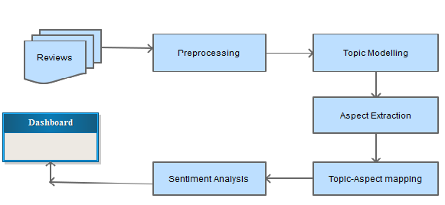
Fig: Processing in sentiment analysis

Slide 7
Types of Sentiment Analysis
Fine-grained sentiment analysis:
  provides a more precise level of polarity by breaking down the text into further categories.
Emotion detection:
  identifies specific emotions rather than positivity and negativity.
Intent-based analysis:
  acknowledges actions behind a text in addition to opinion.
Aspect-based analysis:
  gathers the specific component being positively or negatively mentioned.

Slide 8
Levels of Sentiment Analysis:
  Document level sentiment analysis:
    entire document or paragraph.
  Sentence level sentiment analysis:
    a single sentence.
  Sub-sentence level sentiment analysis:
    sub-expressions among a sentence.

Slide 9
Proposed System
The proposed system is to construct a user reviewing system in which a score is automatically generated on the basis of the review by categorizing it as positive, negative or neutral reviews.
The system uses the K-Nearest Neighbour algorithm to implement this technique.

Slide 10
K-Nearest Neighbour Algorithm[KNN]
Non-parametric supervised learning technique .
Simplest of classification algorithm.
Captures information of all training cases and classifies new cases based on a similarity .
Classifies new cases by a majority vote of its k neighbours.
The algorithm looks at the different centroids and compares distance using some of functions, and then analyzes those results and assigns each point to the group .

Slide 11
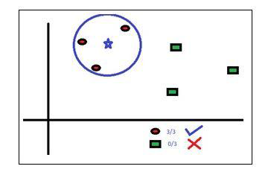
Fig:Example of KNN

Slide 12
Steps:
  Step 1:
    Strings are broken into tokenized arrays of single words.
  Step 2:
    These words are analyzed against txt files that contain different words with the ratings.
  Step 3:
    A score is then calculated based on this analyses and this forms the "Sentiment analysis score".

Slide 13
K-NN Algorithm:
  Load the data
  Initialise the value of k
  For getting the predicted class, iterate from 1 to total number of training data points
    Calculate the distance between test data and each row of training data.
    Here we will use levenshtein distance as our distance metric.
    Sort the calculated distances in ascending order based on distance values .
    Get top k rows from the sorted array
    Get the most frequent class from these rows.
    Return the predicted class.

Slide 14
Phrase Analysis:
  Function to identify whether the phrase in questions can be compared to phrases that we have analyzed and stored before.
  It uses Levenshtein distance to calculate distance between word length phrases against the dataset we already have.
    The phrase is broken up into n-gram lengths.
    The array is sorted in reverse.
    Phrases are matched against positive, negative and neutral phrases with the appropriate TXT files.
    Only matches that meet the minimum levenshtein min distance & similiarity_min_distance are kept

Slide 15
Levenshtein distance:
  measure the difference between two sequences.
  minimum number of edits in a single-character required to change one word to the other.

Slide 16
Comparative Study
Machine Learning Classifier | Advantages | Disadvantages
KNN | It is simple and also used for multiclass categorization of document. | It requires more time to categorize when huge number data are inclined. Takes lot of memory for running a process
Decision Tree | This is very fast in learning data set. Easy for understanding purpose | It has problem that it is difficult handle data with noisy data. Over fitting of data
Naïve Bayesian | Simple and work well with textual as well as numerical data. Easy to implement. Computationally cheap | Performs very poorly when feature set is highly correlated. It gives relatively low classification performance for large data set. Independent assumption of attribute may lead to inaccurate result.
Support Vector Machine | High accuracy even with large data set. Works well with many number of dimensions. No over fitting | Problems in representing document into numerical vector.

Slide 17
Result
The precision, recall & accuracy of the proposed system is higher than the traditional system.
Processing time is totally depend upon the size of dataset.
  as the size increases the processing time increases and remain same for these classifiers,
  and if different number of documents (and of different dataset size) are used then we can observe the processing time differences.
  It is difficult to calculate the score when there is shortcut words are used.

Slide 18
Conclusion
The sentiment analysis is a research area of great scope.
New researches have been emerging in the field of natural language processing.
Here, the K-Nearest Neighbour algorithm is used to effectively calculate the polarity of the reviews, by grouping the reviews as positive, negative and neutral values.
This technique gives a 83.65% accurate result and the efficiency of result can be further increased by using better feature selection methods like CHI Square, Information Gain, etc.

Slide 19


