Slide 1
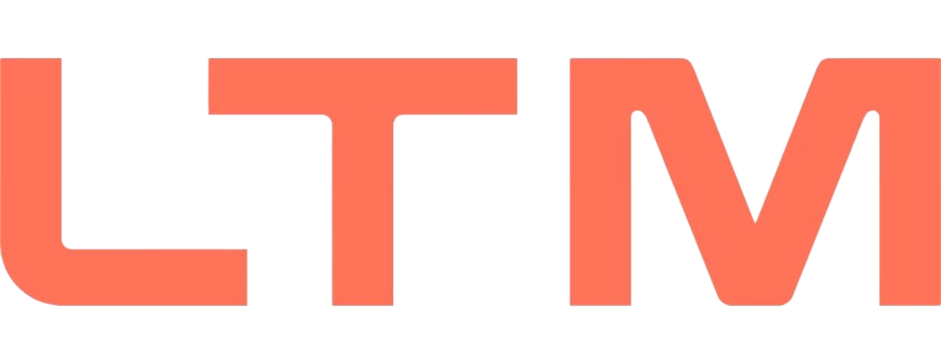

M.Tech Program
Advanced Industry Integrated Programs
Jointly offered by University and LTIMindTree
Contract Guardian :
An AI System for Contract Risk Detection, Longitudinal Drift Tracking, and Regulatory Change Ripple Mapping
LIYA ELIZABETH RAJU
Knowledge partner | Implementation partner

Slide 2
Contract Guardian : An AI System for Contract Risk Detection, Drift Tracking, and Ripple Mapping
Introduction….
Contracts, terms-of-service agreements, and privacy policies govern nearly every business relationship a freelancer or small company enters into — yet the people signing them rarely have the legal expertise or budget to review them properly.
This creates three compounding risks:
Risky clauses go unnoticed at signing
Agreements silently change after acceptance
Regulatory shifts leave existing documents unreviewed for compliance impact.

Slide 3
Contract Guardian : An AI System for Contract Risk Detection, Drift Tracking, and Ripple Mapping
Objective….
Detect risky clauses — parse and classify contracts into structured clause units, flagging deviations from standard terms with a cited reference clause.
Track document drift — diff historical versions of ToS/privacy policies and summarize changes in plain language.
Map regulatory ripple effects — build a lightweight dependency graph so a regulatory change surfaces which of a user's documents are affected.
Ground every output — one shared RAG pipeline ensures every flag or summary cites its source, avoiding unsupported claims.
Stay advisory, not prescriptive — outputs are framed as "flagged for review," never as legal verdicts.

Slide 4
Contract Guardian : An AI System for Contract Risk Detection, Drift Tracking, and Ripple Mapping
Scope….
Risk Highlighter: Parse and classify contract clauses, detect red flags using a pgvector reference corpus, and provide RAG-based, confidence-scored explanations.
Drift Tracker: Track selected ToS/privacy policies using historical snapshots, perform clause-level diffing, and summarize important changes in plain language.
Ripple Mapper: Focus on one jurisdiction/regulation (e.g., India’s DPDP Act) and map affected clause types to regulatory sections to identify impacted user documents.

Slide 5
Contract Guardian : An AI System for Contract Risk Detection, Drift Tracking, and Ripple Mapping
Literature Review….
CLAUDETTE: Uses NLP and machine learning to detect potentially unfair clauses in consumer contracts.
ContractNLI: Applies natural language inference to identify whether contracts satisfy specific legal hypotheses.
Legal-BERT / Transformer Models: Improve clause classification and legal text understanding.
Limitation: Most systems analyze a contract as a single snapshot and focus on identifying risky clauses rather than monitoring them over time.

Slide 6
Contract Guardian : An AI System for Contract Risk Detection, Drift Tracking, and Ripple Mapping
Literature Review….
Research on privacy-policy evolution studies how terms change across different versions and providers.
Diff-based and NLP approaches identify additions, deletions, and semantic changes between policy versions.
Studies reveal that policies can undergo significant changes that users may not notice.
Limitation: Existing work is primarily corpus-level or research-oriented, rather than tracking the cumulative impact on an individual user's accepted documents.

Slide 7
Contract Guardian : An AI System for Contract Risk Detection, Drift Tracking, and Ripple Mapping
Literature Review….
PrivComp-KG: Represents relationships between privacy regulations, requirements, and compliance concepts.
GraphCompliance: Uses knowledge graphs to connect regulatory requirements with compliance information.
Legal knowledge graphs: Support regulatory reasoning, entity relationships, and compliance analysis.
Limitation: These systems generally reason about regulations in isolation and do not identify which specific documents belonging to a user are affected by a regulatory change.

Slide 8
Contract Guardian : An AI System for Contract Risk Detection, Drift Tracking, and Ripple Mapping
Summary of Literature….
Contract analysis tools such as CLAUDETTE detect potentially unfair clauses, while privacy-policy research studies changes in documents over time. Compliance knowledge graphs such as PrivComp-KG and GraphCompliance model relationships between regulations and compliance requirements.
These approaches address clause risk, document drift, and regulatory compliance separately and are not personalized to an individual’s document set. Contract Guardian integrates all three through a clause-level parsing engine, enabling risk highlighting at signing, tracking cumulative rights erosion, and identifying which user documents are affected when regulations change.

Slide 9
Contract Guardian : An AI System for Contract Risk Detection, Drift Tracking, and Ripple Mapping
Additional Information….
DATA AQUISITION
Hand-labeled contracts : Used to validate the clause parser & classifier (CUAD)
Standard clause database : Reference/red-flag clauses, indexed in pgvector; the actual product value for the Risk Highlighter.
ToS & privacy policy pages : Historical snapshots via the Wayback Machine, feeding the Drift Tracker.
Regulatory text corpus : Official gazette RSS or legal-tracking API —input for the Ripple Mapper.

Slide 10
Contract Guardian : An AI System for Contract Risk Detection, Drift Tracking, and Ripple Mapping
Additional Information….
TIMELINE
Week | Focus | Key Tasks
Week 1 | Foundation | Clause parser + classifier, validated on hand-labeled contracts; finalize scope & data sources
Week 2 | Risk Highlighter core | Curate reference clause corpus; build pgvector RAG pipeline + grounded generation for risk flags
Week 3 | Dashboard + Drift/Ripple PoCs | Wire backend to React dashboard; build Drift Tracker PoC (Wayback snapshots, clause diffing); build Ripple Mapper PoC (single-jurisdiction dependency graph: regulation → clause type → document)
Week 4 | Integration + Demo | End-to-end testing across all three modules on fresh documents; polish grounded explanations; package full demo

Slide 11
Contract Guardian : An AI System for Contract Risk Detection, Drift Tracking, and Ripple Mapping
Additional Information….
TIMELINE
Project Phase | Week 1 | Week 2 | Week 3 | Week 4
Foundation & Clause Intelligence | ████████
Risk Highlighter & RAG |  | ████████
Dashboard + Drift/Ripple PoCs |  |  | ████████
Integration, Testing & Demo |  |  |  | ████████

Slide 12
Contract Guardian : An AI System for Contract Risk Detection, Drift Tracking, and Ripple Mapping
Modules to cover….
Ingestion
Clause Parser
Retrieval Corpus (RAG, pgvector)
Risk Engine
Drift Engine
Ripple
Frontend

Slide 13
Contract Guardian : An AI System for Contract Risk Detection, Drift Tracking, and Ripple Mapping
Document Ingestion Engine
Transforms raw legal documents from multiple sources into clean, machine-readable content.
What it does :
Accepts PDF, DOCX, and web-based Terms of Service and privacy policies
Extracts text from digitally generated and messy real-world documents
Handles formatting inconsistencies, scanned layouts, headers, and document noise
Preserves document structure and metadata for downstream processing
Creates a standardized document representation
Output : Clean, structured legal document ready for clause-level analysis

Slide 14
Contract Guardian : An AI System for Contract Risk Detection, Drift Tracking, and Ripple Mapping
Clause Parser & Classification Engine
Breaks complex legal documents into meaningful, structured, and addressable clauses.
What it does :
Segments documents into individual clauses and sections
Identifies clause boundaries and hierarchical relationships
Classifies clauses into legal categories
Uses the CUAD 41-category taxonomy for training and validation
Assigns metadata such as clause type, position, and source document
Output : Structured clause objects that can be searched, compared, and analyzed

Slide 15
Contract Guardian : An AI System for Contract Risk Detection, Drift Tracking, and Ripple Mapping
Retrieval & Knowledge Layer (RAG)
Provides relevant legal context for intelligent clause analysis.
What it does :
Converts clauses into vector embeddings
Stores and indexes embeddings using pgvector
Retrieves semantically similar clauses from reference corpora
Supports multiple knowledge sources through one retrieval architecture
Supplies grounded context to the AI analysis engines
Output : Relevant legal context for every clause being analyzed

Slide 16
Contract Guardian : An AI System for Contract Risk Detection, Drift Tracking, and Ripple Mapping
Risk Intelligence Engine
Identifies potentially risky, unusual, or unfavorable clauses in legal documents.
What it does :
Analyzes each incoming clause against similar reference clauses
Detects deviations from standard legal language
Identifies potential red flags and unusual obligations
Generates grounded explanations for every risk flag
Explains why a clause is risky, rather than simply assigning a score
Output : Clause-level risk flags with explainable reasoning

Slide 17
Contract Guardian : An AI System for Contract Risk Detection, Drift Tracking, and Ripple Mapping
Policy & Contract Drift Engine
Tracks how legal documents change over time.
What it does :
Collects and compares multiple versions of the same ToS or policy
Uses historical versions and archived snapshots
Performs clause-level comparison between versions
Detects additions, removals, and modifications
Summarizes cumulative changes in plain language
Output : A timeline of meaningful legal and policy changes

Slide 18
Contract Guardian : An AI System for Contract Risk Detection, Drift Tracking, and Ripple Mapping
Regulatory Ripple Engine
Identifies which documents may be affected when regulations change.
What it does :
Maps clause categories to relevant regulations
Builds a dependency graph between documents, clauses, and regulations
Detects changes in regulatory requirements
Retrieves affected regulatory content
Identifies contracts and policies requiring review
Output : A prioritized compliance review and impact-triage list

Slide 19
Contract Guardian : An AI System for Contract Risk Detection, Drift Tracking, and Ripple Mapping
Frontend & User Experience
Provides a single interface for interacting with all legal intelligence features.
Key Features :
Document Upload
Risk-Annotated Document Viewer
Clause-Level Risk Insights
Policy Change Timeline
Regulatory Ripple Alerts
Output : A unified legal intelligence dashboard for faster document review and compliance monitoring

