Slide 1
Visualizing Data
Histograms
Box-plots
Bar charts
Line plots
Scatter plots
Proportion plots
Chart Junk

Slide 2
Histogram
Single Quantitative Variable

Slide 3
Histogram
A histogram is a bar chart in which:
The y-axis is frequency or count
The x-axis is a quantitative variable
The entire range of data is covered on the x-axis
The range of data is typically divided into bins
(almost same process as for calculating mode)
Notes:
Go to Excel Spreadsheet

Slide 4
Box Plot
Single Quantitative Variable

Slide 5
Box Plots
Indicates the variability by showing key percentiles:
Min
25%
Median
75%
Max
Allows comparison of the distribution of multiple variables
Can be modified to show outliers: extreme data points that fall far outside the range of most of the data

Slide 6
Outlier
Tukey’s definition:
Any point outside:
25th percentile – 1.5 * (IQR)
75th percentile + 1.5 * (IQR)

Slide 7
Bar Chart
Categorical Variable(s)
vs.
Quantitative Variable

Slide 8
Bar Chart
Useful for plotting categorical variables against quantitative variables
Typically used for comparing types of things
Error bars show variability
Helpful hints:
The quantitative variable is typically shown on the y-axis
Try to have the axis showing the quantitative variable start from meaningful point (usually 0)
Don’t forget to label your axes!
Notes:
Use student data to create bar chart of heights for women vs. men

Slide 9
Line plots
Qualitative Variable(s)
vs.
Quantitative Variable

Slide 10
Line plots
Useful for plotting qualitative variables against ordered quantitative variables
Helpful when comparing factors
Error bars can be used to show variability
Helpful hints:
The quantitative variable is typically shown on the y-axis
Try to have the axis showing the quantitative variable start from meaningful point (usually 0)
Don’t forget to label your axes!

Slide 11
Scatter Plots
Quantitative Variable
vs.
Quantitative Variable

Slide 12
Scatter plots
Used to visualize the relationship between two quantitative variables:
How does one variable change in response to change in another variable?
How closely related are the variables?
Notes:
Show relationship between height and shoe size

Slide 13
Proportion plots
Categorical Variable
vs.
Proportion

Slide 14
Proportion plots
Shows whole divided into parts by proportion
Pie charts
Stacked bar charts

Slide 15
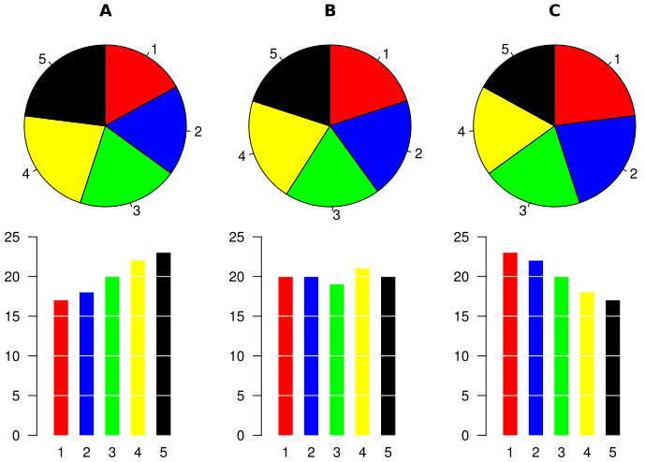
Why pie charts are bad

Slide 16
Multiple variables
Using colors, markers, line styles, etc.
3-D plots

Slide 17
Bad visualizations

Slide 18
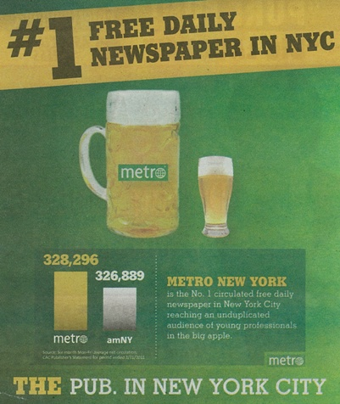
What story does this tell?

Slide 19
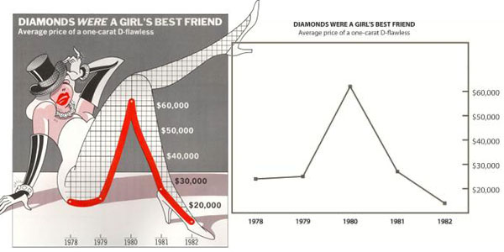
Chartjunk

Slide 20
Choosing a Figure
How many variables are you trying to plot?
More than 4 is almost always too difficult to make sense of
What types of variables are you plotting?
What is the purpose of the plot?
i.e., What are you trying to show?

Slide 21
Rules of Thumb
Make the visualization understandable without explanation (or as little as possible)
Additional information can be helpful
BUT don’t let it distract from the main point
Use as little ink as possible
(See also: books by Edward Tufte)
Notes:
http://junkcharts.typepad.com/junk_charts/2011/08/light-entertainment-how-social-media-saves-education-and-education-saves-us-all.html
http://flowingdata.com/2011/09/09/girl-scout-cookie-pie-chart/
http://junkcharts.typepad.com/junk_charts/2011/08/chart-of-the-.html
http://flowingdata.com/2011/08/26/generic-terms-for-streams-mapped/
http://flowingdata.com/2011/08/12/rethinking-the-food-nutrition-label/
http://flowingdata.com/2011/09/07/five-years-of-kiva-lending-and-borrowing/

