Slide 1


Slide 2
Supervised Learning
Classification

Slide 3
Outline
Classification
Supervised Learning
Measures of Accuracy
Logistic regression
Support Vector Machines
Decision Trees
Vowpal Wabbit

Slide 4
Classification
Notes:
The final supervised machine learning algorithm we’ll describe is one of the newest and most powerful, called Support Vector Machines.

Slide 5
An example application
An emergency room in a hospital measures 17 variables (e.g., blood pressure, age, etc) of newly admitted patients.
A decision is needed: whether to put a new patient in an intensive-care unit.
Due to the high cost of ICU, those patients who may survive less than a month are given higher priority.
Problem: to predict high-risk patients and discriminate them from low-risk patients.
Notes:
Notes borrowed from Bing Liu, UIC

Slide 6
Another application
A credit card company receives thousands of applications for new cards. Each application contains information about an applicant,
age
Marital status
annual salary
outstanding debts
credit rating
etc.
Problem: to decide whether an application should approved, or to classify applications into two categories, approved and not approved.

Slide 7
Supervised Learning
Our focus: learn a target function that can be used to predict the values of a discrete class attribute, e.g., approve or not-approved, and high-risk or low risk.
The task is commonly called: Supervised learning, classification, or inductive learning.

Slide 8
The data and the goal
Data: A set of data records (also called examples, instances or cases) described by
k attributes: A₁, A₂, … A_{k}.
a class: Each example is labelled with a pre-defined class.
Goal: To learn a classification model from the data that can be used to predict the classes of new (future, or test) cases/instances.
Notes:
Induction is different from deduction and DBMS does not not support induction;
The result of induction is higher-level information or knowledge: general statements about data
There are many approaches. Refer to the lecture notes for CS3244 available at the Co-Op.
We focus on three approaches here, other examples:
Other approaches
Instance-based learning
other neural networks
Concept learning (Version space, Focus, Aq11, …)
Genetic algorithms
Reinforcement learning

Slide 9
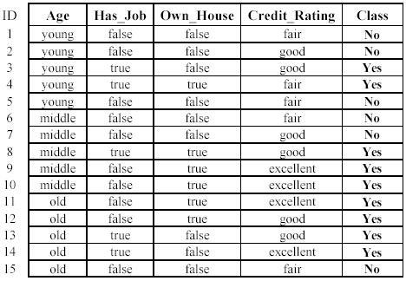
An example: (loan application)
Approved or not

Slide 10
An example: the learning task
Learn a classification model from the data
Use the model to classify future loan applications into
Yes (approved) and
No (not approved)
What is the class for following case/instance?

Slide 11
Supervised vs. unsupervised Learning
Supervised learning: classification is seen as supervised learning from examples.
Supervision: The data (observations, measurements, etc.) are labeled with pre-defined classes. It is like that a “teacher” gives the classes (supervision).
Test data are classified into these classes too.
Unsupervised learning (clustering)
Class labels of the data are unknown
Given a set of data, the task is to establish the existence of classes or clusters in the data

Slide 12
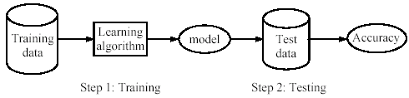
Supervised learning process: two steps
Learning (training): Learn a model using the training data
Testing: Test the model using unseen test data to assess the model accuracy

Slide 13
What do we mean by learning?
Given
a data set D,
a task T, and
a performance measure M,
a computer system is said to learn from D to perform the task T if after learning the system’s performance on T improves as measured by M.
In other words, the learned model helps the system to perform T better as compared to no learning.

Slide 14
An example
Data: Loan application data
Task: Predict whether a loan should be approved or not.
Performance measure: accuracy.
No learning: classify all future applications (test data) to the majority class (i.e., Yes):
Accuracy = 9/15 = 60%.
We can do better than 60% with learning.

Slide 15
Fundamental assumption of learning
Assumption: The distribution of training examples is identical to the distribution of test examples (including future unseen examples).
In practice, this assumption is often violated to certain degree.
Strong violations will clearly result in poor classification accuracy.
To achieve good accuracy on the test data, training examples must be sufficiently representative of the test data.

Slide 16
Evaluating classification methods
Predictive accuracy
Accuracy =
Efficiency
time to construct the model
time to use the model
Robustness: handling noise and missing values
Scalability: efficiency in disk-resident databases
Interpretability:
understandable and insight provided by the model
Compactness of the model: size of the tree, or the number of rules.

Slide 17
Evaluation methods
Holdout set: The available data set D is divided into two disjoint subsets,
the training set D_{train} (for learning a model)
the test set D_{test} (for testing the model)
Important: training set should not be used in testing and the test set should not be used in learning.
Unseen test set provides a unbiased estimate of accuracy.
The test set is also called the holdout set. (the examples in the original data set D are all labeled with classes.)
This method is mainly used when the data set D is large.

Slide 18
Evaluation methods (cont…)
n-fold cross-validation: The available data is partitioned into n equal-size disjoint subsets.
Use each subset as the test set and combine the rest n-1 subsets as the training set to learn a classifier.
The procedure is run n times, which give n accuracies.
The final estimated accuracy of learning is the average of the n accuracies.
10-fold and 5-fold cross-validations are commonly used.
This method is used when the available data is not large.

Slide 19
Evaluation methods (cont…)
Leave-one-out cross-validation: This method is used when the data set is very small.
It is a special case of cross-validation
Each fold of the cross validation has only a single test example and all the rest of the data is used in training.
If the original data has m examples, this is m-fold cross-validation

Slide 20
Evaluation methods (cont…)
Validation set: the available data is divided into three subsets,
a training set,
a validation set and
a test set.
A validation set is used frequently for estimating parameters in learning algorithms.
In such cases, the values that give the best accuracy on the validation set are used as the final parameter values.
Cross-validation can be used for parameter estimating as well.

Slide 21
Classification measures
Accuracy is only one measure (error = 1-accuracy).
Accuracy is not suitable in some applications.
In text mining, we may only be interested in the documents of a particular topic, which are only a small portion of a big document collection.
In classification involving skewed or highly imbalanced data, e.g., network intrusion and financial fraud detections, we are interested only in the minority class.
High accuracy does not mean any intrusion is detected.
E.g., 1% intrusion. Achieve 99% accuracy by doing nothing.
The class of interest is commonly called the positive class, and the rest negative classes.

Slide 22
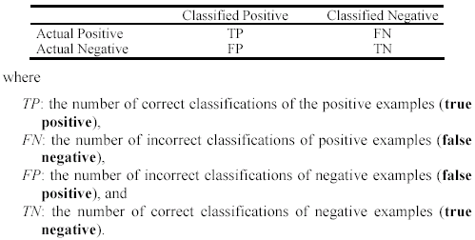
Precision and recall measures
Used in information retrieval and text classification.
We use a confusion matrix to introduce them.

Slide 23

Precision and recall measures
Precision p is the number of correctly classified positive examples divided by the total number of examples that are classified as positive.
Recall r is the number of correctly classified positive examples divided by the total number of actual positive examples in the test set.

Slide 24

An example
This confusion matrix gives
precision p = 100% and
recall r = 1%
because we only classified one positive example correctly and no negative examples wrongly.
Note: precision and recall only measure classification on the positive class.

Slide 25
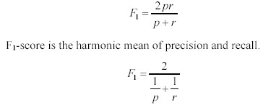
F₁-measure
It is hard to compare two classifiers using two measures. F₁ score combines precision and recall into one measure
The harmonic mean of two numbers tends to be closer to the smaller of the two.
For F₁-value to be large, both p and r must be large.

Slide 26
Decision Trees
Notes:
The final supervised machine learning algorithm we’ll describe is one of the newest and most powerful, called Support Vector Machines.

Slide 27
Introduction
Decision tree learning is one of the most widely used techniques for classification.
Its classification accuracy is competitive with other methods, and
it is very efficient.
The classification model is a tree, called decision tree.
C4.5 by Ross Quinlan is perhaps the best known system. It can be downloaded from the Web.

Slide 28
The loan data (reproduced)
Approved or not

Slide 29
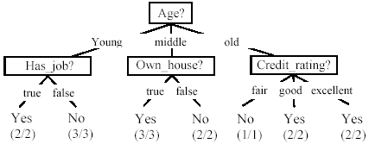
A decision tree from the loan data
Decision nodes and leaf nodes (classes)

Slide 30

Use the decision tree
No

Slide 31
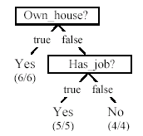
Is the decision tree unique?
No. Here is a simpler tree.
We want smaller tree and accurate tree.
Easy to understand and perform better.
Finding the best tree is NP-hard.
All current tree building algorithms are heuristic algorithms

Slide 32


From a decision tree to a set of rules
A decision tree can be converted to a set of rules
Each path from the root to a leaf is a rule.

Slide 33
Algorithm for decision tree learning
Basic algorithm (a greedy divide-and-conquer algorithm)
Assume attributes are categorical now (continuous attributes can be handled too)
Tree is constructed in a top-down recursive manner
At start, all the training examples are at the root
Examples are partitioned recursively based on selected attributes
Attributes are selected on the basis of an impurity function (e.g., information gain)
Conditions for stopping partitioning
All examples for a given node belong to the same class
There are no remaining attributes for further partitioning – majority class is the leaf
There are no examples left

Slide 34
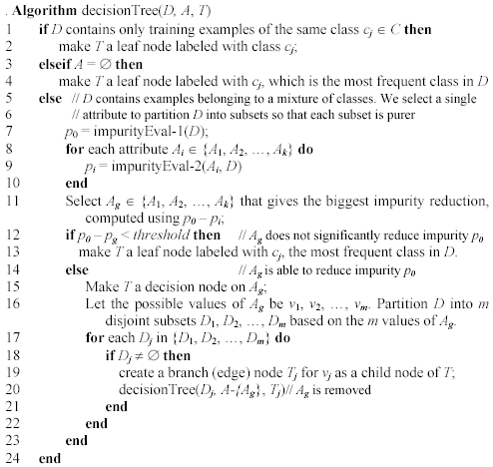
Decision tree learning algorithm

Slide 35
Choose an attribute to partition data
The key to building a decision tree - which attribute to choose in order to branch.
The objective is to reduce impurity or uncertainty in data as much as possible.
A subset of data is pure if all instances belong to the same class.
The heuristic in C4.5 is to choose the attribute with the maximum Information Gain or Gain Ratio based on information theory.

Slide 36
The loan data (reproduced)
Approved or not

Slide 37
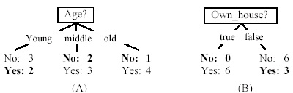
Two possible roots, which is better?
Fig. (B) seems to be better.

Slide 38
Information theory
Information theory provides a mathematical basis for measuring the information content.
To understand the notion of information, think about it as providing the answer to a question, for example, whether a coin will come up heads.
If one already has a good guess about the answer, then the actual answer is less informative.
If one already knows that the coin is rigged so that it will come with heads with probability 0.99, then a message (advanced information) about the actual outcome of a flip is worth less than it would be for a honest coin (50-50).

Slide 39
Information theory (cont …)
For a fair (honest) coin, you have no information, and you are willing to pay more (say in terms of $) for advanced information - less you know, the more valuable the information.
Information theory uses this same intuition, but instead of measuring the value for information in dollars, it measures information contents in bits.
One bit of information is enough to answer a yes/no question about which one has no idea, such as the flip of a fair coin

Slide 40
Information theory: Entropy measure
The entropy formula,
Pr(c_{j}) is the probability of class c_{j} in data set D
We use entropy as a measure of impurity or disorder of data set D. (Or, a measure of information in a tree)

Slide 41
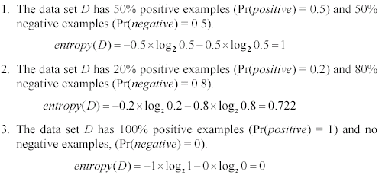
Entropy measure: let us get a feeling
As the data become purer and purer, the entropy value becomes smaller and smaller. This is useful to us!

Slide 42

Information gain
Given a set of examples D, we first compute its entropy:
If we make attribute A_{i}, with v values, the root of the current tree, this will partition D into v subsets D₁, D₂ …, D_{v} . The expected entropy if A_{i} is used as the current root:

Slide 43
Information gain (cont …)
Information gained by selecting attribute A_{i} to branch or to partition the data is
We choose the attribute with the highest gain to branch/split the current tree.

Slide 44
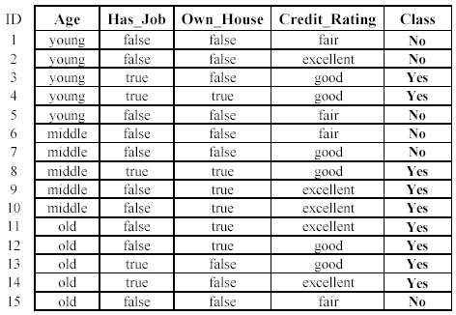

An example
Own_house is the best choice for the root.

Slide 45
We build the final tree
We can use information gain ratio to evaluate the impurity as well (see the handout)

Slide 46
Handling continuous attributes
Handle continuous attribute by splitting into two intervals (can be more) at each node.
How to find the best threshold to divide?
Use information gain or gain ratio again
Sort all the values of an continuous attribute in increasing order {v₁, v₂, …, v_{r}},
One possible threshold between two adjacent values v_{i} and v_{i+1}. Try all possible thresholds and find the one that maximizes the gain (or gain ratio).

Slide 47
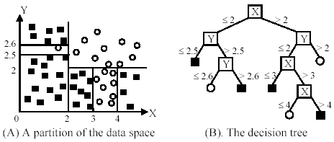
An example in a continuous space

Slide 48
Avoid overfitting in classification
Overfitting: A tree may overfit the training data
Good accuracy on training data but poor on test data
Symptoms: tree too deep and too many branches, some may reflect anomalies due to noise or outliers
Two approaches to avoid overfitting
Pre-pruning: Halt tree construction early
Difficult to decide because we do not know what may happen subsequently if we keep growing the tree.
Post-pruning: Remove branches or sub-trees from a “fully grown” tree.
This method is commonly used. C4.5 uses a statistical method to estimates the errors at each node for pruning.
A validation set may be used for pruning as well.

Slide 49
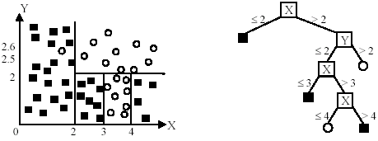
An example
Likely to overfit the data

Slide 50
Other issues in decision tree learning
From tree to rules, and rule pruning
Handling of miss values
Handing skewed distributions
Handling attributes and classes with different costs.
Attribute construction
Etc.

Slide 51
Support Vector Machines
Notes:
The final supervised machine learning algorithm we’ll describe is one of the newest and most powerful, called Support Vector Machines.

Slide 52
Perceptron Revisited:
Linear Classifier: y(x) = sign(w.x + b)
w.x + b > 0
w.x + b = 0
w.x + b < 0
Notes:
To explain the basic principle behind Support Vector Machines, consider a higher simplified case where two sets of points are linearly separable.
Linearly separable means that at least in 2 dimensional space, a single line completely separates the two sets of points; In 3 dimensional space, it means that a plane completely separates the two sets of points, and in higher dimensional space, what we call a hyperplane separates the two sets of points.
Support Vector Machines find the “best” hyperplane that separates the two sets of points.

Slide 53
Which one is the best?
Notes:
But, what is meant by “best”, since as we can see, many lines separate the two sets of points?

Slide 54
Notion of Margin
Distance from a data point to the hyperplane:
Data points closest to the boundary are called support vectors
Margin d is the distance between two classes.
d
r
Notes:
“Best” means we choose the hyperplane that maximizes what we call margin, or the distance between the two sets of points and the dividing hyperplane.
Mathematically, as well as intuitively, it turns out maximizing margin is equivalent to maximizing the distance between the hyperplane and what we call the “support vectors”, which are the data points closest to the dividing hyperplane.

Slide 55
Maximizing Margin
Maximizing margin is a quadratic optimization problem.
Quadratic optimization problems are a well-known class of mathematical programming problems, and many (rather intricate) algorithms exist for solving them.
Notes:
Maximizing margin is a well known problem called a quadratic optimization problem, and there are many known algorithms for solving them.

Slide 56
Kernel Trick
What if the dataset is non-linearly separable?
We use a kernel to map the data to a higher-dimensional space:
0
x
x²
0
x
Notes:
What do we do in the more general case, where data are NOT linearly separable?
For example, in the top figure, no line completely separates the blue data points from the red ones.
In such more general cases, we use what is called a Kernel Trick, which uses what is called a Kernel Function to map the original data into a higher dimensional space where the data are now linearly separable.
We can see an example of this in the lower figure where the kernel is the mapping x to x,x^2.

Slide 57
Non-linear SVMs: Feature spaces
General idea: The original space can always be mapped to some higher-dimensional feature space where the training set becomes separable:
Φ: x → φ(x)
Notes:
And this works in general: The original space can always be mapped to some higher-dimensional feature space where the training set becomes separable

Slide 58
Examples of Kernel Trick
For the example in the previous figure:
The non-linear mapping
A more commonly used radial basis function (RBF) kernel
Notes:
Many possible kernels can be used.
In the first example, we used the x goes to x,x^2 mapping.
A more commonly used kernel is a radial basis function.

Slide 59
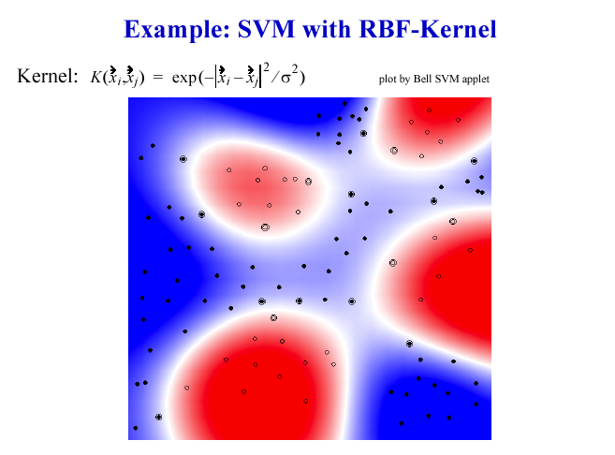
Notes:
Here, we see an example of an SVM with an RBF-kernel applied to a more general dataset.

Slide 60
Advantages and Applications of SVM
Advantages of SVM
Unlike neural networks, the class boundaries don’t change as the weights change.
Generalizability is high because margin is maximized.
No local minima and robustness to outliers.
Applications of SVM
Used in almost every conceivable situation where automatic classification of data is needed.
(example from class) Raymond Mooney and his KRISPER natural language parser.
Notes:
What are the advantages of SVMs?
Well, unlike neural networks, which constantly update weights, the class boundaries don’t change.
Also, because margin is maximized, generalizability is high.
You also have no local minima, and there is robustness to outliers.
As far as applications are concerned, SVMs are used in almost every conceivable situation, from genetics to geology, to classify data of interest.
Raymond Mooney’s KRISPER algorithm, a natural language parser, is an example.

