Slide 1


Slide 2
Supervised Learning
Classification

Slide 3
Outline
Supervised Learning & Classification
Measures of Accuracy
Decision Trees
Logistic regression
Support Vector Machines
Vowpal Wabbit

Slide 4
Classification
Notes:
The final supervised machine learning algorithm we’ll describe is one of the newest and most powerful, called Support Vector Machines.

Slide 5
Classification
Learn a method for predicting the instance class from pre-labeled (classified) instances
Many approaches: Regression,
Decision Trees,
SVMs,
Bayesian,
Neural Networks,
...
Given a set of points from classes
what is the class of new point ?

Slide 6
An example application
An emergency room in a hospital measures 17 variables (e.g., blood pressure, age, etc) of newly admitted patients.
A decision is needed: whether to put a new patient in an intensive-care unit.
Due to the high cost of ICU, those patients who may survive less than a month are given higher priority.
Problem: to predict high-risk patients and discriminate them from low-risk patients.
Notes:
Notes borrowed from Bing Liu, UIC

Slide 7
Another application
A credit card company receives thousands of applications for new cards. Each application contains information about an applicant,
age
Marital status
annual salary
outstanding debts
credit rating
etc.
Problem: to decide whether an application should approved, or to classify applications into two categories, approved and not approved.

Slide 8
Supervised Learning
The goal: learn a target function that can be used to predict the values of a discrete class attribute, e.g., approve or not-approved, and high-risk or low risk.
The task is commonly called: Supervised learning, classification, or inductive learning.

Slide 9
The data and the goal
Data: A set of data records (also called examples, instances or cases) described by
k attributes: A₁, A₂, … A_{k}.
a class: Each example is labelled with a pre-defined class.
Goal: To learn a classification model from the data that can be used to predict the classes of new (future, or test) cases/instances.

Slide 10
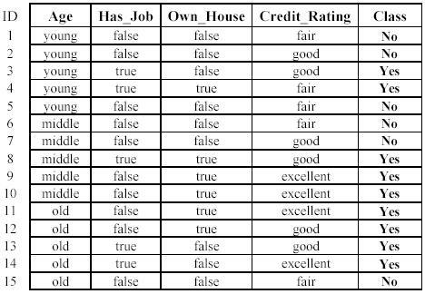
An example: (loan application)
Approved or not

Slide 11
An example: the learning task
Learn a classification model from the data
Use the model to classify future loan applications into
Yes (approved) and
No (not approved)
What is the class for following case/instance?

Slide 12
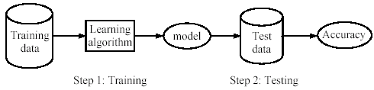
Supervised learning: two steps
Learning (training):
Learn a model using the training data
Testing:
Test the model using unseen test data to assess the model accuracy

Slide 13
What do we mean by learning?
Given
a data set D,
a task T, and
a performance measure M,
A system is said to learn from D to perform the task T if after learning the system’s performance on T improves as measured by M.
In other words, the learned model helps the system to perform T better as compared to no learning.

Slide 14
An example: (loan application)
Approved or not

Slide 15
An example
Data
Loan application data
Task
Predict whether a loan should be approved or not.
Performance measure
accuracy.
No learning
classify all future applications (test data) to the majority class (i.e., Yes): Accuracy = 9/15 = 60%.
Can we do better than 60% with learning?

Slide 16
Fundamental assumption of learning
Assumption: The distribution of training examples is identical to the distribution of test examples (including future unseen examples).
In practice, this assumption is usually violated to some extent.
Strong violations will clearly result in poor classification accuracy.
To achieve good accuracy on the test data, training examples must be sufficiently representative of the test data.

Slide 17

Classifying iris flowers
 | Sepal length | Sepal width | Petal length | Petal width | Type
1 | 5.1 | 3.5 | 1.4 | 0.2 | Iris setosa
2 | 4.9 | 3.0 | 1.4 | 0.2 | Iris setosa
…
51 | 7.0 | 3.2 | 4.7 | 1.4 | Iris versicolor
52 | 6.4 | 3.2 | 4.5 | 1.5 | Iris versicolor
…
101 | 6.3 | 3.3 | 6.0 | 2.5 | Iris virginica
102 | 5.8 | 2.7 | 5.1 | 1.9 | Iris virginica
…
If petal length < 2.45 then Iris setosa If sepal width < 2.10 then Iris versicolor ...
witten&eibe

Slide 18
Evaluating Models
Notes:
The final supervised machine learning algorithm we’ll describe is one of the newest and most powerful, called Support Vector Machines.

Slide 19
Evaluating classification methods
Predictive accuracy
Accuracy = # correct classifications / # examples
Efficiency
time to construct the model time to use the model
Robustness
handling noise and missing values
Scalability
efficiency in computer memory
Interpretability
understandable and insight provided by the model
Compactness of the model
Number of parameters, size of the decision tree, or the number of rules.

Slide 20
Holdout Set
The available data set D is divided into two disjoint subsets,
the training set D_{train} (for learning a model)
the test set D_{test} (for testing the model)
The training set should not be used in testing and the test set should not be used in learning.
Unseen test set provides a unbiased estimate of accuracy.
The test set is also called the holdout set.

Slide 21
N-fold cross-validation
The available data is partitioned into N equal-sized, disjoint subsets.
Use each subset as the test set and combine the remaining N-1 subsets to be the training set for the classifier.
The procedure is run N times, which gives N accuracies.
The final estimated accuracy of learning is the average of the N accuracies.
10-fold and 5-fold cross-validations are common.

Slide 22
Leave-one-out cross-validation
This method is used when the data set is very small.
It is a special case of cross-validation
Each fold of the cross validation has only a single test example and all the remaining data is used in training.
If the original data has m examples, this is m-fold cross-validation

Slide 23
Validation Set
The available data is divided into three subsets,
a training set,
a validation set and
a test set.
A validation set is used frequently for estimating parameters in learning algorithms.
In such cases, the values that give the best accuracy on the validation set are used as the final parameter values.
Cross-validation can be used for parameter estimation as well.

Slide 24
Classification measures
Accuracy is only one measure (error = 1-accuracy).
Accuracy is not suitable in some applications.
In text mining, we may only be interested in the documents of a particular topic, which are only a small portion of a big document collection.
In classification involving skewed or highly imbalanced data, e.g., network intrusion and financial fraud detections, we are interested only in the minority class.
High accuracy does not mean any intrusion is detected.
E.g., 1% intrusion. Achieve 99% accuracy by doing nothing.
The class of interest is commonly called the positive class, and the rest negative classes.

Slide 25
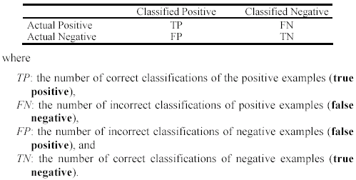
Precision and Recall
Used in information retrieval and text classification.
We use a confusion matrix to introduce them.

Slide 26

Precision and Recall
Precision p is the number of correctly classified positive examples divided by the total number of examples that are classified as positive.
Recall r is the number of correctly classified positive examples divided by the total number of actual positive examples in the test set.

Slide 27

An example
This confusion matrix gives
precision p = 100% and
recall r = 1%
because we only classified one positive example correctly and no negative examples wrongly.
Note: precision and recall only measure classification on the positive class.

Slide 28
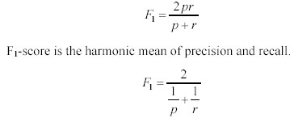
F₁-measure
It is hard to compare two classifiers using two measures. F₁ score combines precision and recall into one measure
The harmonic mean of two numbers tends to be closer to the smaller of the two.
For F₁-value to be large, both p and r must be large.

Slide 29
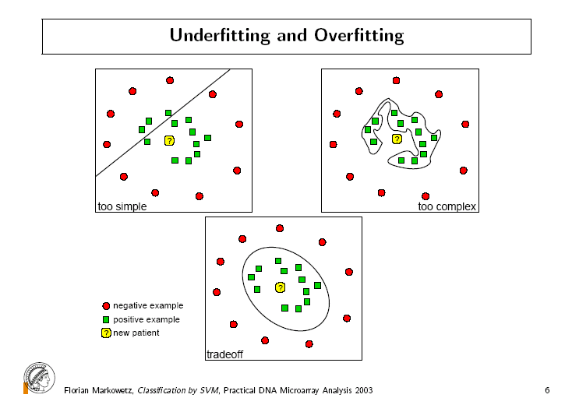

Slide 30
Decision Trees
Notes:
The final supervised machine learning algorithm we’ll describe is one of the newest and most powerful, called Support Vector Machines.

Slide 31
Classification: Decision Trees
if X > 5 then blue
else if Y > 3 then blue
else if X > 2 then green
else blue
Y
3
2
5
X

Slide 32
Introduction
Decision trees are one of the most widely used techniques for classification.
Classification accuracy is competitive with other methods
They are very efficient
They are interpretable

Slide 33
An example: (loan application)
Approved or not

Slide 34
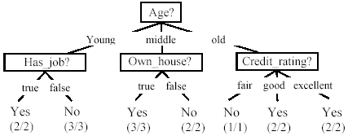
A decision tree from loan data
Decision trees are composed of
decision nodes and leaf nodes (classes)

Slide 35

Use the decision tree
No

Slide 36
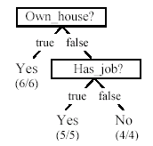
Is the decision tree unique?
No. Here is a simpler tree.
We want a smaller and more accurate tree.
Easier to understand and performs better.
Finding the best tree is NP-hard.
All current tree-building algorithms are heuristic algorithms

Slide 37


From a decision tree to a set of rules
Any decision tree can be converted to a set of rules.
Each path from the root to a leaf is a rule.

Slide 38
Algorithm for decision tree learning
Basic algorithm (a greedy divide-and-conquer algorithm)
Assume attributes are categorical (for now; continuous attributes can be handled too)
Tree is constructed in a top-down recursive manner
At start, all the training examples are at the root
Examples are partitioned recursively based on selected attributes
Attributes are selected on the basis of an impurity function (e.g., information gain)
Conditions for stopping partitioning
All examples for a given node belong to the same class
There are no remaining attributes for further partitioning – majority class is the leaf
There are no examples left

Slide 39
Choosing the attribute to partition data
The key to building a decision tree is which attribute to choose to create a branch.
The objective is to reduce impurity or uncertainty in data as much as possible.
A subset of data is pure if all instances belong to the same class.

Slide 40
An example: (loan application)
Approved or not

Slide 41
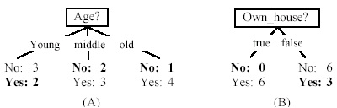
Two possible roots: Which is better?

Slide 42
Information Entropy
Pr(c_{j}) is the probability of class c_{j} in data set D
We use entropy as a measure of impurity or disorder of data set D.

Slide 43
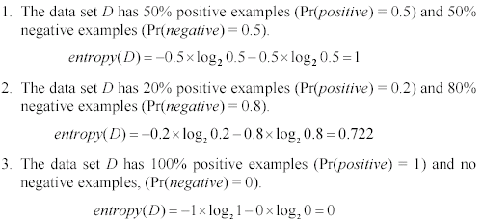
Information Entropy
As the data become purer and purer, the entropy value becomes smaller and smaller.

Slide 44
Information gain
Given a set of examples D, we first compute its entropy:
If we make attribute A_{i}, with v values, the root of the current tree, this will partition D into v subsets D₁, D₂ …, D_{v} . The expected entropy if A_{i} is used as the current root:

Slide 45
Information gain (cont …)
Information gained by selecting attribute A_{i} to branch or to partition the data is
We choose the attribute with the highest gain to branch/split the current tree.

Slide 46
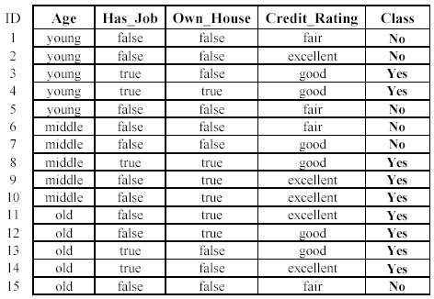

An example
Own_house is the best choice for the root.

Slide 47
We build the final tree
We can use information gain ratio to evaluate the impurity as well

Slide 48
Continuous attributes
Handle continuous attribute by splitting into two intervals (can be more) at each node.
How to find the best threshold to divide?
Use information gain or gain ratio again
Sort all the values of an continuous attribute in increasing order {v₁, v₂, …, v_{r}},
One possible threshold between two adjacent values v_{i} and v_{i+1}. Try all possible thresholds and find the one that maximizes the gain (or gain ratio).

Slide 49
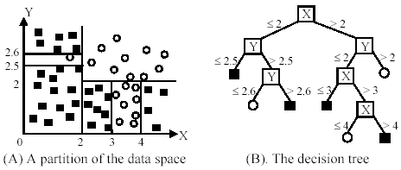
An example in a continuous space

Slide 50
Avoid overfitting in classification
Overfitting: A tree may overfit the training data
Good accuracy on training data but poor on test data
Symptoms: tree too deep and too many branches, some may reflect anomalies due to noise or outliers
Two approaches to avoid overfitting
Pre-pruning: Halt tree construction early
Difficult to decide because we do not know what may happen subsequently if we keep growing the tree.
Post-pruning: Remove branches or sub-trees from a “fully grown” tree.
This method is commonly used. C4.5 uses a statistical method to estimates the errors at each node for pruning.
A validation set may be used for pruning as well.

Slide 51
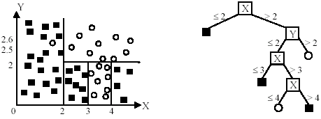
An example
Likely to overfit the data

Slide 52
Logistic Regression
Notes:
The final supervised machine learning algorithm we’ll describe is one of the newest and most powerful, called Support Vector Machines.

Slide 53
Classification: Regression

Slide 54
Logistic regression
Regression model for categorical response (y_{i}) data
Categorical response with 2 levels
(binary: 0 and 1)
Categorical response with ≥ 3 levels
(nominal or ordinal)
Predictor variables (x_{i}) can take on any form: binary, categorical, and/or continuous

Slide 55
Logistic Regression Curve
1.0
0.9
0.8
0.7
Probability
0.6
0.5
0.4
0.3
0.2
0.1
0.0
1
2
3
4
5
6
7
8
9
10
11
12
13
14
15
16
17
18
19
20
21
x
Notes:
The relationship between y_{i} and x_{i}’s is not a linear function.

Slide 56
Logit Transformation
Logistic regression models transform probabilities called logits.
where
i indexes all cases (observations).
p_{i} is the probability the event occurs in the i^{th} case

Slide 57
Assumption
p_{i}
(p_{i} )
Notes:
INTERNAL USE FIG. 05S03F03

Slide 58
Logistic regression model with a single continuous predictor
logit (p_{i}) = log (odds) = β₀ + β₁X₁
where
logit(p_{i}) logit transformation of the probability of the event
β₀ intercept of the regression line
β₁ slope of the regression line

Slide 59
Interpretation of a single continuous parameter
The sign (±) of β determines whether the log odds of y is increasing or decreasing for every 1-unit increase in x.
If β > 0, there is an increase in the log odds of y for every 1-unit increase in x.
If β < 0, there is a decrease in the log odds of y for every 1-unit increase in x.
If β = 0 there is no linear relationship between the log odds and x.

Slide 60
Parameter interpretation (ctd).
Exponentiating both sides of the logit link function we get the following:
= odds = exp(β₀ + β₁X₁) = e ^{β0} e ^{β1X1}
The odds increase multiplicatively by e^{β} for every 1-unit increase in x.
Whether the increase is greater than 1 or less than one depends on whether β >0 or β <0.
The odds at X = x+1 are e^{β} times the odds at X = x.
Therefore, e^{β} is an odds ratio!

Slide 61
Logistic regression model with a single categorical (≥ 2 levels) predictor
logit (p_{i}) = log (odds) = β₀ + β_{k}X_{k}
where
logit(p_{i}) logit transformation of the probability of the event
β₀ intercept of the regression line
β_{k} difference between the logits for category k vs. the reference category

Slide 62
Reference category
Each factor has as many parameters as categories, but one is redundant, so we need to specify a reference category.
Similar concept to what you just learned for simple linear regression.

Slide 63
Interpretation of a single categorical parameter
If your reference group is level 0, then the coefficient of β_{k} represents the difference in the log odds between level k of your variable and level 0.
Therefore, e^{β} is an odds ratio for category k vs. the reference category of x.

Slide 64
Support Vector Machines
Notes:
The final supervised machine learning algorithm we’ll describe is one of the newest and most powerful, called Support Vector Machines.

Slide 65
Classification: SVMs

Slide 66
Linear Classifiers
Linear Classifier: y(x) = sign(w.x + b)
w.x + b > 0
w.x + b = 0
w.x + b < 0
Notes:
To explain the basic principle behind Support Vector Machines, consider a higher simplified case where two sets of points are linearly separable.
Linearly separable means that at least in 2 dimensional space, a single line completely separates the two sets of points; In 3 dimensional space, it means that a plane completely separates the two sets of points, and in higher dimensional space, what we call a hyperplane separates the two sets of points.
Support Vector Machines find the “best” hyperplane that separates the two sets of points.

Slide 67
Which one is the best?
Notes:
But, what is meant by “best”, since as we can see, many lines separate the two sets of points?

Slide 68
Notion of Margin
Distance from a data point to the hyperplane:
Data points closest to the boundary are called support vectors
Margin d is the distance between two classes.
d
r
Notes:
“Best” means we choose the hyperplane that maximizes what we call margin, or the distance between the two sets of points and the dividing hyperplane.
Mathematically, as well as intuitively, it turns out maximizing margin is equivalent to maximizing the distance between the hyperplane and what we call the “support vectors”, which are the data points closest to the dividing hyperplane.

Slide 69
Maximizing Margin
Maximizing margin is a quadratic optimization problem.
Quadratic optimization problems are a well-known class of mathematical programming problems, and many (rather intricate) algorithms exist for solving them.
Notes:
Maximizing margin is a well known problem called a quadratic optimization problem, and there are many known algorithms for solving them.

Slide 70
Kernel Trick
What if the dataset is non-linearly separable?
We use a kernel to map the data to a higher-dimensional space:
0
x
x²
0
x
Notes:
What do we do in the more general case, where data are NOT linearly separable?
For example, in the top figure, no line completely separates the blue data points from the red ones.
In such more general cases, we use what is called a Kernel Trick, which uses what is called a Kernel Function to map the original data into a higher dimensional space where the data are now linearly separable.
We can see an example of this in the lower figure where the kernel is the mapping x to x,x^2.

Slide 71
Non-linear SVMs: Feature spaces
General idea: The original space can always be mapped to some higher-dimensional feature space where the training set becomes separable:
Φ: x → φ(x)
Notes:
And this works in general: The original space can always be mapped to some higher-dimensional feature space where the training set becomes separable

Slide 72
Examples of Kernel Trick
For the example in the previous figure:
The non-linear mapping
A more commonly used radial basis function (RBF) kernel
Notes:
Many possible kernels can be used.
In the first example, we used the x goes to x,x^2 mapping.
A more commonly used kernel is a radial basis function.

Slide 73
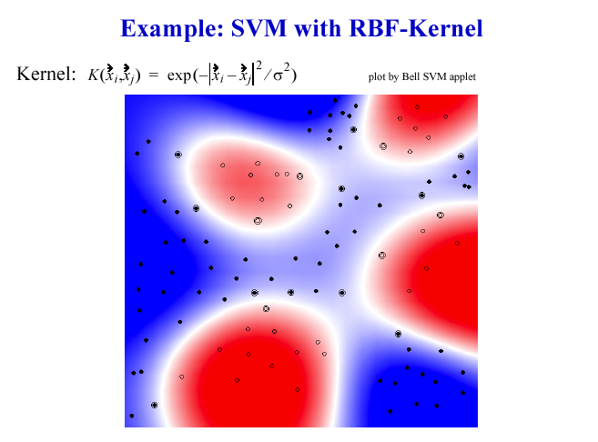
Notes:
Here, we see an example of an SVM with an RBF-kernel applied to a more general dataset.

Slide 74
Advantages and Applications
Advantages of SVM
Generalizability is high because margin is maximized.
No local minima and robustness to outliers.
Applications of SVM
Used in almost every conceivable situation where automatic classification of data is needed.

Slide 75
Vowpal Wabbit
Notes:
The final supervised machine learning algorithm we’ll describe is one of the newest and most powerful, called Support Vector Machines.

