Slide 1
Capstone Project Liyana Roslie
The important keywords in Data Science Industry

Slide 2
TABLE OF CONTENTS
03
04
DATA PREPROCESSING
DATA EXPLORATION
05
06
TOPIC MODELLING
CHALLENGES
01
02
GOAL & PROBLEM STATEMENT
DATASET OVERVIEW
What to achieve for this project
What the data is about
How to clean the data
What insights can be derived from data
How to conduct topic modelling
What kind of challenges are anticipated
07
FUTURE PLANS
How to expand on the project

Slide 3
01
GOAL & PROBLEM STATEMENT
What to achieve for this project

Slide 4

GOAL
As a Data Science student who is about to graduate, I will like to find out if there are missing skillsets, knowledge, etc that I can address before entering the job market and the areas that I can work on to progress well in my Data Science career

Slide 5
PROBLEM STATEMENT
Find what are topics or keywords or domains that are relevant and important in the Data Science industry to improve the prospects of landing a Data Science job and excel in Data Science career

Slide 6
02
DATASET OVERVIEW
What the data is about

Slide 7
DATASET OVERVIEW
2 different datasets:
Blog articles data from towardsdatascience.com
Job listings from glassdoor.com
towardsdatascience.com contains articles on work done in practical industry applications as well as research work in the academic field.
glassdoor.com contains job listings drawn up by employers that highlight the desired skillset and knowledge that the ideal candidate should have. This represent the first hurdle/entry to Data Science(DS) industry and could give a sense of what kind of DS skills that are more sought after. However, as DS job market is still quite new, it might not represent the actual important skillsets but rather just the employer’s assumption
Analyse and compare these 2 different datasets’ keywords to gain a better understanding of the DS industry.

Slide 8
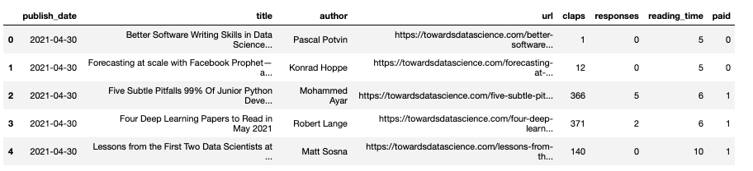
DATASET OVERVIEW
https://www.kaggle.com/annpastushko/towards-data-science-articles-dataset-20102021
TowardsDataScience articles since 2010
42,660 rows of data
key categories: url, claps, responses
No duplicate or missing data
Require further extraction of articles content via URL

Slide 9
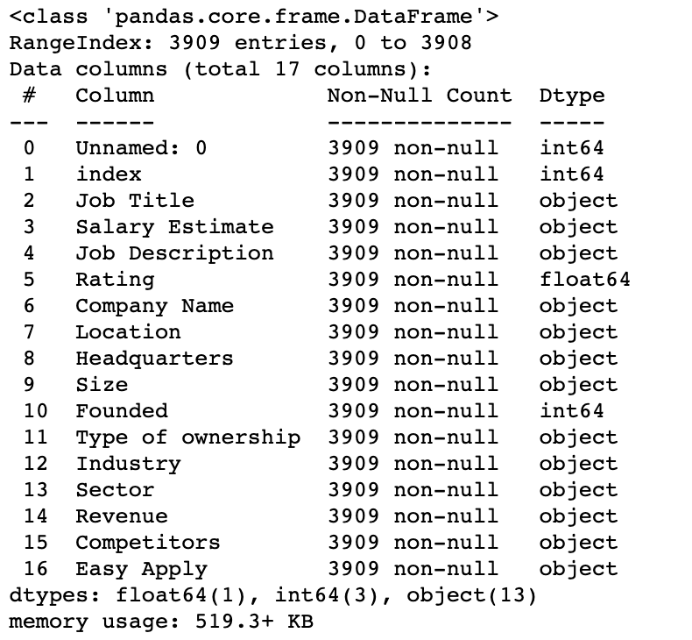
DATASET OVERVIEW
https://www.kaggle.com/andrewmvd/data-scientist-jobs
DS related job listings scraped from glassdoor.com on July 2020 in the USA region
3909 rows of data
Missing data listed as -1
No duplicate data
Key category: Job Description

Slide 10
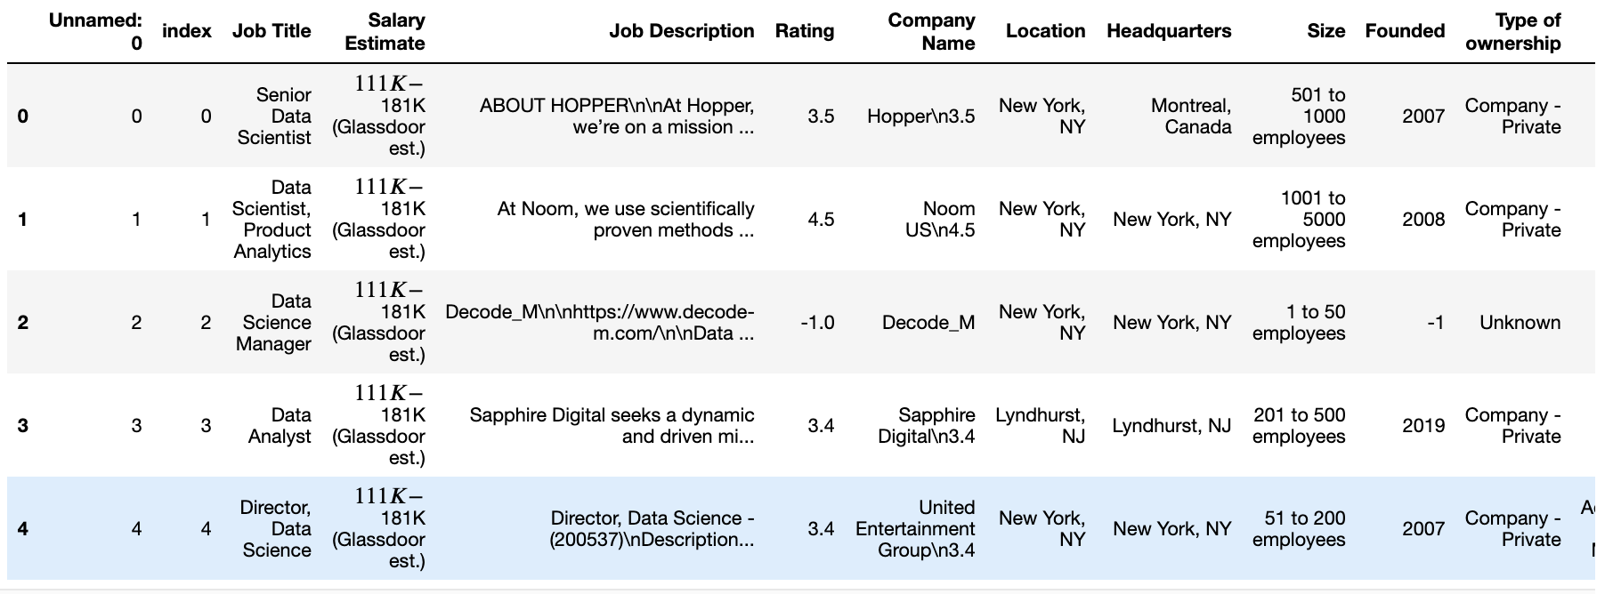
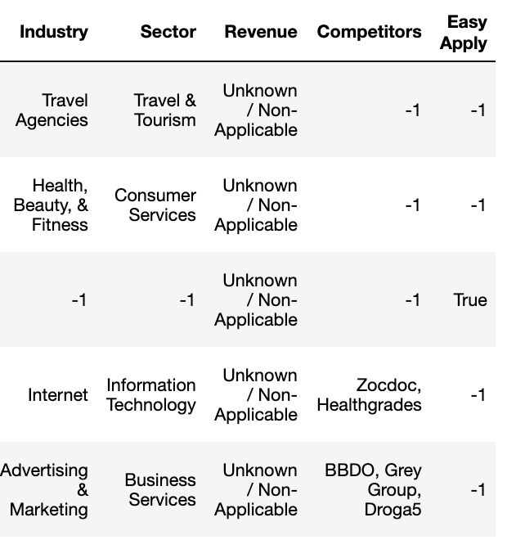
DATASET OVERVIEW

Slide 11
03
DATA PREPROCESSING
How to clean the data

Slide 12
DATASET PREPROCESSING
For both EDA and Topic Modelling:
Remove punctuation, escape characters, special characters including HTML markups, emojis, define extra stopwords and remove them
Make relevant data to be all in lowercase
In articles content data:
Remove articles with missing content. Some URLs has been taken down
Remove author name
Remove first phrase which includes reading time summary
In jobs description data
Extract company name in company column before “\n” appears
Remove company name

Slide 13
DATASET PREPROCESSING
In Topic Modelling ONLY:
Lemmatize: change words to noun
Stem : reduce words to root form
Convert a document into list of tokens
Prepare list of tokens into
Bag of words
TF-IDF

Slide 14
04
DATA EXPLORATION
What insights can be derived from data

Slide 15

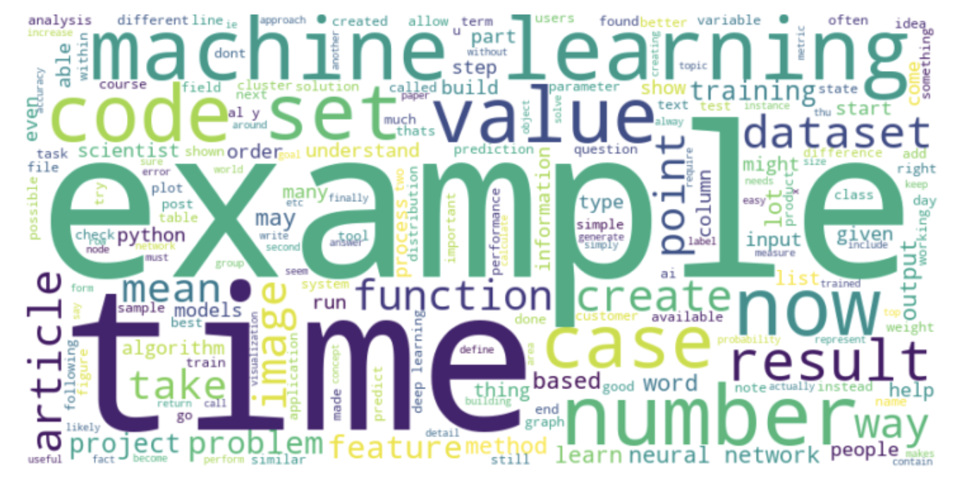
MOST FREQUENT WORDS IN ARTICLES
Most frequent words that appear in articles

Slide 16

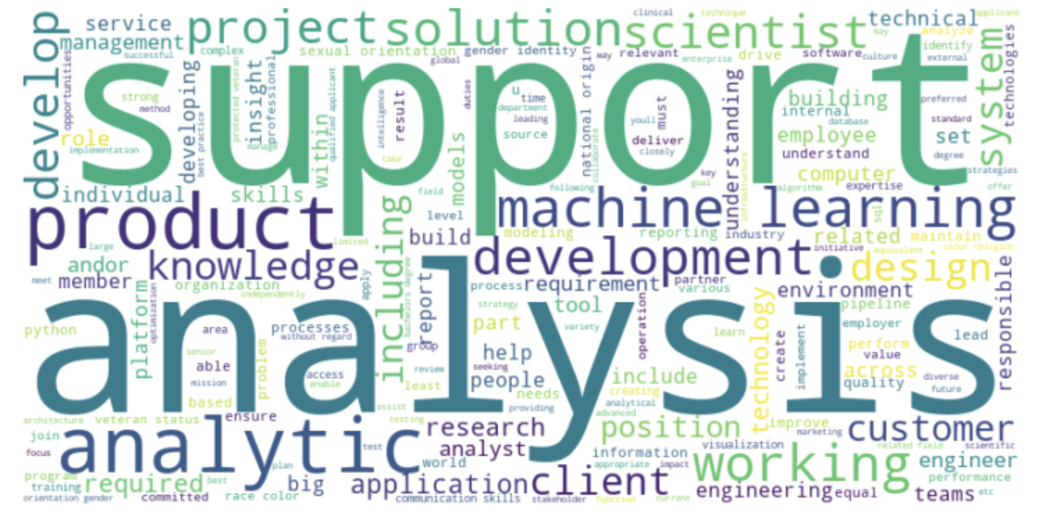
MOST FREQUENT WORDS IN JOBS LISTINGS
Most frequent words that appear in job’s listings

Slide 17

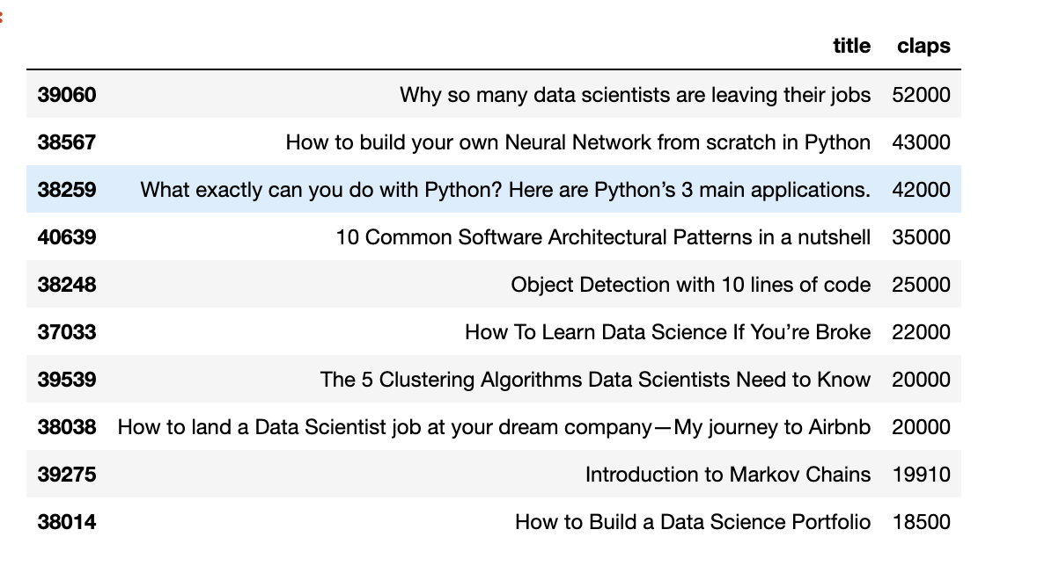
TOP 10 ARTICLES WITH MOST CLAPS
Neural Network
Python language for Data Science
Data Science algorithms
Computer Vision
Data Science career
More informative topics

Slide 18

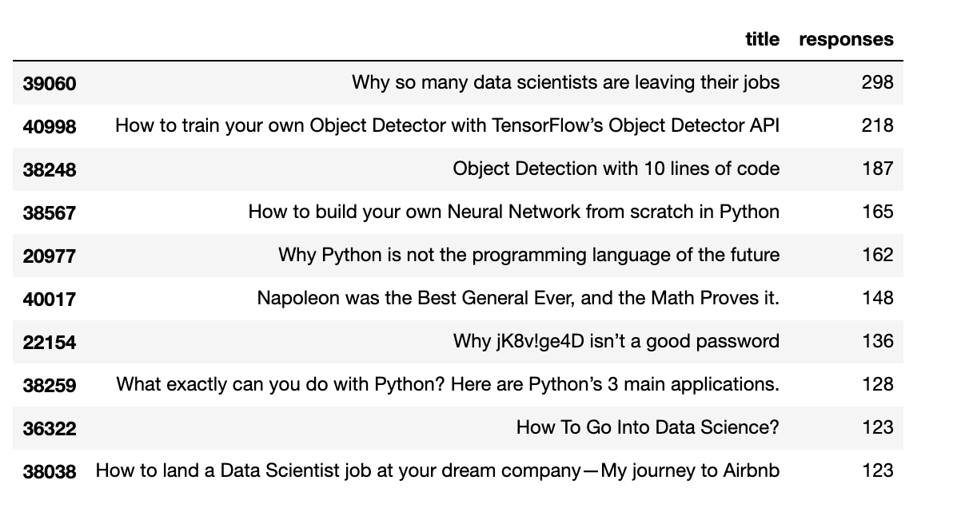
TOP 10 ARTICLES WITH MOST RESPONSES
Neural Network
Python
Data Science career
Computer Vision
Controversial headlines

Slide 19
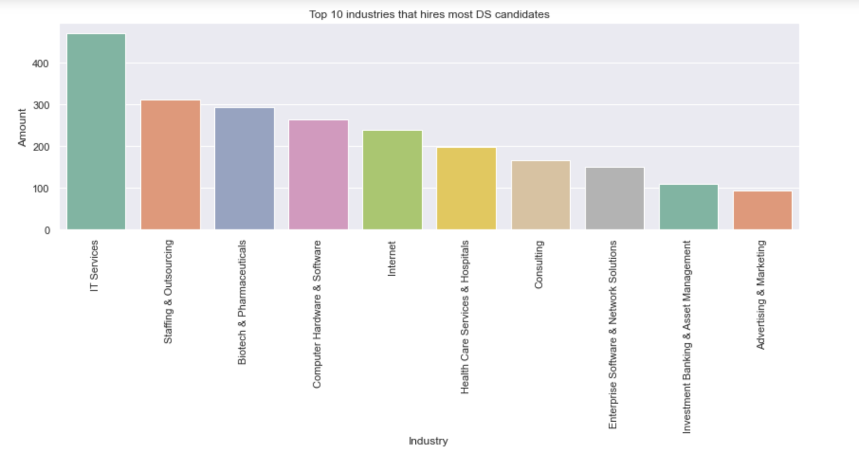
TOP 10 INDUSTRY

Slide 20
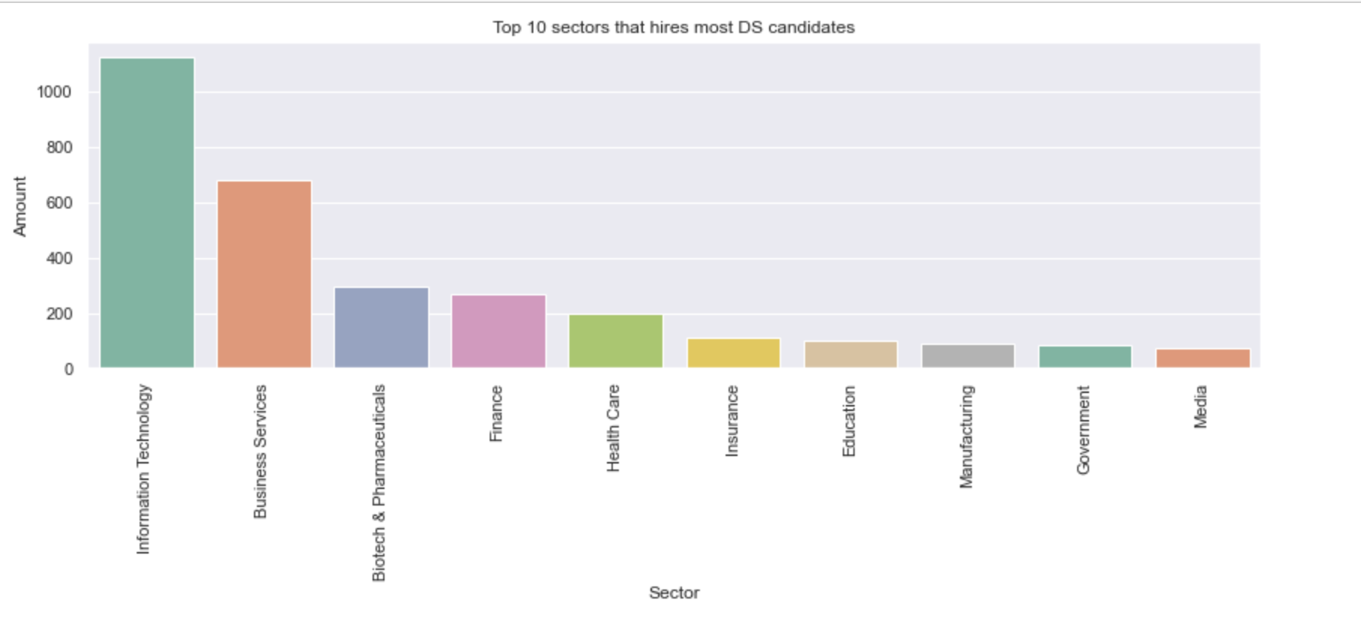
TOP 10 SECTOR

Slide 21
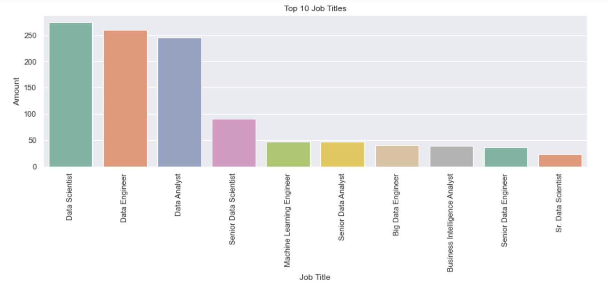
TOP 10 JOB TITLES

Slide 22
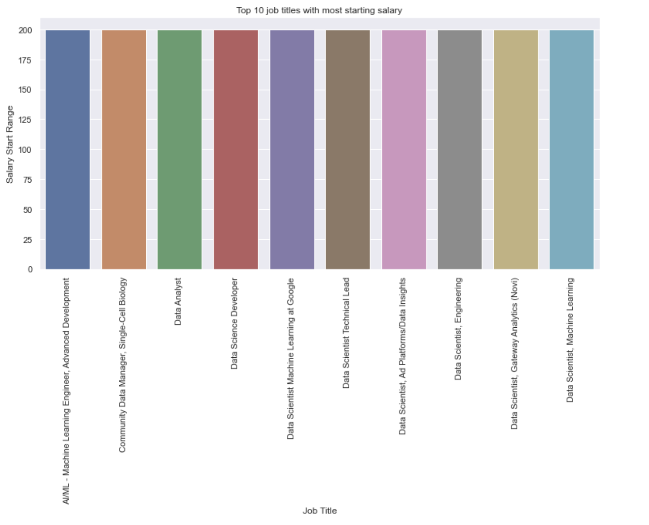
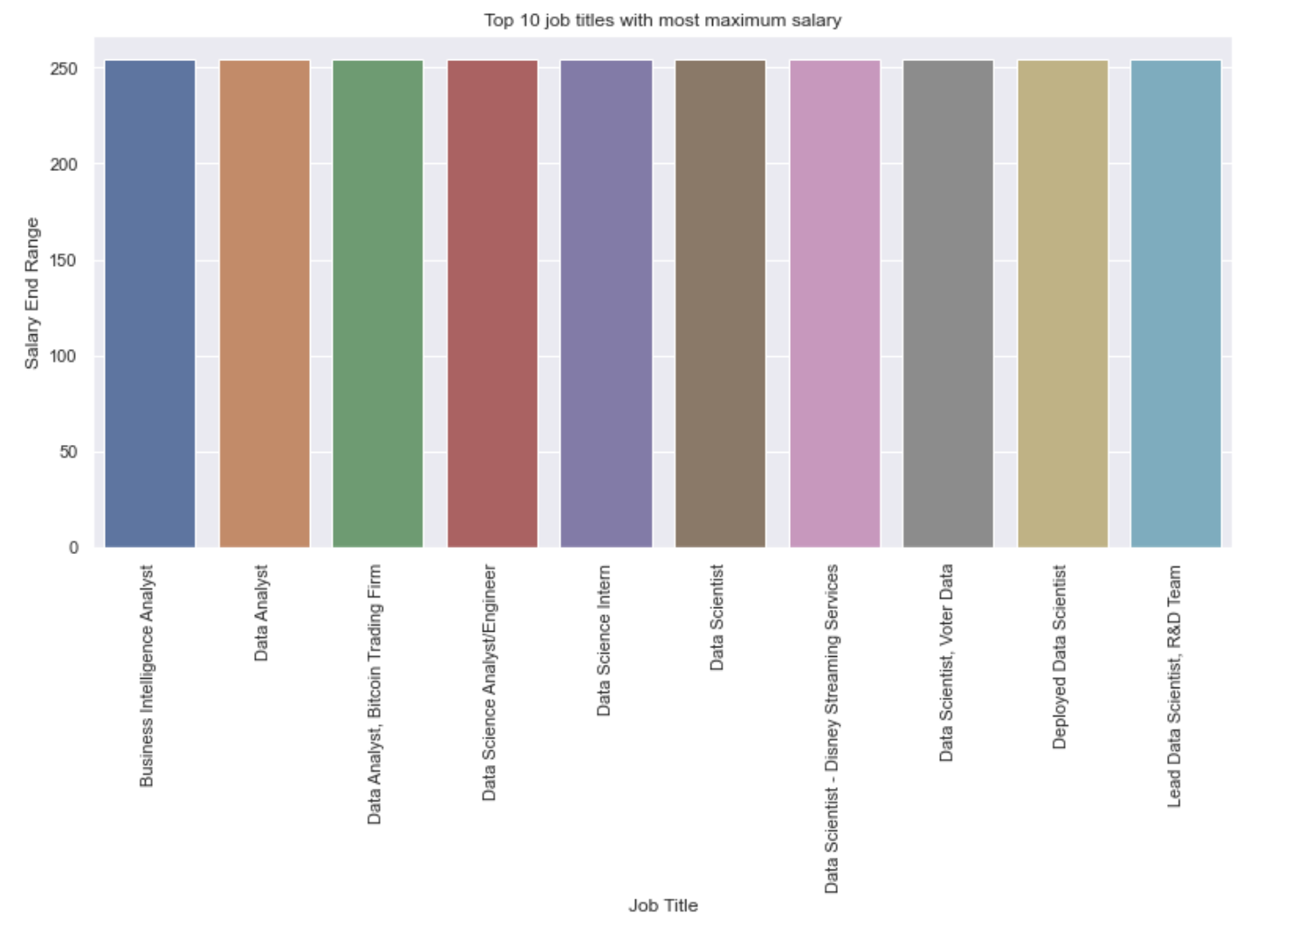
TOP 10 PROMISING SALARIES

Slide 23
05
TOPIC MODELLING
How to conduct topic modelling

Slide 24
TOPIC MODELLING
Topic modelling done separately for articles and job listings dataset

Slide 25
06
CHALLENGES
What kind of challenges are anticipated

Slide 26
CHALLENGES
Trying to find satisfactory datasets for both job articles and job listings
Ready ones are either too little or too much that require complex data cleaning
Scraping requires more time but would fit requirement better
Require more time to conduct research and apply topic modelling due to unfamiliarity
Many different libraries to select and implement (too much choice and confusion)
Require time to clean data into a suitable format before EDA and topic modelling

Slide 27
07
FUTURE PLANS
How to expand on the project

Slide 28
FUTURE PLANS
Implement using different libraries and test which give better performance or results
text pre-processing,
TF-IDF/bag-of-words,
LSA
LDA
Topic Modelling using BERT (Transformer base ML), Top2Vec
Text summarization

Slide 29
THANKS
https://github.com/LiyanaRoslie/ds-keywords
Do you have any questions?
Please keep this slide for attribution.

