Slide 1
Capstone Project Liyana Roslie
The important keywords in Data Science Industry

Slide 2
TABLE OF CONTENTS
03
04
DATA PREPROCESSING
DATA EXPLORATION
05
06
TOPIC MODELLING
CHALLENGES
01
02
GOAL & PROBLEM STATEMENT
DATASET OVERVIEW
What to achieve for this project
What the data is about
How to clean the data
What insights can be derived from data
How to conduct topic modelling
What kind of challenges are anticipated
07
FUTURE PLANS
How to expand on the project

Slide 3
01
GOAL & PROBLEM STATEMENT
What to achieve for this project

Slide 4

GOAL
As a Data Science student who is about to graduate, I will like to find out if there are missing skillsets, knowledge, etc that I can address before entering the job market and the areas that I can work on to progress well in my Data Science career

Slide 5

PROBLEM STATEMENT
Find what are topics or keywords or domains that are relevant and important in the Data Science industry to improve the prospects of landing a Data Science job and excel in Data Science career

Slide 6
02
DATASET OVERVIEW
What the data is about

Slide 7

DATASET OVERVIEW
2 different datasets:
Blog articles data from towardsdatascience.com
Job listings from glassdoor.com
towardsdatascience.com contains articles on work done in practical industry applications as well as research work in the academic field.
glassdoor.com contains job listings drawn up by employers that highlight the desired skillset and knowledge that the ideal candidate should have.
represent the entry to Data Science(DS) industry and could give a sense of what kind of DS skills that are more sought after. However, as DS job market is still quite new, it might not represent the actual important skillsets but rather just the employer’s assumption
Dataset is collected on July 10, 2020 from glassdoor US
Analyse and compare these 2 different datasets’ keywords to gain a better understanding of the DS industry.

Slide 8
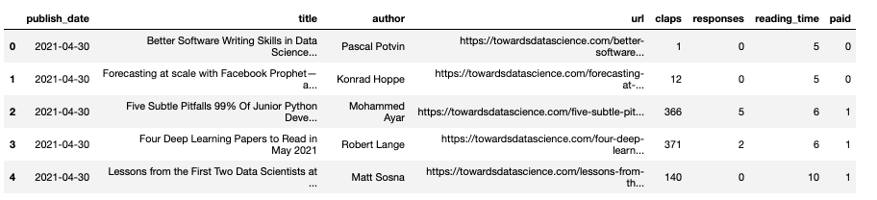
ARTICLE DATASET OVERVIEW
https://www.kaggle.com/annpastushko/towards-data-science-articles-dataset-20102021
TowardsDataScience articles since 2010
Initial: 42,660 rows of data
Has duplicated content and some URL has been taken down
Require further extraction of articles content via URL

Slide 9
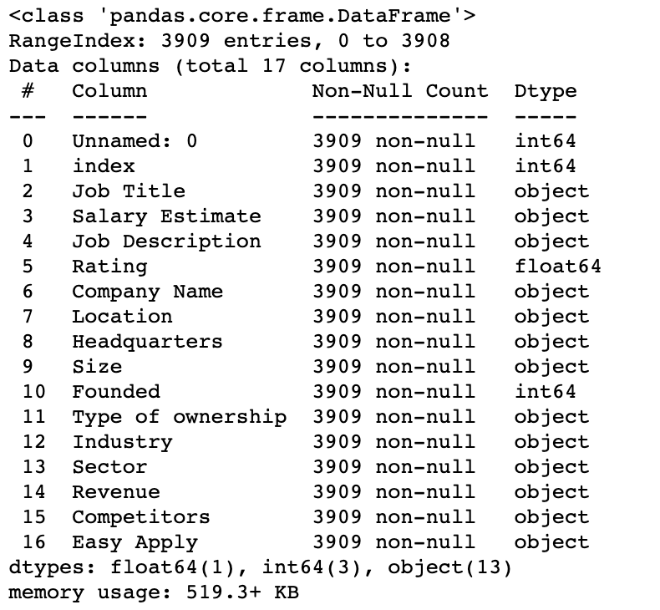
JOB ARTICLE DATASET OVERVIEW
https://www.kaggle.com/andrewmvd/data-scientist-jobs
DS related job listings scraped from glassdoor.com on July 2020 in the USA region
3909 rows of data
Missing data listed as -1
Has some duplicate jobs listings

Slide 10
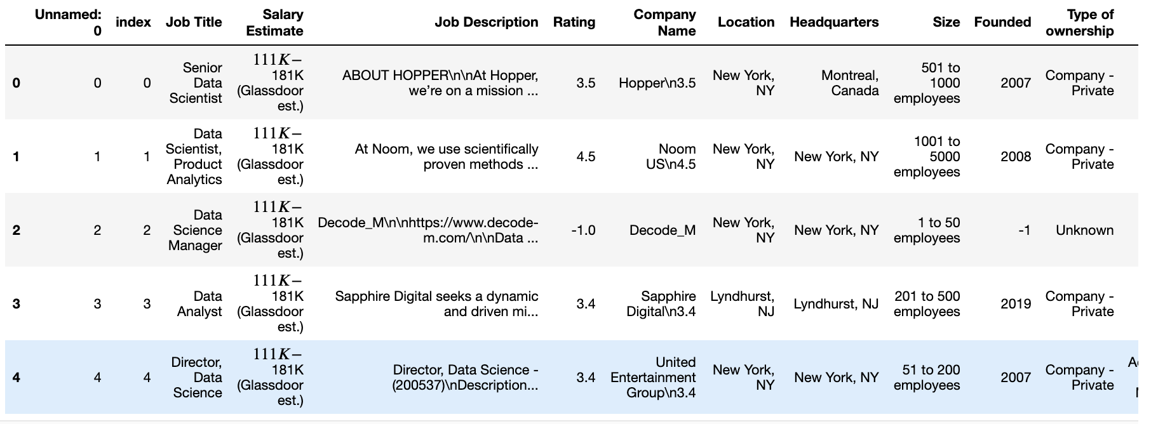
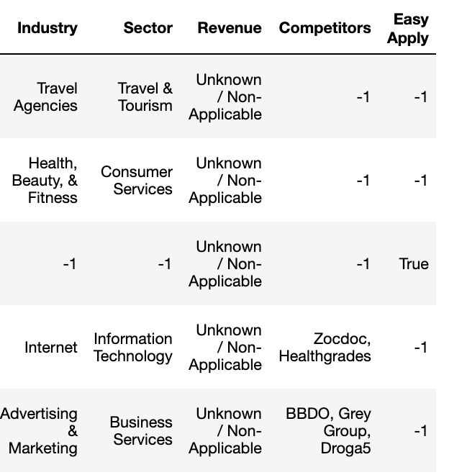
JOB ARTICLE DATASET OVERVIEW

Slide 11
03
DATA PREPROCESSING
How to clean the data

Slide 12

DATASET PREPROCESSING OVERVIEW
For both EDA and Topic Modelling:
Remove punctuation, escape characters, special characters including HTML markups, emojis, remove duplicate contents, define extra stopwords and remove them
Make relevant data to be all in lowercase
In articles content data:
Remove articles with missing content. Some URLs has been taken down
Remove author name
Remove first phrase which includes reading time summary
In jobs description data
Extract company name in company column before “\n” appears
Remove company name

Slide 13
DATASET PREPROCESSING
In Topic Modelling ONLY:
Lemmatize: change words to noun
Stem : reduce words to root form
Convert a document into list of tokens
Prepare list of tokens into
Bag of words
TF-IDF

Slide 14
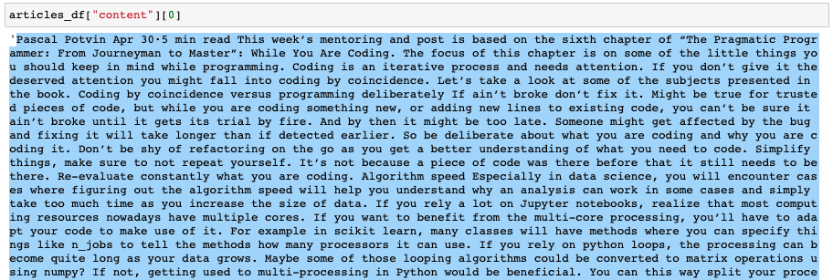
ARTICLE DATASET PREPROCESSING EXAMPLE
Mix of lowercase and uppercase
Author’s name
Reading time

Slide 15
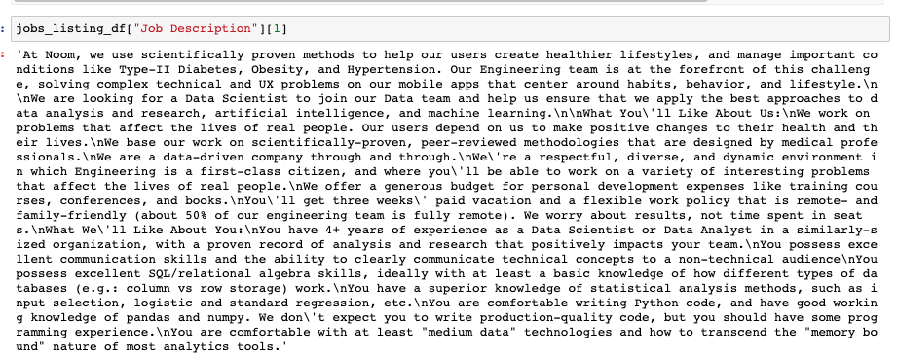
JOBS LISTINGS DATASET PREPROCESSING EXAMPLE
Mix of lowercase and uppercase
Company’s name
Escape character

Slide 16
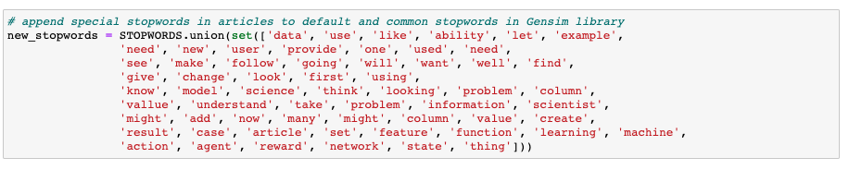
ARTICLES STOPWORDS EXAMPLE
Frequently used words in articles
Doesn’t provide clues as keywords

Slide 17
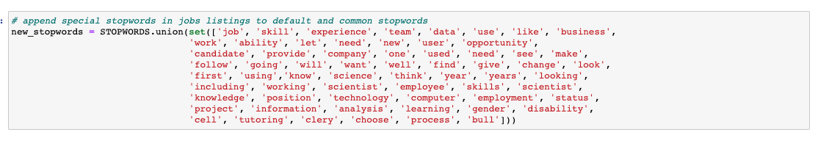
JOBS LISTINGS STOPWORDS EXAMPLE
Separate from articles
Some overlaps or common stopwords in articles
Frequently used words in articles
Doesn’t provide clues as keywords

Slide 18
04
DATA EXPLORATION
What insights can be derived from data

Slide 19

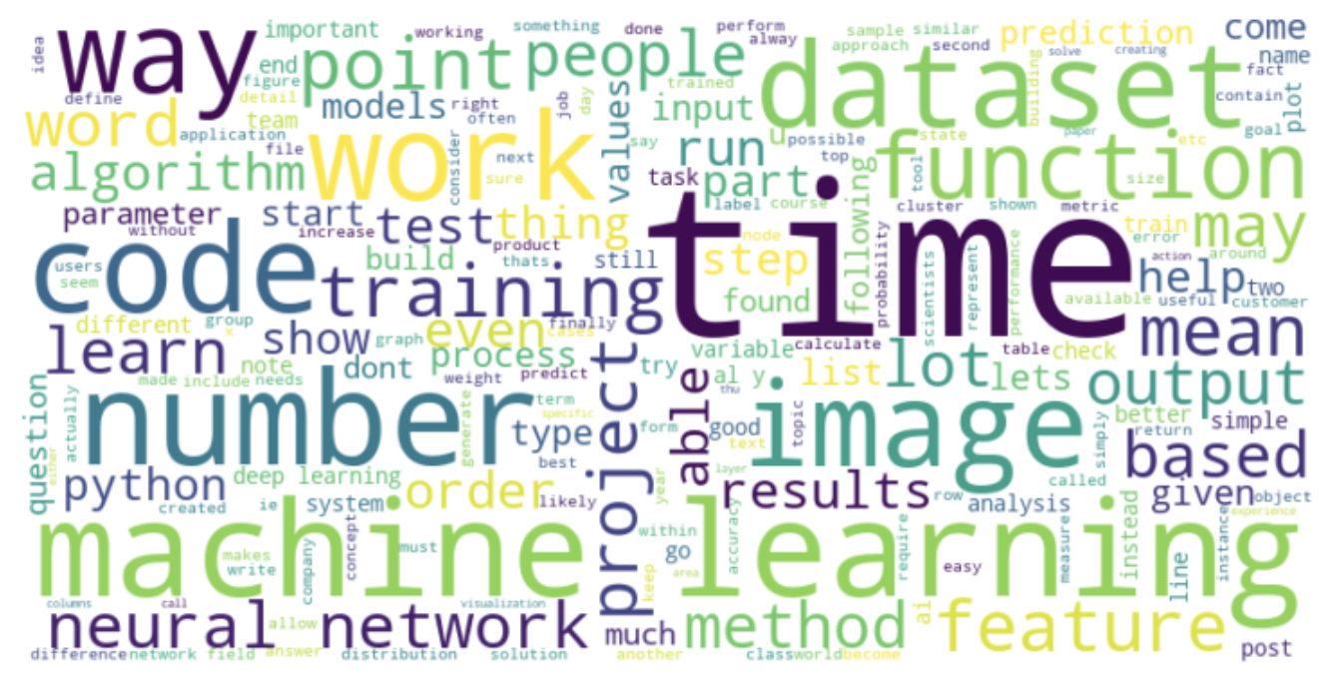
MOST FREQUENT WORDS IN ARTICLES
dataset
image
time
neural network
machine learning
function
code
project
training
feature
Popular branch of ML: computer vision, time series, neural network
Creating dataset through web scraping and handling imbalanced dataset
Feature engineering
Project ideas

Slide 20

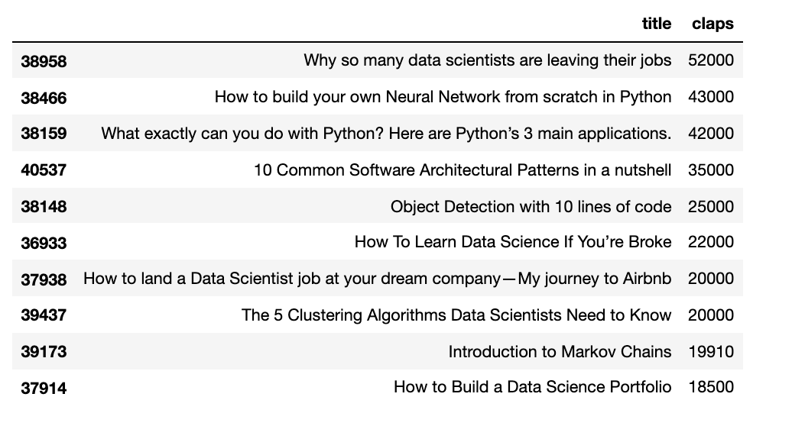
TOP 10 ARTICLES WITH MOST CLAPS
Computer Vision
Neural Network
Python language for Data Science
Data Science algorithms
Data Science career
More informative topics
Popular branch of ML: computer vision, neural network
Coding in Python language
Different algorithms in DS and career entry and growth

Slide 21

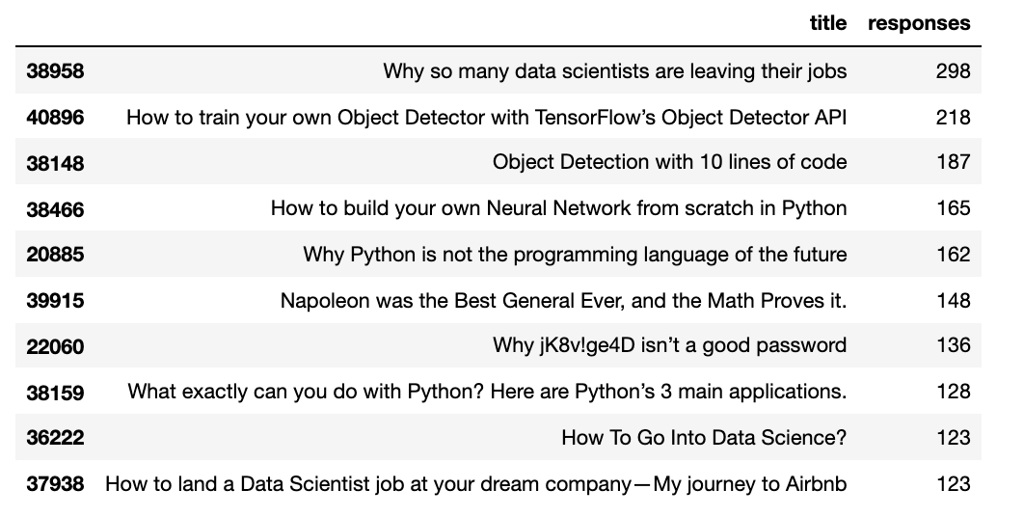
TOP 10 ARTICLES WITH MOST RESPONSES
Neural Network
Python
Data Science career
Computer Vision
Controversial headlines
Not all articles are the same as the articles with most claps but still similar topic results
Difference is the headlines provoke controversy and debate

Slide 22

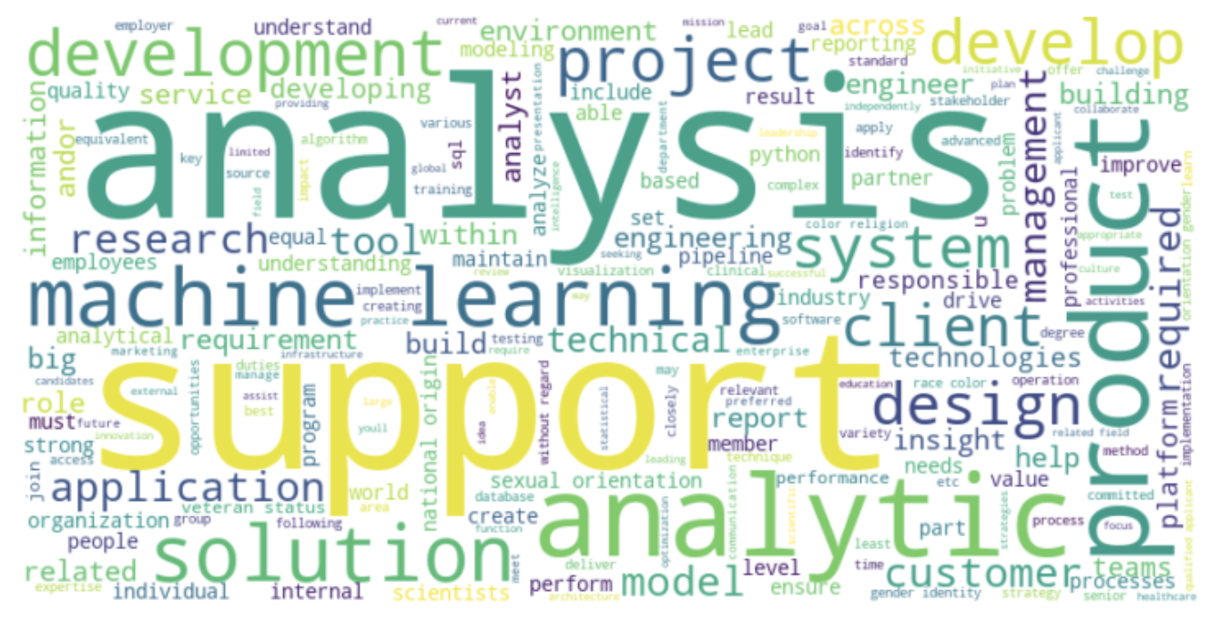
MOST FREQUENT WORDS IN JOBS LISTINGS
technical
management
support
product
service
project
analysis / analytic / analyst
insight
system
application
solution
development
research
involve working with people from other teams such as the product team and even senior managements and providing them with some support.
research as part of his or her work.
explaining or translating the technical terms for other non-technical people that is involved in the project that you are working on and also explaining on the insights that you have gotten from the analysis.

Slide 23
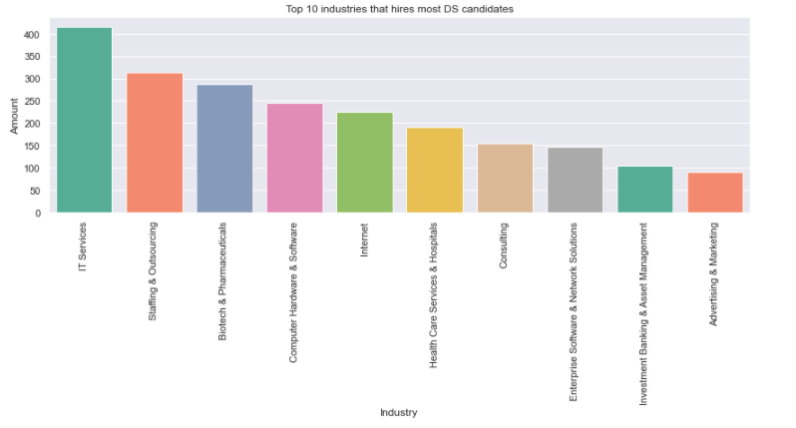
TOP 10 INDUSTRY
Dominating industry is the IT related services industry.
Existing, stable and automated system of collecting data
Other industries probably approached Staffing and Outsourcing companies to help them with the hiring process.
Healthcare, Pharmaceutical industry (Computer Vision), Investment Banking (Time series) and Advertising and Marketing industry. (NLP)

Slide 24
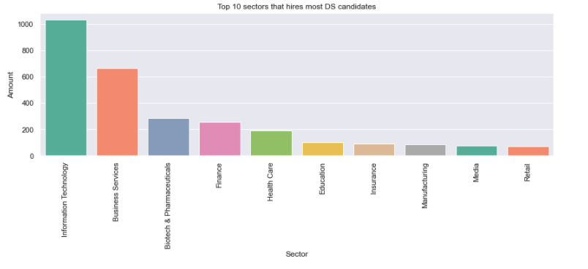
TOP 10 SECTOR
Most of the top ten sectors are also related to the top ten industry.
Information Technology, Business Services, Biotech and Pharmaceuticals, Health Care, Finance, Media.
The new sectors that were previously not mentioned are Education (NLP), Insurance, Manufacturing and Retail (time series).
possibly the ones that hire Data Scientist through Outsourcing companies.

Slide 25
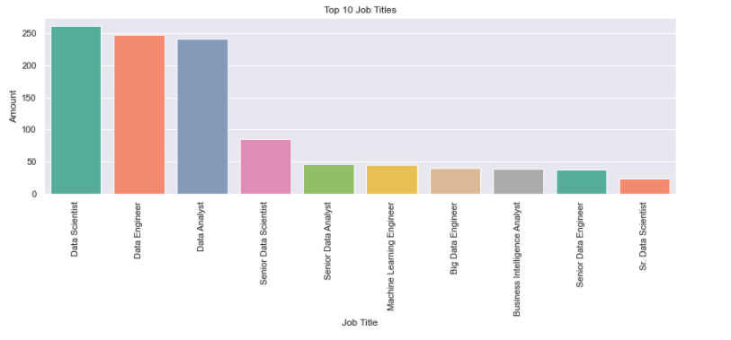
TOP 10 JOB TITLES
good mix of job positions as Data Scientist, Data Analayst and Data Engineer related titles.
not much demand for senior position in the Data engineering related roles.
most of them transition into other roles instead of remaining as a data engineer.
data engineer roles are newer compared to data analyst or data scientist, so the market has not yet reflected demand for senior data engineer

Slide 26
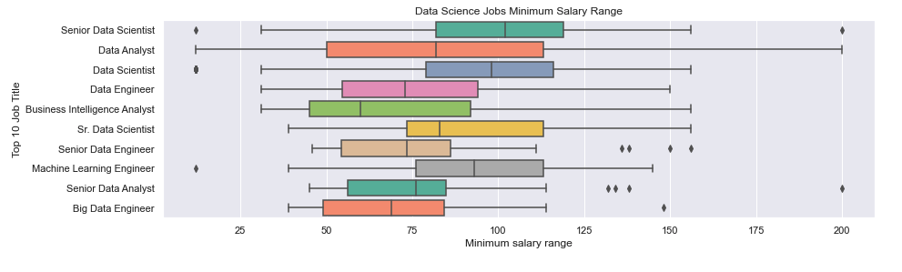
TOP 10 SALARIES MINIMUM RANGE
Start minimum range is higher for data scientist compared to data analyst or data engineer
Low outlier range for senior data scientist, data scientist, machine learning engineer
High outlier range for senior data scientist, senior data engineer, senior data analyst, big data engineer
Can enjoy more starting salary as a data scientist
However, there a small number of data scientist willing to get lower than most min salary to enter the job market
Senior roles can fetch much higher salary than average (more than 200K). These salaries are usually doled out by large tech firms
Some firms recognised the importance of data engineers and they are also willing to pay high minimum salary
Notes:
Change to boxplot

Slide 27
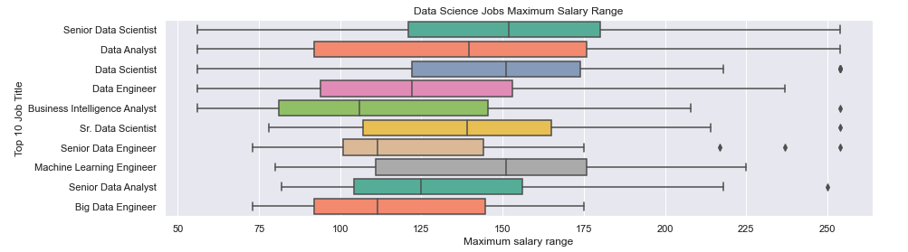
TOP 10 SALARIES MAXIMUM RANGE
Possible to get more salary as a data scientist or as much as a senior data scientist
High outlier range for
data scientist
BI analyst
Senior data scientist
Senior data engineer
Senior data analyst
Senior positions can earn as much as 250K or more. Possibility is more for senior data scientist or data analyst
As gain more experience and gain senior positions, salary variability is very similar among data scientist, data engineer, data analyst
Notes:
Change to boxplot

Slide 28
05
TOPIC MODELLING
How to conduct topic modelling

Slide 29
TOPIC MODELLING OVERVIEW
Topic modelling done separately for articles and job listings dataset
Latent Semantic Analysis (LSA)
Bag of words (BOW)
Term frequency–inverse document frequency (TF-IDF)
focus on reducing matrix dimension while LDA
words will occurs in similar pieces of text if they have similar meaning
Latent Dirichlet Allocation (LDA)
Bag of words (BOW)
Term frequency–inverse document frequency (TF-IDF)
solves topic modeling problems
each document mix with various topics and every topic mix with various words
Extract top topics and dominant documents

Slide 30
ARTICLES TOPIC MODELLING – LSA + BOW

Slide 31
06
CHALLENGES
What kind of challenges are anticipated

Slide 32
CHALLENGES
Trying to find satisfactory datasets for both job articles and job listings
Ready ones are either too little or too much that require complex data cleaning
Scraping requires more time but would fit requirement better
Require more time to conduct research and apply topic modelling due to unfamiliarity
Many different libraries to select and implement (too much choice and confusion)
Require time to clean data into a suitable format before EDA and topic modelling
Require time to keep training the dataset until satisfy. Then still require manual checking unlike other ML solutions

Slide 33
07
FUTURE PLANS
How to expand on the project

Slide 34
FUTURE PLANS
Implement using different libraries and test which give better performance or results
text pre-processing,
TF-IDF/bag-of-words,
LSA
LDA
Topic Modelling using word embedding such as BERT, Top2Vec
Text summarization

Slide 35
THANKS
https://github.com/LiyanaRoslie/ds-keywords
Do you have any questions?
Please keep this slide for attribution.

