Slide 1
PCDS0220_DS105 Machine Learning
Presentation
Liyana Roslie

Slide 2
Presentation Outline
Scenario & Goal
Problem Statement
Dataset Overview
Preliminary Exploratory Data Analysis (Prelim EDA)
Data Preprocessing & Feature Engineering
Applying different ML models
Model Metric Comparison & Model Selection
Applying Dimensionality Reduction
Feature Importance
Challenges
Conclusion

Slide 3
Scenario & Goal
You are an indie developer who has just started out and wants to develop and then publish your first mobile application on Google PlayStore.
As a new indie developer, you would like as much people to use your mobile app
The metric to evaluate the amount of users who uses your mobile app is the number of installs (range) in Google PlayStore

Slide 4
Problem Statement
To predict the range of the app installs in Google PlayStore

Slide 5
Dataset Overview
Taken from Kaggle dataset
https://www.kaggle.com/gauthamp10/google-playstore-apps
Contains data on mobile application extracted from Google PlayStore on December 2020
About 1,118,136 rows and 23 columns
Some missing data in dataset to deal with (< 35% of data in the column)
Fill in with median or mode depending on variable type
No duplicate rows found

Slide 6
Preliminary EDA
To get a better an overview of what kind of actions to take before even starting ML prediction
Correlation between any numeric variables
App Rating
App Rating Count
Top 10 categories
Top 10 categories with most installations

Slide 7
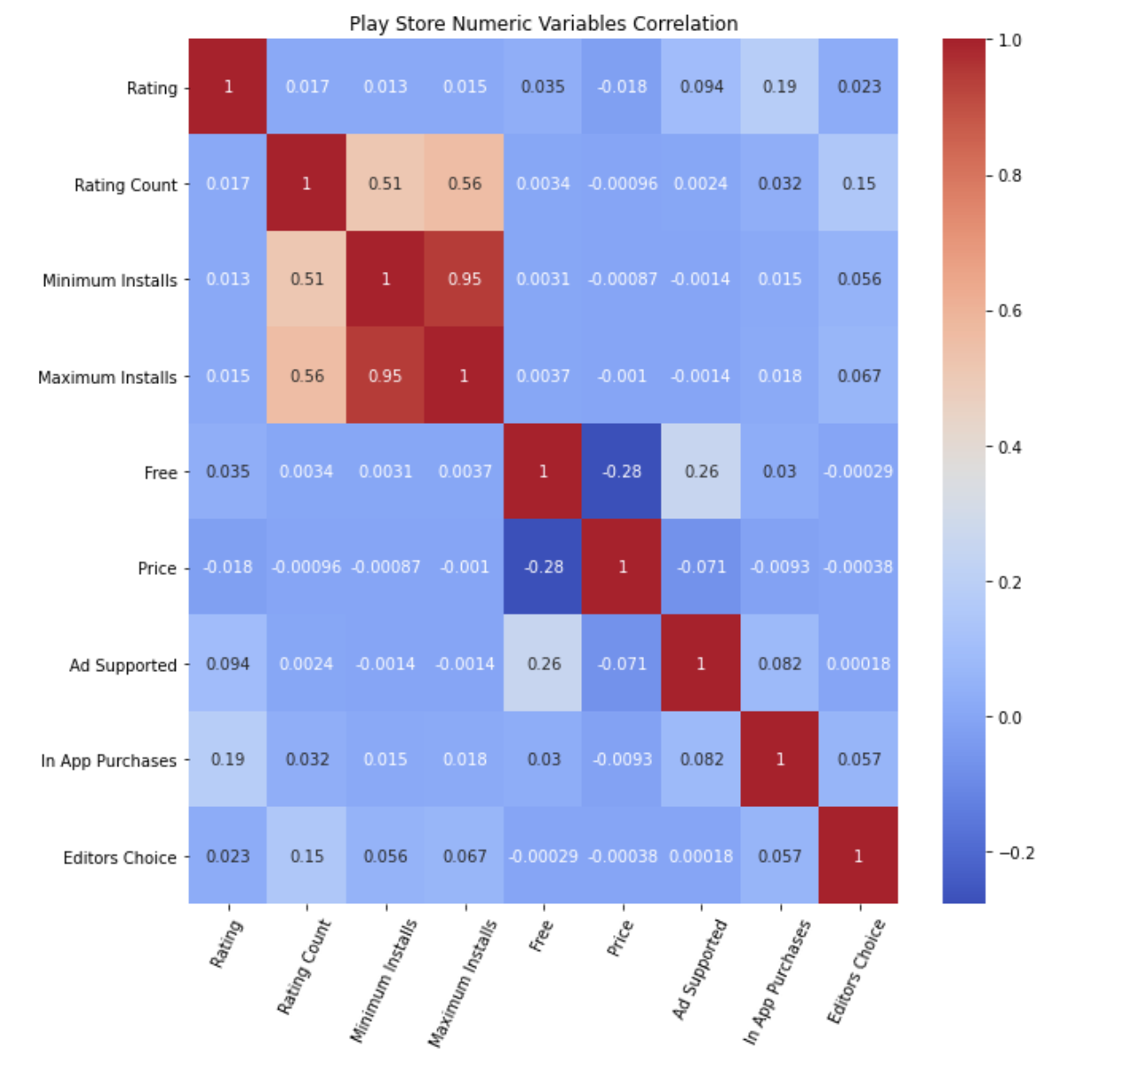
EDA: Correlation
The only strong correlation factors found are between Minimum Installs and Maximum Installs
Therefore, they will NOT be used in Machine Learning models

Slide 8
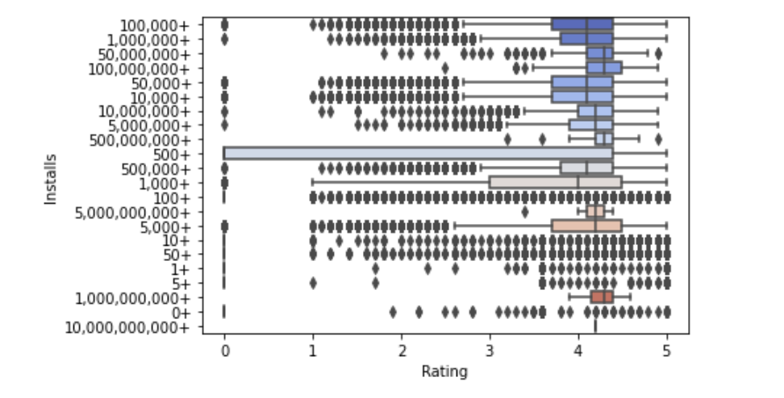
EDA: Rating
Rating has many outliers especially in the lower quartile range.
The rating for installs < 50 is very few compared to larger installs range.
Most rating are in the lower outlier range, especially below 3.
The range with more installations like 100, 000 + has median rating of about 3.5 and above.
It is same to assume that the range with higher installations has better rating.
If users rate the app low, can encourage user to update ratings after making improvements to the app

Slide 9
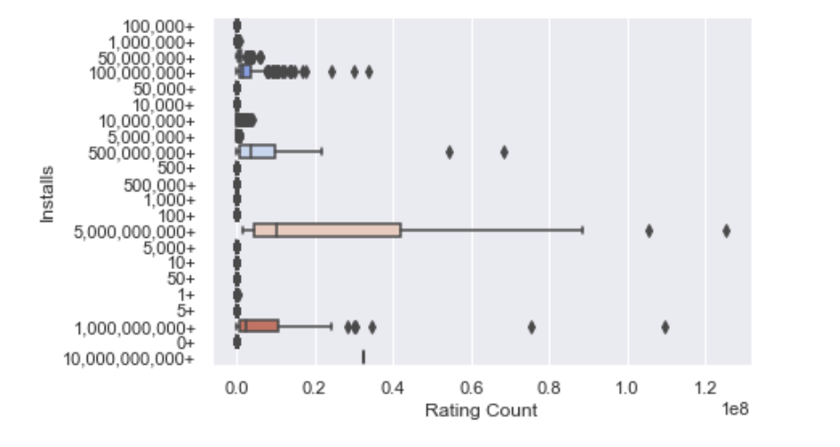
EDA: Rating Count
There are a lot of “0” rating count for almost all installs range.
The lower end of installs range (<50) all has 0 rating count
The higher range installs such as 500 million, the rating count is on the higher end.
Conclude that more installation range has more rating count
So to increase chances of more installs, get more ratings from users
Can remind users to rate app if they have skipped the rating or have not done it yet
It is also good to get more rating to average out the rating especially after receiving some bad reviews

Slide 10
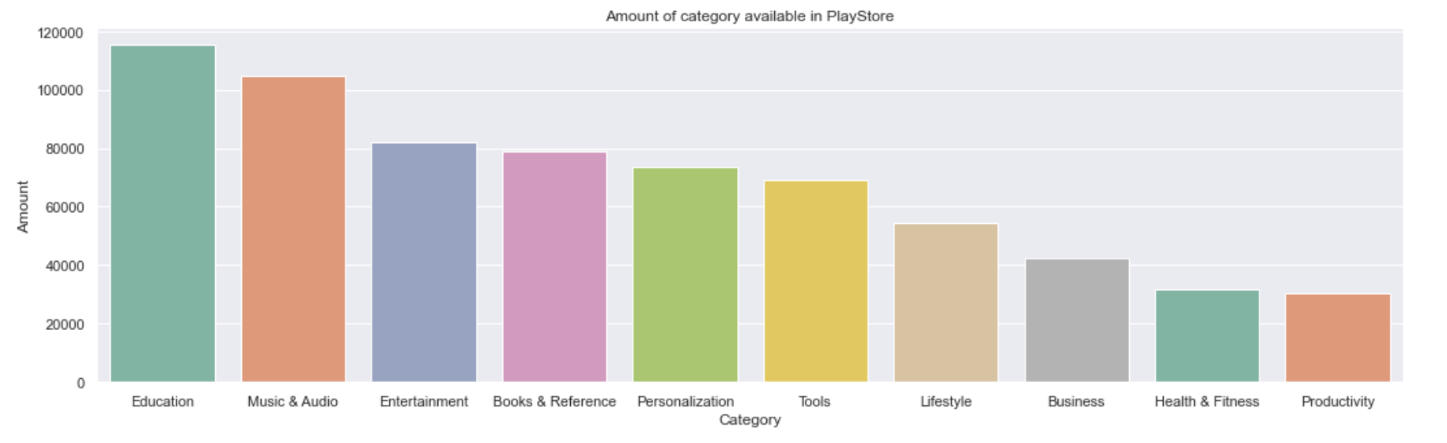
EDA: Top 10 categories
Even though Entertainment category is ranked quite highly (top 3), other top categories include more ‘tool or aid like’ apps such as Education, Books & Reference, Tools, Business, Health & Fitness and Productivity apps

Slide 11
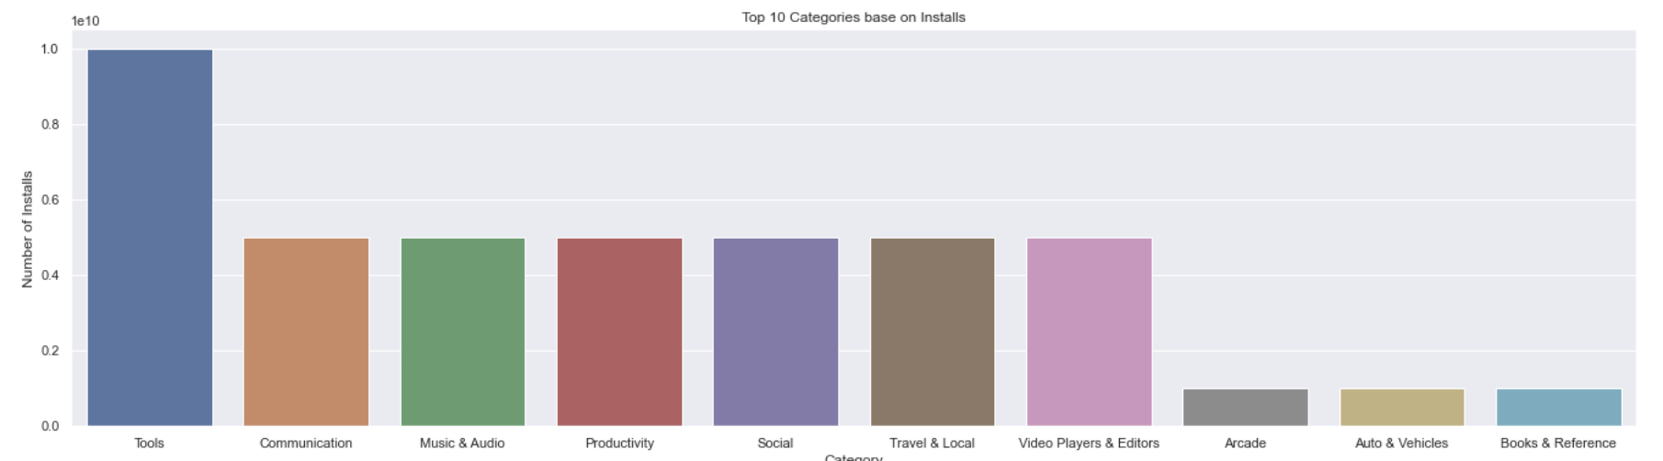
EDA: Top 10 categories with most installs
Comparing top 10 categories that receive the most installs to the top 10 categories, there seems to be some overlap. Entertainment category is not even listed here
But there are still a few ‘tool or aid like’ apps such such as Tools, Productivity, Video Players & Editors, Books & Reference
These mentioned apps has the most potential for development for an indie developer
Even though Communication and Social is considered ‘tool and aid like’ apps, their success are tied heavily to the number of users using the app. Therefore, they are not advisable for indie developers to implement

Slide 12
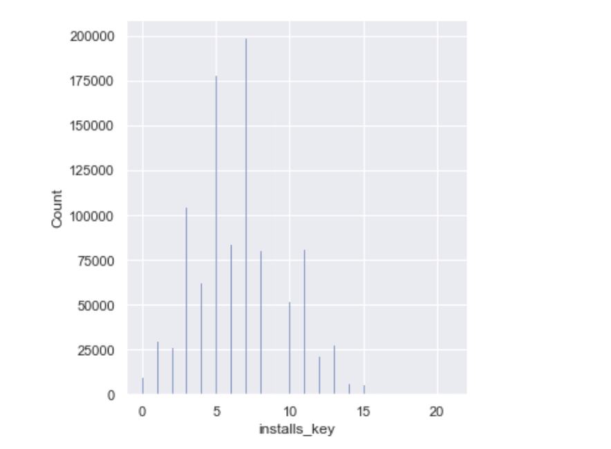
EDA: Distribution of Installs
Slight right skewed distribution
Most installs are in the range of 100 to 50,000. (installs key 5 to 9)
That means most apps in the Google Playstore has installs between 100 to 50,000

Slide 13
ML process
Data Prepocessing + Engineering
ML models baseline
Selected Parameter Tuning
compare ML models base on metric score
Dimensionality Reduction
Feature Importance

Slide 14
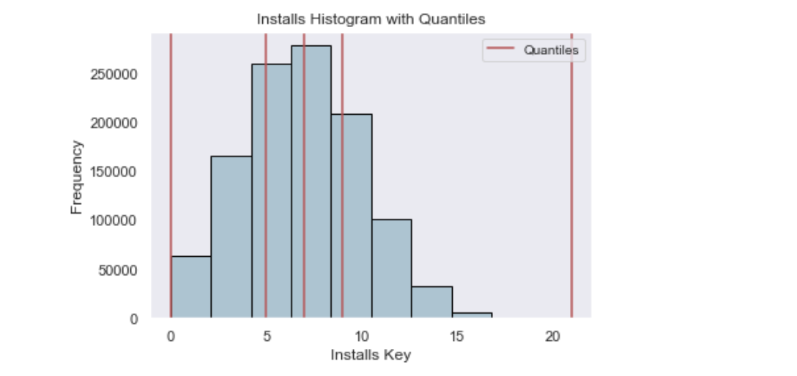
Data Preprocessing for y
Installs classes:
0 -> 0 to 100 installs
1 -> 101 to 1000 installs
2 -> 1001 to 10,000 installs
3 -> 10,001 to 10,000,000,000 installs
Quantile binning for y to separate into 4 different classes to represent 4 stages/phases of app development
To accumulate installs as indie developer with not much marketing power, accumulating installs is quite hard, hereby dividing into 4 classes instead of 2
Because of y skewness, dividing using IQR is a good choice to start with

Slide 15
Feature (X) Engineering
Raw Features (1) | Derived Features (1) | Raw Features (2) | Derived Features (2)
Category |  | Updated Date | Released Date – Update Date (Length of update)
Rating |  | Content Rating
Rating Count |  | Ad Supported
Free |  | In App Purchases
Minimum Android Version |  | Editors Choice
Released Date | Released Year Released Month Released Date Released Weekend | Developer ID | Frequency of same developer ID

Slide 16
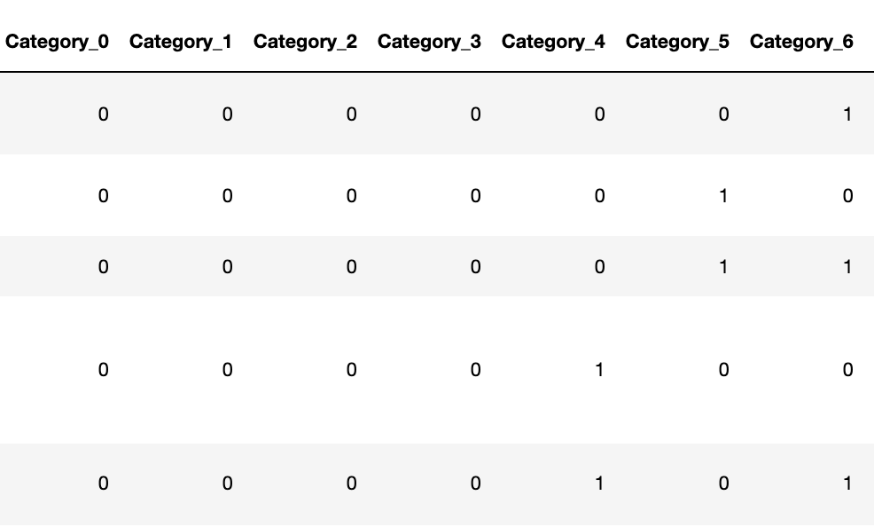
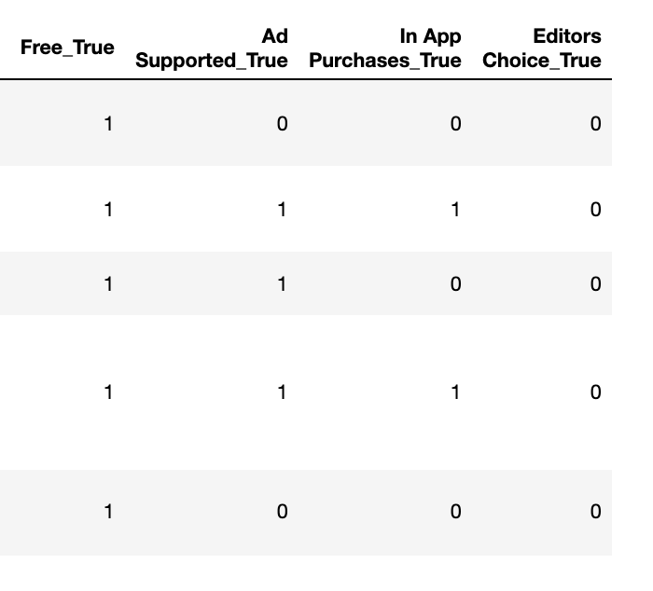
Feature (X) Encoding
Category
Binary Encoding
Free
Ad Supported
In App Purchases
Editors Choice
Dummy Encoding

Slide 17
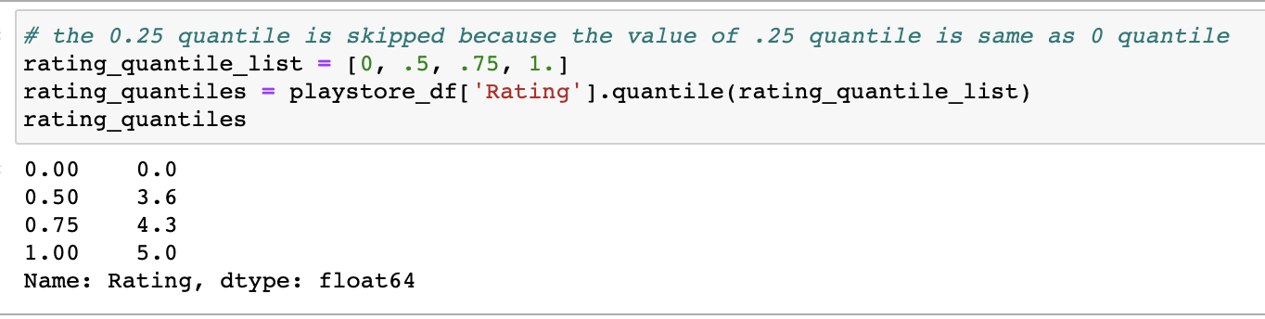
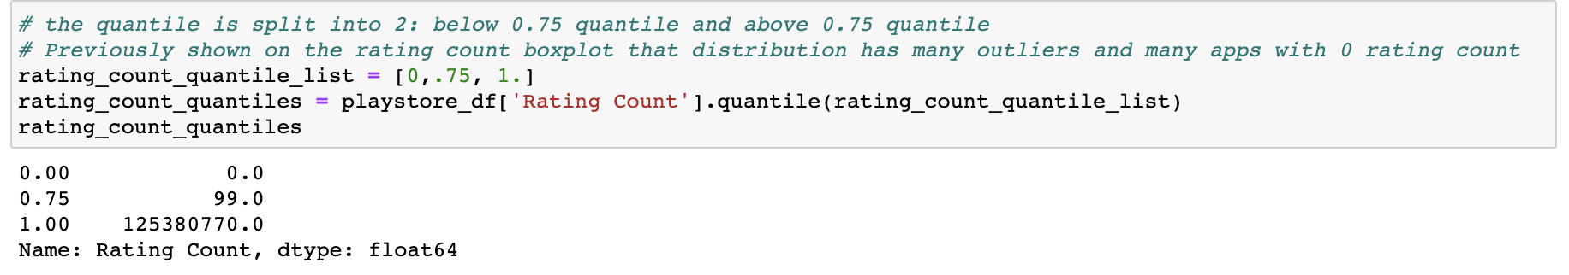
Feature (X) Encoding
Rating
Custom Quantile Encoding + Robust Scaler
Rating Count
Robust Scaler is mainly used for standardizations in many encodings in this project due to the presence of skewed distributions and outliers

Slide 18
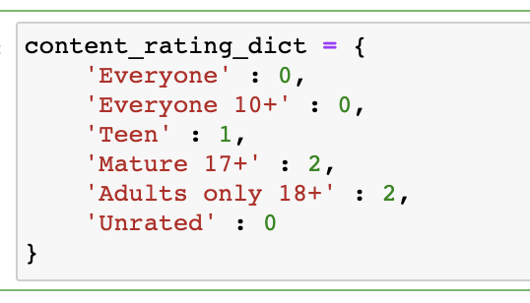
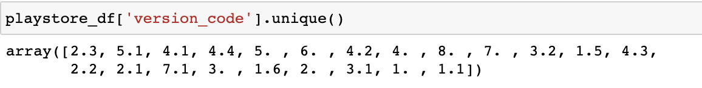
Feature (X) Encoding
Content Rating
Custom Ordinal Encoding
Custom Extraction
Minimum Android

Slide 19
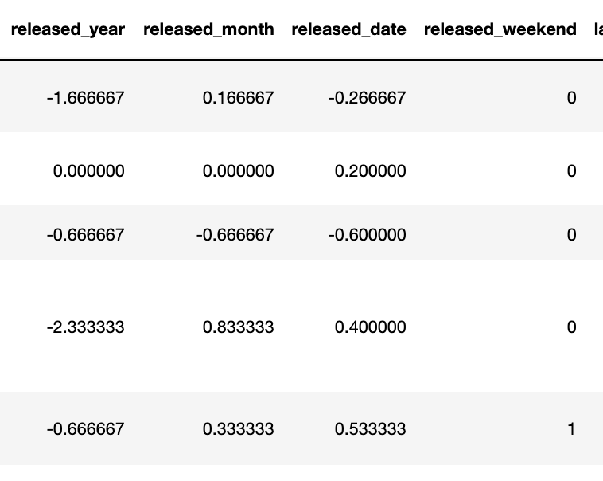
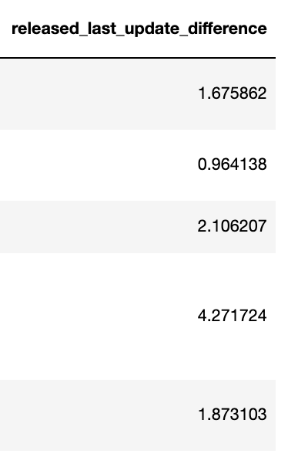
Feature (X) Encoding
Released Date
Custom Extraction + Robust Scaler
Updated Date

Slide 20
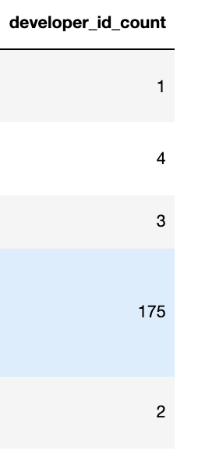
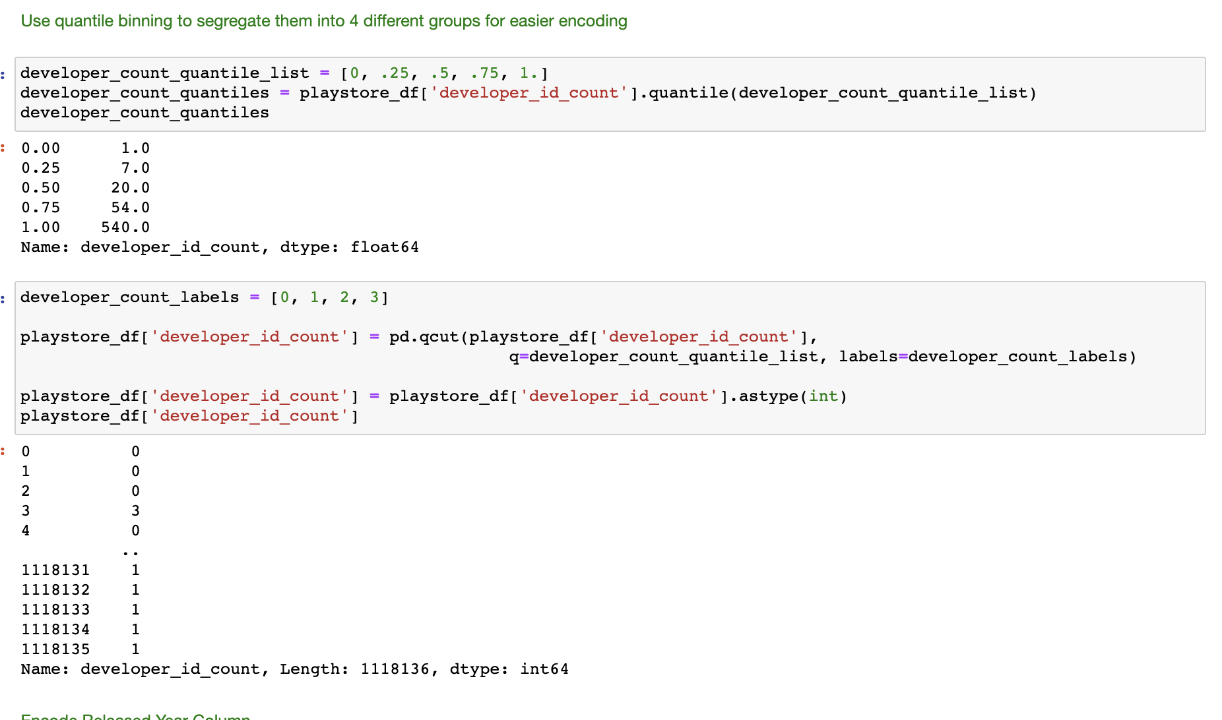
Feature (X) Encoding
Developer Id
Derive Frequency + Quantile Binning

Slide 21
Applying ML Models
Model Name | Parameters
Logistic Regression | multi_class='multinomial', solver='newton-cg', C = 166.81005372000593, random_state=13, class_weight= y_installs_weights['weights']
KNN | n_neighbors = 5, p = 2, weights = 'distance'
Decision Tree | criterion = 'entropy', max_depth = 5, class_weight=y_installs_weights['weights']
Random Forest | n_estimators = 100, criterion = 'entropy', random_state = 555, class_weight = y_installs_weights['weights']
Gradient Boosting | n_estimators= 100 , learning_rate= 0.1 ,max_depth= 10, random_state=12
XGBoost | objective='multi:softmax', random_state =42, max_depth=6, gamma=1.0, learning_rate=0.1

Slide 22
Applying ML Models
Metric | Reason
F1 Score | seek balance between Precision and Recall due to uneven class distribution.
ROC AUC one vs one (ovo) | represents the degree or measure of separability. It tells how much the model is capable of distinguishing between classes. Ovo used for multiclass targets
Logloss | To compare between different models especially when the other scores are very similar

Slide 23
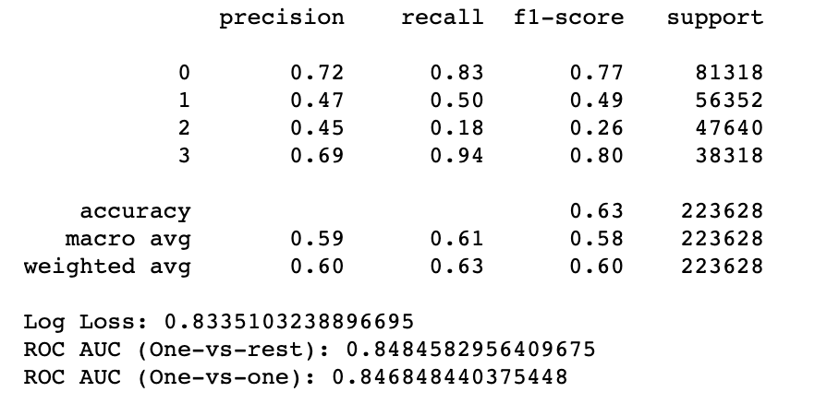
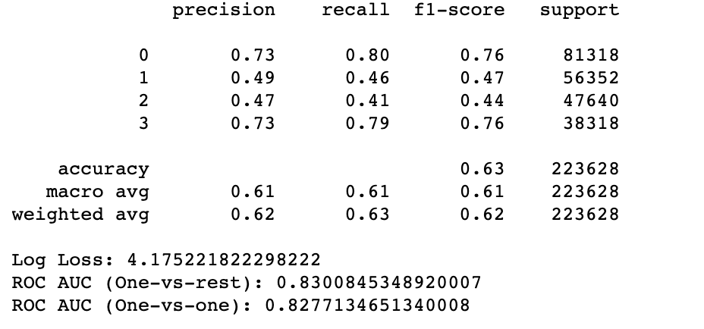
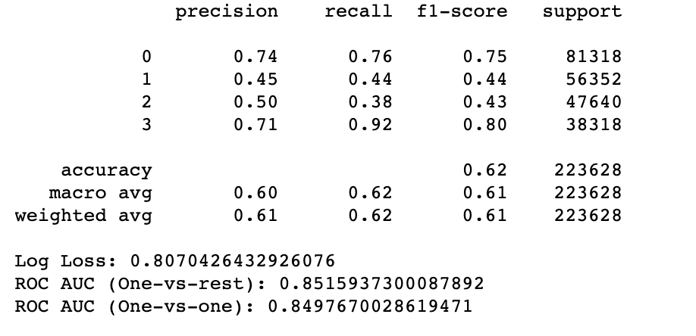
Model Metric Comparison
Logistic Regression
KNN
Decision Tree

Slide 24
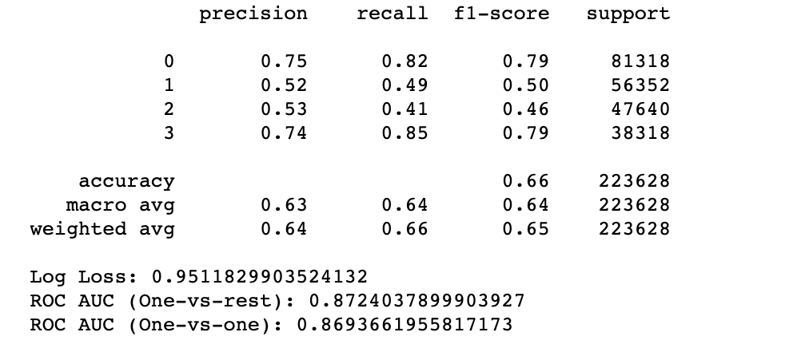
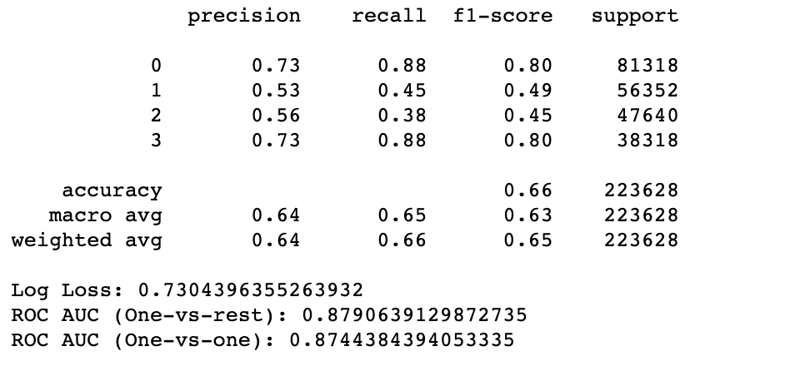
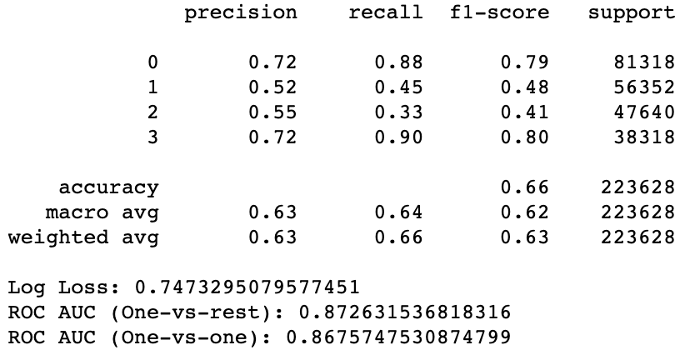
Model Metric Comparison: Model Selection
Random Forest
Gradient Boosting
XGBoost

Slide 25
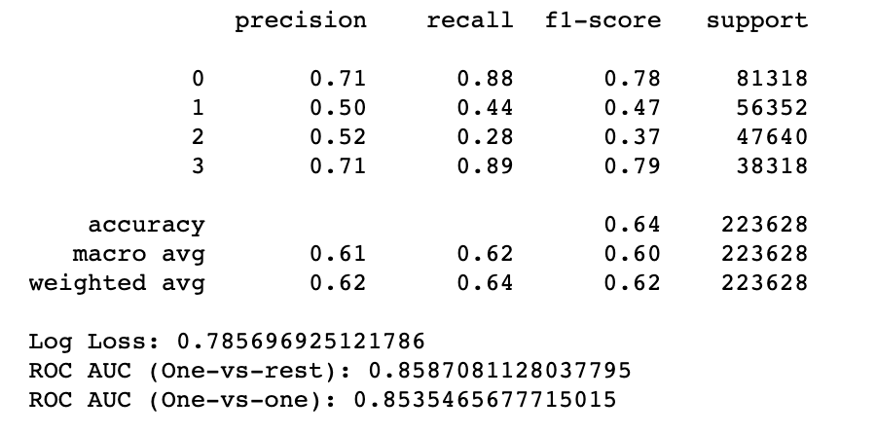
Applying Dimensionality Reduction
Linear discriminant analysis (LDA)
reduce
2 components
apply
xgboost
results
Xgboost before LDA
Xgboost after LDA
Before LDA perform better

Slide 26
Model Selection
Gradient Boosting Model performs best

Slide 27
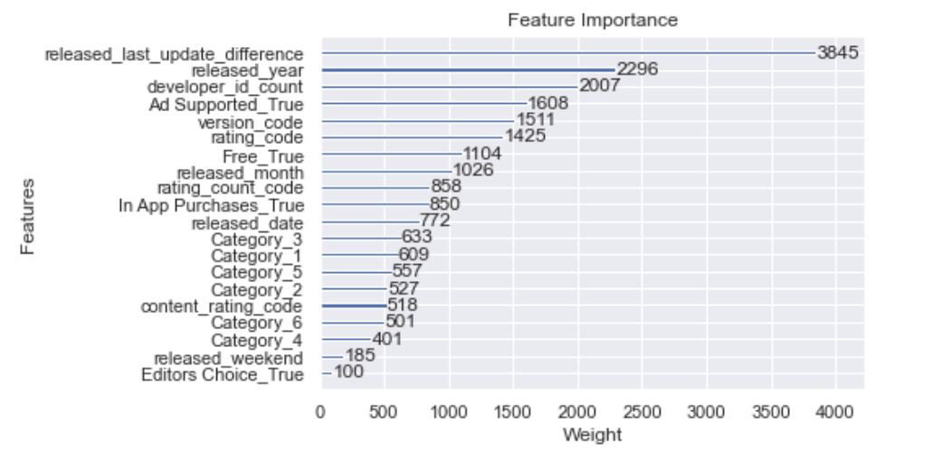
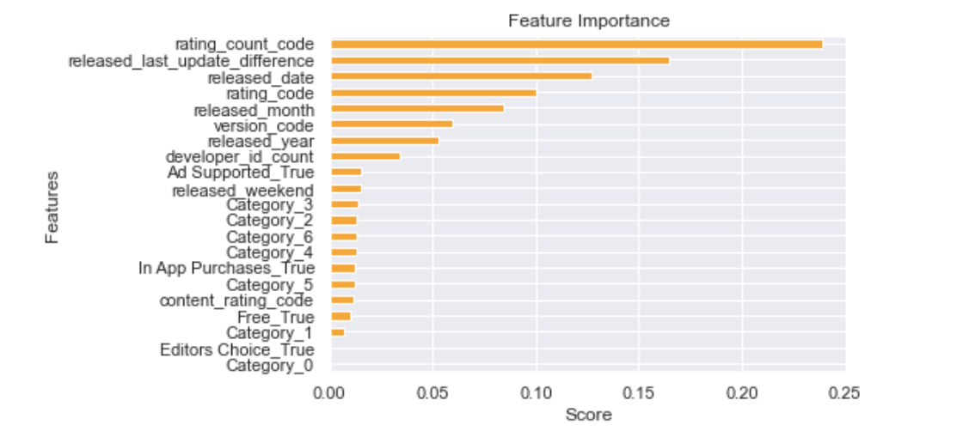
Feature Importance
Top 5 XGBoost: release_last_update_difference, released_year, developer_id_count, Ad_Supported, version_code.
Top 5 Random Forest: rating_count_code, release_last_update_difference, released_date, rating_code, released_month
XGBoost Plot Importance
Random Forest Feature Importance
Depending on the which ML models used, different features might have different weights.
Look at both top 5 weights and conduct further investigations. Try to reverse engineer factors such as released_year to see how to exploit those factors to increase number of installs for your app. Conduct more detailed EDA to analyse these factors further.

Slide 28
Challenges
The dataset is quite complex with many categorical data therefore many features(X) requires encoding before it can fit into ML model. The preprocessing and encoding process takes a long time to complete
Imbalanced data for the labels (y) so requires adjustment to prevent overfitting
Stratify dataset during train test validation step
Adjust class weights in the model
Use boosting algorithm
Prediction f1-score is not good for the middles class (1 and 2)
Parameter Tuning takes at least a few hours and does not yield significantly good result. Therefore only select a few to do models to do parameter tuning. Can do model selection without completing all parameter tuning.

Slide 29
Conclusion
The more classes or range for classification ML problems, the prediction for each class will not perform as well compared to lesser or binary classes.
However, sometimes, in order to devise business strategy, it might not be useful to have lesser range or classes to predict. In this case of being an indie developer who just started out, it is better to be able to get an overview of the class range in order to plan for how to proceed with increasing the number of app installs step by step instead of getting better prediction. Once achieve one of the class installation range, can re-do the ML prediction again by making it having lesser classes
Therefore, in this case, multi class prediction is tradeoff between prediction performance and business strategy. Depending on situation, you will have to choose one over another.

Slide 30
Thanks!
Github:
https://github.com/LiyanaRoslie/google-apps-ml
Please keep this slide for attribution.

