Slide 1
PCDS0220_DS105 Machine Learning
Presentation
Liyana Roslie

Slide 2
Presentation Outline
Goal
Problem Statement
Dataset
EDA
Data Preprocessing & Feature Engineering
Applying different ML model
Model Metric Comparison & Model Selection
Applying Dimensionality Reduction
Feature Importance
Challenges
Conclusion

Slide 3
Goal
You are an indie developer who has just started out and wants to develop and then publish your first mobile application on Google PlayStore.
As a new indie developer, you would like as much people to use your mobile app
The metric to evaluate the amount of users who uses your mobile app is the number of installs (range) in Google PlayStore

Slide 4
Problem Statement
To predict the range of the app installs in Google PlayStore

Slide 5
Dataset Overview
Taken from Kaggle dataset
https://www.kaggle.com/gauthamp10/google-playstore-apps
Contains data on mobile application extracted from Google PlayStore on December 2020
About 1,118,136 rows and 23 columns
Some missing data in dataset to deal with (< 35% of data in the column)
No duplicate rows found

Slide 6
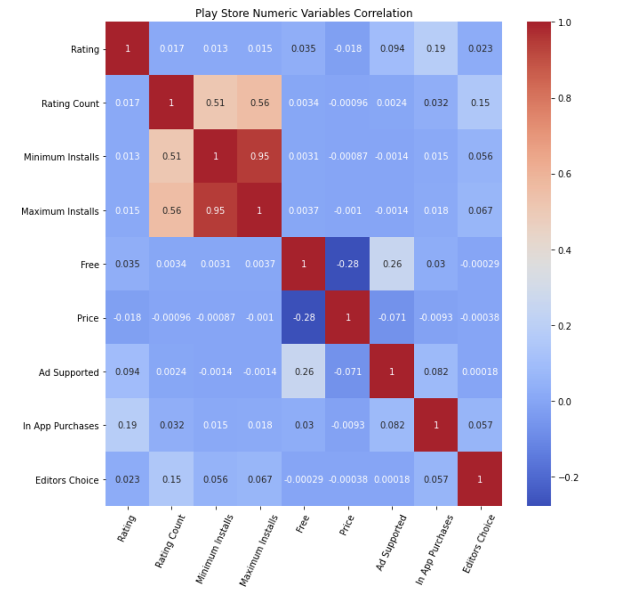
EDA: Correlation
The only strong correlation factors found are between Minimum Installs and Maximum Installs
Therefore, they will NOT be used in Machine Learning models

Slide 7
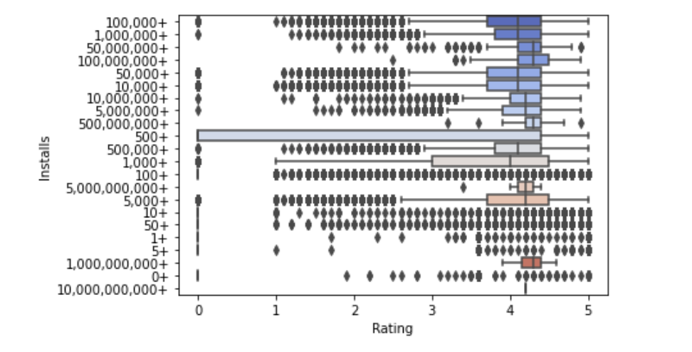
EDA: Distribution of Rating
Rating has many outliers especially in the lower quartile range.
The rating for installs < 50 is very few compared to larger installs range.
Most rating are in the lower outlier range, especially below 3. Most likely, users are motivated to leave rating when they encounter bad experience. To achieve good rating, developer need to think of creative ways to incentivize and remind users to leave good rating to minimize and average out bad ratings. Also if users rate the app low, can encourage user to update ratings after making improvements to the app

Slide 8
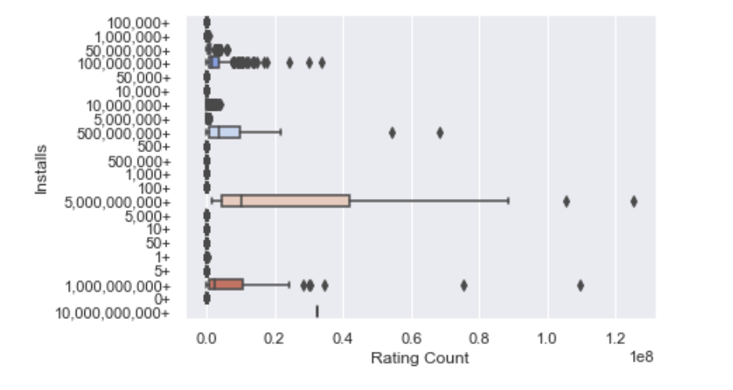
EDA: Distribution of Rating Count
There are a lot of “0” rating count for almost all installs range.
The lower end of installs range (<50) all has 0 rating count
The higher range installs such as 500 million, the rating count is on the higher end
To increase chances of more installs, get more ratings from users
Remind users to rate app if they have skipped the rating

Slide 9
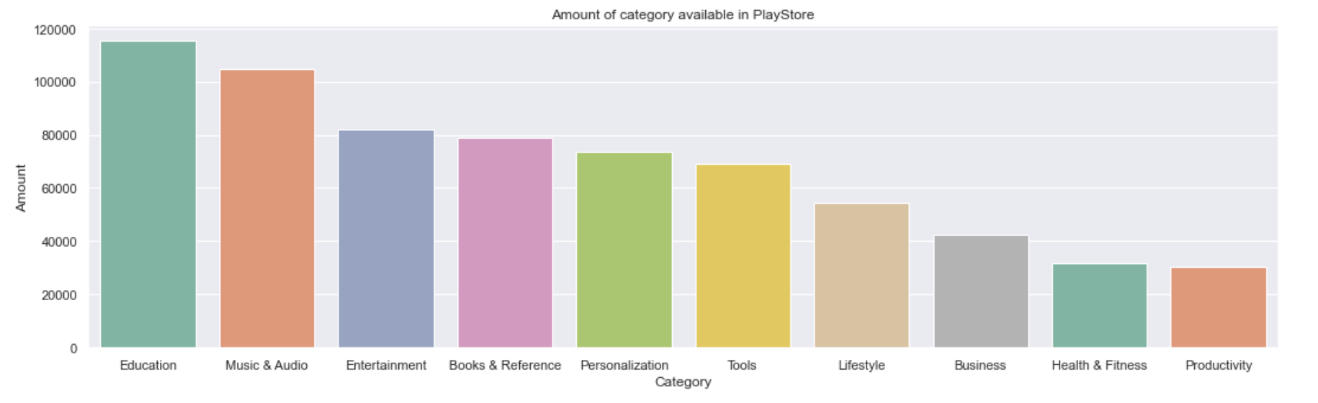
EDA: Top 10 categories
Even though Entertainment category is ranked quite highly (top 3), other top categories include more ‘tool or aid like’ apps such as Education, Books & Reference, Tools, Business, Health & Fitness and Productivity apps

Slide 10
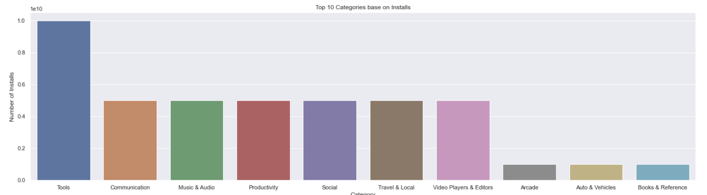
EDA: Top 10 categories with most installs
Comparing top 10 categories that receive the most installs to the top 10 categories, there seems to be some overlap. Entertainment category is not even listed here
But there are still a few ‘tool or aid like’ apps such such as Tools, Productivity, Video Players & Editors, Books & Reference
These mentioned apps has the most potential for development for an indie developer
Even though Communication and Social is considered ‘tool and aid like’ apps, their success are tied heavily to the number of users using the app. Therefore, they are not advisable for indie developers to implement

Slide 11
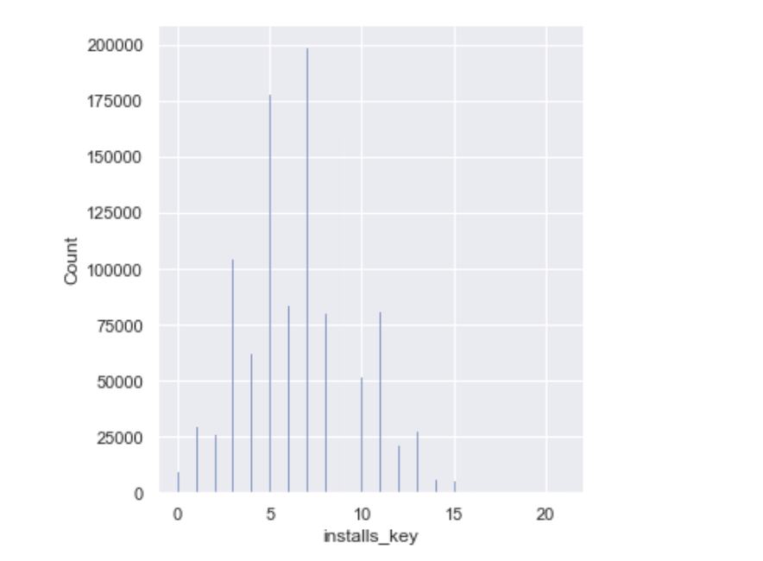
EDA: Distribution of Installs
Slight right skewed distribution
Most installs are in the range of 100 to 50,000. (installs key 5 to 9)
Require scaling of installs before fitting in ML model
That means most apps in the Google Playstore has installs between 100 to 50,000

Slide 12
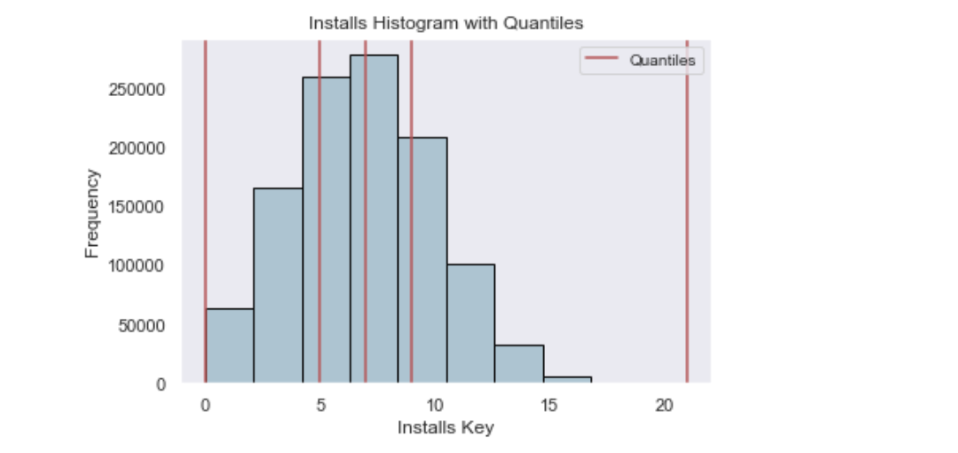
Data Preprocessing for y
Installs classes:
0 -> 0 to 100 installs
1 -> 101 to 1000 installs
2 -> 1001 to 10,000 installs
3 -> 10,001 to 10,000,000,000 installs
Quantile binning for y to separate into 4 different classes to represent 4 stages/phases of app development
To accumulate installs as indie developer with not much marketing power, accumulating installs is quite hard, hereby dividing into 4 classes instead of 1
Because of y skewness, dividing using IQR is a good choice to start with

Slide 13
Feature (X) Engineering
Raw Features (1) | Derived Features (1) | Raw Features (2) | Derived Features (2)
Category |  | Updated Date | Released Date – Update Date (Length of update)
Rating |  | Content Rating
Rating Count |  | Ad Supported
Free |  | In App Purchases
Minimum Android Version |  | Editors Choice
Released Date | Released Year Released Month Released Date Released Weekend | Developer ID | Frequency of same developer ID

Slide 14
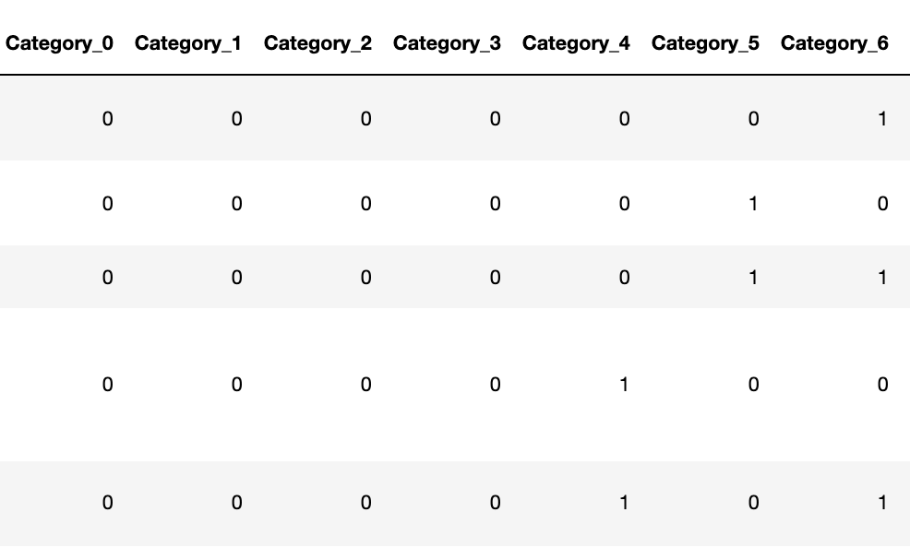
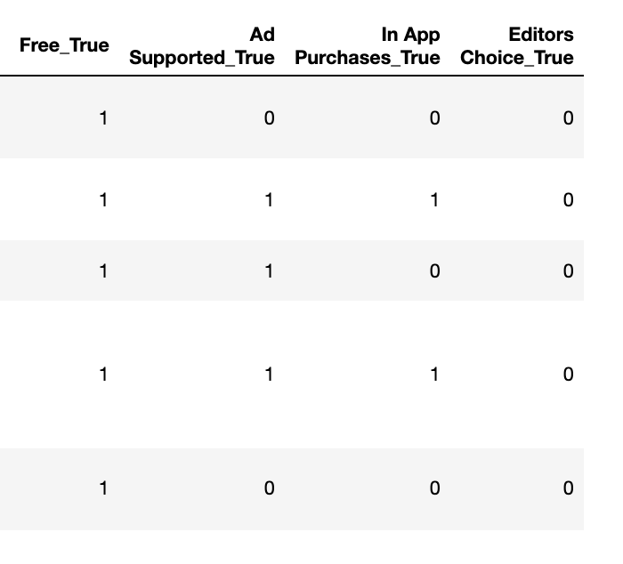
Feature (X) Encoding
Category
Binary Encoding
Free
Ad Supported
In App Purchases
Editors Choice
Dummy Encoding

Slide 15
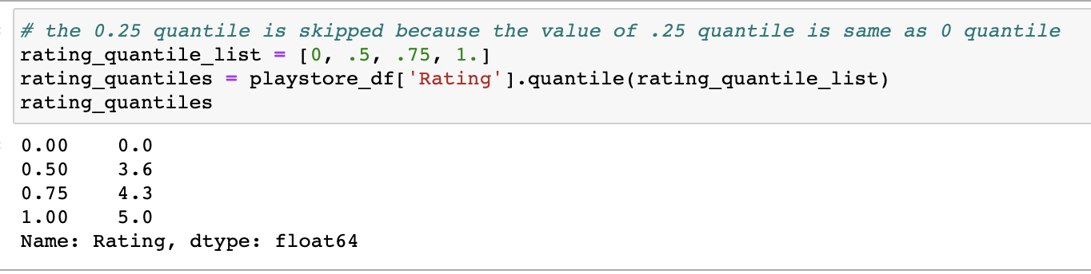
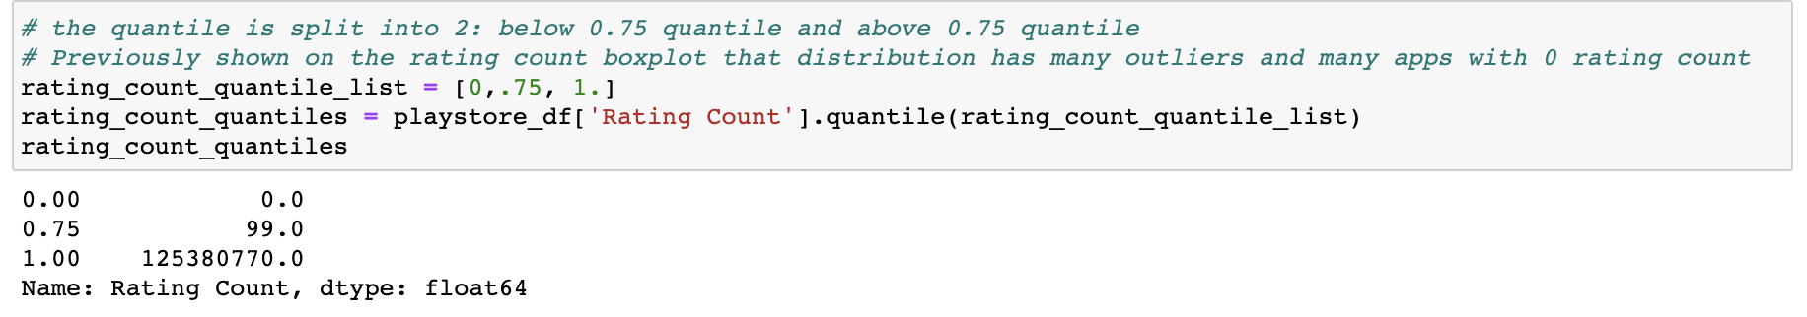
Feature (X) Encoding
Rating
Custom Quantile Encoding + Robust Scaler
Rating Count
Robust Scaler is mainly used for standardizations in many encodings in this project due to the presence of skewed distributions and outliers

Slide 16
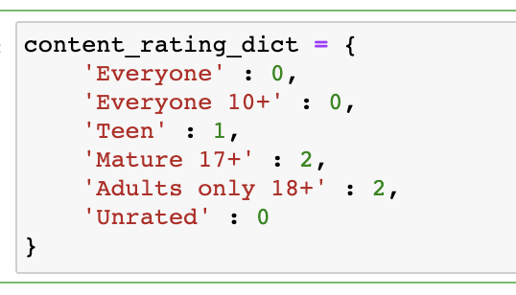
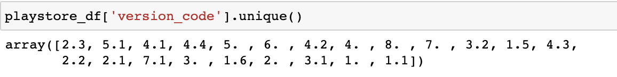
Feature (X) Encoding
Content Rating
Custom Ordinal Encoding
Custom Extraction
Minimum Android

Slide 17
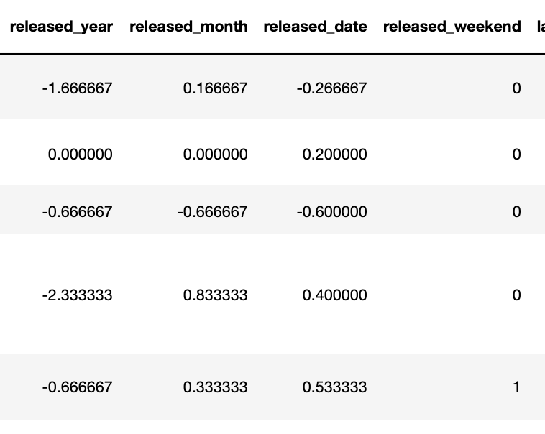
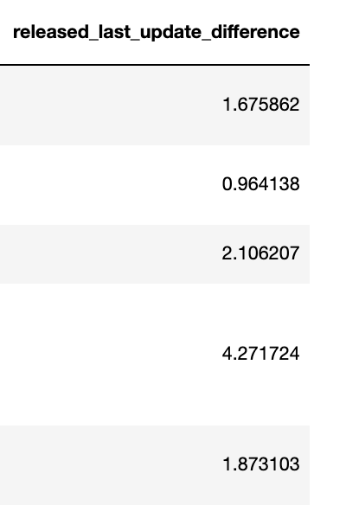
Feature (X) Encoding
Released Date
Custom Extraction + Robust Scaler
Updated Date

Slide 18
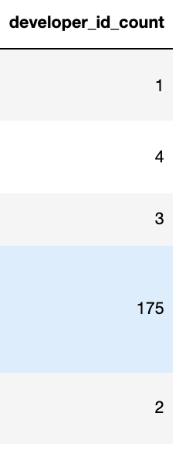
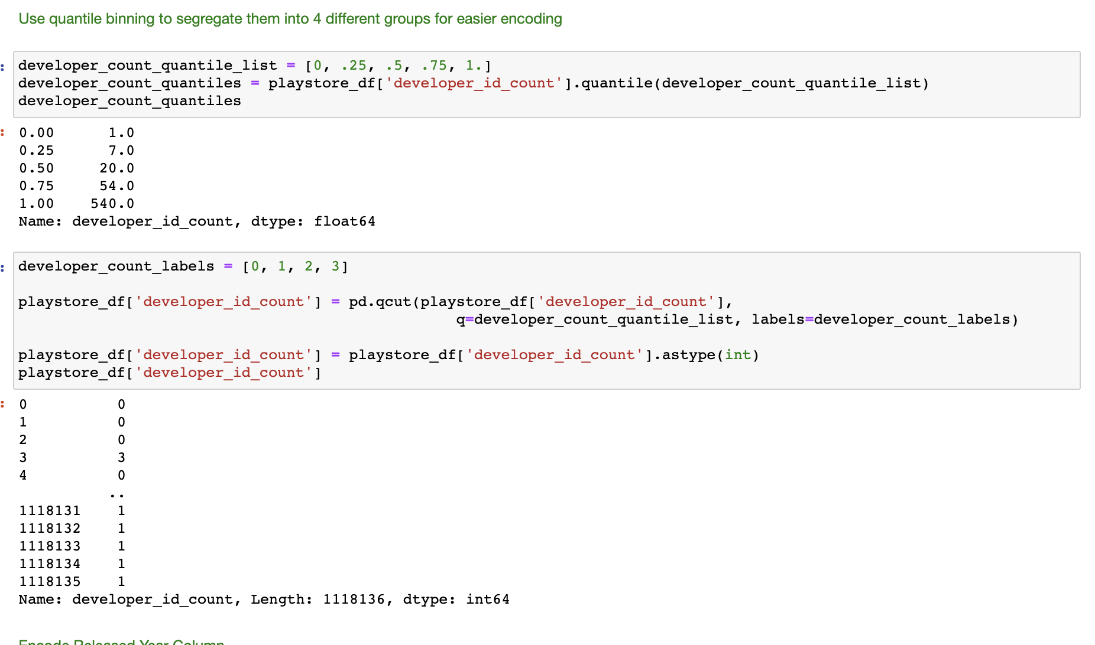
Feature (X) Encoding
Developer Id
Derive Frequency + Quantile Binning

Slide 19
Applying ML Models
Model Name | Parameters
Logistic Regression | multi_class='multinomial', solver='newton-cg', C = 166.81005372000593, random_state=13, class_weight= y_installs_weights['weights']
KNN | n_neighbors = 5, p = 2, weights = 'distance'
Decision Tree | criterion = 'entropy', max_depth = 5, class_weight=y_installs_weights['weights']
Random Forest | n_estimators = 100, criterion = 'entropy', random_state = 555, class_weight = y_installs_weights['weights']
Gradient Boosting | n_estimators= 100 , learning_rate= 0.1 ,max_depth= 10, random_state=12
XGBoost | objective='multi:softmax', random_state =42, max_depth=6, gamma=1.0, learning_rate=0.1

Slide 20
Applying ML Models
Metric | Reason
F1 Score | seek balance between Precision and Recall due to uneven class distribution.
ROC AUC one vs one (ovo) | represents the degree or measure of separability. It tells how much the model is capable of distinguishing between classes. Ovo used for multiclass targets
Logloss | To compare between different models especially when the other scores are very similar

Slide 21
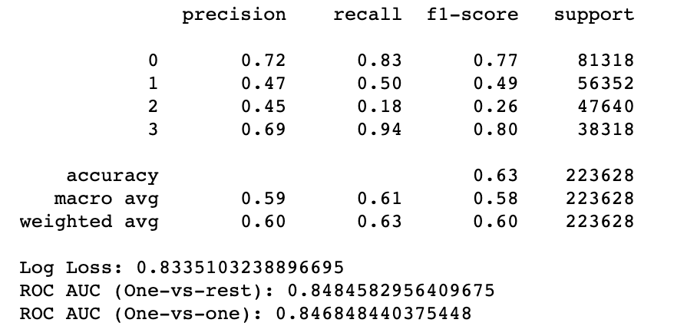
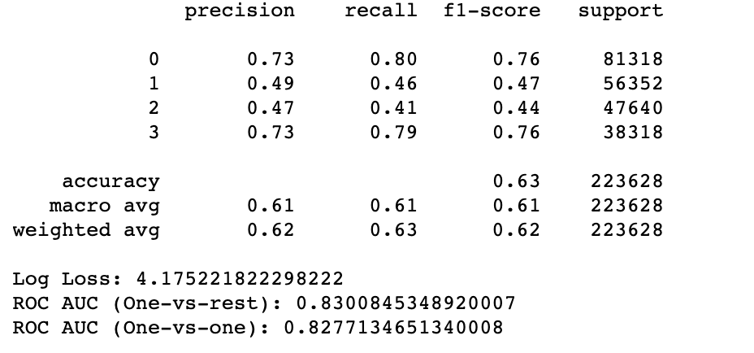
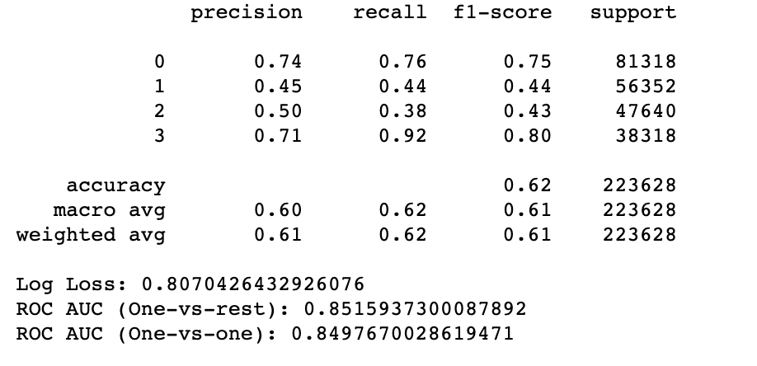
Model Metric Comparison
Logistic Regression
KNN
Decision Tree

Slide 22
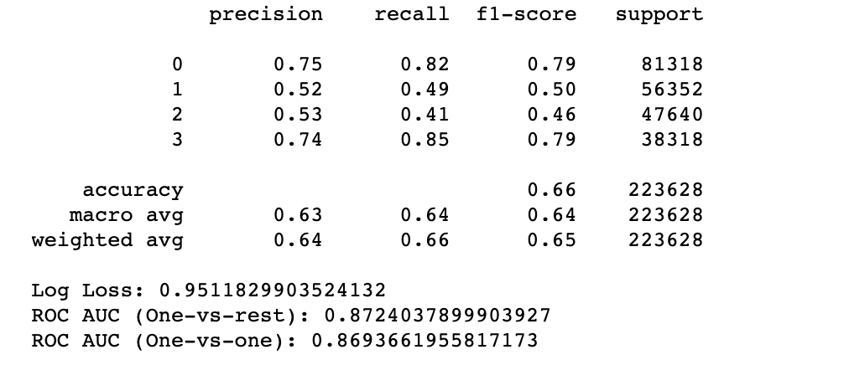
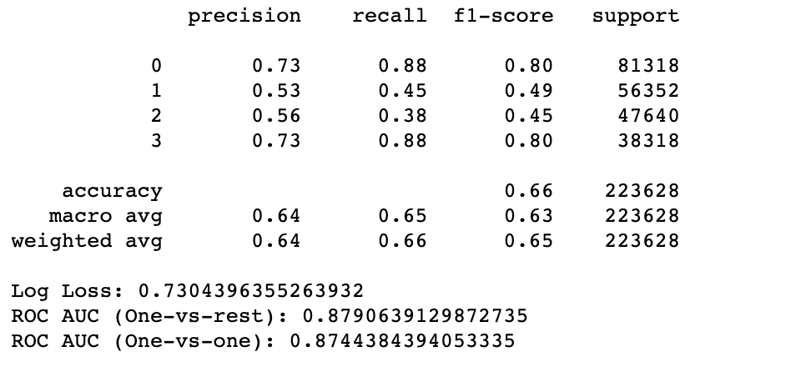
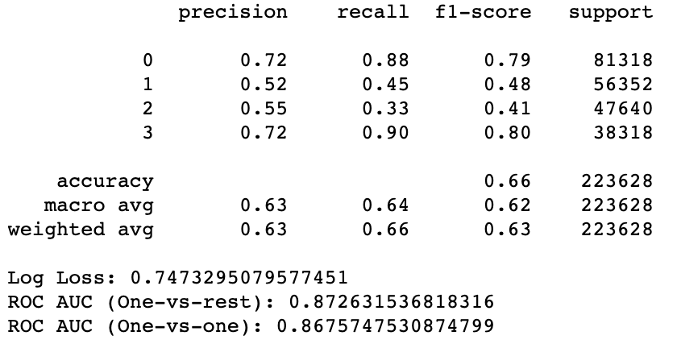
Model Metric Comparison: Model Selection
Random Forest
Gradient Boosting
XGBoost

Slide 23
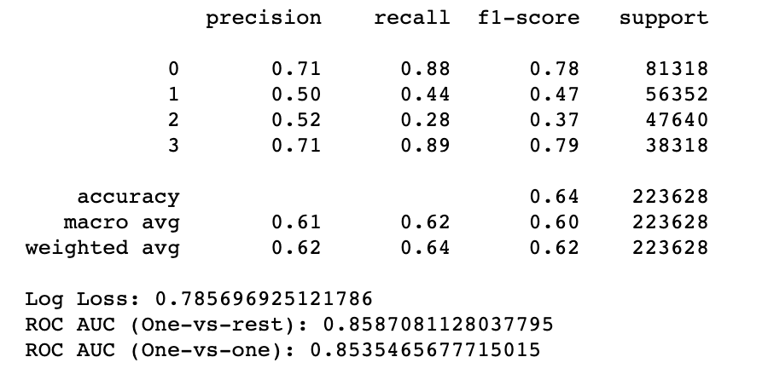
Applying Dimensionality Reduction
Linear discriminant analysis (LDA)
reduce
2 components
apply
xgboost
results
Xgboost before LDA
Xgboost after LDA
Before LDA perform better

Slide 24
Model Selection
Gradient Boosting Model performs best

Slide 25
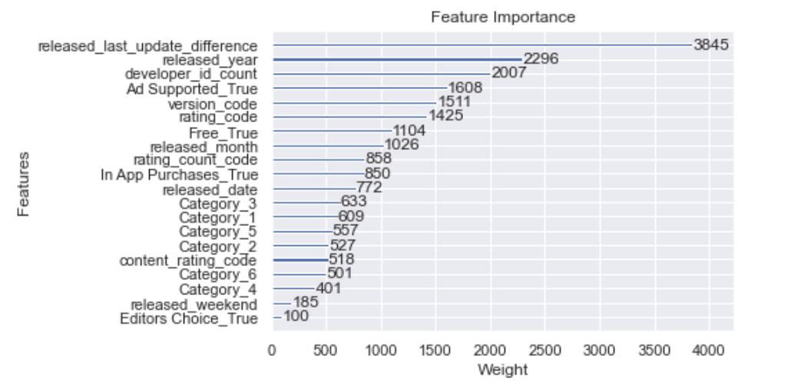
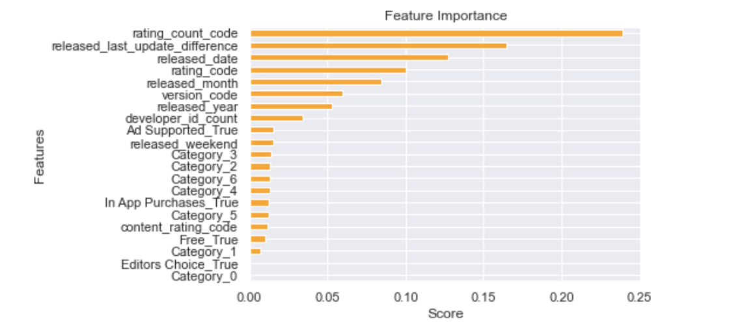
Feature Importance
Top 5 XGBoost: release_last_update_difference, released_year, developer_id_count, Ad_Supported, version_code.
Top 5 Random Forest: rating_count_code, release_last_update_difference, released_date, rating_code, released_month
XGBoost Plot Importance
Random Forest Feature Importance
Depending on the which ML models used, different features might have different weights.
Look at both top 5 weights and conduct further investigations. Try to reverse engineer factors such as released_year to see how to exploit those factors to increase number of installs for your app.

Slide 26
Challenges
The dataset is quite complex with many categorical data therefore many features(X) requires encoding before it can fit into ML model. The encoding process might not bring good result if it is not done correctly.
Imbalanced data for the labels (y) so requires adjustment to prevent overfitting
Stratify dataset during train test validation step
Adjust class weights in the model
Use boosting algorithm
Prediction f1-score is not good for the middles class (1 and 2)
Parameter Tuning takes at least a few hours and does not yield significantly good result

Slide 27
Conclusion
The more classes or range for classification ML problems, the prediction for each class will not perform as well compared to lesser or binary classes.
However, sometimes, in order to devise business strategy, it might not be useful to have lesser range or classes to predict. In this case of being an indie developer who just started out, it is better to be able to predict more class range in order to plan for how to proceed with increasing the number of app installs step by step.
Therefore, in this case, multi class prediction is tradeoff between prediction performance and business strategy

Slide 28
Thanks!
Github:
https://github.com/LiyanaRoslie/google-apps-ml
Please keep this slide for attribution.

