Slide 1

Advertisement CTR Prediction
Exploratory Data Analysis
DS5220 / Fall 2023 Semester
Team Members: Liyang Song, Qian Yin
Oct 29, 2023

Slide 2
Updates on the source dataset
As the original dataset contains over 40 million observations, it could be expensive to run a GridSearch or complex modeling (e.g. Random Forest) in the afterward modeling phase.
After communicating with the professor, we would only randomly resample 2.5% of all observations (around 1 million) from the original set for our project.
Also, we have uploaded the resampled dataset on our AWS S3, which can be downloaded through download_data.ipynb, and split into train and test set through train_test_split.ipynb.
We use GitHub for version control and collaborative development. Our repository: https://github.com/LiyangSong/Advertisement-CTR-Prediction

Slide 3
Reproducibility
Submitted files include Python module files (.py ), Jupyter Notebooks (.jpynb and .html), an environment file (.yml), and PowerPoints (.pdf).
Run download_data.ipynb to download resampled dataset.
Run train_test_split.ipynb to implement train and test set split.
Run eda.ipynb to implement exploratory data analysis (EDA).
Run prep.ipynb to try data transformation and EDA on the transformed dataset.

Slide 4
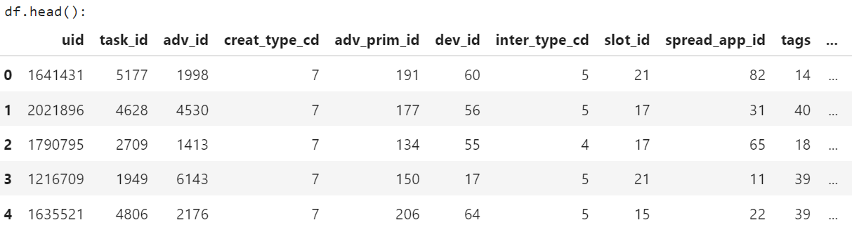
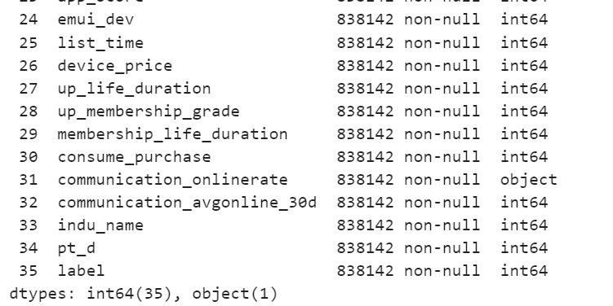
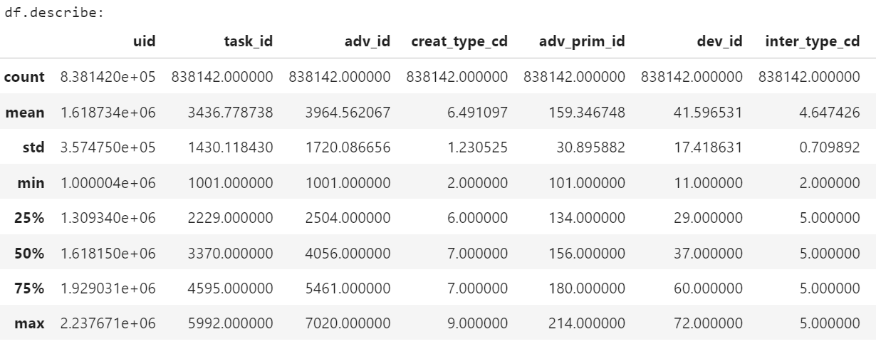

EDA on Train Set: General information

Slide 5
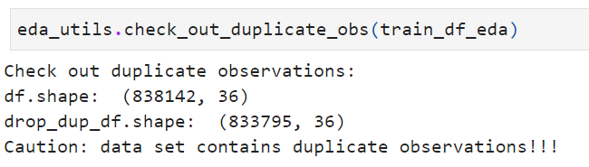
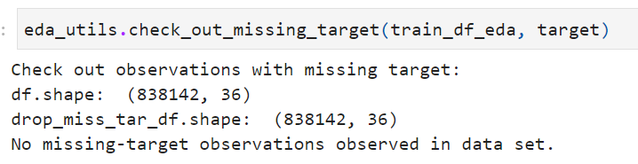
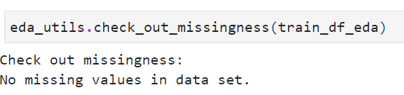
EDA on Train Set: Duplication and missingness
There are duplicate observations in the set, which should be dropped at the beginning of the data transformation.
No missing value in both attributes and the target variable.

Slide 6
EDA on Train Set: Identify numerical and categorical attributes
Based on the data type of attribute columns, there is only one categorical attribute communication_onlinerate. However, some 'numerical' attributes seem to be categorical from the field explanation (see data_fields.json in repo) and domain knowledge.
After checking the original dataset, it seems the data has been label-encoded, which means categories in categorical attributes are replaced with numbers.
These pre-encoded categorical attributes have no statistical meaning with their number. These numbers can be actually seen as another type of 'label'.
In addition, directly label-encoding categorical attributes may be not suitable sometimes. It could be suitable if the attribute is ordinal, yet label-encoding nominal attributes is meaningless, as there is no actual numerical relationship between them.
Thus, we will look at the distribution of all 'numerical' attributes and find actually categorical ones within them.

Slide 7
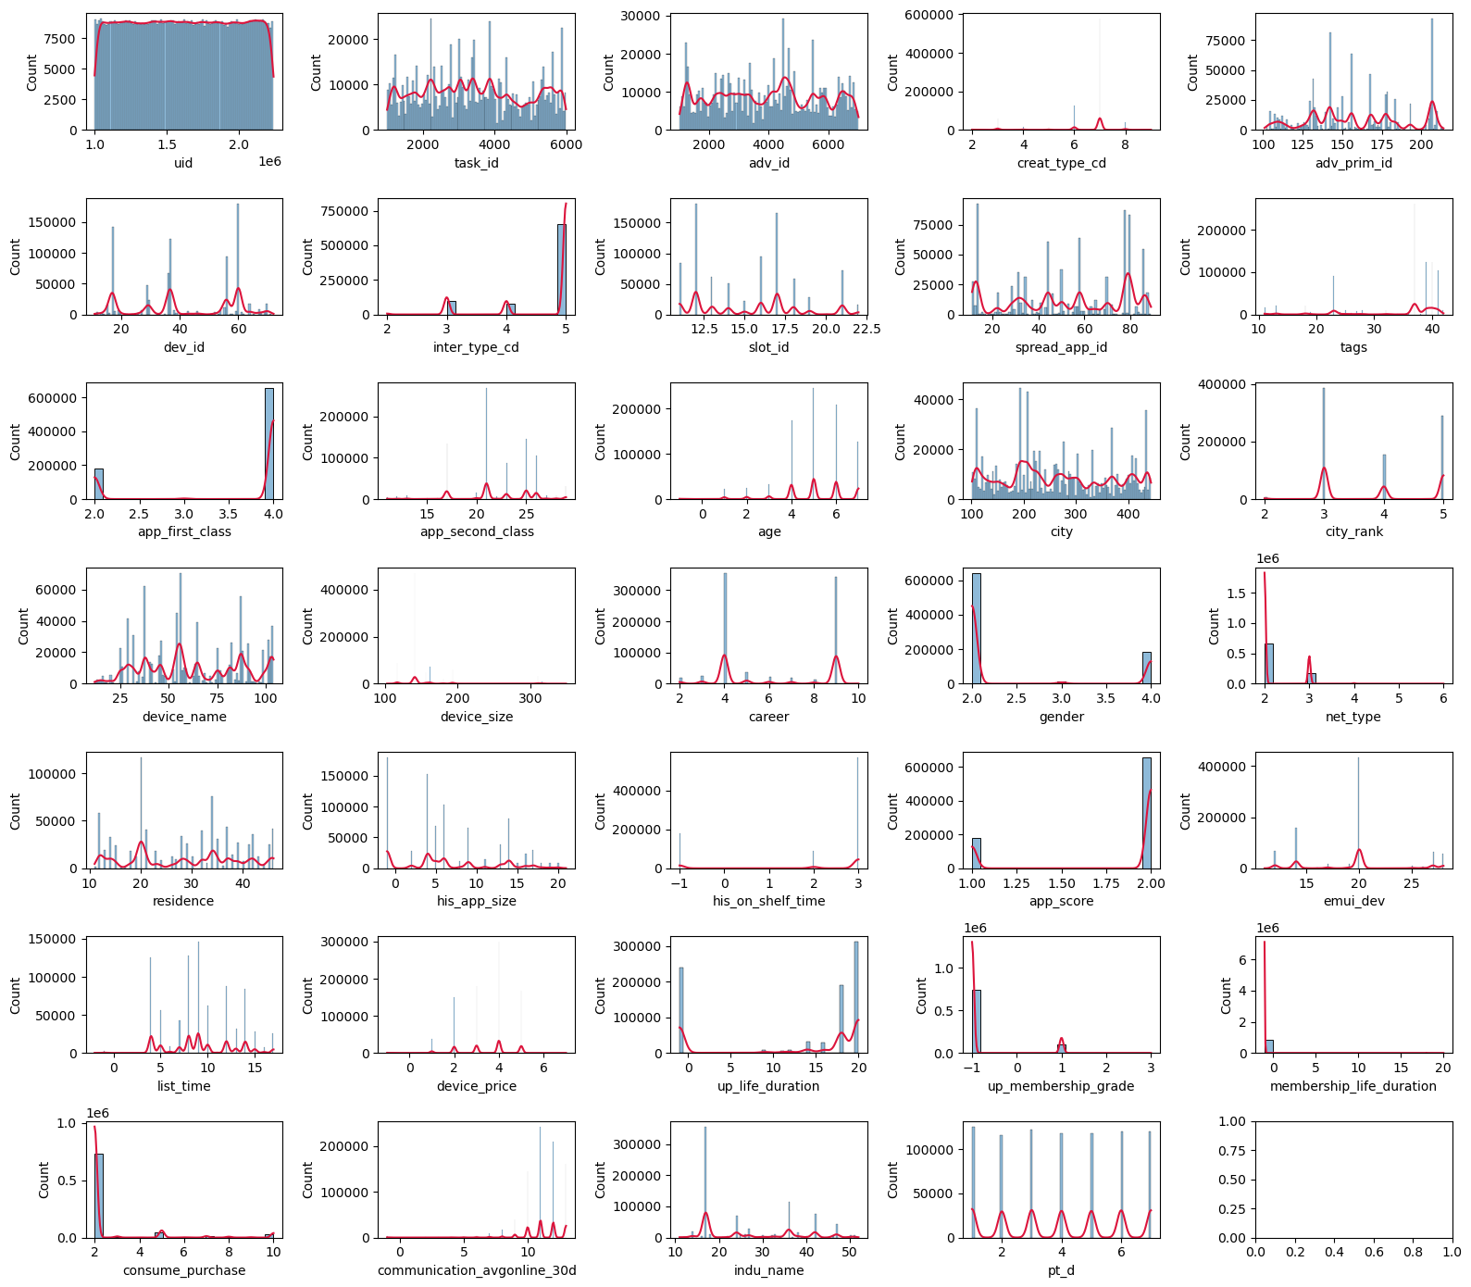
EDA on Train Set: Identify numerical and categorical attributes
The histogram plots reveal some possible pre-encoded attributes.
Some are clearly nominal: IDs(uid, task_id, etc), city, career, gender, etc.
Some are like ordinal: age, city_rank, etc. However, they may also be pre-aggregated. For instance, there are only 8 unique values of age, which is not realistic.
After communicating with the professor, we would treat all categorical attributes as the same type rather than splitting into nominal and ordinal ones.
After looking into the original dataset, all attributes are pre-encoded and no one can be defined as numerical. It may be for the consideration of privacy.

Slide 8
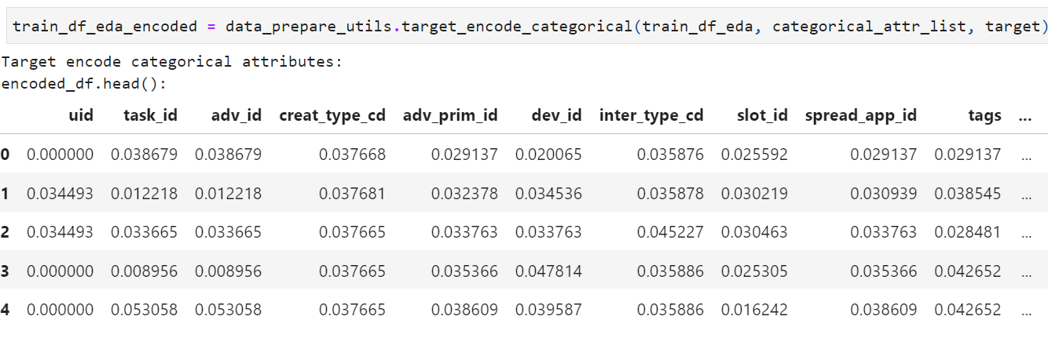
EDA on Train Set: Target encode categorical attributes
As the high number of unique values in some attributes, Target-Encoding rather than OneHot-Encoding should be applied.

Slide 9
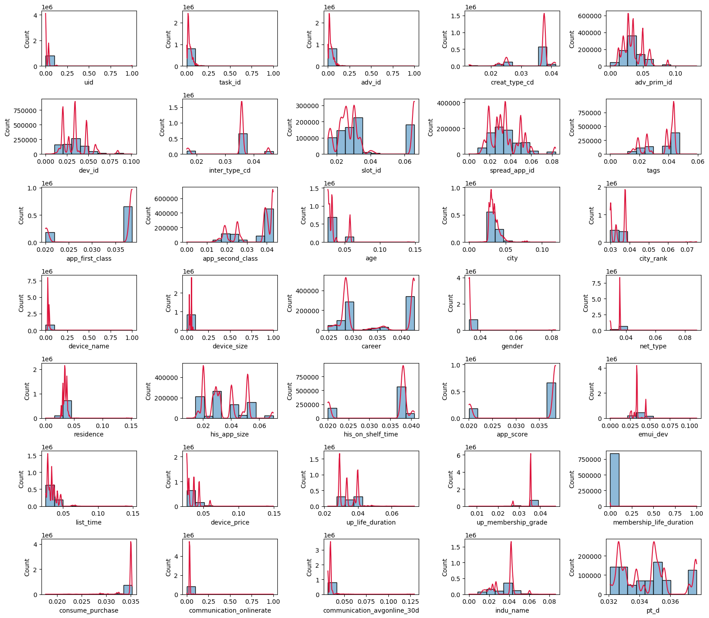
EDA on Train Set: EDA on encoded attributes (distribution)
The distribution of encoded attributes becomes consecutive and smoother than before, as target encoding is less sensitive to extreme values.

Slide 10
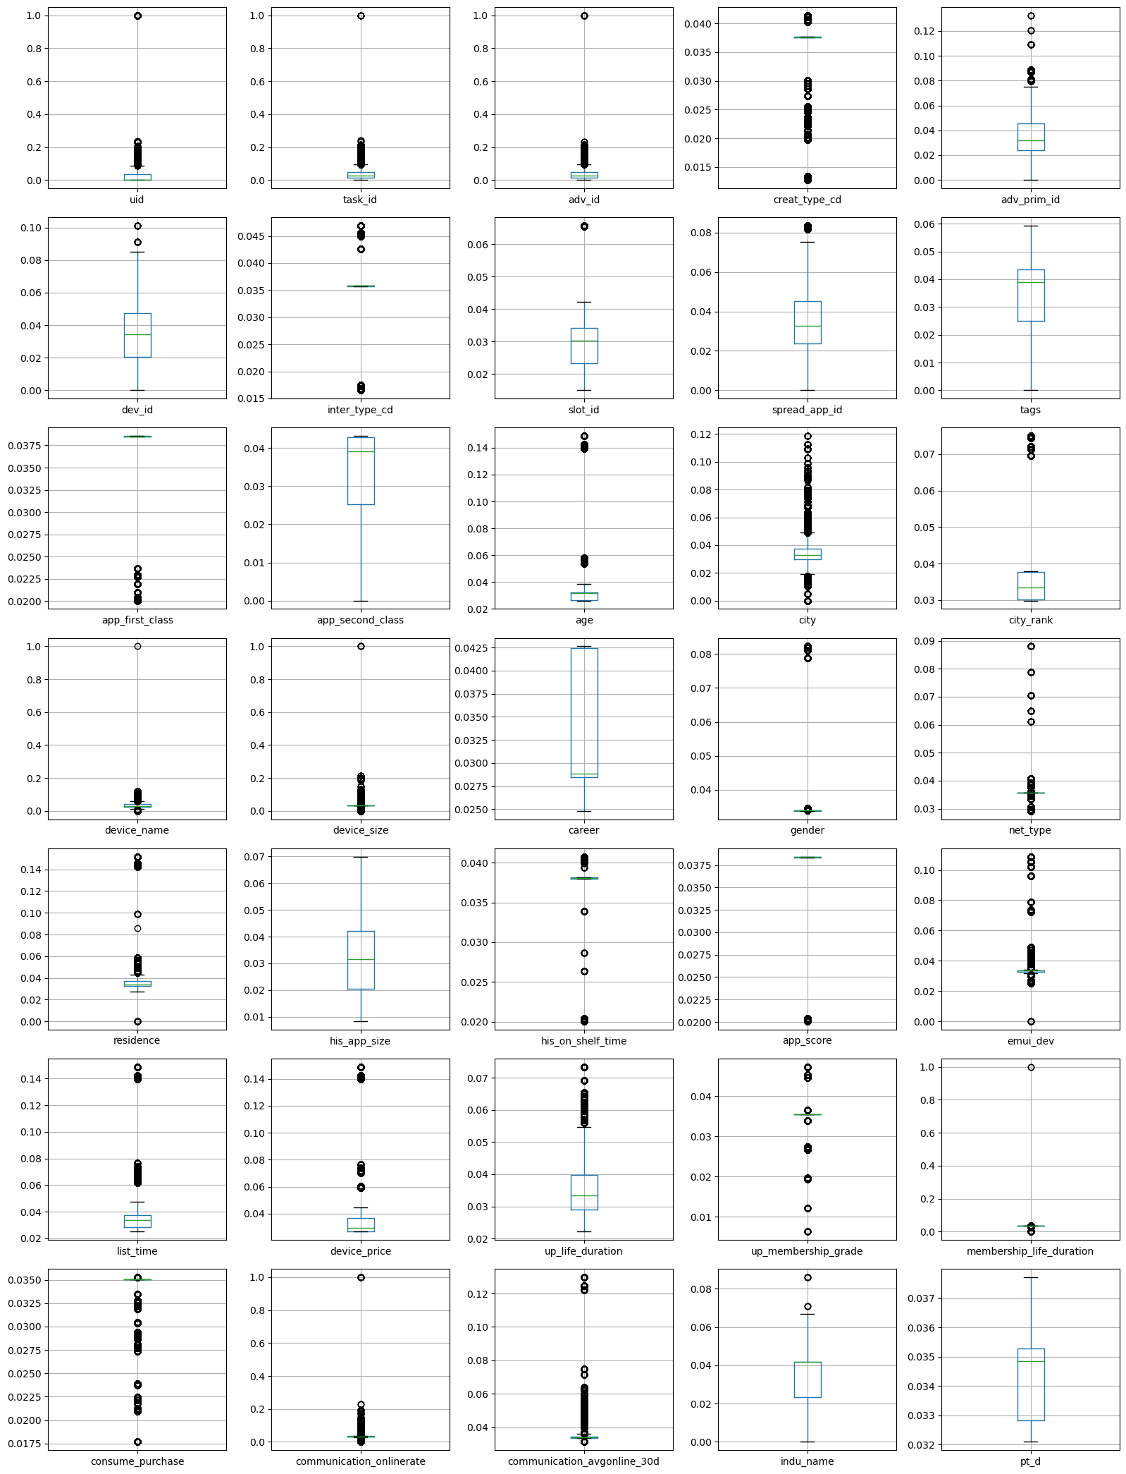
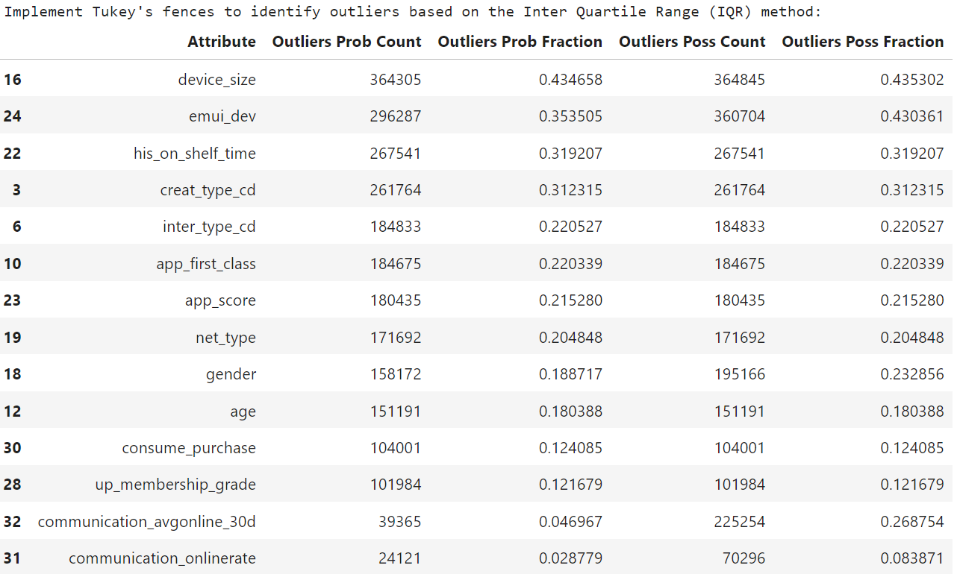
EDA on Train Set: EDA on encoded attributes (outlier detection)
Outlier fraction in all attributes decreased after target encoding. This is reasonable as target encoding can kind of smooth extreme values and make the feature less "outliery".
However, there are still some attributes with a significantly high outlier fraction (>20%). We will not decide to drop them simply in this step. Some of them seem like useful predictors.

Slide 11
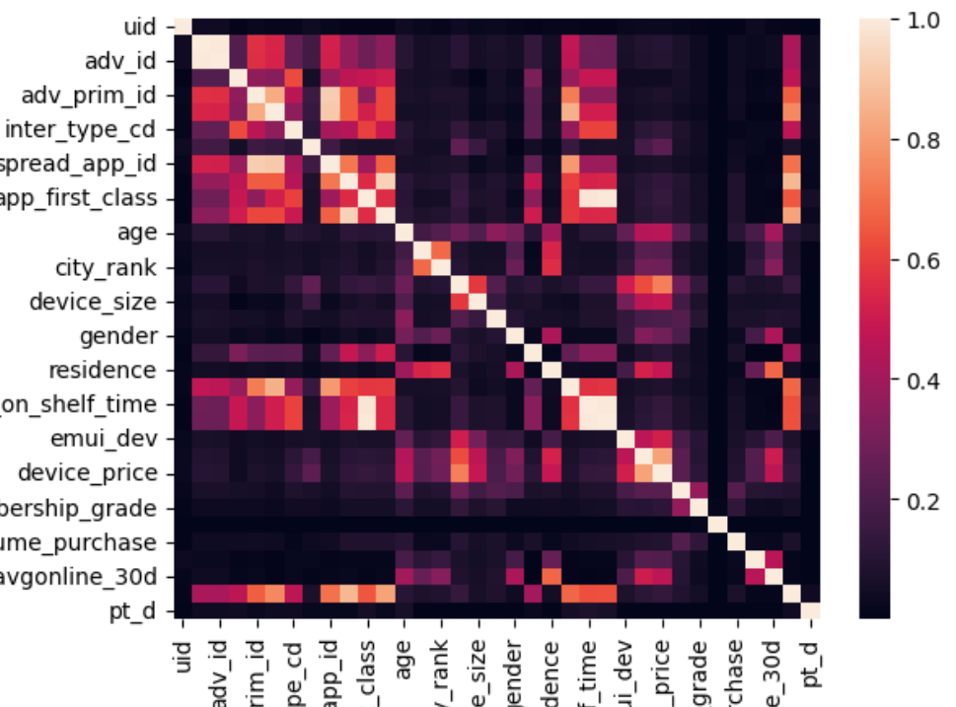
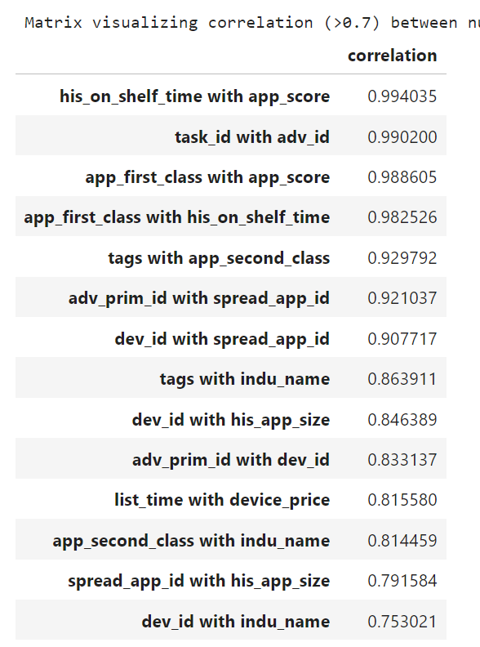
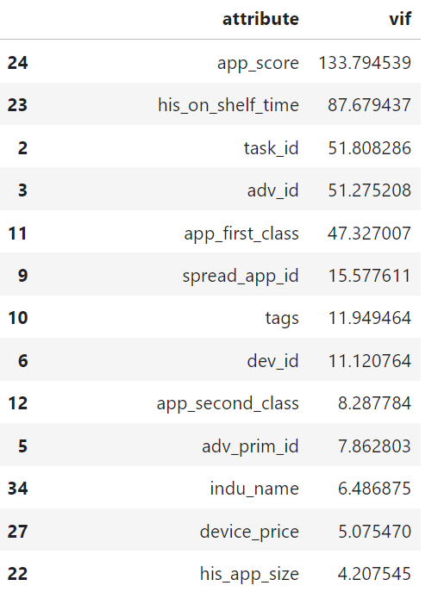
EDA on Train Set: EDA on encoded attributes (feature correlation)
There are a remarkable number of attribute pairs with a high correlation (>0.7). We will consider dropping one from the pair of them.
There are some very high VIFs (>5), which reveals the existence of multi co-linearity.

Slide 12
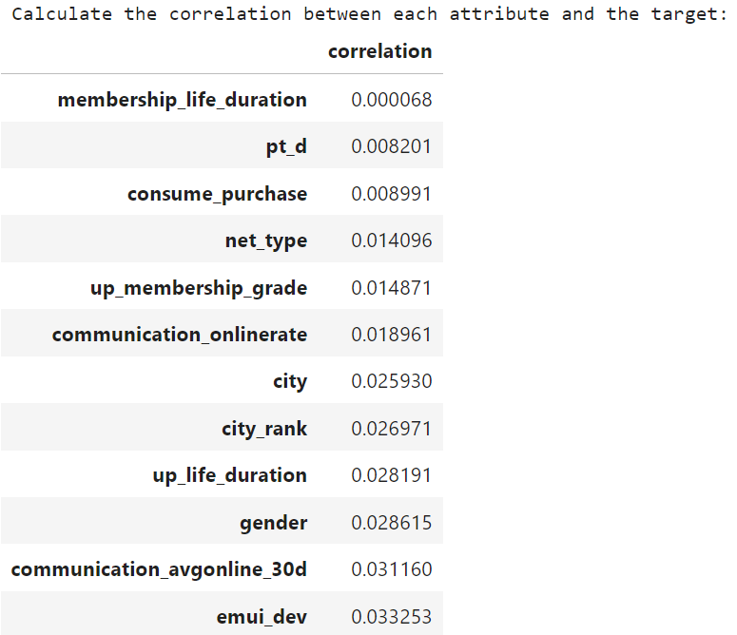
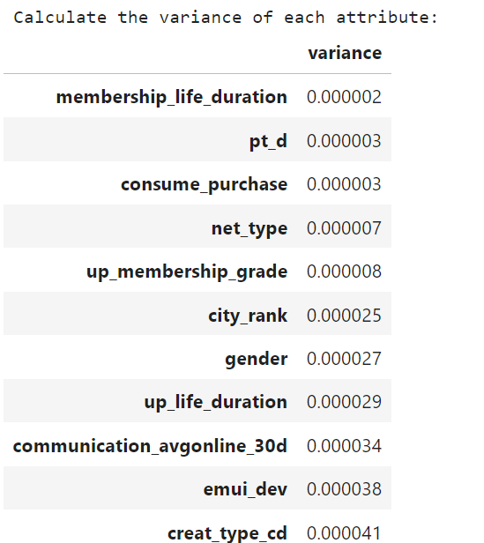
EDA on Train Set: EDA on encoded attributes (feature usefulness)
The correlation of each attribute with the target is not high enough. This is reasonable for a large-number attributes model.
The variance for all attributes is quite tiny with the biggest one < 0.01. This may due to the highly unbalanced target variable, or the high cardinality of attributes.
Low-variance attributes do not represent useless as they may still carry useful information.

Slide 13
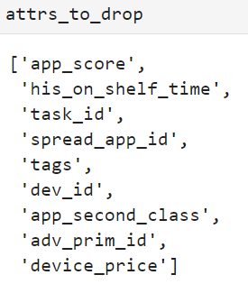
Identify the promising transformations
Deal with duplicate observations.
No missingness in data set.
Targe encode categorical attributes.
Drop highly correlated attributes.
app_score. A very high VIF, very high correlations, and a high outlier fraction.
his_on_shelf_time. A very high VIF, very high correlations, and a high outlier fraction.
task_id. A very high VIF and a very high correlation.
spread_app_id. A high VIF and very high correlations.
tags. A high VIF and very high correlations.
dev_id. A high VIF and very high correlations.
app_second_class. A high VIF and very high correlations.
adv_prim_id. A high VIF and very high correlations.
device_price. A high VIF and very high correlations.

