Slide 1

Advertisement CTR Prediction
Fine-tune the System
DS5220 / Fall 2023 Semester
Team Members: Liyang Song, Qian Yin
Dec 10, 2023

Slide 2
Introduction
In this part, we tune hyperparameters and classification threshold to improve model performances.
Goal:
Minimize Type I error (Increase precision score)
Five models used:
SGD classifier
Random forest classifier
Decision tree classifier
Adaboost classifier
Gradient boosting classifier
Steps for each model:
Tune hyperparameters of composite estimators
Evaluate tuned composite estimators on train set and validation set
Check for false discoveries
Calculate permutation feature importance
Tune classification threshold
Find the best model and evaluate model on the test set

Slide 3
Best Estimator Hyperparameters
SGD Classifier
Ada Boost Classifier
Decision Tree Classifier
Gradient Boosting Classifier
Random forest classifier

Slide 4
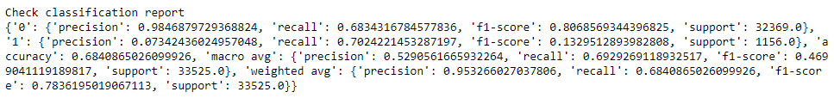
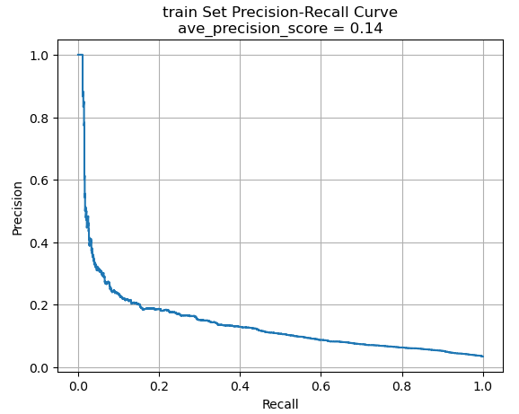
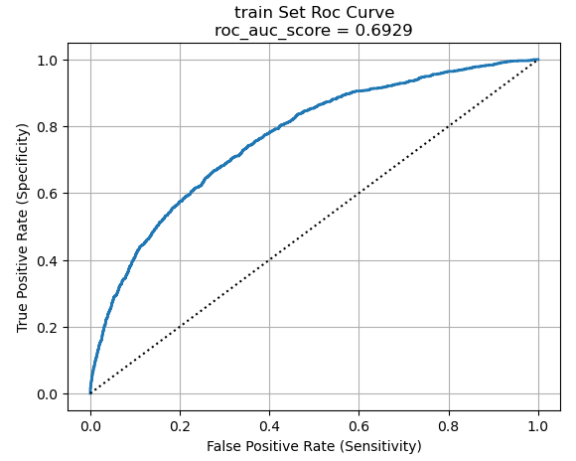
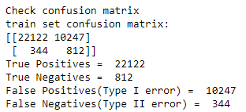
SGD classifier – Performance on train
Compared with the default model, precision and ave_precision_score increase. The number of false positives increases slight.

Slide 5
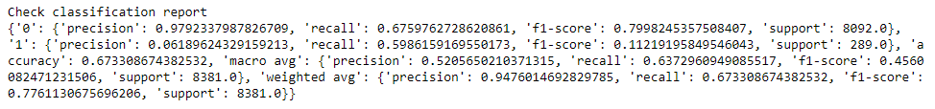
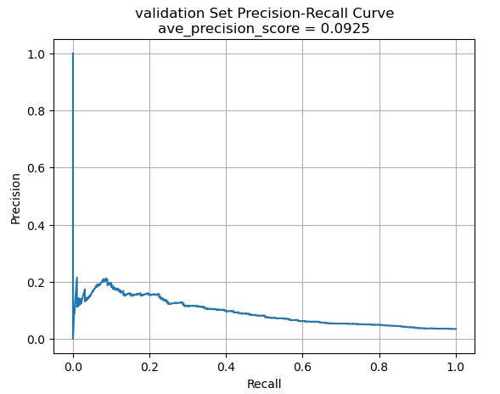
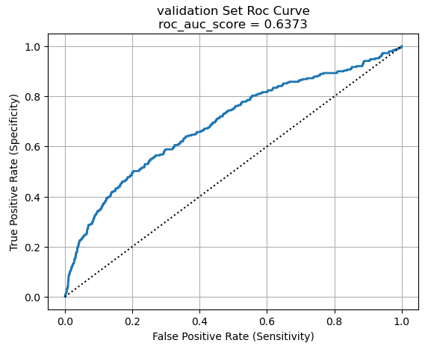
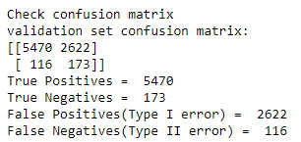
SGD classifier – Performance on validation
Compared to the performance on the train set, the performance on validation set doesn’t change much.

Slide 6
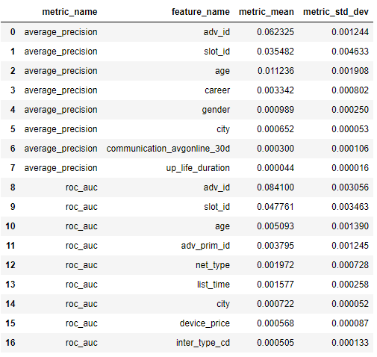
SGD classifier – Permutation Feature Importance
This is a list of the most significant attributes.

Slide 7
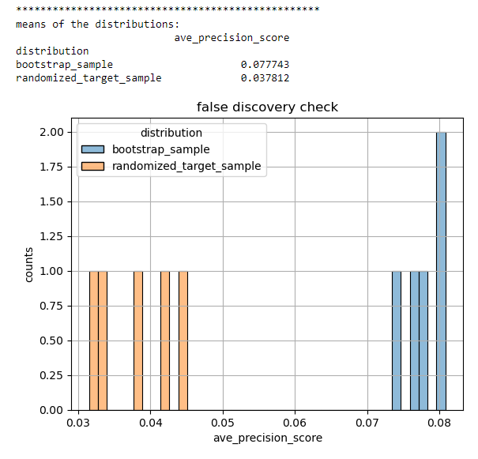
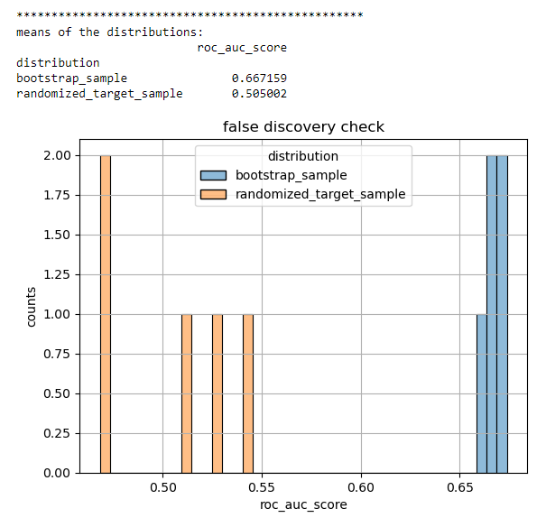
SGD classifier – False Discoveries
Todo

Slide 8
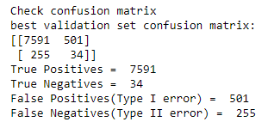
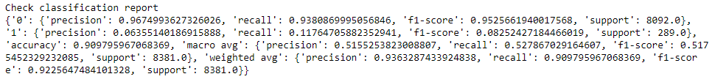
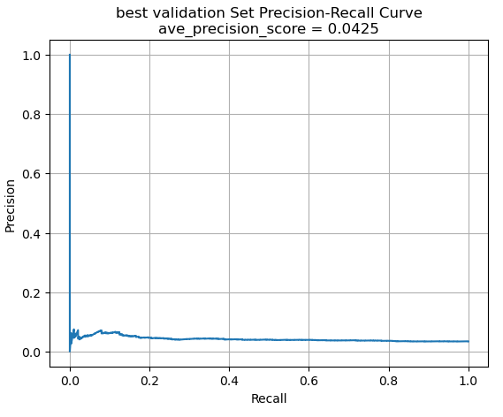
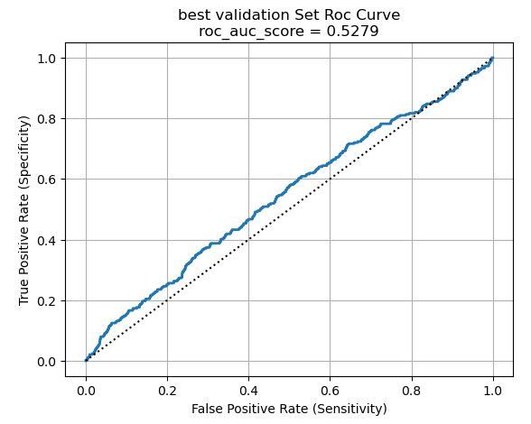
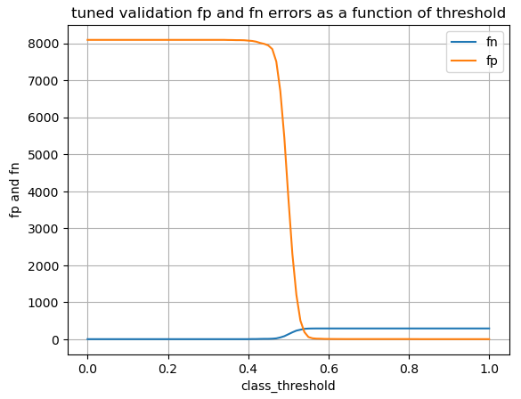
SGD classifier – Assess classification thresholds
Best threshold is 0.53. After adjusting the classification threshold, the false positives is much lower.

Slide 9
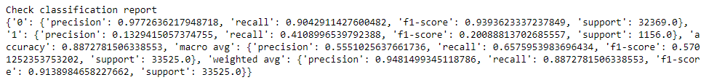
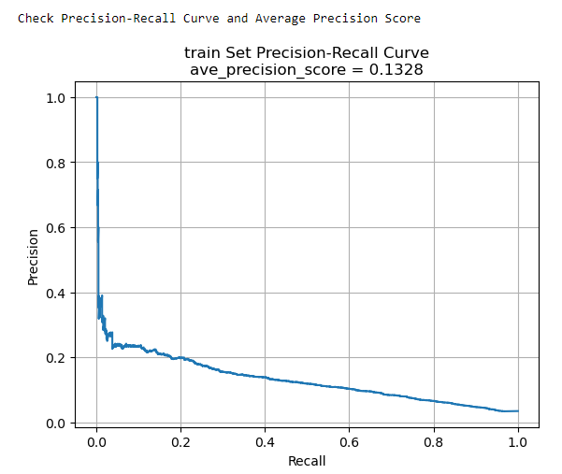
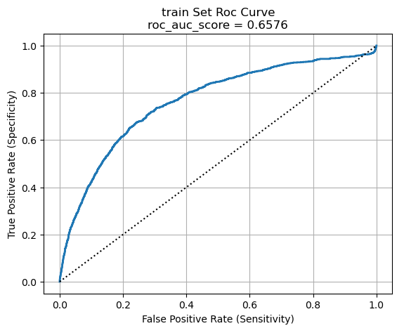
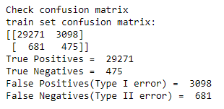
Random forest classifier – Performance on train
Compared with the default model, false positives increase, and the precision score is much lower.

Slide 10
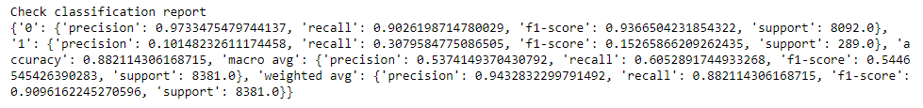
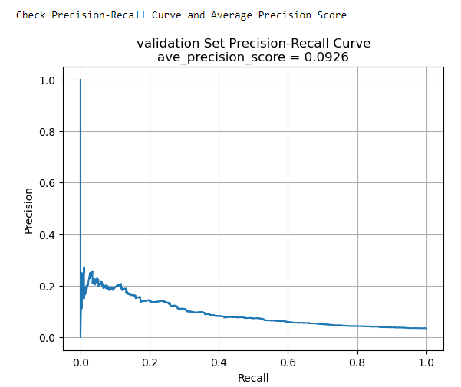
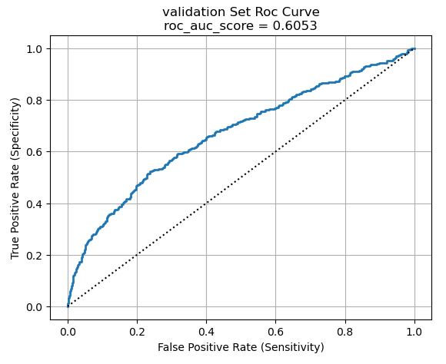
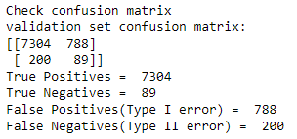
Random forest classifier – Performance on validation
The performance on the validation slightly decreases.

Slide 11
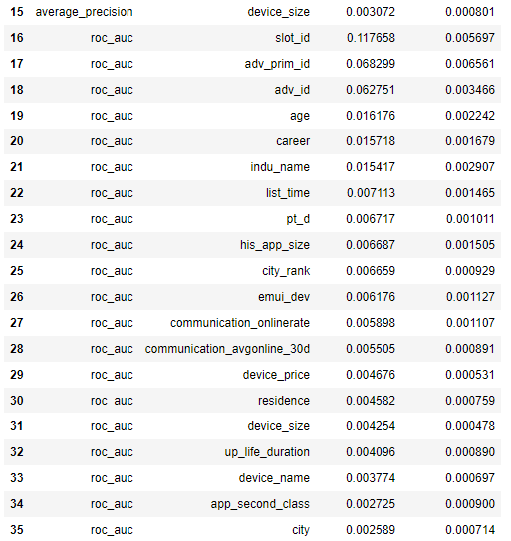
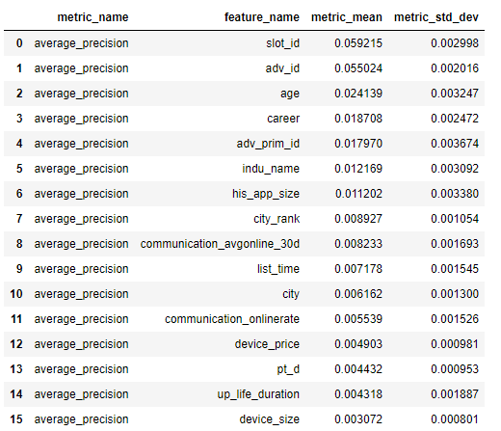
RF classifier – Permutation Feature Importance
This is a list of the most significant attributes.

Slide 12
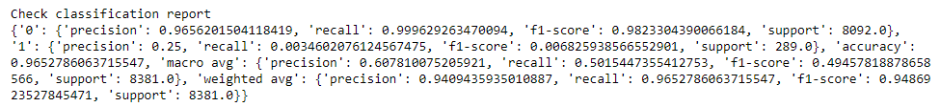
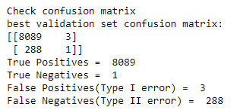
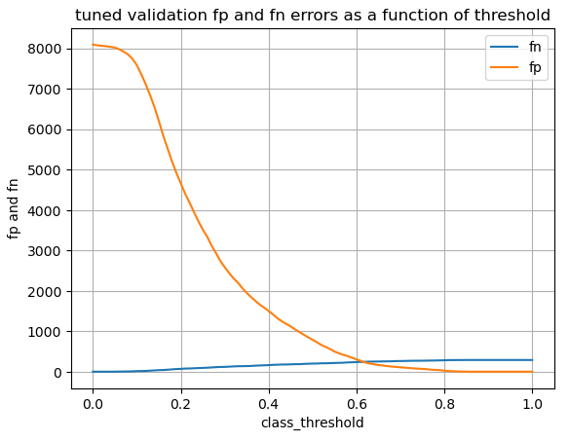
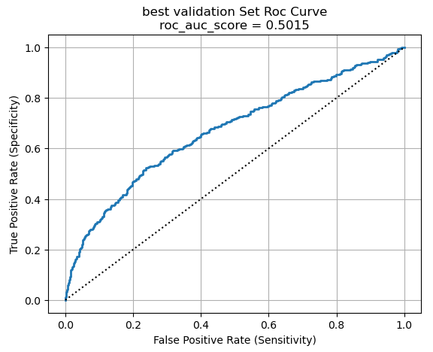
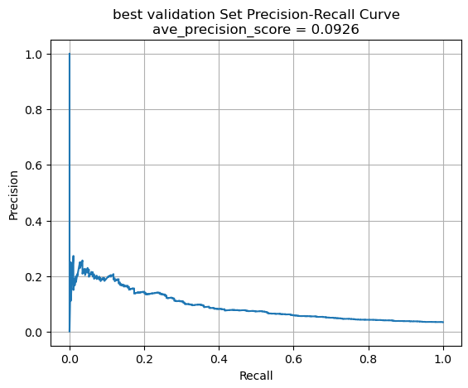
RF classifier – Assess classification thresholds
best_threshold = 0.84. After using the best threshold, the rate of Type I error decreases.

Slide 13
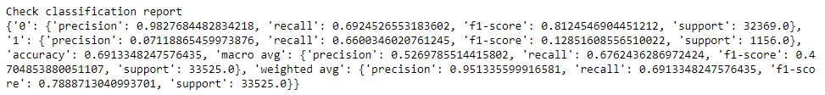
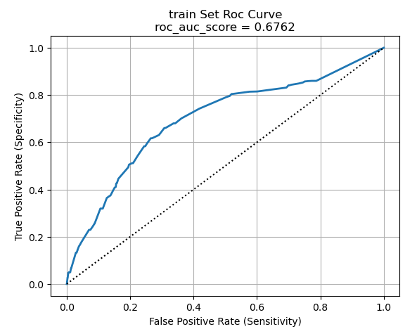
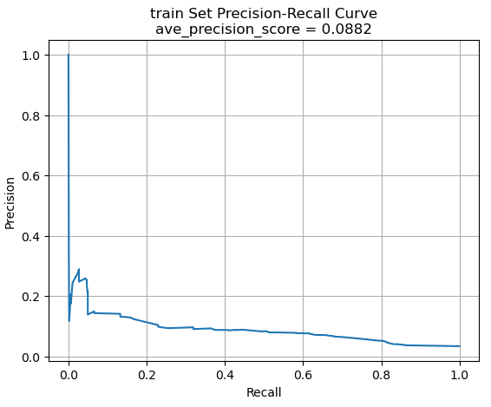
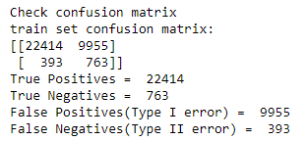
Decision Tree Classifier – Performance on train
Todo

Slide 14
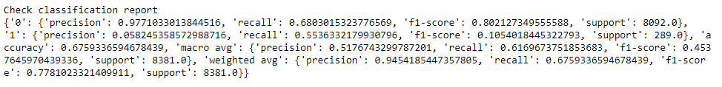
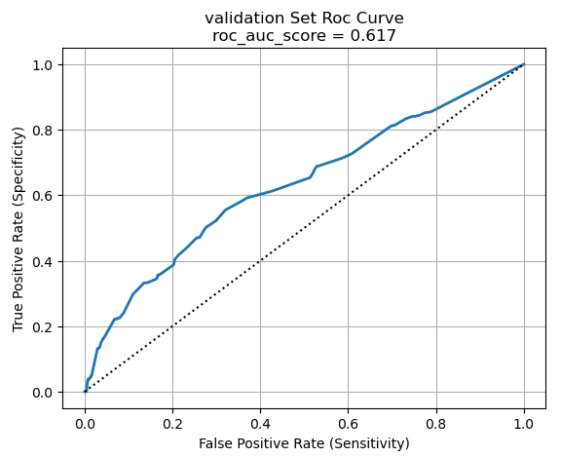
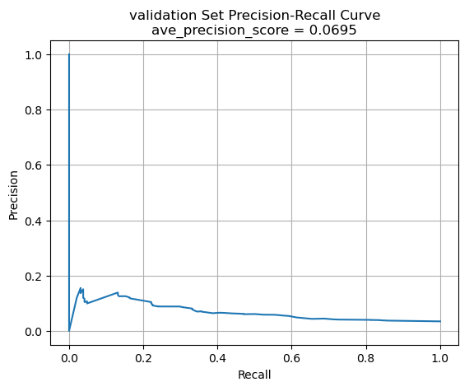
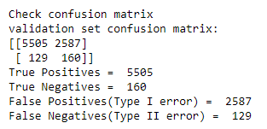
Decision Tree Classifier – Performance on validation
The performances on the train set and validation set are similar.

Slide 15
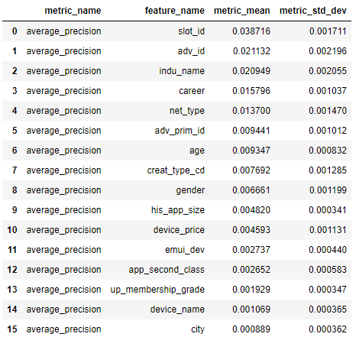
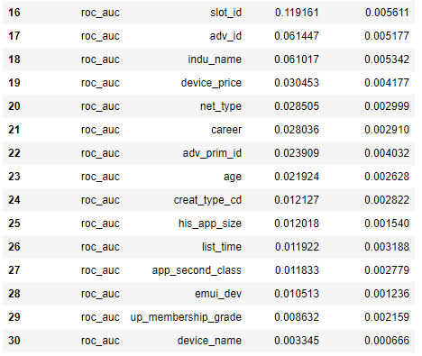
DT Classifier– Permutation Feature Importance
This is a list of the most significant attributes.

Slide 16
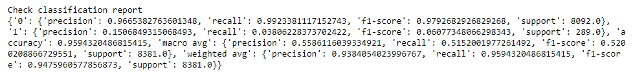
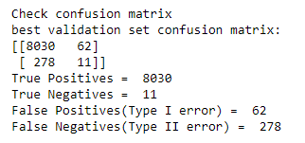
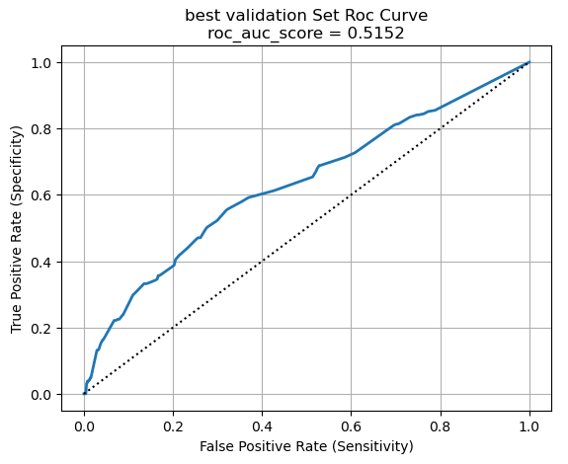
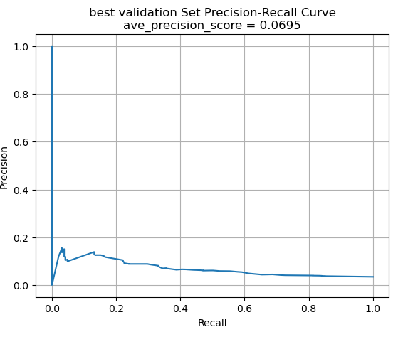
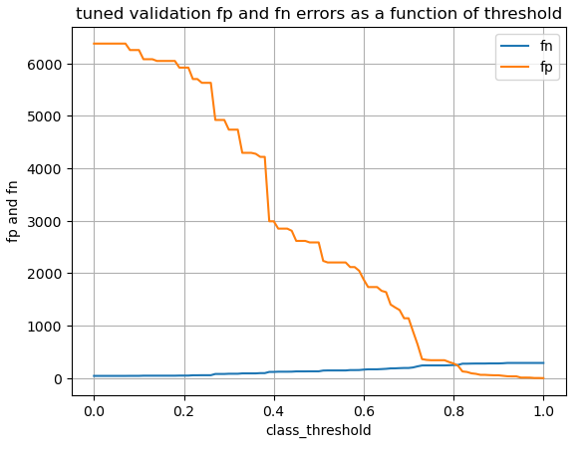
DT Classifier – Assess classification thresholds
best_threshold = 0.86. The adjustment of threshold is useful since the performance metrics are better.

Slide 17
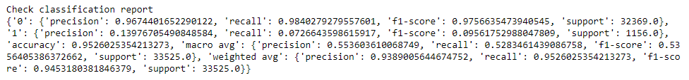
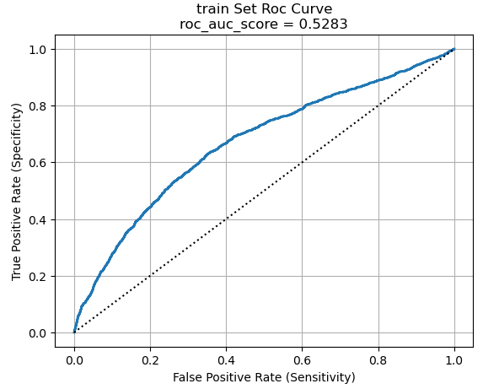
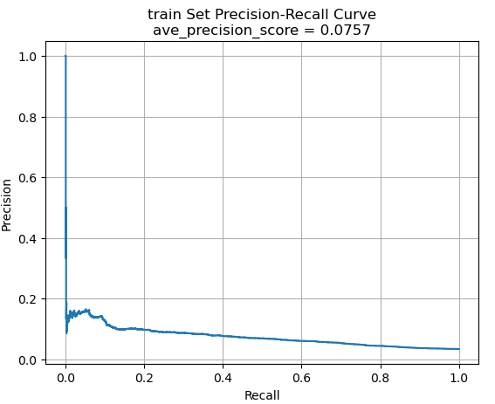
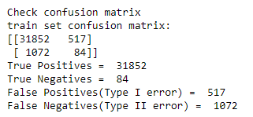
Adaboost Classifier – Performance on train
Compared to the default model, the number of false positives greatly decreases although the number of false negative shows a subtle increase.

Slide 18




Adaboost Classifier – Performance on validation
The performance on the validation set is similar to the performance on the train set.

Slide 19


Adaboost Classifier– Permutation Feature Importance
This is a list of the most significant attributes.

Slide 20





Adaboost Classifier – Assess classification thresholds
best_threshold = 0.78. Adjusting threshold improves the performance since many metrics perform better.

Slide 21




Gradient Boosting Classifier – Performance on train
The performances between the default model and the tuned model are similar.

Slide 22




GBoosting Classifier – Performance on validation
The validation set also shows a similar performance.

Slide 23

GBoosting Classifier – Permutation Feature Importance
This is a list of the most significant attributes.

Slide 24





GBoosting Classifier – Assess classification thresholds
best_threshold = 0.13. Adjusting classification thresholds changes the matrix. The number of false positives increases. The precision score for class 1 is increased.

Slide 25





Classifiers – Comparison
SGD Classifier
Decision Tree Classifier
Random Forest Classifier
Gradient Boosting Classifier
Adaboost Classifier
Todo

Slide 26
Best model on test set
Todo

Slide 27
Discussions
Estimate the generalization error

