Slide 1

Advertisement CTR Prediction
Data Preparation
DS5220 / Fall 2023 Semester
Team Members: Liyang Song, Qian Yin
Oct 29, 2023

Slide 2
Identify required transformations
Based on the exploratory data analysis conducted, we identify three required transformations.
The first one is to drop 9 attributes listed below.
app_score
hist_on_shelf_time
task_id, spread_app_id
Tags
dev_id
app_second_class
adv_prim_id
device_price
The third transformation is target encoding for categorical data.
Target encoding is implemented to transform data into numerical values.
The second transformation is to perform data standardization.
We choose standardization as the method to re-scale features so that values of each feature have zero mean and unit variance.
It is less sensitive to outliers than normalization.

Slide 3
Identify unnecessary transformations
The following data transformation steps will not be included in our project
Drop outliers
Some data points are significantly different from the rest of dataset, but they will not be
considered as ‘outliers’ based on the fact that all attributes are categorical and pre-encoded.
Fill/drop missingness
Because no missing value is found, this step is skipped.
Discretize continuous features
Based on our observation, many of the attributes in the original data set are probably
discretized already.

Slide 4
Identify unnecessary transformations - continued
Decompose features
We lack information to understand the context; therefore, decomposing these
transformed features is unnecessary.
Transform features
All features are categorical; therefore, log transformation or square root transformation is
not considered.
Aggregate features into new features
The actual meanings of numerous values are unclear, preventing us from constructing
meaningful and useful features.

Slide 5
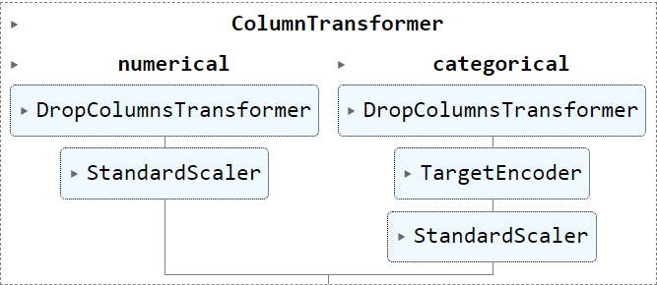
A pipeline of transformers
A pipeline of transformers is created to perform several important transformations listed below.

Slide 6


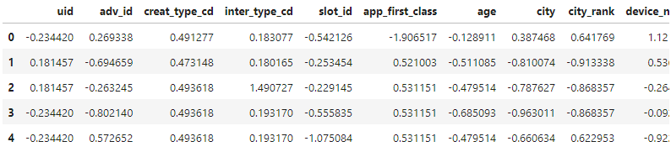
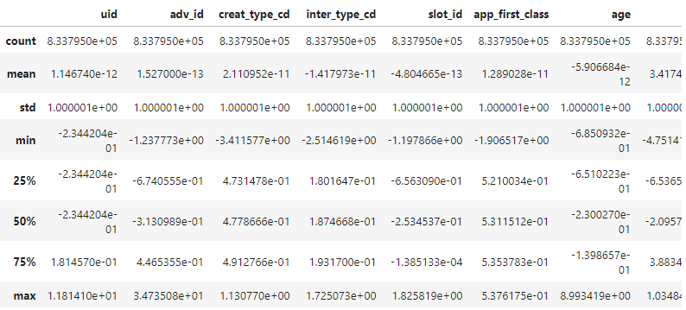
EDA on transformed train set: General Information
Smaller data set
Rows: 838142 > 833795
Columns: 36 > 27
Modified data types
The data types of most all attributes are changed from integer to float.
No object data type exists.
Updated values in the descriptive statistics table
The dispersion and shape of data distribution is changed.

Slide 7


EDA on transformed train set: Duplication and missingness
New duplicate values are found.
This existence of new duplicate values is possible when the size of this data set is
large and ranges of values are small.
No missing value exists in both features and the target variable.

Slide 8
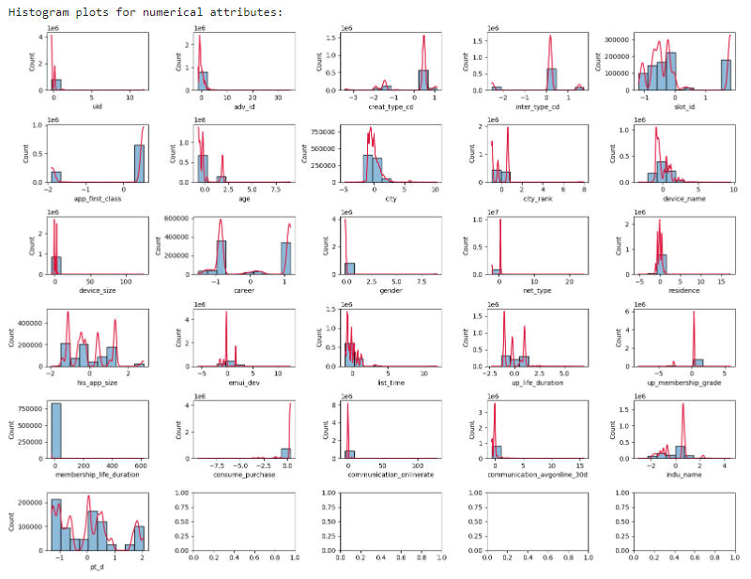
EDA on transformed train set: Distribution
The effect of standardization is shown on the histogram plots (x-axis).
The number of plots is decreased because of dropped attributes.

Slide 9
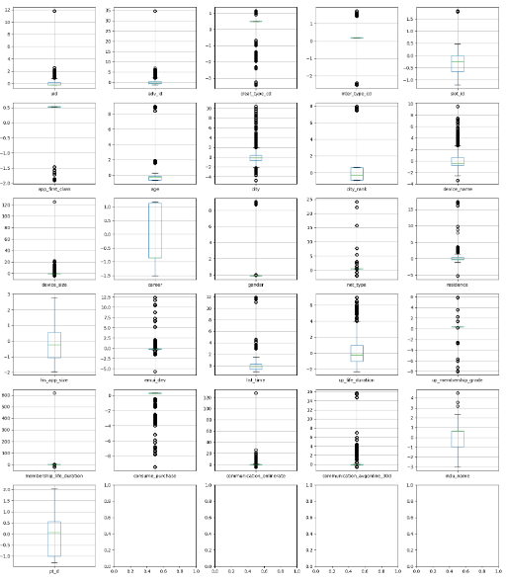
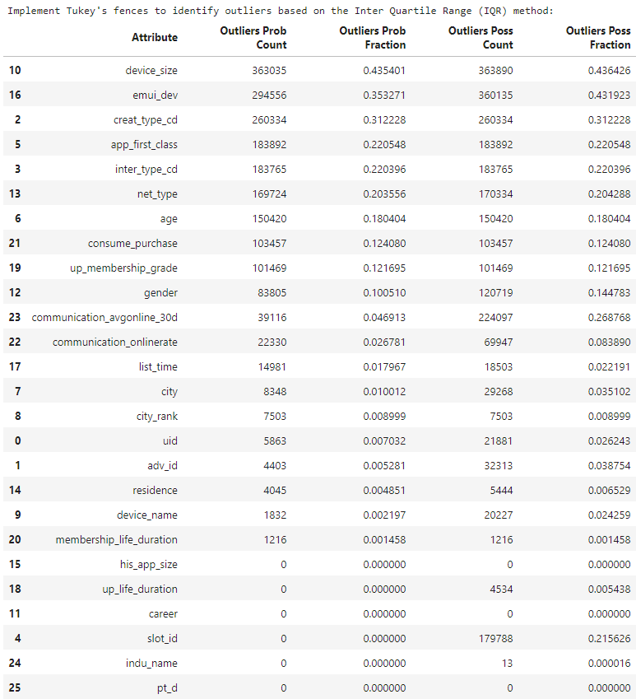
EDA on transformed train set: Outlier detection
The difference in outlier fraction between pre-transformed and post-transformed data is very small.
Because all attributes are categorical, the existence of numerous ‘outliers’ is reasonable. No modification on these data points is added.

Slide 10
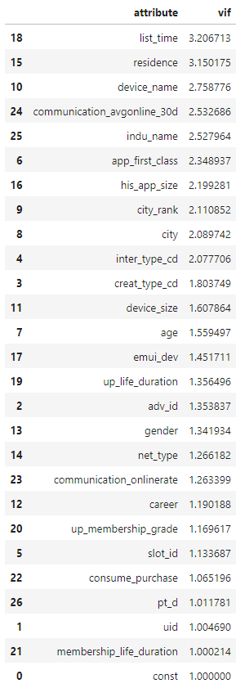
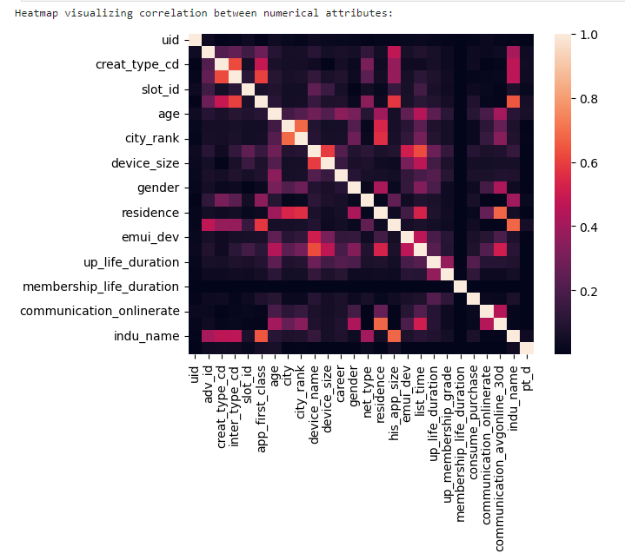
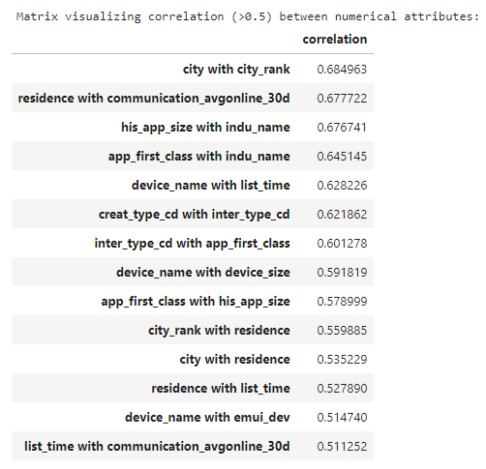
EDA on transformed train set: Correlation and VIF
Some attribute pairs have correlations greater than 0.5, but no attribute pair has a correlation greater than 0.7 after the transformation.
The VIFs of all attributes are below 5, indicating that attributes are moderately correlated.

Slide 11
Discussions
Checking if the original data set is pre-encoded and if values have statistical meaning are important. We need to use the description of attributes and the distribution of dataset to identify whether attributes should be considered as categorical or numerical.
Using the commonly used strategies to detect and handle outliers may be ineffective for pre-encoded categorical data.

