Slide 1

Advertisement CTR Prediction
Fine-tune the System
DS5220 / Fall 2023 Semester
Team Members: Liyang Song, Qian Yin
Dec 10, 2023

Slide 2
Introduction
In this part, we tune hyperparameters and classification threshold to improve model performances.
Goal:
Minimize Type I error (Increase precision score)
Five models used:
SGD classifier
Random forest classifier
Decision tree classifier
Adaboost classifier
Gradient boosting classifier
Steps for each model:
Tune hyperparameters of composite estimators
Evaluate tuned composite estimators on train set and validation set
Check for false discoveries
Calculate permutation feature importance
Tune classification threshold
Find the best model and evaluate model on the test set

Slide 3
Best Estimator Hyperparameters
SGD Classifier
Ada Boost Classifier
Decision Tree Classifier
Gradient Boosting Classifier
Note:
Random forest classifier

Slide 4
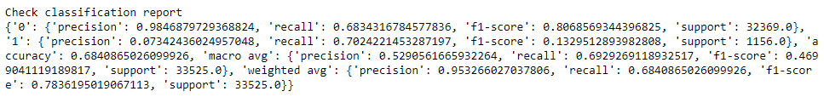
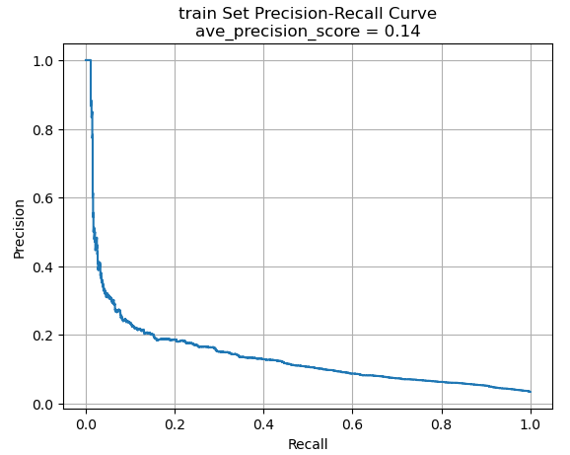
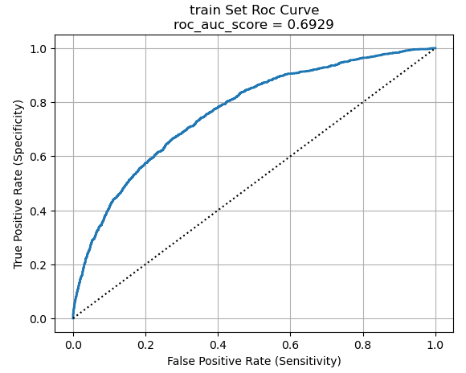
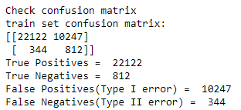
SGD classifier – Performance on train
Compared with the default model, precision and ave_precision_score increase. The number of false positives increases slight.

Slide 5
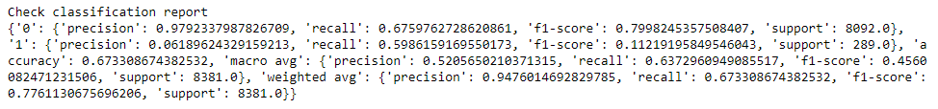
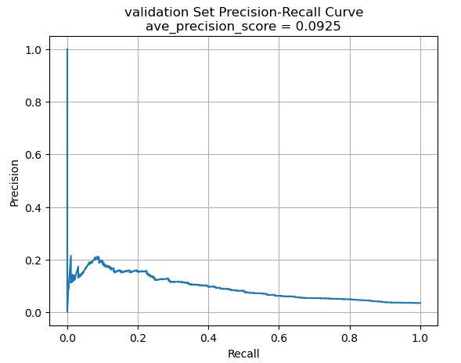
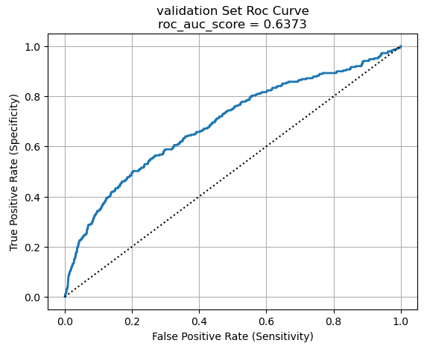
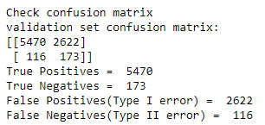
SGD classifier – Performance on validation
Compared to the performance on the train set, the performance on validation set doesn’t change much.

Slide 6
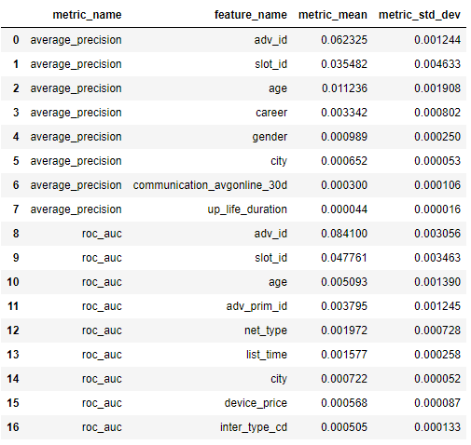
SGD classifier – Permutation Feature Importance
This is a list of the most significant attributes.

Slide 7
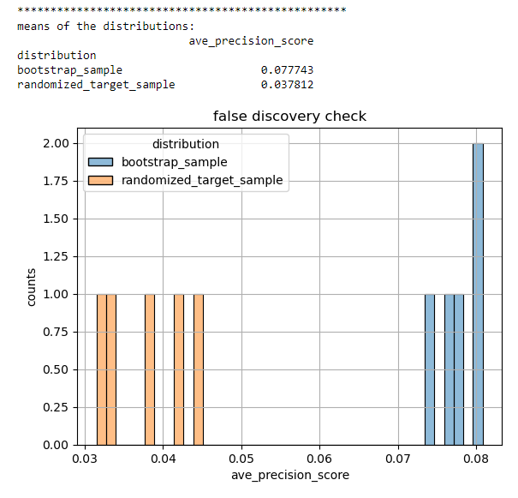
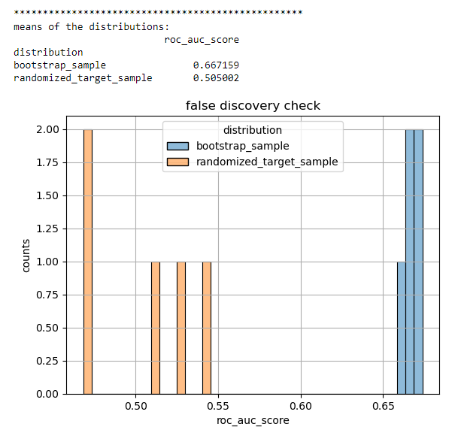
SGD classifier – False Discoveries
Todo

Slide 8
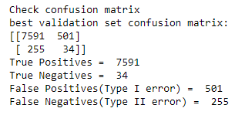
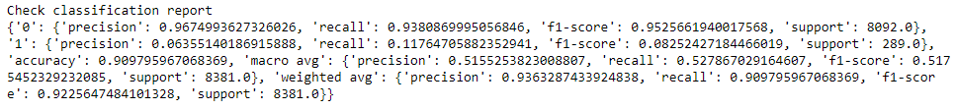
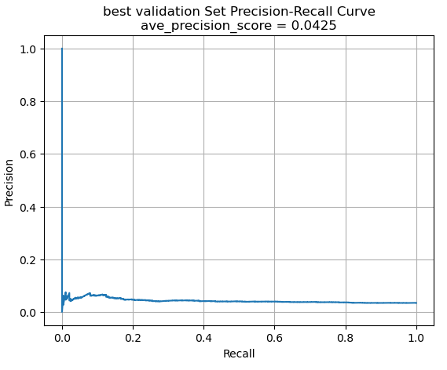
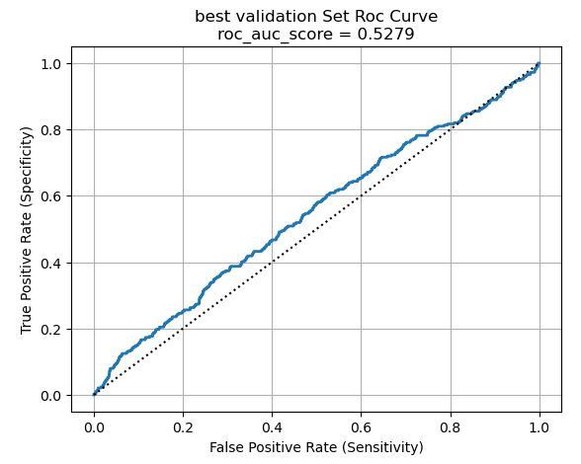
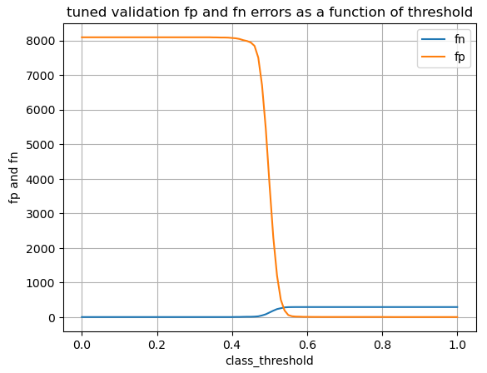
SGD classifier – Assess classification thresholds
Best threshold is 0.53.

Slide 9
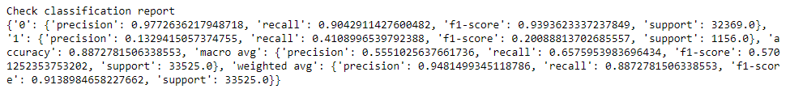
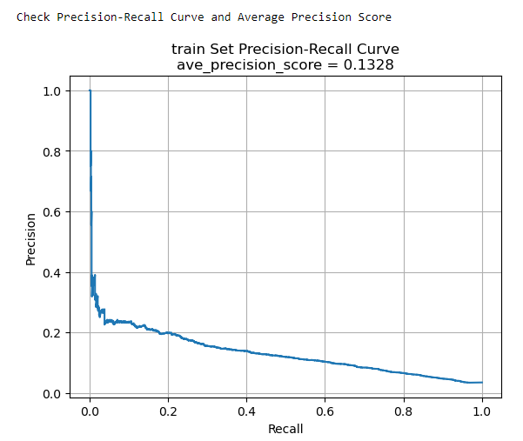
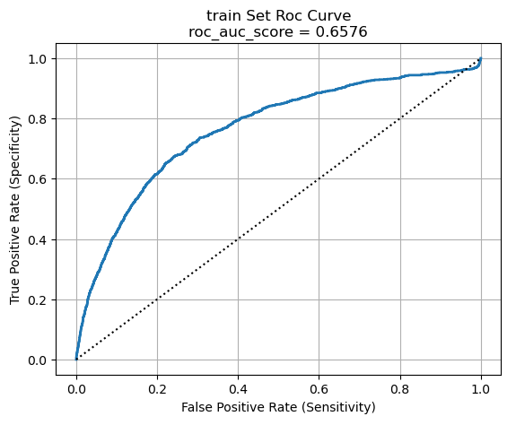
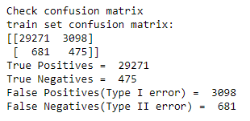
Random forest classifier – Performance on train
Todo

Slide 10
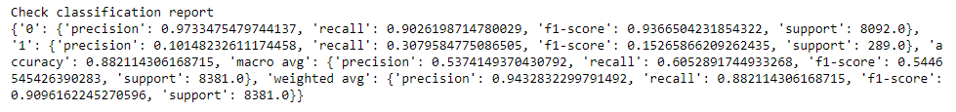
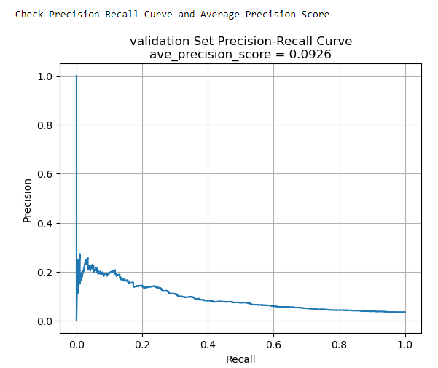
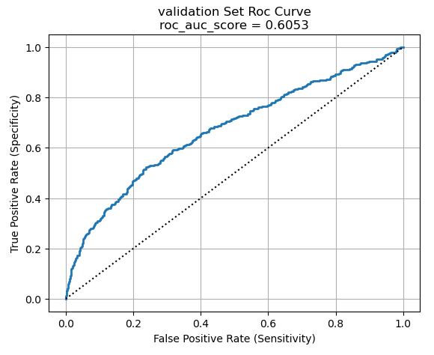
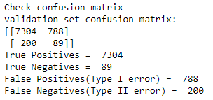
Random forest classifier – Performance on validation
Todo

Slide 11
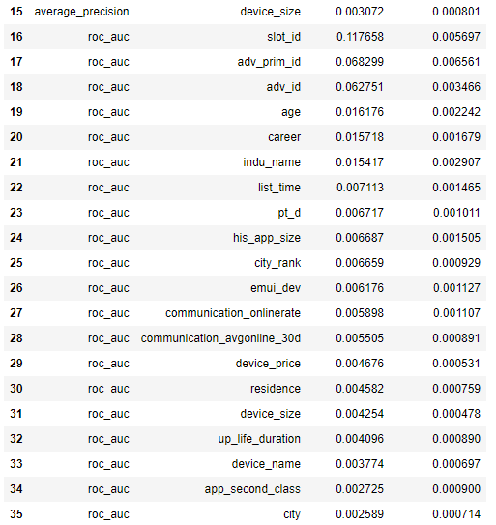
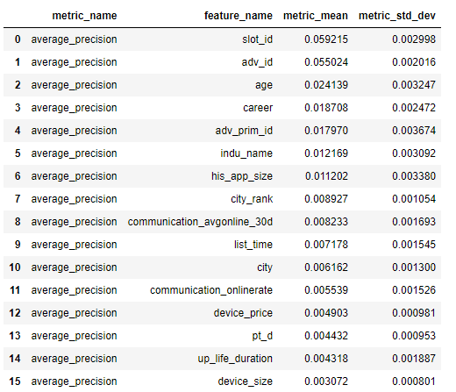
RF classifier – Permutation Feature Importance
This is a list of the most significant attributes.

Slide 12
RF classifier – False Discoveries
Todo

Slide 13
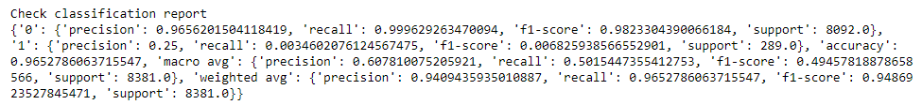
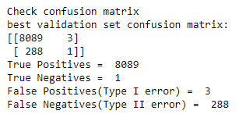
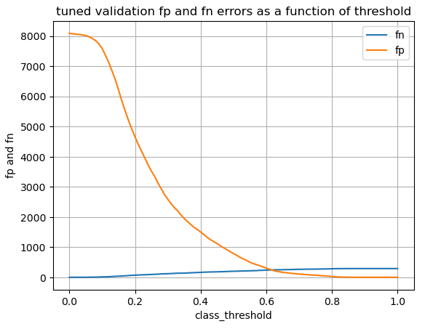
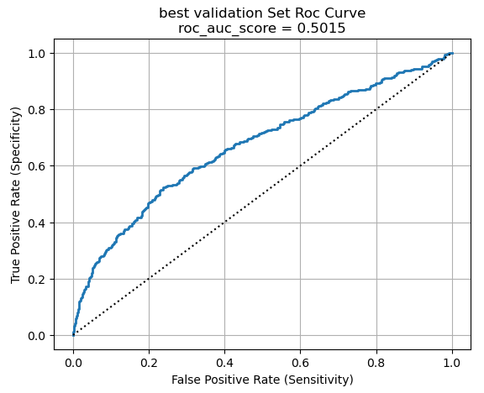
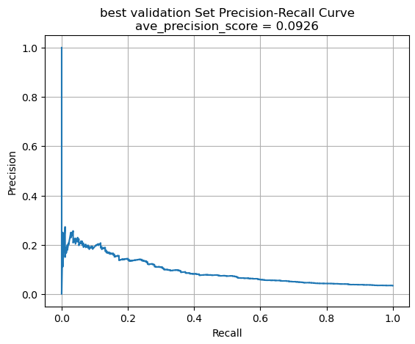
RF classifier – Assess classification thresholds
best_threshold = 0.84

Slide 14
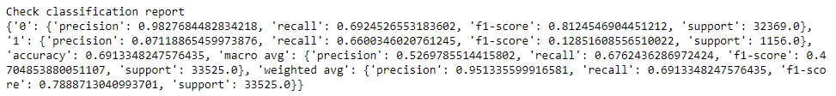
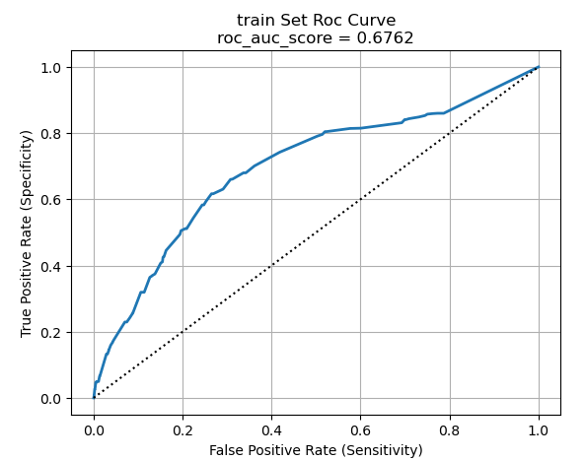
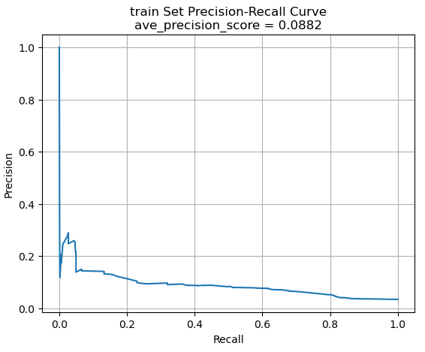
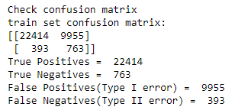
Decision Tree Classifier – Performance on train
Todo

Slide 15
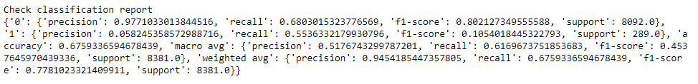
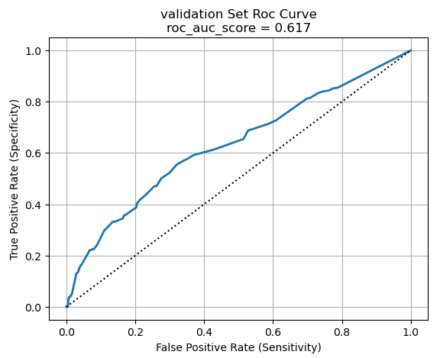
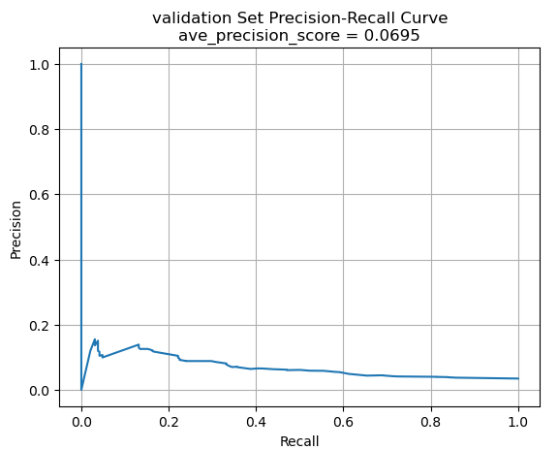
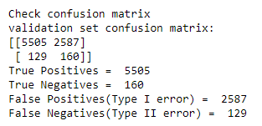
Decision Tree Classifier – Performance on validation
Todo

Slide 16
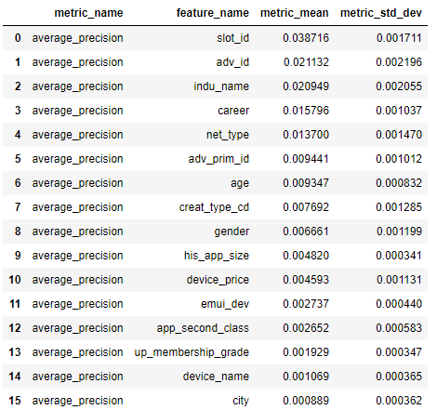
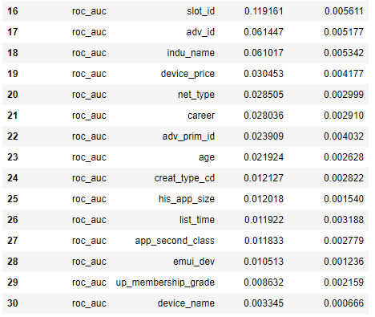
DT Classifier– Permutation Feature Importance
This is a list of the most significant attributes.

Slide 17
DT Classifier – False Discoveries
Todo

Slide 18
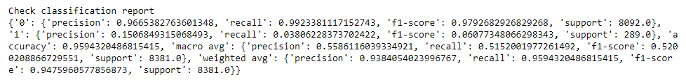
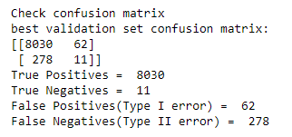
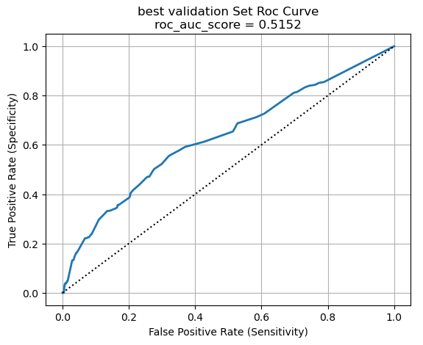
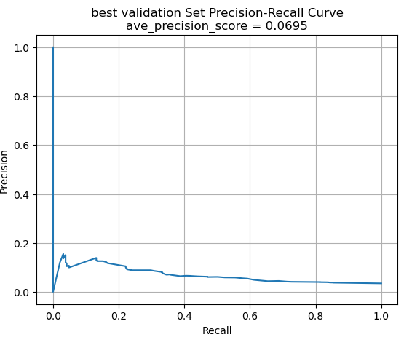
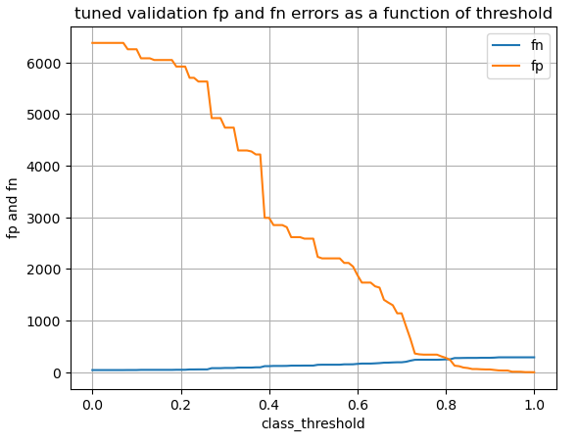
DT Classifier – Assess classification thresholds
best_threshold = 0.86

Slide 19
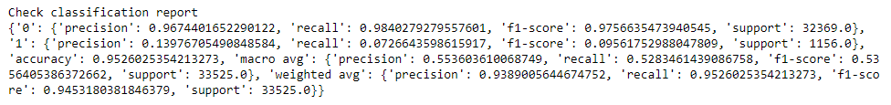
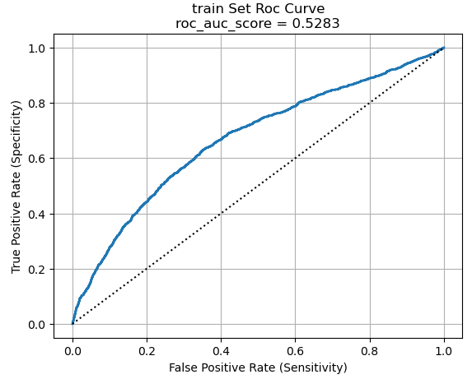
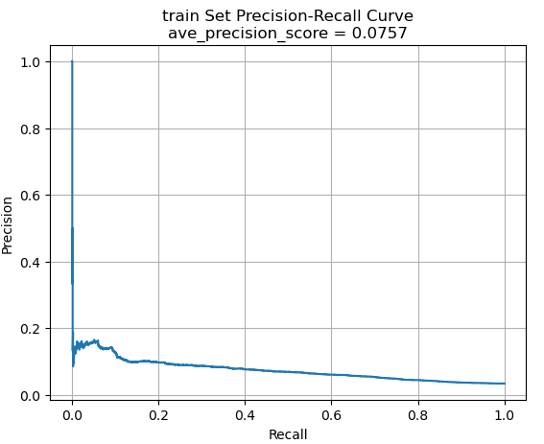
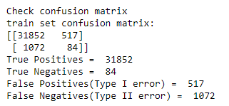
Adaboost Classifier – Performance on train
Todo

Slide 20




Adaboost Classifier – Performance on validation
Todo

Slide 21


Adaboost Classifier– Permutation Feature Importance
This is a list of the most significant attributes.

Slide 22
Adaboost Classifier – False Discoveries
Todo

Slide 23





Adaboost Classifier – Assess classification thresholds
best_threshold = 0.78

Slide 24




Gradient Boosting Classifier – Performance on train
Todo

Slide 25




GBoosting Classifier – Performance on validation
Todo

Slide 26

GBoosting Classifier – Permutation Feature Importance
This is a list of the most significant attributes.

Slide 27
GBoosting Classifier – False Discoveries
Todo

Slide 28





GBoosting Classifier – Assess classification thresholds
best_threshold = 0.13

Slide 29





Classifiers – Comparison
SGD Classifier
Decision Tree Classifier
Random Forest Classifier
Gradient Boosting Classifier
Adaboost Classifier
Todo

Slide 30
Best model on test set
Todo

Slide 31
Discussions
Estimate the generalization error

