Slide 1

Advertisement CTR Prediction
Shortlist Promising Models
DS5220 / Fall 2023 Semester
Team Members: Liyang Song, Qian Yin
Dec 10, 2023

Slide 2
Introduction
In this part, we trained five different models using standard parameters.
Goal:
Minimize false positive instances (Type I error) to lower the rate of sending advertisements to users who are not interested
Five models used:
SGD classifier
Random forest classifier
Decision tree classifier
Adaboost classifier
Gradient boosting classifier
Steps for each model:
Define default model
Evaluate model performance on train set
Evaluate model performance on validation set
Drop the least important attributes based on permutation importance
Re-evaluate the model performance on validation set
Update the attributes that need to be dropped

Slide 3
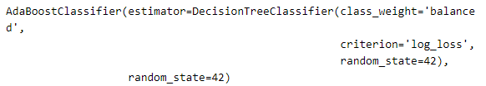
Classifier defined
SGD Classifier
Note: Because the distribution (0/1) is imbalanced, we set ‘class_weight=balanced’ to adjust the weights of the classes.
Ada Boost Classifier
Decision Tree Classifier
Gradient Boosting Classifier
Random forest classifier

Slide 4
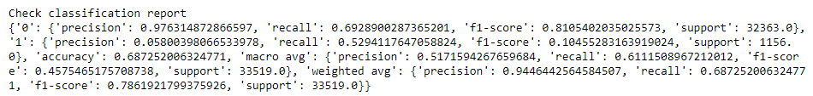
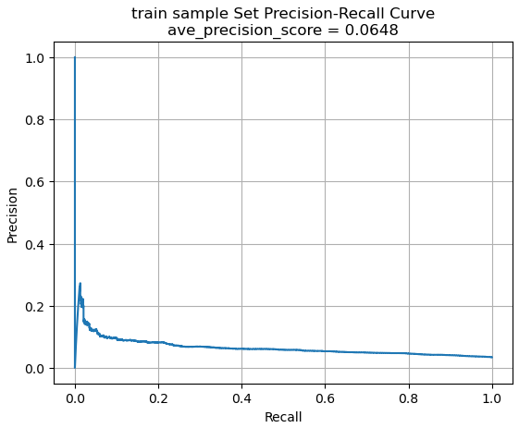
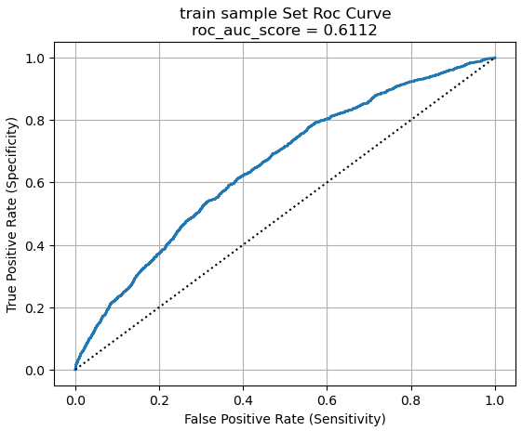
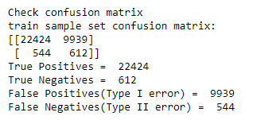
SGD classifier – Performance on train
The low precision score and the large number of false positive instances indicate that the model is not performing well in correctly identifying positive instances. The average precision score is very low.

Slide 5
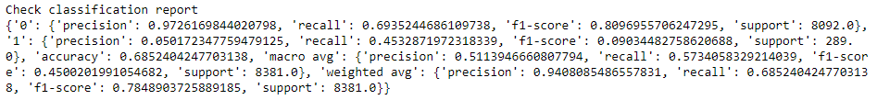
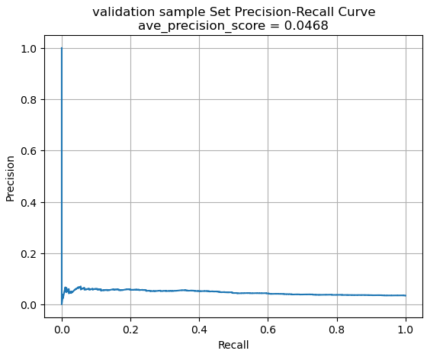
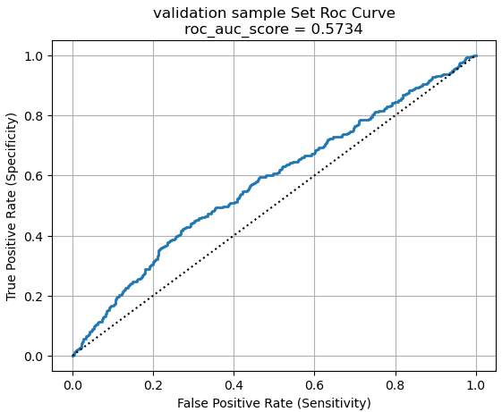
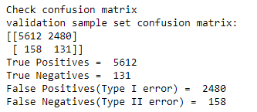
SGD classifier – Performance on validation
The performances on train set and validation set are similar. The average precision score is slightly lower on validation set.

Slide 6
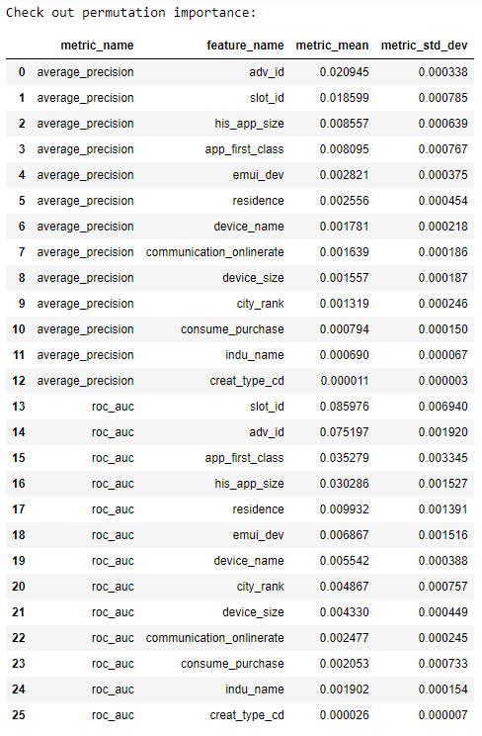
SGD classifier – Feature selection
We use average_precision and roc_auc to list the most significant features.
To improve the performance, we conduct a feature selection. Below are additional features that might be dropped
'indu_name',
'creat_type_cd',
'emui_dev',
'residence',
'city_rank',
'communication_onlinerate',
'device_name',
'consume_purchase',
'device_size'

Slide 7
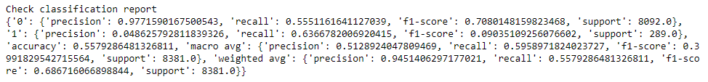
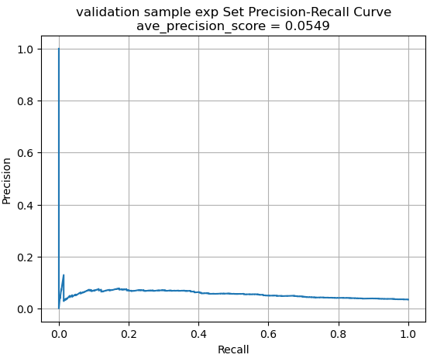
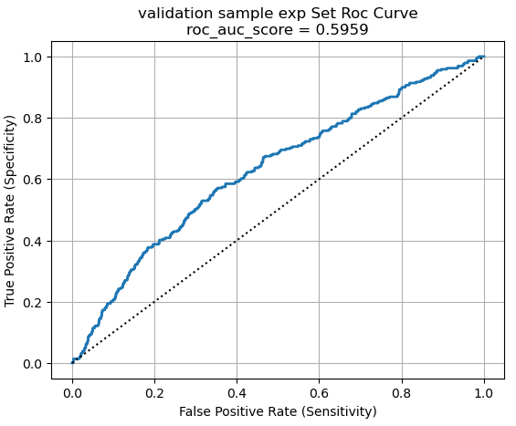
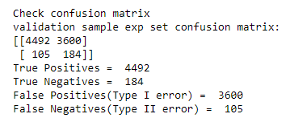
SGD classifier – Performance after feature selection (v)
Above is the performance after dropping those additional features on the validation set. The number of false positive instances increases greatly; therefore, we won’t drop features at this step.

Slide 8
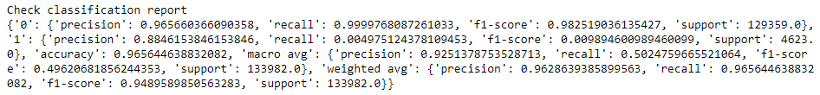
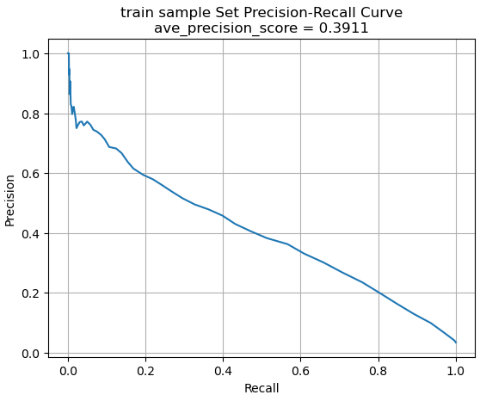
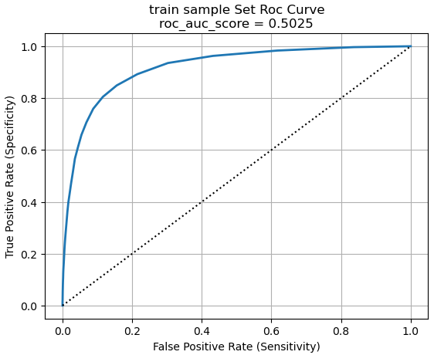
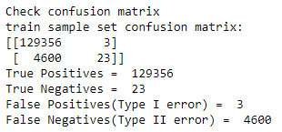
Random forest classifier – Performance on train
This model has few false positive although the number of false negatives is large.

Slide 9
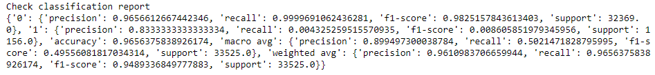
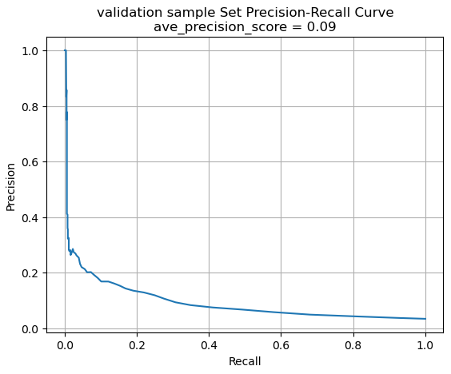
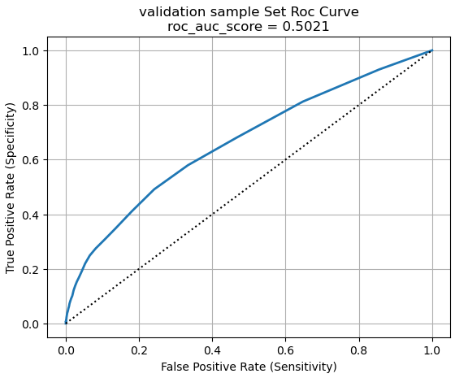
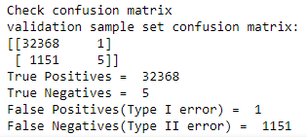
Random forest classifier – Performance on validation
Compared to the performance on the train set, the ave_precision_score decreases significantly

Slide 10
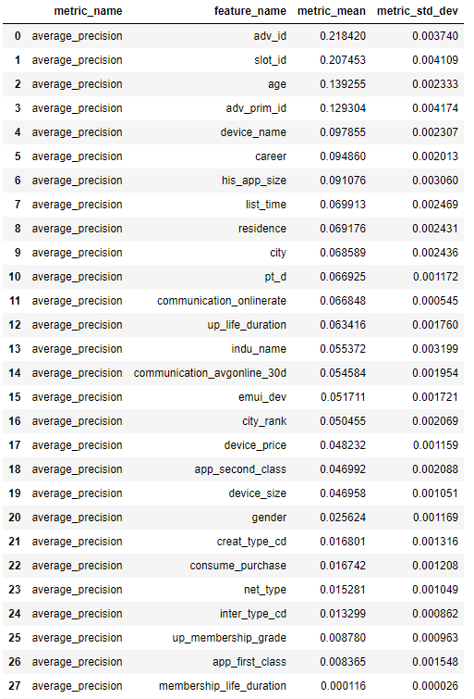
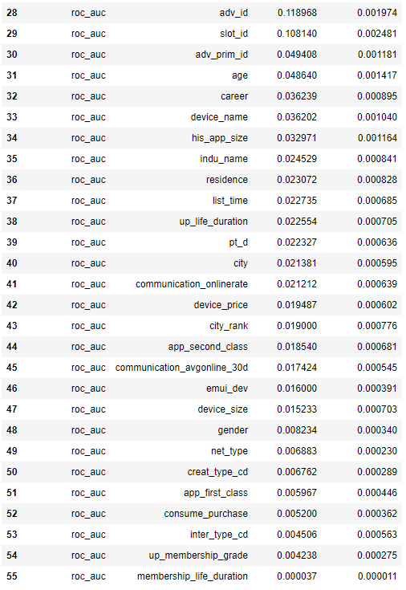
Random forest classifier – Feature selection
We use average_precision and roc_auc to rank features.
Features to be dropped
'creat_type_cd',
'up_membership_grade',
'membership_life_duration',
'net_type',
'consume_purchase',
'app_first_class',
'gender',
'inter_type_cd'

Slide 11
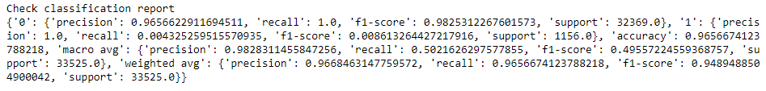
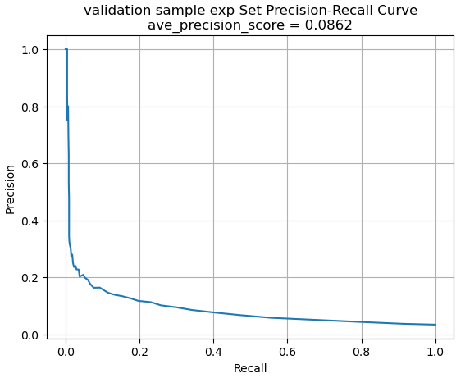
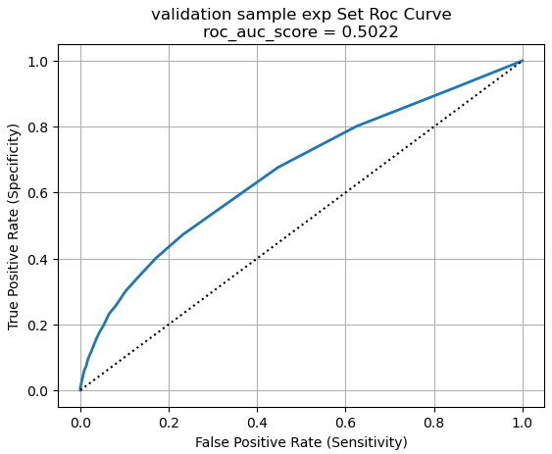
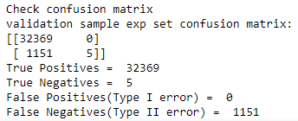
RF classifier – Performance after feature selection (v)
Because dropping attributes doesn't significantly decrease the performance, we would apply the new drop list in the fine-tuning stage.

Slide 12
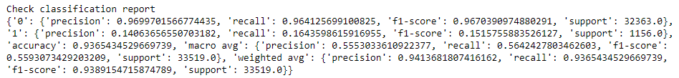
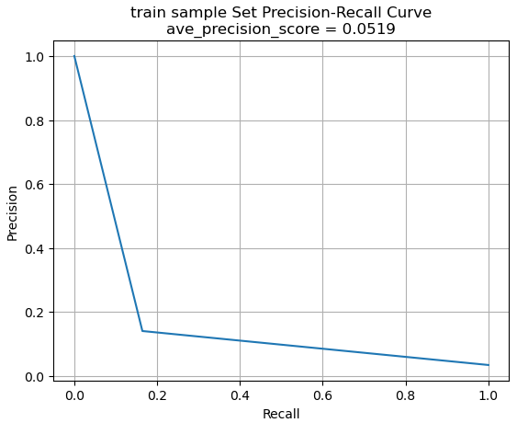
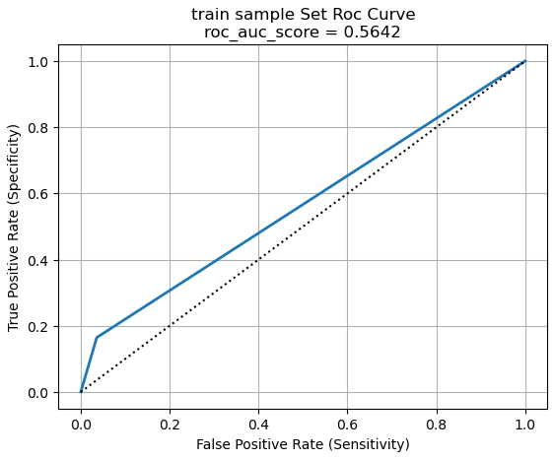
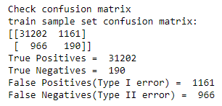
Decision Tree Classifier – Performance on train
The low ave_precision_score and the number of false positives indicate a high rate of Type I error.
False negatives is also high, indicating that the model doesn’t perform well in identifying users who actually click on ads.

Slide 13
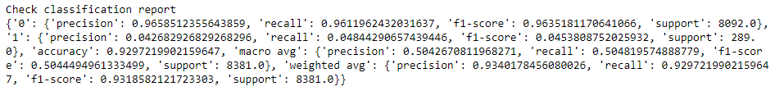
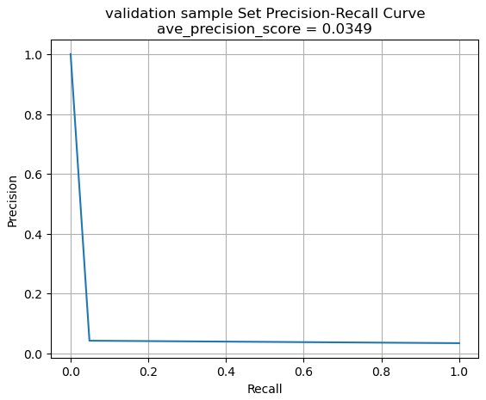
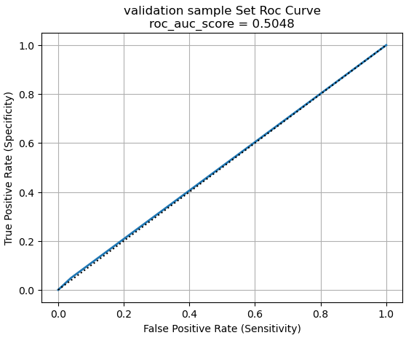
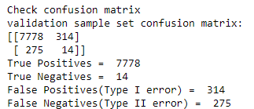
Decision Tree Classifier – Performance on validation
Compared to the train set, the precision score decreases significantly. Other performance metrics also decrease slightly. The model doesn’t generalize to new and unseen data well.

Slide 14
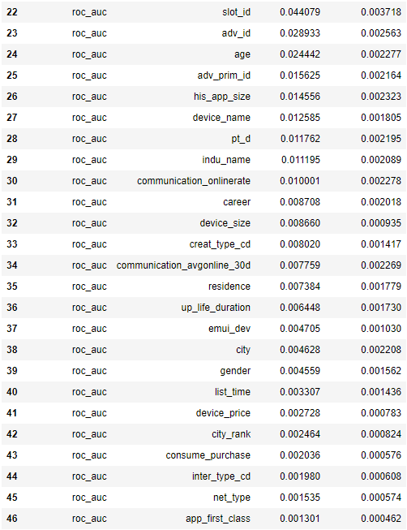
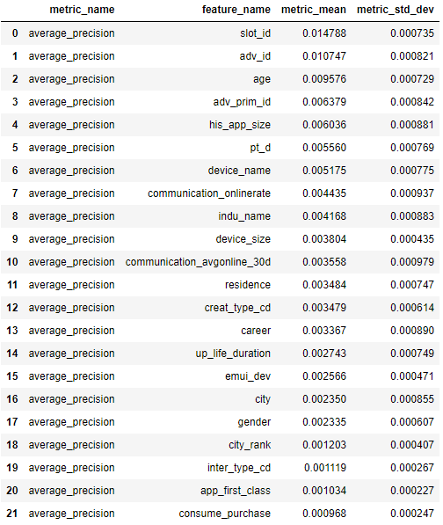
Decision Tree Classifier– Feature selection
The use of average_precision and roc_auc together calculates which feature is important.
Features to be dropped
'inter_type_cd',
'city_rank',
'app_first_class’,
'consume_purchase'

Slide 15
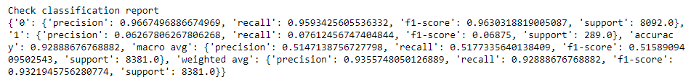
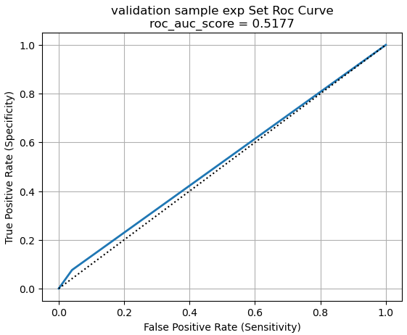
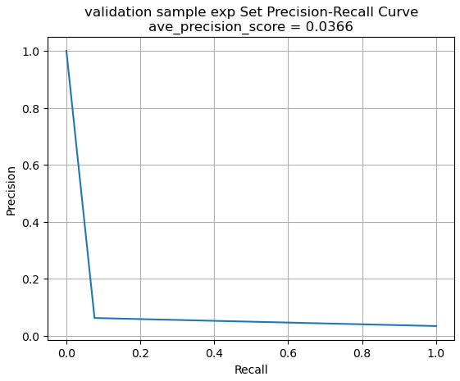
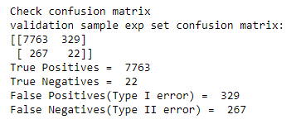
DTree Classifier – After feature selection validation
Because the decrease in false positives is subtle and other performance metrics don’t change much, we’ll consider dropping these features in the fine-tuning stage.

Slide 16
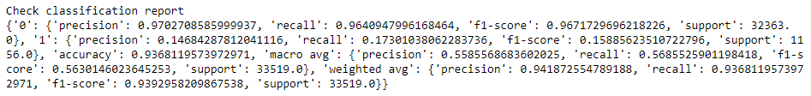
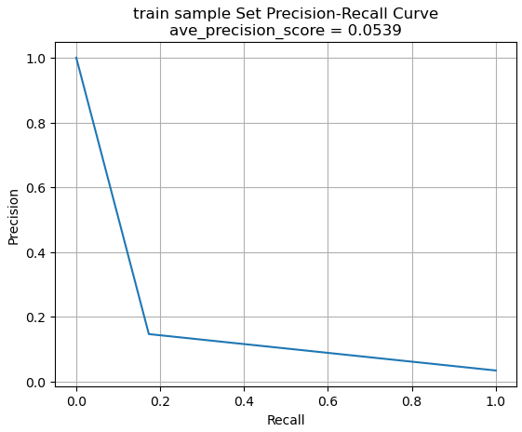
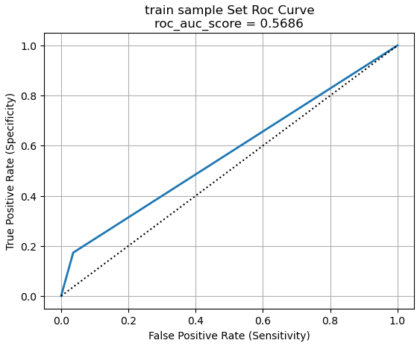
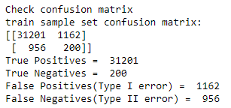
Adaboost Classifier – Performance on train
The default model has many false positives and false negatives. The model fails to predict the instances well.

Slide 17
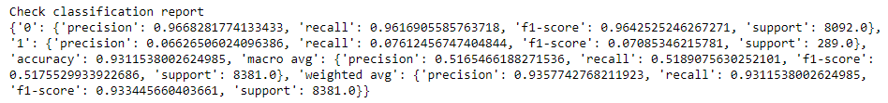
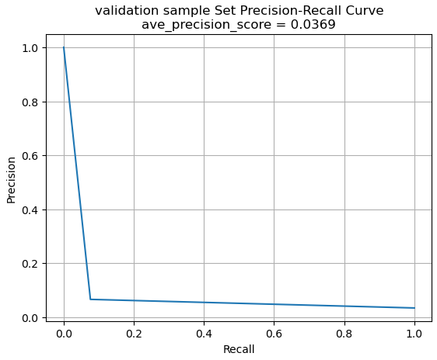
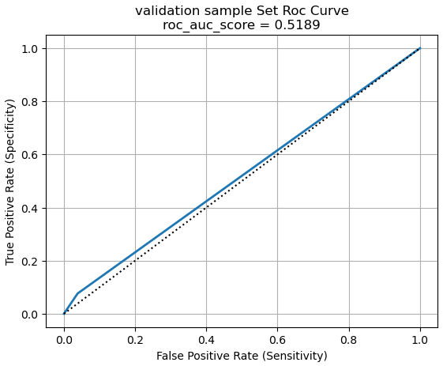
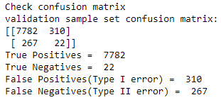
Adaboost Classifier – Performance on validation
Compared to the performance on the train set, the performance on the validation set is worse.

Slide 18


Adaboost Classifier– Feature selection
Features to be dropped
'city_rank',
'consume_purchase',
'emui_dev',
'inter_type_cd’,
'app_second_class',
'creat_type_cd',

Slide 19




Adaboost Classifier – After feature selection validation
Because the decrease in false positives is subtle and other performance metrics don’t change much, we’ll consider dropping these features in the fine-tuning stage.

Slide 20




Gradient Boosting Classifier – Performance on train
This model has few false positive although the number of false negatives is large.

Slide 21




GBoosting Classifier – Performance on validation
Compared to the train set, the validation set has much lower precision score and ave_precision_score. Notably, precision score for class 1 is 0.

Slide 22


GBoosting Classifier – Feature selection
Features to be dropped
'device_size',
'pt_d',
'career',
'emui_dev',
'communication_avgonline_30d',
'adv_prim_id',
'gender',
'list_time',
'city_rank',
'communication_onlinerate',
'device_price'

Slide 23




GBoosting Classifier – After feature selection validation
The model performances before and after dropping some common least important features in permutation importance test are similar. We’ll drop these features in the fine-tuning stage.

Slide 24





Classifiers – Comparison
SGD Classifier
Decision Tree Classifier
Random Forest Classifier
Gradient Boosting Classifier
Adaboost Classifier
This is a summary table for all models.

Slide 25
Discussions
Analyze the most significant attributes for each algorithm
Analyze the types of errors the models make
What data would a human have used to avoid these errors
Shortlist the top three to five most promising models

