Slide 1

Gesture Recognition Reading Muscle Activity
Project Phase 1 - Data Set Selection and Preparation
DS5230 / Spring 2024 Semester
Team Members: Liyang Song
Jan 20, 2024

Slide 2
Version Control
We have established a GitHub Repository for versional control:
https://github.com/LiyangSong/Gesture-Recognition-Reading-Muscle-Activity.git
Clone the repo to local including all data files, Jupyter Notebooks, python files, and other related information.

Slide 3
Reproducibility
All works are completed within Jupyter Notebooks and have been fully executed. To reproduce:
Download the environment.yml and recreate project_venv virtual environment using the command:
(base) : conda env create -f environment.yml
Activate project_venv using the command:
(base) : conda activate usml_base_ds
Create an ipykernel using the command:
(usml_base_ds) : python -m ipykernel install --user –name usml_base_ds --display-name "Python (usml_base_ds)"
Open project_phase_1.ipynb in browser, click restart the kernel and rerun all cells button to reproduce all works.

Slide 4

Data Set Information
Data set: Classify gestures by reading muscle activity.
https://www.kaggle.com/datasets/kyr7plus/emg-4
Data set description:
Each dataset line has 8 consecutive readings of all 8 sensors. so 64 columns of EMG data. The last column is a resulting gesture that was made while recording the data (classes 0-3).
So each line has the following structure: [8sensors][8sensors][8sensors][8sensors][8sensors][8sensors][8sensors][8sensors][GESTURE_CLASS]
A classifier given 64 numbers would predict a gesture class (0-3). Gesture classes were : rock - 0, scissors - 1, paper - 2, ok - 3.
Data set size: 4 separated CSV files with total size of (11678, 65).

Slide 5
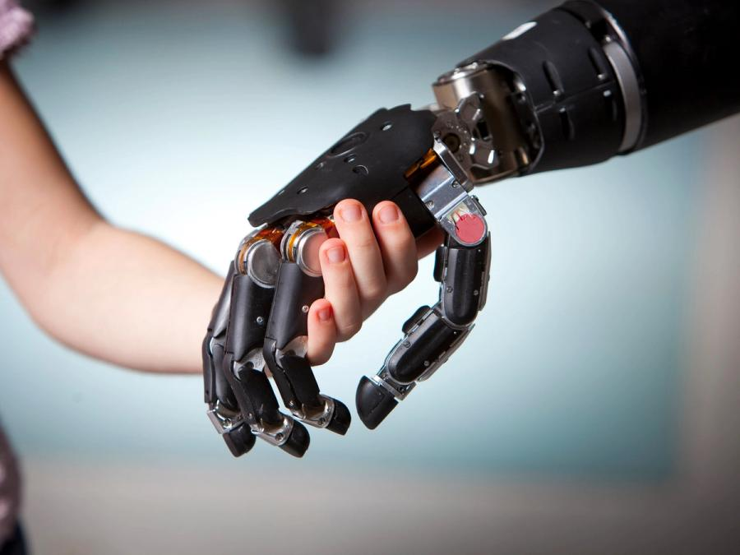
Data Set Information
This project have the potential to make a significant difference in the lives of people who use prosthetic limbs. By mapping muscle movements to prosthetic actions, users can control their artificial limbs more naturally and effectively, improving their quality of life. It can also help individuals recovering from injuries or surgeries to regain muscle functions.
Beyond prosthetics, this technology can also be applied to develop sophisticated human-machine interfaces. It can be integrated with VR or gaming devices where users could control game characters or navigate virtual environments using natural muscle movements.

Slide 6
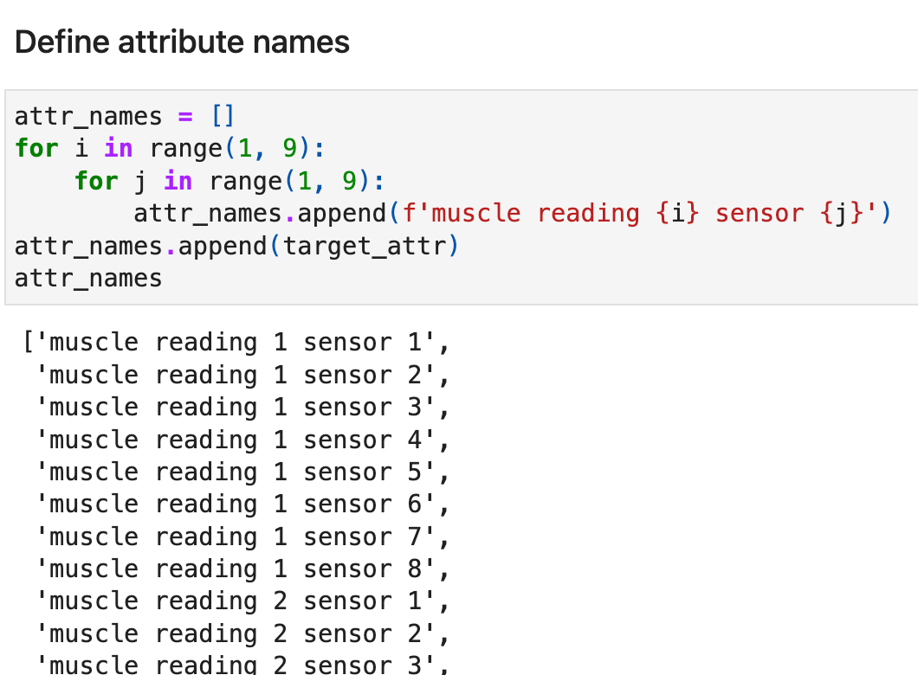
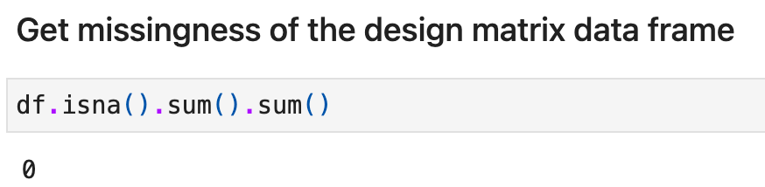
Attributes Information
'muscle reading X sensor Y'
meaning: the Xth reading data of sensor Y (total 64 columns)
dtype: float
measurement scale: interval or ratio scale. The true meaning of sensor digits was not given (not sure whether there is true zero)
missingness: 0
'gesture class (0-3)'
meaning: gesture class. rock - 0, scissors - 1, paper - 2, ok - 3
dtype: integer
measurement scale: nominal scale. Classes are categorized but their rank has no meaning.
missingness: 0

Slide 7
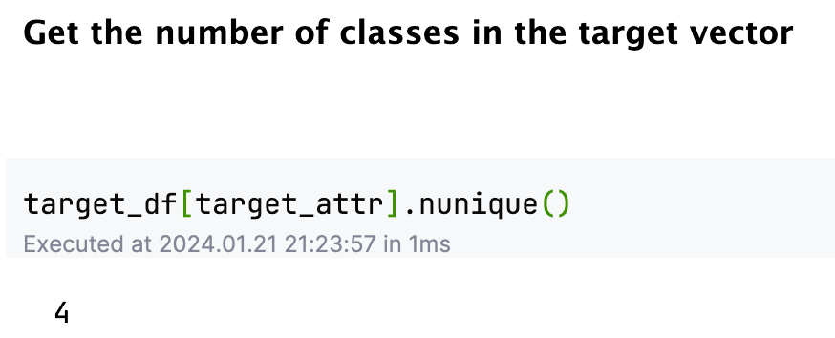
Number of Classes in the Target Vector

Slide 8
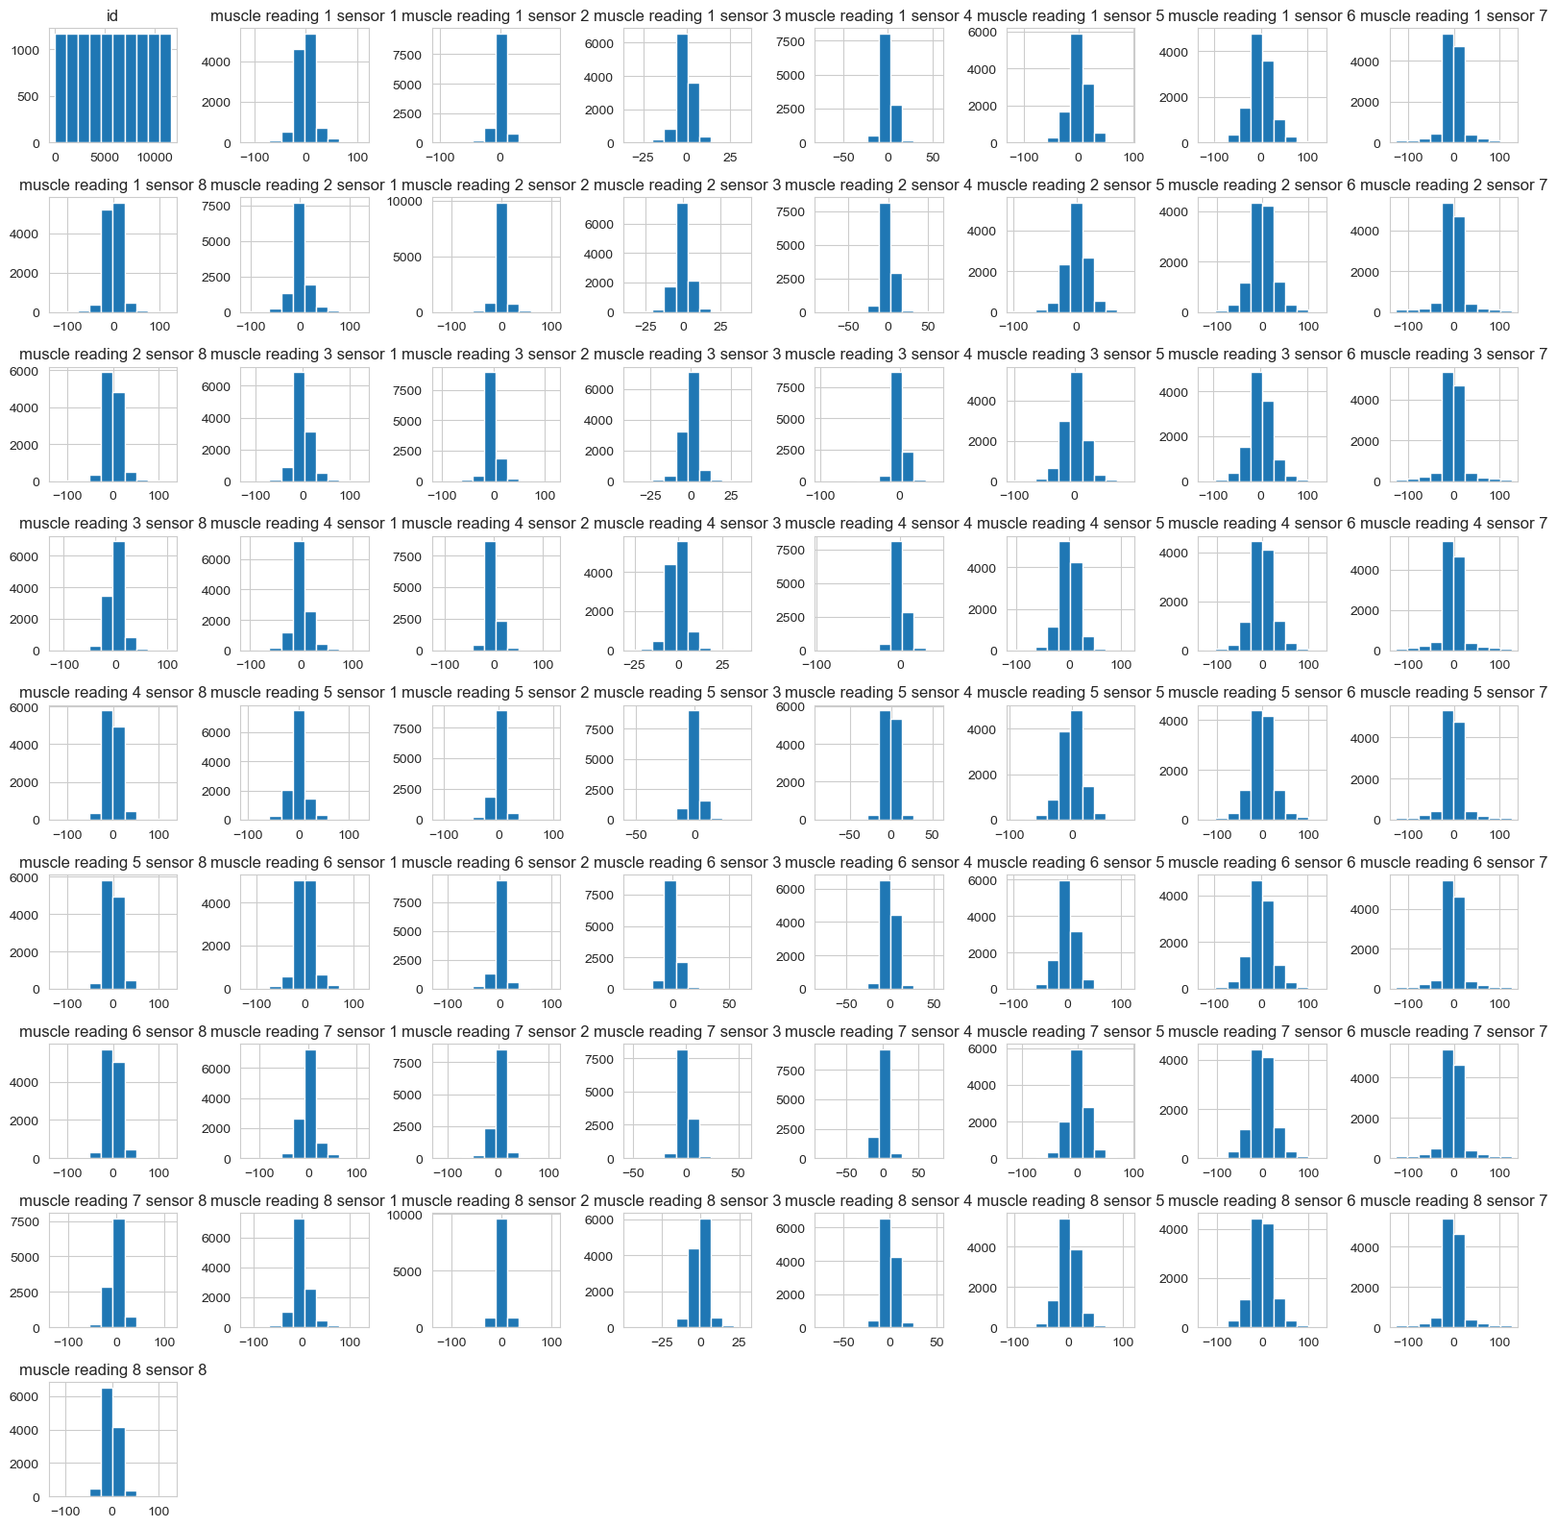
Histograms of the Attributes in the Design Matrix Data Frame

