Slide 1

Gesture Recognition Reading Muscle Activity
Project Phase 2 - Preprocessing Pipelines and EDA
DS5230 / Spring 2024 Semester
Team Members: Liyang Song
Mar 08, 2024

Slide 2
Reproducibility
All works are completed within Jupyter Notebooks and have been fully executed. To reproduce:
Download the environment.yml and recreate project_venv virtual environment using the command:
(base) : conda env create -f environment.yml
Activate project_venv using the command:
(base) : conda activate project_venv
Create an ipykernel using the command:
(project_venv) : python -m ipykernel install --user –name project_venv --display-name "Python (project_venv)"
Open project_phase_2.ipynb in browser, click restart the kernel and rerun all cells button to reproduce all works.

Slide 3
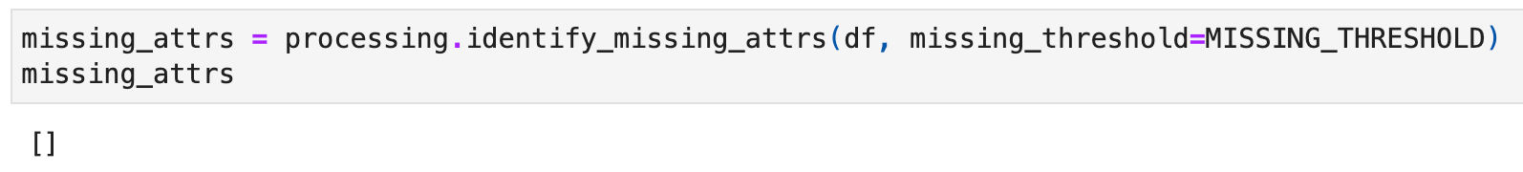
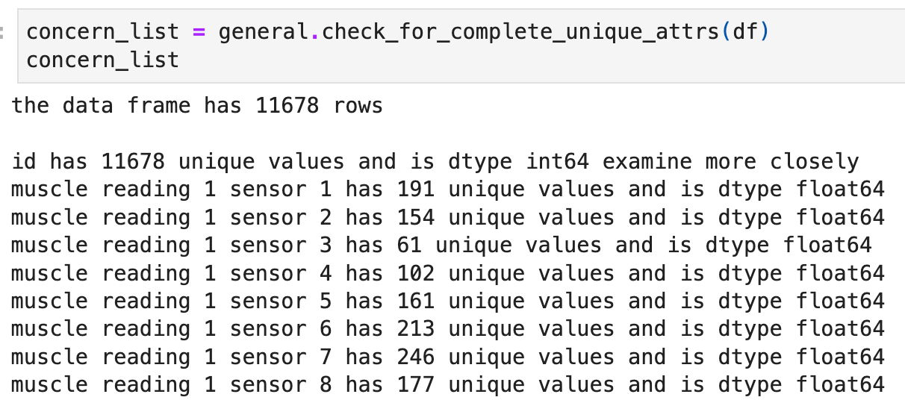

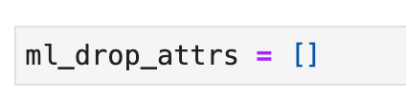
Preprocessing - Establish machine learning attribute configuration
Identify attributes with missing value count greater than 0.20.
Identify non machine learning attributes .
No other attributes to drop from machine learning.

Slide 4
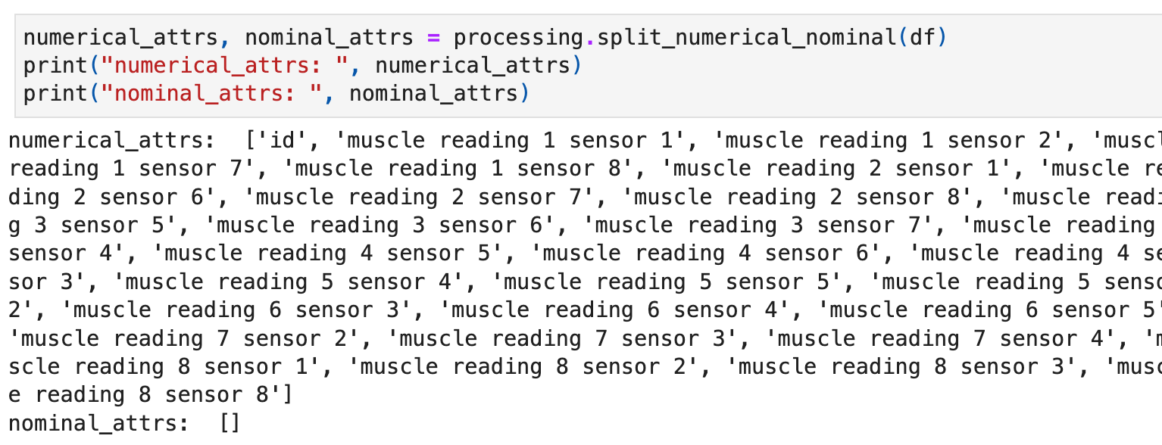
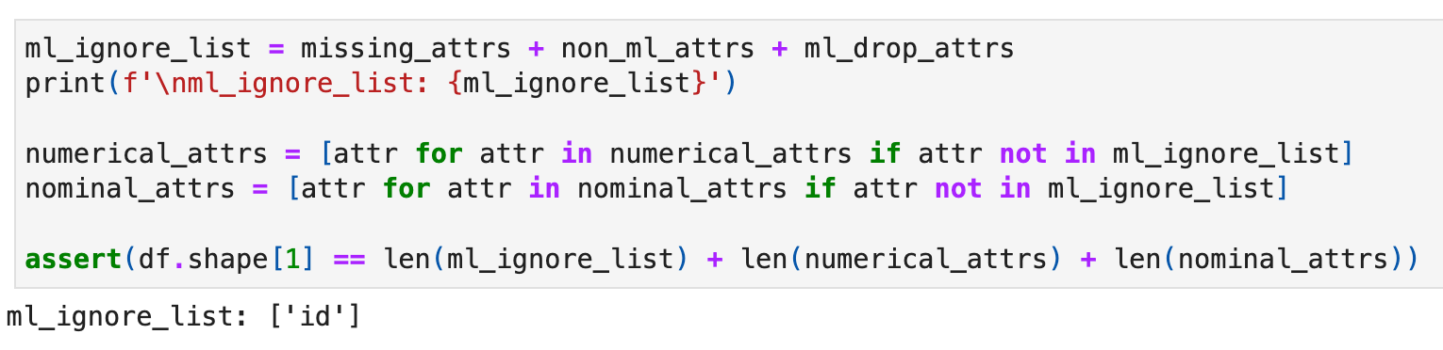
Preprocessing - Establish machine learning attribute configuration
Establish numerical and nominal attributes.
Machine learning attribute configuration.

Slide 5
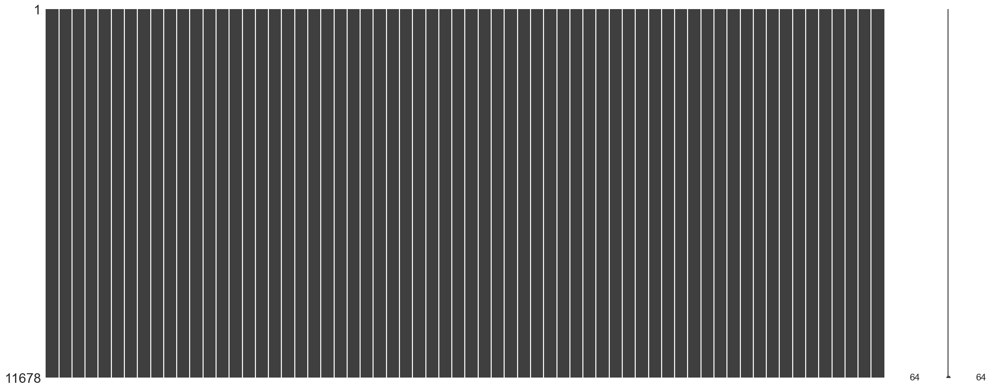
Preprocessing - Check out the missingness of attributes
There is no missing value in all attributes, which is also shown in the missingno matrix.

Slide 6
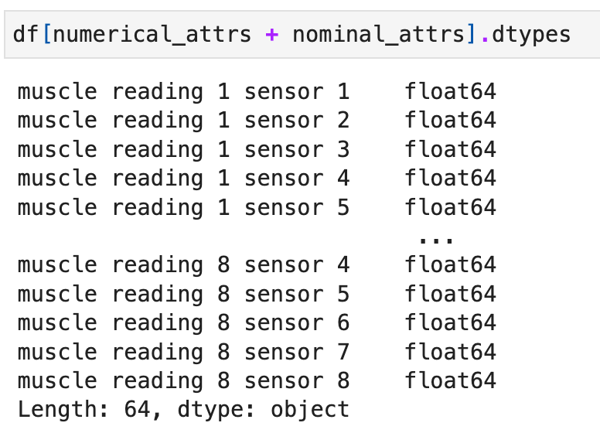
Preprocessing - Checkout the types of attributes
All 64 machine learning attributes are float64 type.

Slide 7
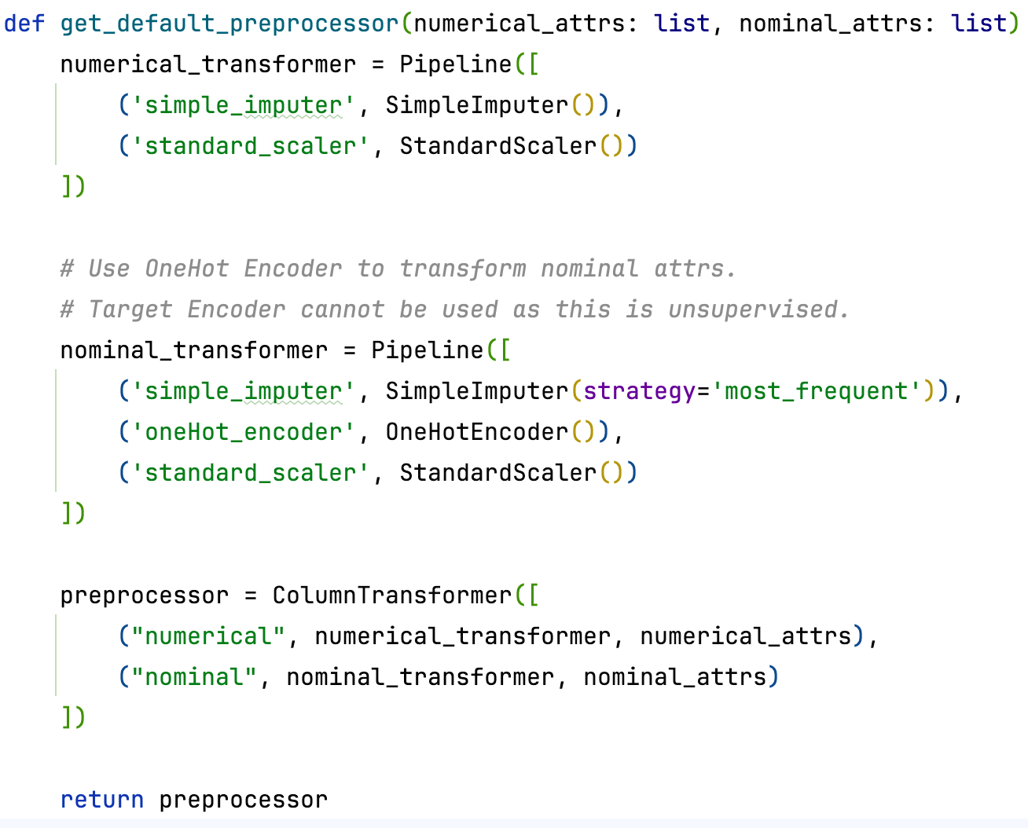
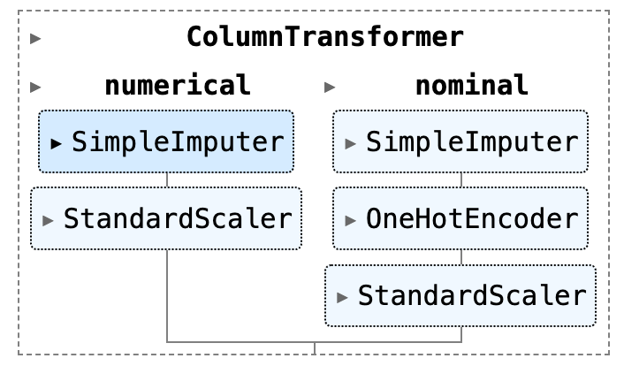
Preprocessing - Build a preprocessing pipeline
As this is an unsupervised machine learning task, TargetEncoder cannot be used and OneHotEncoder was applied.
Although there is no missing value and no nominal attributes, SimpleImputer and nominal_transformer were applied in the pipeline for the new data in the future.

Slide 8
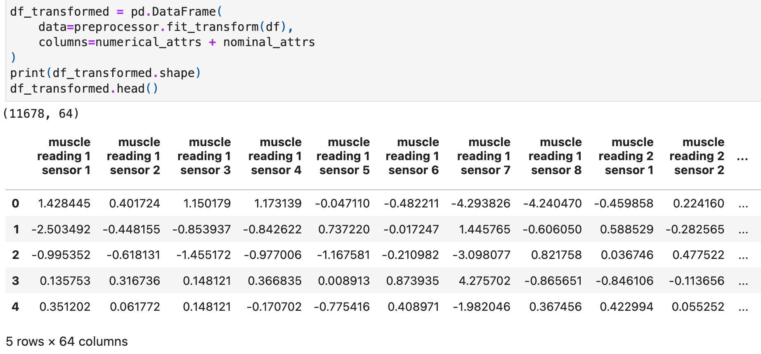
Preprocessing - Apply the preprocessing pipeline to the data frame

Slide 9
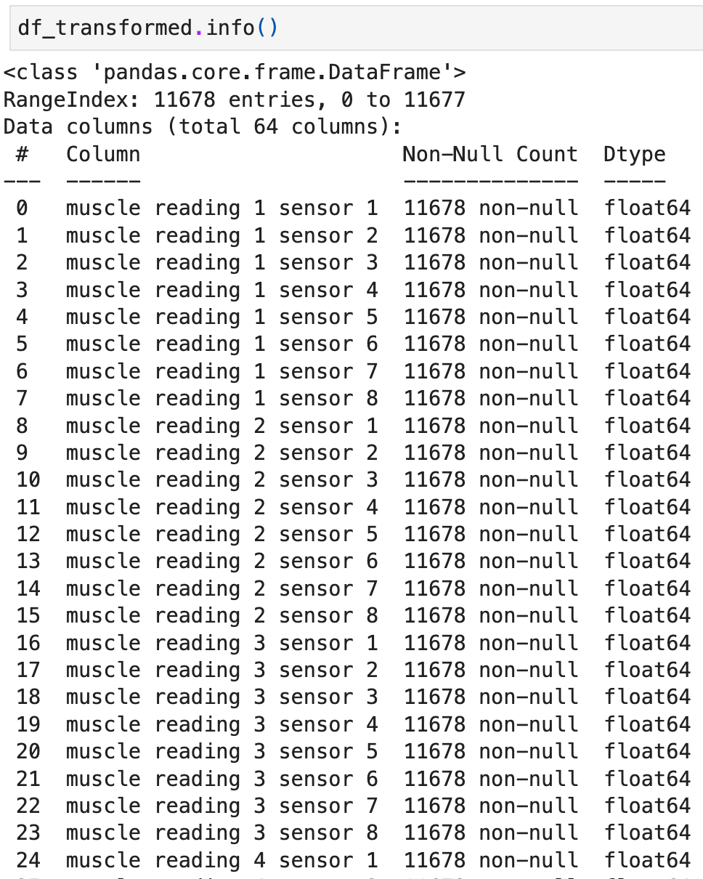
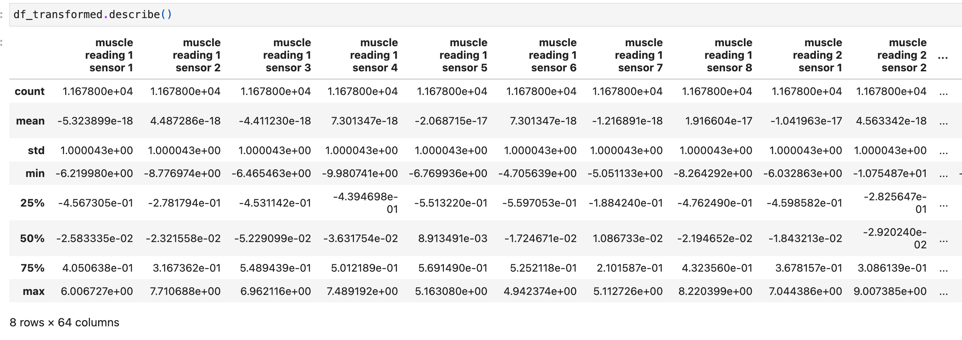
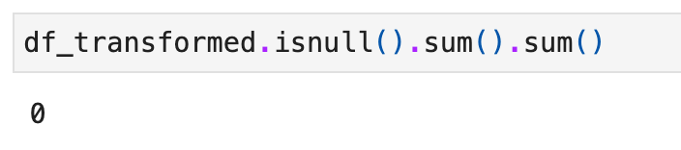
EDA – Non-graphical analysis

Slide 10
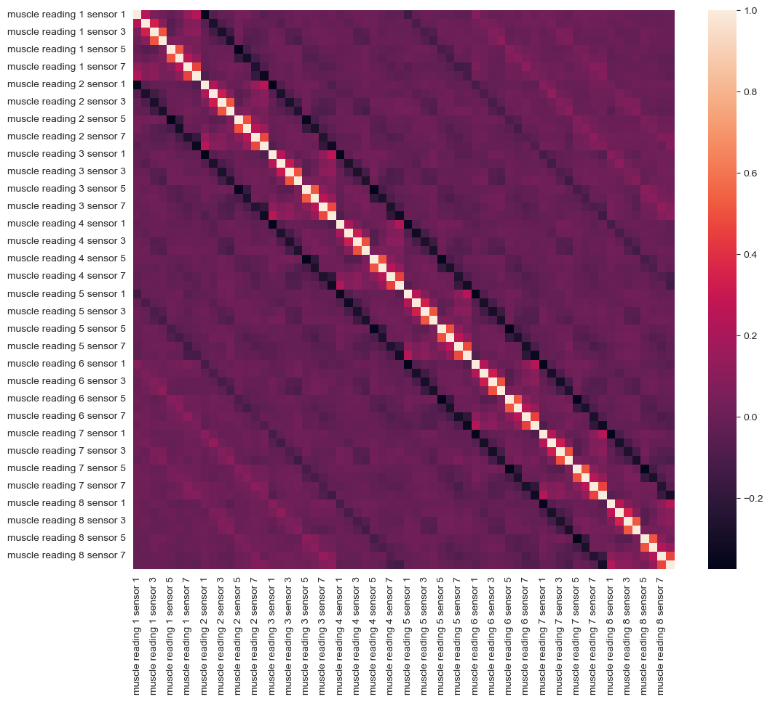
EDA - Pair plots to look for possible clusters
It's not practical to draw pair plots for all 64 columns, which will generate 64 * 64 / 2 = 2048 scatter plots.
We tried using correlation heatmap to check the correlations between attrs, and drawing pair plots for principal components.
The heatmap does not reveal extremely high correlations. Some relatively high correlations show between adjacent sensors in the same reading (e.g. sensor 3 and 4 in reading 1). This may be due to the muscle movement affecting adjacent sensors.
Most correlations between attrs are relatively low, which is normal for a high-dimension dataset.

Slide 11
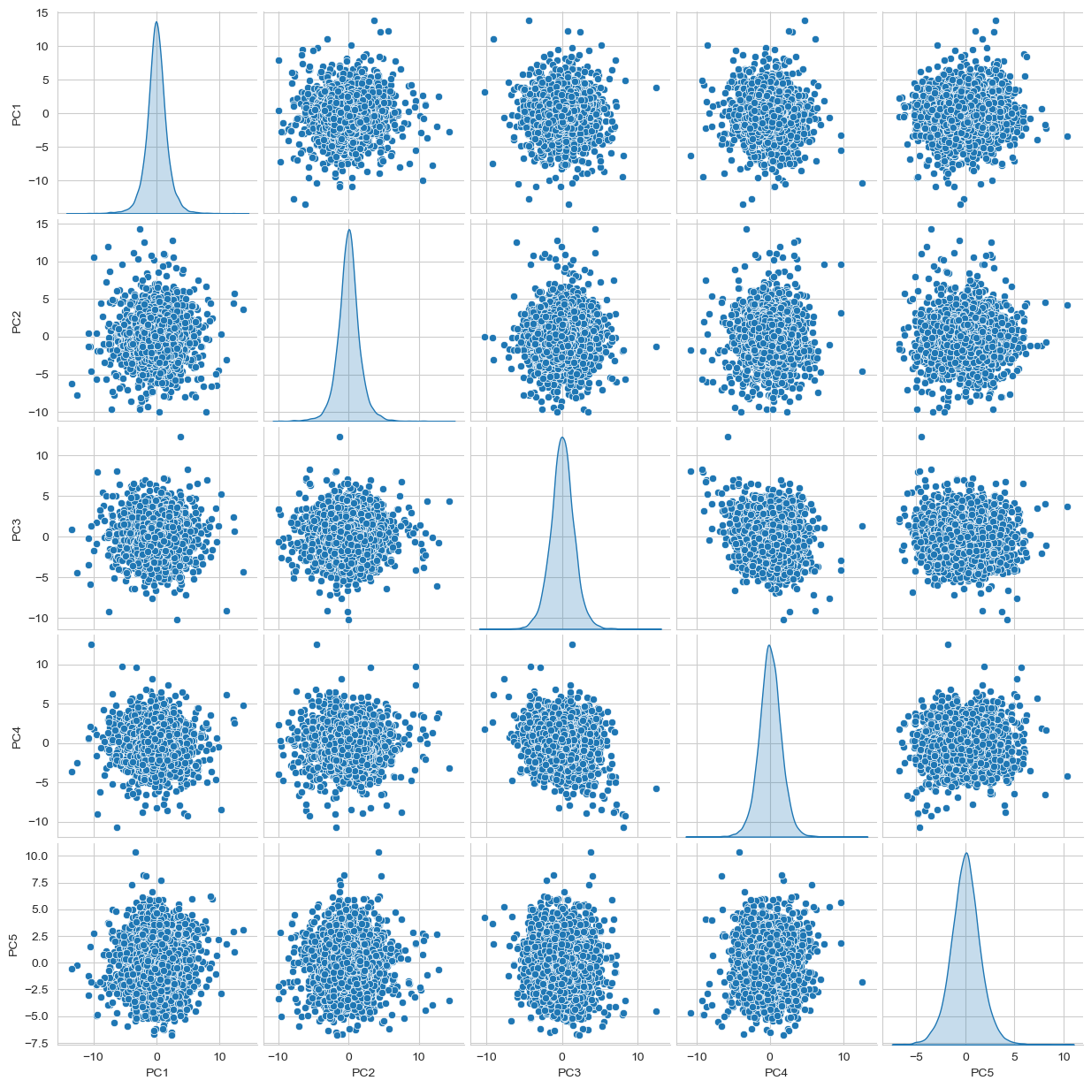
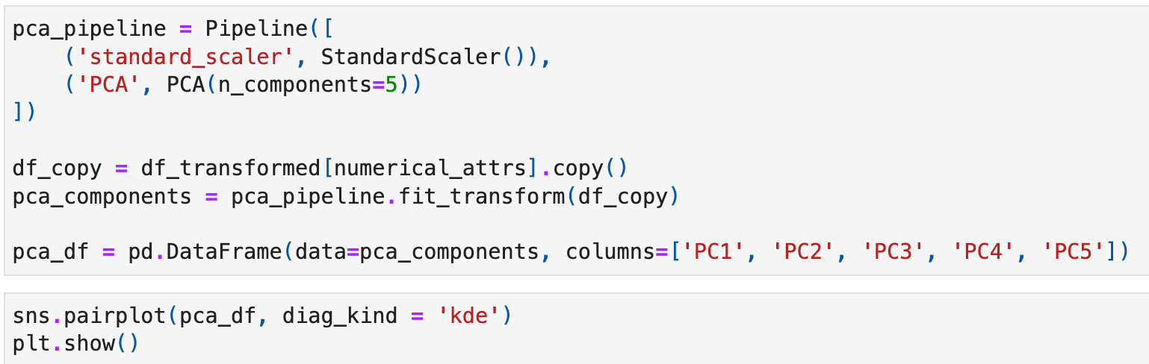
EDA - Pair plots to look for possible clusters
Use PCA to reduce dimensionality to 5 and then draw pair plots for principal components.
The plots do not show very high correlations between pairs, whether linear or non-linear.

Slide 12
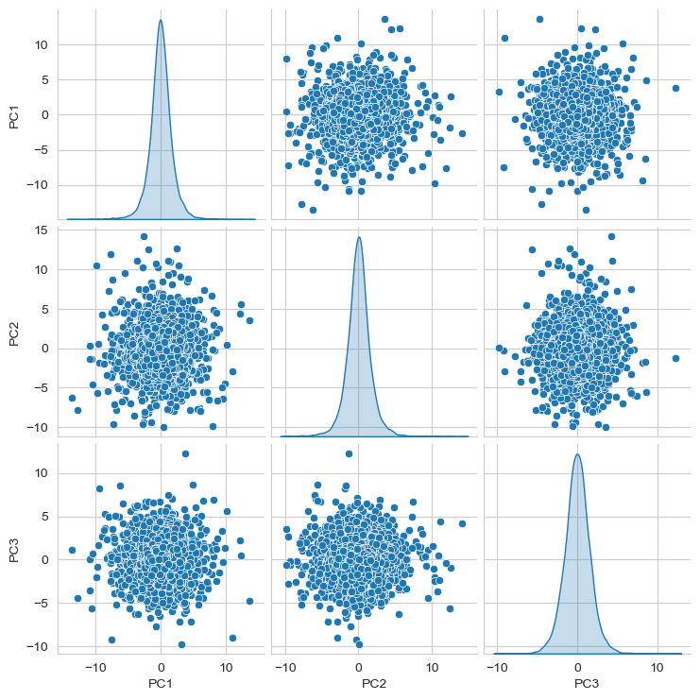
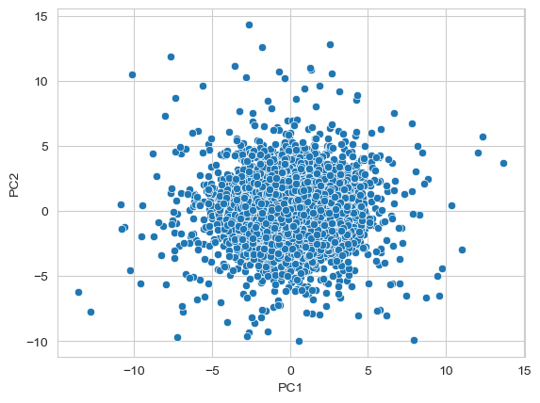
EDA - Pair plots to look for possible clusters
We also tried PCA to reduce dimensionality to 3 and 2 and then draw pair plots for them. Still, no distinct clusters are shown in the plots.

Slide 13
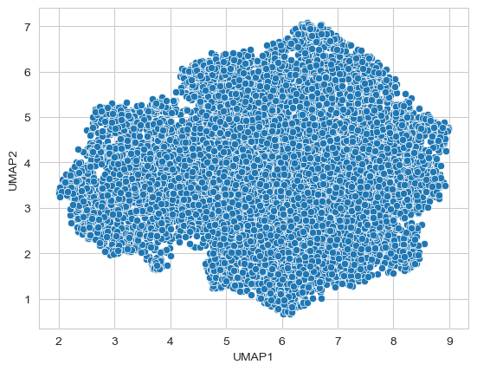
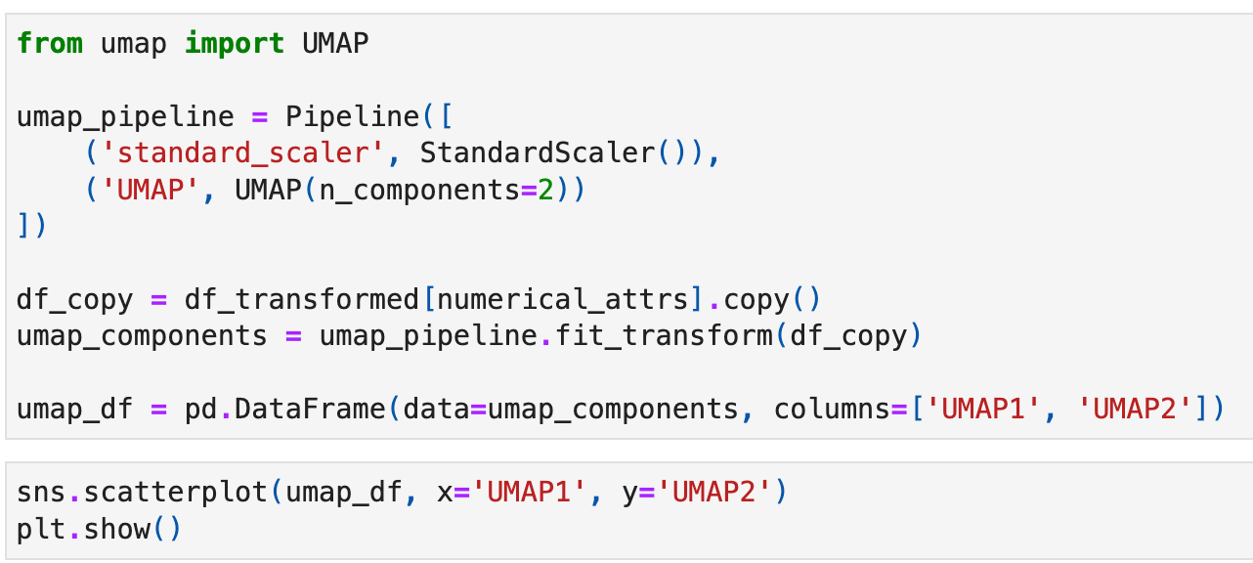
EDA - Pair plots to look for possible clusters
As PCA is linear combination of attrs, we tried using UMAP as the non-linear dimension reduction method. Drawing plot between two UMAP principal components also did not revear distinct clusters.

Slide 14
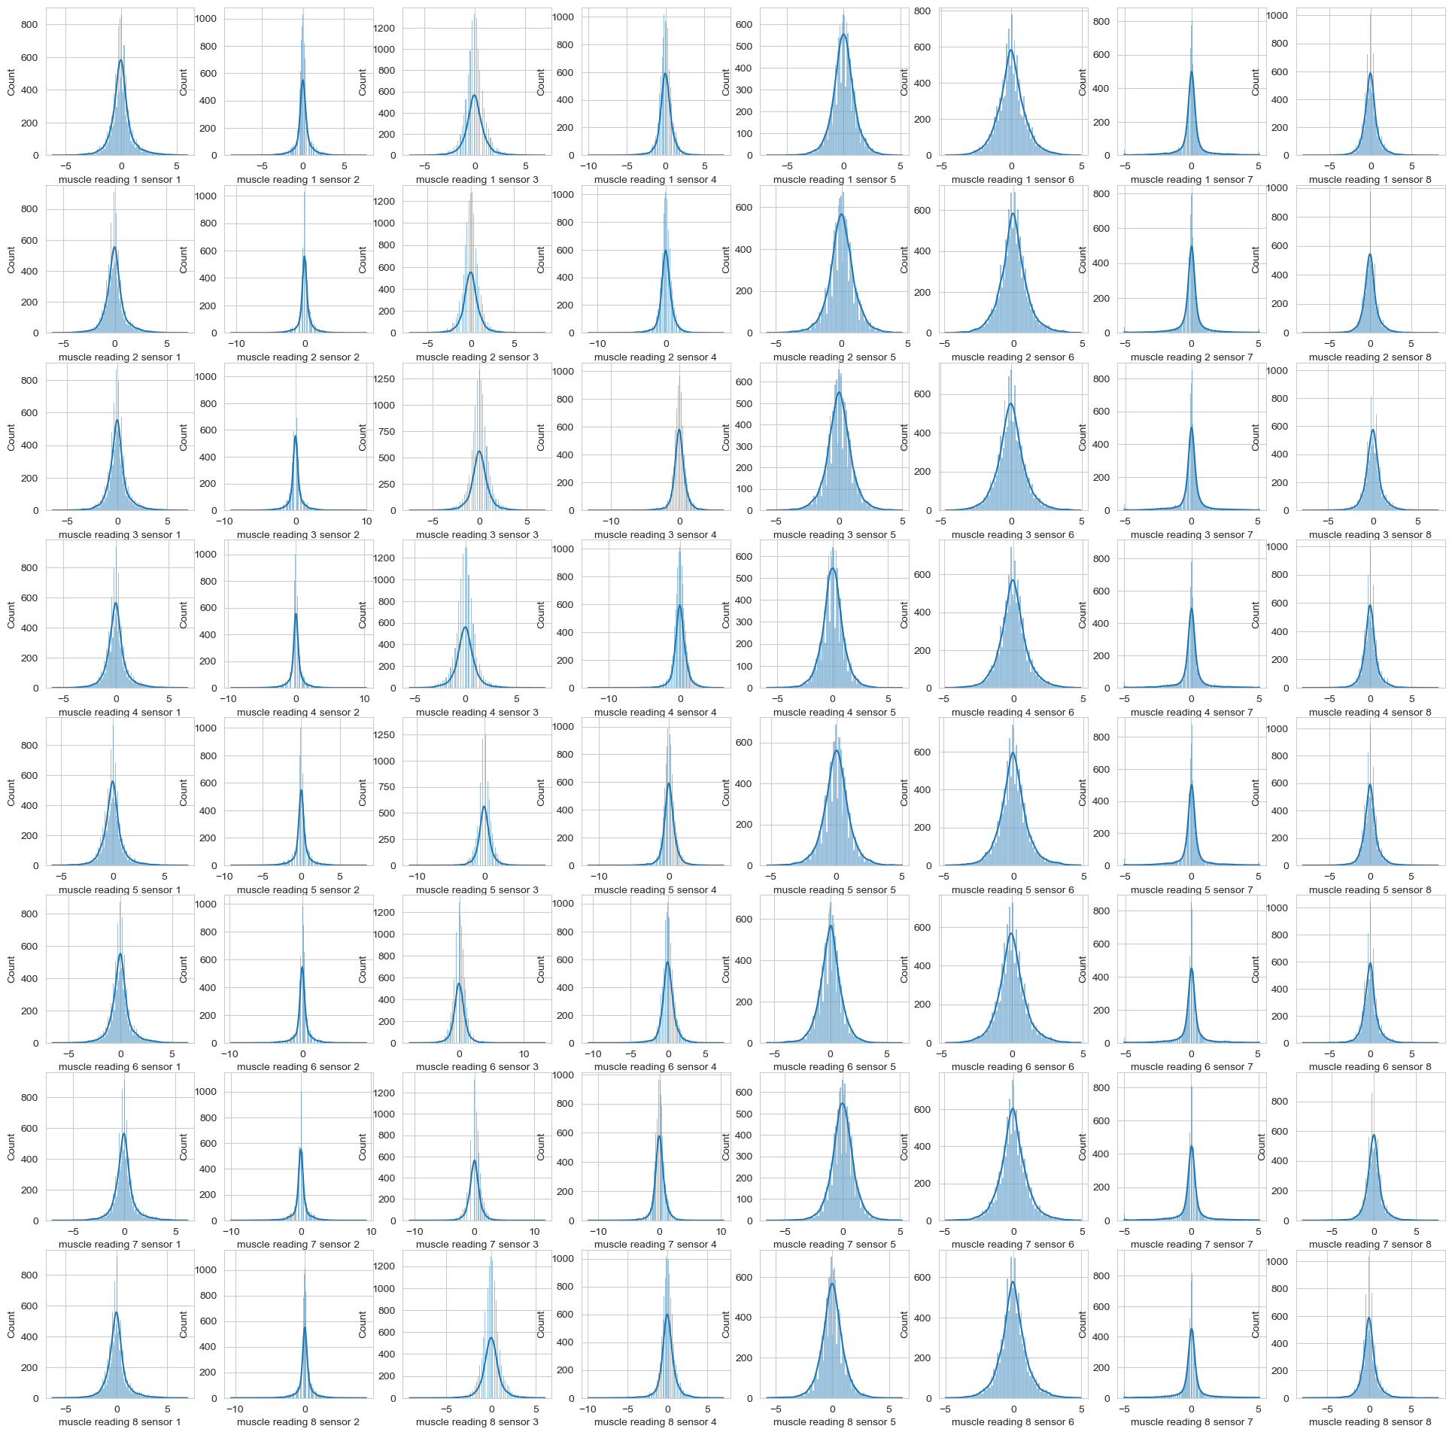
EDA - Histograms to look for possible clusters
The histograms show some similar distributions. Most attrs follow a Gaussian distribution pattern.
The variance among attrs are relatively uniform, which may add the difficulty to find distinct clusters.
In the next phase, we will try tuning the UMAP hyperparameters, or try more different algorithms like K-Means to find the clusters.

