Slide 1
TinyML Smart Pantry & Waste Reducer
An Engineering Journey: Physical Constraints, Optimization, and Lessons Learned
Hardware Target: Arduino Nano 33 BLE Sense + OV7675 Camera
Team: Daniel Tseng, Miles Chin

Slide 2
TINYML SMART PANTRY
Core Vision: Privacy-Preserving Food Tracking
The Pantry Problem
• Goal: Automatically log groceries at the pantry entrypoint and estimate expiration using USDA FoodKeeper to reduce waste.
• Edge Privacy: Perform all computer vision inference locally on-device. Images never leave the microcontroller.
• Trigger Flow: Pantry door sensor activates the camera, captures a short image, and transmits a simple event label + timestamp over BLE/Serial.
Target Hardware Constraints
• Processor: ARM Cortex-M4F microcontroller running at 64 MHz.
• Flash Memory: 1 MB - plenty of space for compiling optimized neural net binaries.
• SRAM Memory: 256 KB total. Crucially, Mbed OS and BLE firmware consume ~120-160 KB, leaving only 80-100 KB for model activations!
• Sensor: OV7675 image sensor capturing low-resolution QQVGA frames.

Slide 3
TINYML SMART PANTRY
Model Design Iterations & Optimization
3-Layer Grayscale
• Input: 96x96x1 (Grayscale)
• Architecture: 3 Conv2D layers with Batch Normalization & ReLU
• Knowledge Distillation: Student model trained to mimic a larger MobileNetV2 RGB teacher
• Quantization: Post-training quantized to 8-bit integer weights/activations
3-Layer RGB
• Input: 96x96x3 (RGB Color)
• Architecture: 3 Conv2D layers with Batch Normalization & ReLU
• Why Color: Added RGB channels to provide color boundaries (essential for telling foods apart)
• Quantization: Quantization-aware training (QAT) to maintain accuracy
4-Layer RGB
• Input: 96x96x3 (RGB Color)
• Architecture: Expanded to 4 Conv2D layers for higher capacity
• Goal: Squeeze maximum capacity to correctly classify complex dishes
• Quantization: QAT to INT8 for local deployment

Slide 4
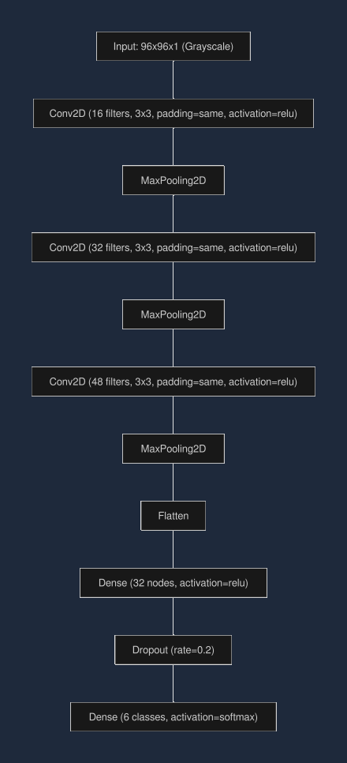
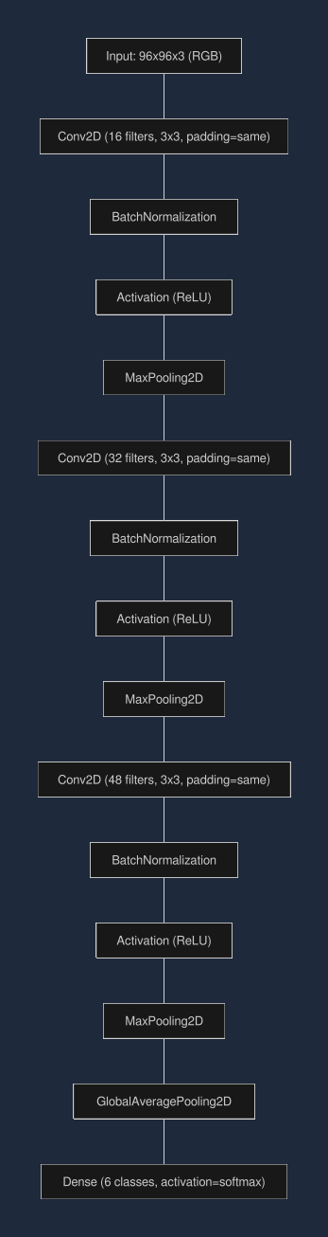
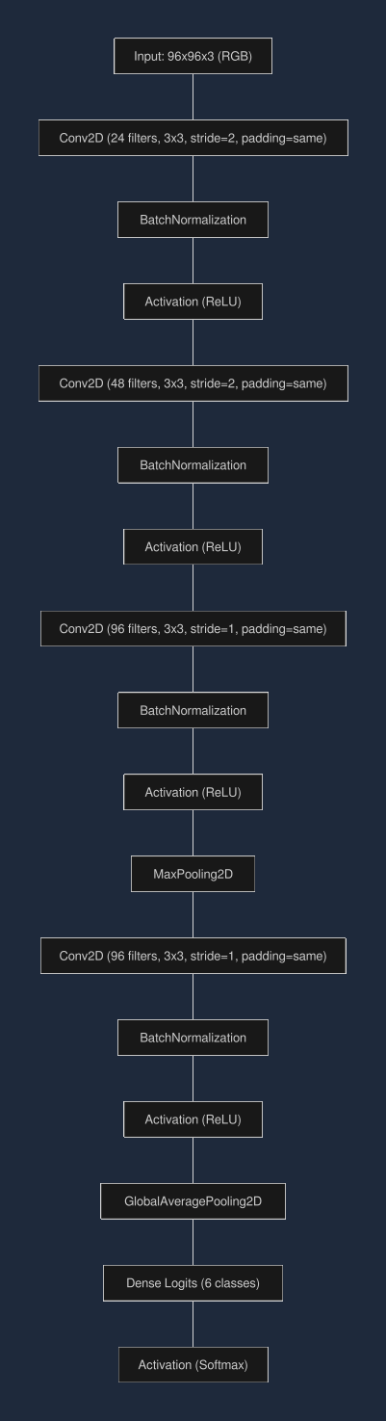
TINYML SMART PANTRY
Model Architecture Comparison

Slide 5
TINYML SMART PANTRY
The Results & The Physical SRAM Wall
Model Configuration | Input Space | Val Accuracy (QAT) | Binary Size (Flash)
3-Layer Grayscale (Distilled) | 96x96x1 | 45.6% | ~149 KB
3-Layer RGB (Float) | 96x96x3 | 58.0% | ~150 KB
4-Layer RGB (Best Capacity) | 96x96x3 | 72.2% | ~150 KB
Critical Bottleneck Analysis: RAM vs. Flash
In TinyML, model binary size (stored in Flash) is rarely the primary constraint; activation memory (RAM) is the hard boundary. While our 4-layer RGB model compressed to 150 KB and easily fit within the 1 MB Flash, its peak activation tensors required ~323 KB. This far exceeds the available SRAM on the Arduino, causing compilation and runtime allocation failures.

Slide 6
TINYML SMART PANTRY
The Pivot & Dataset Domain Gaps
The Pivot: Pizza vs. Apple Pie
• Binary Scope: To bypass memory constraints, we reduced the problem to a simple binary task (Pizza vs. Apple Pie).
• Feature Overlap: Both foods are round, crust-based, and baked. Distinguishing them without color (grayscale) and at 96x96 resolution remained highly unreliable.
• Resolution Limits: 96x96 resolution completely washes away the fine texture detail required to identify structural features of dishes.
Dataset Domain Mismatch
• Generalist Data: Food-101 is web-scraped for general computer vision tasks, not industrial edge sensors.
• Label Noise: Many images contain busy backgrounds, macro shots, or people (e.g. a person taking a selfie with a cake is labeled 'cheesecake').
• Pantry Gap: A network trained on diverse web photos cannot bridge the domain gap to top-down, fixed-lighting pantry camera captures.

Slide 7
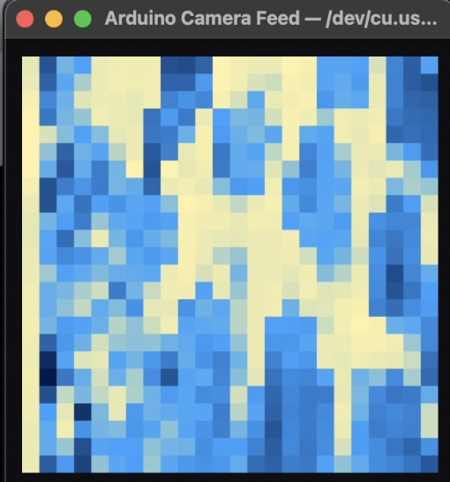
TINYML SMART PANTRY
Demo: What the Hardware Actually Sees
A PIZZA (a pizza… right?)
The Reality of 'Hardware Eye'
• On-Device Print: Generated directly on the Arduino Nano using our visualDebugPrint() helper, which outputs a 24x24 ASCII grid downsampled from the 96x96 grayscale buffer.
• Contrast & Scale: Highlights the blocky, low-contrast grayscale crop that the model is forced to interpret.
• Explainable Failure: Visualizing this input makes it immediately clear why classification fails: color, edge, and texture details are completely washed away, leaving only generic shapes.

Slide 8
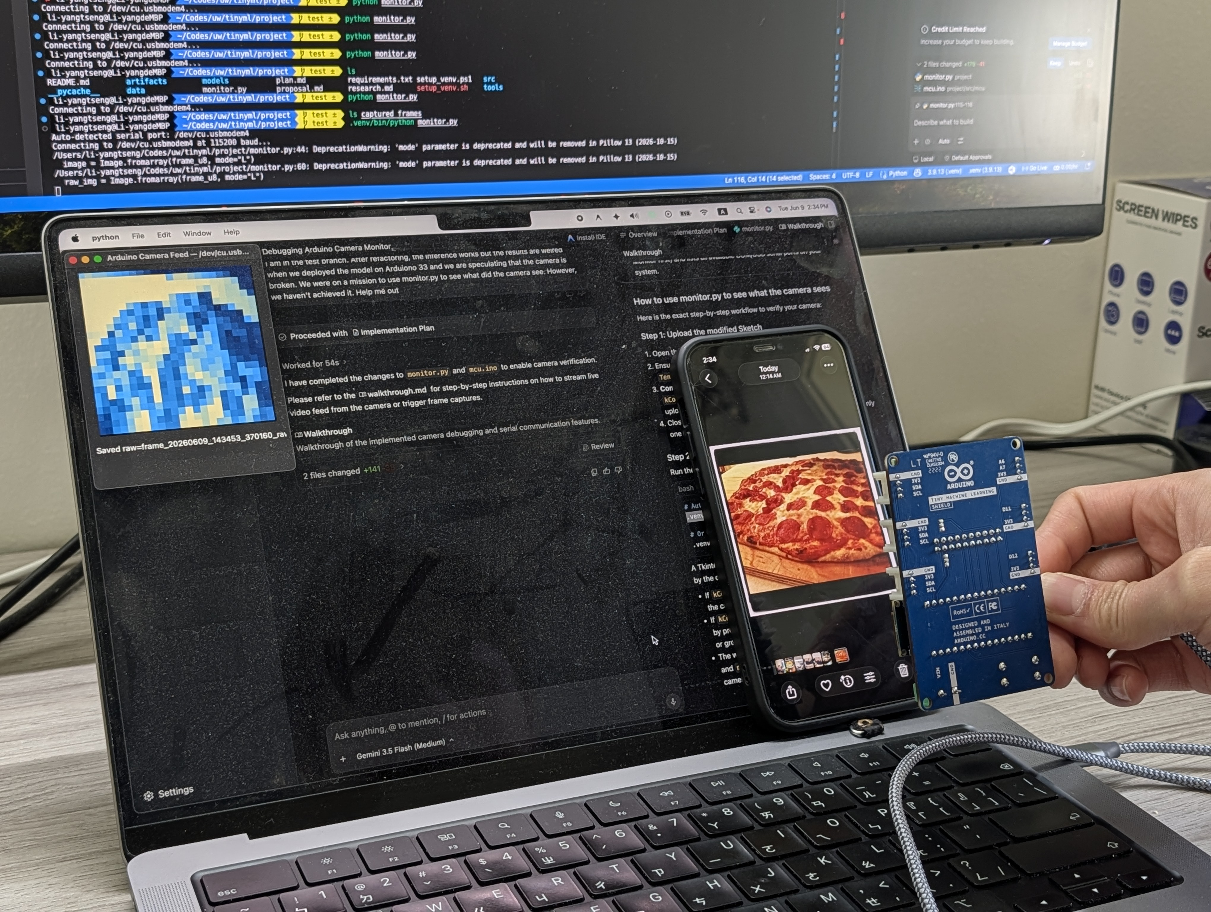
TINYML SMART PANTRY
Real Snapshot: Reality vs. Camera View
Visual Gap in Practice
• Human Perspective: Full-resolution, high-contrast, color-rich image where food details and boundaries are distinct.
• Microcontroller View: Grayscale, 96x96 resolution downsampled image where colors merge and edges blur.
• Why It Matters: Differentiating complex dishes like pizza vs. cheesecake requires color and texture. When reduced to a blocky silhouette, the classification boundaries overlap completely, leading to high-uncertainty predictions.

Slide 9
DEMO TIME!
Let's watch the real-time pantry logging in action...

Slide 10
TINYML SMART PANTRY
Lessons Learned & Edge CV Realities
Key Takeaways
• RAM is the Hard Constraint: In TinyML, memory footprint of weights (Flash) is secondary. Activation tensors (RAM) determine model feasibility.
• Sufficient Feature Size: Vision classification requires minimum information capacity. Grayscale 96x96 images lack the entropy required to differentiate complex dishes.
• Constraint-Driven Scope: CV on sub-256KB RAM devices is only practical for high-contrast, geometric shapes under rigid lighting (e.g., bar codes, simple gestures).
Future Directions
• Hardware Upgrades: Select microcontrollers with external PSRAM (e.g., ESP32-S3) to support larger activation buffers without scaling down resolution.
• Sensor Fusion: Integrate low-power non-vision sensors, such as gas/volatile compound sensors, weight cells, or temperature sensors to track freshness directly.
• Custom In-Situ Data: Collect a custom in-situ dataset inside the fridge itself rather than relying on noisy web-scraped databases like Food-101.

