Slide 1
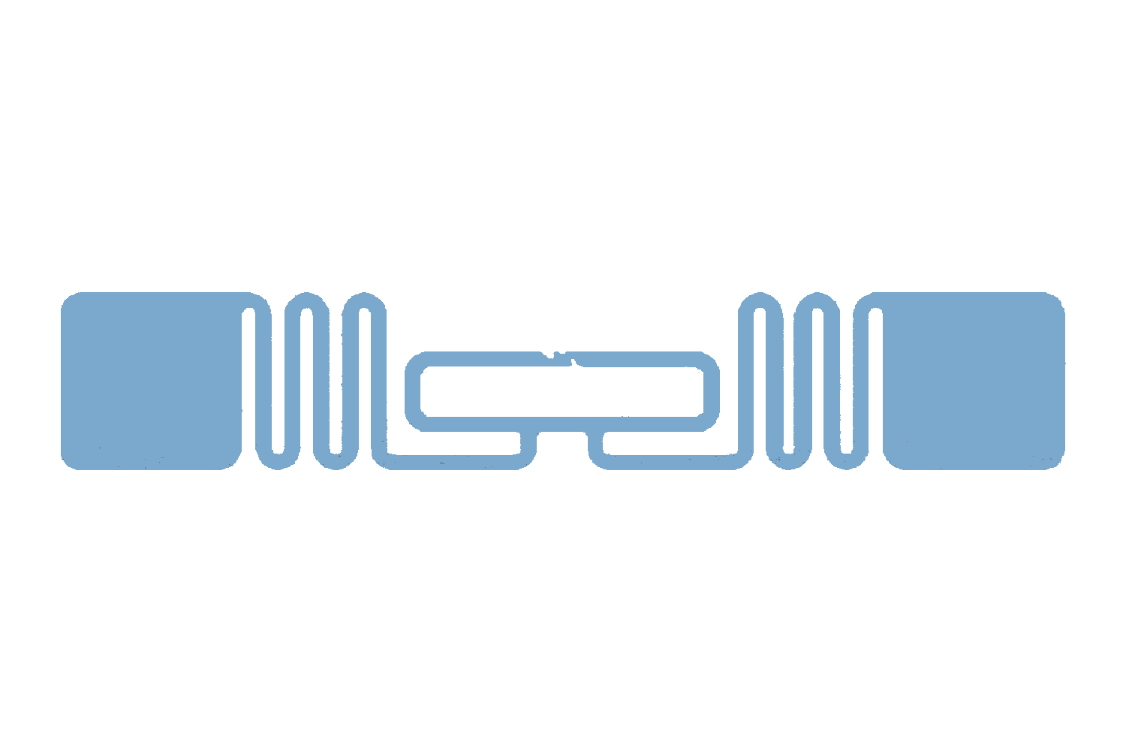


Touch detect
Incident wave
h_{tx}
Material
sensing
h_{Tag}(I_{t})
h_{rx}
Backscatter wave
Reader
RFID tag
Temperature detect

Slide 2
Touch detect
Incident wave
h_{tx}
Material
sensing
h_{Tag}(I_{t})
h_{rx}
Backscatter wave
Reader
RFID tag
Temperature detect

